Slide 1
Supplementary Table 1 Anthocyanidin content in alfalfa lines with different petal colors
Compounds | Line 1 | Line 2 | Line 3 | Line 4 | Line 5
Cyanidin-3-(6-O-p-caffeoyl)-glucoside | 0.27 | 0.14 | 0.24 | 0.08 | 0.12
Cyanidin-3-O-glucoside | 0.00 | 0.17 | 6.37 | 2.71 | 0.40
Cyanidin-3-(6''-caffeylsophoroside)-5-glucoside | 0.01 | 0.01 | 0.01 | 0.00 | 0.00
Cyanidin-3-O-xyloside | 0.01 | 0.02 | 0.01 | 0.02 | 0.01
Cyanidin-3-O-sambubioside | 0.14 | 0.10 | 0.43 | 0.01 | 0.10
Cyanidin-3-O-(6-O-p-coumaroyl)-glucoside | 0.30 | 0.35 | 0.61 | 0.10 | 0.12
Cyanidin-3-O-(6-O-malonyl-beta-D-glucoside) | 0.07 | 0.03 | 0.08 | 0.03 | 0.02
Cyanidin-3-O-galactoside | 0.55 | 3.91 | 3.80 | 0.52 | 0.26
Cyanidin-3-O-sambubioside-5-O-glucoside | 0.00 | 0.00 | 0.00 | 0.05 | 0.03
Cyanidin-3-O-sophoroside | 0.03 | 0.08 | 0.15 | 0.09 | 0.05
Cyanidin-3-O-5-O-(6-O-coumaroyl)-diglucoside | 0.38 | 0.26 | 0.20 | 0.19 | 0.14
Cyanidin-3,5-O-diglucoside | 1.96 | 2.76 | 147.25 | 72.73 | 22.00
Cyanidin-3,5,3'-O-triglucoside | 0.01 | 0.01 | 0.19 | 0.23 | 0.02
Delphinidin-3-O-(6-O-acetyl)-glucoside | 0.14 | 0.07 | 0.00 | 0.00 | 0.23
Delphinidin-3-O-rhamnoside | 0.00 | 0.04 | 0.00 | 0.00 | 0.03
Delphinidin-3-O-(6-O-malonyl)-glucoside-3'-glucoside | 0.01 | 0.02 | 0.01 | 0.01 | 0.02
Delphinidin-3-O-rutinoside-5-O-glucoside | 0.00 | 0.00 | 0.00 | 0.00 | 0.00
Delphinidin-3-O-sophoroside | 0.06 | 0.08 | 0.39 | 2.23 | 1.50
Delphinidin-3-O-arabinoside | 0.01 | 0.02 | 0.02 | 0.04 | 0.05
Delphinidin-3-O-(6-O-malonyl-beta-D-glucoside) | 0.08 | 0.09 | 0.07 | 0.06 | 0.10
Delphinidin-3,5-O-diglucoside | 53.12 | 58.03 | 3127.76 | 5354.15 | 4996.92
Delphinidin | 0.00 | 0.00 | 0.11 | 0.42 | 0.00
Delphinidin-3-O-glucoside | 2.11 | 3.72 | 91.75 | 261.68 | 168.08
Delphinidin-3-O-(6-O-p-coumaroyl)-glucoside | 0.08 | 0.17 | 0.05 | 0.10 | 0.00
Malvidin-3-O-sophoroside | 0.00 | 0.00 | 2.09 | 0.93 | 1.59
Malvidin-3-O-(6-O-malonyl-beta-D-glucoside) | 0.00 | 0.00 | 0.07 | 0.38 | 0.26
Malvidin | 0.02 | 0.04 | 0.00 | 0.00 | 0.09
Malvidin-3-O-galactoside | 0.02 | 0.00 | 5.12 | 0.00 | 3.24
Malvidin-3-O-glucoside | 0.12 | 0.29 | 56.87 | 73.57 | 62.76
Malvidin-3,5-O-diglucoside | 1.50 | 5.37 | 969.00 | 1628.08 | 1974.01
Malvidin-3-O-(6-O-p-coumaroyl)-glucoside | 0.01 | 0.03 | 0.06 | 0.10 | 0.02
Pelargonidin-3-O-galactoside | 0.07 | 0.00 | 0.00 | 0.00 | 0.00
Pelargonidin-3-O-rutinoside | 0.00 | 0.00 | 0.02 | 0.00 | 0.00
Pelargonidin-3-O-sambubioside | 0.03 | 0.00 | 0.02 | 0.02 | 0.03
Pelargonidin-3-sophoroside-5-glucoside | 0.00 | 0.00 | 0.06 | 0.02 | 0.00
Pelargonidin-3,5-O-diglucoside | 0.06 | 0.04 | 37.20 | 7.76 | 1.49
Pelargonidin-3-O-(6-O-p-coumaroyl)-glucoside | 0.02 | 0.01 | 0.01 | 0.01 | 0.00
Pelargonidin-3-O-glucoside | 0.01 | 0.01 | 0.94 | 0.22 | 0.03
Pelargonidin-3-O-arabinoside | 0.07 | 0.00 | 0.05 | 0.03 | 0.02
Peonidin | 0.00 | 0.00 | 0.01 | 0.00 | 0.02
Peonidin-3,5-O-diglucoside | 0.09 | 0.09 | 49.86 | 9.99 | 3.77
Peonidin-3-O-glucoside | 0.00 | 0.00 | 3.02 | 0.18 | 0.05
Peonidin-3-O-(6-O-malonyl-beta-D-glucoside) | 0.00 | 0.00 | 0.01 | 0.00 | 0.00
Peonidin-3-O-sambubioside | 0.00 | 0.00 | 0.01 | 0.00 | 0.00
Peonidin-3-O-sophoroside | 0.01 | 0.00 | 0.06 | 0.00 | 0.00
Petunidin-3-O-galactoside | 0.86 | 1.85 | 185.52 | 402.01 | 271.13
Petunidin-3-O-(6-O-malonyl-beta-D-glucoside) | 1.27 | 0.84 | 0.60 | 1.76 | 2.92
Petunidin-3-O-sambubioside | 0.04 | 0.06 | 0.15 | 0.05 | 0.16
Petunidin-3-O-glucoside | 0.17 | 0.41 | 38.27 | 81.61 | 55.54
Petunidin-3-O-sophoroside | 0.61 | 0.89 | 1.63 | 0.00 | 1.88
Petunidin-3-O-arabinoside | 0.00 | 0.00 | 0.00 | 0.12 | 0.10
Petunidin-3-O-rutinoside | 0.00 | 0.00 | 0.15 | 0.00 | 0.00

Slide 2
Supplementary Table 2 Comparison statistics of the filtered RNA and the reference genome
ID | Total reads | Unmapped reads (%) | Mapped reads (%) | Secondary alignments (%) | Unique alignments (%)
1-1 | 86,317,833 | 6,787,890(7.86) | 79,529,943(92.14) | 39,968,003(46.3) | 39,561,940(45.83)
1-2 | 87,814,944 | 6,050,389(6.89) | 81,764,555(93.11) | 41,056,084(46.75) | 40,708,471(46.36)
1-3 | 74,479,602 | 4,776,803(6.41) | 69,702,799(93.59) | 34,778,554(46.7) | 34,924,245(46.89)
2-1 | 84,915,202 | 7,595,094(8.94) | 77,320,108(91.06) | 38,778,990(45.67) | 38,541,118(45.39)
2-2 | 87,316,348 | 7,021,181(8.04) | 80,295,167(91.96) | 40,281,926(46.13) | 40,013,241(45.83)
2-3 | 78,412,626 | 9,674,523(12.34) | 68,738,103(87.66) | 34,423,586(43.9) | 34,314,517(43.76)
3-1 | 83,379,495 | 7,391,601(8.87) | 75,987,894(91.13) | 37,928,901(45.49) | 38,058,993(45.65)
3-2 | 76,072,436 | 4,663,222(6.13) | 71,409,214(93.87) | 35,426,532(46.57) | 35,982,682(47.3)
3-3 | 84,180,146 | 5,460,494(6.49) | 78,719,652(93.51) | 39,210,778(46.58) | 39,508,874(46.93)
4-1 | 82,264,912 | 5,621,008(6.83) | 76,643,904(93.17) | 38,875,416(47.26) | 37,768,488(45.91)
4-2 | 85,399,311 | 9,791,809(11.47) | 75,607,502(88.53) | 38,243,991(44.78) | 37,363,511(43.75)
4-3 | 89,790,676 | 9,891,853(11.02) | 79,898,823(88.98) | 40,965,068(45.62) | 38,933,755(43.36)
5-1 | 83,623,592 | 6,272,953(7.5) | 77,350,639(92.5) | 39,468,610(47.2) | 37,882,029(45.3)
5-2 | 60,793,749 | 5,113,374(8.41) | 55,680,375(91.59) | 27,623,221(45.44) | 28,057,154(46.15)
5-3 | 83,949,460 | 5,648,808(6.73) | 78,300,652(93.27) | 39,147,884(46.63) | 39,152,768(46.64)

Slide 3
Supplementary Table 3 Details of candidate genes
Gene name | Gene ID | Description
4CL | MS.gene007715 | 4-coumarate--CoA ligase-like
 | MS.gene09153
F3'H | MS.gene070401 | flavonoid 3'-monooxygenase
 | MS.gene97807
 | MS.gene94517
DFR | MS.gene24248 | dihydroflavonol 4-reductase
 | MS.gene26988
 | MS.gene26989
 | MS.gene53336
 | MS.gene90701
 | MS.gene24249
UGT | new_gene1980 | UDP-glycosyltransferase
 | MS.gene024093 | UDP-glycosyltransferase 74F2
 | MS.gene08835 | UDP-glycosyltransferase 75C1
 | MS.gene023471
 | MS.gene08987
 | MS.gene09259
MYB | MS.gene67361 | Transcription factor MYB48
 | MS.gene84326 | Myb-related protein 2
 | MS.gene61126 | Transcription factor MYB48
 | MS.gene48572 | MYB domain-containing protein-like
 | MS.gene26169 | MYB family transcription factor
 | MS.gene32128 | Myb-like DNA-binding domain
 | MS.gene61428
 | MS.gene005866
bHLH | MS.gene066418 | transcription factor bHLH48
 | new_gene1915 | transcription factor bHLH18

Slide 4
500 µm
1 2 3 4 5
Supplementary Figure 1 Style, stigma, ovary, filament, and anther color of different alfalfa lines.

Slide 5
Line 1 Line 2 Line 3 Line 4 Line 5
Supplementary Figure 2 Scanning electron microscope (SEM) of alfalfa lines with different flower colors.

Slide 6
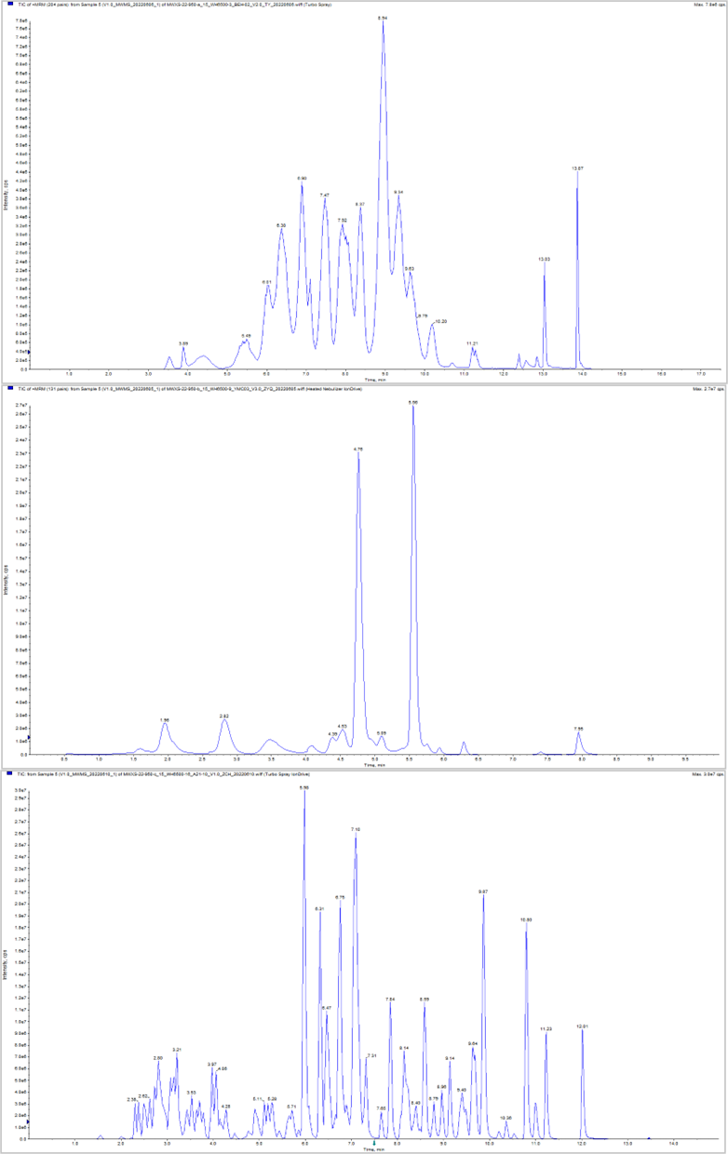
(a)
(b)
(c)
Supplementary Figure 3 Analysis of the total ion flow diagram of mixed samples by mass spectrometry.
(a) Anthocyanin. (b) Carotenoid. (c) Flavonoid.

Slide 7
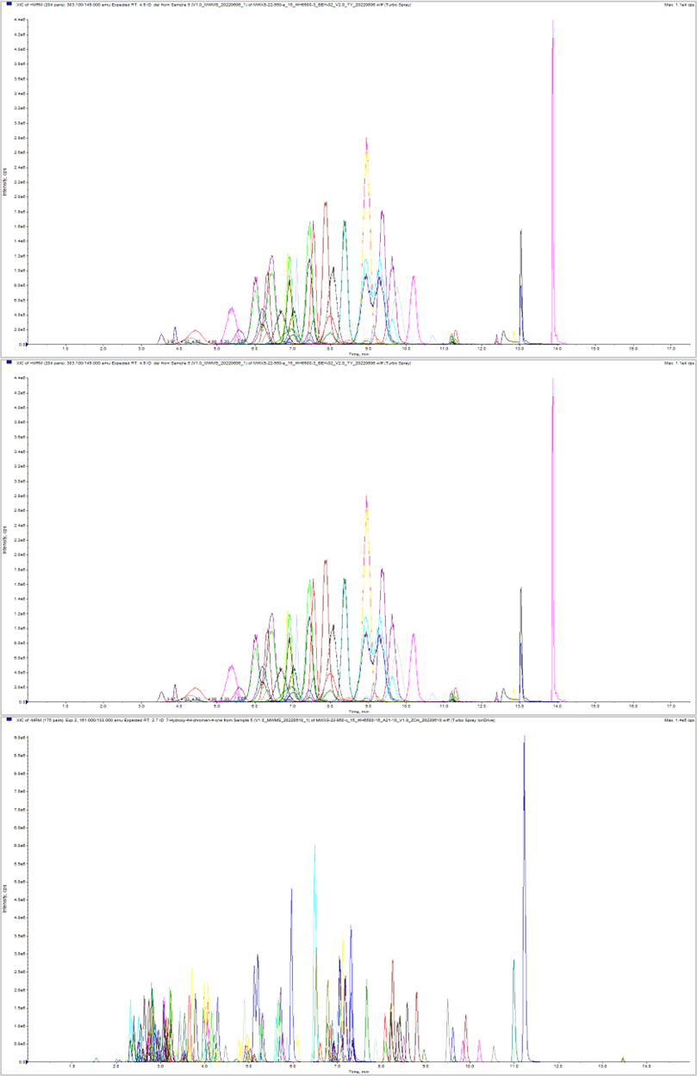
(a)
(b)
(c)
Supplementary Figure 4 Multi-peak map of MRM metabolite detection.
Each color of the mass spectrum peak represents a metabolite detected. (a) Anthocyanin. (b) Carotenoid. (c) Flavonoid.

Slide 8
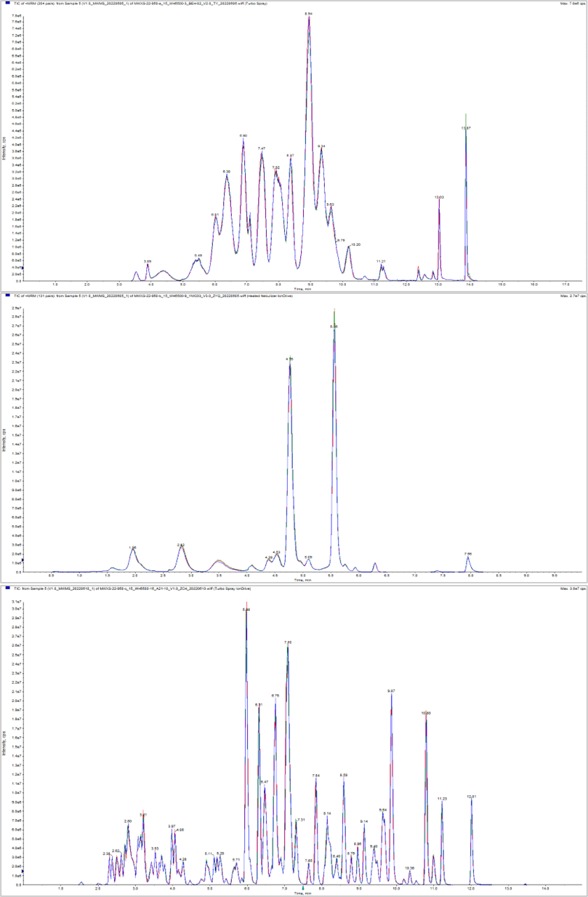
(a)
(b)
(c)
Supplementary Figure 5 TIC overlap map of QC samples detected by mass spectrometry.
Abscissa is the retention time of metabolite detection (Retentiontime, Rt); ordinate is the ion current intensity of ion detection (unit of intensity is cps, countpersecond). (a) Anthocyanin. (b) Carotenoid. (c) Flavonoid.

Slide 9
(a)
(b)
Supplementary Figure 6 Content of different anthocyanin types.
(a) Classification according to the basic structure of anthocyanins. (b) Classification according to anthocyanins produced by the same gene. Error bars represent the standard deviations (SDs) of three biological replicates.

Slide 10
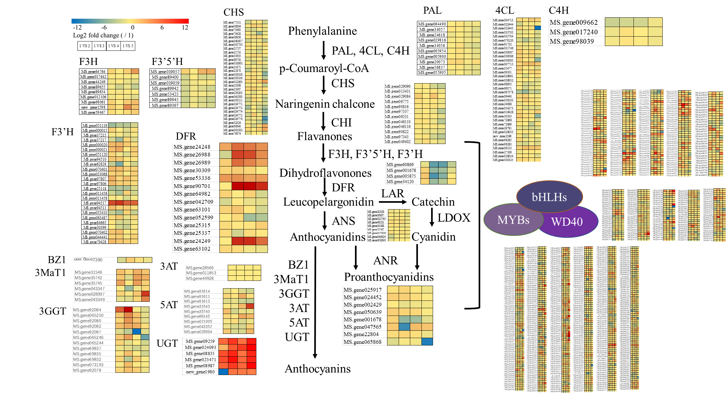
Supplementary Figure 7 Cluster heatmap of all expressed genes inanthocyanin biosynthetic pathway in alfalfa.
PAL: phenylalanine ammonia-lyase; 4CL: 4-coumarate: CoA ligase; C4H: cinnamate 4-hydroxylase; CHS: chalcone synthase; CHI: chalcone isomerase; F3’H: flavonoid 3'-hydroxylase; F3'H: flavonoid 3'-hydroxylase; F3'5'H: flavonoid 3', 5'-hydroxylase; DFR: dihydroflavonol reductase; LAR: leucoanthocyanidin reductase; ANS: anthocyanidin synthase; LDOX: leucoanthocyanidin dioxygenase; ANR: anthocyanidin reductase; BZ1: anthocyanidin 3-O-glucosyltransferase; 3MaT1: anthocyanin 3-O-glucoside-6''-O-malonyltransferase; 3GGT: anthocyanidin 3-O-glucoside 2''-O-glucosyltransferase; 3AT: anthocyanidin 3-O-glucoside 6''-O-acyltransferase; 5AT: anthocyanin 5-aromatic acyltransferase; UGT: UDP-glycosyltransferases.

