Slide 1
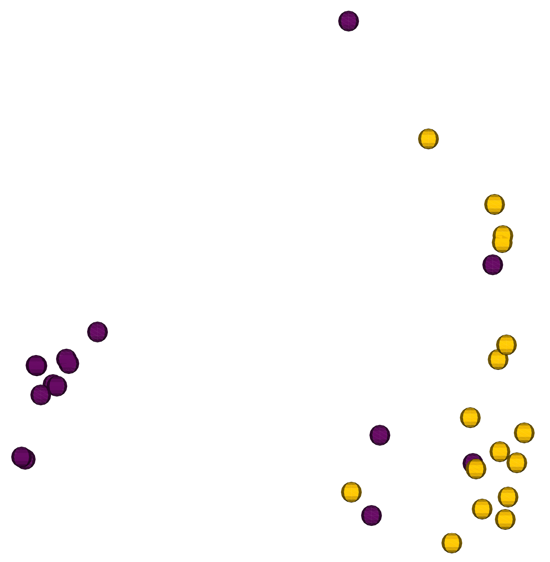
Axis 2 (9.449 %)
Axis 1 (27.25 %)
Axis 3 (7.684 %)
Supplemental Figure S1. Bray Curtis PCoA plot for microbial composition from uterine swabs collected at one week postpartum from metritis (blue circles) and healthy (yellow circles) cows.

Slide 2
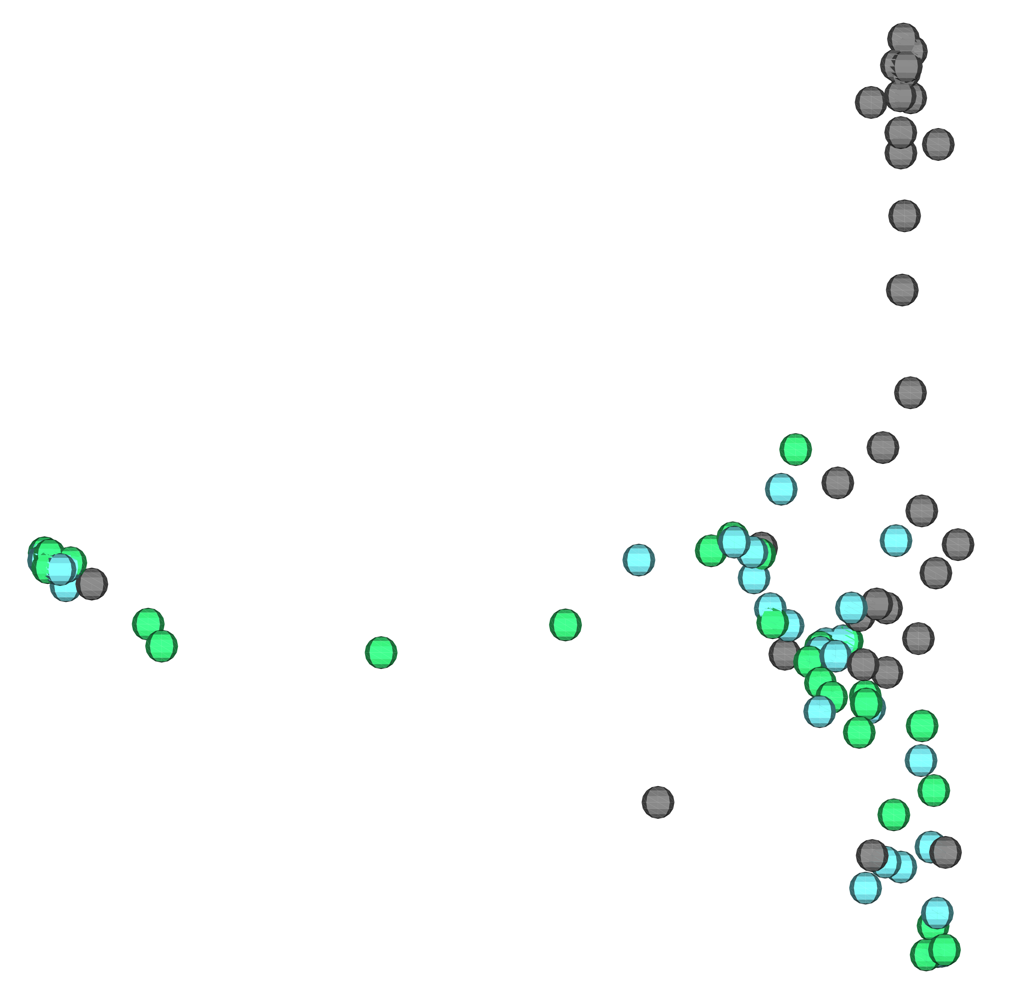
Axis 2 (9.392 %)
Axis 1 (18.61 %)
Axis 3 (7.275 %)
Supplemental Figure S2. Bray Curtis PCoA plots for the similarities in microbial composition between samples from the previously gravid (light blue circles) and non-gravid (light green circles) horns compared with control samples collected from the outside of the uterus (gray circles).

Slide 3
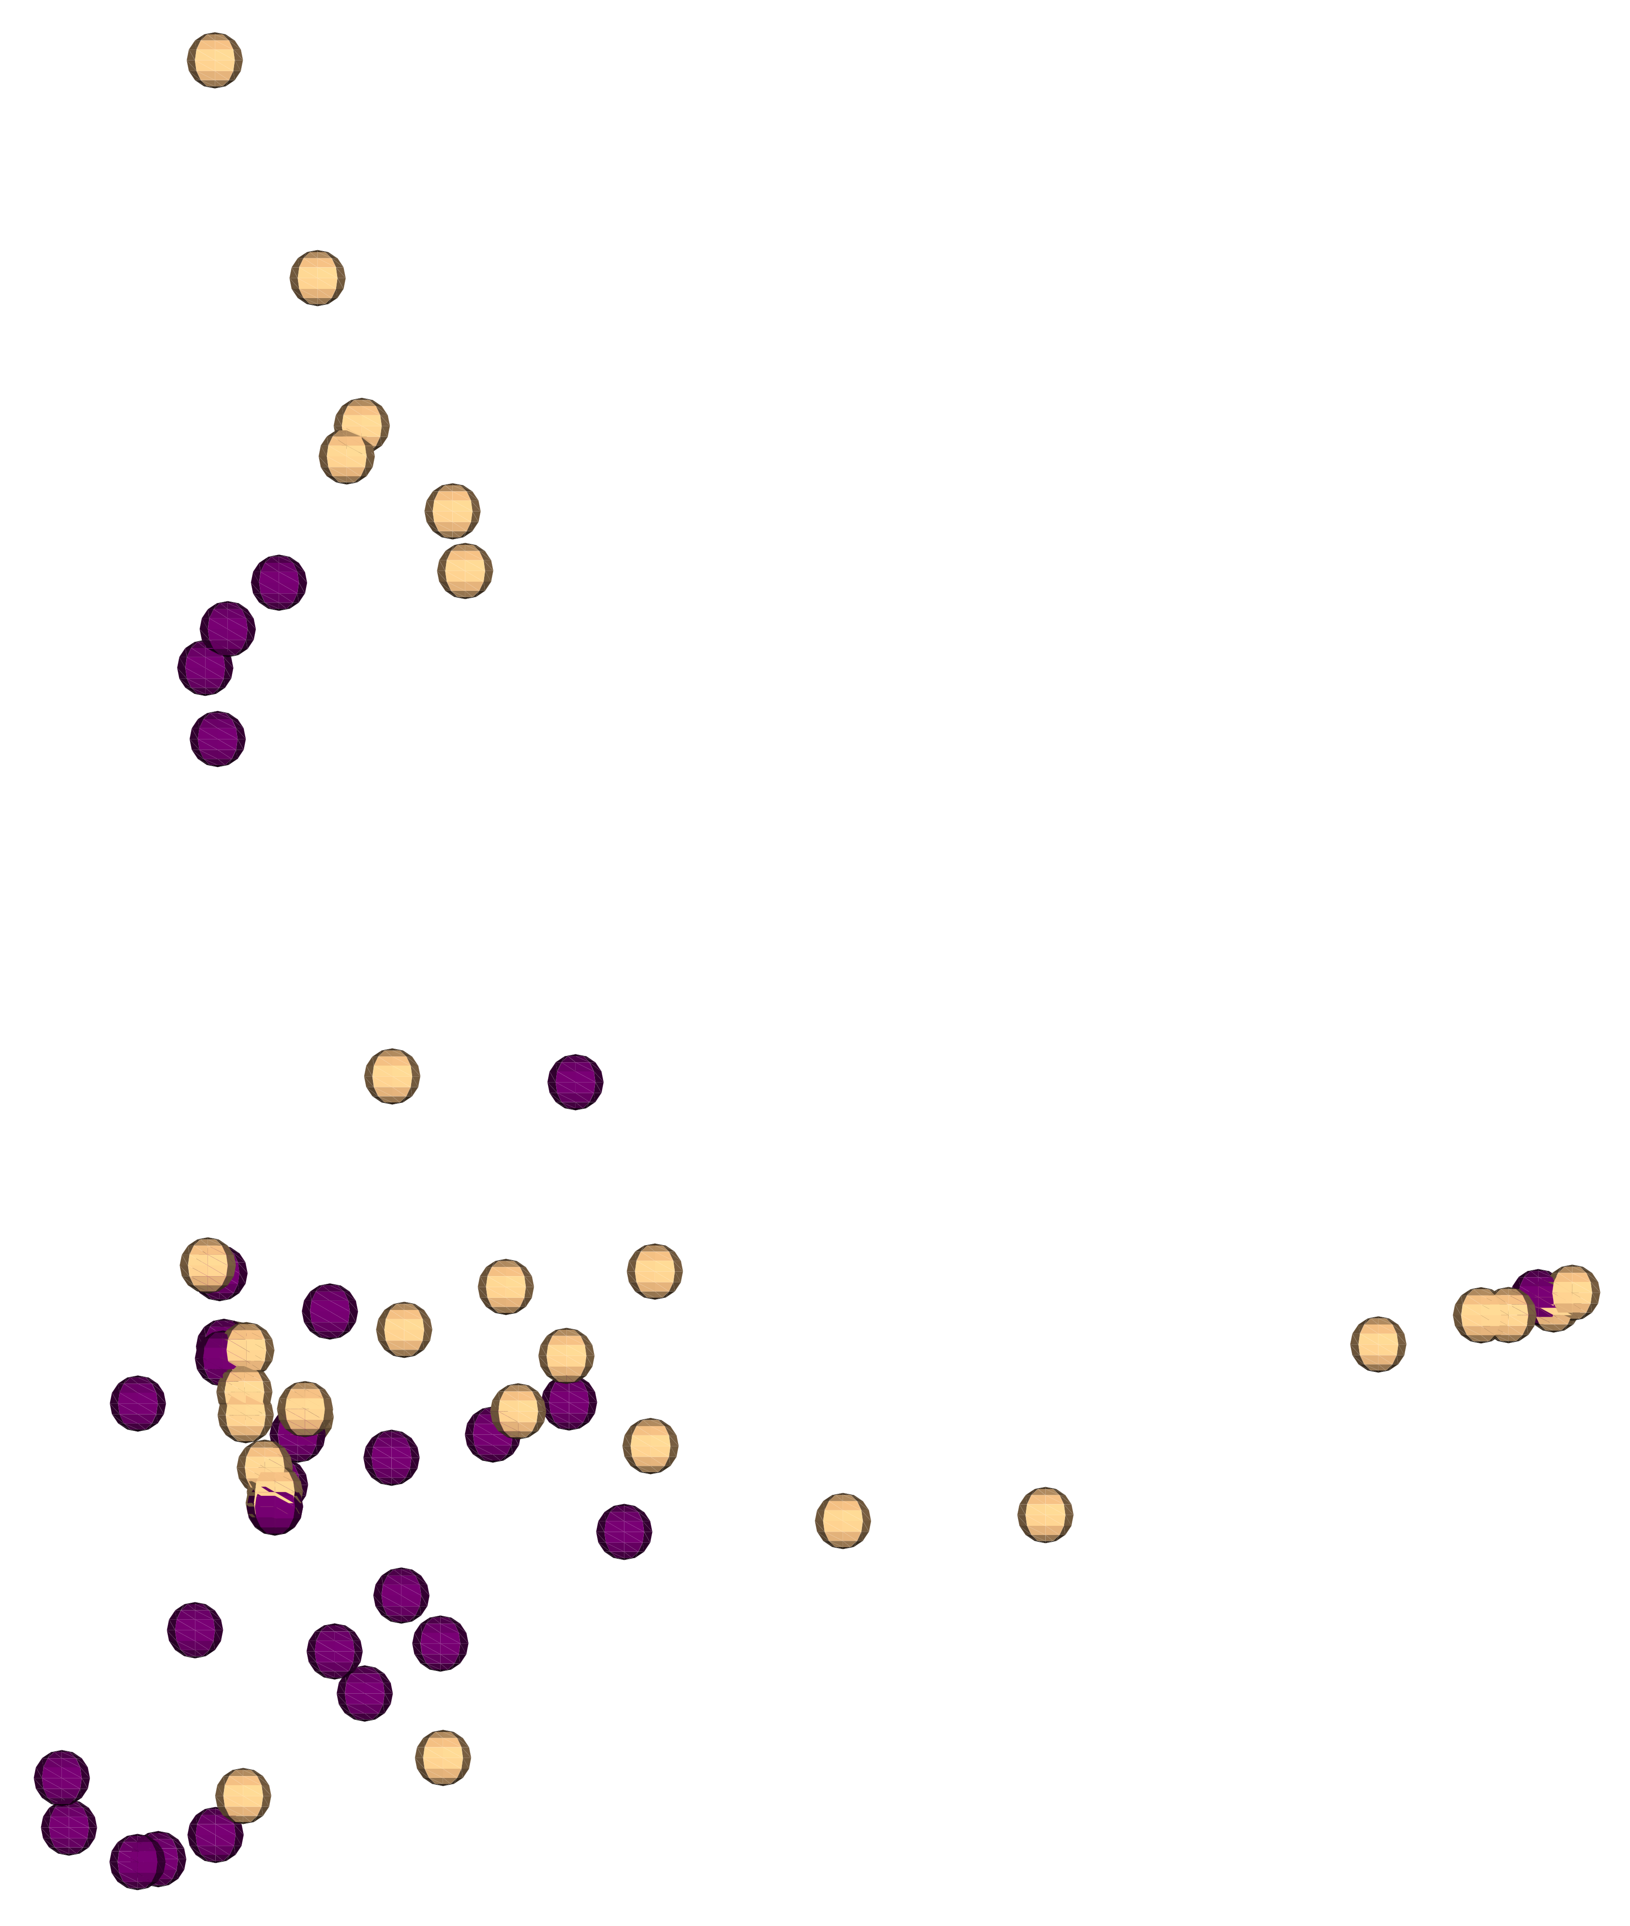
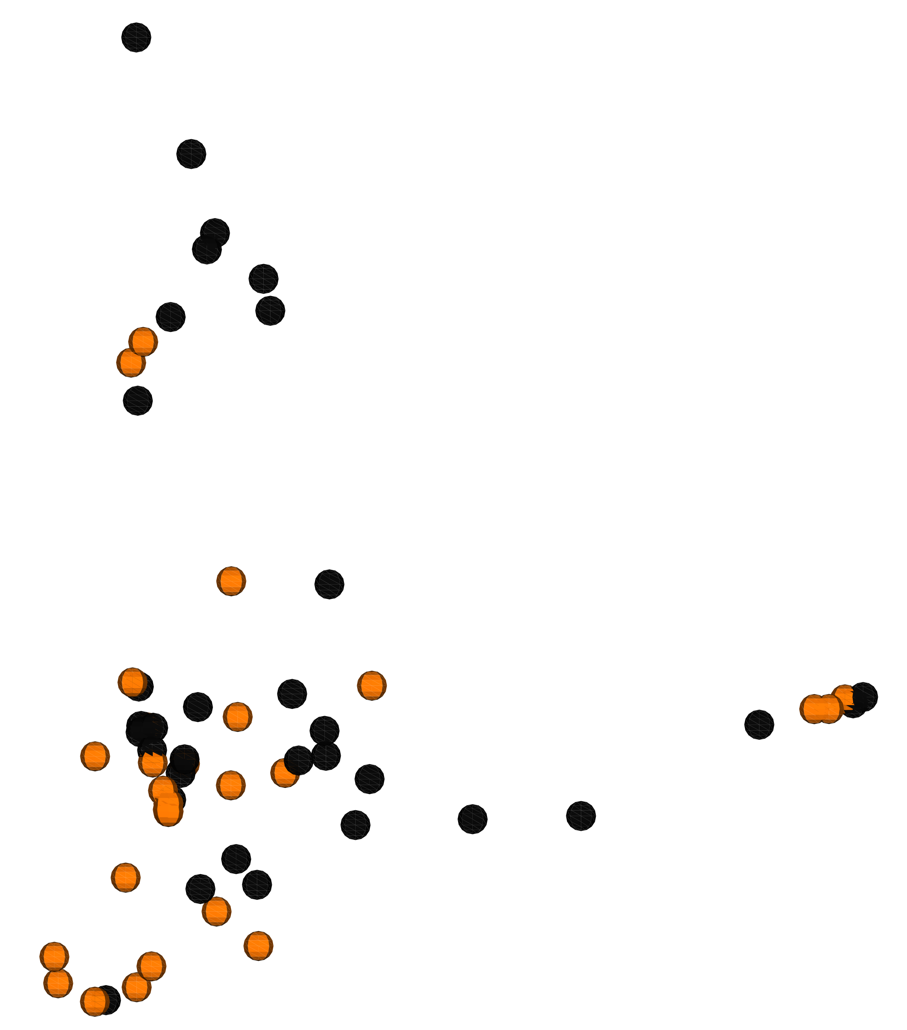
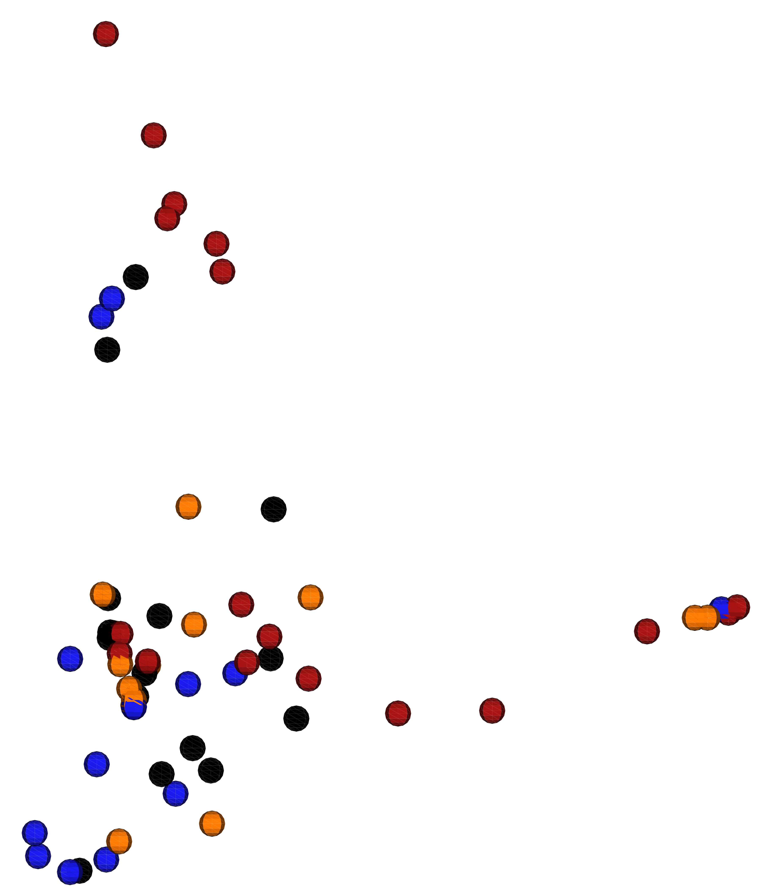
Axis 2 (10.60 %)
Axis 2 (10.60 %)
A
B
Axis 1 (25.05 %)
Axis 3 (9.256 %)
Axis 3 (9.256 %)
Axis 1 (25.05 %)
Figure S3. Bray Curtis PCoA plot for uterine microbiome at one-month postpartum for cows that were healthy at disease diagnosis (purple circles) or were diagnosed with metritis (yellow circles) (A), for antibiotic-treated (orange circles) and untreated cows (back circles) (B), and for the interaction of uterine disease and antibiotic treatment [C, Healthy – antibiotic treated (blue circles); Healthy – untreated (black dots); Metritis antibiotic treated (orange dots); Metritis untreated (red circles)].
C
Axis 2 (10.60 %)
Axis 3 (9.256 %)
Axis 1 (25.05 %)

Slide 4
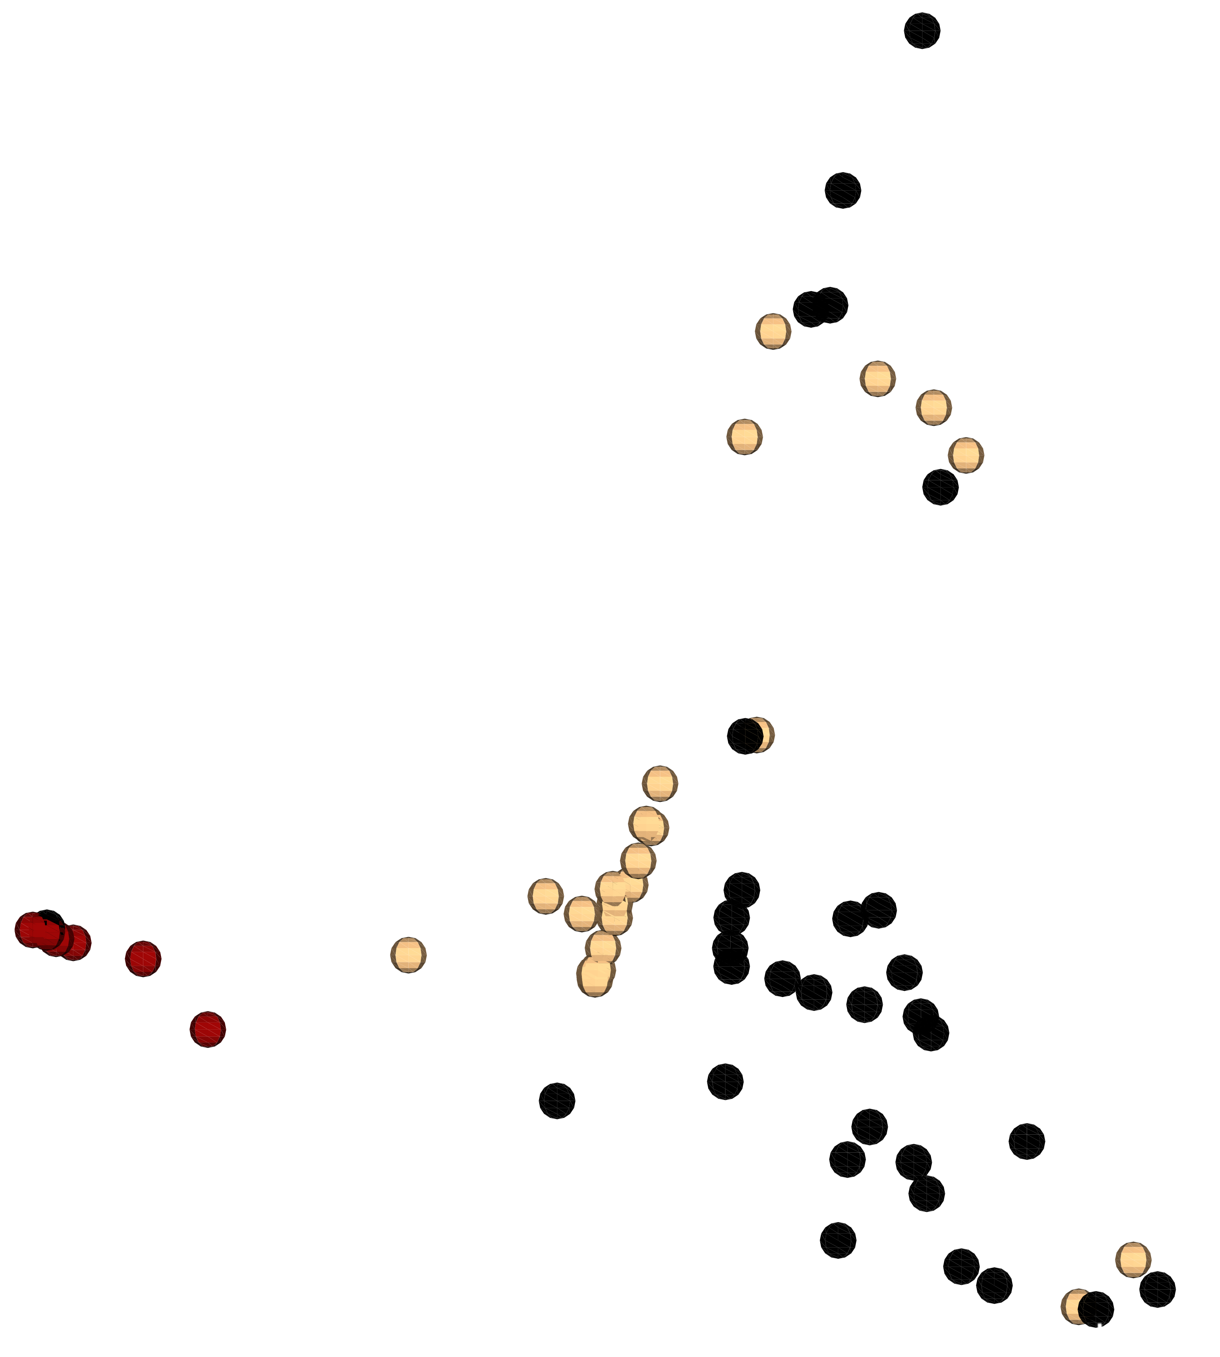
Axis 2 (10.59 %)
Axis 1 (24.93 %)
Axis 3 (9.282 %)
Supplemental Figure S4. Bray Curtis PCoA plots for the similarities in microbial composition between uterine samples from the clear flush (black circles), purulent flush (yellow circles) and acutely infected (red dots) cows.

