Slide 1
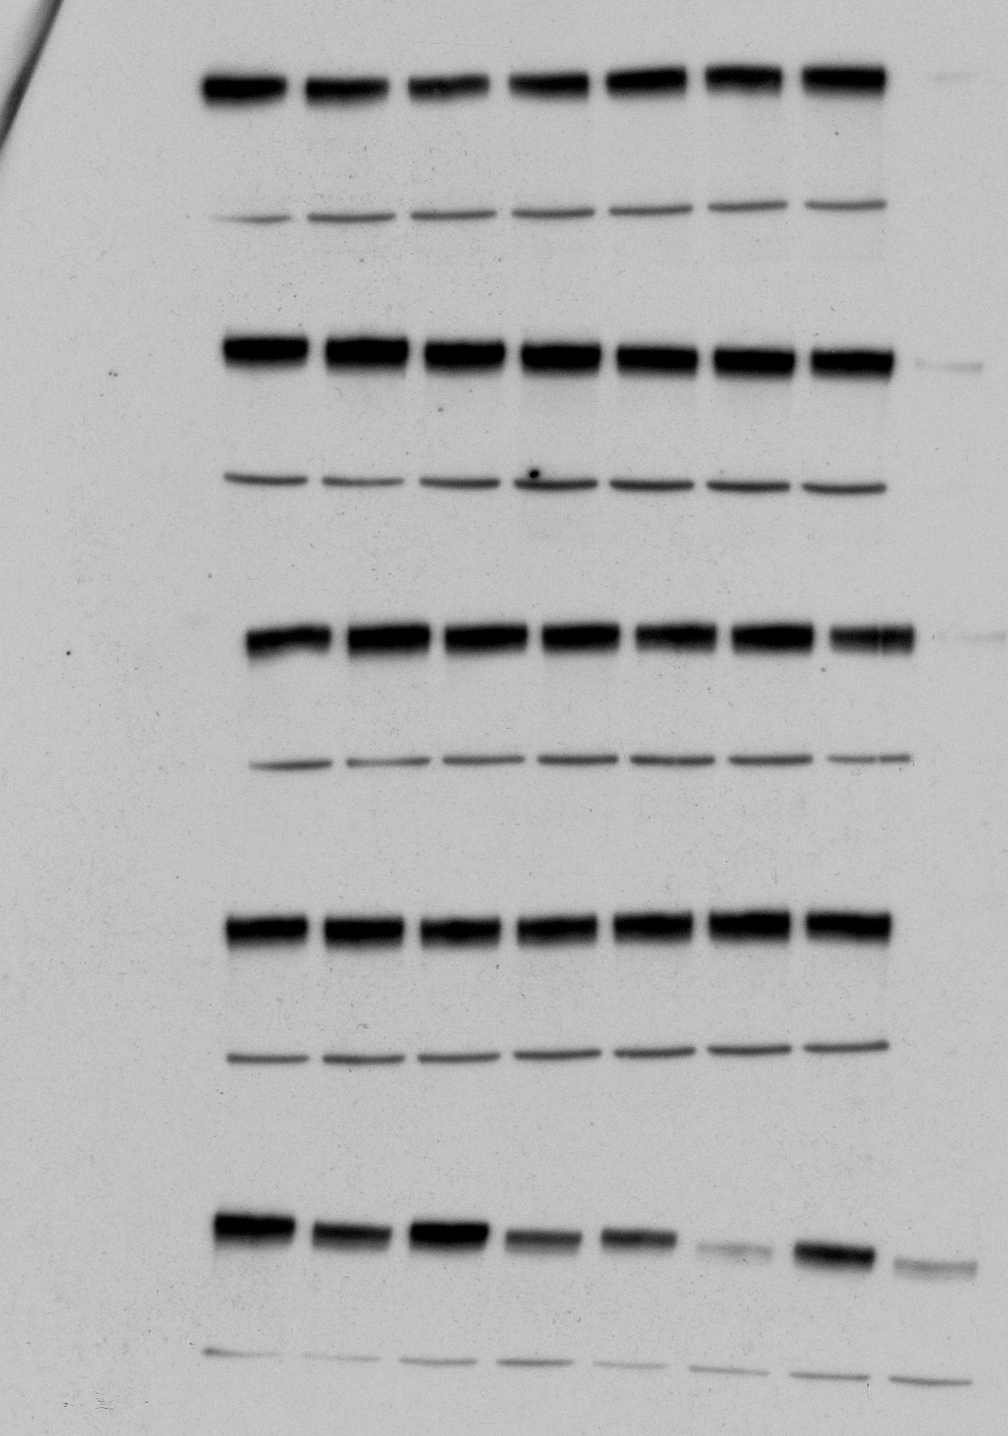
Figure 2:
Wt
#4
#5
#6
#13
#17
#24
HER2 extracto 1
Calnexina
Wt
#5
#6
#24
#4
#13
#17
HER2 extracto 1
Calnexina
Wt
#4
#5
#6
#13
#17
#24
HER2 extracto 2
Calnexina
Wt
#5
#6
#24
#4
#13
#17
HER2 extracto 2
Calnexina

Slide 2
Figure 2:

Slide 3
Figure 3:

Slide 4
Figure 3:
shHER2 #1
shHER2 #1
shHER2 #2
shHER2 #1
shHER2 #2
shHER2 #1
shHER2 #2
shHER2 #2
pLKO
pLKO
pLKO
pLKO
BT474
BTRN #5
BTRN #6
BTRN #24

Slide 5
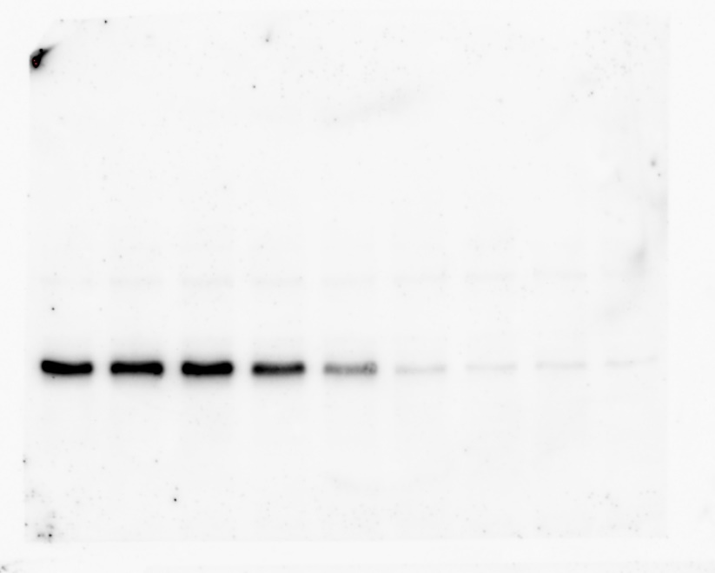
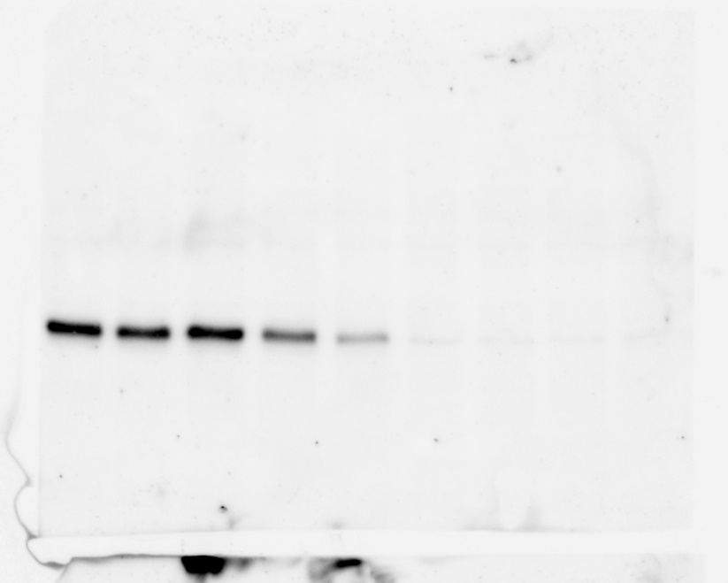
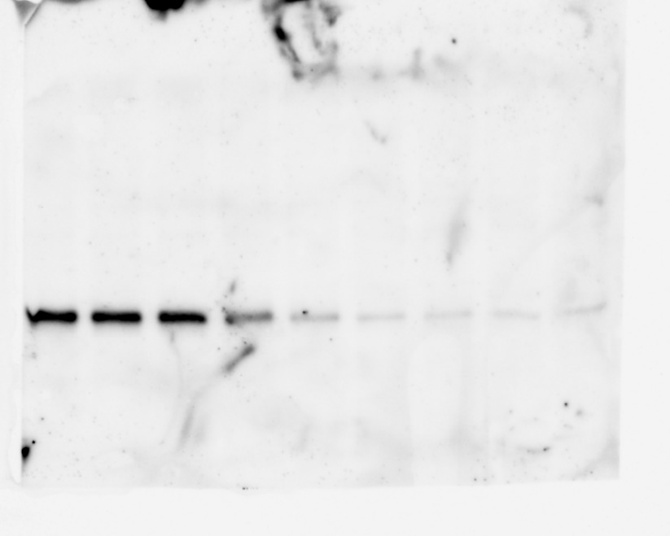
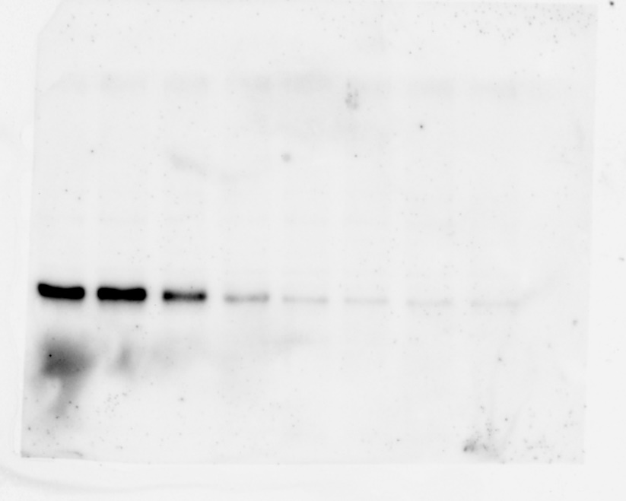
Figure 3:
pS6:
BT474
BTRN #5
C
C
1
5
10
25
50
100
100
C
C
1
5
10
25
50
100
100
[Neratinib], nM
BTRN #6
BTRN #24
C
C
1
5
10
25
50
100
100
C
C
1
5
10
25
50
100
100

Slide 6
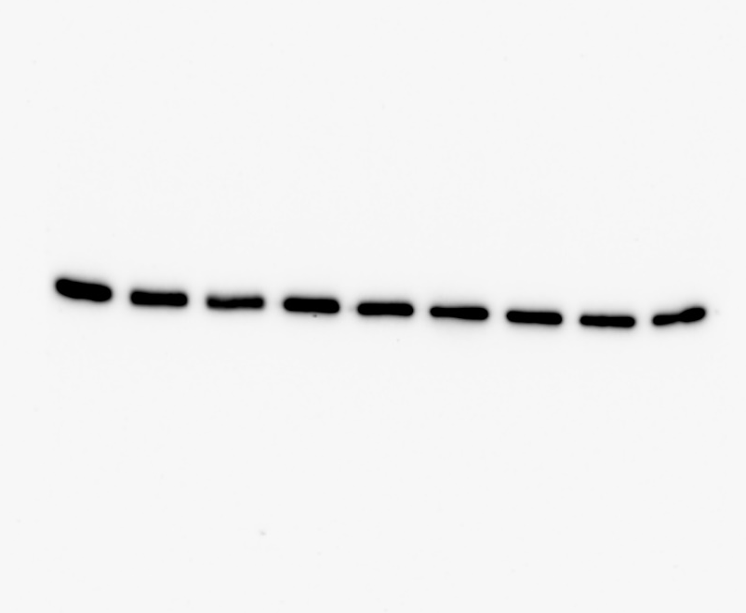
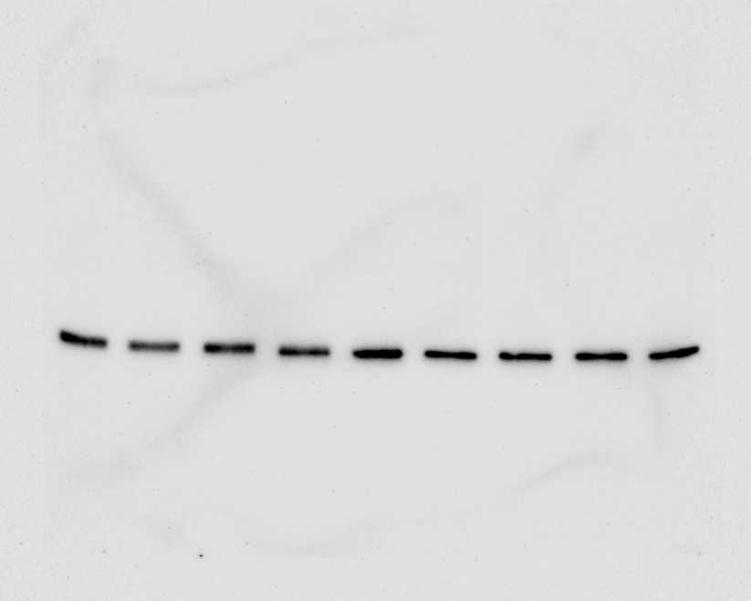
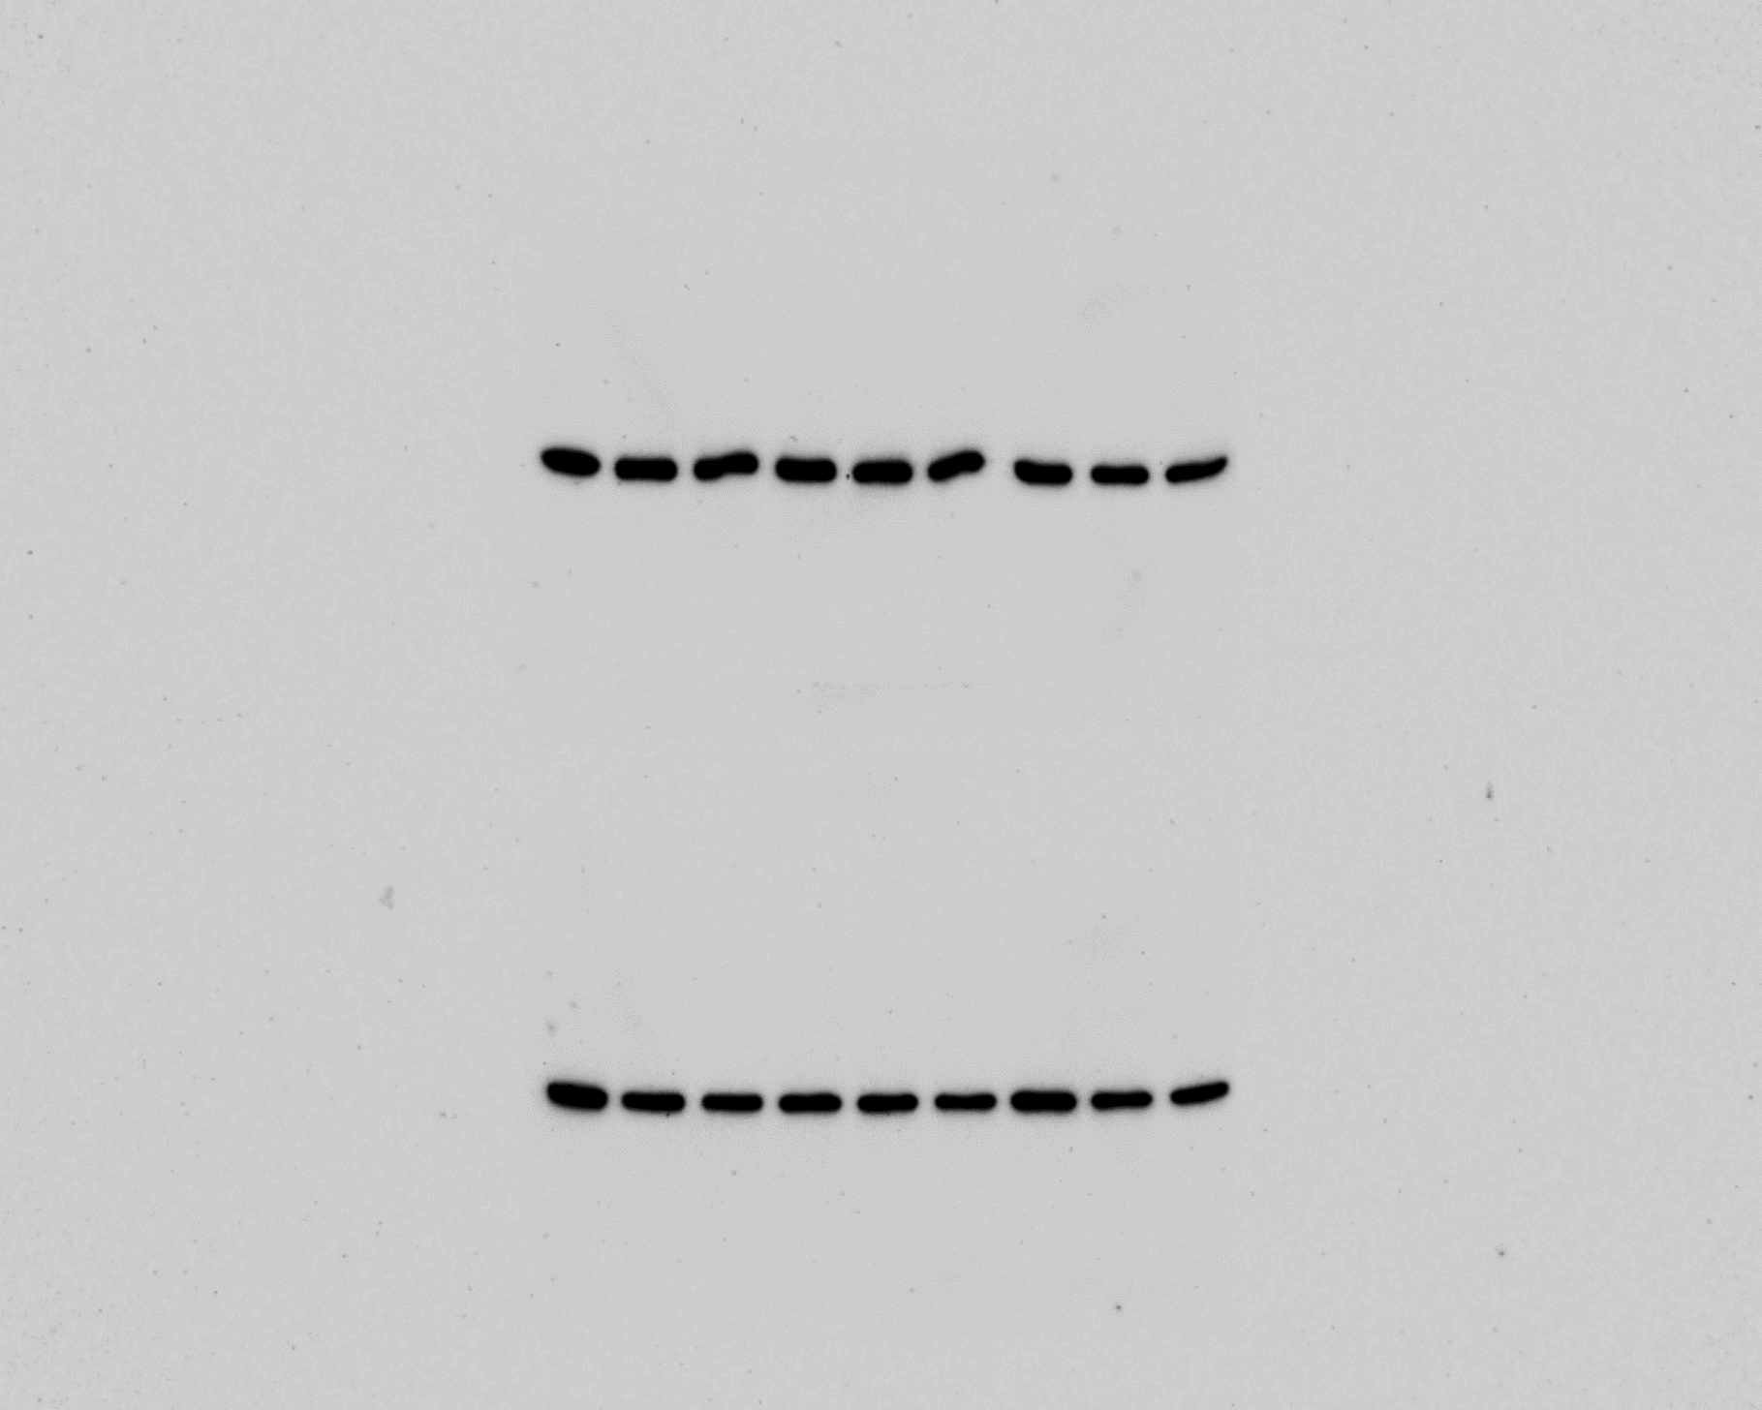
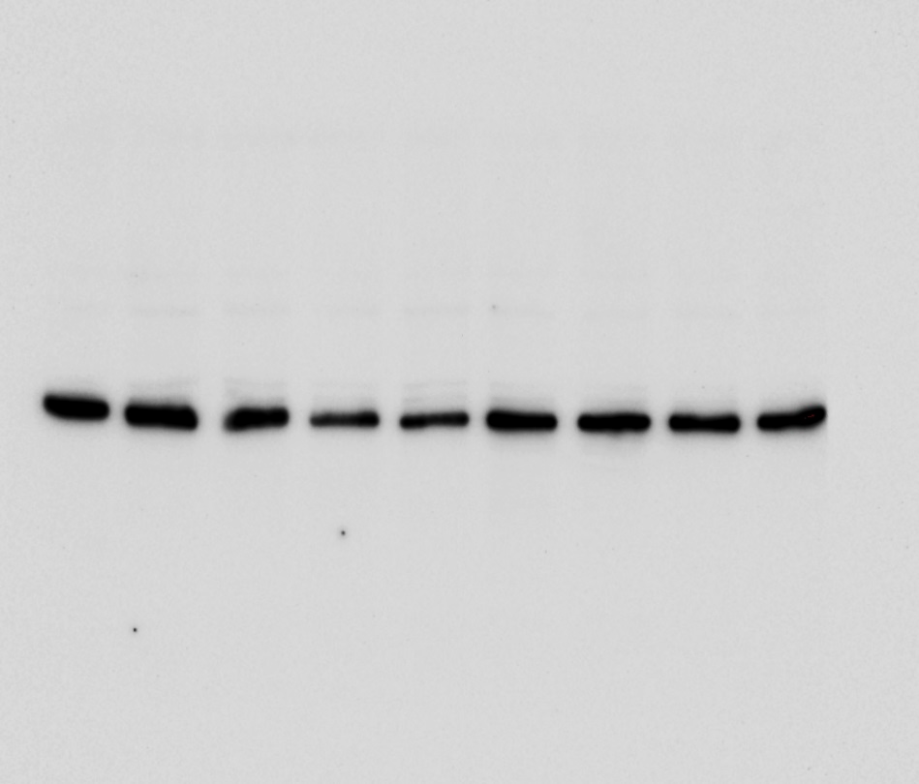
Figure 3:
S6:
BTRN #5
[Neratinib], nM
C
C
1
5
10
25
50
100
100
C
C
1
5
10
25
50
100
100
BTRN #6
BTRN #24
C
C
1
5
10
25
50
100
100
C
C
1
5
10
25
50
100
100

Slide 7
Figure 5:

Slide 8
Figure 6:

Slide 9
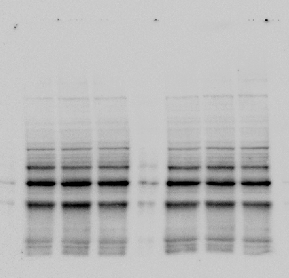
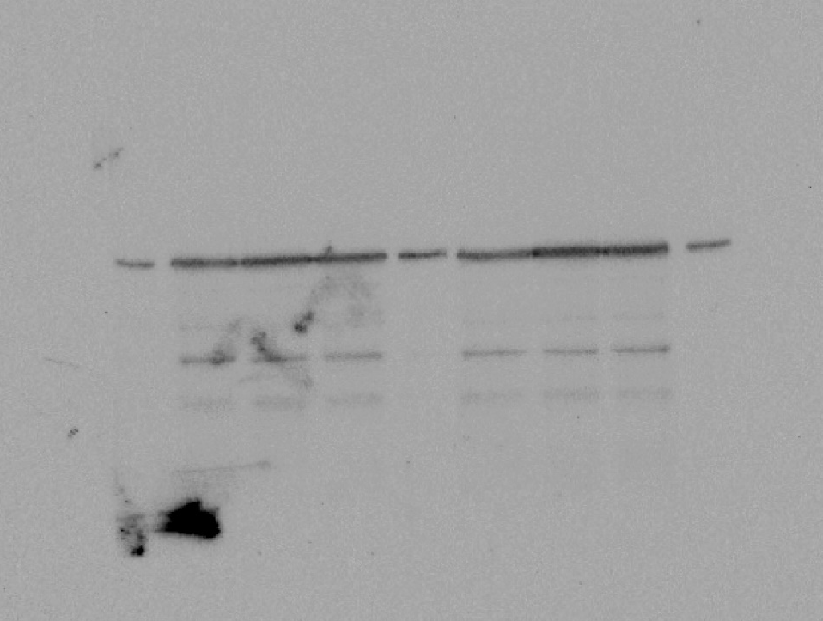
Figure 6:
PADI3
shPADI3 #37
shPADI3 #36
shPADI3 #37
pLKO
shPADI3 #36
pLKO
PADI3
1st experiment
2nd experiment
Calnexin
shPADI3 #37
shPADI3 #37
shPADI3 #36
shPADI3 #36
pLKO
pLKO
1st experiment
2nd experiment

Slide 10
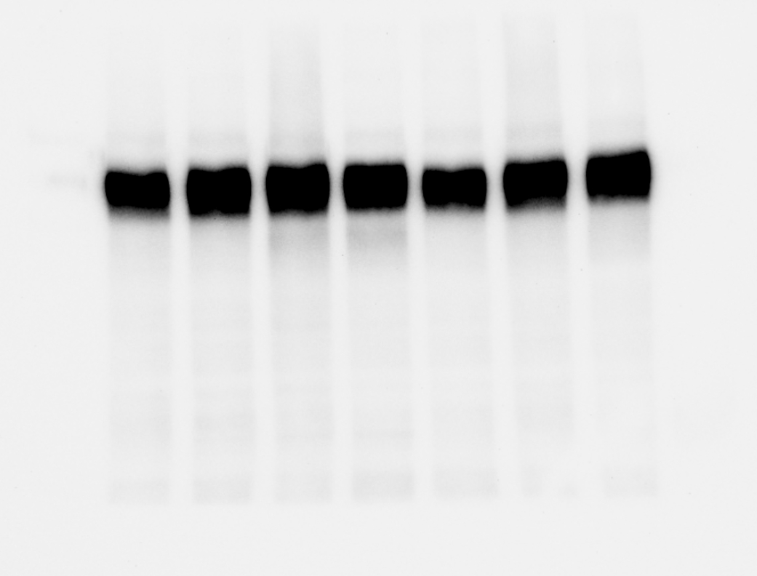
Supplementary Figure 2:
C
Clones resistant to Neratinib
BT474
#5
#6
#24
HER2

