Slide 1
Enhancing Nurse Competence in Early Recognition of Cardiotoxicity
Jeffry P. Kolbus, DNP, CCRN

Slide 2
Agenda
Enhancing Nurse Competence in Early Recognition of Cardiotoxicity
Introduction
  Study objective and overview of cardiotoxicity in cancer treatment.
Background
  Importance of cardiotoxicity and nurse's role in early detection.
Study Aim
  Objective: Assess educational intervention on nurse's self-efficacy.
Methodology
  Sample/Setting, study design, & intervention overview.
Results
  Key findings: Improved self-efficacy in recognizing cardiotoxicity.
Discussion
  Significance of results and study limitations.
Implications
  Impact on healthcare systems, healthcare economics, and nursing practice.
Conclusion & Q&A

Slide 3
Study Objective
Enhancing Nurse Competence in Early Recognition of Cardiotoxicity
#1
To assess the impact of an education intervention on nurses self-efficacy in recognizing symptoms of cardiotoxicity.
#2
Highlight the importance of enhancing nurse competence in early recognition of cardiotoxic symptoms.

Slide 4

Overview of Cardiotoxicity in Cancer Treatment
Enhancing Nurse Competence in Early Recognition of Cardiotoxicity
What is Cardiotoxicity?
Heart damage that arises from certain cancer treatments or drugs.
(Shields, 2018)
Cardiotoxicity has alarmingly ascended to become the second predominant cause of long-term morbidity and mortality among cancer treatment recipients.
What is Cardio-oncology?
A field aiming to refine the management of cardiovascular complications stemming from cancer treatments.
(Ghizzardi et al., 2017)
(Kelly et al., 2017; Lyon et al., 2022)

Slide 5
Background
The rise of cardiotoxicity and nurses role in early detection.

Slide 6
The Rise of Cardiotoxicity
Advances in cancer treatments have led to:
An improved survival rate of patients while causing life-threating cardiac side effects.
Increase in number of patients who die from heart disease related to cardiotoxicity.
(Herrmann et al., 2014; Bloom et al., 2016; Curigliano et al., 2016)

Slide 7

Cardiotoxicity:
The Role of the Nurse
Nurses occupy a pivotal role in the early detection, monitoring and management of cardiotoxicity.
(Magon et al., 2023)

Slide 8


Gaps in Cardiotoxicity Management in Nurses
Lack of cardiotoxicity education
Low self-efficacy around managing cardiotoxicity
(Belloni et al., 2021; Kelly et al., 2017; Magon et al., 2023).

Slide 9
Study Aim
Objective: Assess an education intervention on nurses perceived self-efficacy.

Slide 10
Study Aim
To elevate the competence of cardiac nurses in the early recognition of cancer therapy-related cardiotoxicity symptoms through education.
with the goal of
Enhancing the quality of patient care and outcomes.

Slide 11
Methodology
Setting/sample, study design, & intervention overview.
Notes:
.

Slide 12
Study Design: Setting & Sample
Setting
Midwest hospital
16-bed cardiac critical care unit (CCU), 462-bed hospital
Nurses caring for a patient population at risk for cardiotoxicity
Sample
Varied cohort of registered nurses (RNs)
Intensive care unit (ICU) RNs:
Resource Team
Contracted travel
Float
CCU staff RNs

Slide 13
Study Design: Setting & Sample Rationale
#1
#2
#3
High Cardiotoxicity Risk Population
Cardio-oncology Providers on Hospital Site-staff
Cardio-Oncology Risk Score

Slide 14
Study Design Overview
Recruitment of Participants
Pre-Education Survey
Education Intervention
Post-Education Survey

Slide 15
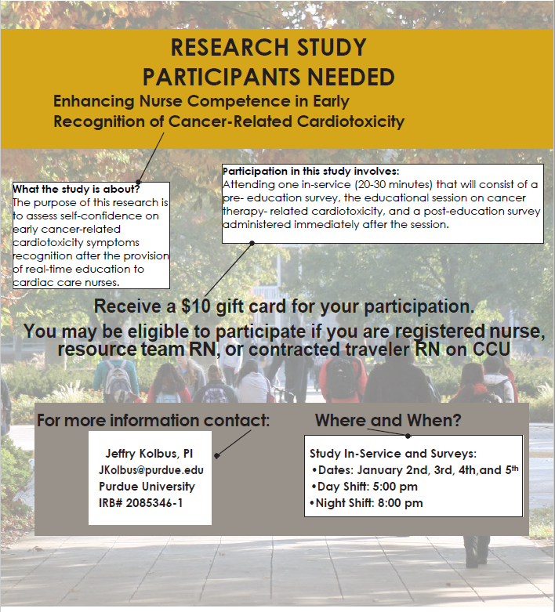

Study Design: Recruitment
Flyer
Recruitment Email

Slide 16
Study Design: Survey
Data Collection
Measure the nurses perceived self-efficacy.
Assessment Tools
7 self-confidence questions from the NSS-CTC.
A 5-point Likert scale ranging from No confidence = 1 to High confidence = 5.
(1) Yes/No question.
Demographic Data
Age
Employment Status
Gender identity
Number of Years of RN Experience
Scale Selection
The Nursing Self-Efficacy Scale for Managing Cancer Treatment-Induced Cardiotoxicity (NSS-CTC), a 15-item self-report tool.
Psychometric Reliability
High reliability in evaluating knowledge and practice-related self-efficacy (Cronbach’s α = 0.924 and 0.937, respectively).
Before and after education intervention.
Eight questions focused on oncology nurses were excluded from the survey and less pertinent to cardiac nurses role in cardiotoxicity.
  Education
  Previous Oncology Nursing Experience
  Primary Unit of Employment
(Magon et al., 2023)

Slide 17
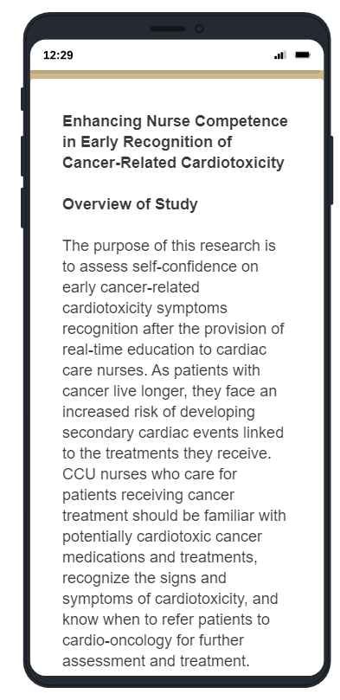
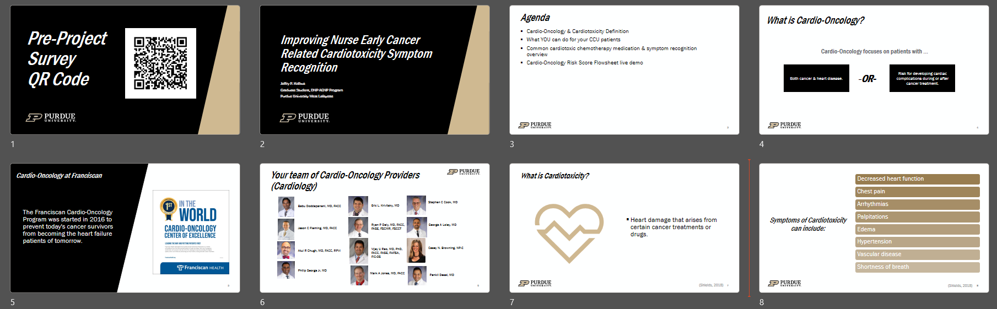
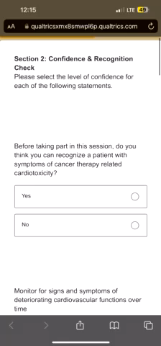
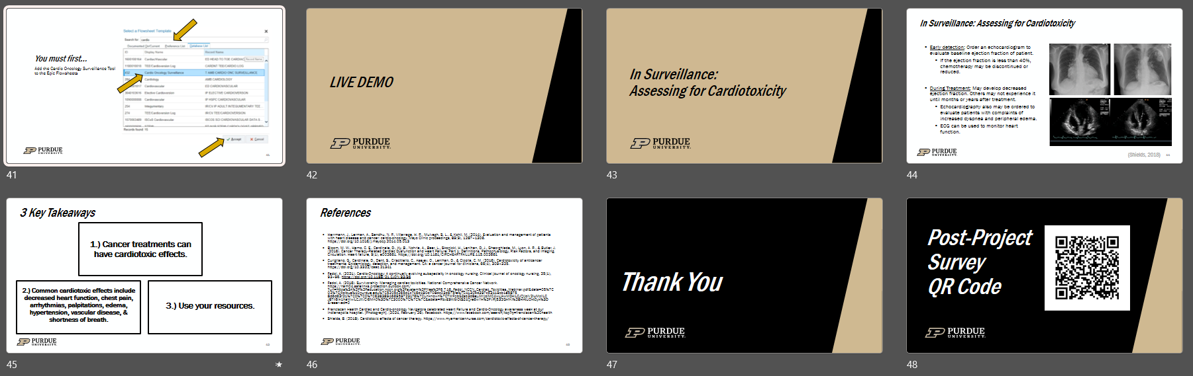
Study Design: Participant Surveys & Education Intervention

Slide 18
Results
Key findings: Improved self-efficacy in recognizing cardiotoxicity.

Slide 19
Results: Pre- & Post-Education Survey Comparative Analysis
#1
Monitor for signs and symptoms of deteriorating cardiovascular functions over time
p = 0.0021
Pre
Post
M = 3.19
M = 3.77
1
No Confidence
2
Little Confidence
3
Some Confidence
4
Confident
5
High Confidence

Slide 20
Results: Pre- & Post-Education Survey Comparative Analysis
#2
Recognize the signs and symptoms of secondary cardiotoxicity caused by chemotherapy treatments
p < 0.0001
Pre
Post
M = 1.88
M = 3.65
1
No Confidence
2
Little Confidence
3
Some Confidence
4
Confident
5
High Confidence

Slide 21
Results: Pre- & Post-Education Survey Comparative Analysis
#3
Recognize which chemotherapy treatments can damage the heart in reversible and irreversible ways
p < 0.0001
Pre
Post
M = 1.85
M = 3.5
1
No Confidence
2
Little Confidence
3
Some Confidence
4
Confident
5
High Confidence

Slide 22
Results: Pre- & Post-Education Survey Comparative Analysis
#4
Recognize chemotherapy treatments that may lead to both early and late cardiovascular damage
p < 0.0001
Pre
Post
M = 1.92
M = 3.5
1
No Confidence
2
Little Confidence
3
Some Confidence
4
Confident
5
High Confidence

Slide 23
Results: Pre- & Post-Education Survey Comparative Analysis
#5
Identify risk factors, both modifiable and not, for chemotherapy-related cardiovascular complications
p < 0.0001
Pre
Post
M = 1.78
M = 3.81
1
No Confidence
2
Little Confidence
3
Some Confidence
4
Confident
5
High Confidence

Slide 24
Results: Pre- & Post-Education Survey Comparative Analysis
#6
Monitor the factors that may have a negative impact on cardiovascular clinical outcomes over time
p < 0.0001
Pre
Post
M = 2.23
M = 3.77
1
No Confidence
2
Little Confidence
3
Some Confidence
4
Confident
5
High Confidence

Slide 25
Results: Pre- & Post-Education Survey Comparative Analysis
#7
Educate the patient undergoing cardiotoxic chemotherapy on how to recognize the symptoms and indicators of altered cardiovascular function (examples: fatigue, pain, dizziness)
p < 0.0001
Pre
Post
M = 2.23
M = 3.58
1
No Confidence
2
Little Confidence
3
Some Confidence
4
Confident
5
High Confidence

Slide 26
Results: Pre- & Post-Education Survey Comparative Analysis
Self-efficacy yes or no question
 | Yes | No
Before taking part in this education, do you think you can recognize a patient with symptoms of cancer therapy-related cardiotoxicity? | 2 (7.7%) | 24 (92.3%)
After taking part in this education, do you think you can recognize a patient with symptoms of cancer therapy-related cardiotoxicity? | 26 (100%) | 0 (0%)

Slide 27
Discussion
Significance of the results and study limitations.

Slide 28



Discussion: Demographic Highlights
High-level of formal education among study participants
Zero nurses reported prior oncology nursing experience
Majority of the respondents were employed in the CCU
Most common: Bachelor’s degree in nursing
Critical data point given the context of the study
Focused expertise in cardiac care care

Slide 29
Discussion: Significance of Results
Cardiac RNs with no previous oncology experience can progress from little confidence towards confident in early recognition after one educational intervention.
Educational Intervention
From
To
Total M = 2.15
Total M = 3.65
1
No Confidence
2
Little Confidence
3
Some Confidence
4
Confident
5
High Confidence

Slide 30
Discussion: Limitations
The use of self-reported measures for self-efficacy could introduce subjective biases.
Excluding certain questions from the NSS-CTC could limit the survey comprehensiveness.
Environmental factors in the clinical setting, such as interruptions, could impact the effectiveness of the educational intervention.
The study's one-day intervention did not capture long-term knowledge retention or implemented practice changes.
Future research should utilize mixed methods to validate self-reported data, and conduct longitudinal studies to assess the lasting impacts of education interventions.

Slide 31
Implications
Impact on healthcare systems, healthcare economics, and nursing practice.

Slide 32
Implications: Healthcare Systems
Education to detect early signs of cardiotoxicity
  is a strategic move to curtail the long-term morbidity and mortality linked to cancer treatments.
  fosters interdisciplinary collaboration, enhancing the synergy between nurses and cardio-oncology experts.
  highlights the critical role of continuous nursing education within healthcare systems in elevating patient outcomes and overall healthcare quality.
#1
As cardiotoxicity in cancer patients continues to rise, integrating cardio-oncology into healthcare services becomes imperative.
#2
(Alvarez-Cardona et al., 2020)
#3
(Lyon et al., 2020)

Slide 33
Implications: Healthcare Economics
Early recognition of cardiotoxicity can reduce long-term costs.
Examples (below) from Wong et al.’s (2018) assessment of health care costs associated with adverse cardiotoxic events in 412,005 patients with cancer.
Adverse Cardiotoxic Event | Cost Per Treatment Episode
Hypertension | $28,983
Chest pain/angina | $20,081
Thromboembolic events | $26,080
Arrhythmias | $25,232
Heart failure | $26,348
Hypotension | $21,378

Slide 34
Implications: Nursing Practice
#1
#2
#3
A cardiac nurse is a crucial member of the interdisciplinary cardio-oncology team.
Self-efficacy of cardiac nurses with no previous oncology experience can be increased from little confidence to confident after one educational intervention.
A patient may first present signs of cardiotoxicity in the presence of an RN on a cardiac unit, rather than an oncology unit.

Slide 35
Conclusion

Slide 36

Conclusion
+
=
Lack of cardiotoxicity nursing education
Increasing cardiotoxicity in cancer patients
Essential need for cardiac nurse early symptom recognition education.

Slide 37
References
  Alvarez-Cardona, J. A., Ray, J., Carver, J., Zaha, V., Cheng, R., Yang, E., Mitchell, J. D., Stockerl-Goldstein, K., Kondapalli, L., Dent, S., Arnold, A., Brown, S. A., Leja, M., Barac, A., Lenihan, D. J., Herrmann, J., & Cardio-Oncology Leadership Council (2020). Cardio-oncology education and training: JACC council perspectives. Journal of the American College of Cardiology, 76(19), 2267-2281. https://doi.org/10.1016/j.jacc.2020.08.079
  Belloni, S., Arrigoni, C., Dellafiore, F., Biagioli, V., Piredda, A., & Caruso, R. (2021). Symptom- level description of nursing perceptions about unwarranted clinical variation, inequality in access to cancer services, specific-symptom knowledge: An Italian web-based survey. Seminars in Oncology Nursing, 37(2). https://doi.org/10.1016/j.soncn.2021.151138
  Ghizzardi, G., Pittella, F., Dellafiore, F., & Caruso, R. (2017). Does cardiotoxicity management represent a rare bird for cancer nursing care delivery? An Italian study on nurses' self- efficacy. European Journal of Cancer, 71(1), 119-120. https://doi.org/10.1016/S0959-8049(17)30473-2
  Kelly, F., Carroll, S. K., Carley, M., Dent, S., Shorr, R., Hu, J., Morash, R., & Stacey, D. (2017). Symptom practice guide for telephone assessment of patients with cancer treatment-related cardiotoxic dyspnea: Adaptation and evaluation of acceptability. Cardio-Oncology, 3(7), 1-12. https://doi.org/10.1186/s40959-017-0026-6
  Lyon, A. R., Dent, S., Stanway, S., Earl, H., Brezden-Masley, C., Cohen-Solal, A., Tocchetti, C. G., Moslehi, J. J., Groarke, J. D., Bergler-Klein, J., Khoo, V., Tan, L. L., Anker, M. S., von Haehling, S., Maack, C., Pudil, R., Barac, A., Thavendiranathan, P., Ky, B., Neilan, T. G., … Lenihan, D. (2020). Baseline cardiovascular risk assessment in cancer patients scheduled to receive cardiotoxic cancer therapies: a position statement and new risk assessment tools from the Cardio-Oncology Study Group of the Heart Failure Association of the European Society of Cardiology in collaboration with the International Cardio-Oncology Society. European Journal of Heart Failure, 22(11), 1945-1960. https://doi.org/10.1002/ejhf.1920
  Lyon, A. R., López-Fernández, T., Couch, L. S., Asteggiano, R., Aznar, M. C., Bergler-Klein, J., Boriani, G., Cardinale, D., Cordoba, R., Cosyns, B., Cutter, D. J., de Azambuja, E., de Boer, R. A., Dent, S. F., Farmakis, D., Gevaert, S. A., Gorog, D. A., Herrmann, J., Lenihan, D., Moslehi, J., … Zamorano, J. L. (2022). 2022 ESC Guidelines on cardio-oncology developed in collaboration with the European Hematology Association (EHA), the European Society for Therapeutic Radiology and Oncology (ESTRO) and the International Cardio-Oncology Society (IC-OS). European Heart Journal, 43(41), 4229-4361. https://doi.org/10.1093/eurheartj/ehac244
  Magon, A., Conte, G., Arrigoni, C., Dellafiore, F., de Maria, M., Pittella, F., Rocco, G., Stievano, A., Ghizzardi, G., & Caruso, R. (2023). Development and psychometric validation of the Nursing Self-Efficacy Scale for Managing Cancer Treatment-Induced Cardiotoxicity: An exploratory mixed-method study. Seminars in Oncology Nursing, 39(3), 1-7. https://doi.org/10.1016/j.soncn.2022.151367
  Shields, B. (2018). Cardiotoxic effects of cancer therapy. https://www.myamericannurse.com/cardiotoxic-effects-of-cancer-therapy/
  Wong, W., Yim, Y. M., Kim, A., Cloutier, M., Gauthier-Loiselle, M., Gagnon-Sanschagrin, P., & Guerin, A. (2018). Assessment of costs associated with adverse events in patients with cancer. Plos One, 13(4), 1-13. https://doi.org/10.1371/journal.pone.0196007

