Slide 1
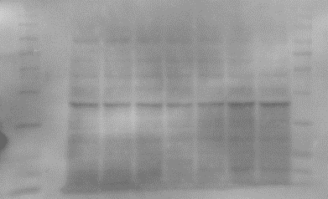
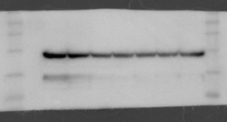
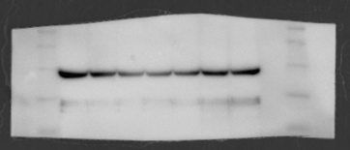
Sham
Sepsis
A
1
2
3
1
2
3
4
B
GOT1
*(0.0150)
ns(0.7941)
β-actin
Sham
Sepsis
GOT1 protein level
(normalized to ß-actin)
GOT2 protein level
(normalized to ß-actin)
1
2
3
1
2
3
4
GOT2
β-actin
Sham
Sepsis
Sham
Sepsis
GOT1 and GOT2 protein expression in splenocyte.
A, B. GOT1 and GOT2 protein expression level in the splenocytes were measured by immunoblotting 24h after induction of sepsis. The immunoblot images were shown by cropping the target protein bands except for the non-specific portion. The full immunoblots are provided in Supplementary figure. (GOT1, GOT2, β-actin, n = 3 to 4 group. ***p < 0 .001, **p < 0 .01 and *p < 0.05 compared with the sham or sepsis group)
Notes:
Method 부분은 작성중입니다. (시약 제품명 찾아서 넣을 예정입니다)
Western blot analysis
The splenocytes were isolated by cell strainer[] from rat spleen and lysed by using RIPA buffer() with a protease inhibitor and phosphatase inhibitor[]. Each samples loading on immunoblot have 20ug protein and were separated by 12% SDS-PAGE. Then the gels were transferred to PVDF membranes and blocked in 5% BSA for 1hr at room temperature. The membranes were incubated with primary antibody (GOT1, GOT2, β-actin [1:1,000; sc-47778, Santa Cruz) overnight at 4 °C and secondary antibody (for GOT1 and GOT2, for β-actin ) for 1hr at room temperature. The proteins were visualized with 000.

Slide 2
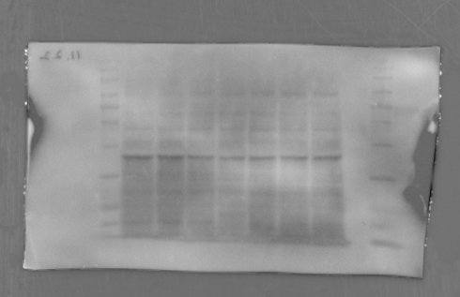
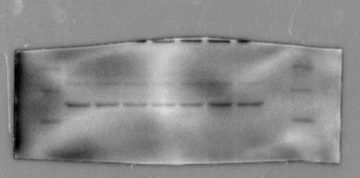
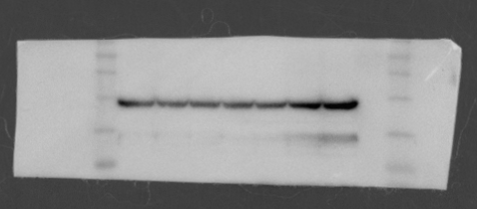
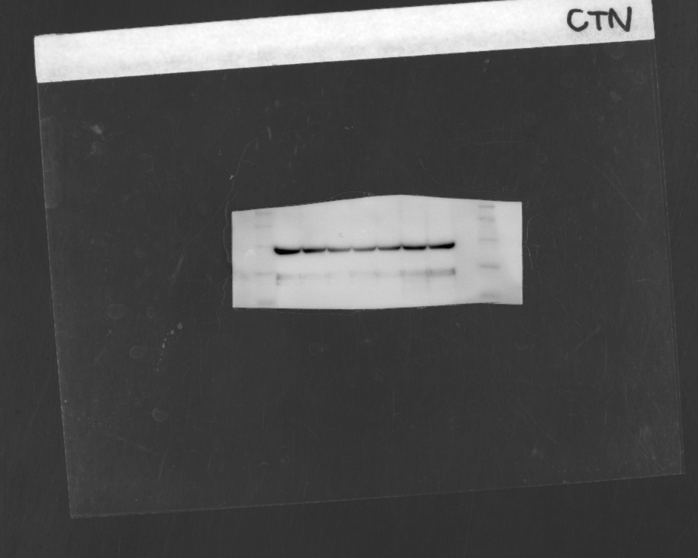
Supplementary Figure
: immunoblotting membrane image crop
Western blot RAW images :
GOT1 and β-actin
GOT2 and β-actin
1. Sham splenocyte
2. Sham splenocyte
3. Sham splenocyte
4. Sepsis splenocyte
5. Sepsis splenocyte
6. Sepsis splenocyte
7. Sepsis splenocyte
GOT1(41kDa)
GOT2(43kDa)
Marker(kDa)
1
2
3
4
5
6
7
Marker(kDa)
1
2
3
4
5
6
7
63ㅡ
100ㅡ
48ㅡ
75ㅡ
63ㅡ
35ㅡ
48ㅡ
35ㅡ
25ㅡ
20ㅡ
β-actin(42kDa)
β-actin(42kDa)
Marker(kDa)
1
2
3
4
5
6
7
Marker(kDa)
1
2
3
4
5
6
7
75ㅡ
75ㅡ
63ㅡ
63ㅡ
48ㅡ
48ㅡ
35ㅡ
35ㅡ
25ㅡ
25ㅡ

Slide 3
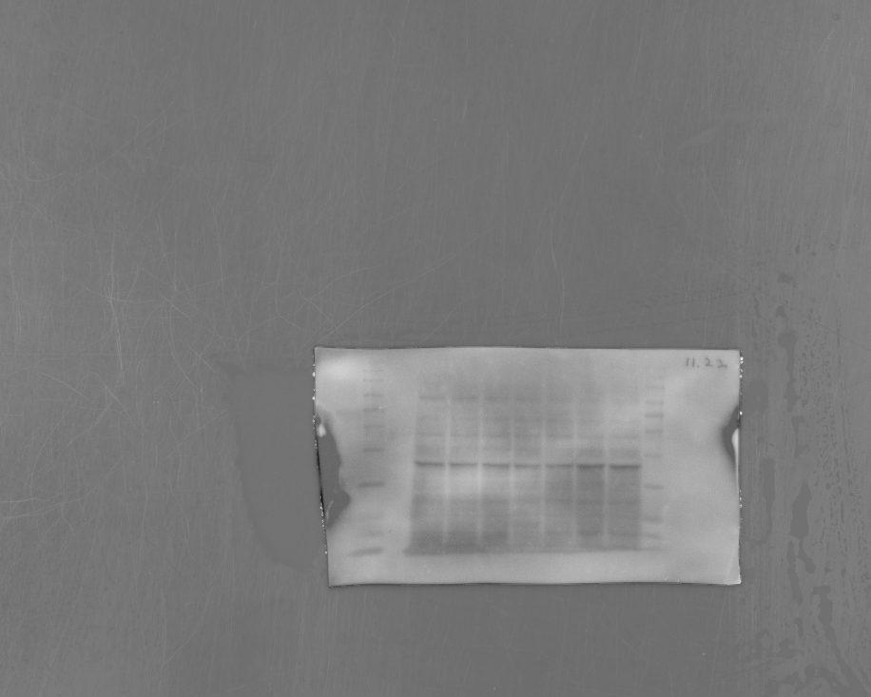
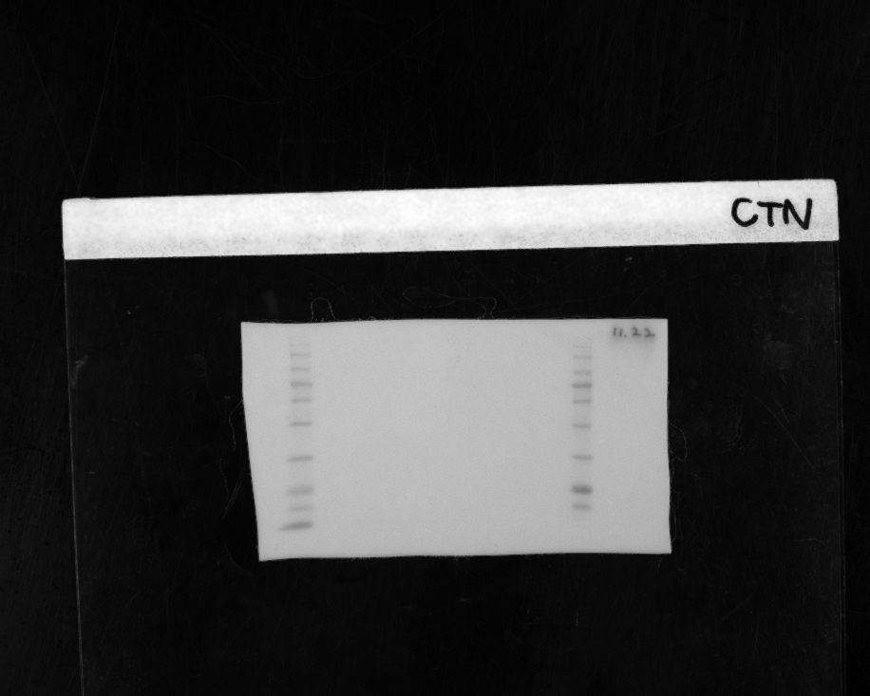
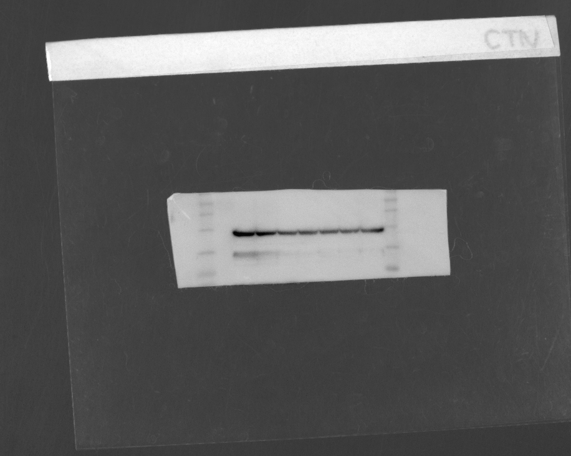
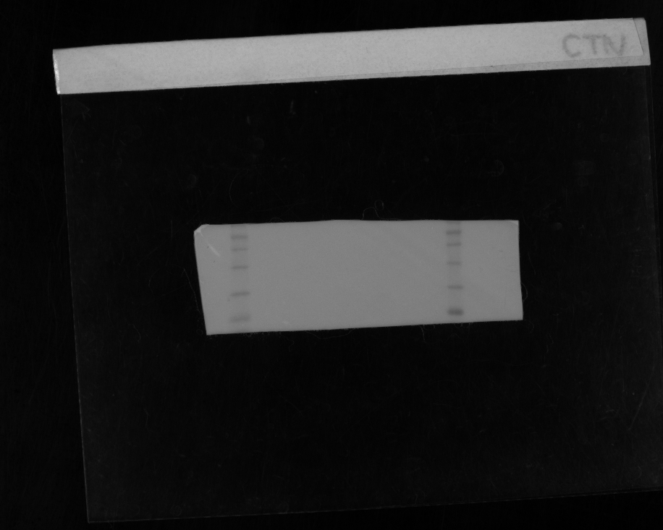
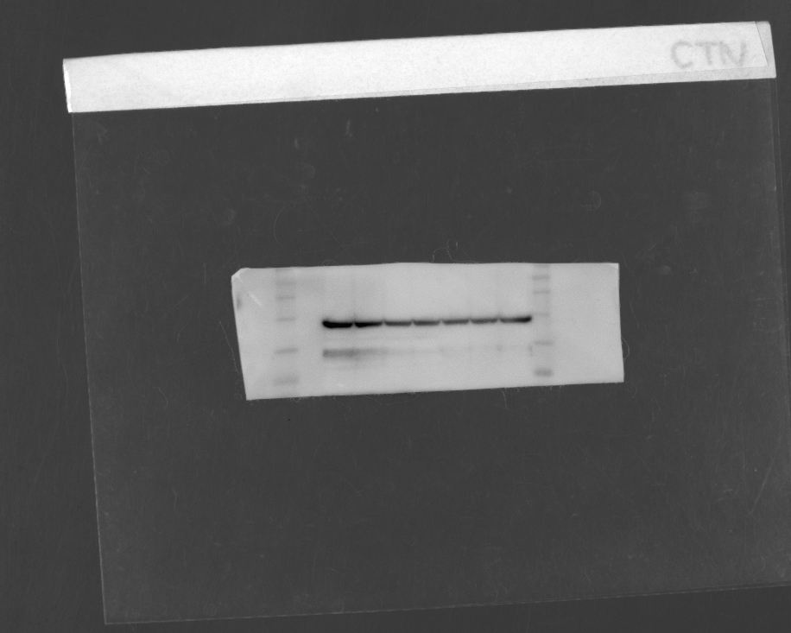
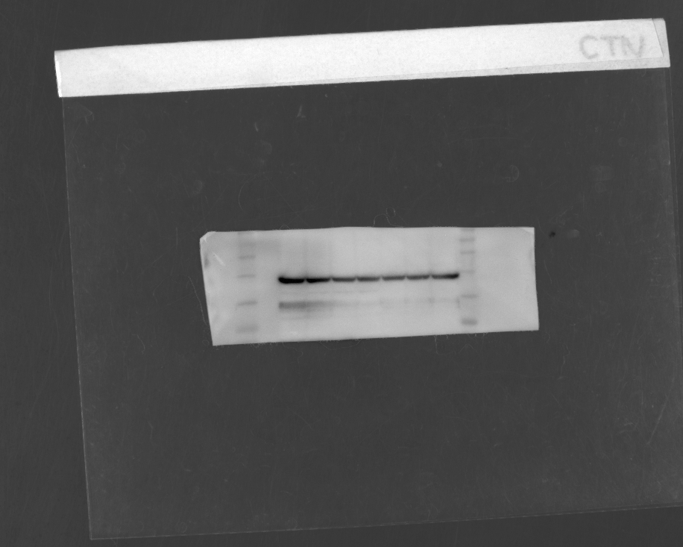
Supplementary Figure
Serial images and original membrane of GOT1 and β-actin
Exposure time
GOT1(41kDa)
Original membrane
5s
75
10s
48
35
15s
Exposure time
β-actin(42kDa)
Original membrane
5s
75
10s
48
35
30s

Slide 4
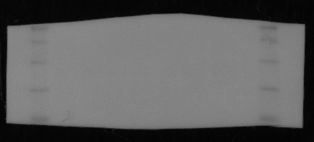

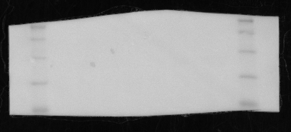
Supplementary Figure
Serial images and original membrane of GOT2 and β-actin
Exposure time
GOT2(43kDa)
Original membrane
10s
75
15s
48
35
20s
Exposure time
β-actin(42kDa)
Original membrane
10s
75
48
35
30s

