Slide 1
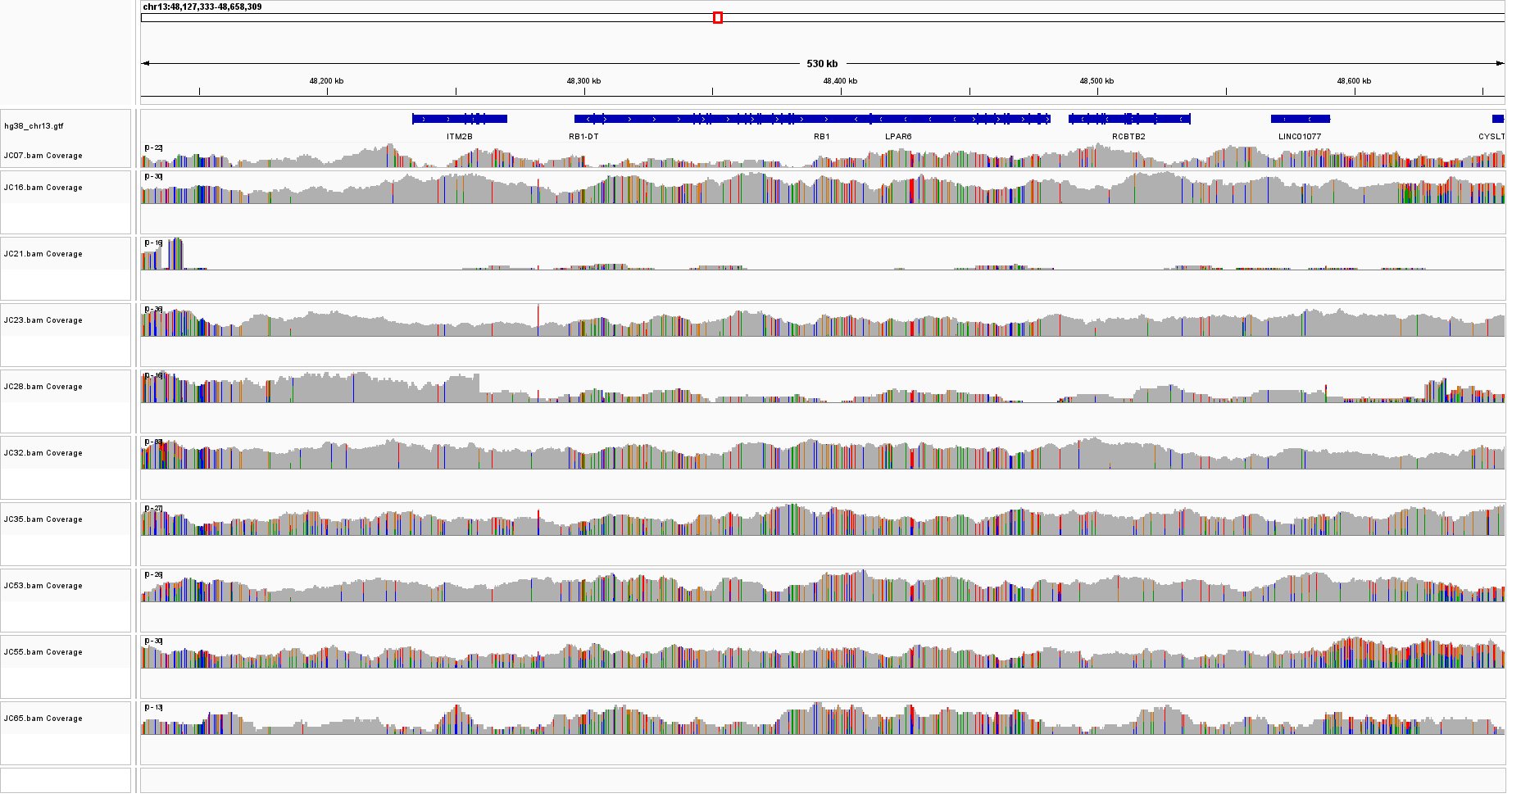
Supplementary Fig. 1
Suppl. Fig. 1 Screen shot from IGV showing the deletion of the gene RB1 in samples JC21 and JC28

Slide 2
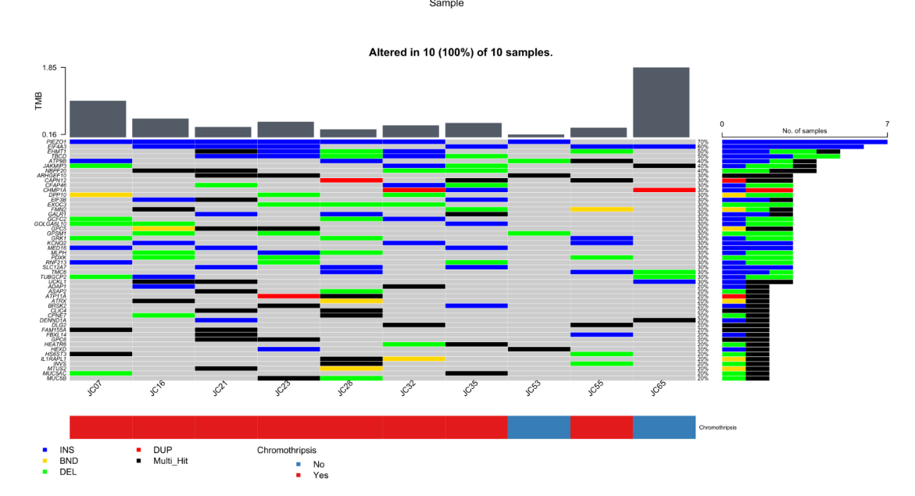
Supplementary Fig. 2
Suppl. Fig. 2 CNA events across uLMS samples from the Karolinska dataset. In the scale on the top of the figure there is a grey histogram with the TMB in each sample, and in the scale on the right the frequency of CNA events across the samples. The color legend for each CNA event is displayed on the bottom of the figure.

Slide 3
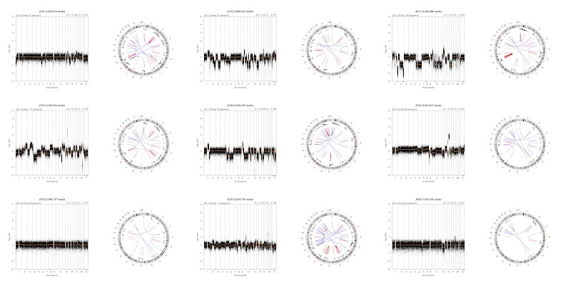
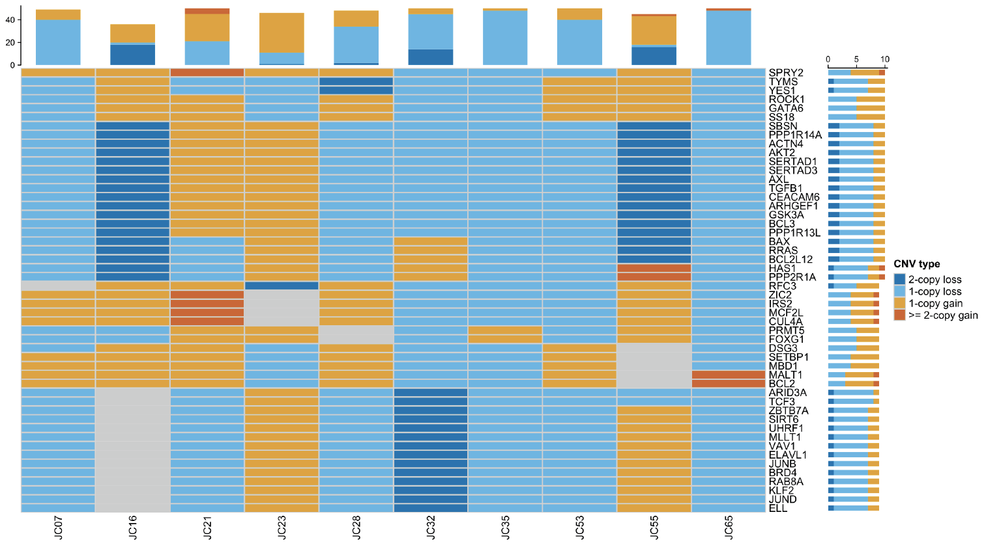
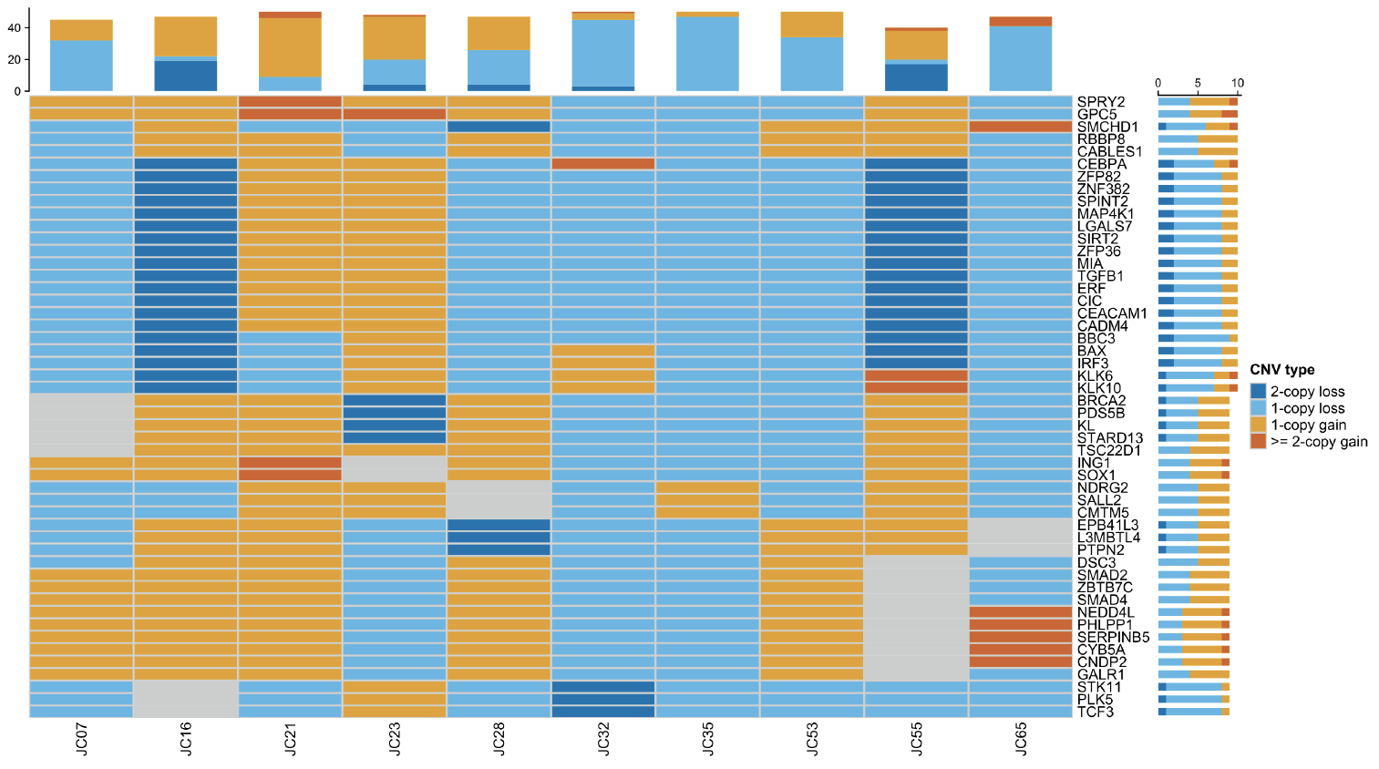
Supplementary Fig. 3
a
b
Suppl. Fig. 3 Chromothripsis signature and CNA events across uLMS samples from the Karolinska dataset. a. In the genome-wide plots we can observe the genomic gains and losses according to the reference genome (yellow line), and in the circle plot it is shown the reciprocal translocations events in each sample. b. In the left it is shown the top 50 proto-oncogenes involved in CNA, and on the right, the list of tumor suppressor genes. In the scale on the top of the figure there is a histogram with the count of each gene per sample, and in the scale on the right the frequency of CNA events across the samples. The color legend for each CNA event is displayed on the bottom of the figure.

Slide 4
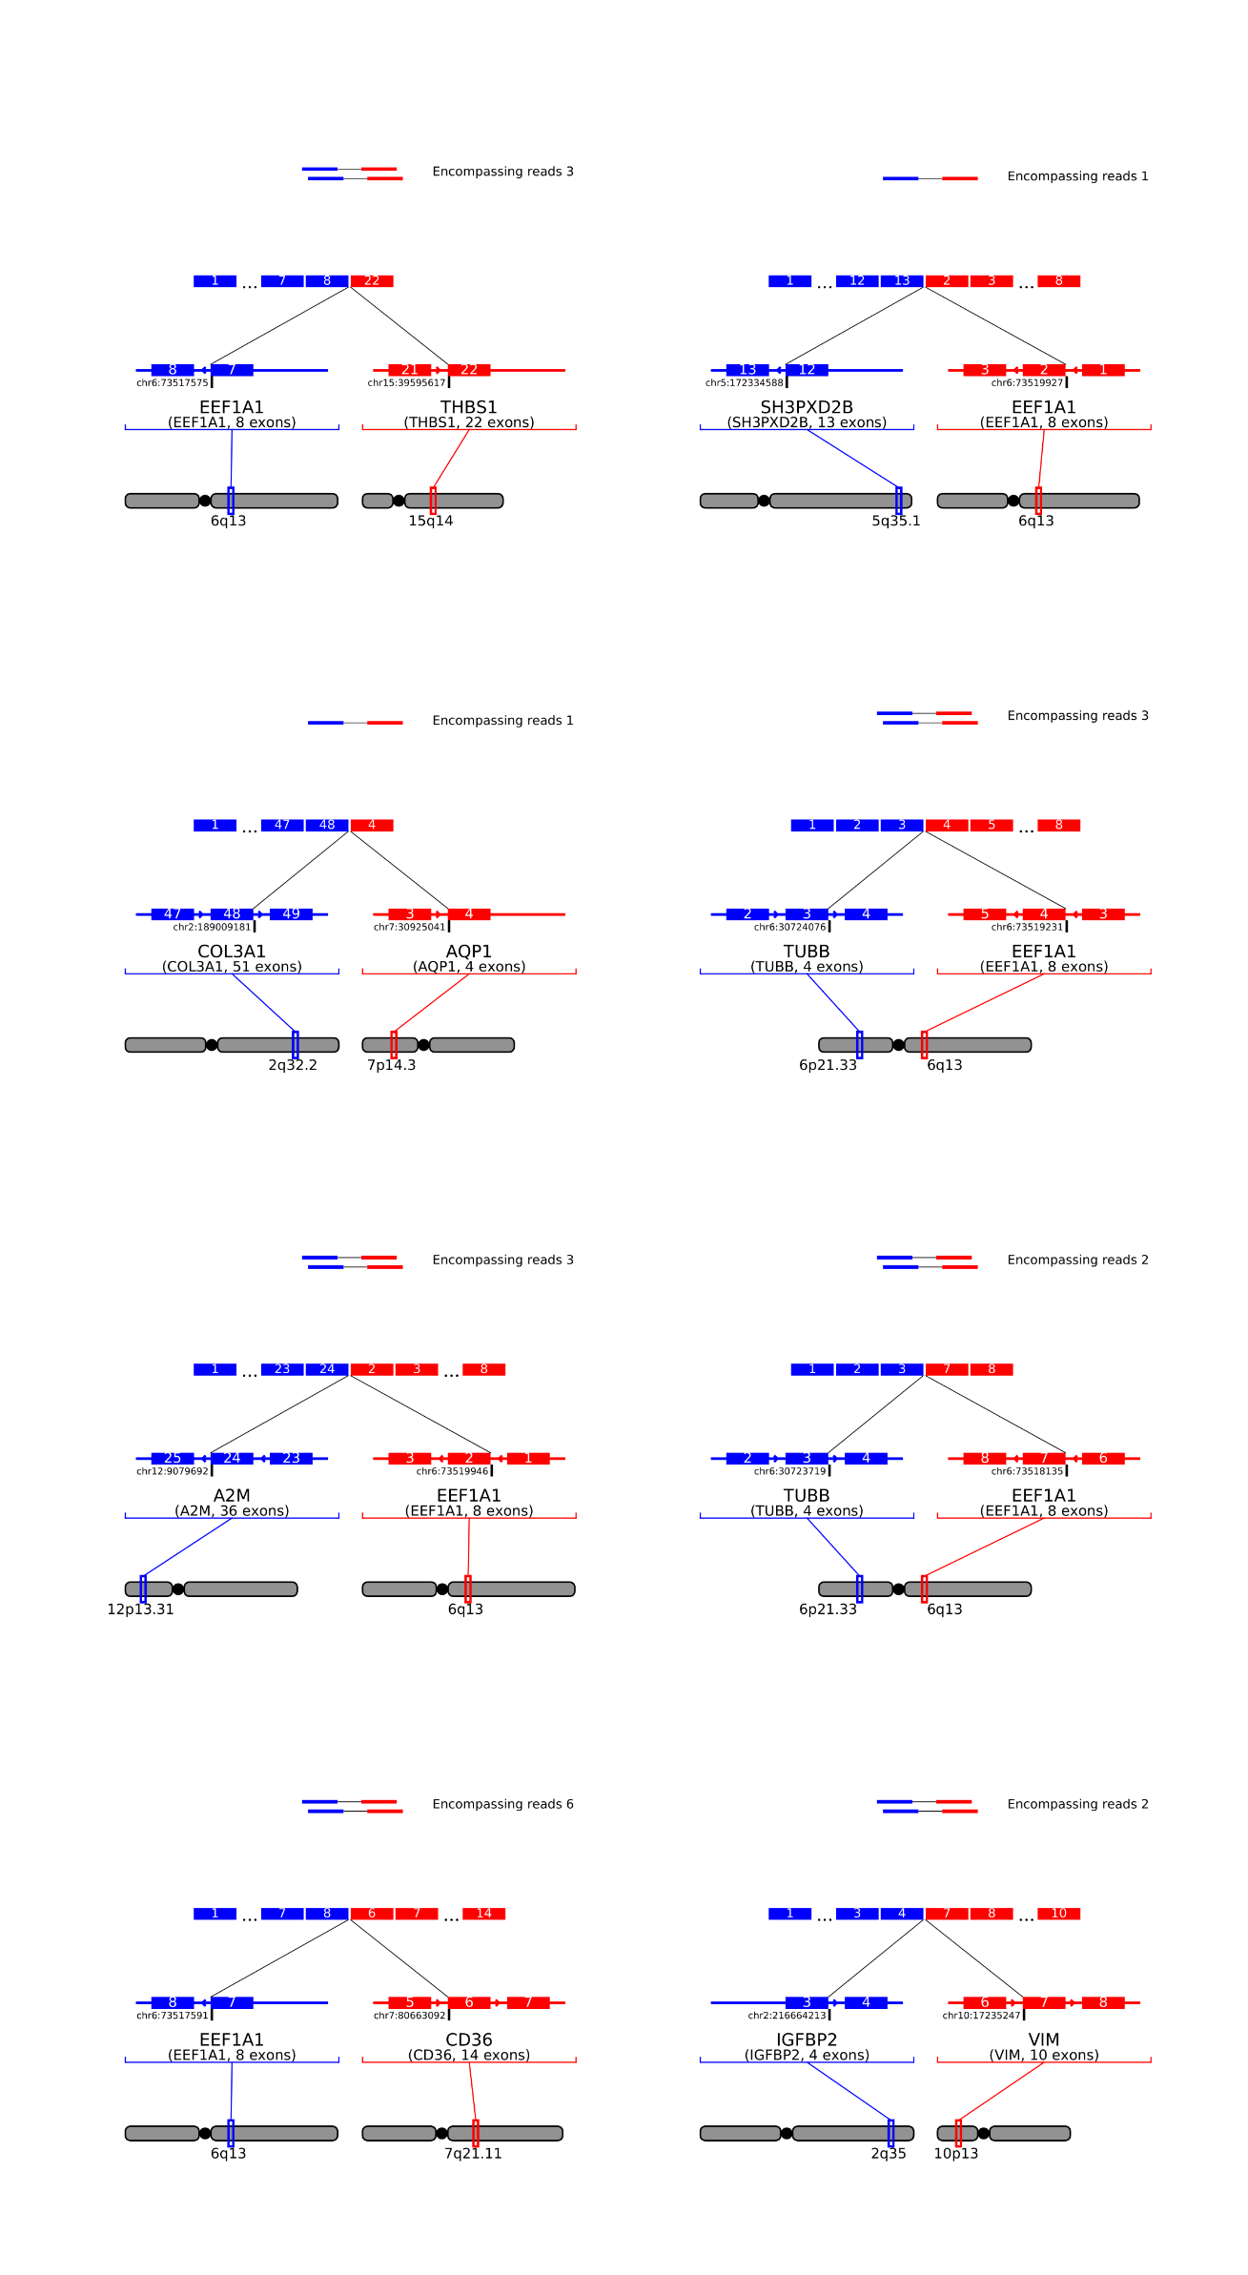
Supplementary Fig. 4
Suppl. Fig. 4 Illustration of chromosomal fusion events highlighting the points of break in each exon of the gene involved in the fusion.

Slide 5
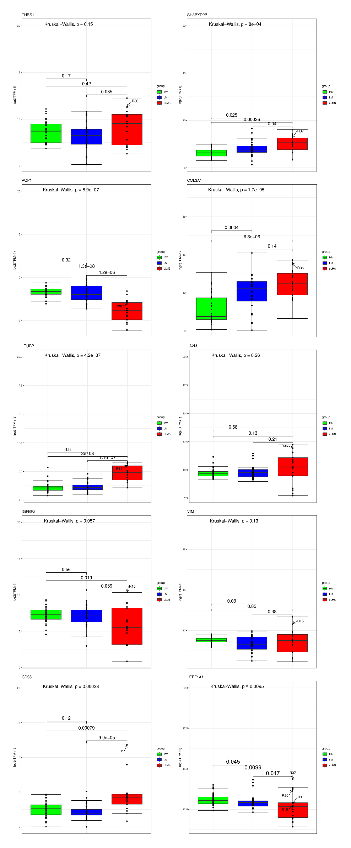
Supplementary Fig. 5
Suppl. Fig. 5 Boxplot with mRNA expression of each gene involved in fusions across the three groups MM, LM and uLMS, as shonw in the color legend. The p value according to Kruskal-Wallis is displayed at the top of each panel

Slide 6
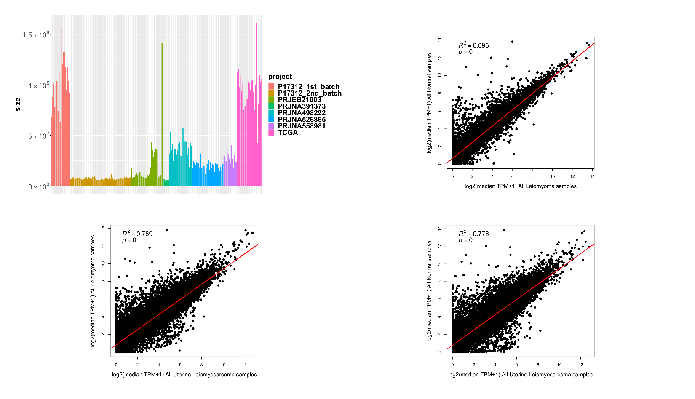
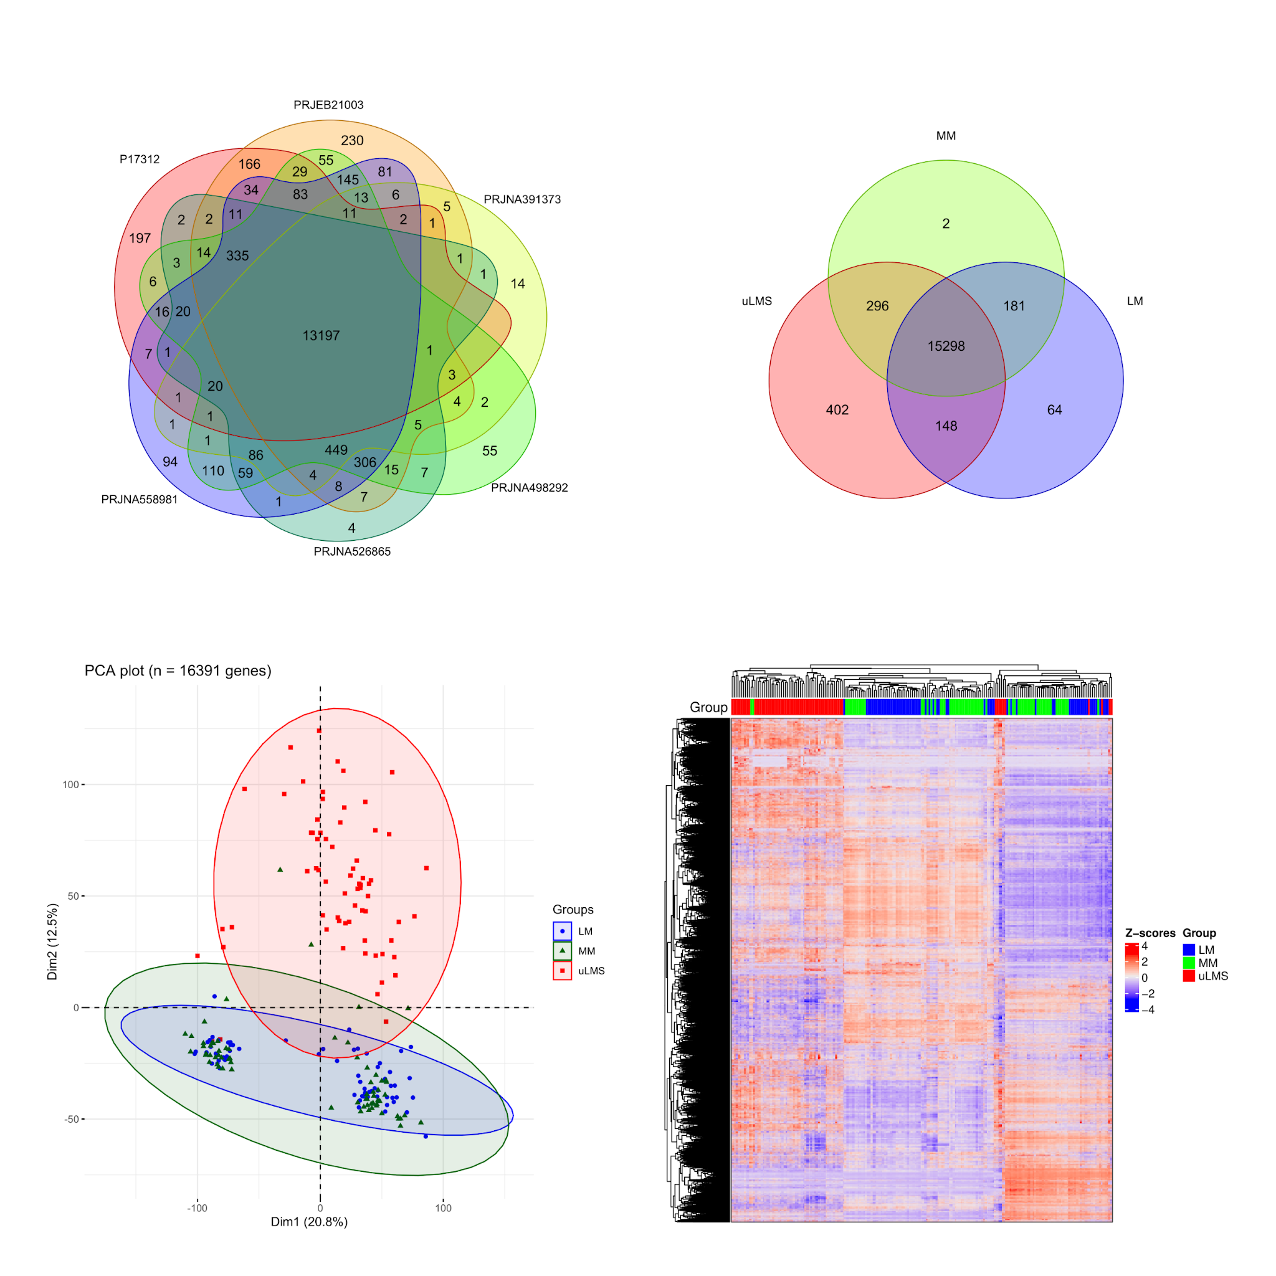
Supplementary Fig. 6
a
b
c
d
e
Suppl. Fig. 6 RNA-Seq data integration analysis among the cohorts resulted in the integration transcriptomics of 201 fresh-frozen samples (68 MM, 66 LM and 67 uLMS). a. b. Expression correlation as Log2(median TPM+1) between MM and LM. c. Expression correlation as Log2(median TPM+1) between LM and uLMS. d. Expression correlation as Log2(median TPM+1) between MM and uLMS. e. Venn Diagram showing a total of 13,197 constitutive genes expressed consistently in all datasets.

Slide 7
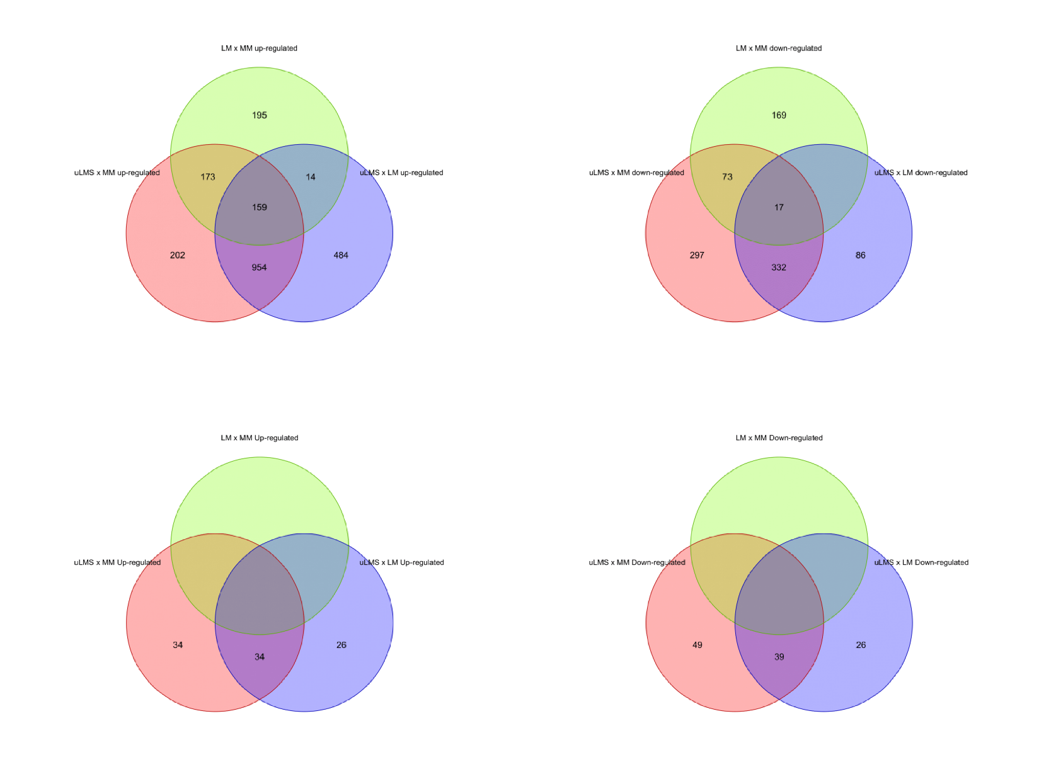
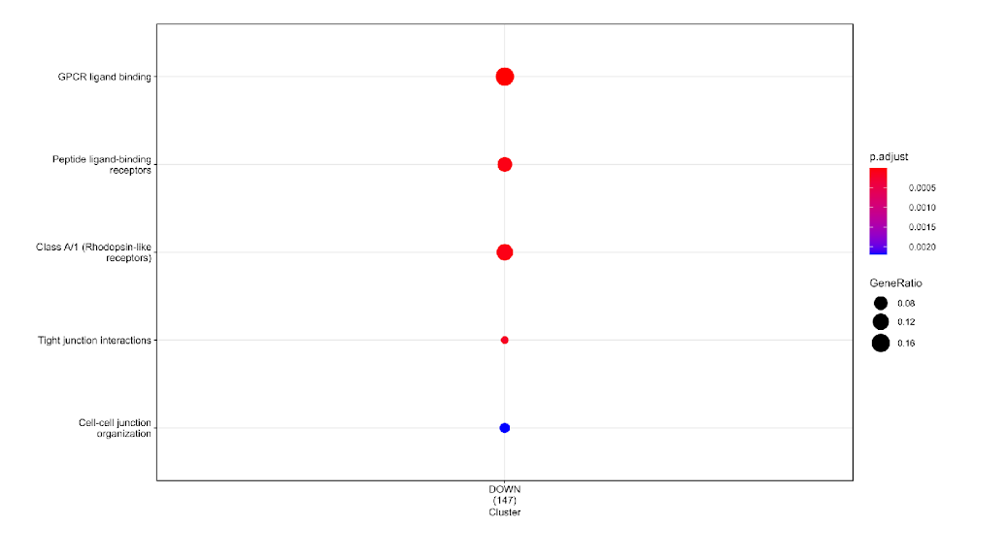
Supplementary Fig. 7
a
b
c
d
e
Suppl. Fig. 7 Venn Diagram comparing DEGs and DEPs among the comparisons LM x MM; uLMS x MM and uLMS x LM. a. Up-regulated genes in mRNA. b. Down-regulated genes in mRNA. c. Up-regulated proteins. d. Down-regulated proteins. e. Over Representation Analysis (ORA) of the list of down-regulated genes.

Slide 8
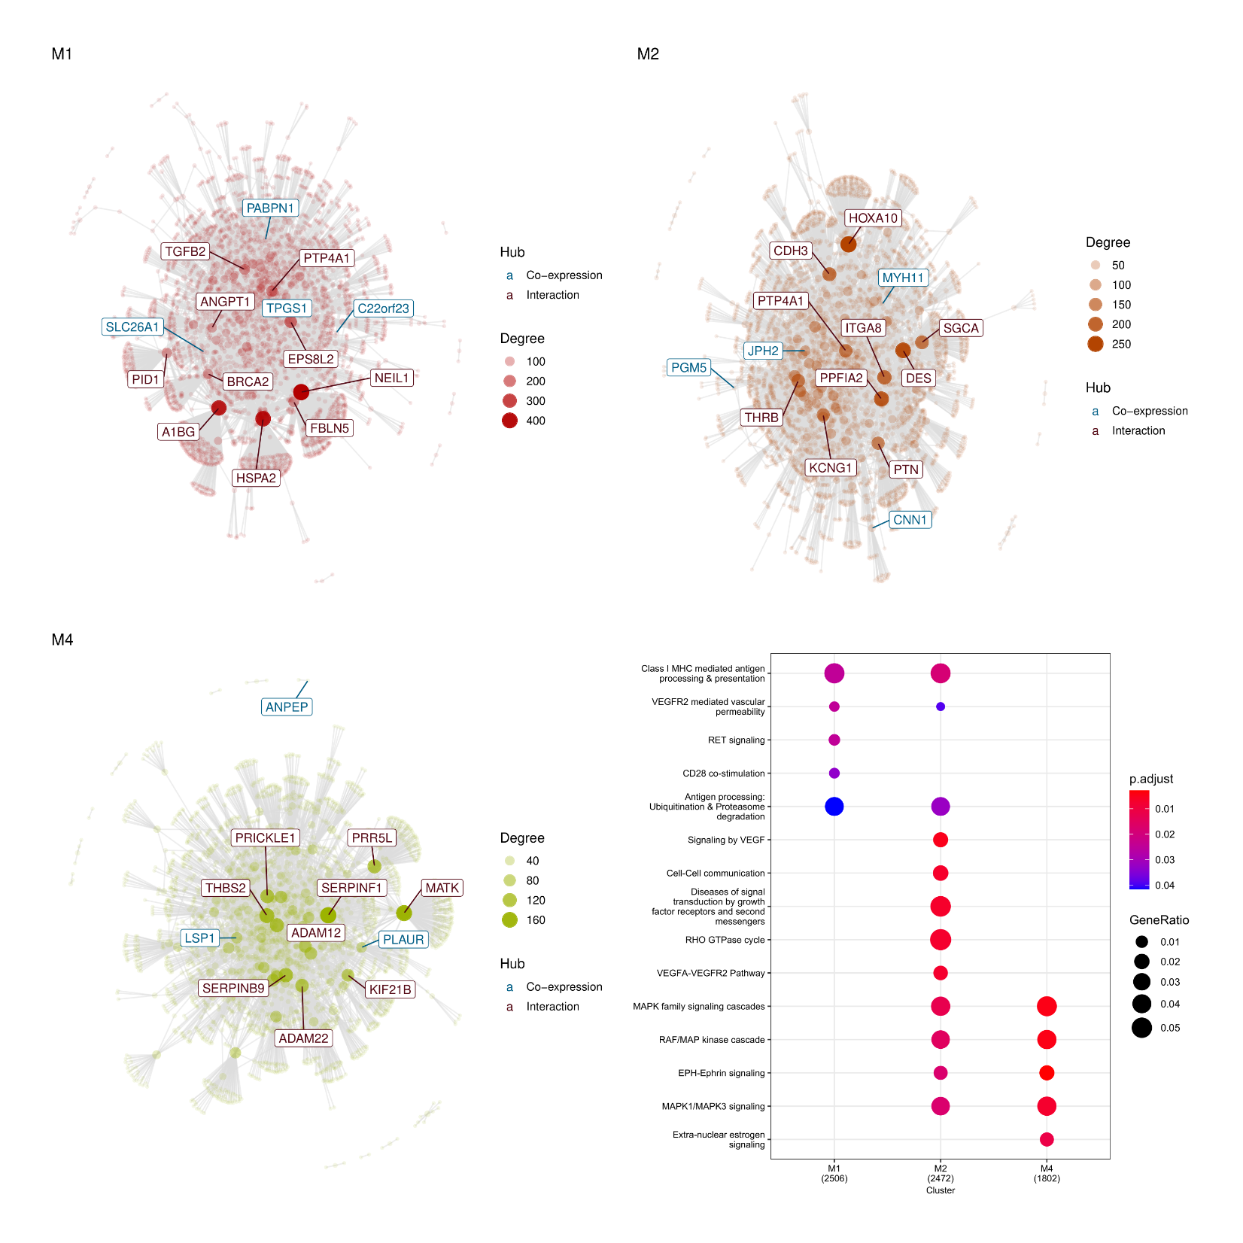
Supplementary Fig. 8
a
b
c
d
Suppl. Fig. 8 Gene co-expression analysis. a. M1 cluster highlighting genes related with immune surveillance and interactions with the TME. b. M2 cluster highlighting genes related with cellular communication processes, regulation of vascular growth and response to growth factors. c. M4 cluster highlighting genes related with extranuclear estrogen signaling. d. Enrichment analysis for M1, M2 and M4 modules.

Slide 9
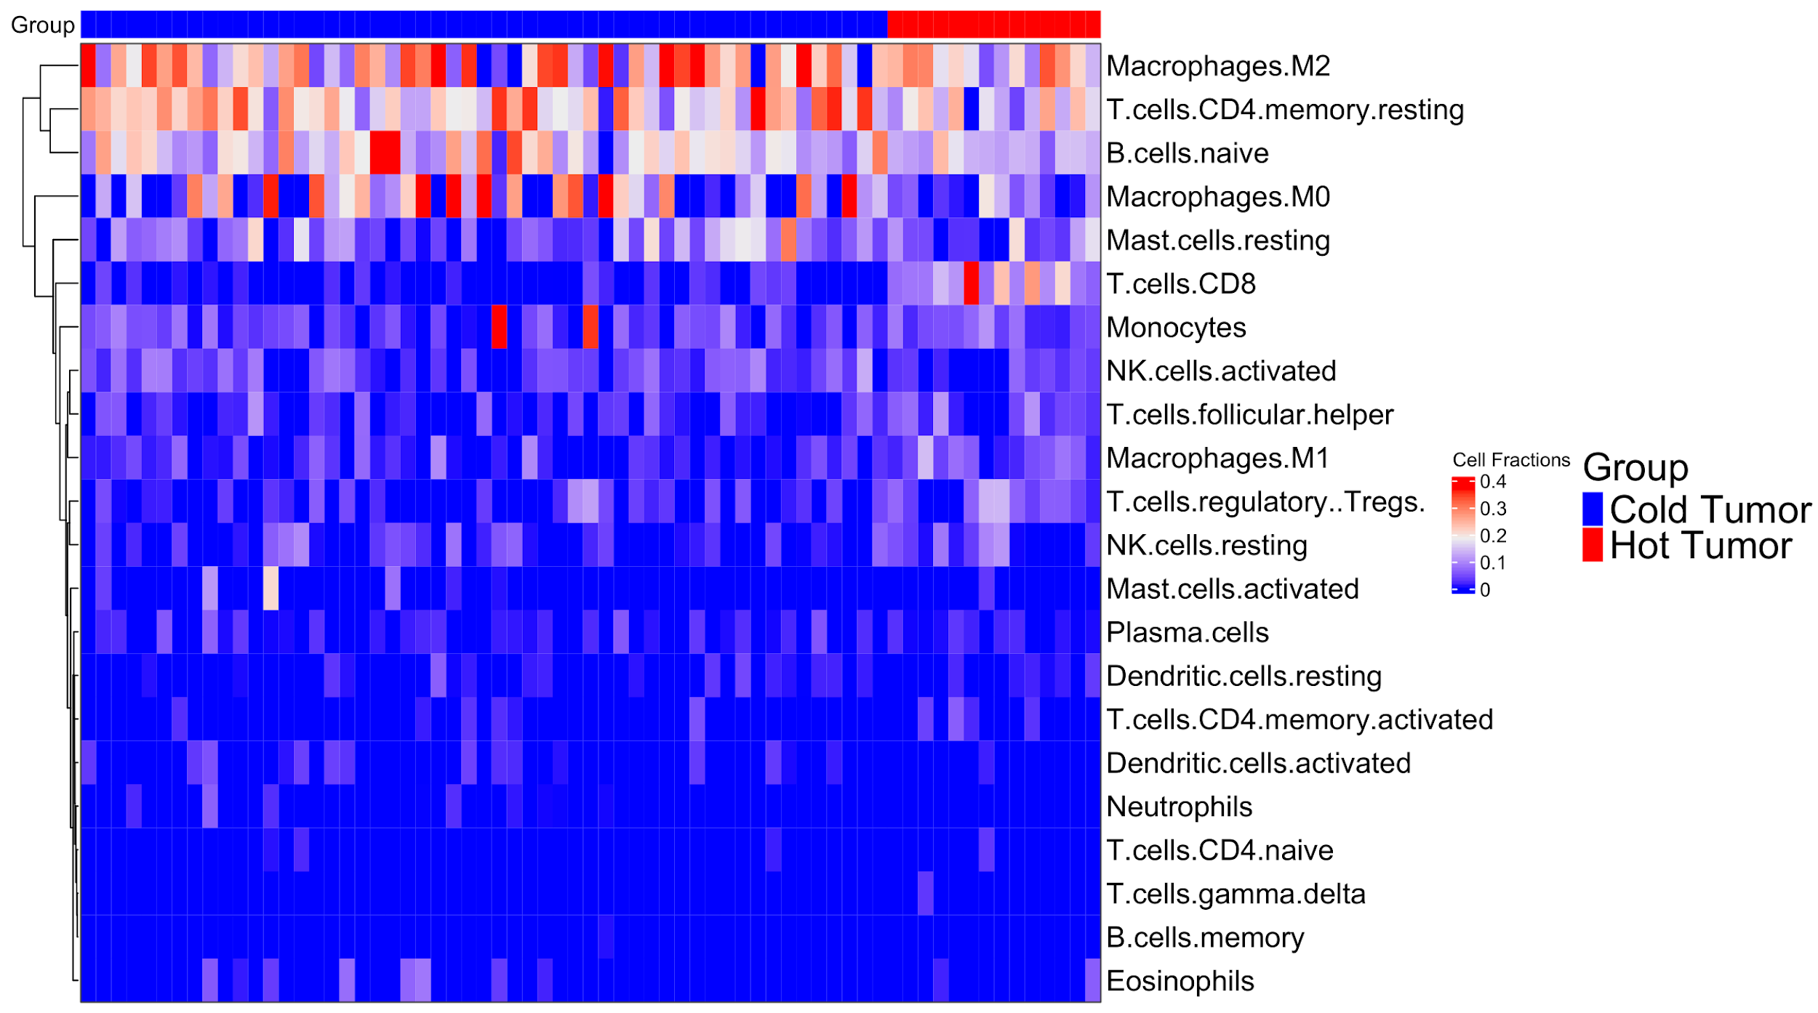
Supplementary Fig. 9
Suppl. Fig. 9 Heatmap with CIBERSORTx in uLMS samples showing the cell fractions from all 22 immune cell subtypes and divided in Cold or Hot.

Slide 10
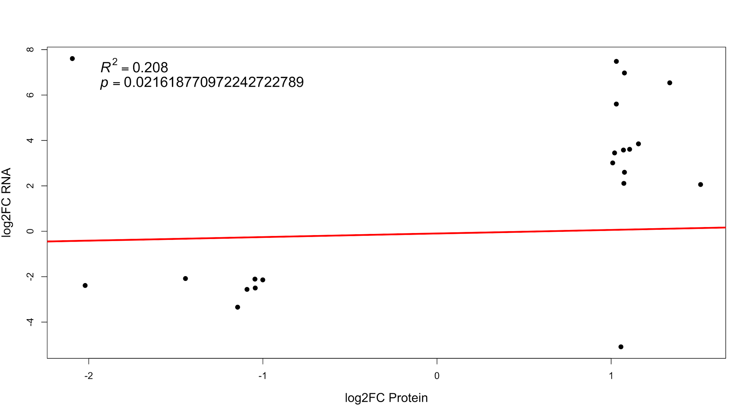
Supplementary Fig. 10
Suppl. Fig. 10 Correlation analysis of genes and proteins using log2FC

Slide 11
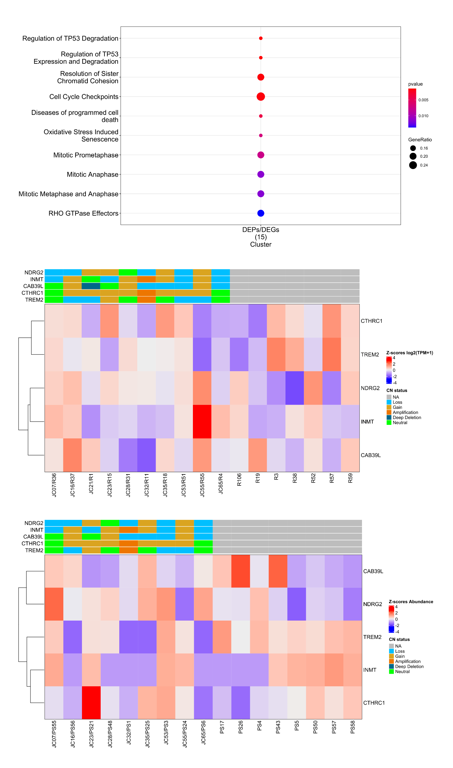
Supplementary Fig. 11
a
b
c
Suppl. Fig. 11 Multi-omics integration analysis. a. ORA analysis from all 21 genes and proteins. b. DNA and RNA-Seq integration. c. and DNA and proteomic integration. The color legend for each CNA event is displayed on the bottom of the figure.

Slide 12
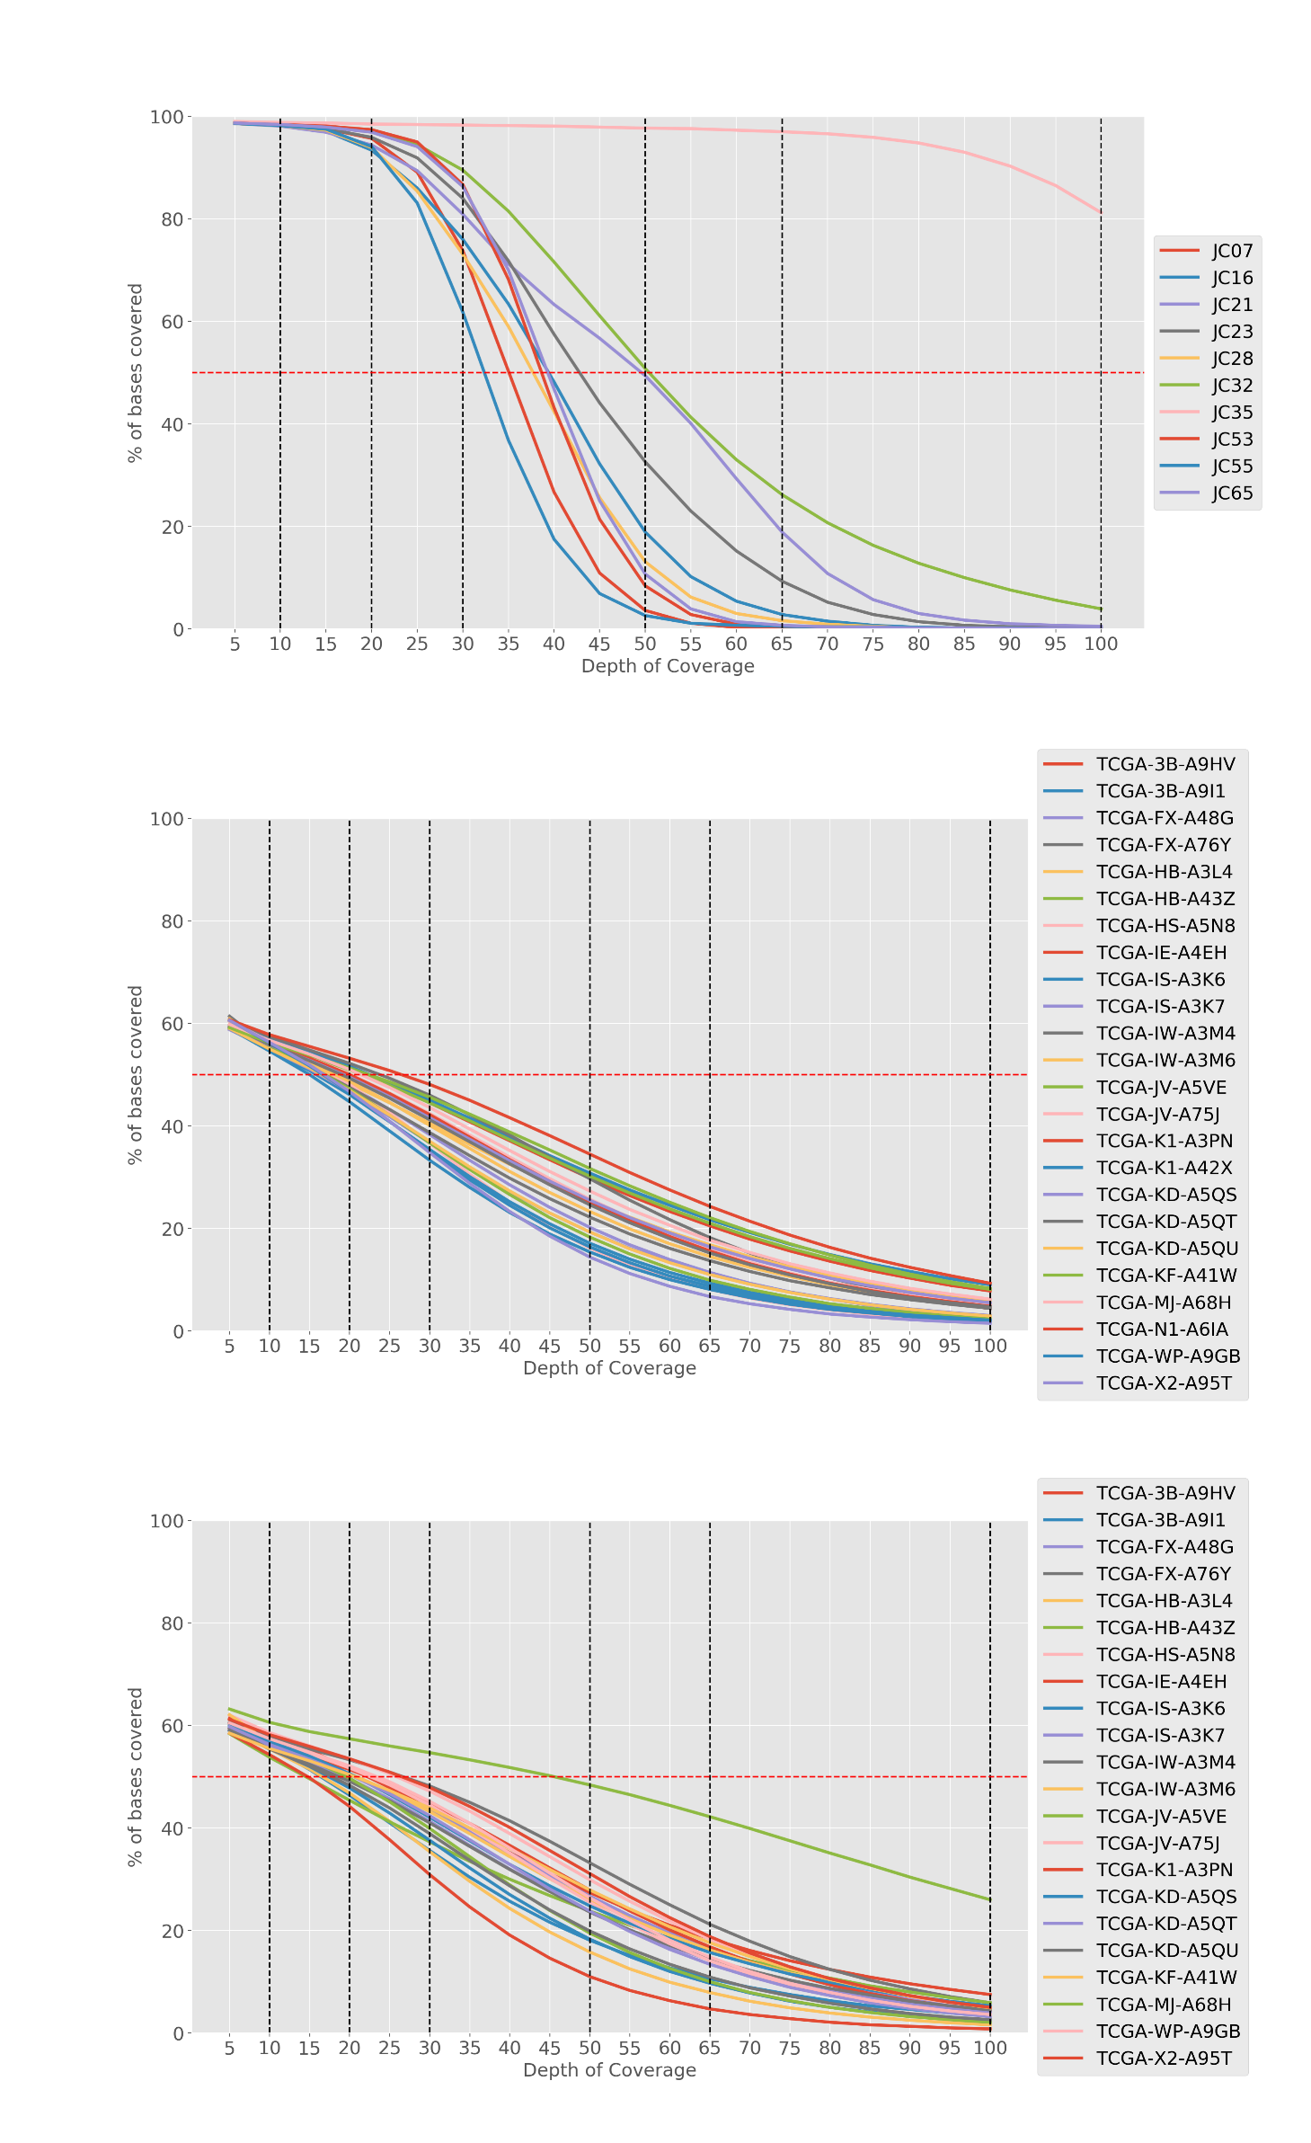
Supplementary Fig. 12
a
b
c
Suppl. Fig. 12 Depth values versus the percentage of covered bases from protein-coding regions for a. Karolinska dataset. b. TCGA solid tumor dataset. c. TCGA normal blood cohort.

Slide 13
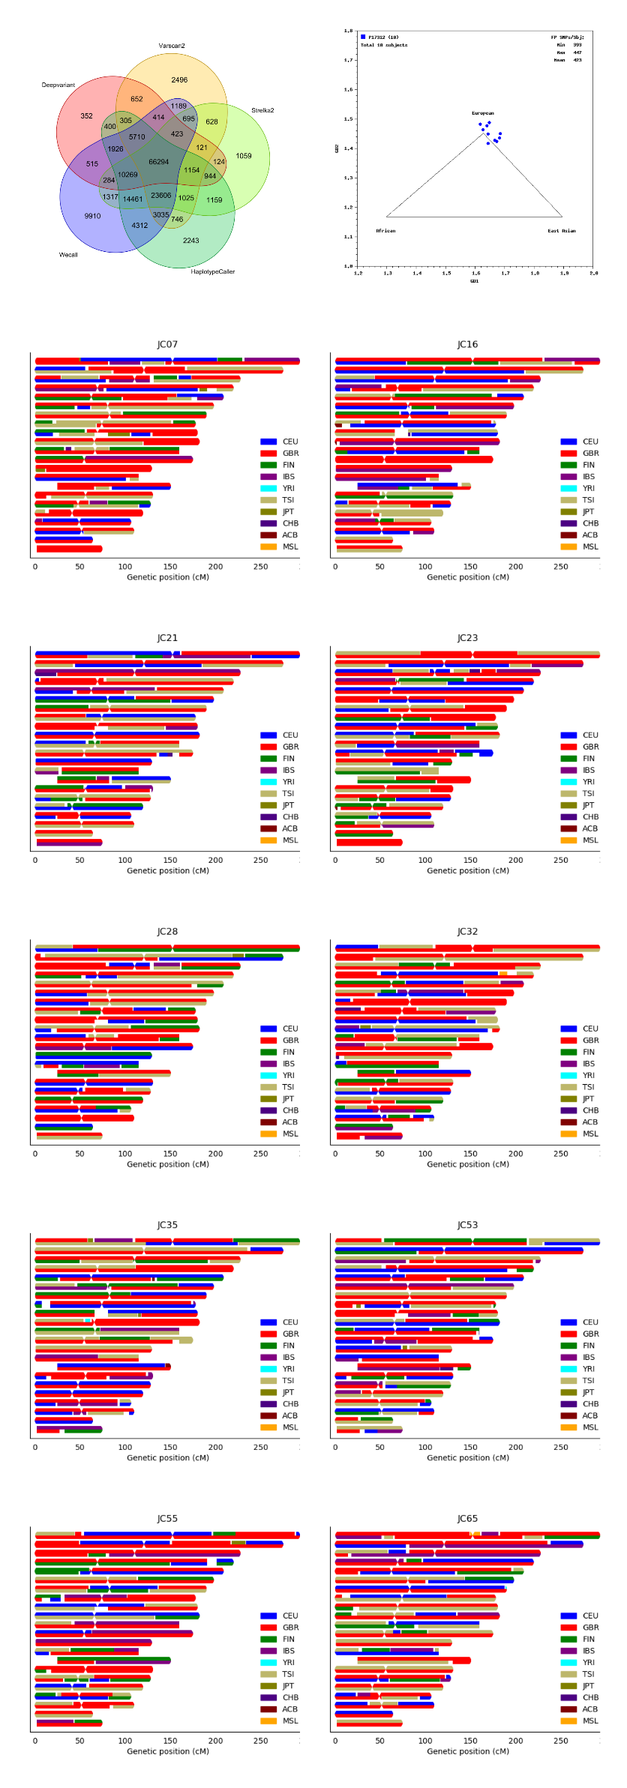
Supplementary Fig. 13
Suppl. Fig. 13 Global ancestry analysis. a. Venn diagram showing the total of variants found in each variant calling. b. Fingerprint SNPS showing the distribution of GRAF-pop scores from all Karolinska individuals. c. Karyograms showing the ancestry composition from all Karolinska individuals.

Slide 14
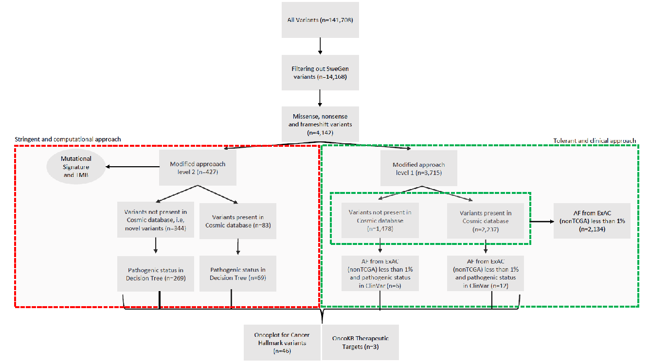
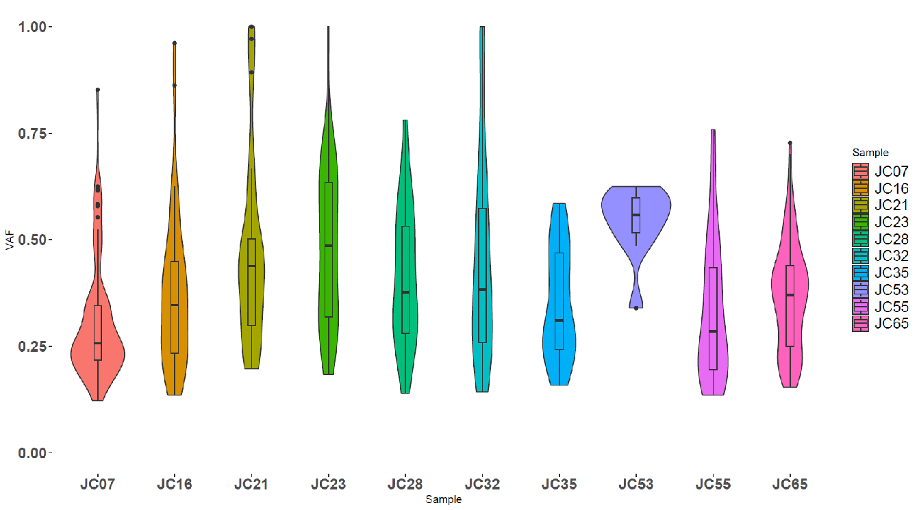
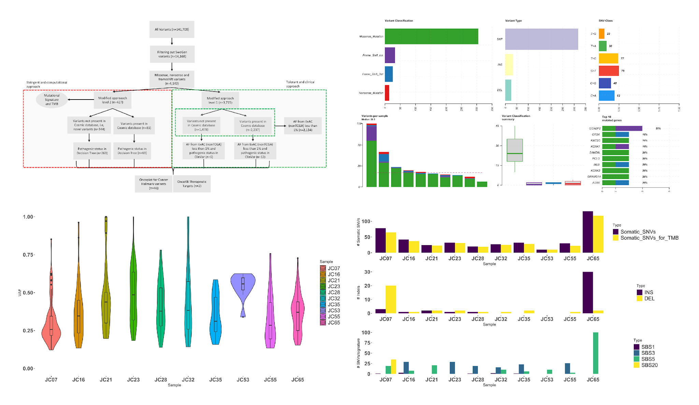
Supplementary Fig. 14
a
b
c
Suppl. Fig. 14 Overall summary of the somatic variants a. Pipeline applied for the use of variants, in a more stringent and computational approach (red rectangle) and another way more tolerant an clinical approach (green rectangle). b. Violin plot shows VAF distribution per sample. c. bar chart shows the amount of somatic SNVs as well as somatic SNVs used for TMB calculation, the short- insertions and deletions and the contribution of each COSMIC signature per sample.

Slide 15
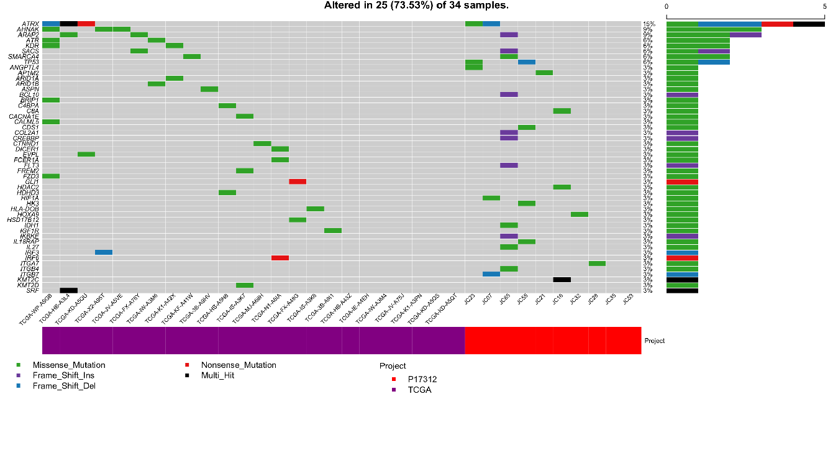
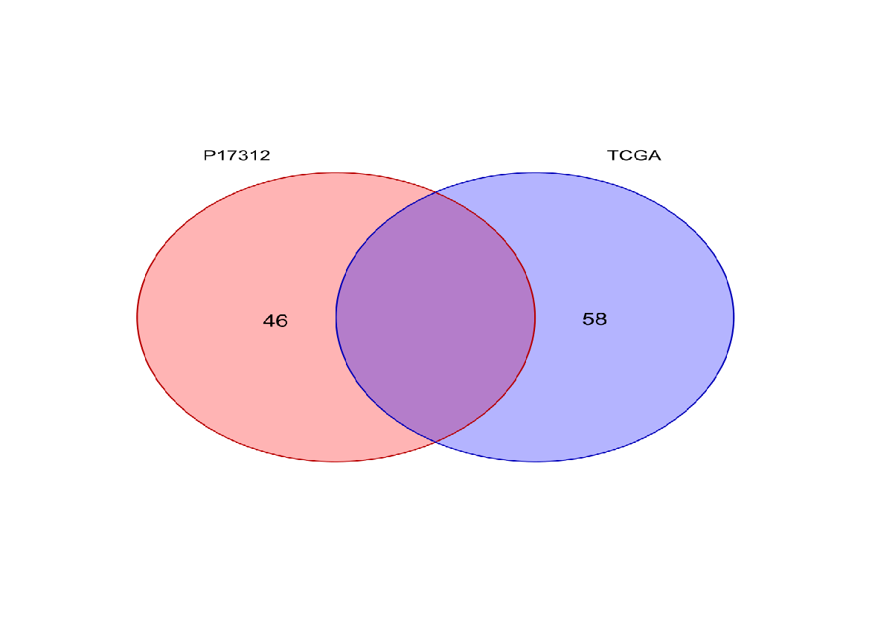
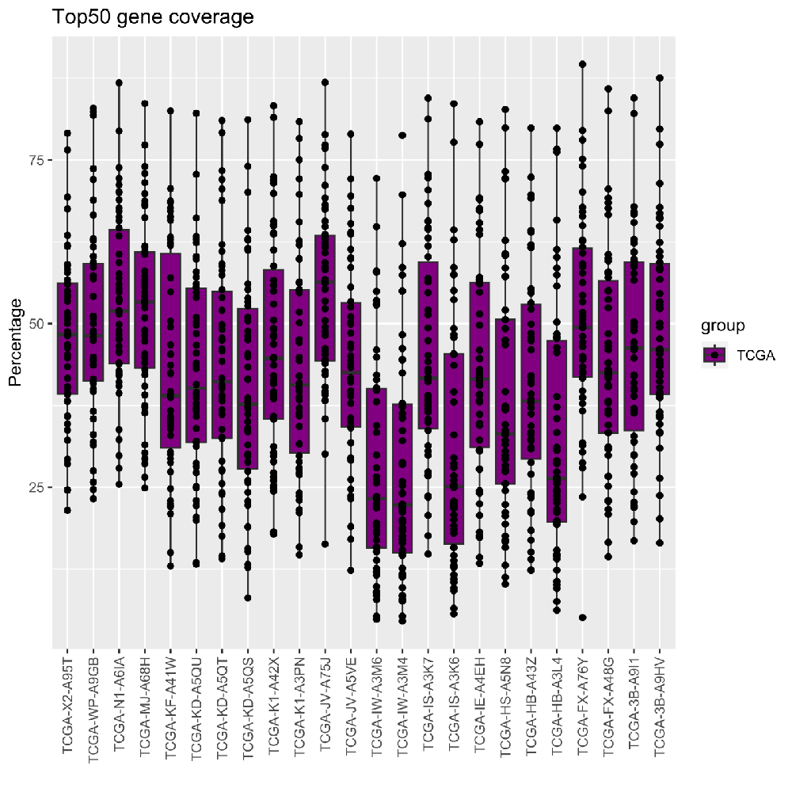
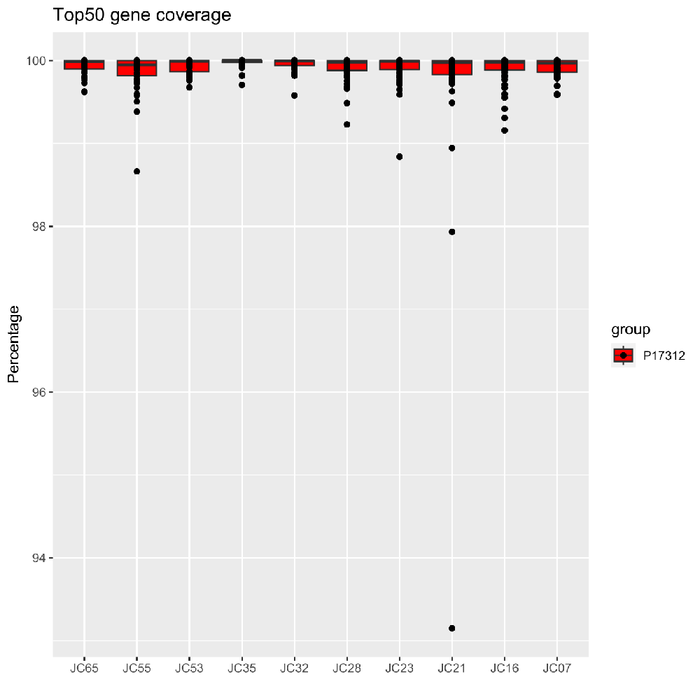
Supplementary Fig. 15
Suppl. Fig. 15 Comparison between somatic variants found on Nanostring Cancer Hallmark Genes set in the Karolinska dataset (P17312) and TCGA dataset. a. Venn diagram showing the total of variants in each cohort. b. Oncoplot showing top 50 genes most mutated when including TCGA cohort to the Karolinska dataset. c. Gene coverage on top 50 genes most mutated in TCGA cohort. d. Gene coverage on top50 genes most mutated in the Karolinska dataset.

Slide 16
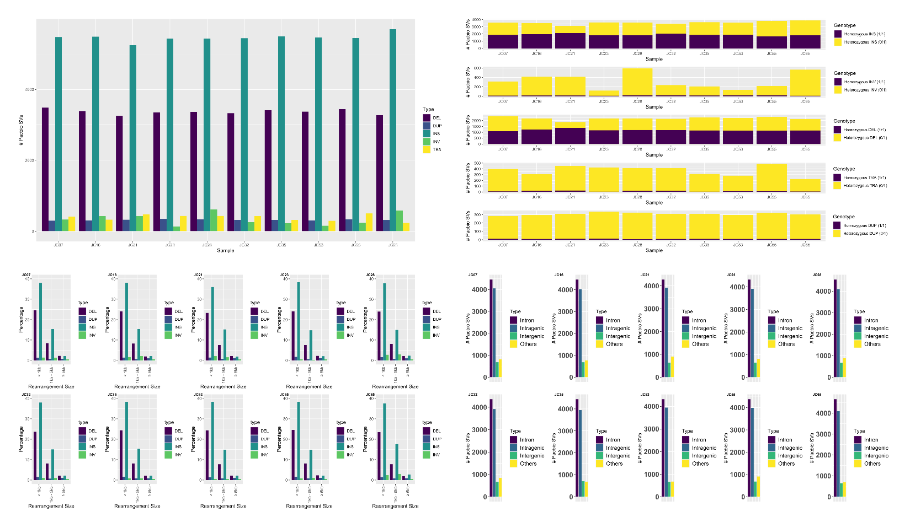
Supplementary Fig. 16
a
b
c
d
Suppl. Fig. 16 Structural Variants (SVs) found using PBSV tool. a. Bar chart showing the distribution for each type of SV. b. stacked bar chart showing the genotype status for each type of SV. c. Bar chart showing length distribution for each type of SV. d. Bar chart showing region type of each SV.

Slide 17
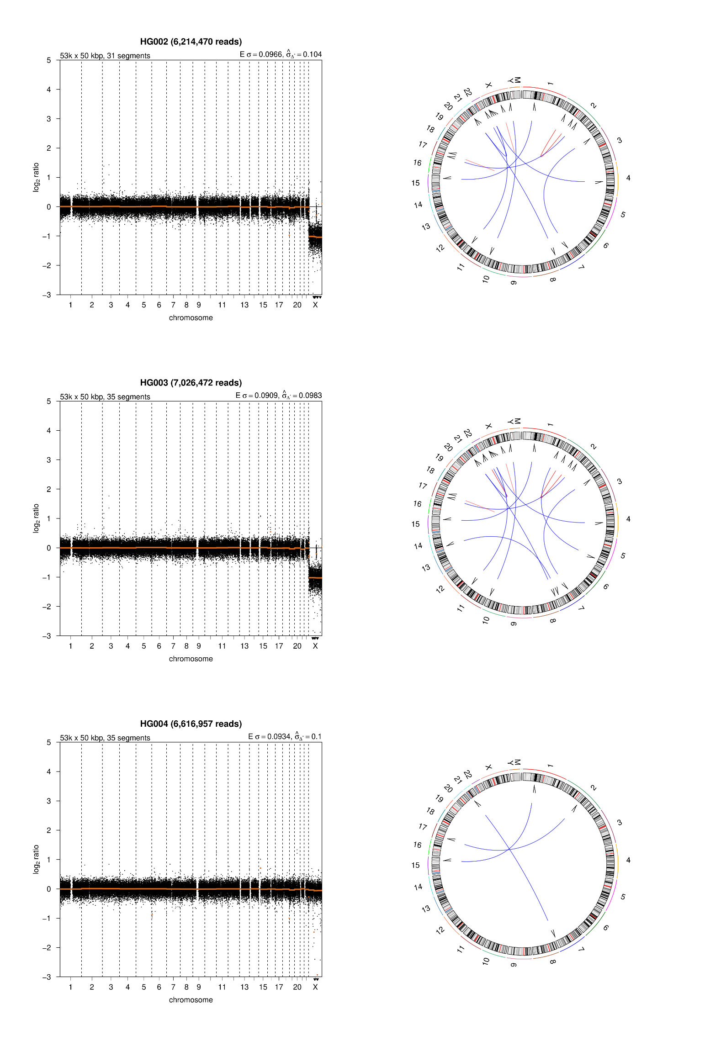
Supplementary Fig. 17
Suppl. Fig. 17 CNA profile and circos plot showing the chromothripsis signature for each Ashkenazim Trio (HG002, HG003 and HG004) from Genome in a Bottle (GIAB).

