Slide 1
Supplementary Figure 1
0 h
Serum (+)
Serum (-)
24 h

Slide 2
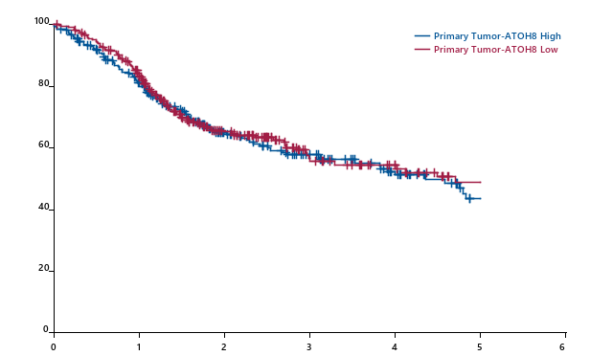


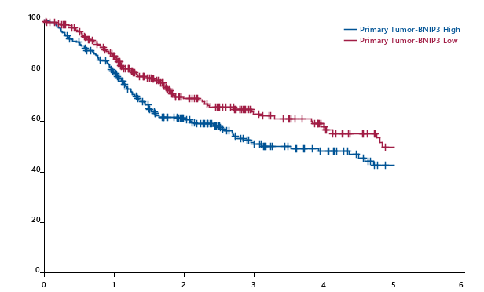
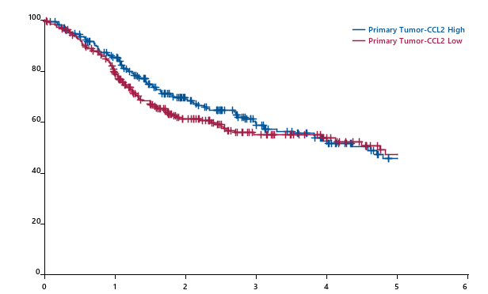
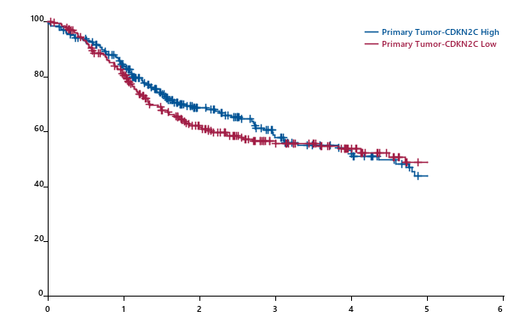
Supplementary Figure 2
A
ATOH8
B
AXIN2
Survival probability (%)
Survival probability (%)
Generalized Wilcoxon Test: p=0.2839
Long-rank Test: p=0.4204
Generalized Wilcoxon Test: p=0.2785
Long-rank Test: p=0.4160
Time (years)
Time (years)
C
BNIP3
D
CCL2
Survival probability (%)
Survival probability (%)
Generalized Wilcoxon Test: p=0.1836
Long-rank Test: p=0.2238
Generalized Wilcoxon Test: p=0.0328
Long-rank Test: p=0.1194
Time (years)
Time (years)
E
CDKN2C
F
CNTN1
Survival probability (%)
Survival probability (%)
Generalized Wilcoxon Test: p=0.1919
Long-rank Test: p=0.4007
Generalized Wilcoxon Test: p=0.2951
Long-rank Test: p=0.4420
Time (years)
Time (years)

Slide 3
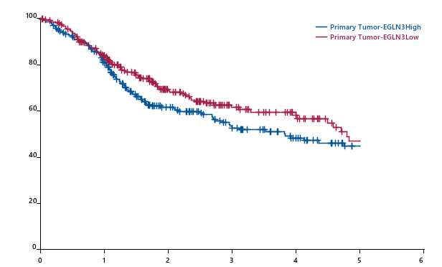

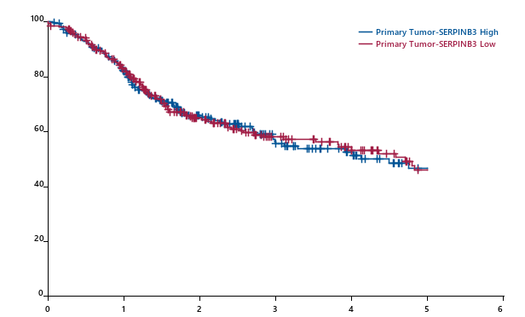
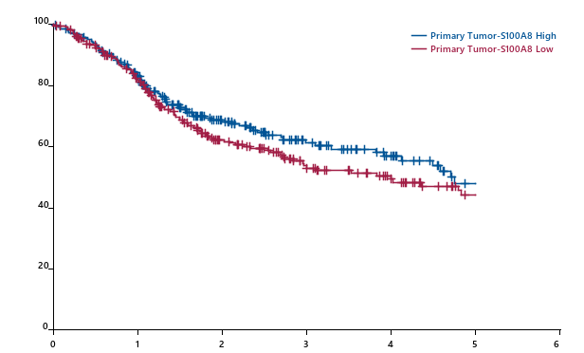
Supplementary Figure 2
G
EGLN3
H
ID2
Survival probability (%)
Survival probability (%)
Generalized Wilcoxon Test: p=0.1833
Long-rank Test: p=0.2135
Generalized Wilcoxon Test: p=0.3800
Long-rank Test: p=0.6235
Time (years)
Time (years)
I
SERPINB3
J
S100A8
Survival probability (%)
Survival probability (%)
Generalized Wilcoxon Test: p=0.9925
Long-rank Test: p=0.8651
Generalized Wilcoxon Test: p=0.5563
Long-rank Test: p=0.5236
Time (years)
Time (years)

