Slide 1
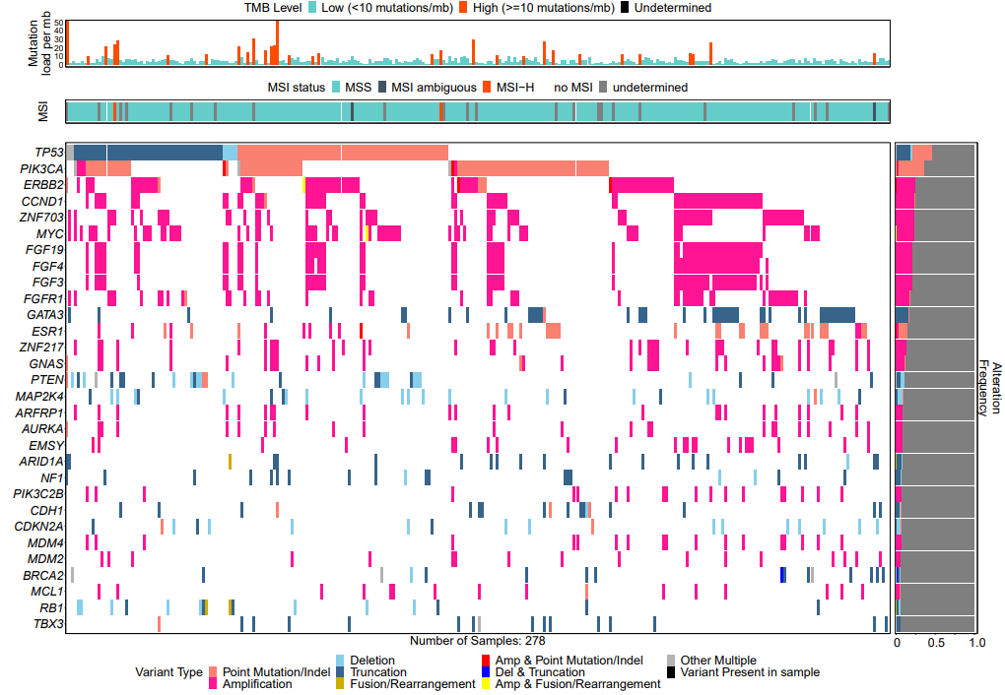
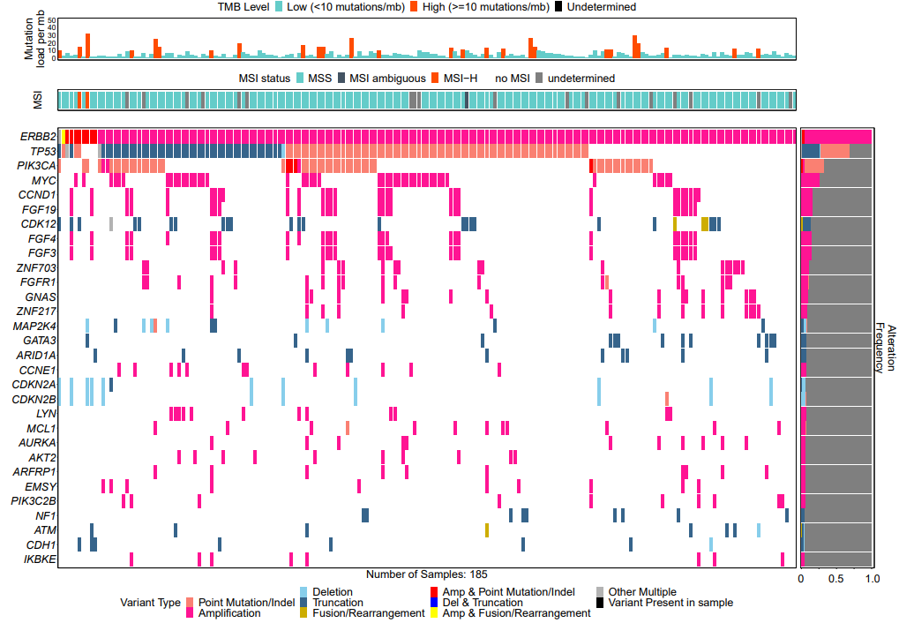
Supplementary Figure 1: Genomic Alterations in BCBM by receptor status.
A.
ER-positive (any HER2)
B.
HER2-positive (any ER)

