Slide 1
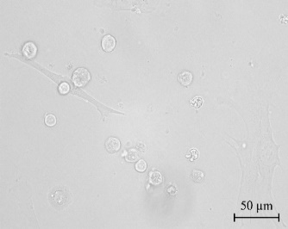
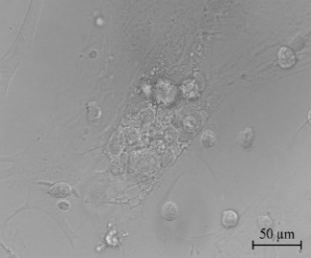
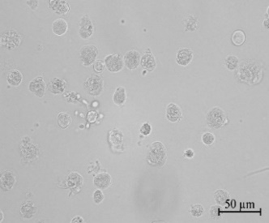
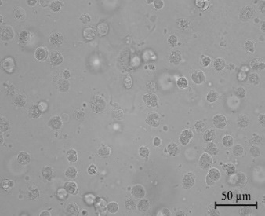
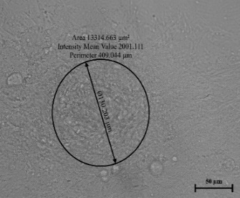
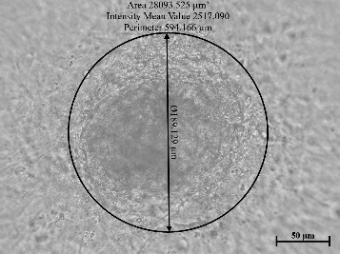
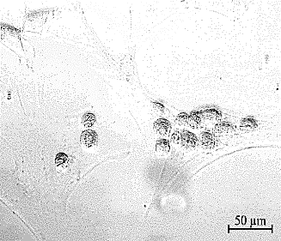
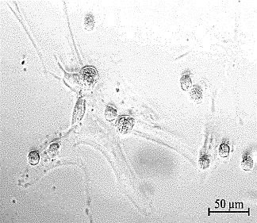
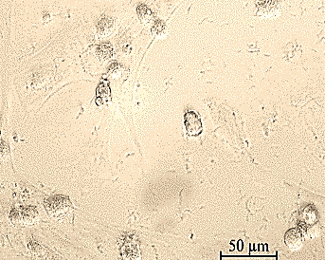
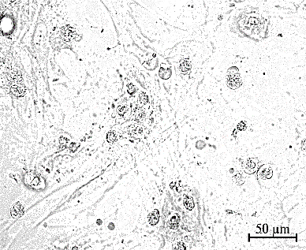
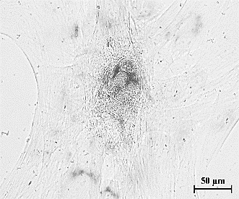
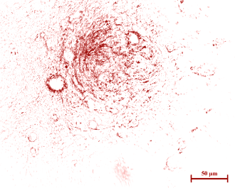
Normoxia
Hypoxia
Normoxia
Hypoxia
Normoxia
Hypoxia
(a) Bright field
(b) AP staining
Day 3
Day 5
Day 7
Supplementary Fig. 1 (a) Phenotypic characteristics of caprine male germline stem cell (cmGSC) colonies obtained by co-culturing of GCs onto the Sertoli cell feeder layer after day 3, 5 and 7 in culture. (b) Alkaline phosphatase (AP) activity in cmGSCs. Cells (1×10⁶ cmGSCs) were seeded and cultured in each culture conditions for 3, 5 and 7 days before the AP activity was analyzed. cmGSCs cultured under hypoxia showed a significant increase in AP activity after 7 days of culture. However, a significant decrease in AP activity post-7 days of culture was detected in cmGSCs cultured under normoxia. AP = alkaline phosphatase; cmGSCs = caprine male germline stem cells. Scale bar, 50 μm

Slide 2
*
*
b
b
y
y
ab
a
x
x
Day 0
Day 3
Day 5
Day 7
Supplementary Fig. 2 Comparison of total cell count, count of live cells (× 10⁵), and survival rate (%) after different days in culture under normoxic or hypoxic conditions. Caprine male germline stem cells (cmGSCs) were seeded in equal number (50000 cells/cm²) onto 6 well tissue culture- treated plates which were kept under either normoxic or hypoxic condition. The cells were obtained by trypsinization for counting of total and live cells. n = 4, and error bars represent standard error (SE). Different letters (a and b or x and y) and * over the bars indicate a significant (p < 0.05) difference in total cell count, live cell count and survival rate among the groups, respectively

Slide 3
**
**
**
**
*
Relative gene expression (fold change)
(a)
*
*
**
**
(b)
Supplementary Fig. 3 Comparison of stemness, adhesion and differentiation specific gene transcription levels in caprine male germline stem cells (cmGSCs) (a) cultured and (b) differentiated under normoxia (control in both a and b for all the genes compared) or hypoxic condition for 5 and 21 days after P3, respectively. Cells (1×10⁶ cmGSCs) were seeded onto 24 well culture plates and incubated under respective culture conditions. Subsequently, transcription levels of GCs-specific genes were estimated by real-time PCR. In case of cmGSCs cultured for 5 days (a), cmGCs showed significantly higher expression of marker genes specific for pluripotency (OCT-4, THY-1, UCHL-1) and adhesion (β-integrin and E-Cadherin). Moreover, the significant (p < 0.05) downregulation of adipogenic (C/EBPα), neurogenic (nestin, β-tubulin), and chondrogenic (COL2A1) differentiation was observed under hypoxic condition compared to the normoxic culture condition. Error bars represent standard error (SE). * p < 0.05; ** p < 0.001. OCT-4 = octamer-binding transcription factor-4; THY-1= THY-1 T-cell antigen; cmGCs= caprine male germline stem cells; PCR = polymerase chain reaction; UCHL-1 = ubiquitin carboxyl-terminal esterase L-1; PPARγ = Peroxisome proliferator-activated receptor gamma, C/EBPα = CCAAT-enhancer-binding protein alpha; COL2A1 = Collagen Type II Alpha 1

