Slide 1
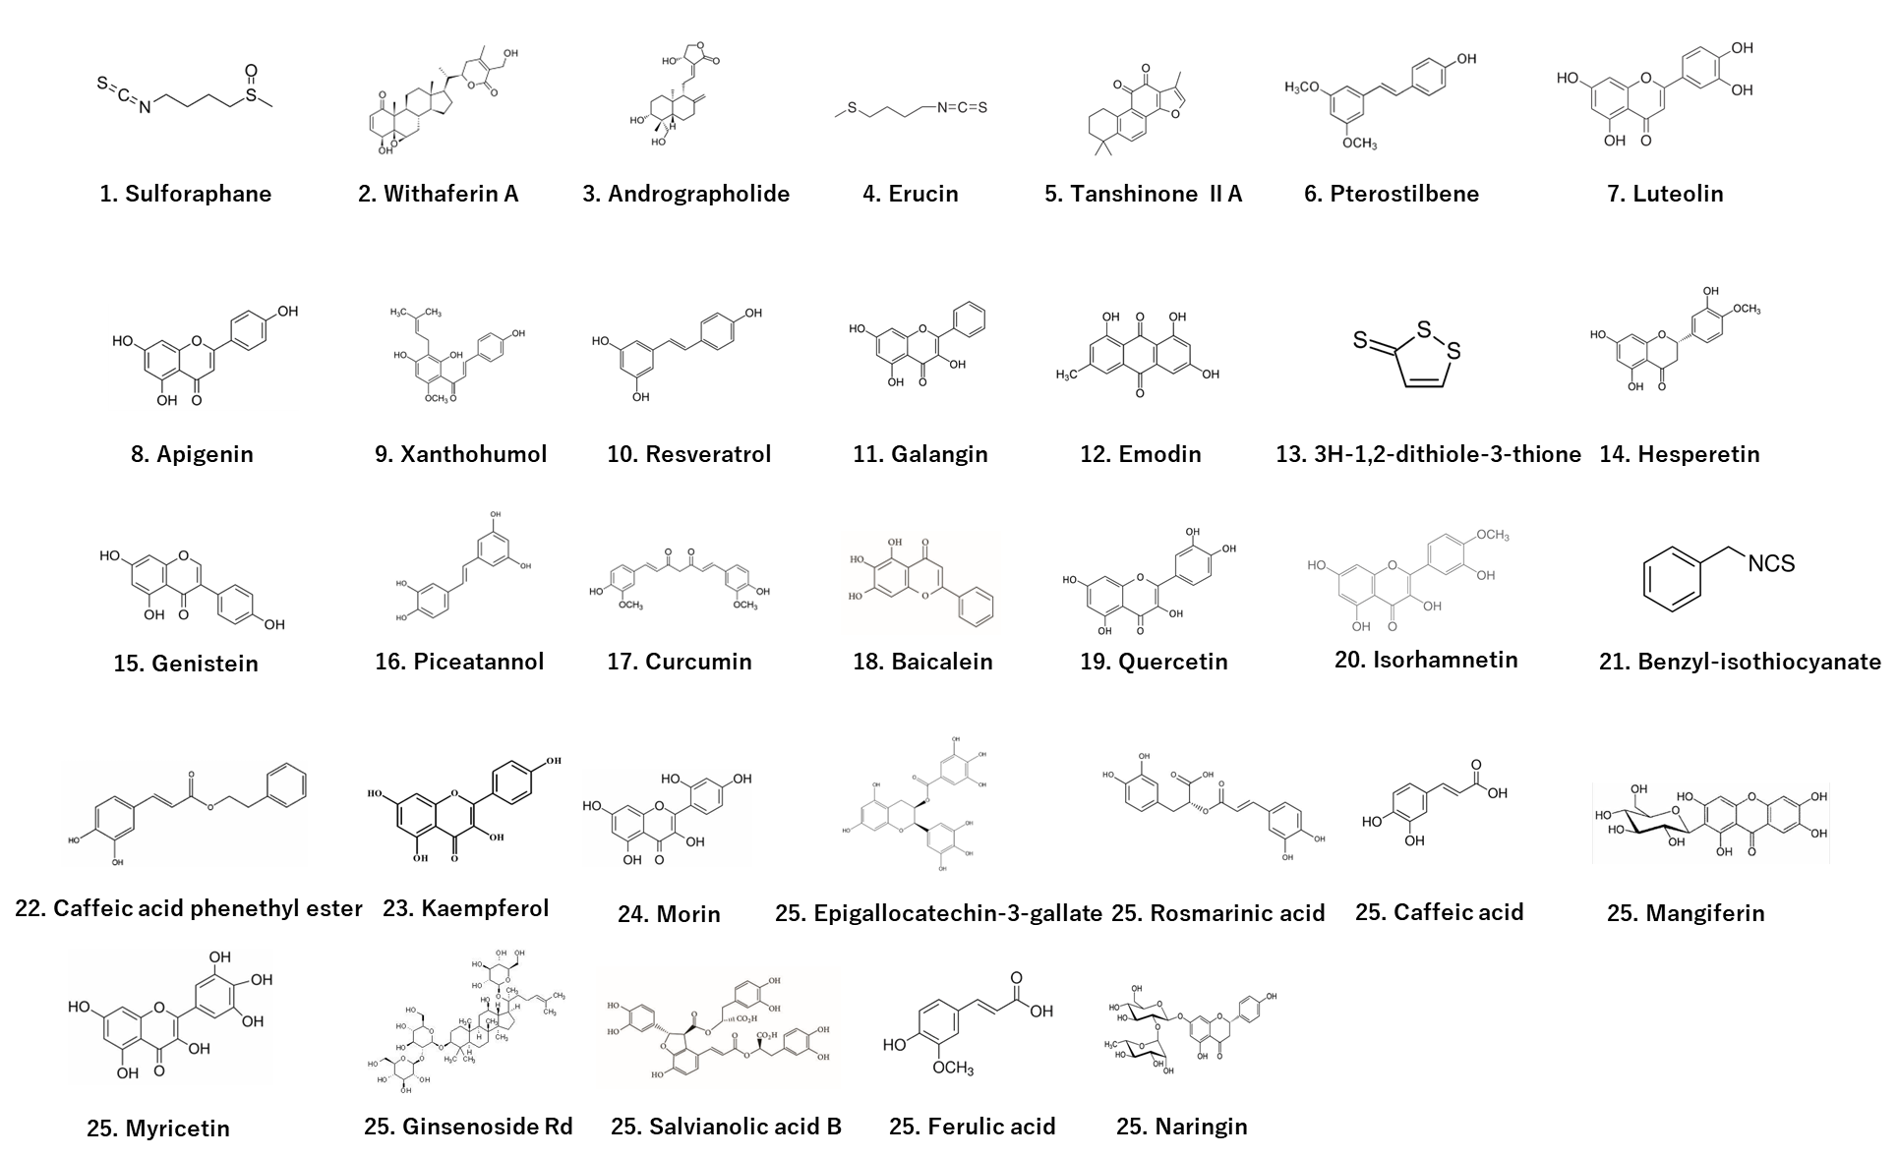
Additional file 2. Chemical structures of the 33 plant-derived compounds

