Slide 1
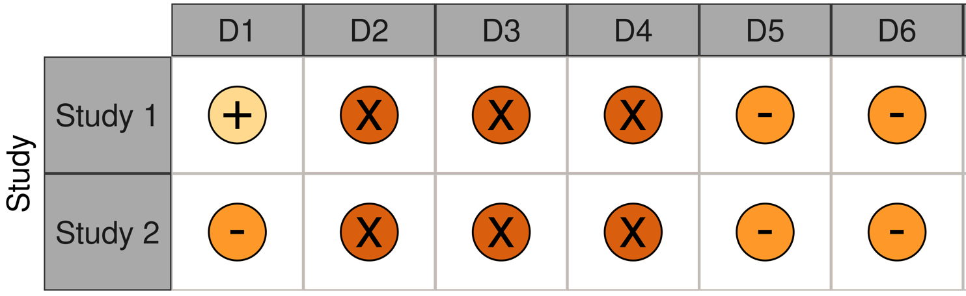
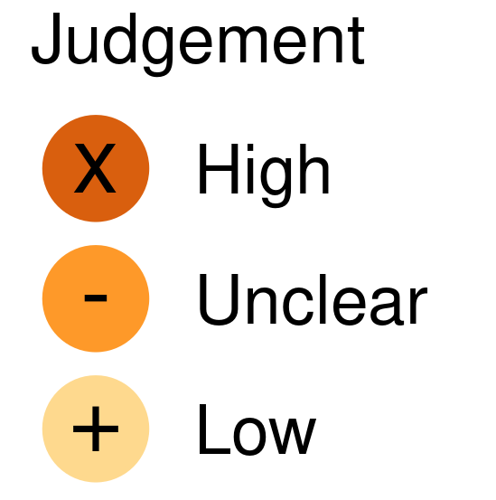
Table2. Result of risk of bias assessment
Study 1: Vaes et al. 2021
Study 2: Wright et al. 2022
D1: Selection of participants
D2: Confounding variables
D3: Measurement of exposure
D4: Blinding of outcome assessments
D5: Incomplete outcome data
D6: Selective outcome reporting

