Slide 1
Sacubitril/valsartan increased survival via inhibiting inflammation and myocardiofibrosis in Takotsubo-like cardiomyopathy
Jiangying Kuang1, Zhiyi Jia1, Tou Kun Chong2, Jian Chen3, Kan Liu4, Martin Cadeiras5, Zhaohua Li1, Jing Zhang1, Yanru Kong1, Xin Wang1, Rong Sun6, Qinghua Lu1, and Yusheng Liu1﹟
1 Department of Cardiology, The Second Hospital, Cheeloo College of Medicine, Shandong University, Jinan, Shandong 250031, P. R. China;
2 Department of Cardiology, Kiang Wu Hospital, Macao Special Administrative Region of the People’s Republic of China;
3 Department of Cardiology, The Fifth Affiliated Hospital of Sun Yat-Sen University, Zhuhai, Guangdong 519000, P. R. China;
4 Division of Cardiology, Heart and Vascular Center, Washington University in St. Louis, Barnes-Jewish Hospital, St. Louis, MO, USA.
5 Division of Cardiology, school of medicine, the University of Califoria Davis, Sacmento, Califoria, USA;
6 The Second Hospital, Cheeloo College of Medicine, Shandong University, Jinan, Shandong 250031, P. R. China;
﹟Correspondence to: Dr. Yu-Sheng Liu, Department of Cardiology, The Second Hospital, Cheeloo College of Medicine, Shandong University, Jinan, Shandong, No. 247 Beiyuan Avenue, Jinan, China.
E-mail: 200762011229@sdu.edu.cn

Slide 2
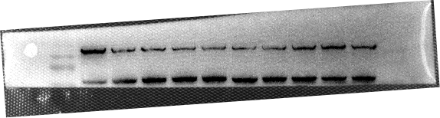
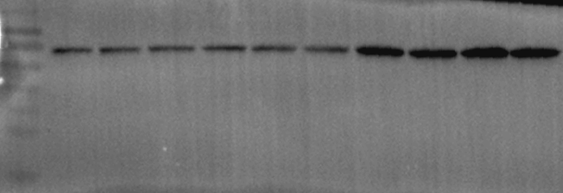
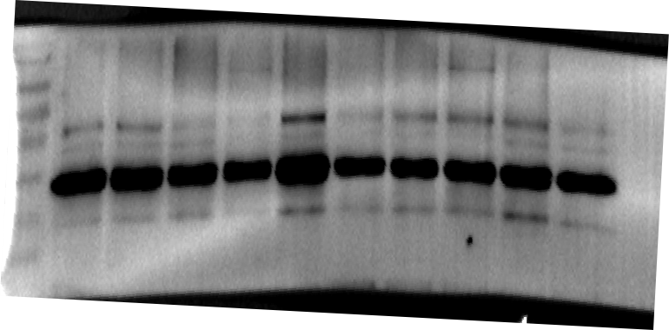
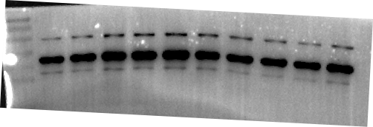
Figure 6A
Repeat 1
Repeat 2
Repeat 3
180
130
180
100
130
TLR4
(100KD)
70
TLR4
(100KD)
TLR4
(100KD)
130
55
100
70
40
55
100
35
40
25
35
70
25
15
15
180
180
130
130
100
180
70
100
p-NF-κB p65
(65KD)
p-NF-κB p65
(65KD)
p-NF-κB p65
(65KD)
130
55
70
40
55
100
35
40
70
25
35
15
25
15
180
130
Day 1
NF-κB p65
(65KD)
100
NF-κB p65
(65KD)
NF-κB p65
(65KD)
70
180
130
55
130
40
100
100
35
70
55
25
40
70
35
15
25
130
130
100
100
55
70
70
β-tubulin
(50KD)
55
GAPDH
(36KD)
GAPDH
(36KD)
40
40
55
35
35
40
25
25
35
15
25
15
15
Control
ISO
Control
ISO
Control
ISO
ISO+Sac/val
75mg/Kg
ISO+Sac/val
50mg/Kg
ISO+Sac/val
100mg/Kg
ISO+Sac/val
75mg/Kg
ISO+Sac/val
50mg/Kg
ISO+Sac/val
75mg/Kg
ISO+Sac/val
100mg/Kg
ISO+Sac/val
50mg/Kg
ISO+Sac/val
100mg/Kg

Slide 3
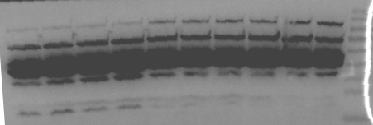
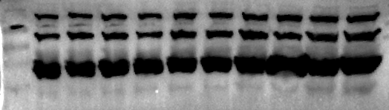
Figure 6B
Repeat 1
Repeat 2
Repeat 3
180
180
130
TLR4
(100KD)
TLR4
(100KD)
100
180
130
TLR4
(100KD)
70
130
100
55
100
70
40
70
35
55
25
40
15
35
100
180
180
130
130
p-NF-κB p65
(65KD)
100
p-NF-κB p65
(65KD)
p-NF-κB p65
(65KD)
70
70
100
55
70
55
40
55
35
40
25
15
35
25
180
130
180
Day 5
180
100
130
NF-κB p65
(65KD)
70
100
NF-κB p65
(65KD)
NF-κB p65
(65KD)
130
55
70
100
40
55
40
35
35
70
25
25
15
15
130
100
100
70
70
55
55
55
40
40
β-tubulin
(50KD)
GAPDH
(36KD)
35
40
35
GAPDH
(36KD)
35
25
25
25
15
15
Control
ISO
Control
ISO
Control
ISO
ISO+Sac/val
75mg/Kg
ISO+Sac/val
50mg/Kg
ISO+Sac/val
100mg/Kg
ISO+Sac/val
75mg/Kg
ISO+Sac/val
50mg/Kg
ISO+Sac/val
75mg/Kg
ISO+Sac/val
100mg/Kg
ISO+Sac/val
50mg/Kg
ISO+Sac/val
100mg/Kg

Slide 4
Figure 6C
Repeat 1
Repeat 2
Repeat 3
180
130
130
100
100
TLR4
(100KD)
70
70
180
TLR4
(100KD)
55
TLR4
(100KD)
55
130
40
40
100
35
35
70
25
25
55
15
180
130
180
100
130
70
100
70
55
p-NF-κB p65
(65KD)
180
p-NF-κB p65
(65KD)
55
p-NF-κB p65
(65KD)
40
40
130
35
100
35
25
70
25
15
15
180
Day 8
130
100
130
NF-κB p65
(65KD)
180
NF-κB p65
(65KD)
70
NF-κB p65
(65KD)
100
130
70
55
100
55
40
40
35
70
35
25
25
15
15
180
130
130
100
100
GAPDH
(36KD)
GAPDH
(36KD)
70
55
70
55
β-Tubulin
(50KD)
55
40
40
40
35
35
35
25
25
25
15
15
15
Control
ISO
Control
ISO
Control
ISO
ISO+Sac/val
75mg/Kg
ISO+Sac/val
50mg/Kg
ISO+Sac/val
75mg/Kg
ISO+Sac/val
100mg/Kg
ISO+Sac/val
50mg/Kg
ISO+Sac/val
100mg/Kg
ISO+Sac/val
75mg/Kg
ISO+Sac/val
50mg/Kg
ISO+Sac/val
100mg/Kg

Slide 5
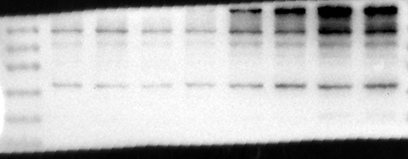
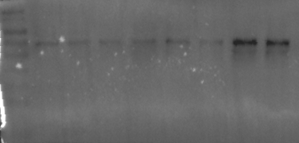
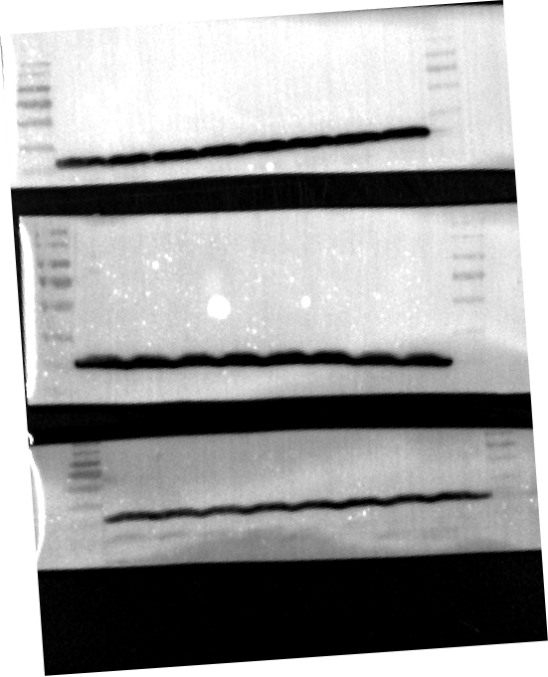
Figure 6F
Repeat 1
Repeat 2
Repeat 3
130
180
180
100
130
130
70
100
TLR4
(100KD)
TLR4
(100KD)
TLR4
(100KD)
55
70
100
55
70
40
40
55
35
35
40
25
35
15
100
180
70
130
55
100
100
p-NF-κB p65
(65KD)
70
40
p-NF-κB p65
(65KD)
p-NF-κB p65
(65KD)
55
70
35
40
55
25
35
40
15
25
35
25
15
180
130
180
180
Neonatal Rat Cardiomyocyte
100
130
130
70
NF-κB p65
(65KD)
NF-κB p65
(65KD)
NF-κB p65
(65KD)
55
100
100
70
70
40
55
55
35
40
40
25
180
180
130
130
100
100
180
70
130
70
55
GAPDH
(36KD)
GAPDH
(36KD)
GAPDH
(36KD)
100
55
40
70
35
55
40
40
35
25
35
25
15
Control
rhBNP
ISO
Control
rhBNP
ISO
Control
rhBNP
ISO
rhBNP/ISO
rhBNP/ISO
rhBNP/ISO

Slide 6
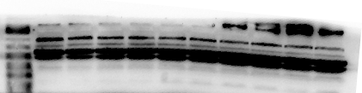
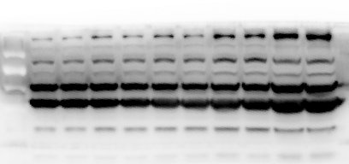
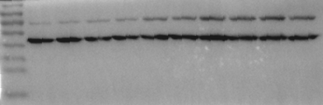
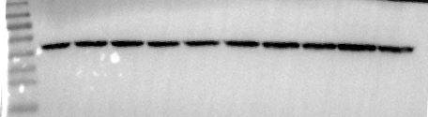
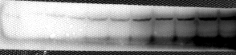
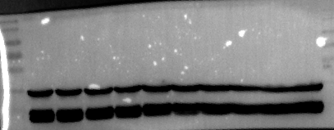
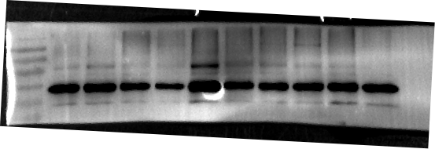
Figure 7E
Repeat 1
Repeat 2
Repeat 3
180
180
130
130
180
100
100
COL1A1
(139KD)
70
130
COL1A1
(139KD)
COL1A1
(139KD)
55
70
100
40
35
55
70
25
40
35
25
180
55
130
100
130
40
70
100
α-SMA
(42KD)
55
70
α-SMA
(42KD)
α-SMA
(42KD)
35
40
55
35
40
25
25
35
25
15
15
55
180
40
180
130
Day 1
TGF-β1
(44KD)
130
35
TGF-β1
(44KD)
TGF-β1
(44KD)
25
100
100
70
70
55
55
15
40
35
40
25
35
15
25
130
180
100
130
100
70
100
70
β-tubulin
(50KD)
GAPDH
(36KD)
55
70
GAPDH
(36KD)
55
55
40
40
35
40
35
25
35
25
15
Control
ISO
Control
ISO
Control
ISO
ISO+Sac/val
75mg/Kg
ISO+Sac/val
50mg/Kg
ISO+Sac/val
75mg/Kg
ISO+Sac/val
100mg/Kg
ISO+Sac/val
50mg/Kg
ISO+Sac/val
75mg/Kg
ISO+Sac/val
100mg/Kg
ISO+Sac/val
50mg/Kg
ISO+Sac/val
100mg/Kg

Slide 7
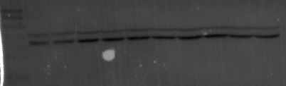
Figure 7F
Repeat 1
Repeat 2
Repeat 3
180
130
180
100
130
70
180
100
55
COL1A1
(139KD)
COL1A1
(139KD)
COL1A1
(139KD)
130
70
40
100
55
35
70
40
25
35
25
15
130
130
55
100
100
70
70
40
55
α-SMA
(42KD)
α-SMA
(42KD)
α-SMA
(42KD)
35
55
40
25
40
35
35
25
25
15
100
70
55
180
130
40
130
100
Day 5
TGF-β1
(44KD)
TGF-β1
(44KD)
70
100
TGF-β1
(44KD)
35
70
55
55
40
25
40
35
35
25
25
15
15
130
100
130
130
70
100
100
β-tubulin
(50KD)
70
70
GAPDH
(36KD)
GAPDH
(36KD)
55
55
55
40
40
35
35
40
25
25
35
15
15
Control
ISO
Control
ISO
Control
ISO
ISO+Sac/val
75mg/Kg
ISO+Sac/val
50mg/Kg
ISO+Sac/val
75mg/Kg
ISO+Sac/val
100mg/Kg
ISO+Sac/val
50mg/Kg
ISO+Sac/val
75mg/Kg
ISO+Sac/val
100mg/Kg
ISO+Sac/val
50mg/Kg
ISO+Sac/val
100mg/Kg

Slide 8
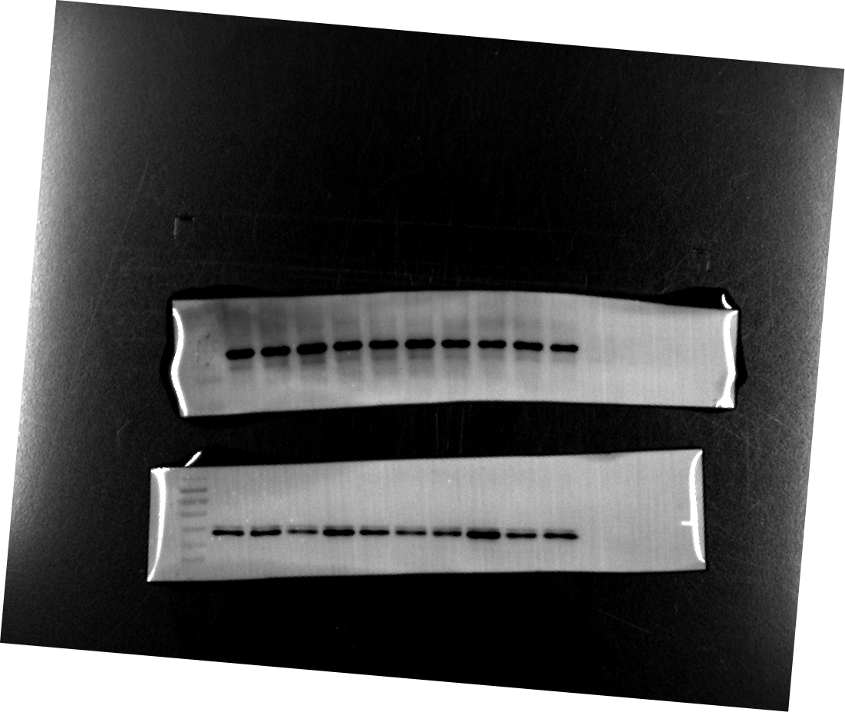
Figure 7G
Repeat 1
Repeat 2
Repeat 3
180
180
130
130
180
100
100
COL1A1
(139KD)
COL1A1
(139KD)
COL1A1
(139KD)
130
70
70
100
55
55
40
40
70
35
35
25
25
15
15
70
180
180
55
130
130
α-SMA
(42KD)
100
α-SMA
(42KD)
100
α-SMA
(42KD)
40
70
70
55
55
35
40
40
35
35
25
25
15
15
55
180
Day 8
40
130
180
TGF-β1
(44KD)
130
TGF-β1
(44KD)
100
TGF-β1
(44KD)
70
100
35
55
70
40
55
25
35
40
25
35
15
25
15
130
100
130
100
70
100
70
70
β-tubulin
(50KD)
GAPDH
(36KD)
GAPDH
(36KD)
55
55
55
40
40
40
35
35
35
25
25
15
15
ISO
Control
ISO
Control
ISO
Control
ISO+Sac/val
75mg/Kg
ISO+Sac/val
50mg/Kg
ISO+Sac/val
75mg/Kg
ISO+Sac/val
100mg/Kg
ISO+Sac/val
50mg/Kg
ISO+Sac/val
75mg/Kg
ISO+Sac/val
100mg/Kg
ISO+Sac/val
50mg/Kg
ISO+Sac/val
100mg/Kg

Slide 9
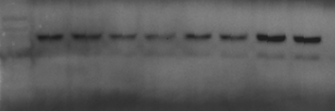
Figure 8A
Repeat 1
Repeat 2
Repeat 3
130
130
α-Sma
(42KD)
100
55
100
α-Sma
(42KD)
α-Sma
(42KD)
70
40
70
55
35
55
40
25
40
35
35
25
25
15
15
130
100
130
130
70
100
100
55
70
70
p-Smad2
(60KD)
p-Smad2
(60KD)
p-Smad2
(60KD)
55
40
55
40
35
40
35
35
25
25
180
180
180
130
130
130
Neonatal myocardial fibroblasts
100
100
100
70
70
70
55
55
55
Smad2
(60KD)
Smad2
(60KD)
Smad2
(60KD)
40
40
40
35
35
25
35
25
180
130
100
180
70
70
130
55
100
55
40
70
β-actin
(43KD)
55
40
GAPAH
(39KD)
GAPDH
(39KD)
35
40
35
25
35
25
15
25
Control
rhBNP
ISO
rhBNP
ISO
rhBNP
ISO
rhBNP/ISO
Control
rhBNP/ISO
Control
rhBNP/ISO

Slide 10
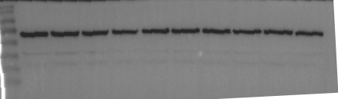
Figure (新增加数据)
Repeat 1
Repeat 2
Repeat 3
180
130
130
180
100
100
130
70
70
100
55
70
55
p-Smad2
(60KD)
p-Smad2
(60KD)
p-Smad2
(60KD)
55
40
40
40
35
35
35
25
25
15
15
130
130
100
100
70
70
55
55
180
Smad2
(60KD)
130
40
40
Smad2
(60KD)
Smad2
(60KD)
35
100
Day1
35
70
25
25
55
15
40
15
35
25
15
130
180
100
130
130
70
100
100
55
70
GAPDH
(36KD)
GAPDH
(36KD)
70
40
55
GAPDH
(36KD)
55
35
40
40
25
35
35
15
25
25
Control
ISO
Control
ISO
Control
ISO
ISO+Sac/val
75mg/Kg
ISO+Sac/val
50mg/Kg
ISO+Sac/val
100mg/Kg
ISO+Sac/val
75mg/Kg
ISO+Sac/val
50mg/Kg
ISO+Sac/val
75mg/Kg
ISO+Sac/val
100mg/Kg
ISO+Sac/val
50mg/Kg
ISO+Sac/val
100mg/Kg

