Slide 1
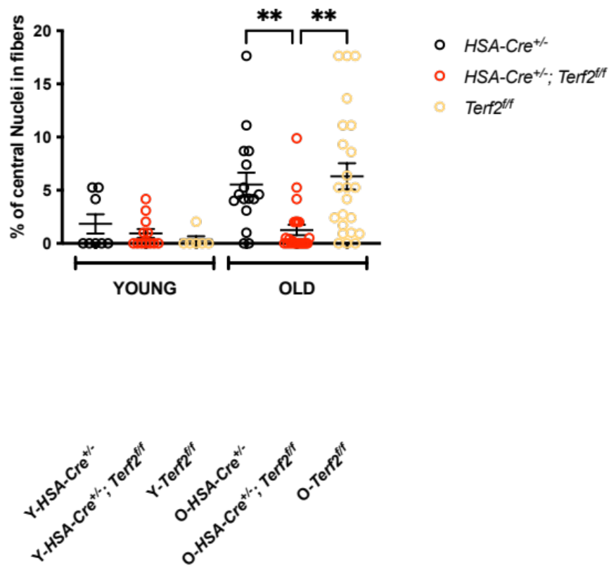
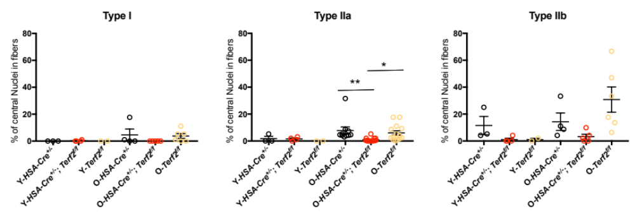
Supplemental Figure 1
YOUNG
OLD
YOUNG
OLD
YOUNG
OLD

Slide 2
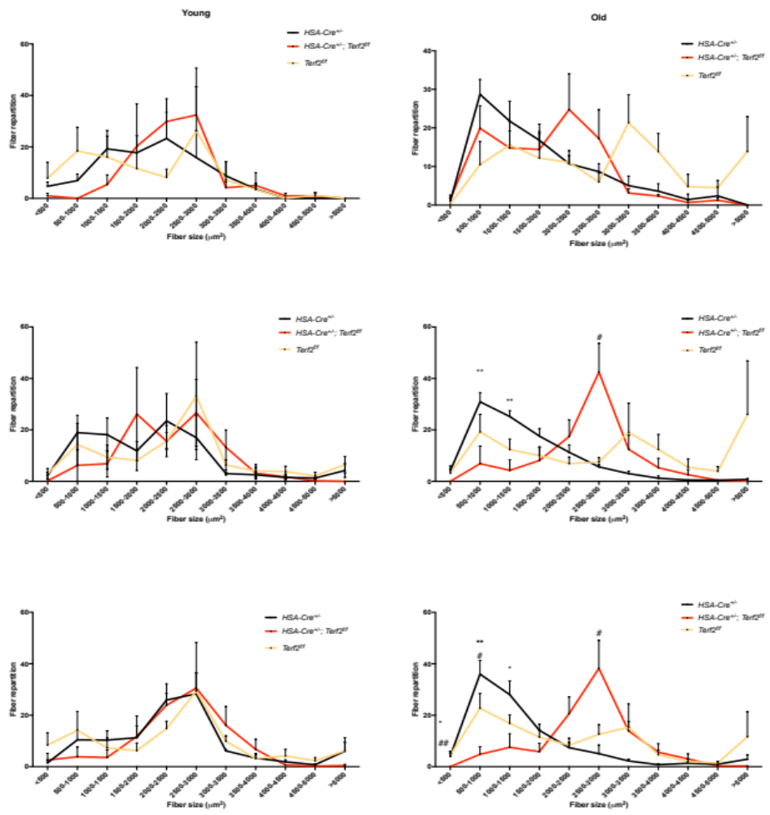
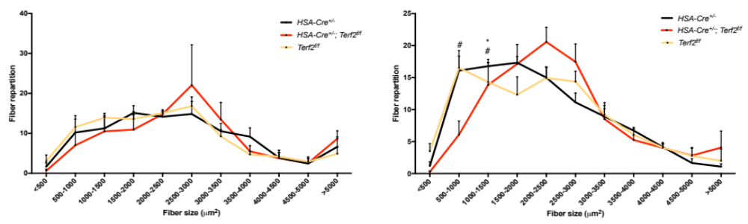
Supplemental Figure 2
A)
Type I
YOUNG
Type I
OLD
B)
Type IIa
Type IIa
C)
Type IIb
Type IIb
D)
gastrocnemius

Slide 3
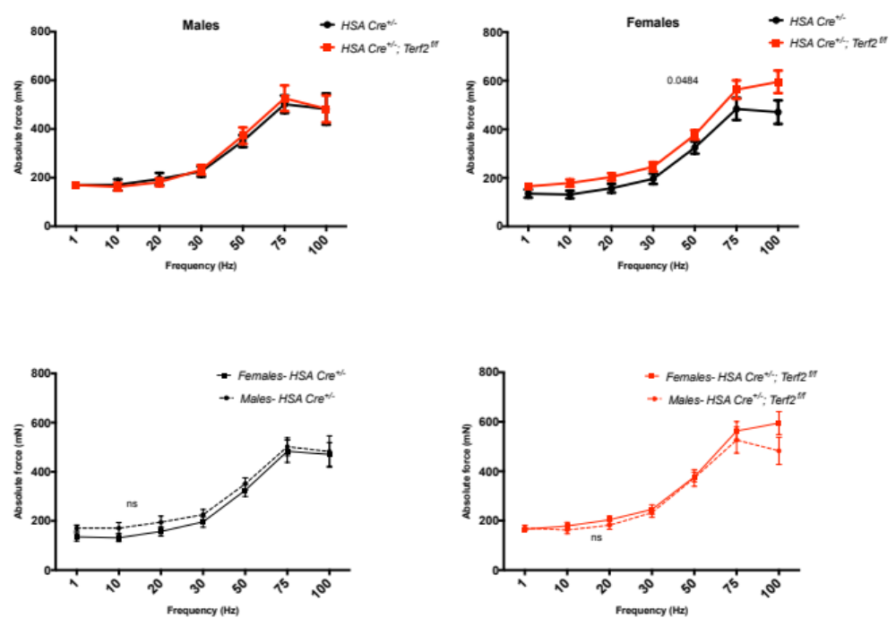
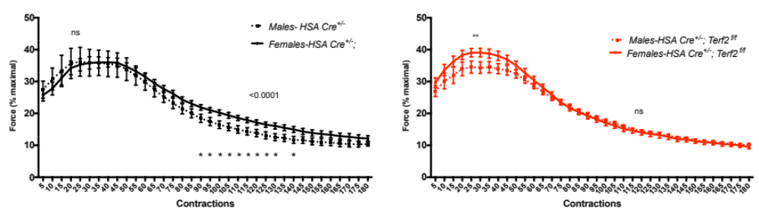
Supplemental Figure 3
A)
B)
C)

Slide 4
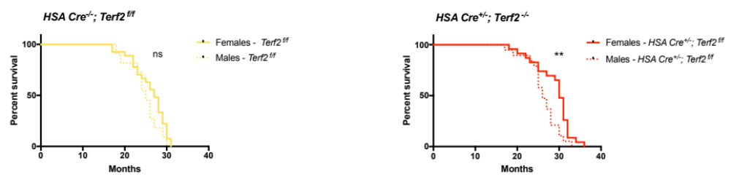
Supplemental Figure 4
A)
B)

Slide 5
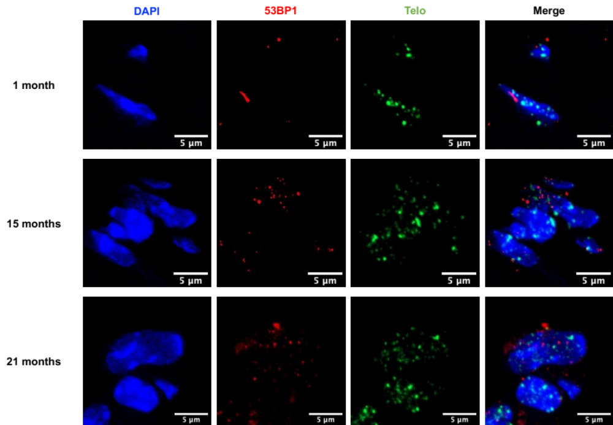
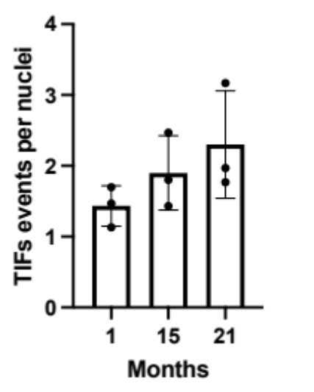
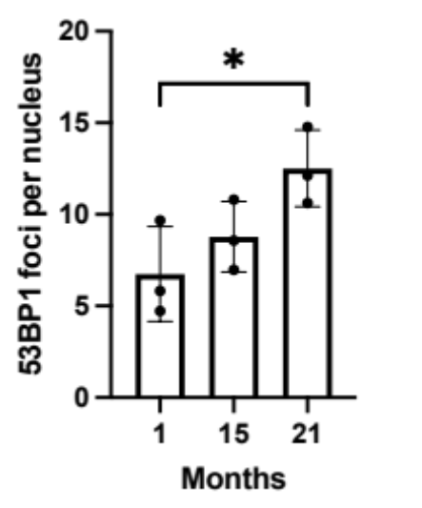
Supplemental Figure 5

Slide 6
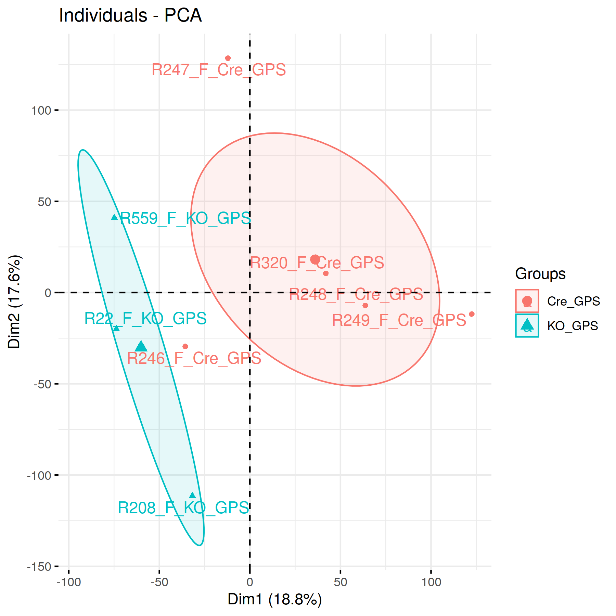
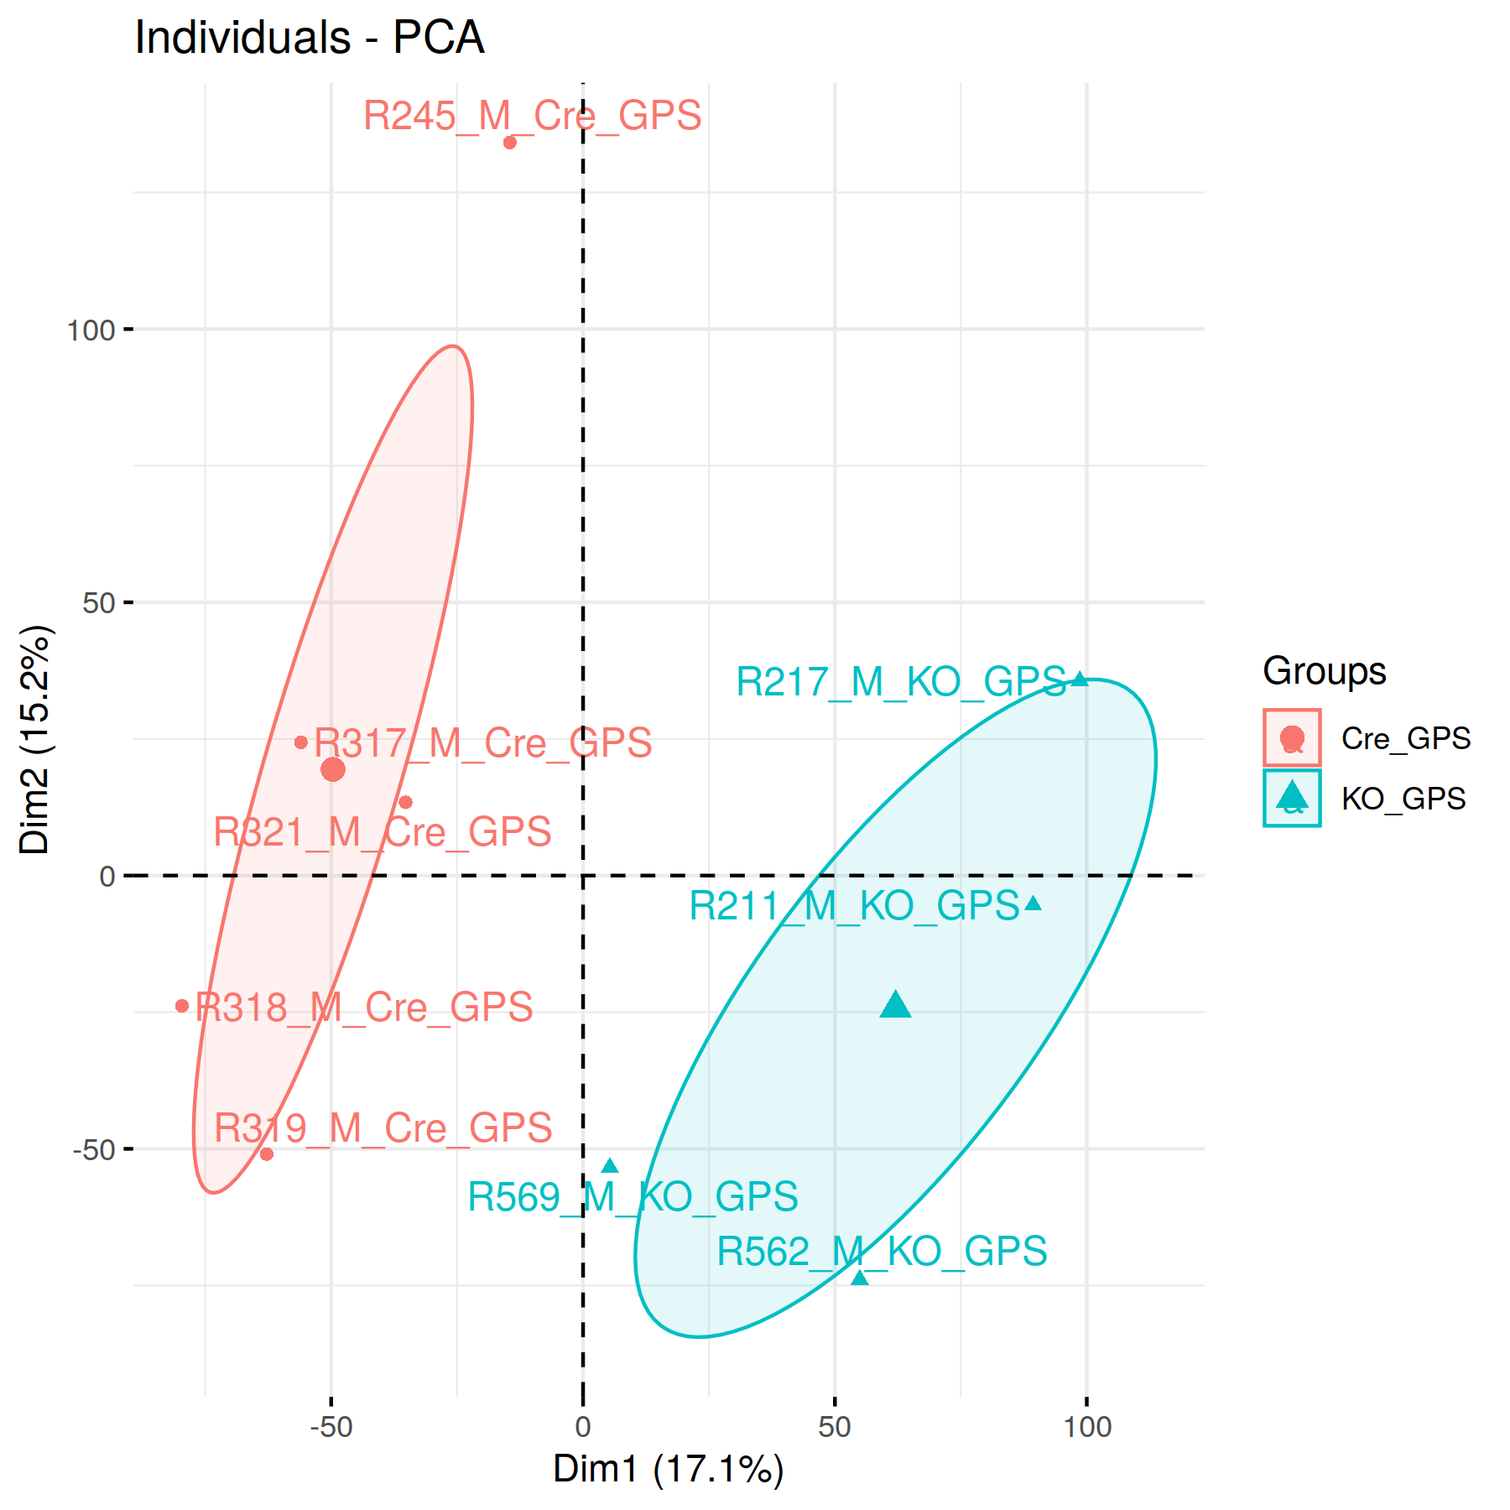
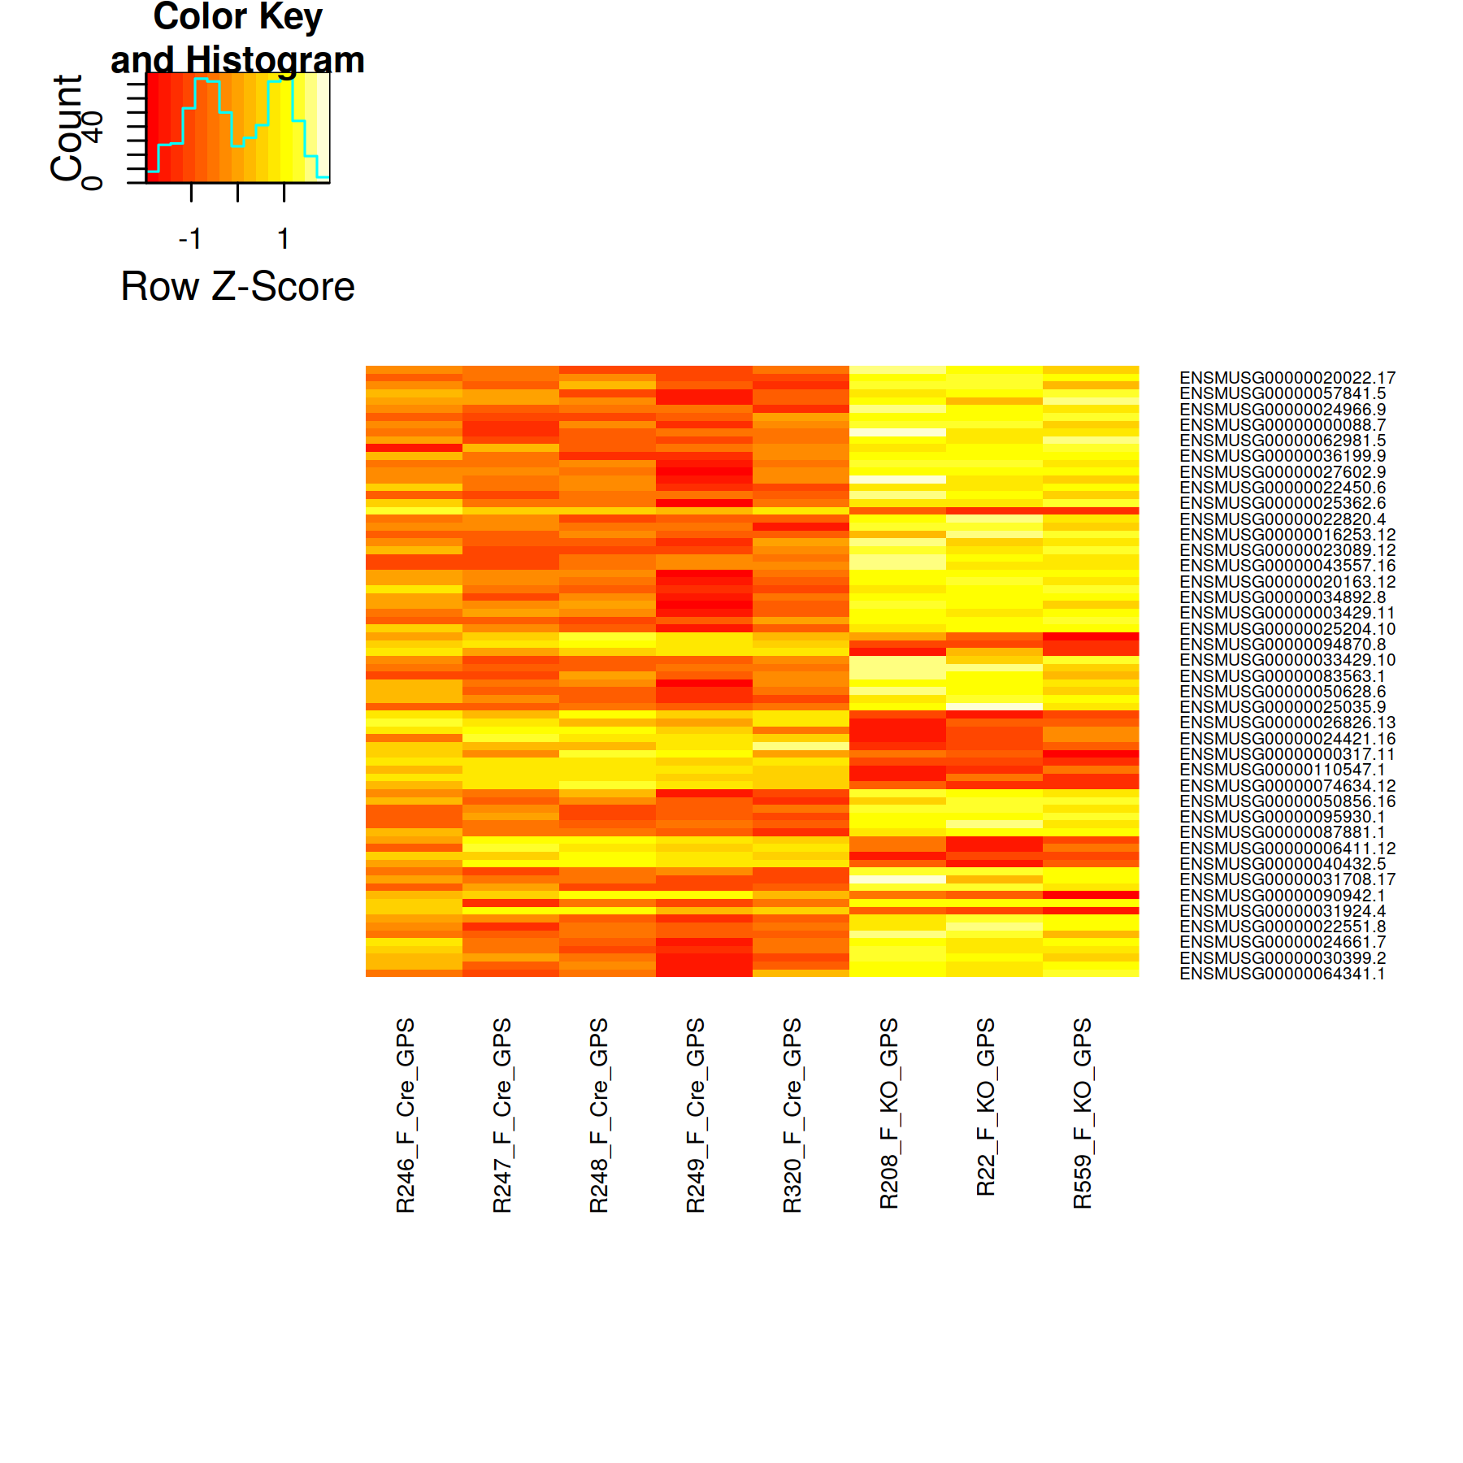
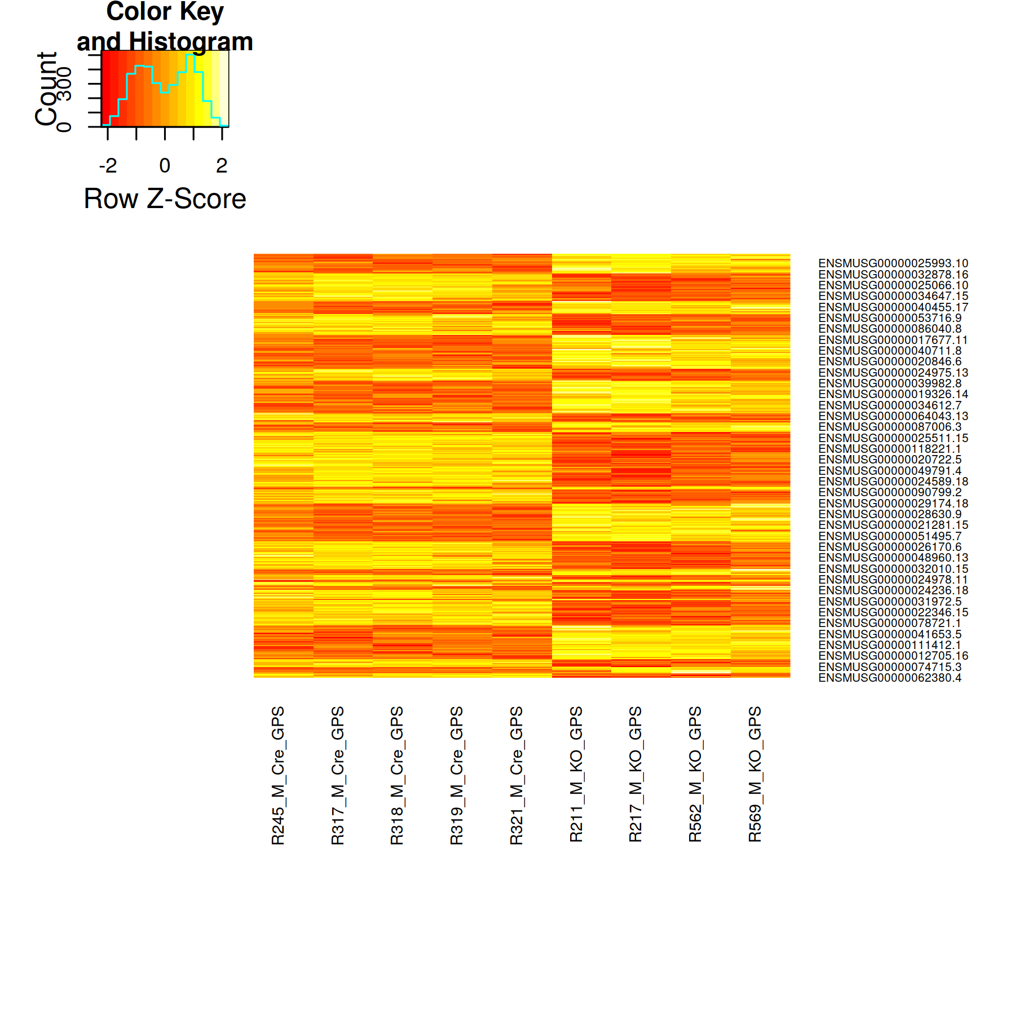
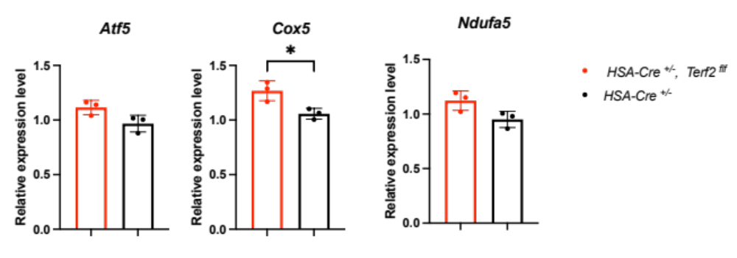
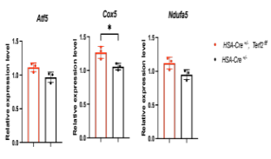
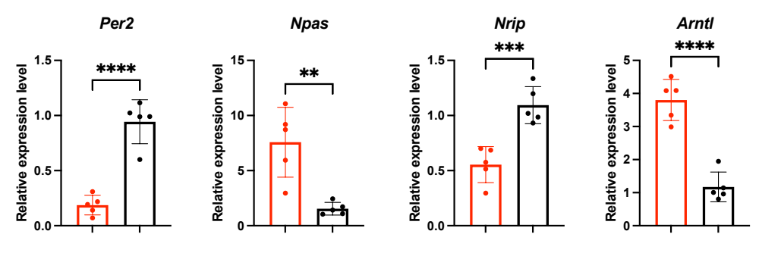
Supplemental Figure 6
A)
Females
Males
B)
Females
Males
HSA Cre ^{+/-}
HSA Cre ^{+/-};
Terf2 ^{f/f}
HSA Cre ^{+/-}
HSA Cre ^{+/-};
Terf2 ^{f/f}
C)
Females
Males

Slide 7
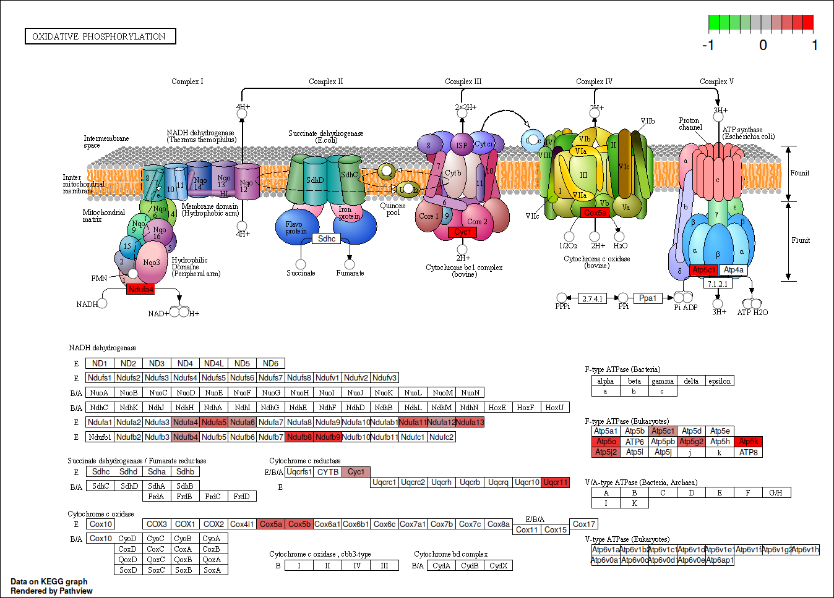
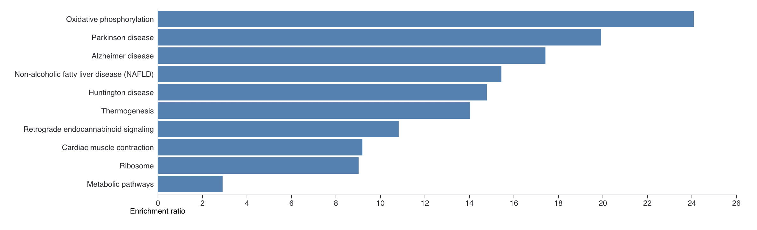
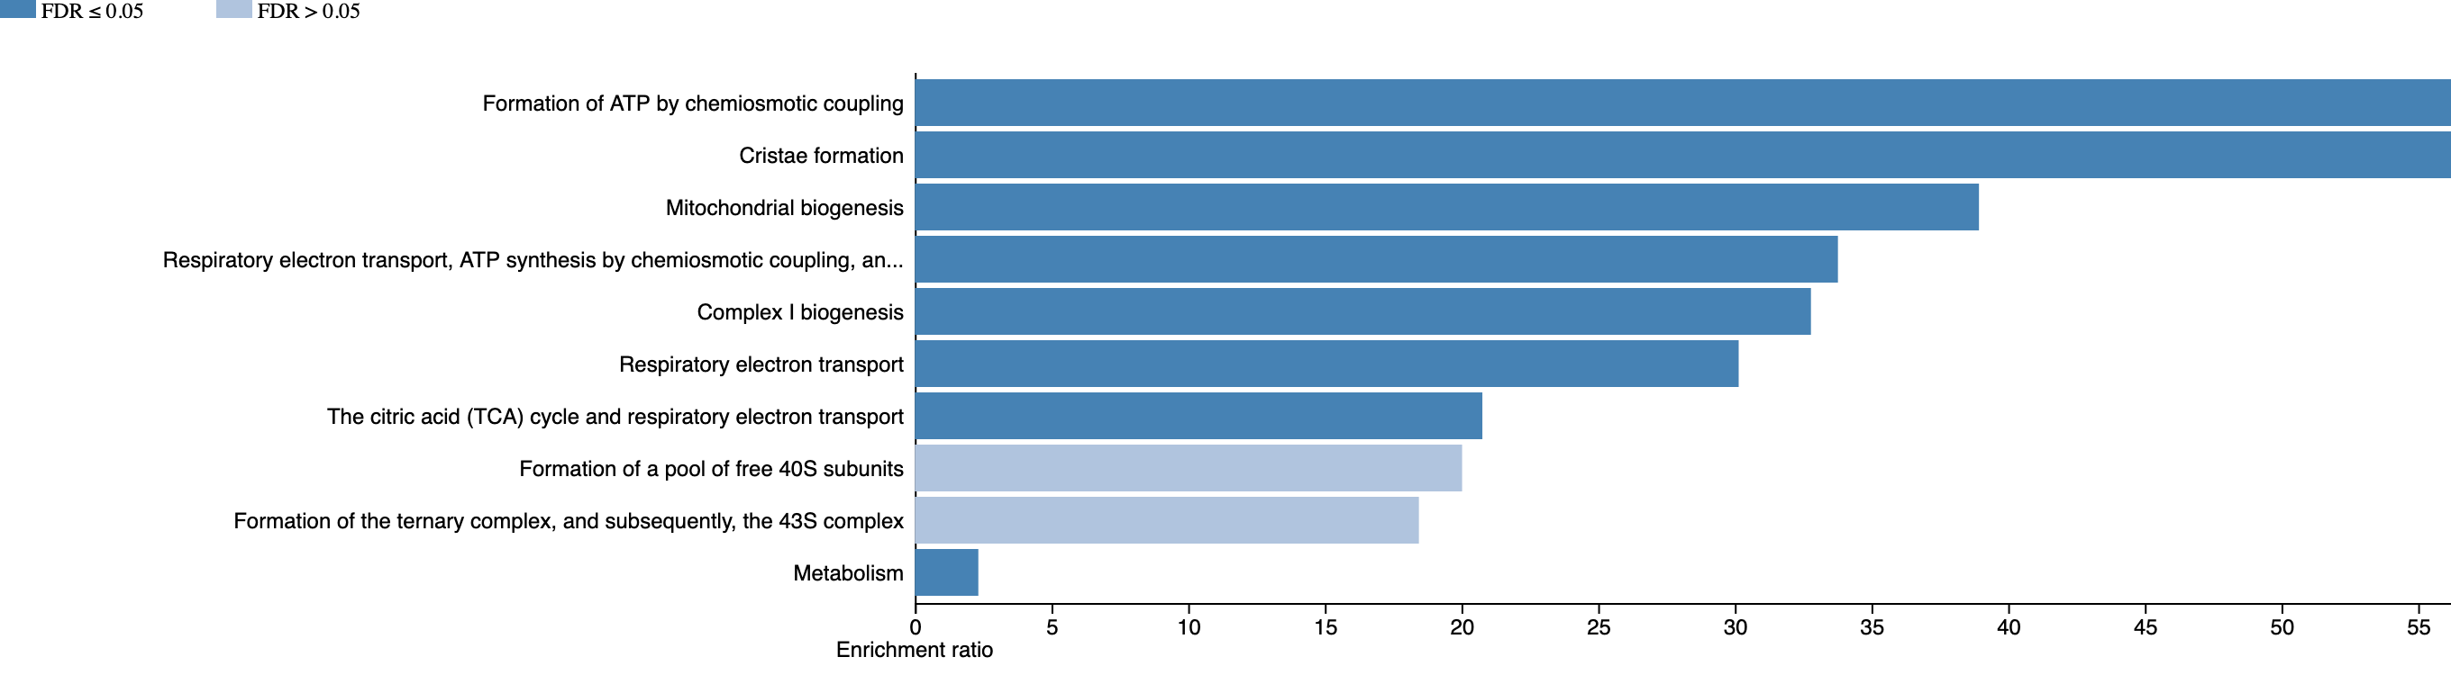
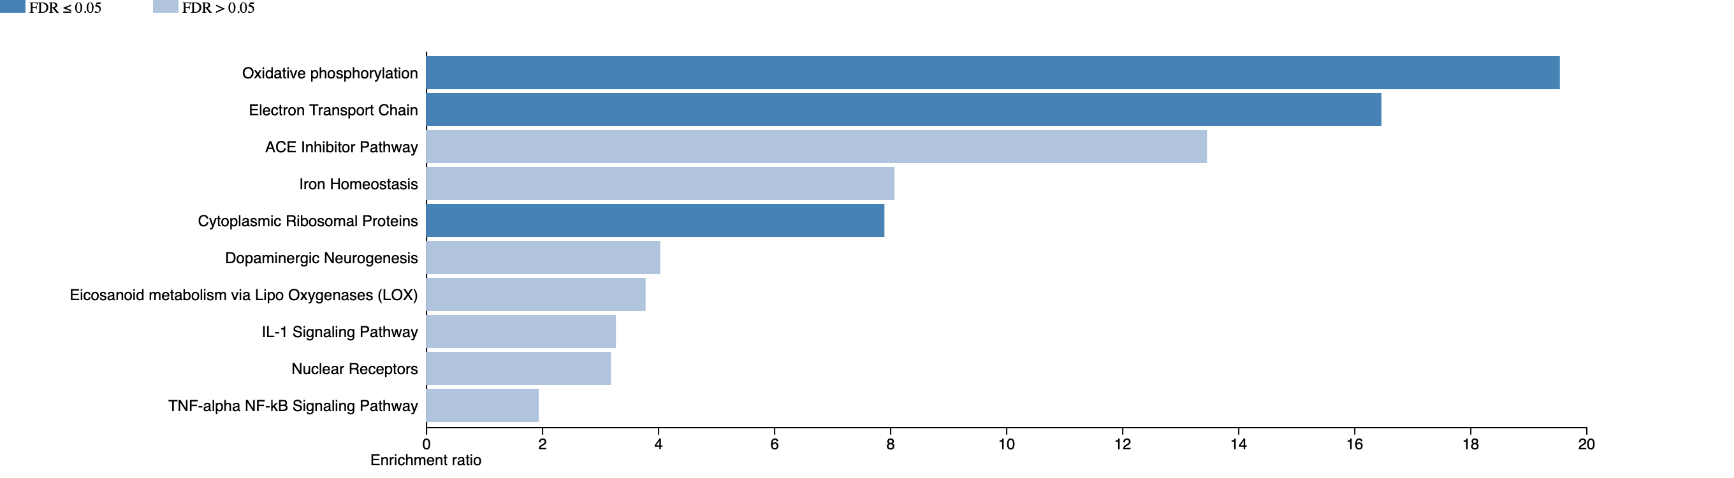
Supplemental Figure 6 bis
A)
B)
KEGG
Wikipathway

