Slide 1
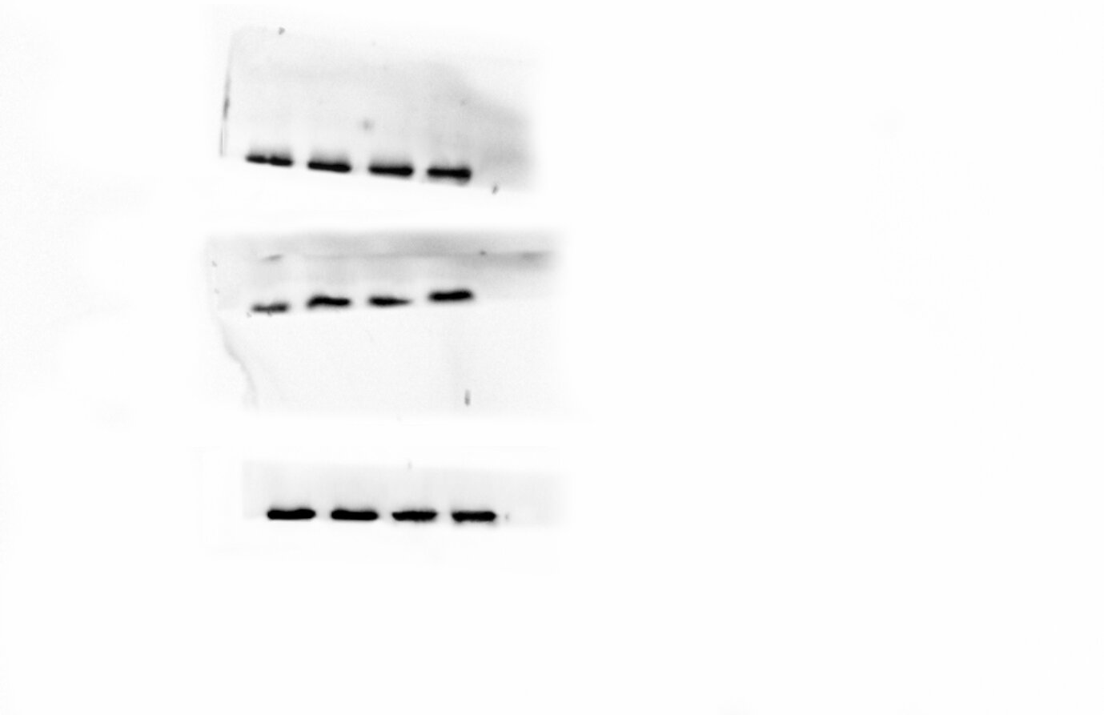
+NaCl
tTreg
at-tTreg
tTreg
at-tTreg
SGK1
pSGK1
GAPDH

Slide 2
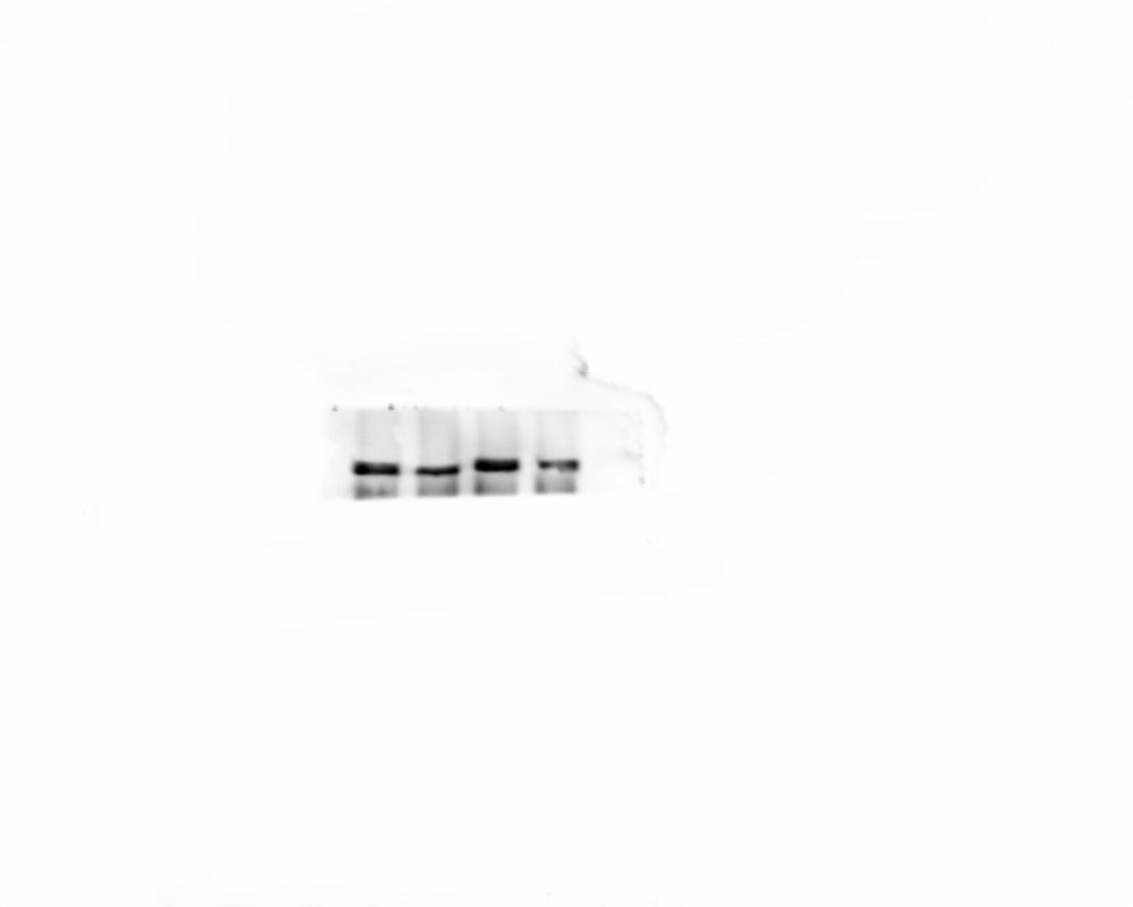
+NaCl
tTreg
at-tTreg
tTreg
at-tTreg

Slide 3
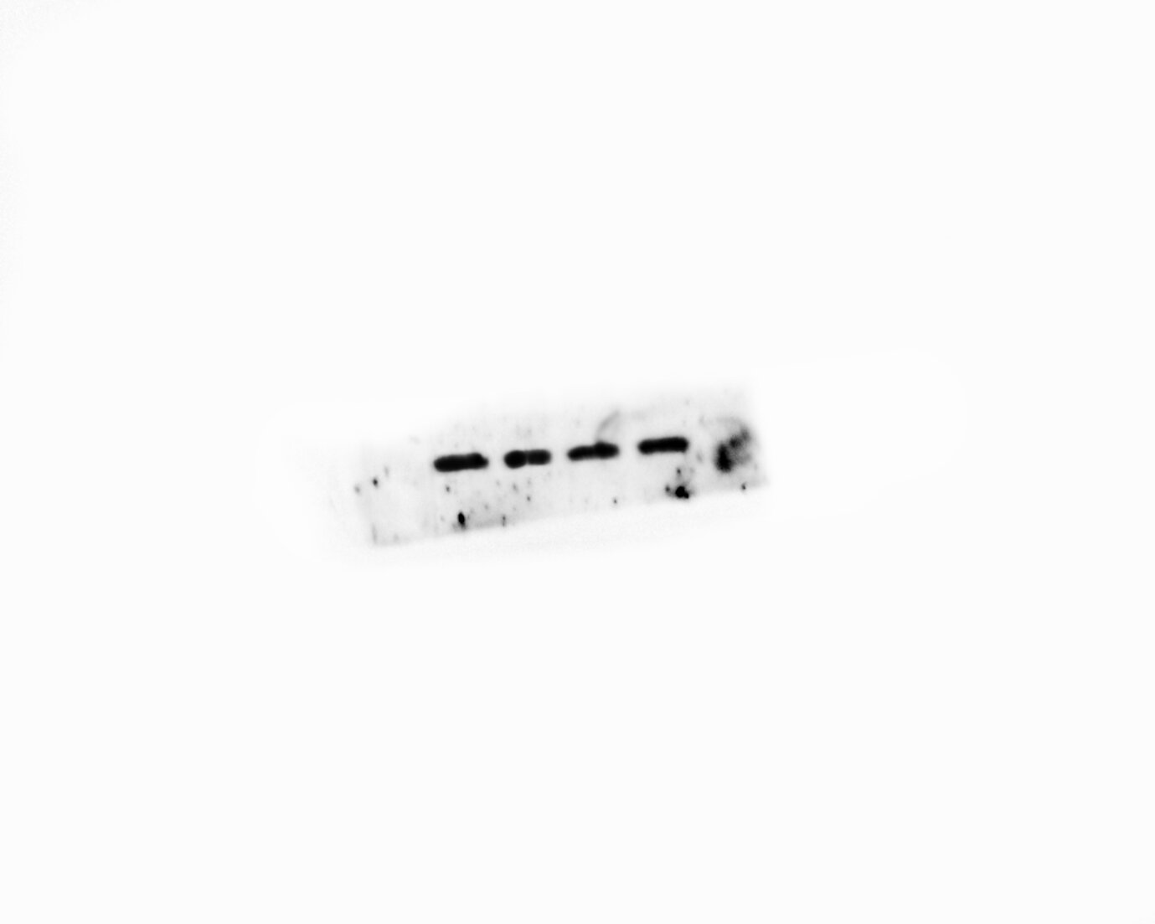
+NaCl
tTreg
at-tTreg
tTreg
at-tTreg

