Slide 1
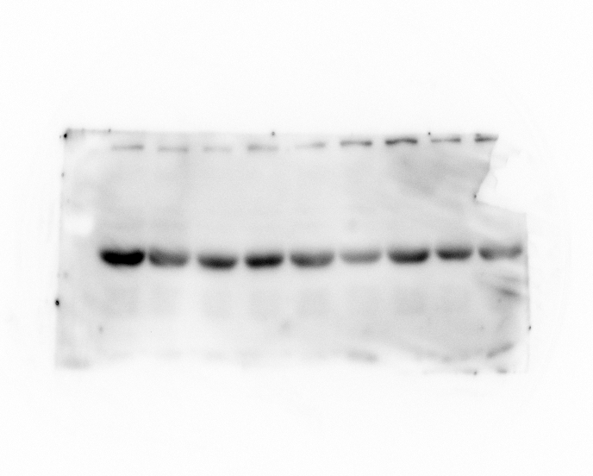
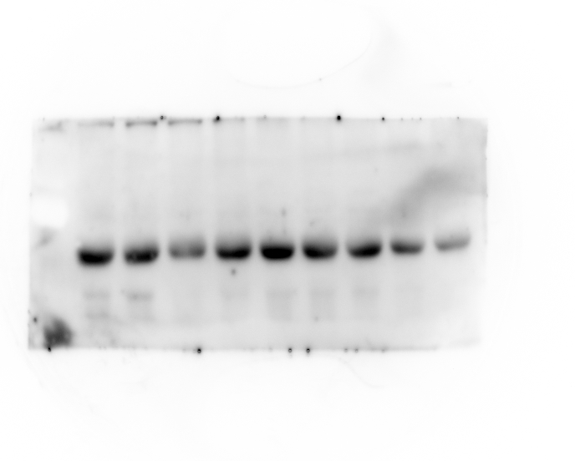
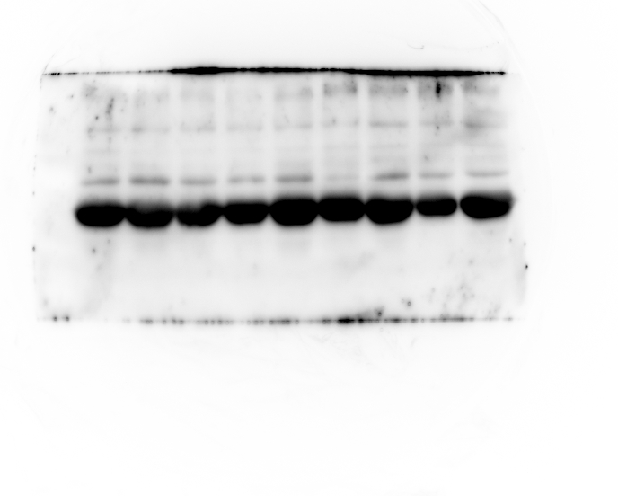
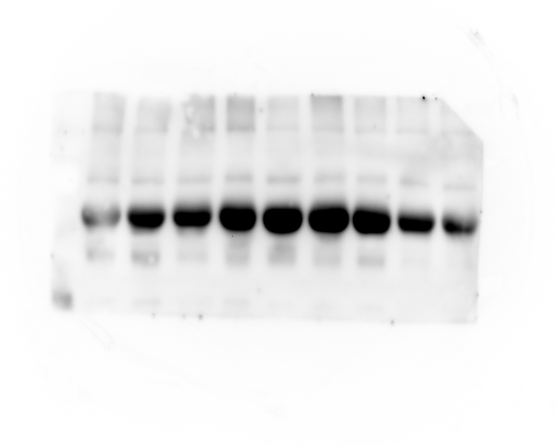
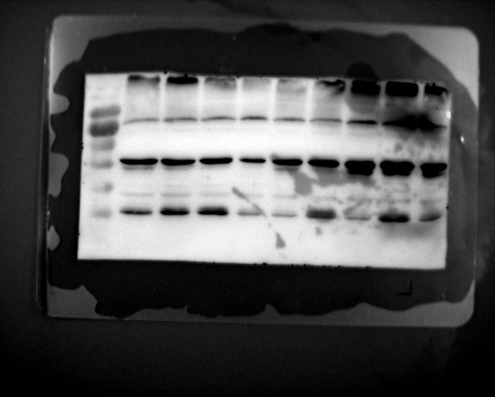
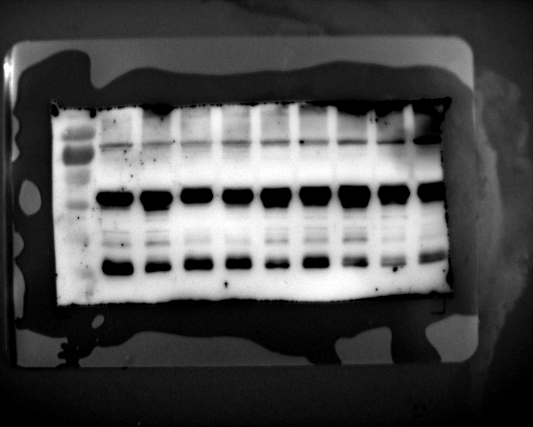
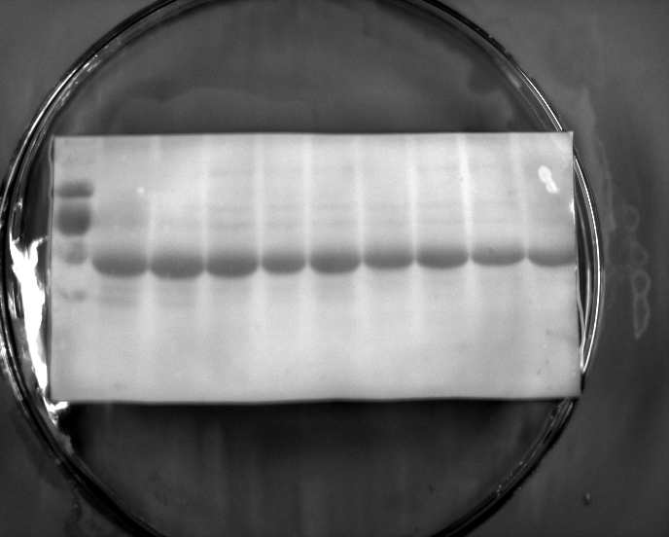
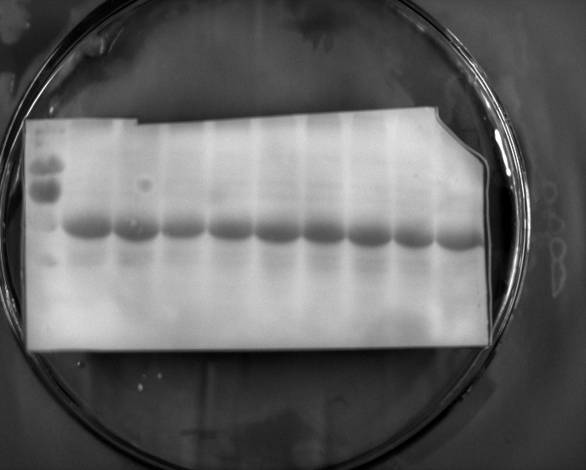
HHZ inoculated with PXO99A
H471 inoculated with PXO99A
Anti-OsbZIP23
Anti-OsbZIP23
Anti-OsCDPK13
Anti-OsCDPK13
Anti-OsMKK4
Anti-OsMKK4
Anti-OsMPK6
Anti-OsMPK6
Coomassie
Coomassie

Slide 2
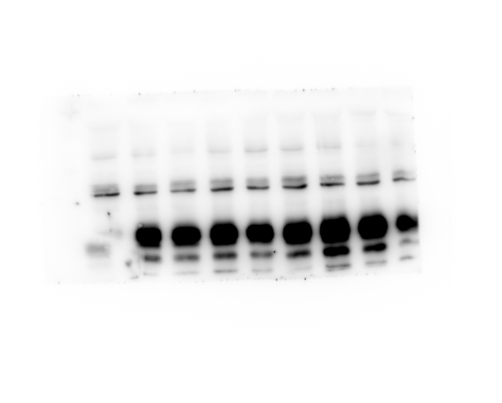
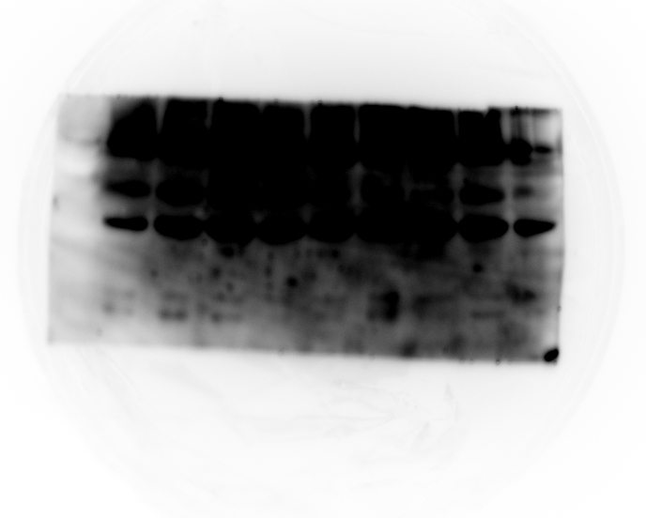
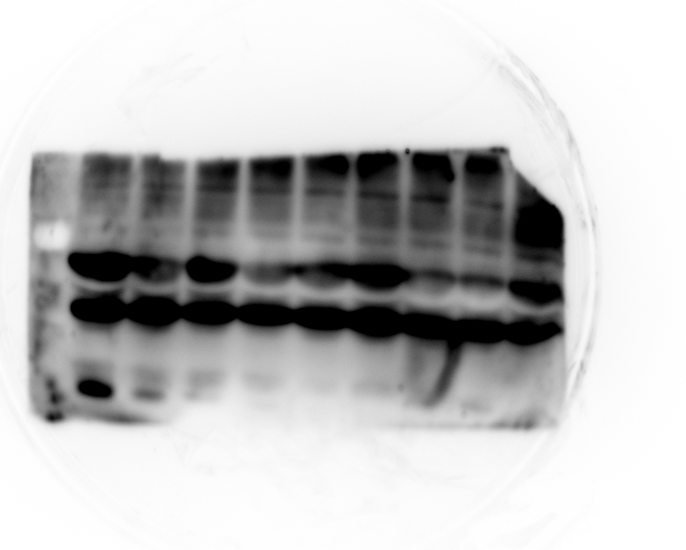
HHZ inoculated with PXO99A
H471 inoculated with PXO99A
Anti-PR1a
Anti-PR1a
Anti-PR1b
Anti-PR1b

