Slide 1
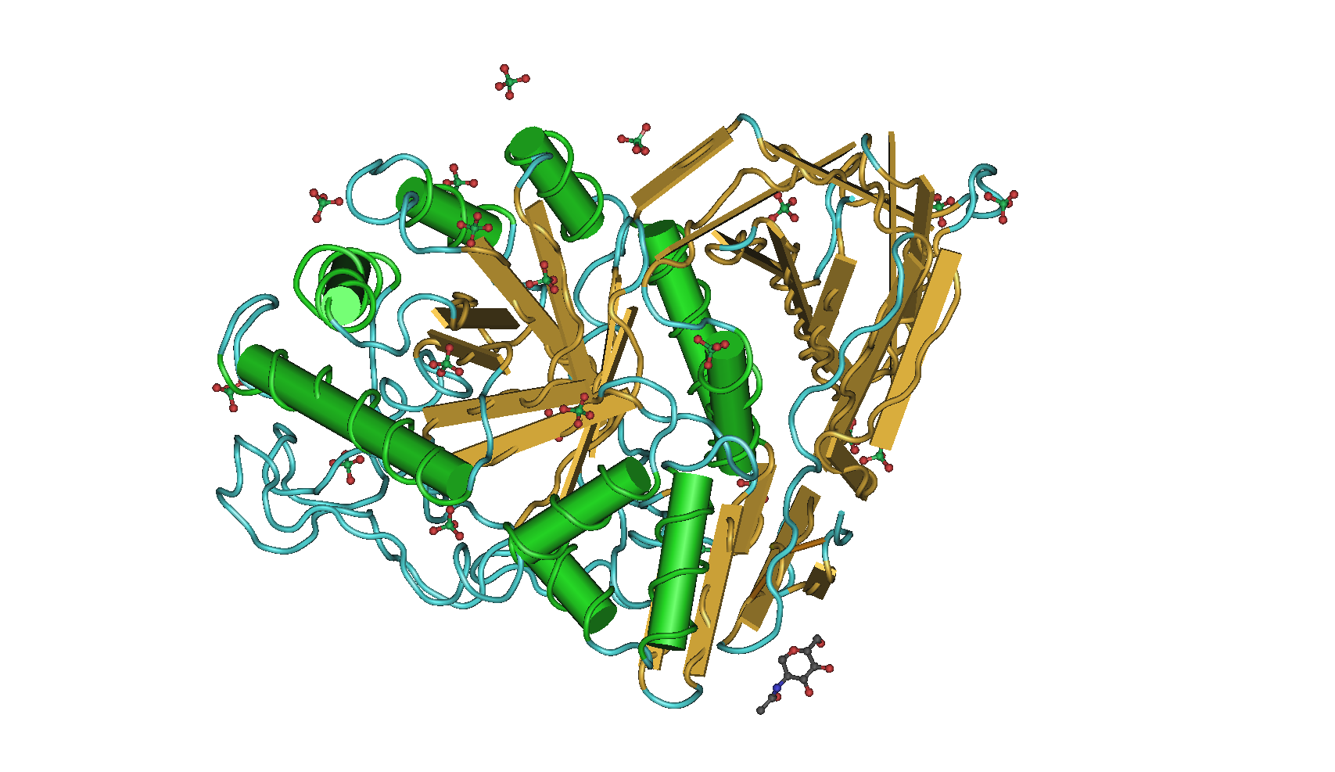
Domain III: catalytic domain
p.G416S
p.W420*
p.R535H
Domain II: immunoglobulin-like domain
p.D354E
p.L483P
p.R316C
p.R296Q
p.P240H
p.G241R
p.F252I
p.R87W
p.G85E
p.N227S
p.N227W
p.V54L
Domain I: contain two disulphide bridge
p.V230G
p.I442T
p.R159W
p.D438N
p.N425K
p.D448H
Notes:
Additional file 1. Three-dimensional structure of GBA and location of GBA mutations

