Slide 1
Overview of bone histology and µCT

Slide 2
µCT

Slide 3
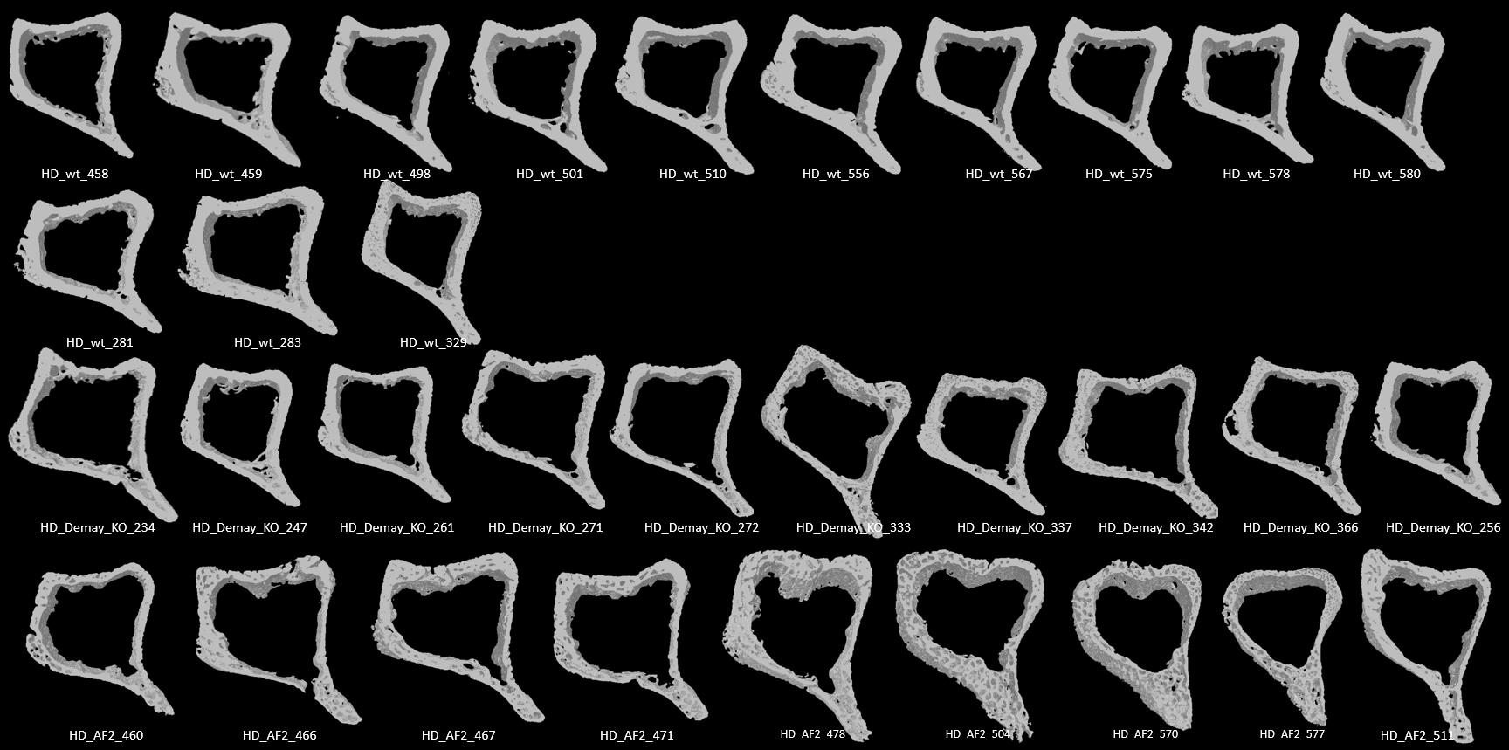
Rescue diet
µCT
Representative image selected for manuscript
Vdr^{+/+}
Vdr^{-/-}
Vdr^{ΔAF2}

Slide 4
Paraffin-embedded bones
Safranin-O staining
H&E staining
TRAP staining
Masson trichrome staining

Slide 5
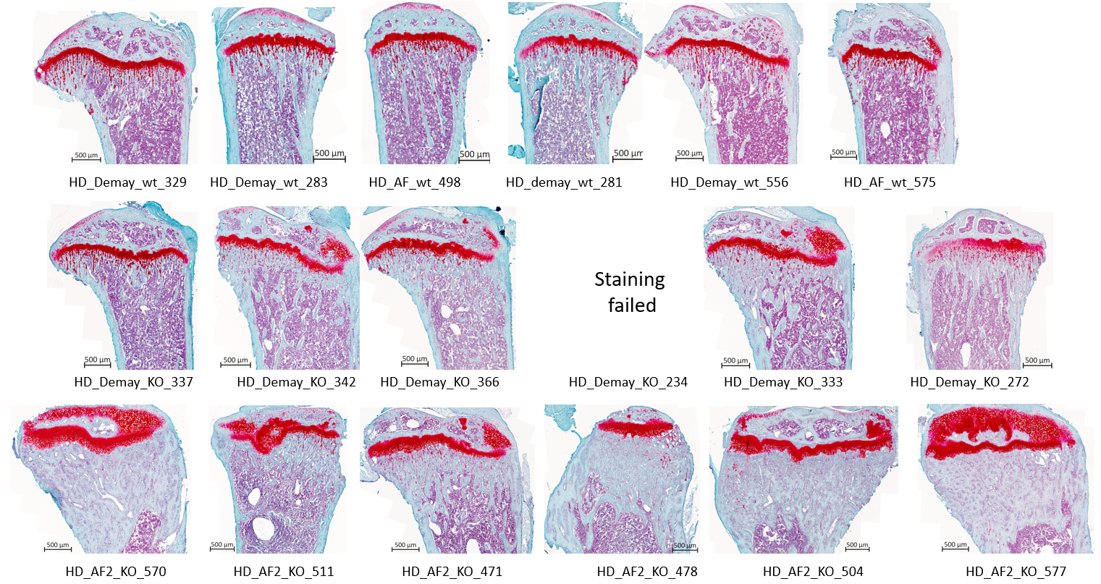
Rescue diet
Safranin-O staining
Representative image selected for manuscript
Vdr^{+/+}
Vdr^{-/-}
Failed staining
Vdr^{ΔAF2}

Slide 6
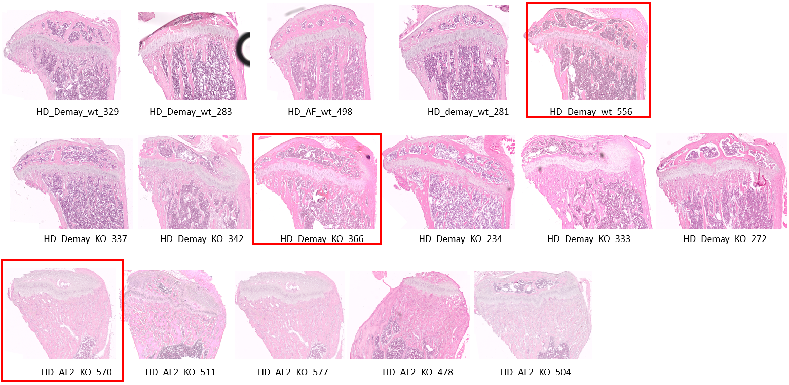
Rescue diet
H&E staining
Representative image selected for manuscript
Vdr^{+/+}
Vdr^{-/-}
Vdr^{ΔAF2}

Slide 7
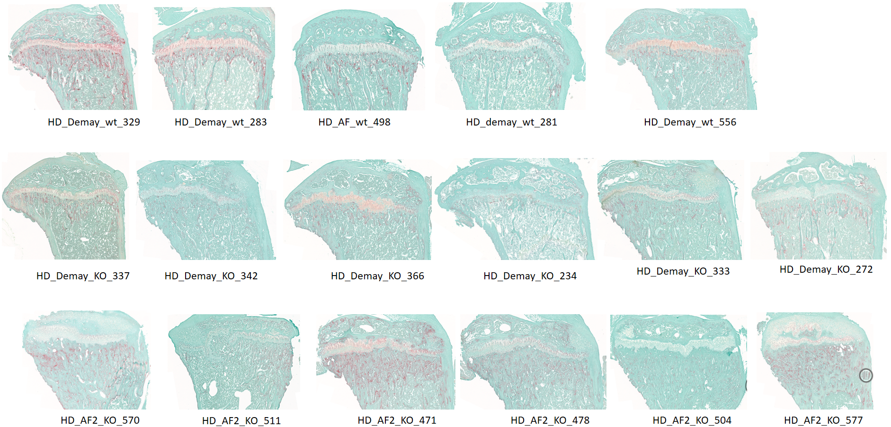
Rescue diet
TRAP staining
Representative image selected for manuscript
Vdr^{+/+}
Vdr^{-/-}
Vdr^{ΔAF2}

Slide 8
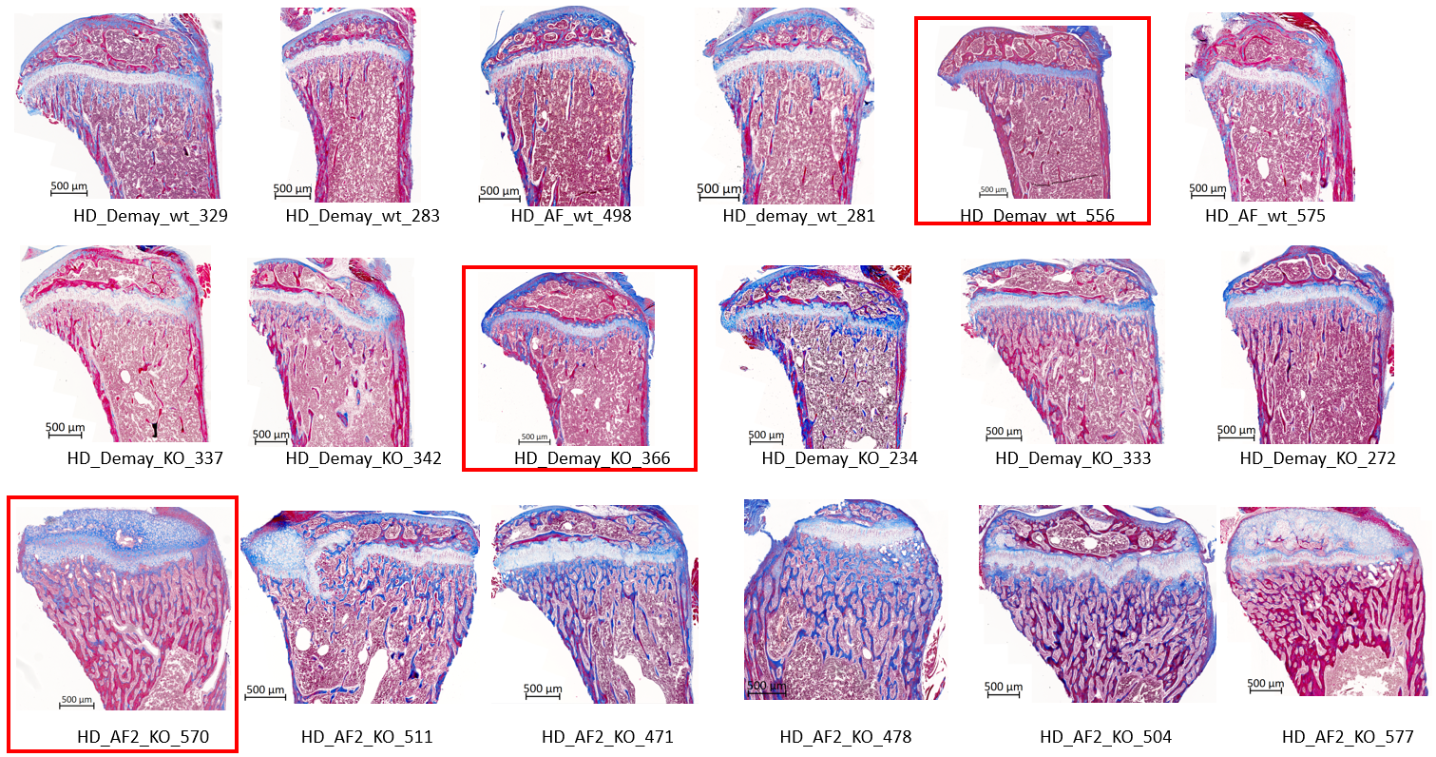
Rescue diet
Masson trichrome staining
Representative image selected for manuscript
Vdr^{+/+}
Vdr^{-/-}
Vdr^{ΔAF2}

Slide 9
MMA-embedded bones
Calcein double labeling
Goldner staining
Von Kossa staining

Slide 10
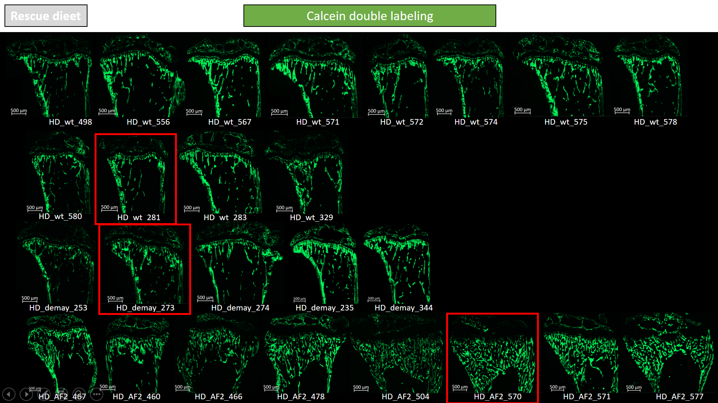
Rescue diet
Calcein double labeling
Representative image selected for manuscript
Vdr^{+/+}
Vdr^{-/-}
Single label
Vdr^{ΔAF2}

Slide 11
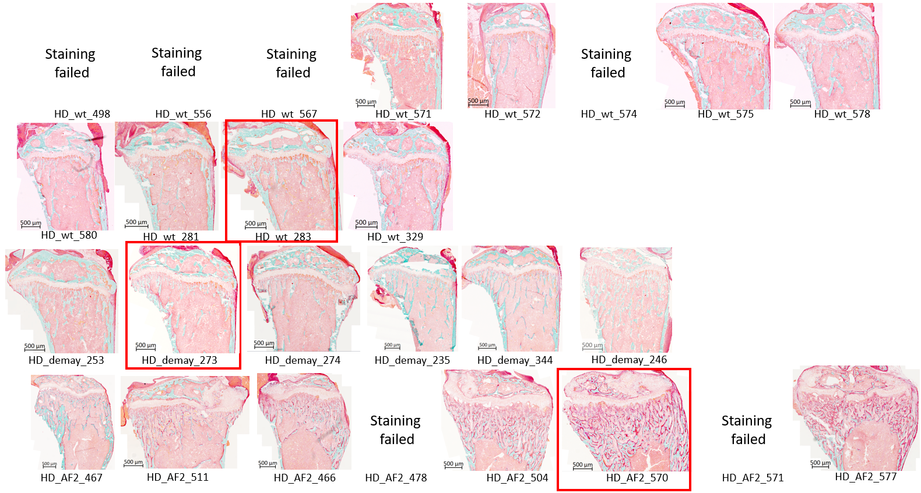
Rescue diet
Goldner staining
Representative image selected for manuscript
Failed staining
Failed staining
Failed staining
Failed staining
Vdr^{+/+}
Vdr^{-/-}
Vdr^{ΔAF2}
Failed staining
Failed staining

Slide 12
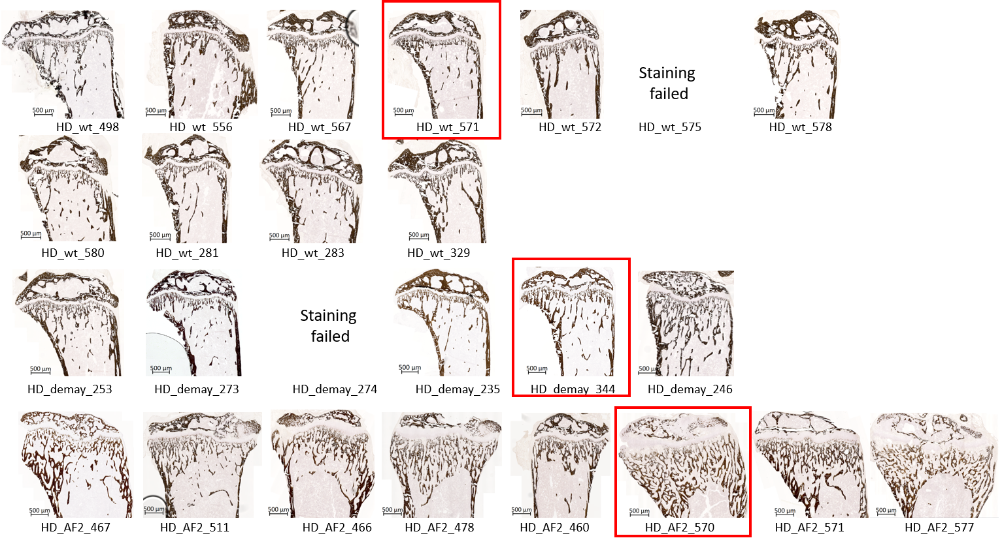
Rescue diet
Von Kossa staining
Representative image selected for manuscript
Failed staining
Vdr^{+/+}
Failed staining
Vdr^{-/-}
Vdr^{ΔAF2}

