Slide 1

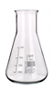



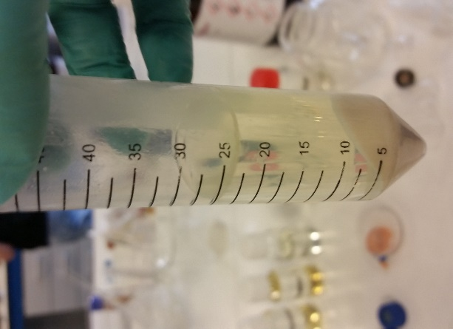

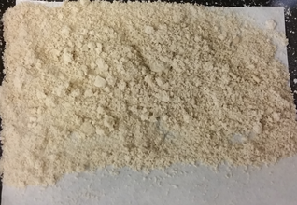
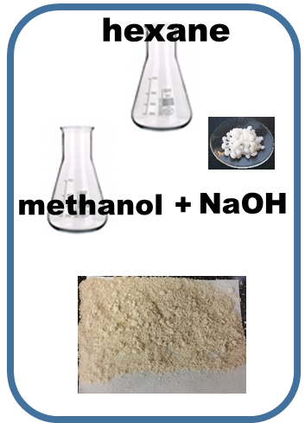



hexane
centrifugation
biodiesel + solvent
methanol +
NaOH
glycerin
ground soybeans
grinding
direct sonication
20 kHz
1 min
soybean seeds

