Slide 1
Supplementary figure 1

Slide 2
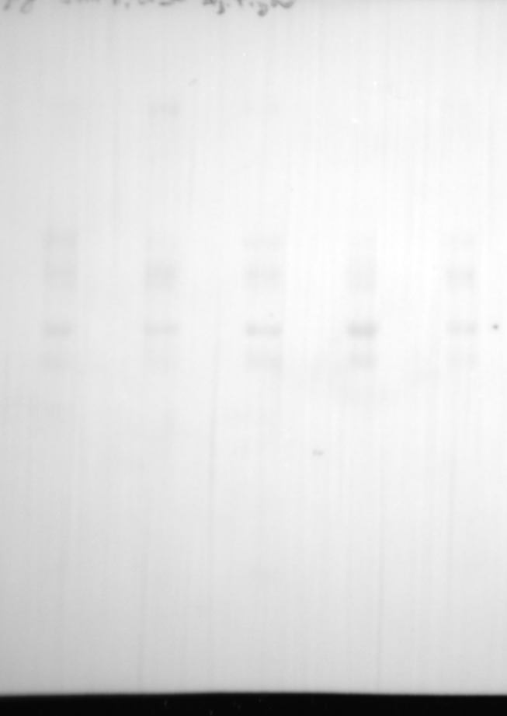
Anti-CD9
Ponceau S
Normal pregnancy
Hydrops due to other causes
Normal pregnancy
Hydrops due to other causes
Bart hydrops
Bart no hydrops
Disease comparator
Bart hydrops
Bart no hydrops
Disease comparator
kDa
kDa
180
180
135
135
100
100
75
75
63
63
48
48
35
35
25
25
17
CD9
17

Slide 3
Anti-HSP70
Ponceau S
Normal pregnancy
Hydrops due to other causes
Normal pregnancy
Hydrops due to other causes
Bart hydrops
Bart no hydrops
Disease comparator
Bart hydrops
Bart no hydrops
Disease comparator
kDa
kDa
180
180
135
135
100
100
75
75
HSP70
63
63
48
48
35
35
25
25
17
17

Slide 4
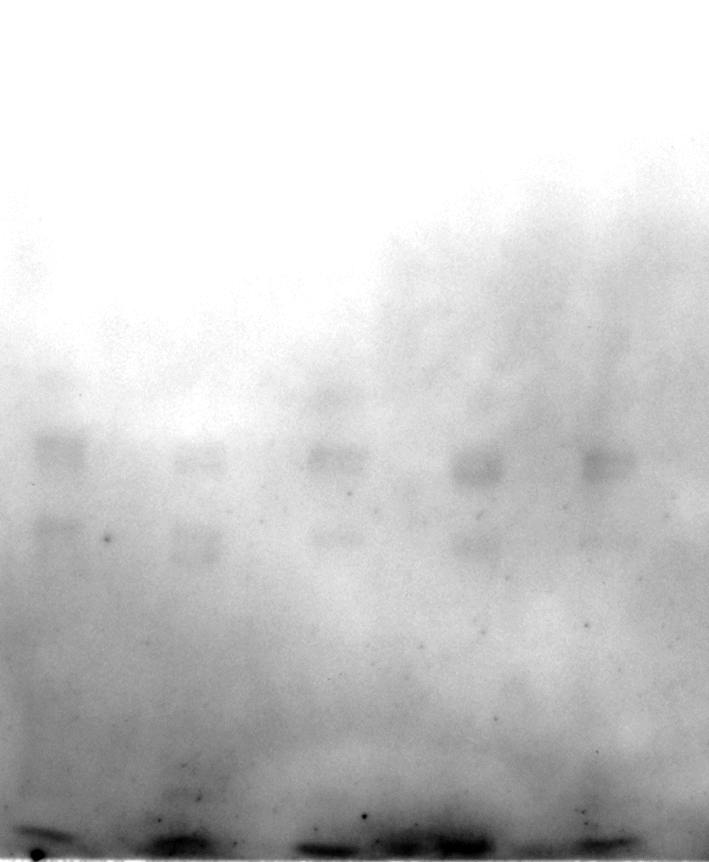
Anti-CD63
Ponceau S
Normal pregnancy
Hydrops due to other causes
Bart hydrops
Bart no hydrops
Disease comparator
Normal pregnancy
Hydrops due to other causes
kDa
Bart hydrops
Bart no hydrops
Disease comparator
kDa
180
180
135
135
100
100
75
75
63
CD63
63
48
48
35
35
25
25

