Slide 1
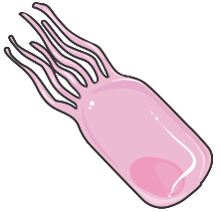
Hippocampus and CSF
Lead exposure
Obviously changed divalent metal
Choroid plexus epithelial cells

