Slide 1
Suppl. Fig. 1
Size-fractionated total RNA
(Wild type parasites)
⍺-Myc IP RNA
(Myc-tagged EhAgo2-1, 2-2, 2-3 and EhAgo2-2^{△NLS-DR} parasites)
5′ P-independent cloning
(TAP or RppH)
NEB sRNA library construction and Illumina sRNA sequencing
Raw reads are separated by barcodes and sRNA sequences are processed
Unique reads (limit size as 15-50nt)
Sequential bowtie alignment against tRNA, rRNA, retrotransposon elements, and the rest of genome and ORFs

Slide 2
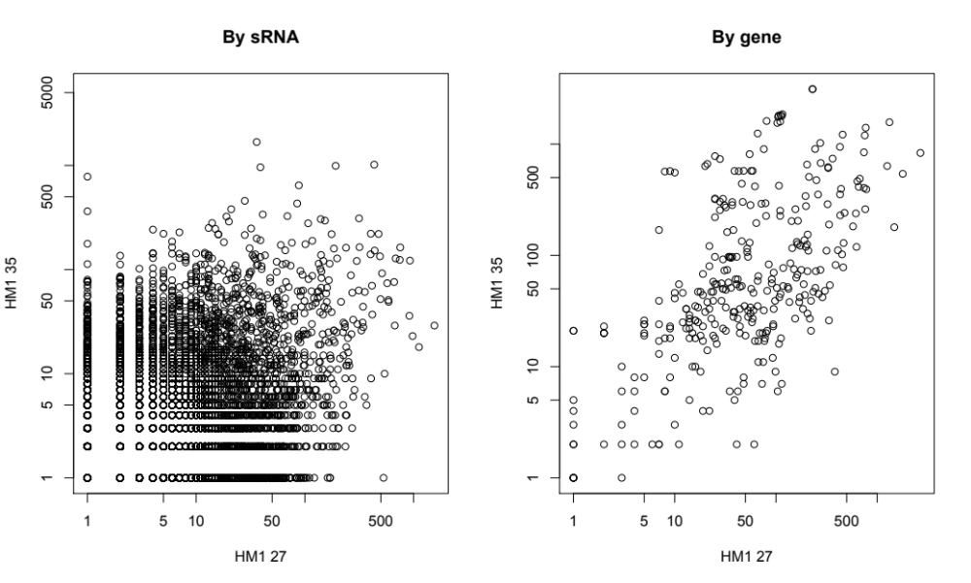
Suppl. Fig. 2A
# unique sRNAs mapped to genes from 31nt peak
# unique sRNAs mapped to genes from 27nt peak

Slide 3
Suppl. Fig. 2B
# sRNAs in 31nt peak
# sRNAs in 27nt peak

Slide 4
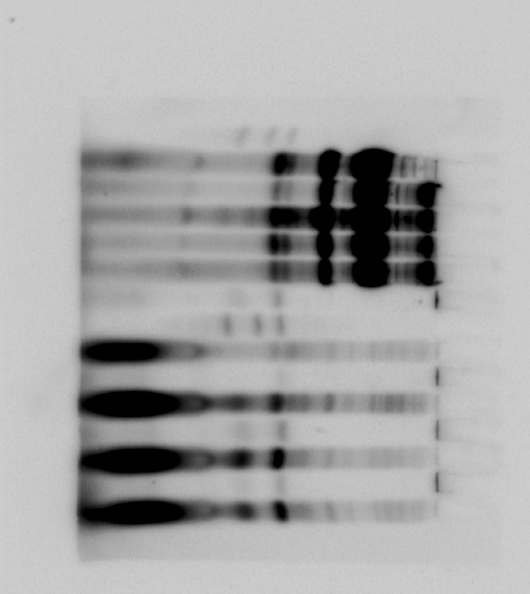
Suppl. Fig. 3A
Encyst 72 hr
Trophozoite
Excyst 8 hr
30nt
24nt
18nt

Slide 5
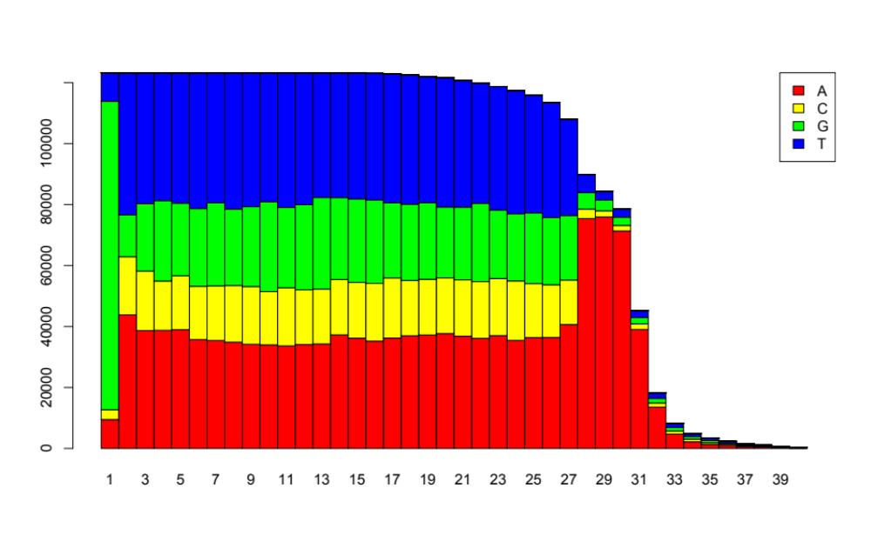
Suppl. Fig. 3B
x10⁴
10
8
Number of sRNA reads
6
4
2
0
1
5
10
15
20
25
30
Nucleotide position of small RNA

Slide 6
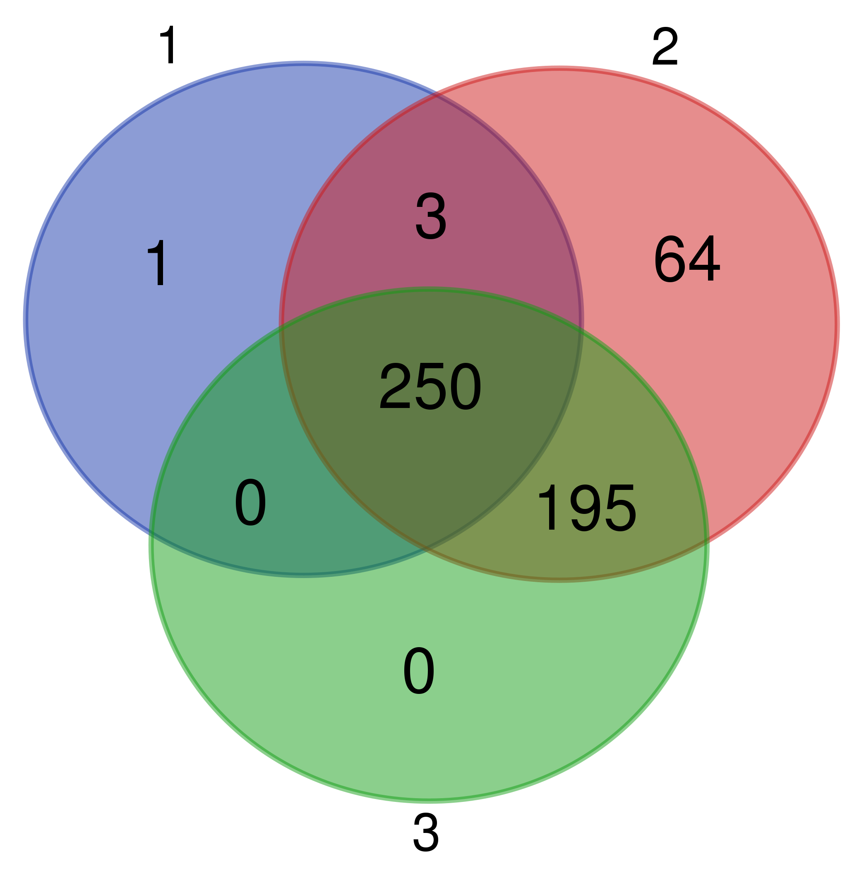
Suppl. Fig. 3C
Trophozoite
Encyst, 72hr
Excyst, 8hr

Slide 7
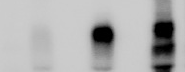
Suppl. Fig. 4A
EhAgo2-1
EhAgo2-2
EhAgo2-3
α-HA IP
α-Myc IP
α-HA IP
α-HA IP
α-Myc IP
α-Myc IP
30nt
24nt
18nt

Slide 8
Suppl. Fig. 4B
EhAgo2-1
EhAgo2-1
EhAgo2-3
EhAgo2-3
EhAgo2-2
EhAgo2-1
EhAgo2-2
EhAgo2-3
EhAgo2-2
Wild type
30nt
24nt
18nt
Wash condition:
Low
(50 mM NaCl)
Medium
(250 mM NaCl)
High
(500 mM NaCl)

Slide 9
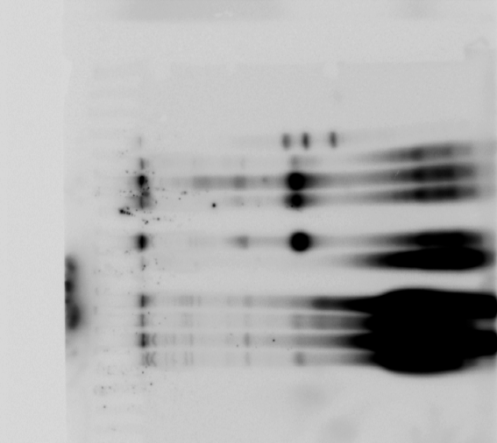
Suppl. Fig. 4C
EhAgo2-2
1D
EhAgo2-3
CIP
[𝛾-³²P]ATP+PNK
+
+ +
+
+ +
30nt
24nt
18nt

Slide 10
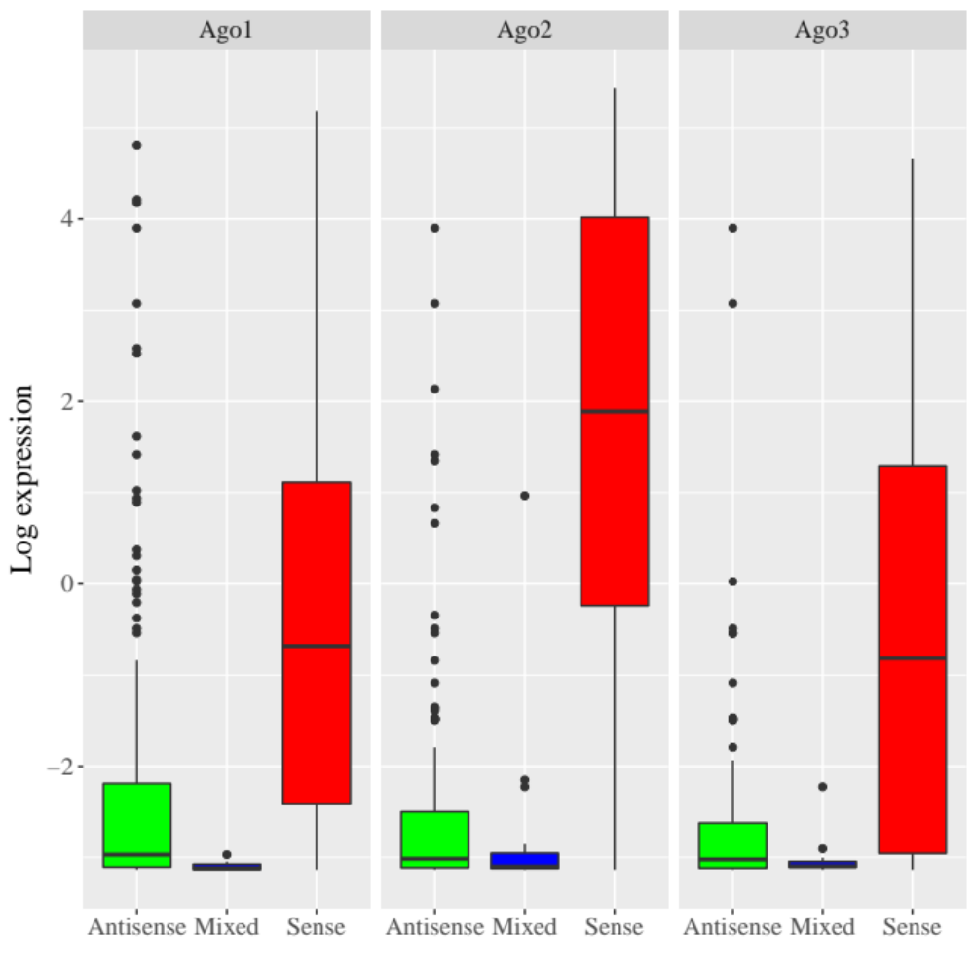
Suppl. Fig. 5A
EhAgo2-1
EhAgo2-2
EhAgo2-3
4
2
Log value of microarray gene expression
0
-2
Antisense
Mixed
Sense
Antisense
Mixed
Sense
Antisense
Mixed
Sense

Slide 11
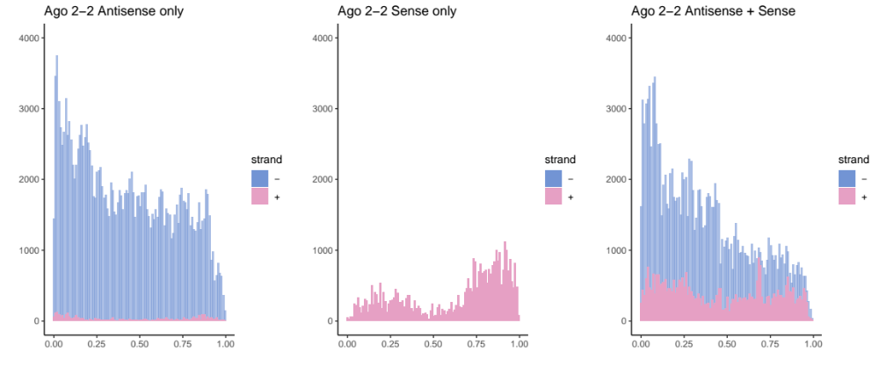
Suppl. Fig. 5B
x10³
x10³
x10³
4
Antisense group
4
Mixed group
4
Sense group
3
3
3
Number of small RNA reads
2
2
2
1
1
1
0
0
0
0
0.25
0.5
0.75
1.0
0
0.25
0.5
0.75
1.0
0
0.25
0.5
0.75
1.0
Small RNA relative position within gene

Slide 12
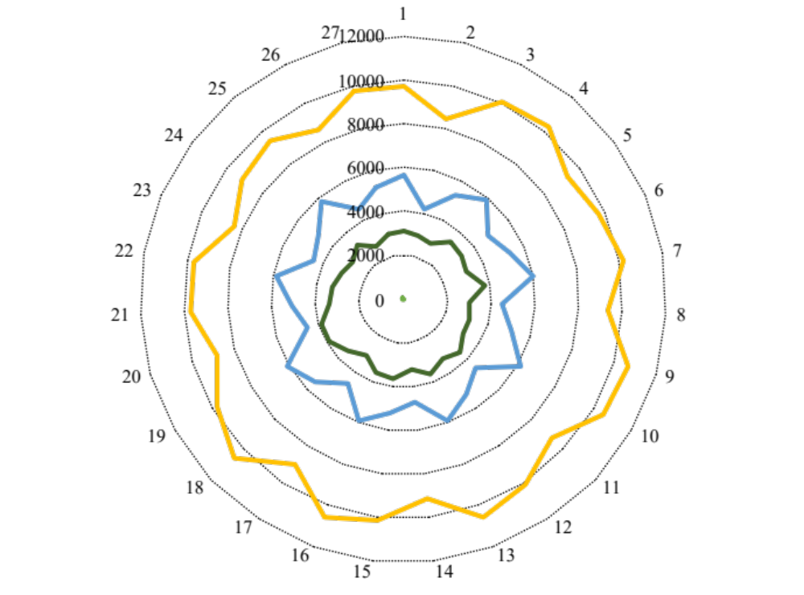
Suppl. Fig. 6
EhAgo2-1
EhAgo2-2
EhAgo2-3

Slide 13
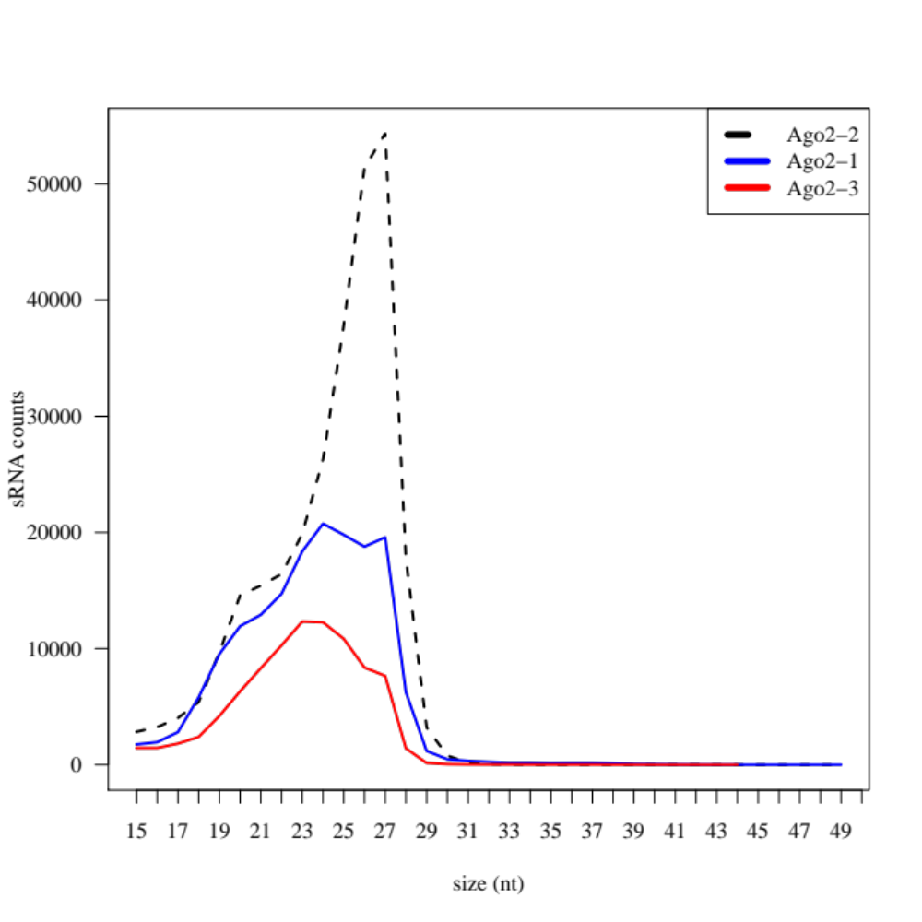
Suppl. Fig. 7A
x10³
5′ P-independent cloning IP libraries, mapped reads
50
EhAgo2-1
EhAgo2-2
40
EhAgo2-3
Number of small RNA reads
30
20
10
0
Size (nt)

Slide 14
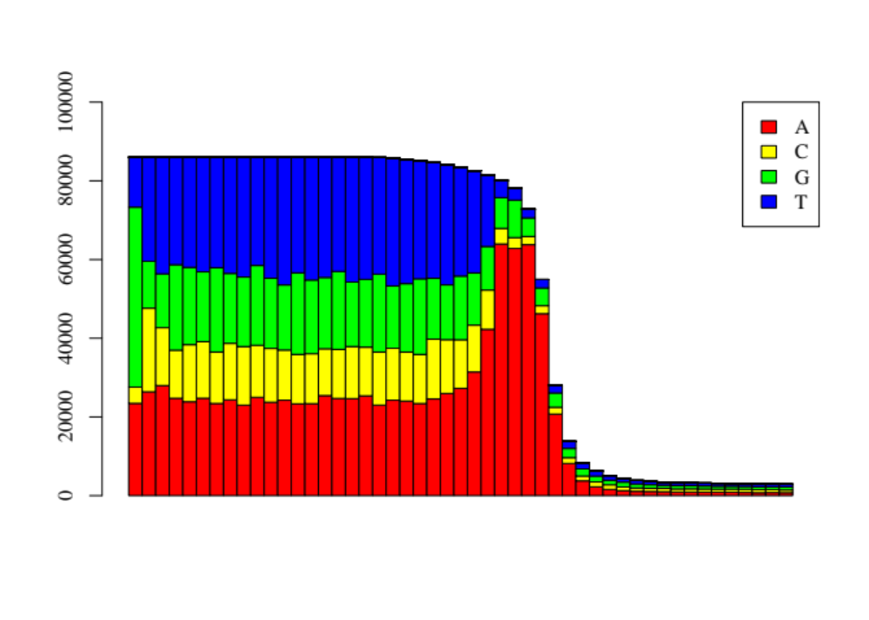
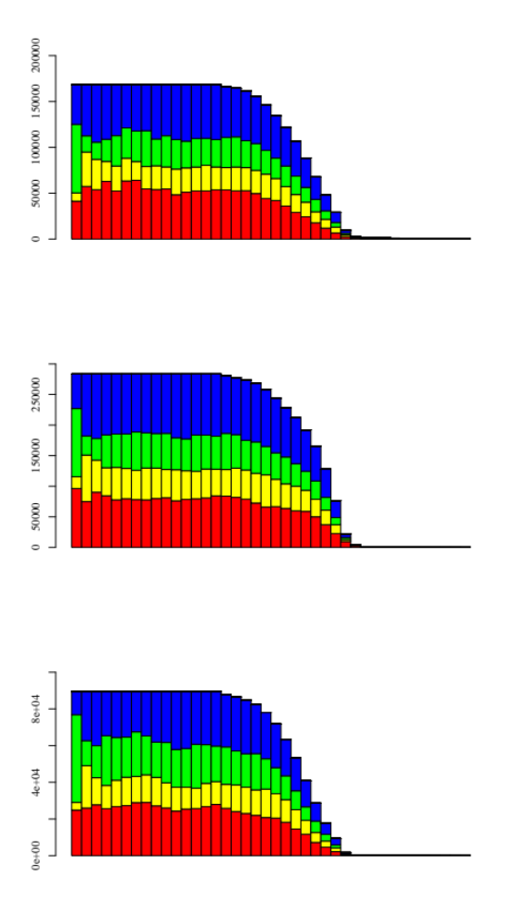
Suppl. Fig. 7B
x10³
x10³
EhAgo2-2
200
EhAgo2-1
300
150
250
200
Number of small RNA reads
Number of small RNA reads
100
150
50
100
50
0
1 3 5 7 9 11 13 15 17 19 21 23 25 27 29 31 35
0
1 3 5 7 9 11 13 15 17 19 21 23 25 27 29 31 35
x10³
EhAgo2-3
100
80
60
Number of small RNA reads
40
20
0
1 3 5 7 9 11 13 15 17 19 21 23 25 27 29 31 35

Slide 15
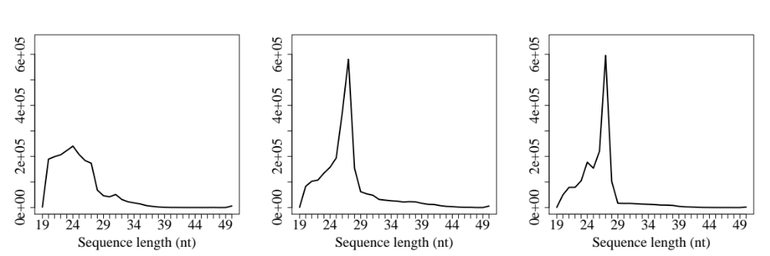
Suppl. Fig. 8
5′ P-independent cloning, EhAgo IP libraries (RppH)
EhAgo2-1
EhAgo2-2
EhAgo2-3

Slide 16
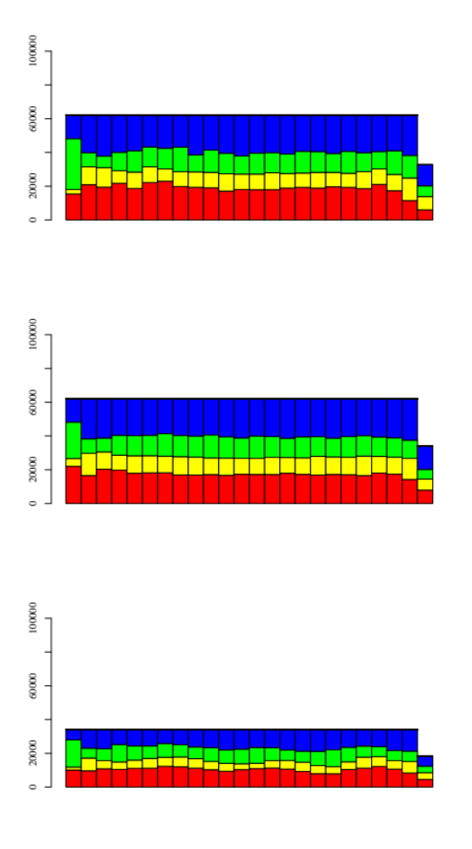
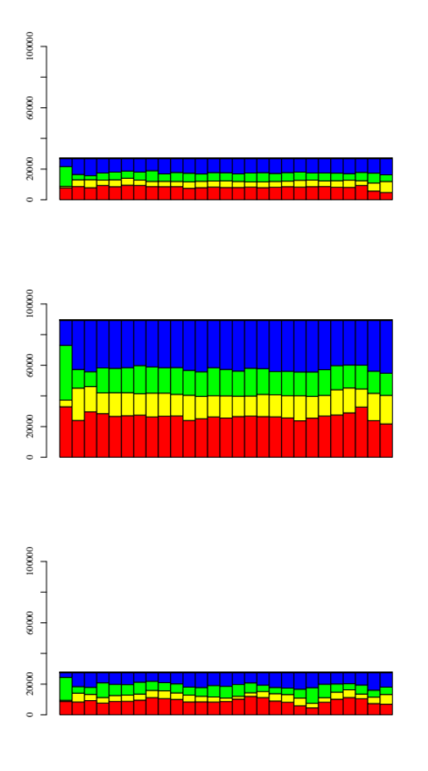
Suppl. Fig. 9
27nt fraction
23/24nt fraction
x10³
x10³
60
40
40
# of sRNA reads
EhAgo2-1
20
20
0
1
3
5
7
9
11
13
15
17
19
21
23
25
27
0
1
3
5
7
9
11
13
15
17
19
21
23
x10³
80
x10³
60
60
# of sRNA reads
EhAgo2-2
40
40
20
20
0
x10³
x10³
# of sRNA reads
40
40
EhAgo2-3
20
20
0
1
3
5
7
9
11
13
15
17
19
21
23
25
27
0
1
3
5
7
9
11
13
15
17
19
21
23
Nucleotide position of sRNA
Nucleotide position of sRNA

Slide 17
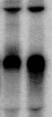
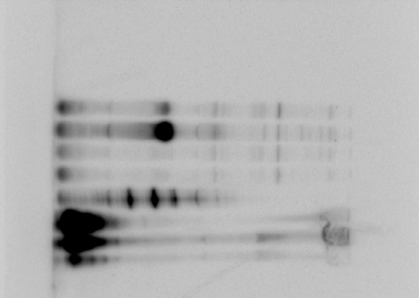
Suppl. Fig. 10
Myc-EhAgo2-2
Myc-EhAgo2-2^{△NLS-DR}
Nuc IP
Nuc IP
Cyto IP
Cyto IP
30nt
24nt
18nt

Slide 18
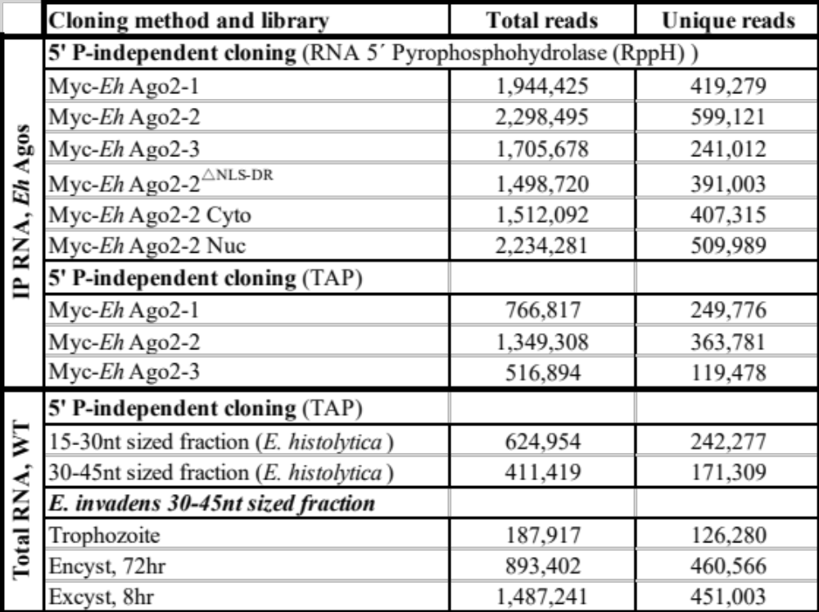
Suppl. Table I

Slide 19
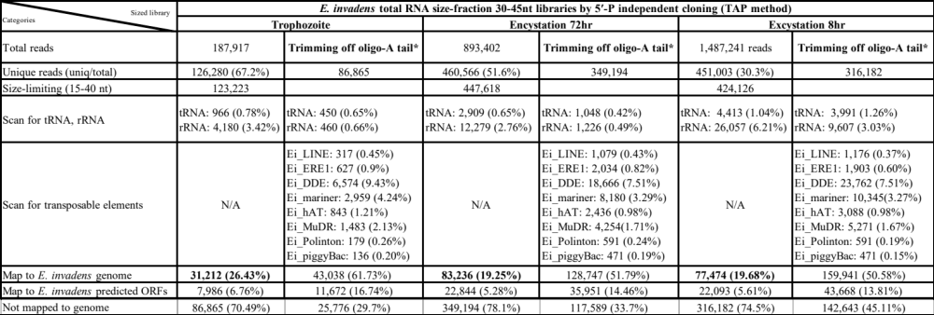
Suppl. Table II

Slide 20
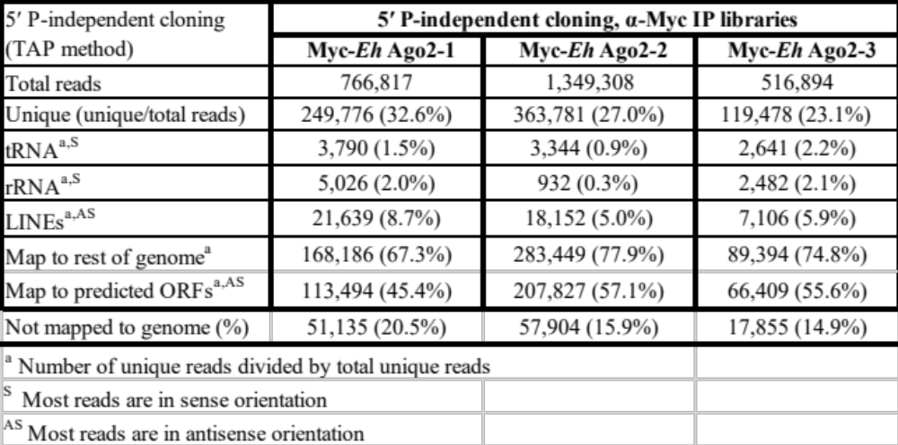
Suppl. Table III

Slide 21
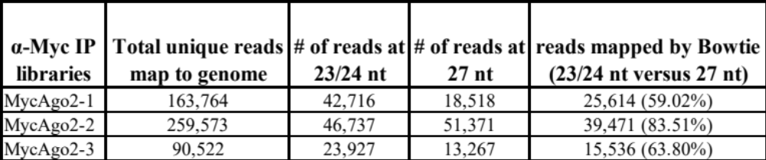
Suppl. Table IV

Slide 22
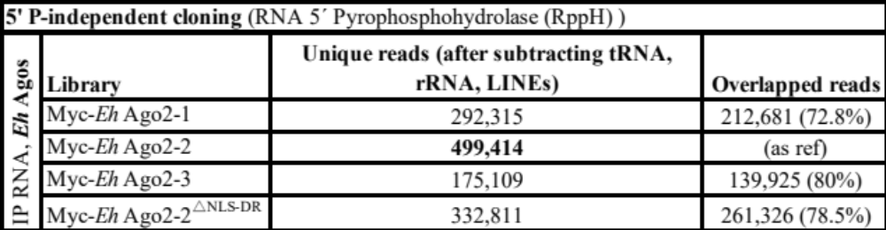
Suppl. Table V

Slide 23
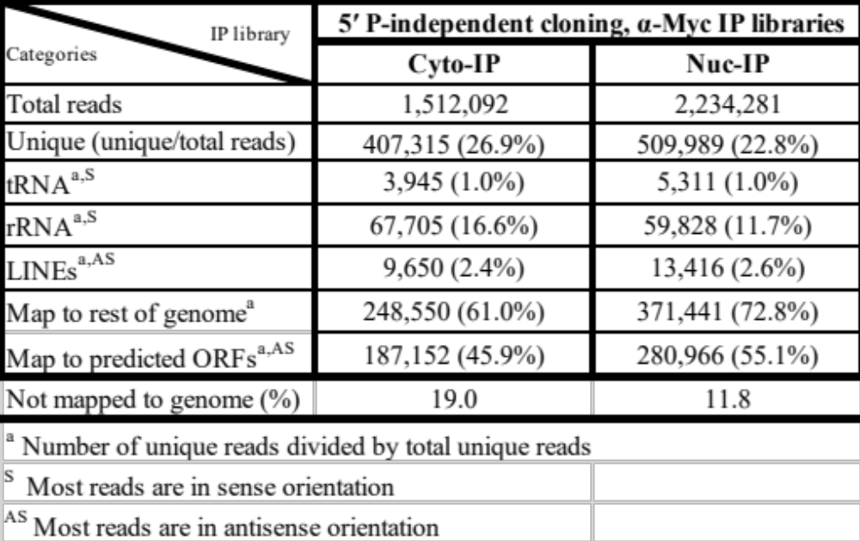
Suppl. Table VI

Slide 24
Suppl. Table VII

Slide 25
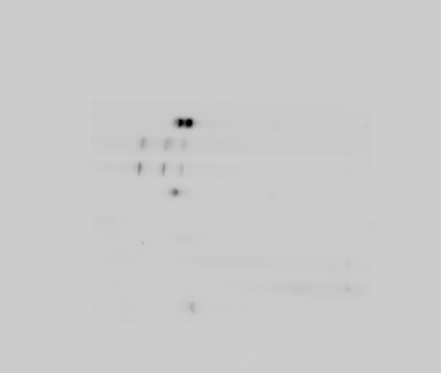
Original blot for Fig. 1C
Probe
A
30nt
24nt
18nt

Slide 26
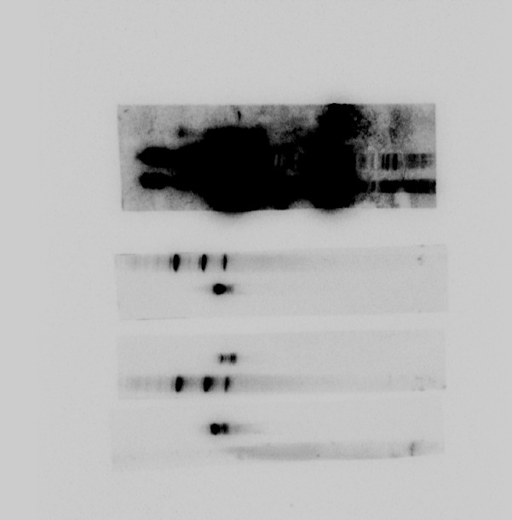
Original blot for Fig. 1C
Probe
C
B
Irrelevant sample
30nt
24nt
18nt

Slide 27
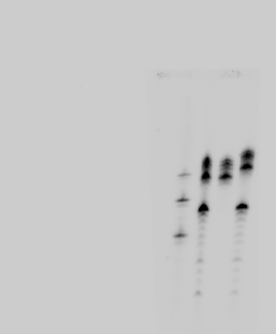
Original blot for Fig. 1D
Probe
A
Probe
LINEs
Terminator
- + -
Terminator
- + -
Capping
- - +
Capping
- - +
30nt
24nt
“spike-in” control
18nt

Slide 28
Original blot for Fig. 2A- ROM1 blot
After stripping,
Probe for EHI_ 164300
After stripping,
Probe for EHI_ 125400
Probe for ROM1
19T-LUC
19T-LUC
19T-ROM1
19T-ROM1
19T-LUC
19T-ROM1
WT
WT
WT
30nt
24nt
18nt

Slide 29
Original blot for Fig. 2A- Ago2-2 blot
After stripping,
Probe for EHI_ 164300
After stripping,
Probe for EHI_ 125400
19T-537 Ago2-2 (24)
Probe for Ago2-2
19T-FL Ago2-2(24)
19T-1064 Ago2-2(6)
WT
30nt
24nt
18nt

Slide 30
Original blot for Fig. 2A- EHI_136360 blot
Probe for EHI_136360
19T-EHI_136160
19T-EHI_136380
After stripping,
Probe for EHI_ 164300
After stripping,
Probe for EHI_ 125400
WT
30nt
24nt
18nt

Slide 31
Original gel for Fig. 2B
DNA ladder
WT 19T-ROM1
RT-PCR for Rom1 gene
+ - + -
Irrelevant sample lanes
RT:
Rom1 gene specific primers
DNA ladder
WT 19T-ROM1
+ - + -
Irrelevant sample lanes
Control (EHI_199600 )

Slide 32
Original gel for Fig. 2B
RT-PCR for Ago2-2 gene
Control (EHI_199600 )
Ago2-2 gene specific primers
DNA ladder
WT 19T-Ago2-2
WT 19T-Ago2-2
+ - + -
+ - + -

Slide 33
Original gel for Fig. 2B
RT-PCR for EHI_136160 gene
DNA ladder
WT 19T-luc 19T-136160
+ - + - + -
EHI_136160 gene specific primers
Control (EHI_199600 )

Slide 34
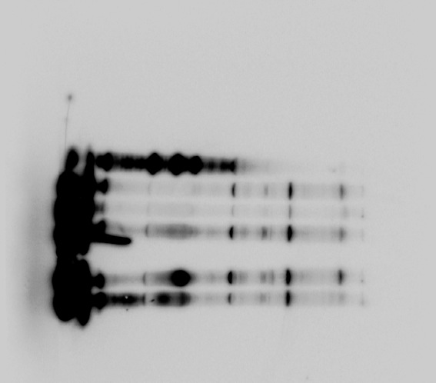
Original blot for Fig. 3A
Myc-Ago2-1
Myc-Ago2-2
Myc-Ago2-3
HM1
30nt
24nt
18nt

Slide 35
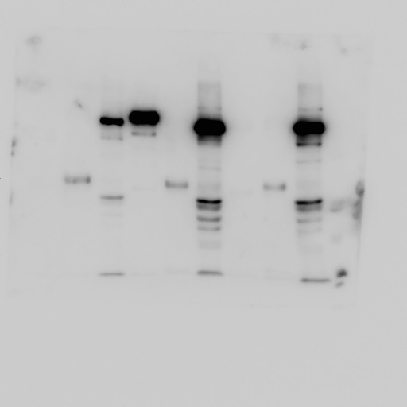
Original blot for Fig. 3B (α-Ago2-2 Western)
EhAgo2-1
EhAgo2-2
EhAgo2-3
Supernatant after IP
Supernatant after IP
Supernatant after IP
α-HA IP control
α-HA IP control
α-HA IP control
α-Myc IP
α-Myc IP
α-Myc IP
100 kDa
α-Ago2-2

Slide 36
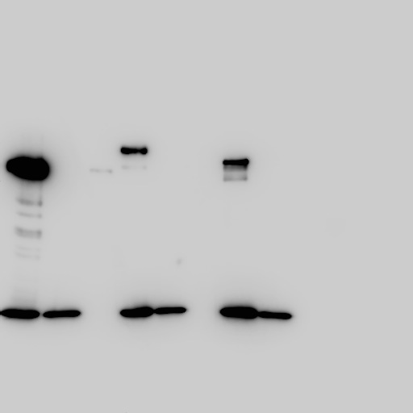
Original blot for Fig. 3B (α-Myc Western)
EhAgo2-1
EhAgo2-2
EhAgo2-3
Supernatant after IP
Supernatant after IP
Supernatant after IP
α-HA IP control
α-HA IP control
α-HA IP control
α-Myc IP
α-Myc IP
α-Myc IP
100 kDa
α-Myc

Slide 37
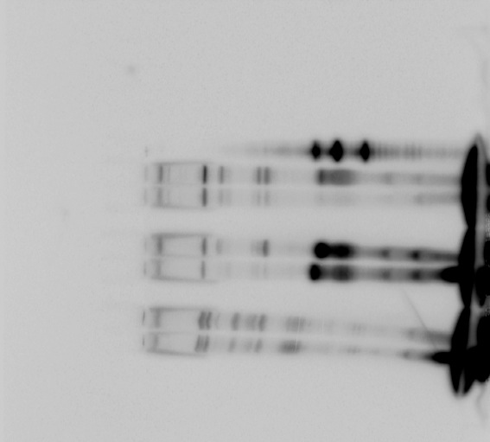
Original blot for Fig. 3C (EhAgo2-1, EhAgo2-3)
IP RNA
WT
Myc-Ago2-1
Myc-Ago2-3
Capping
- +
- +
- +
IP RNA
Myc-Ago2-1
Myc-Ago2-3
Capping
- +
- +
30nt
30nt
24nt
24nt
18nt
18nt

Slide 38
Original blot for Fig. 3C (EhAgo2-2)
Myc-EhAgo2-2
Irrelevant sample lanes
- +
Capping
30nt
24nt
18nt

