Slide 1
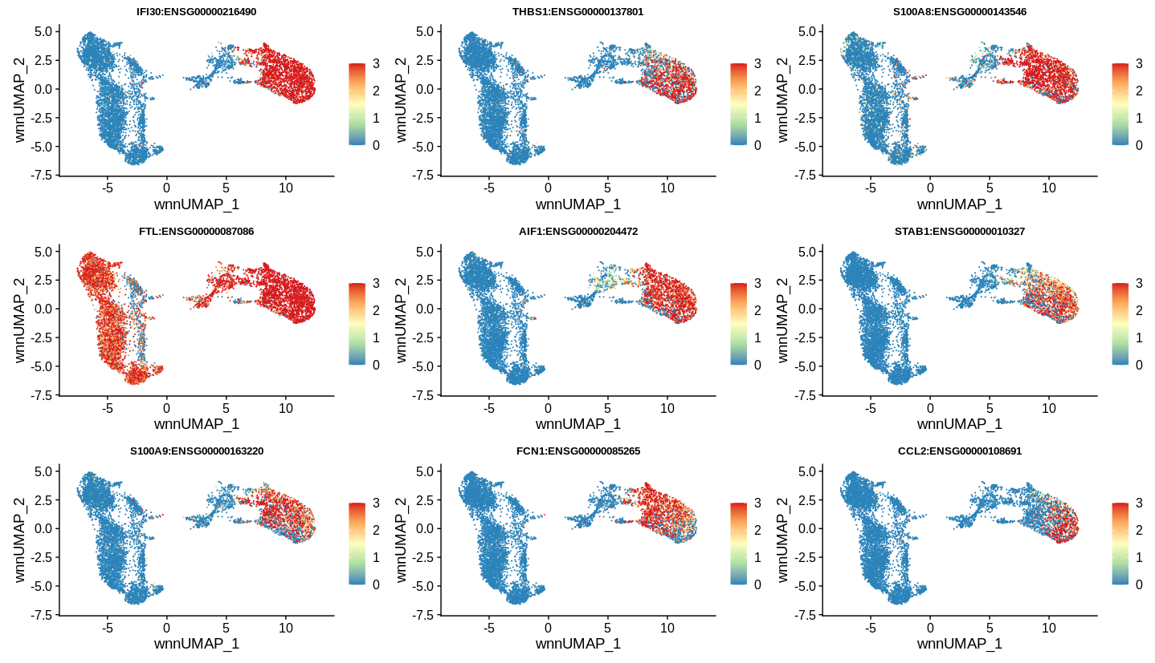
Hallmark gene signature of MDSCs (CD11b+CD33+)
S100A9
THBS1
S100A8
CCL2

Slide 2
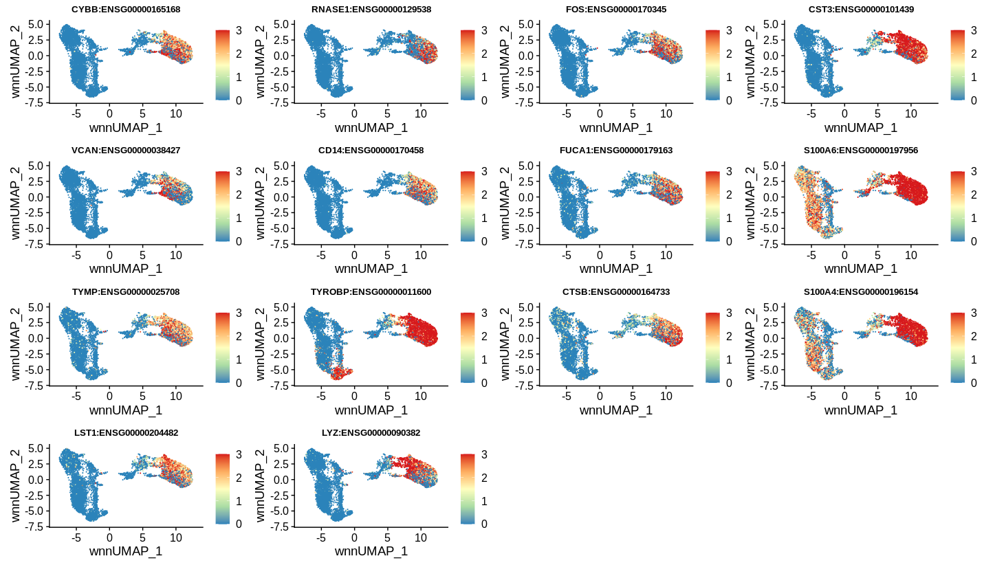
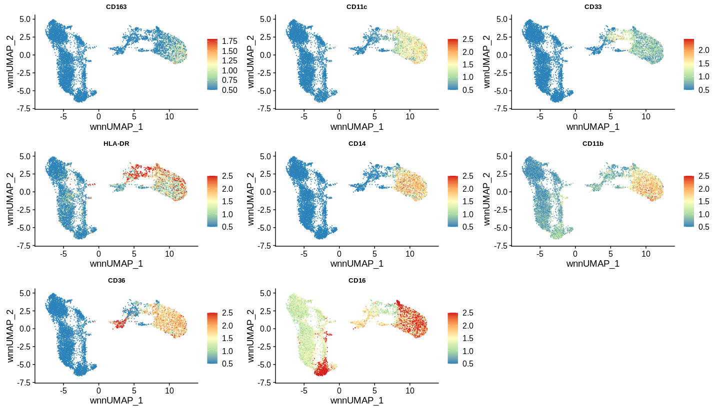
Hallmark gene signature of MDSCs (CD11b+CD33+)
FOS
CST3
S100A6
CD36
S100A4
LYZ
CD16

