Slide 1
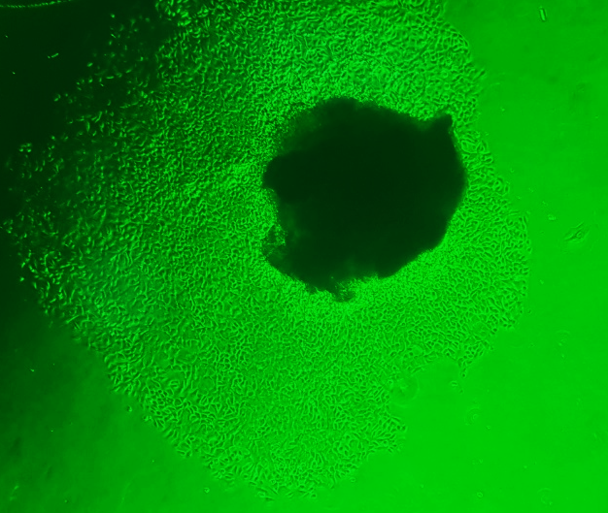
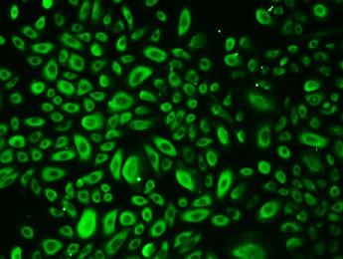
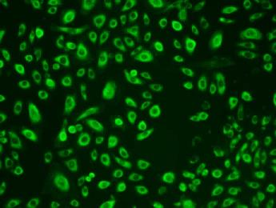
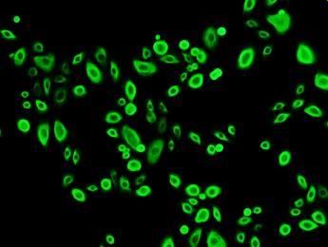
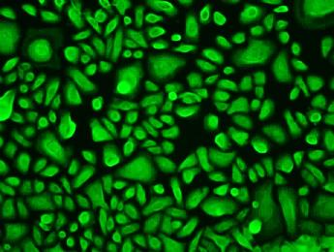
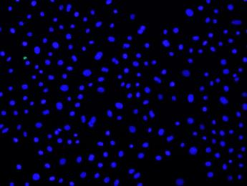
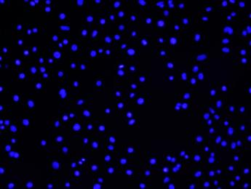
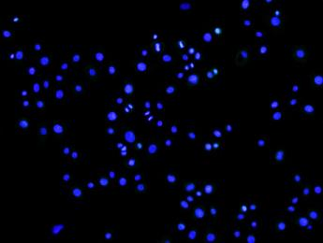
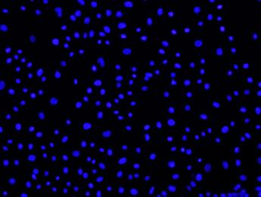
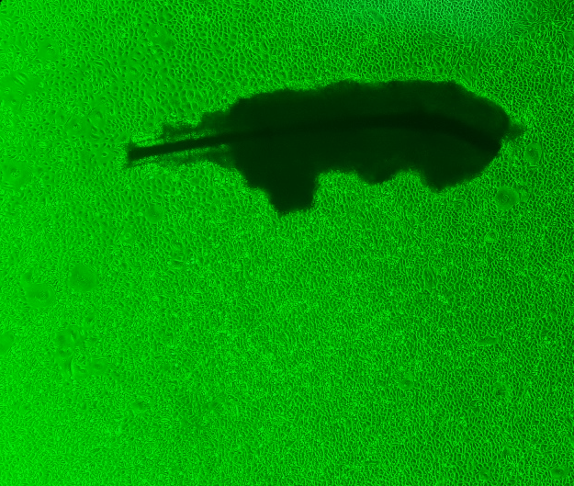
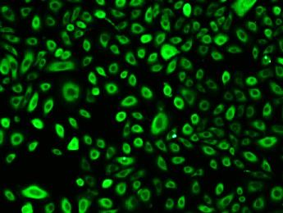
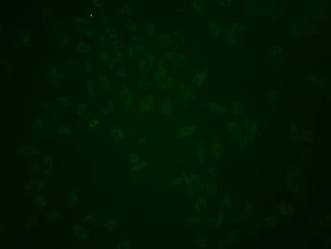
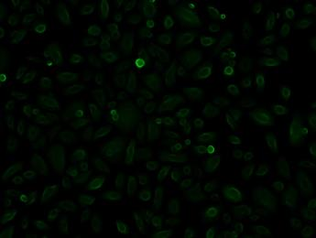
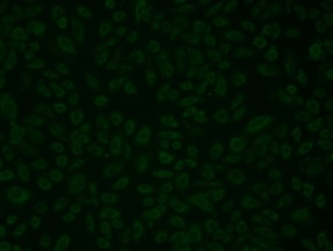
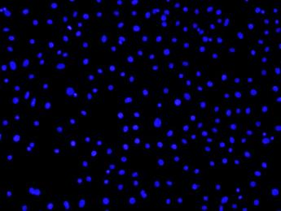
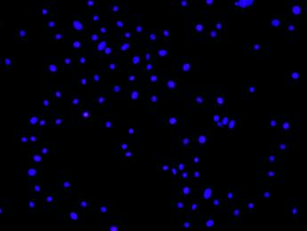
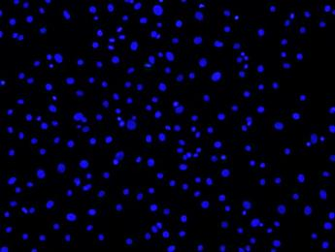
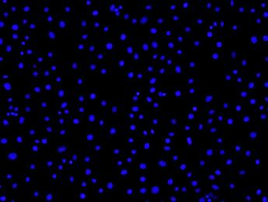
Supplement Fig 1.
A
CK 1-3
CK 15
CK 17
CK 19
Sebocyte
B
CK 1-3
CK 15
CK 17
CK 19
ORS cell

Slide 2
Supplement Fig 2.
Sebocyte
ORS cell
*
*
*
*
Cell proliferation (% of control)
*
100
500
0.1% DMSO
250
(μg/ml)
Control
50

Slide 3
Supplement Fig 3.
A
B
*
*
Sebocyte
*
Sebocyte
ORS cell
ORS cell
*
IL-1β concentration (pg/ml)
IL-6 concentration (pg/ml)
RG
RG
Control
0.1% DMSO
0.1% DMSO
LPS
Control
LPS
24h
24h
C
D
Sebocyte
*
Sebocyte
*
ORS cell
*
ORS cell
TNFα concentration (pg/ml)
IL-8 concentration (pg/ml)
*
RG
RG
0.1% DMSO
Control
0.1% DMSO
Control
LPS
LPS
24h
24h

Slide 4
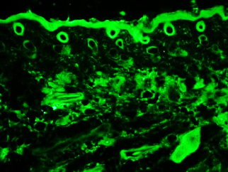
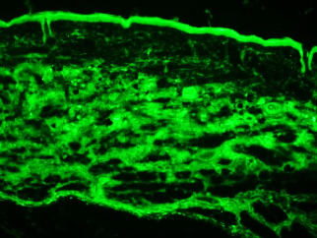
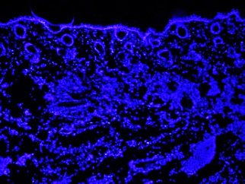
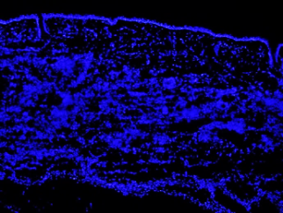
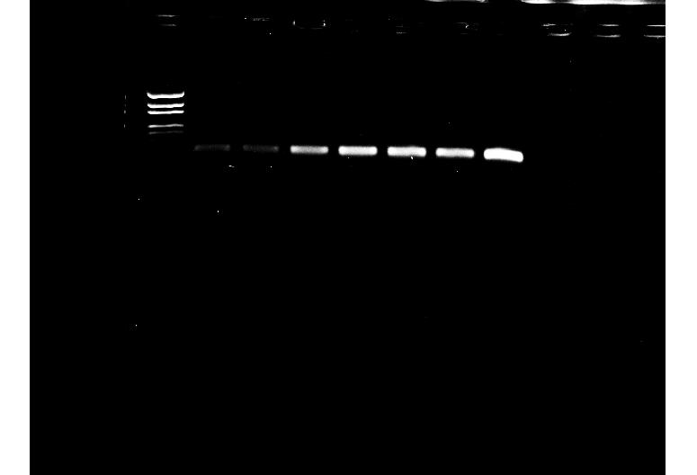
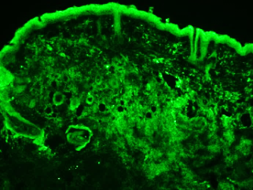
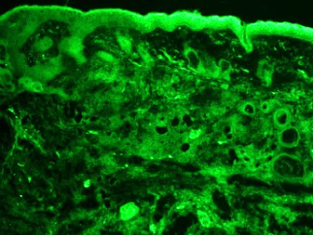
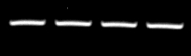
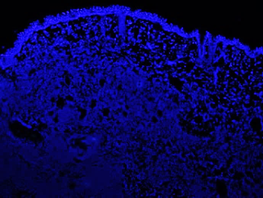
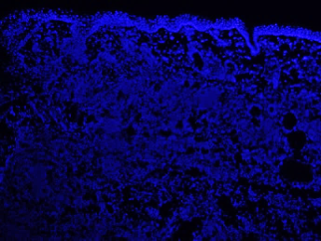
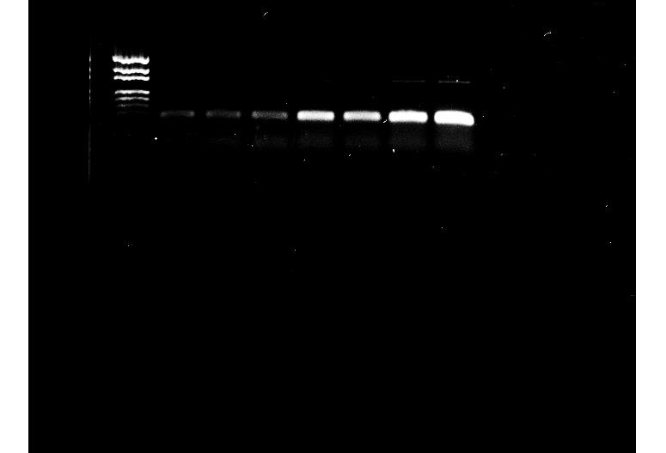
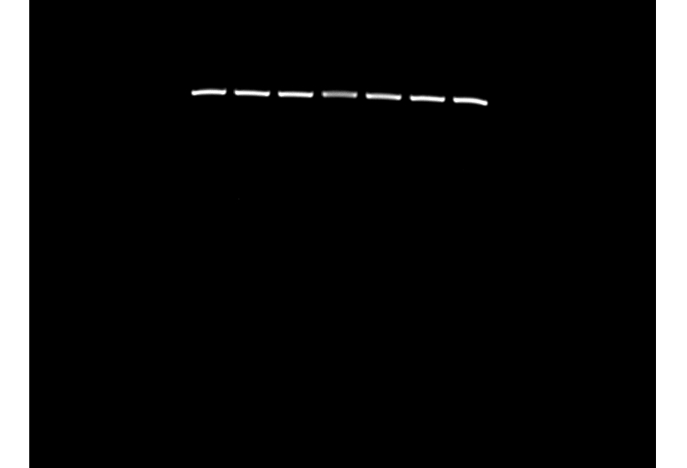
Supplement Fig 4.
A
p. acne
p.acne+ RG
TLR2
control
0.1% DMSO
LPS +RG
B
C
LPS
LL37
C. acne
C.acne + RG
Sebocyte
β-actin
LL37
LL37
ORS cell
β-actin

