Slide 1
Supplementary Material 1- Western blotting
Effect of apigetrin in pseudo-SARS-CoV-2-induced inflammatory and pulmonary fibrosis in vitro model
Hengmin Han^{1+,} Jung-Eun Kim², and Hyo-Jeong Lee ^{1,2, *}

Slide 2
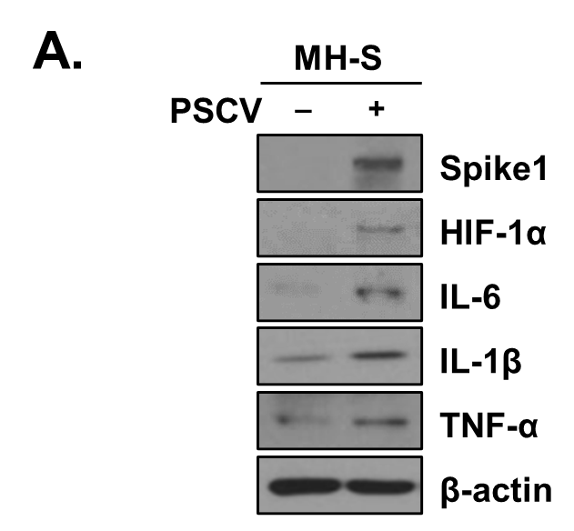
Figure 1. (A)

Slide 3
Figure 1. (A)

Slide 4
Figure 1. (A)

Slide 5
Figure 1. (A)

Slide 6
Figure 1. (A)

Slide 7
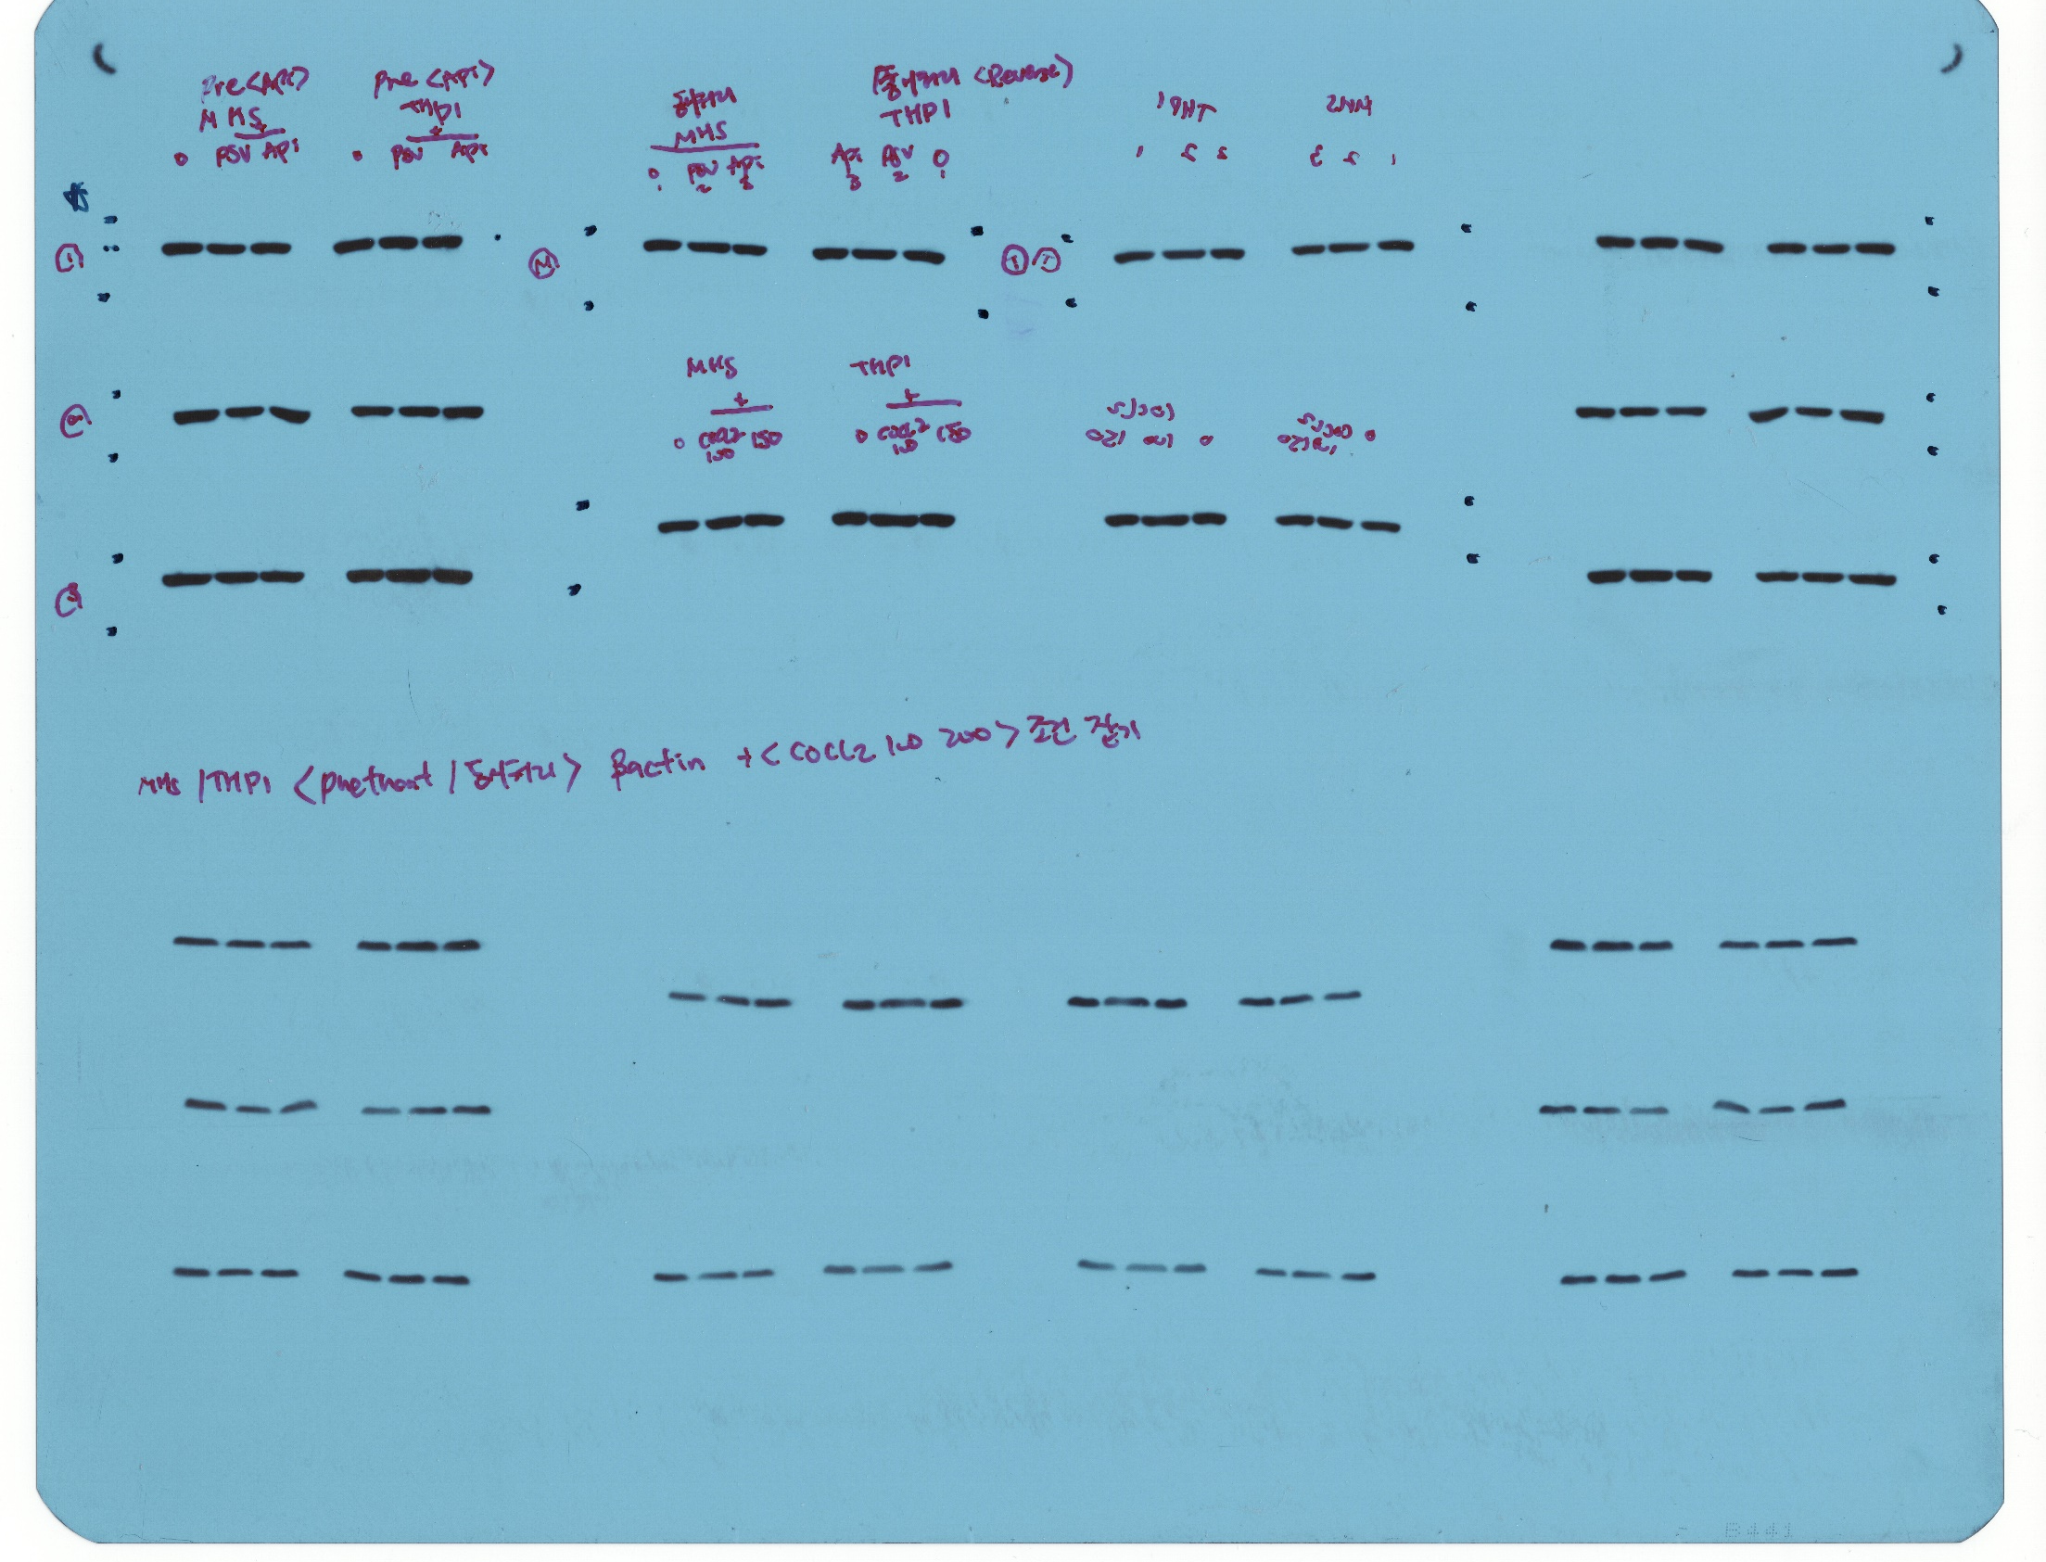
Figure 1. (A)

Slide 8
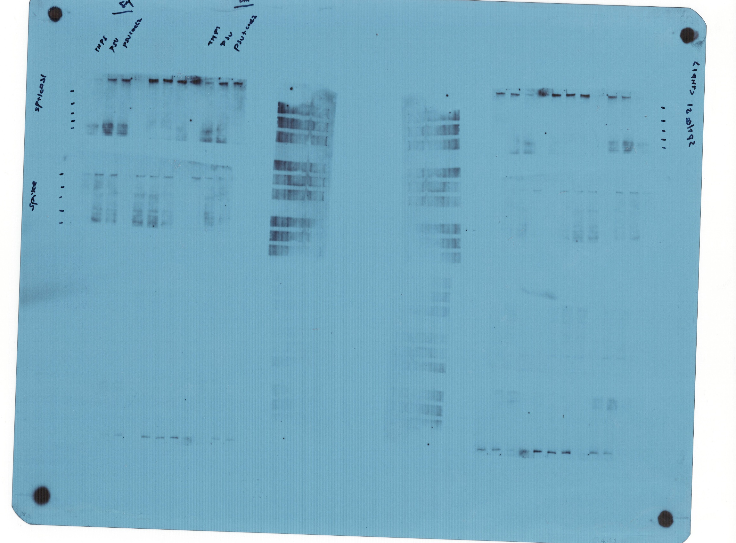
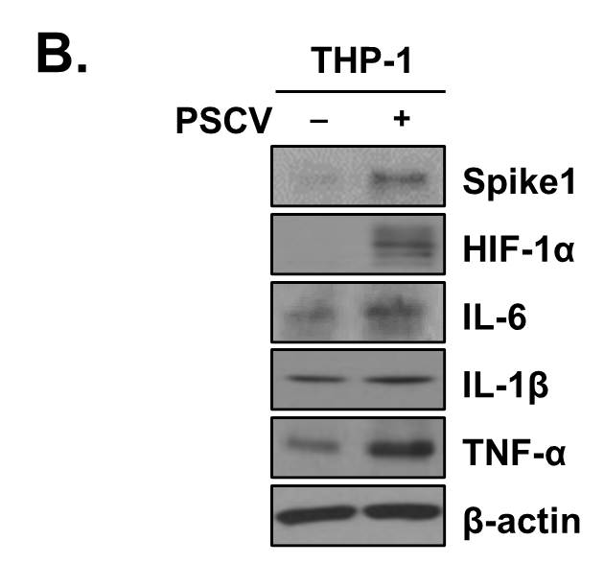
Figure 1. (B)

Slide 9
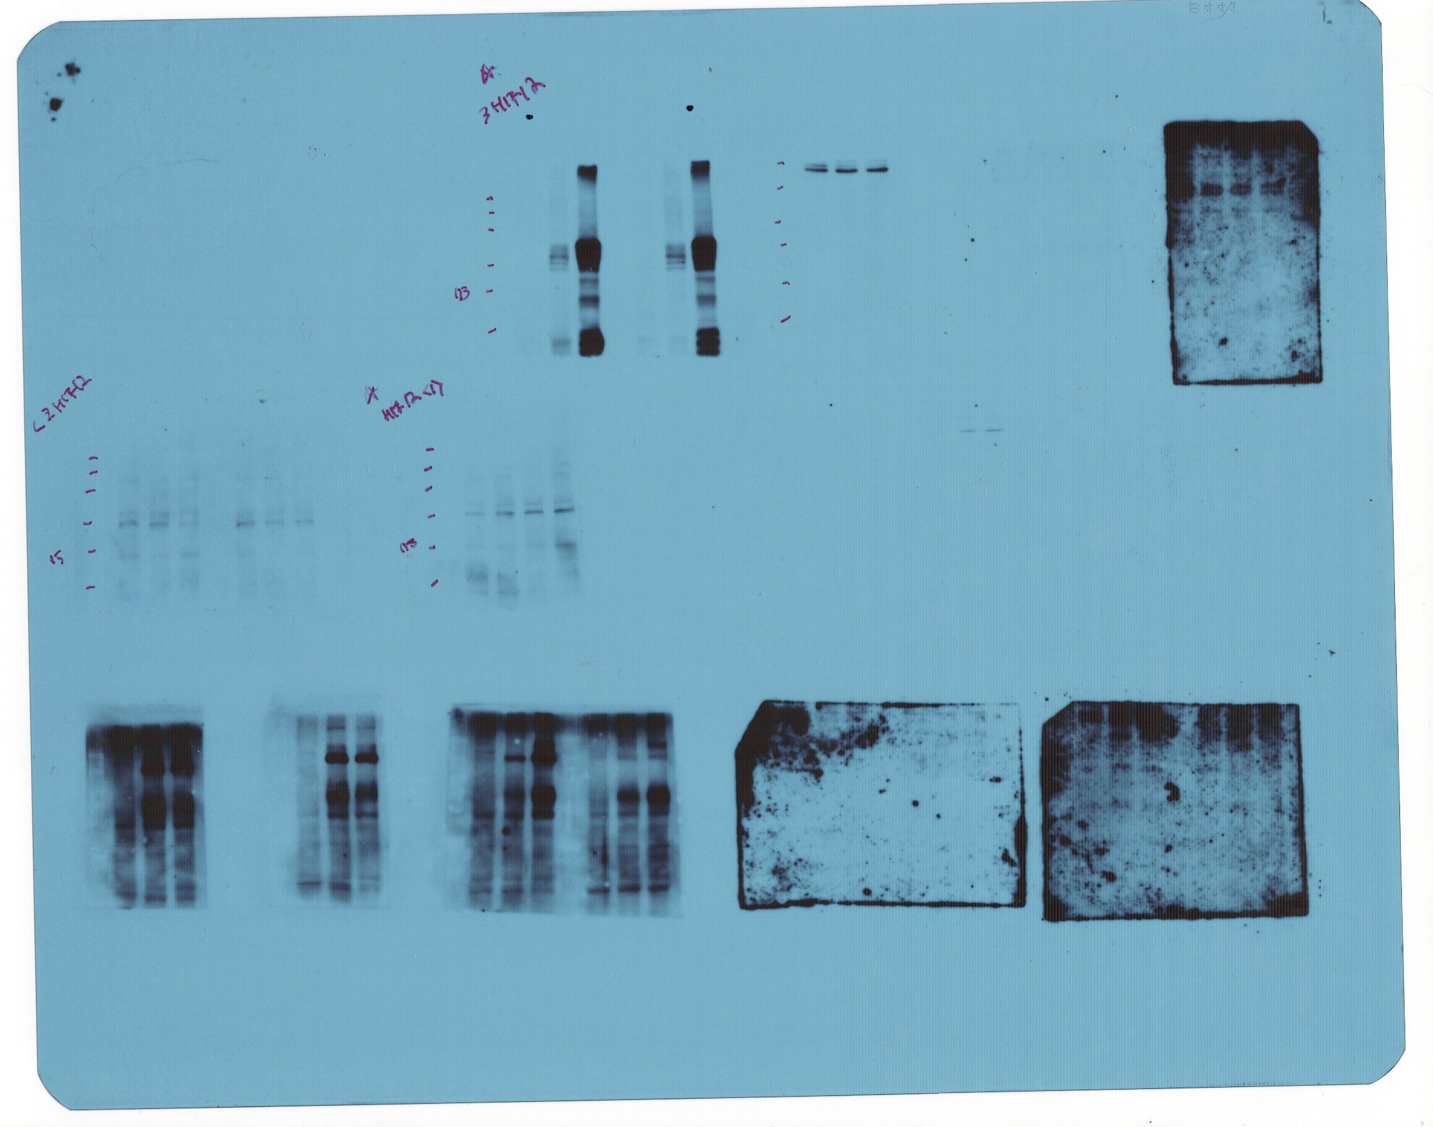
Figure 1. (B)

Slide 10
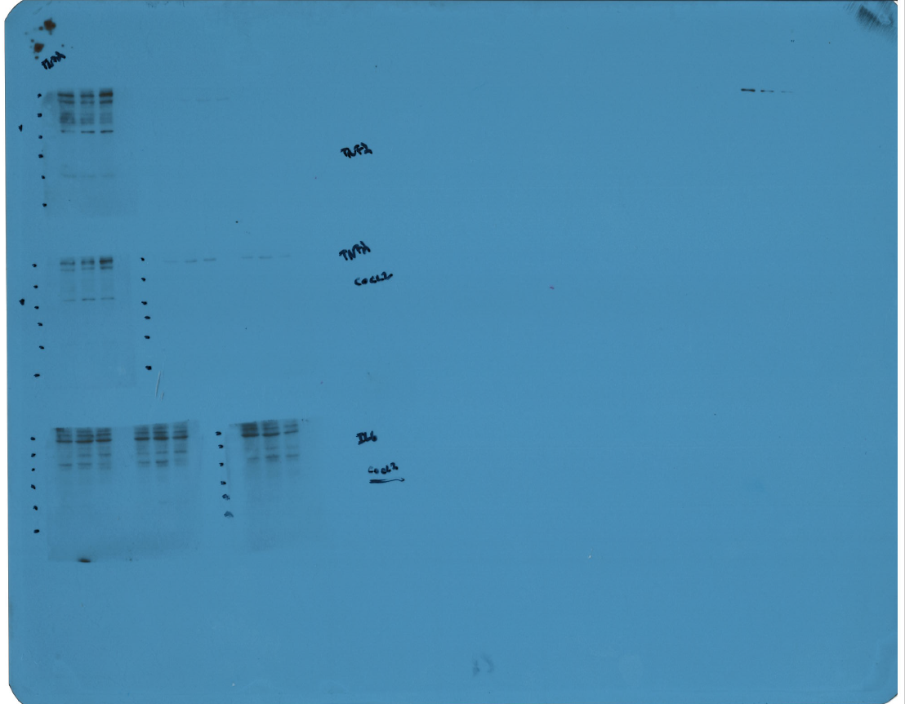
Figure 1. (B)

Slide 11
Figure 1. (B)

Slide 12
Figure 1. (B)

Slide 13
Figure 1. (B)

Slide 14
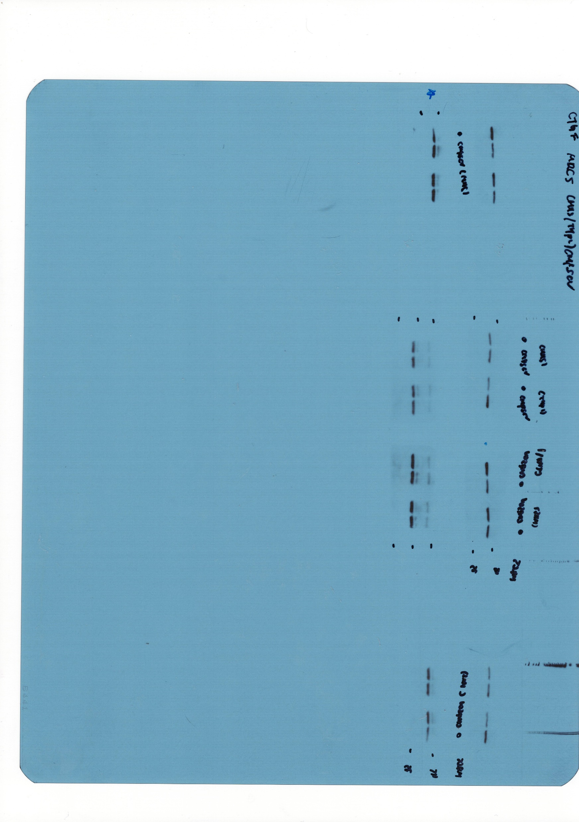
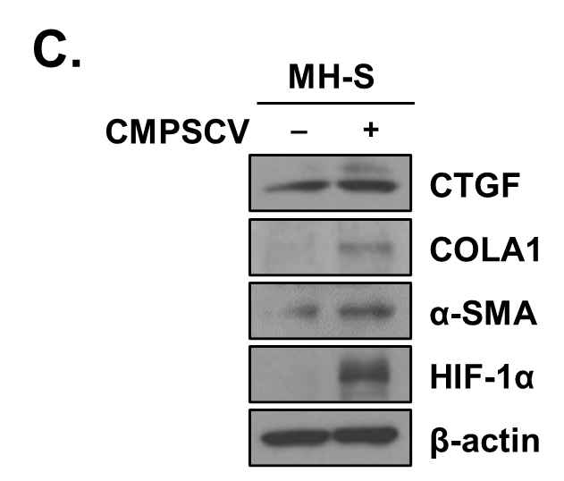
Figure 1. (C)

Slide 15
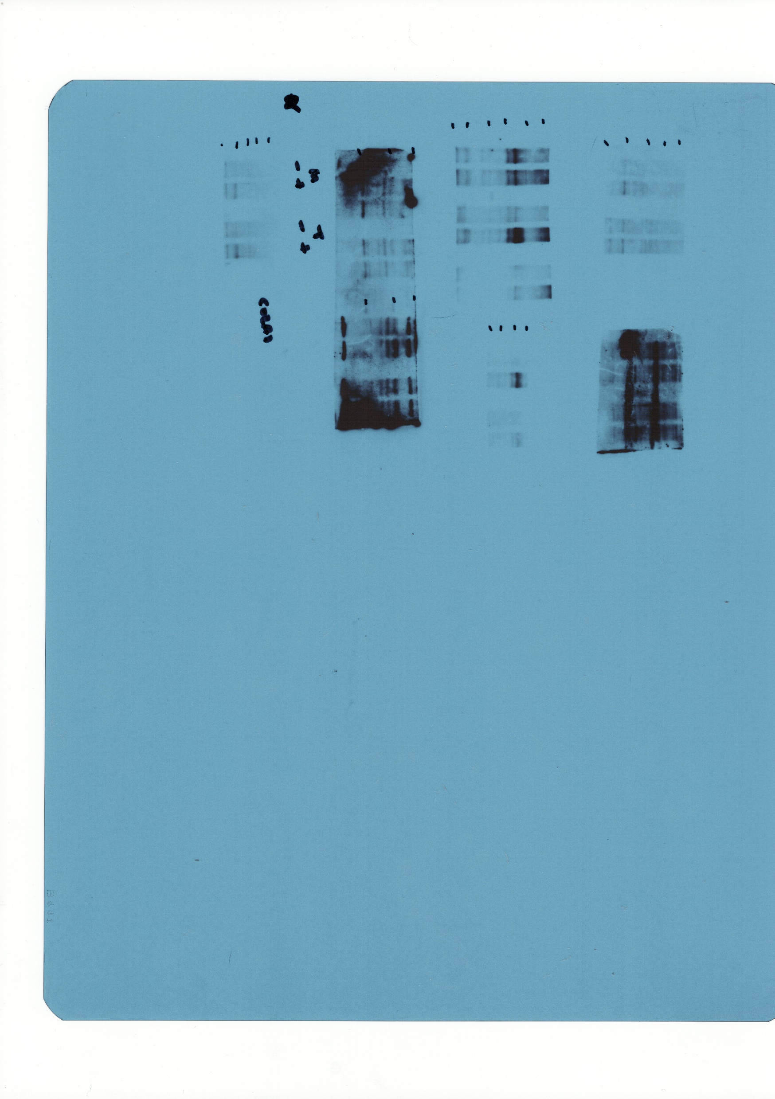
Figure 1. (C)

Slide 16
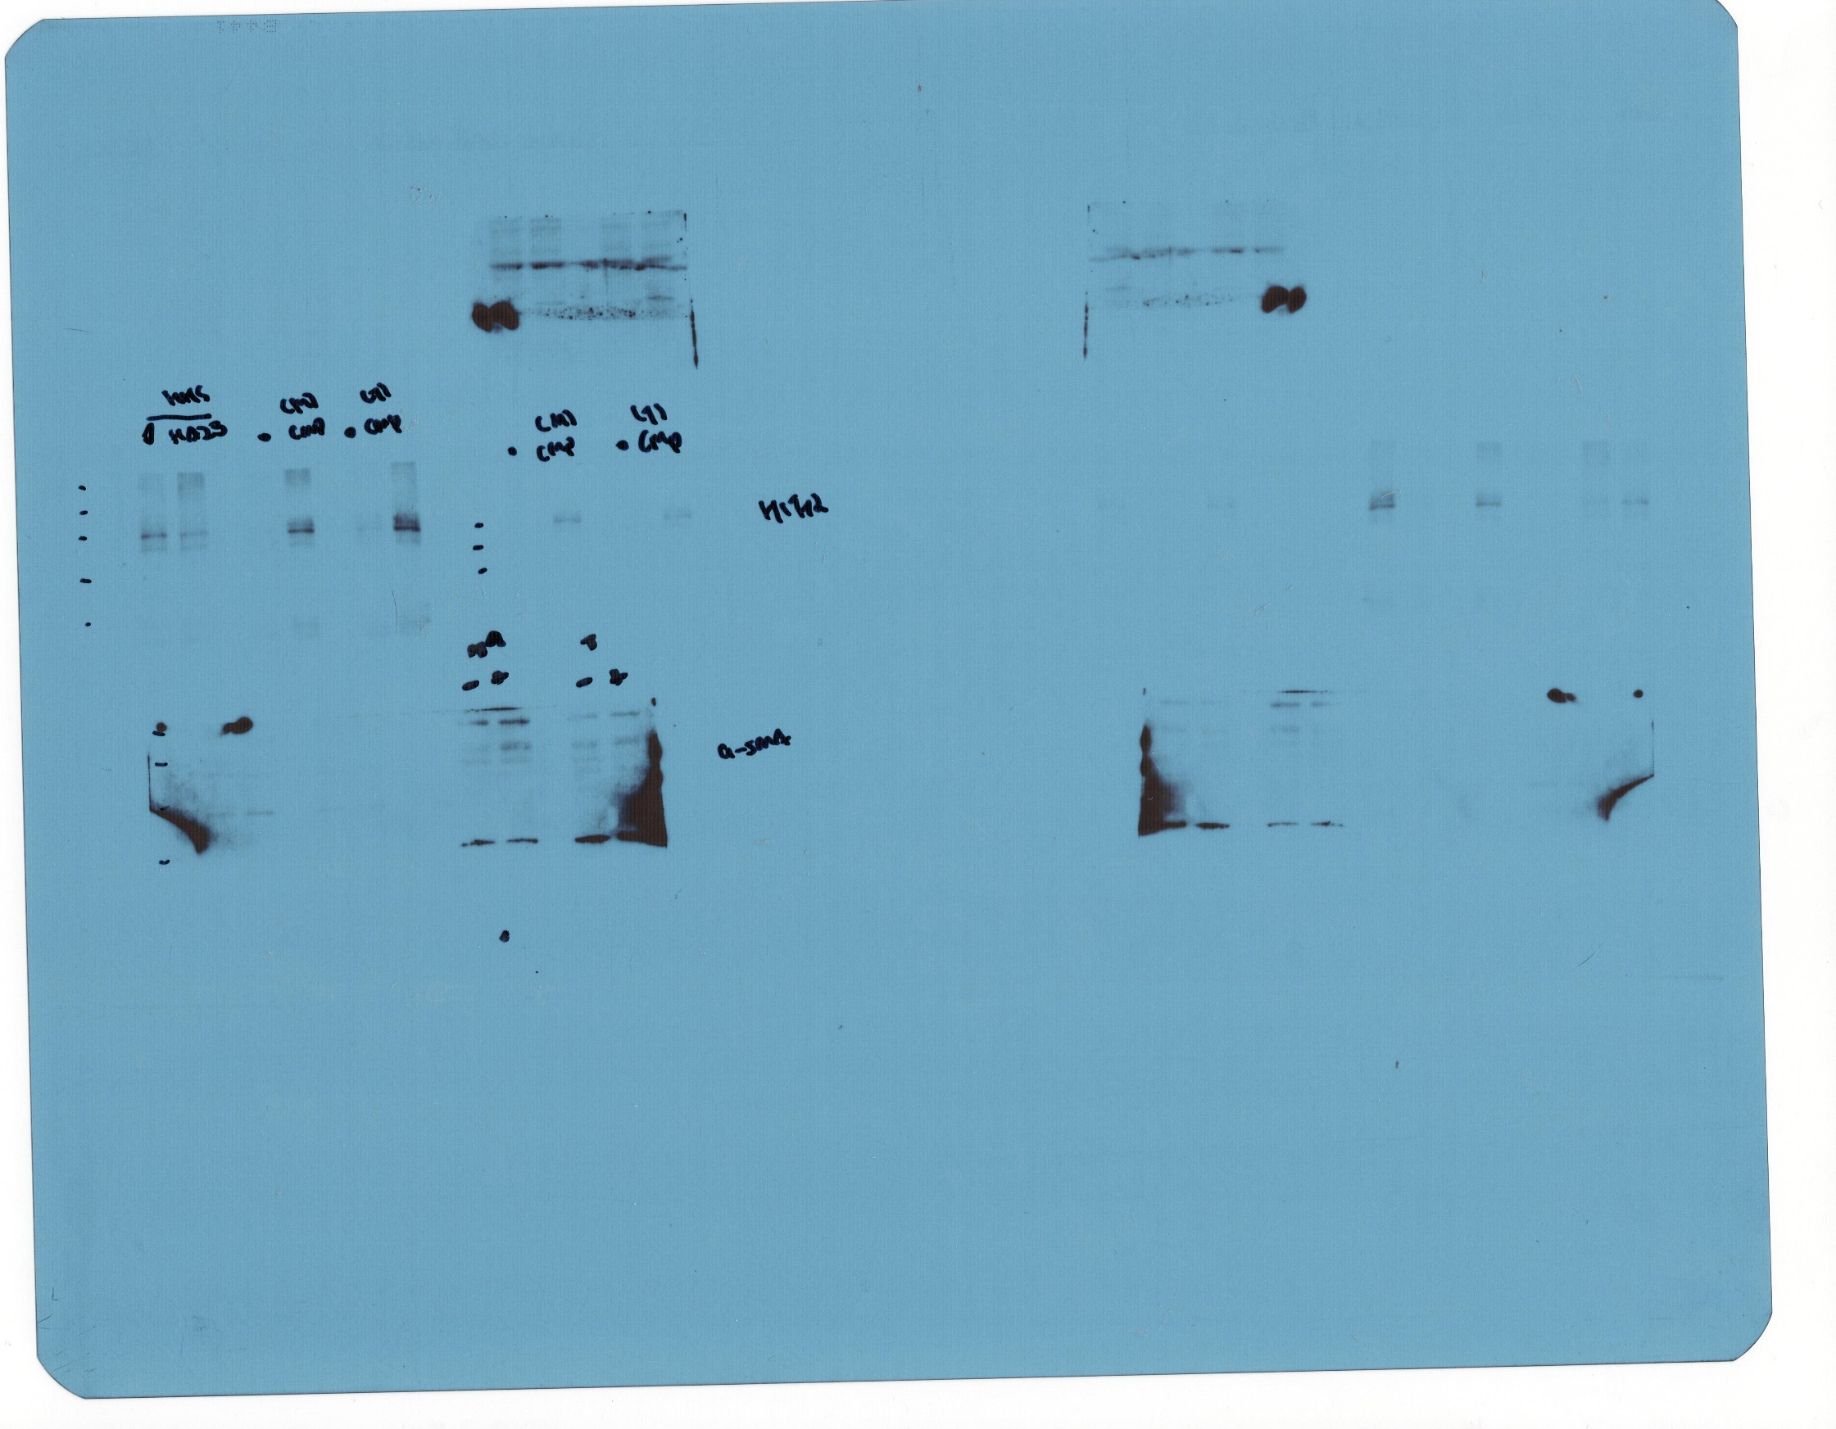
Figure 1. (C)

Slide 17
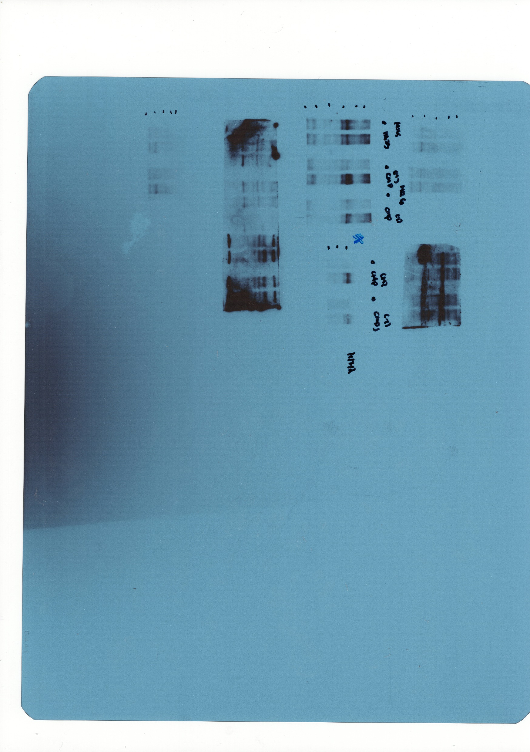
Figure 1. (C)

Slide 18
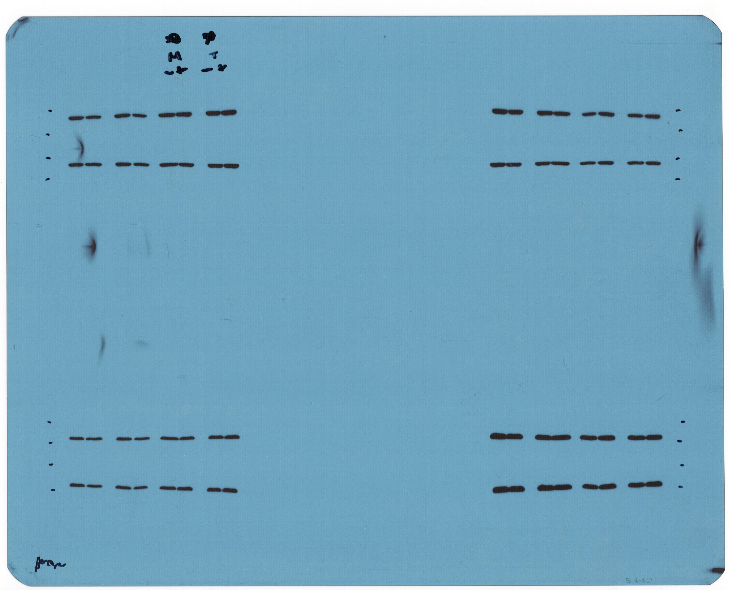
Figure 1. (C)

Slide 19
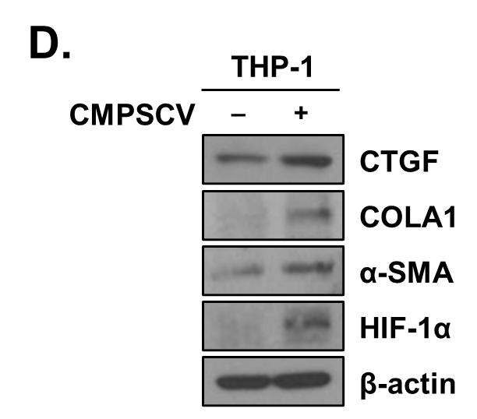
Figure 1. (D)

Slide 20
Figure 1. (D)

Slide 21
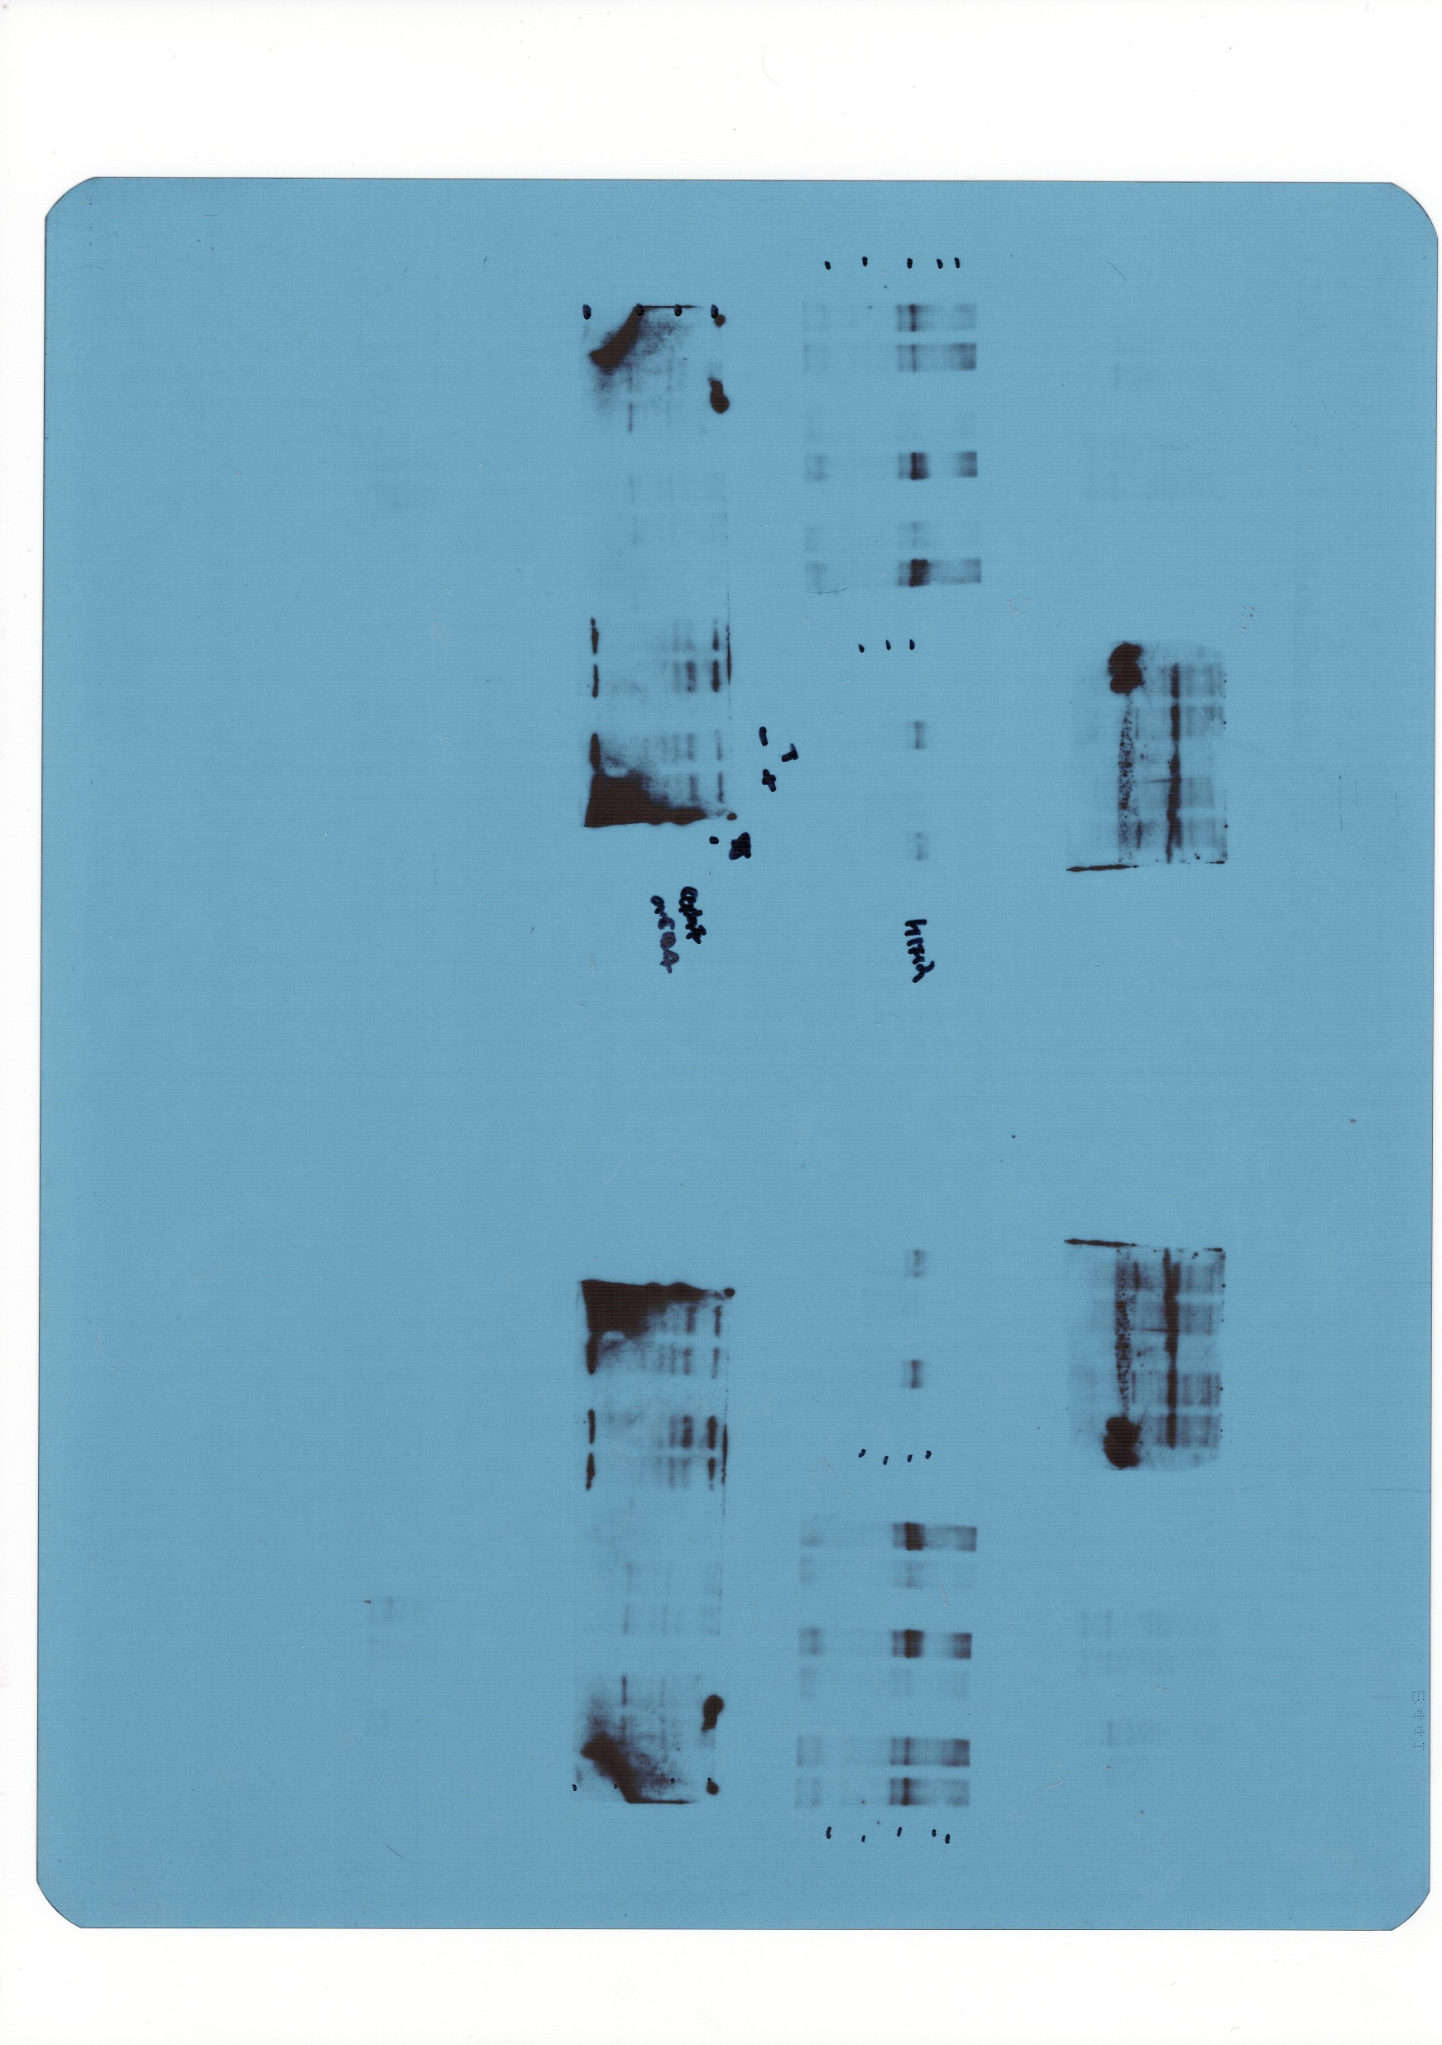
Figure 1. (D)

Slide 22
Figure 1. (D)

Slide 23
Figure 1. (D)

Slide 24
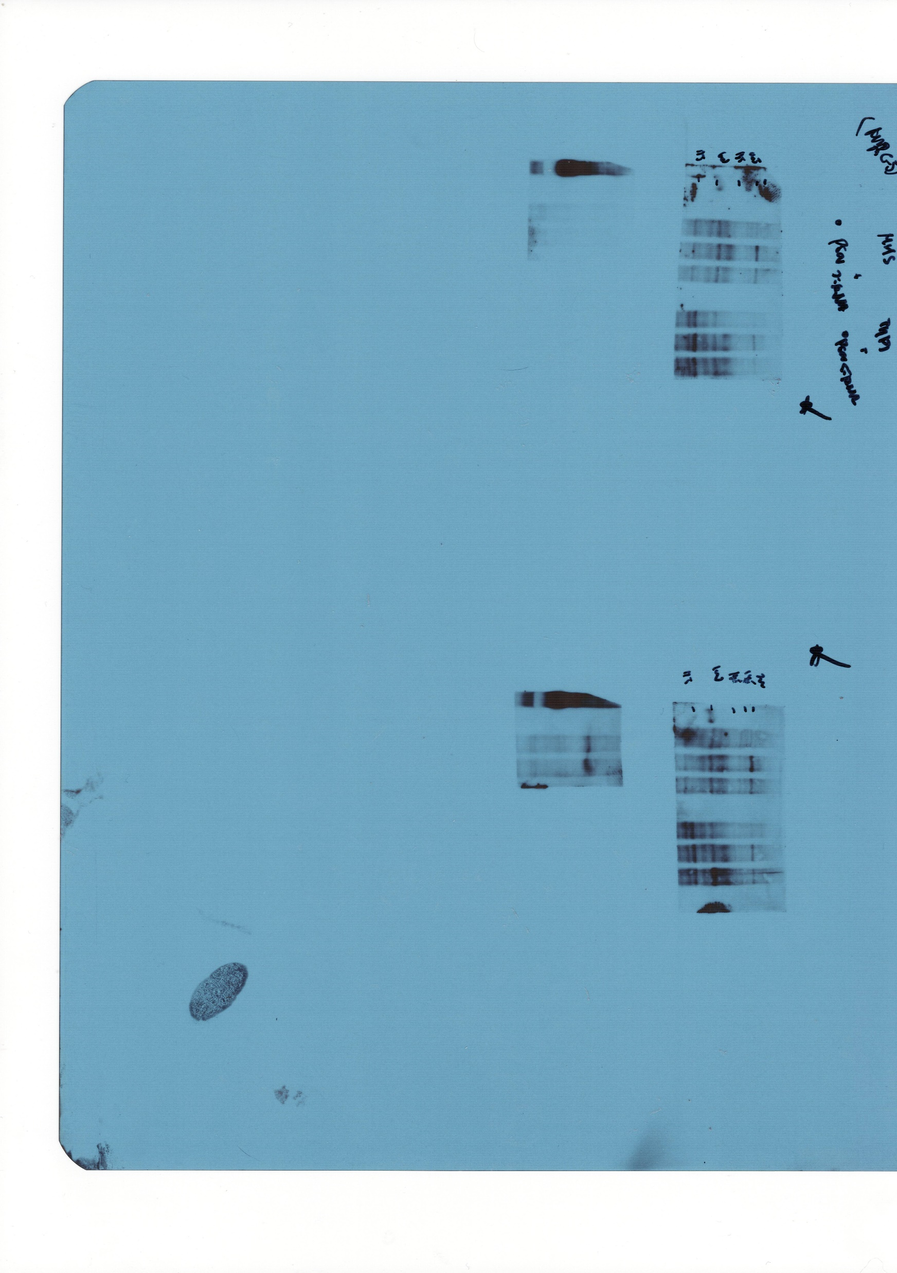
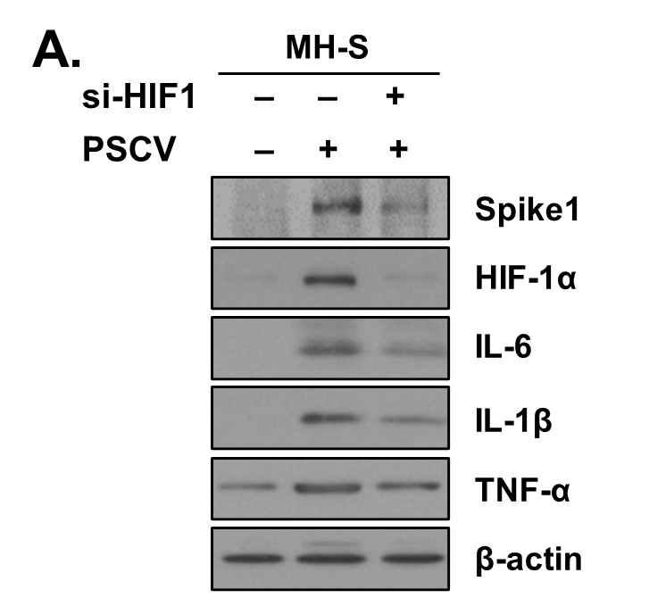
Figure 2. (A)

Slide 25

Figure 2. (A)

Slide 26
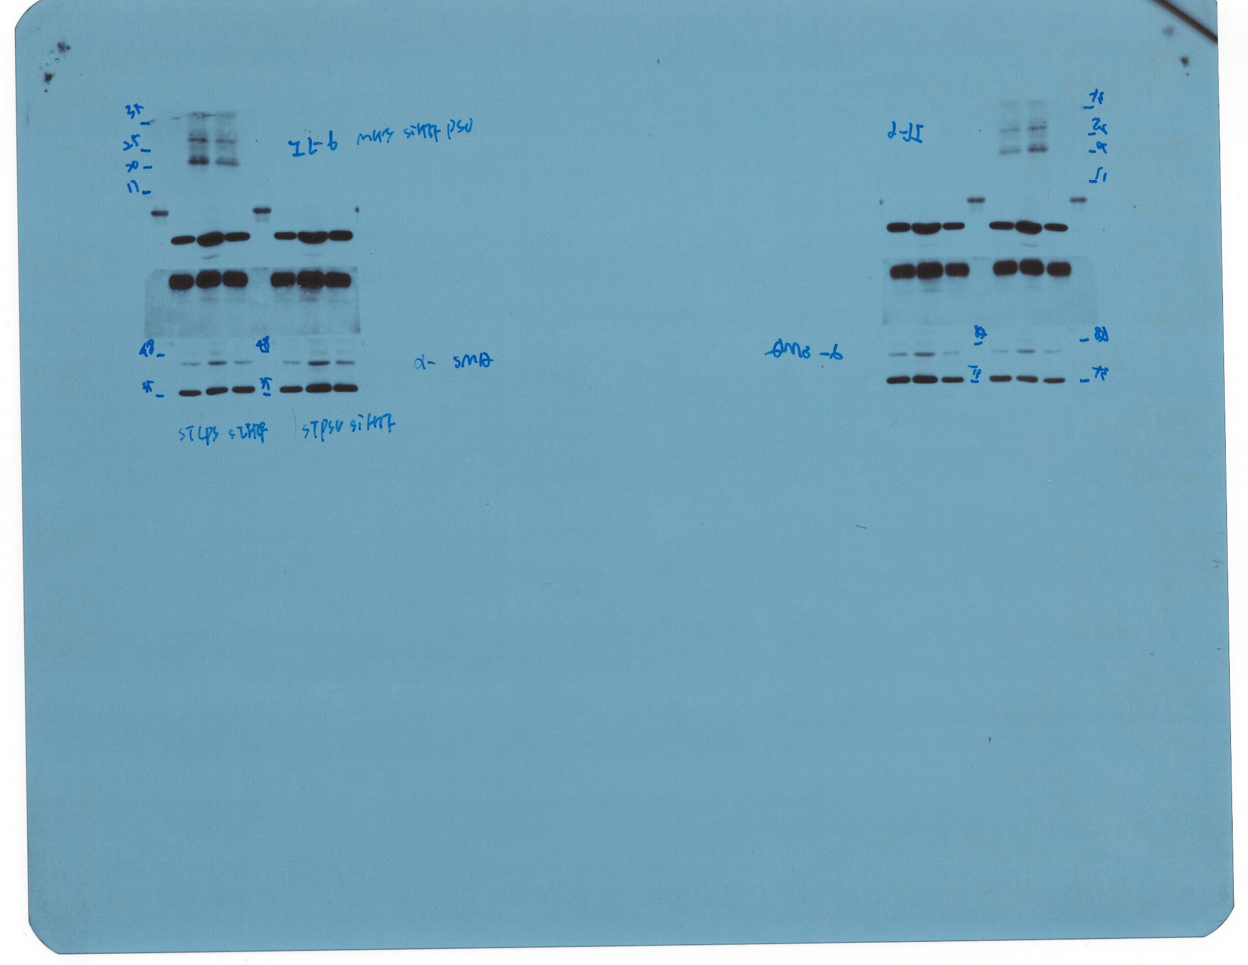
Figure 2. (A)

Slide 27
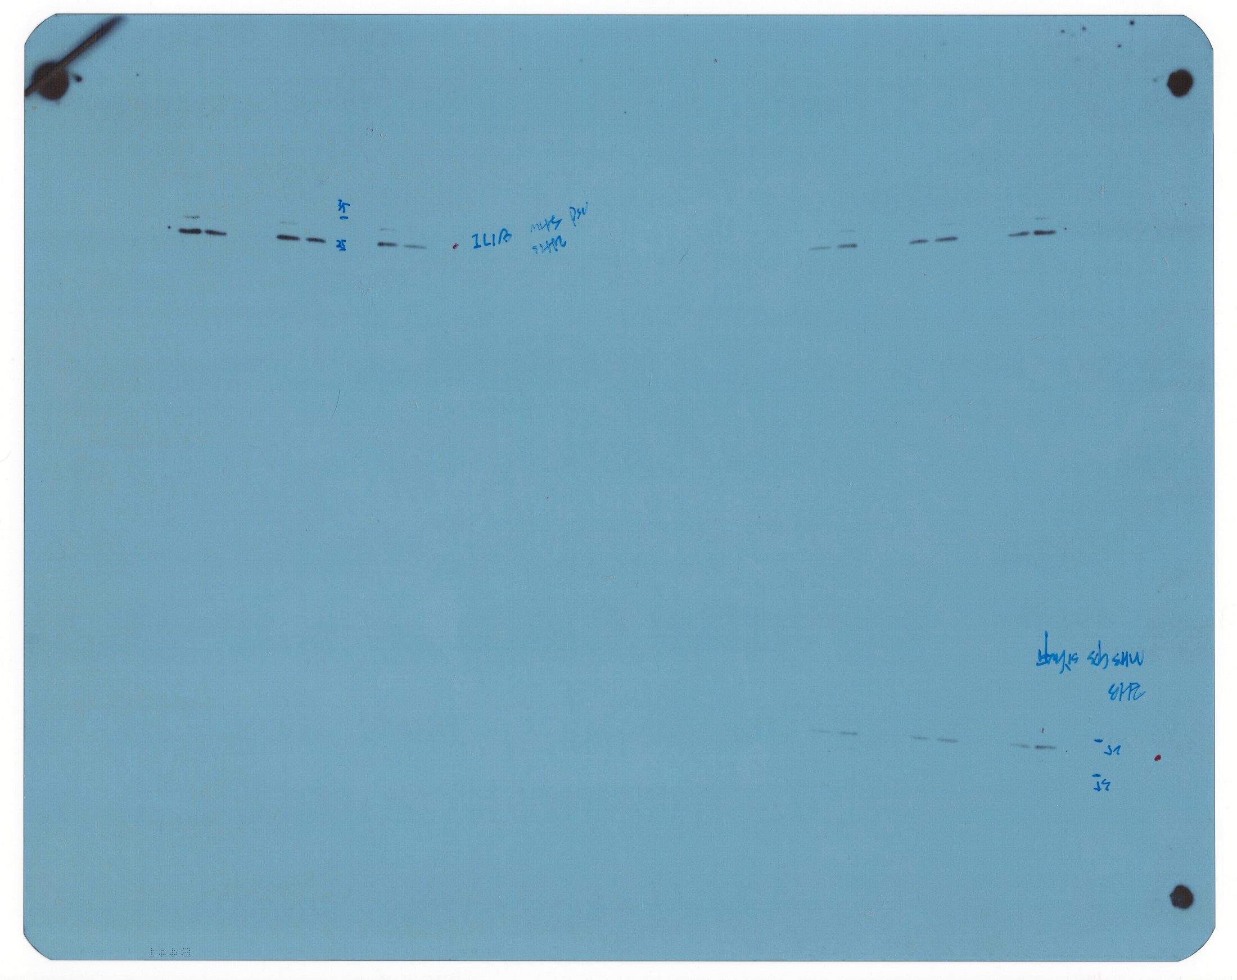
Figure 2. (A)

Slide 28
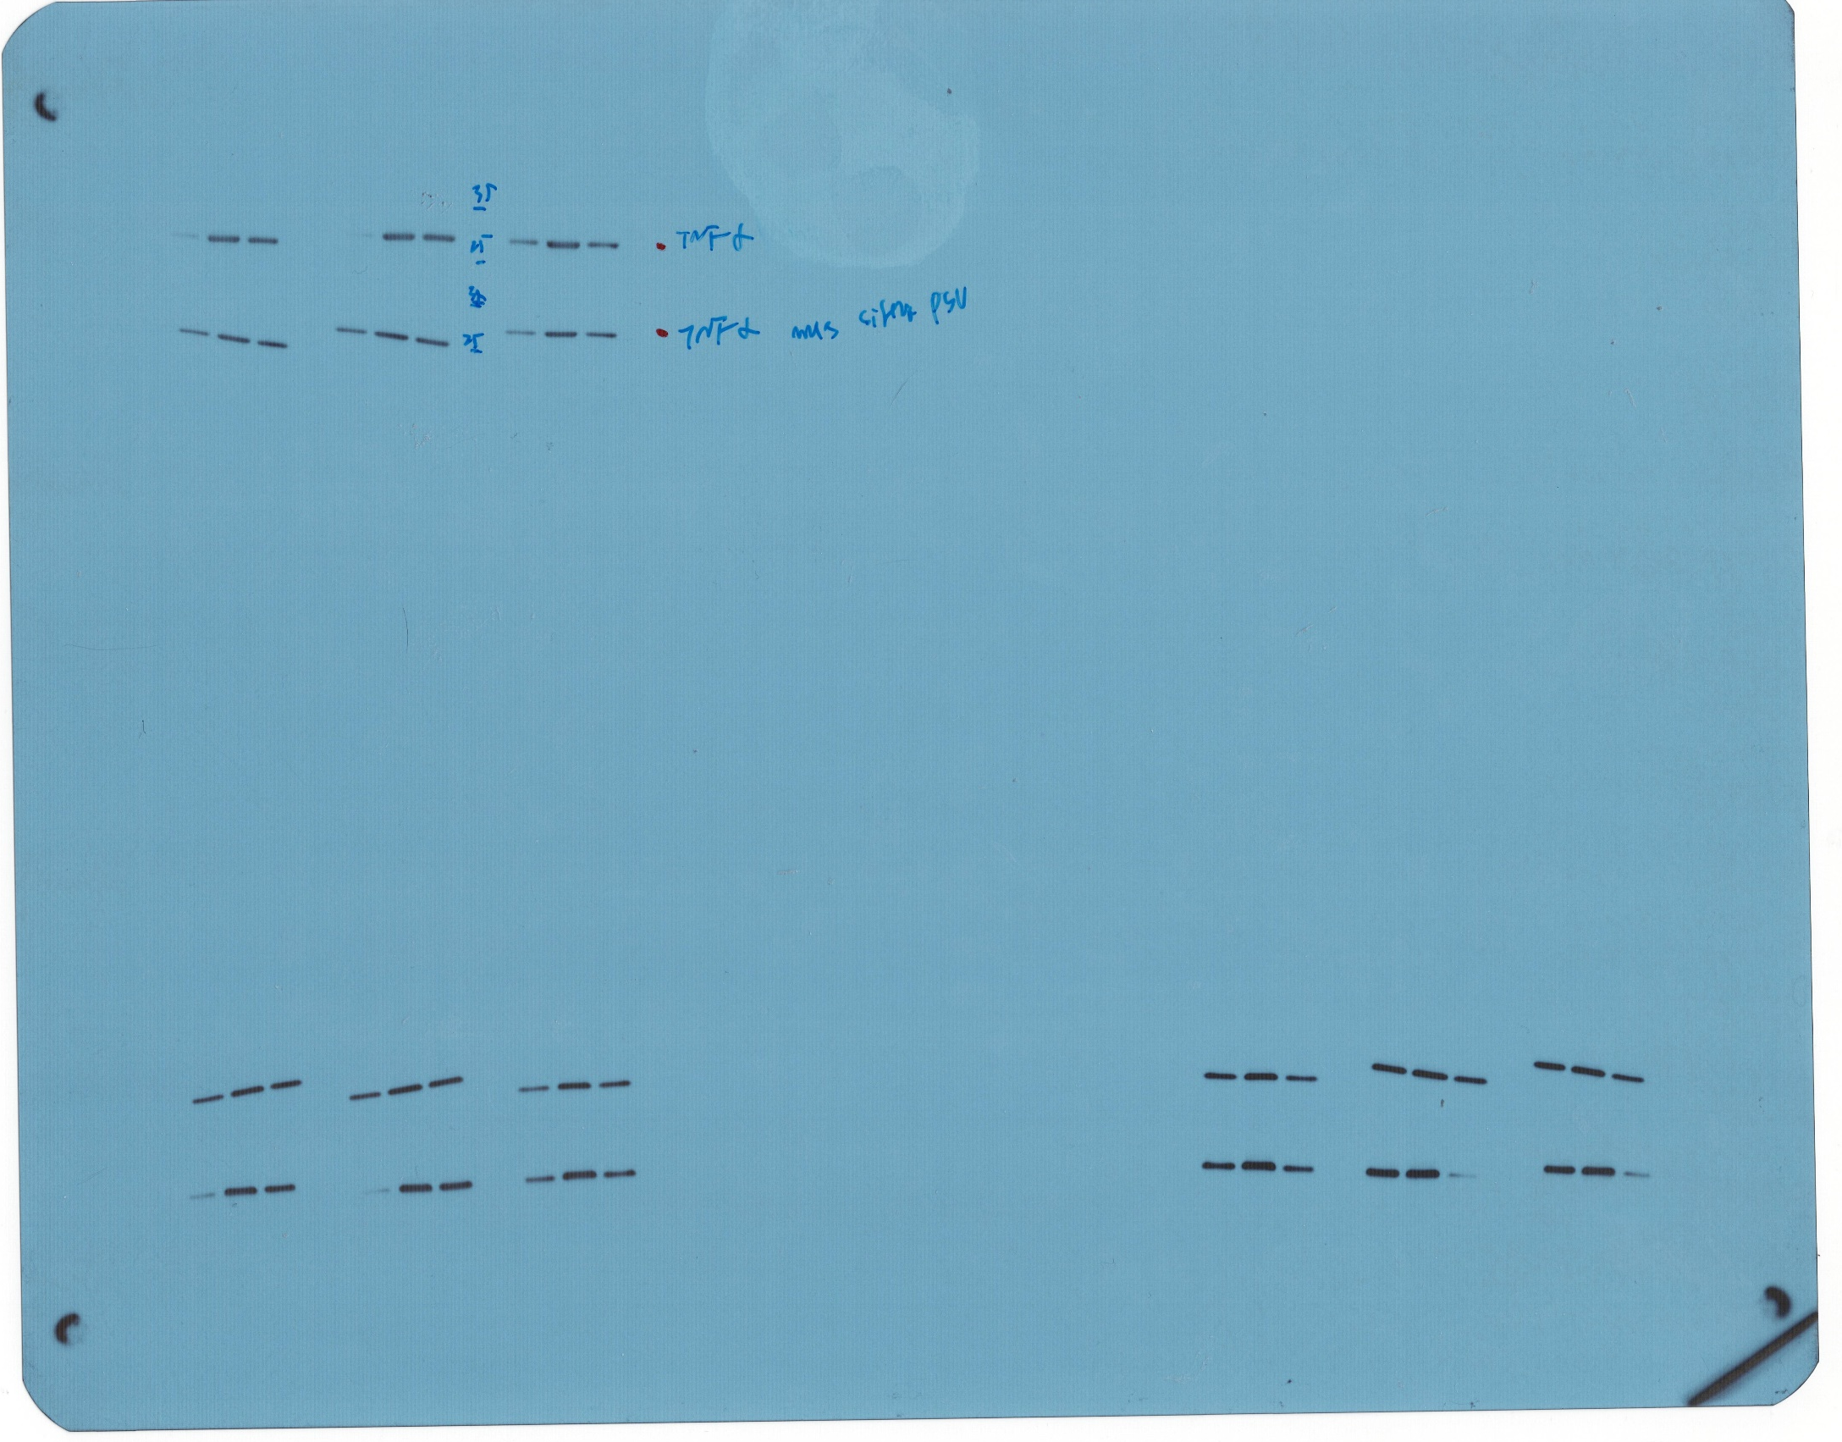
Figure 2. (A)

Slide 29
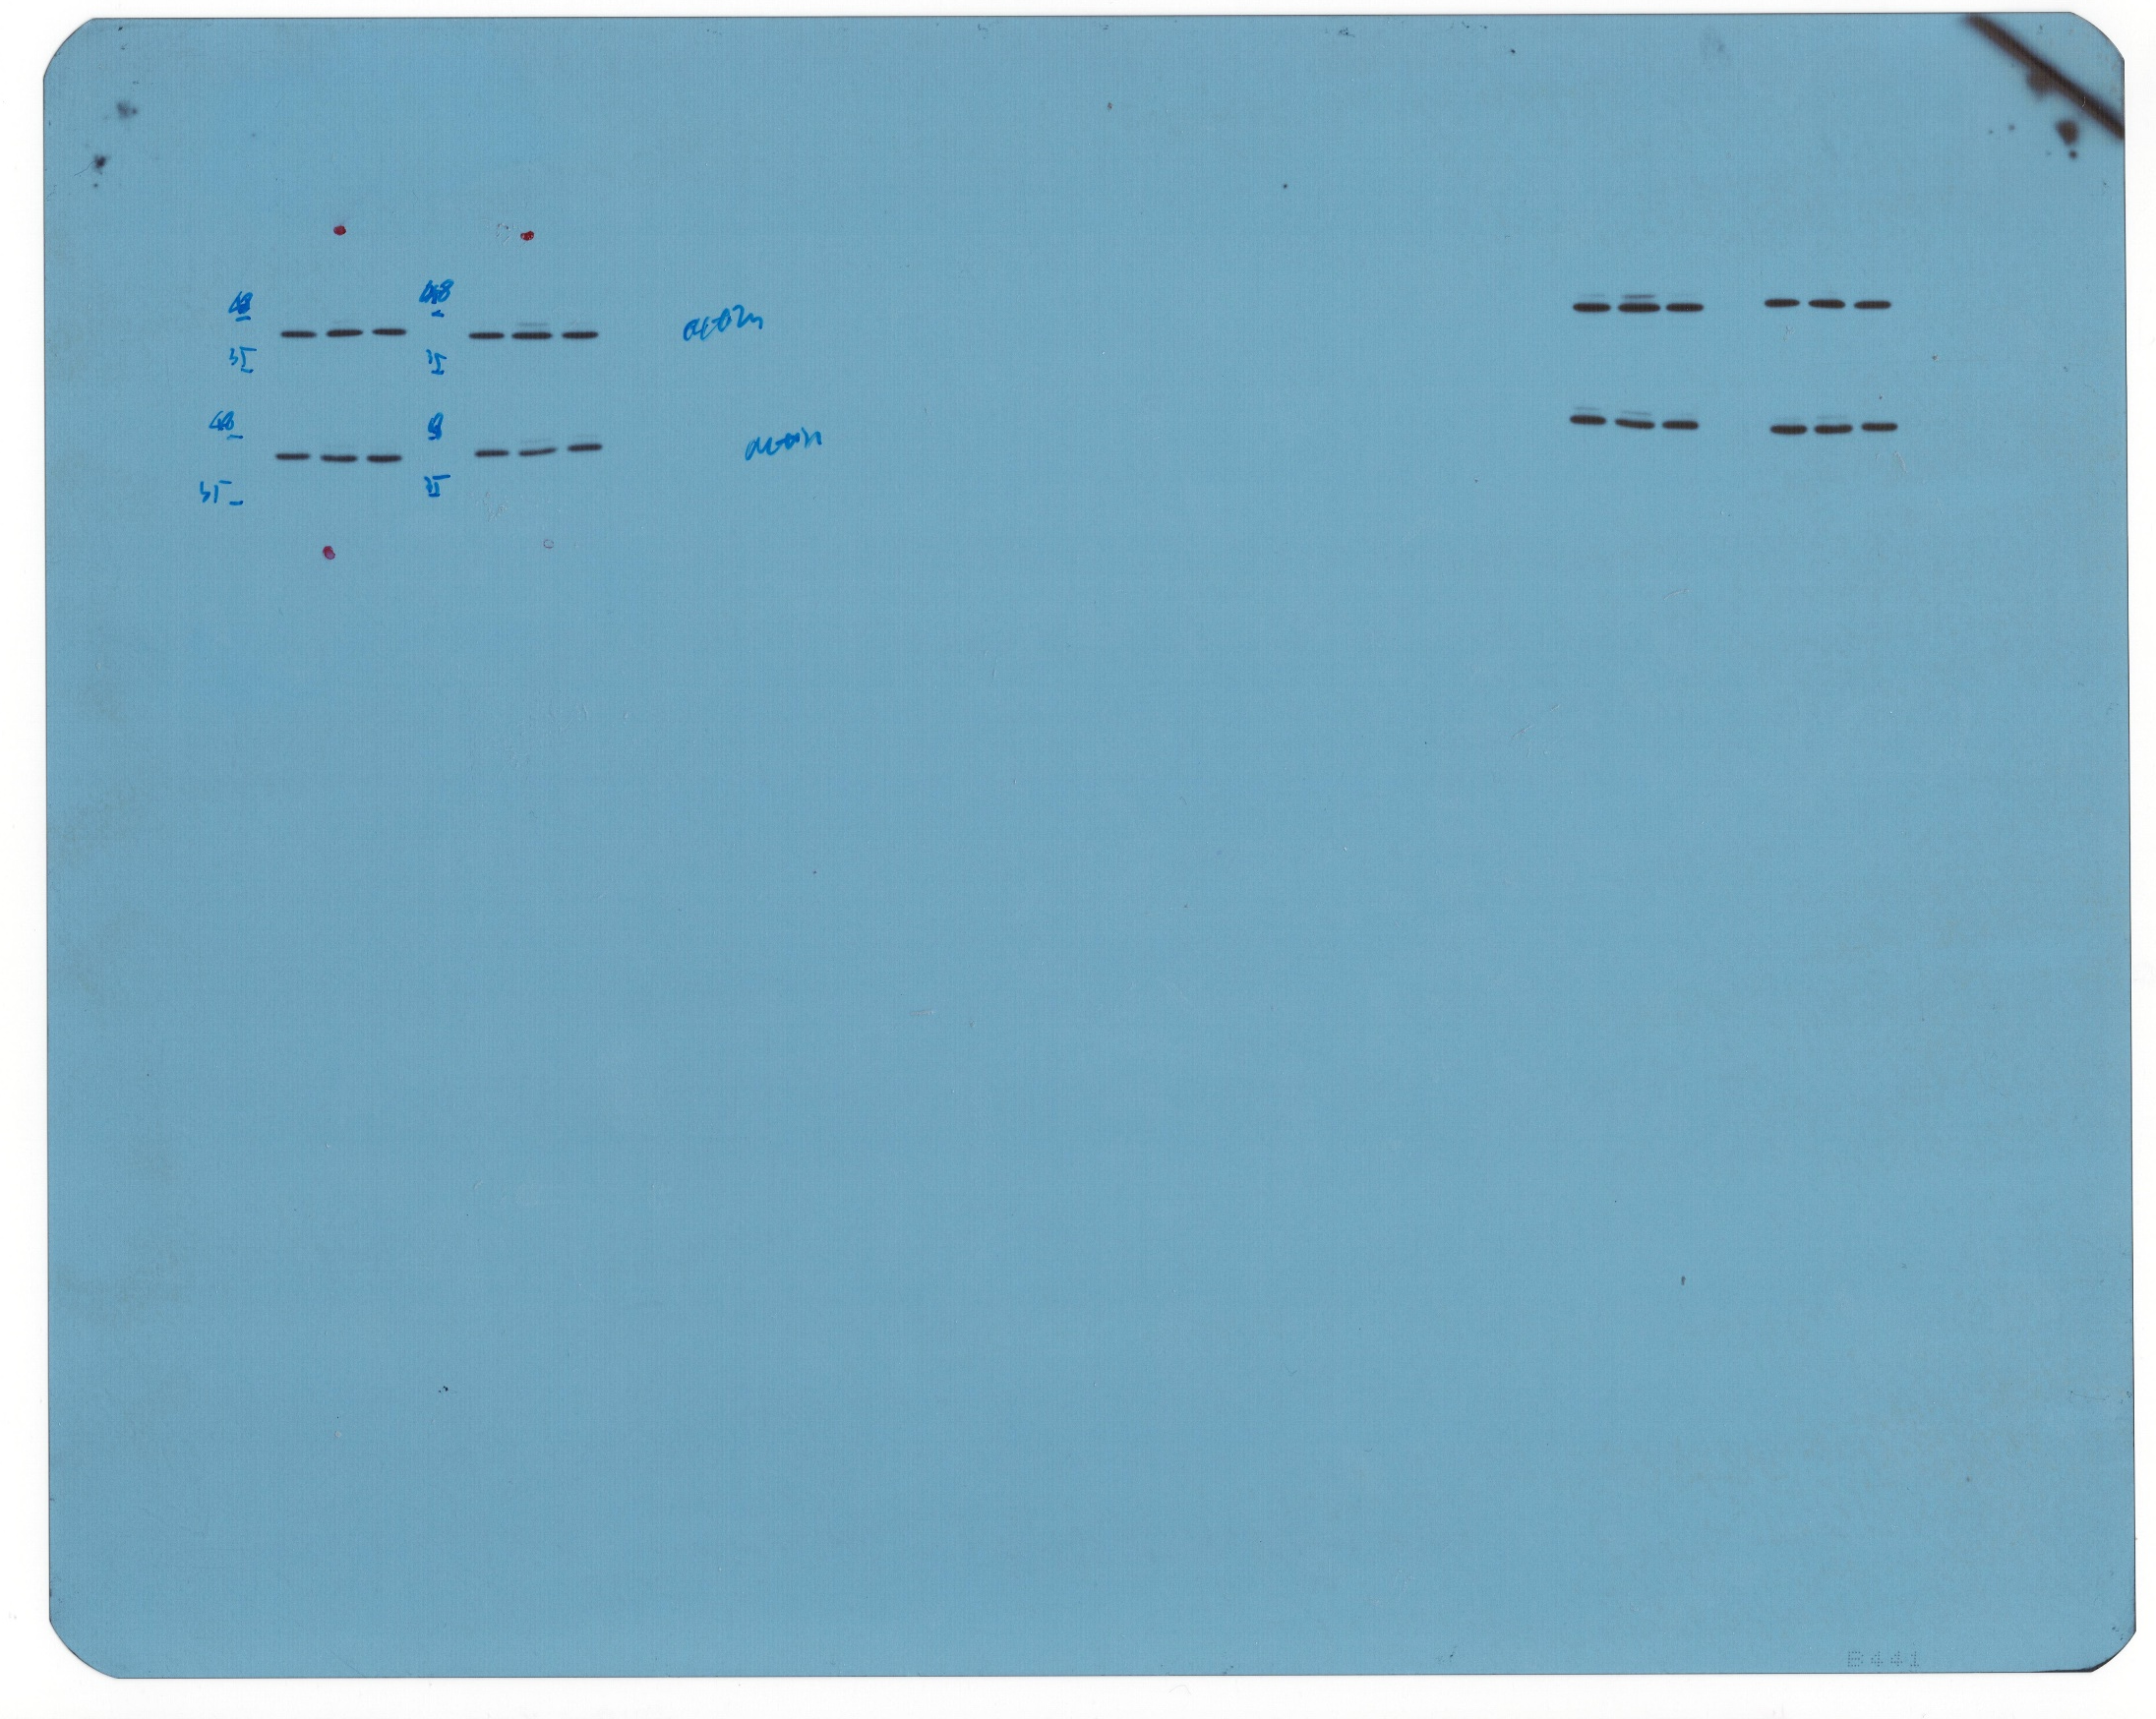
Figure 2. (A)

Slide 30
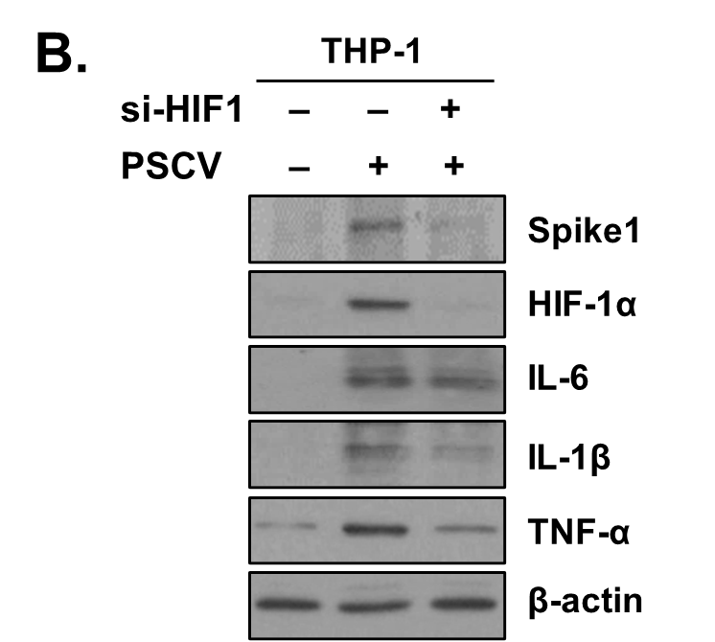
Figure 2. (B)

Slide 31

Figure 2. (B)

Slide 32
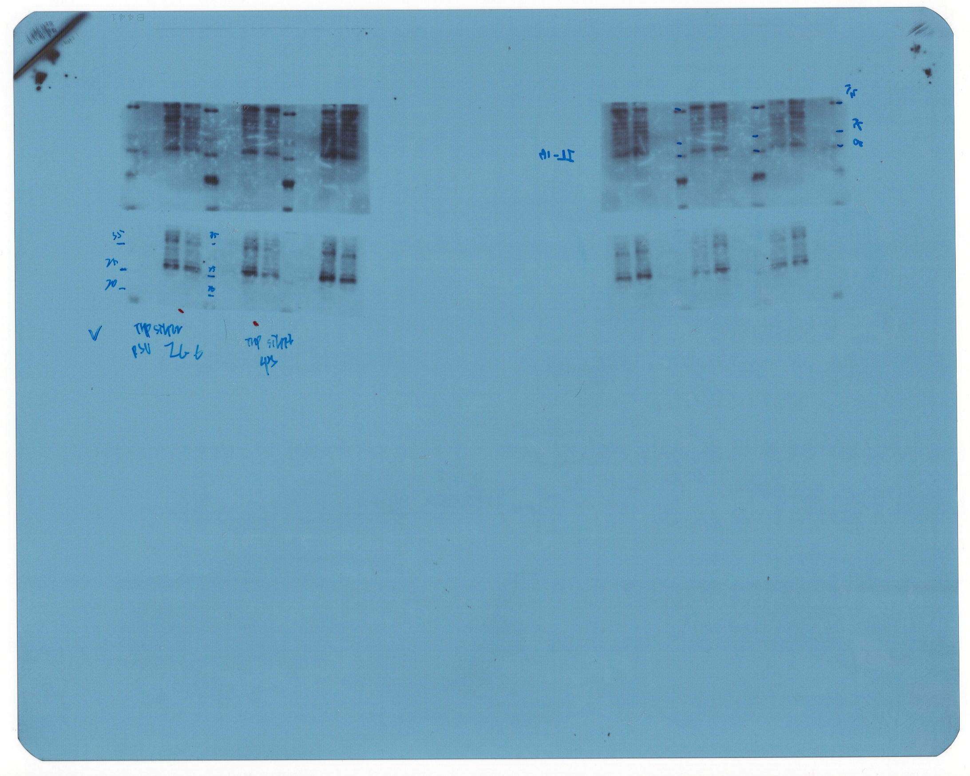
Figure 2. (B)

Slide 33
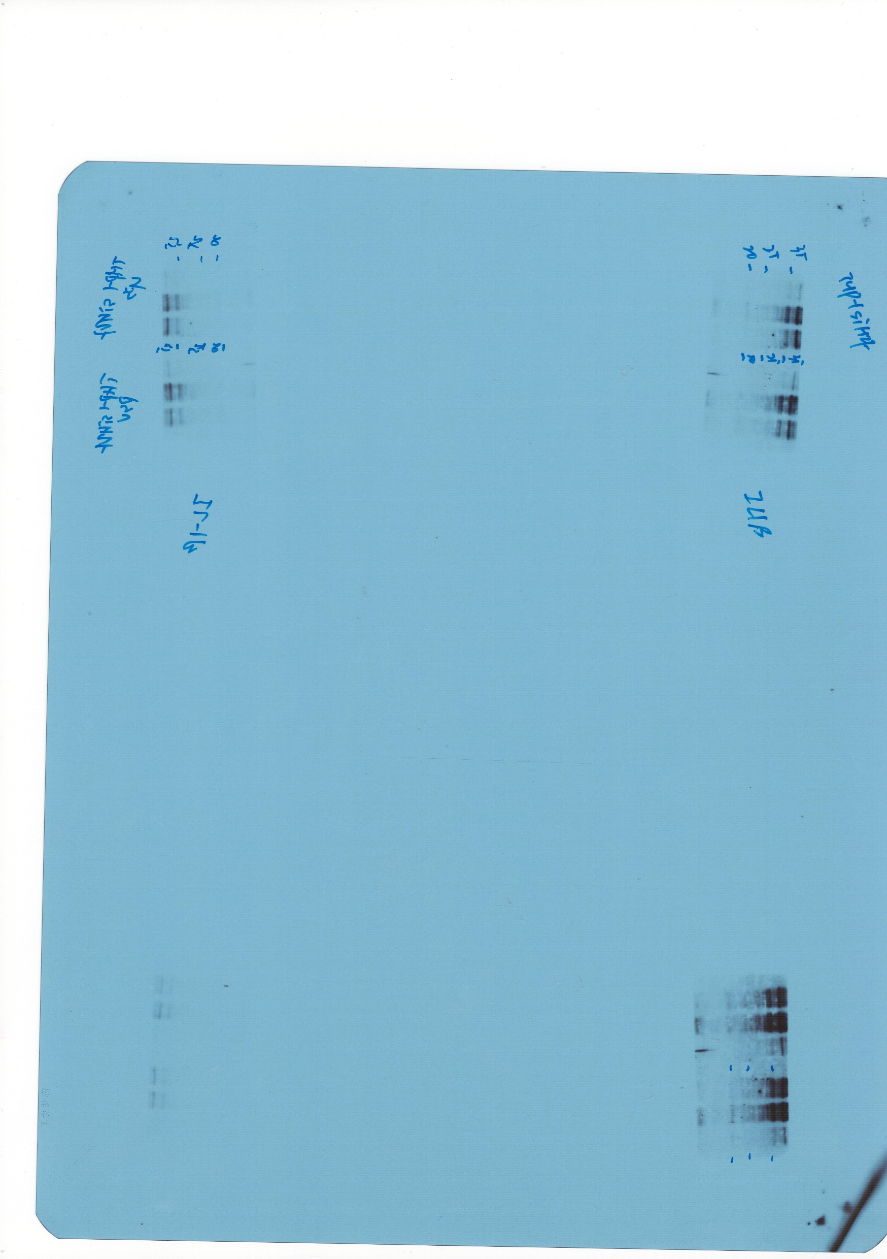
Figure 2. (B)

Slide 34
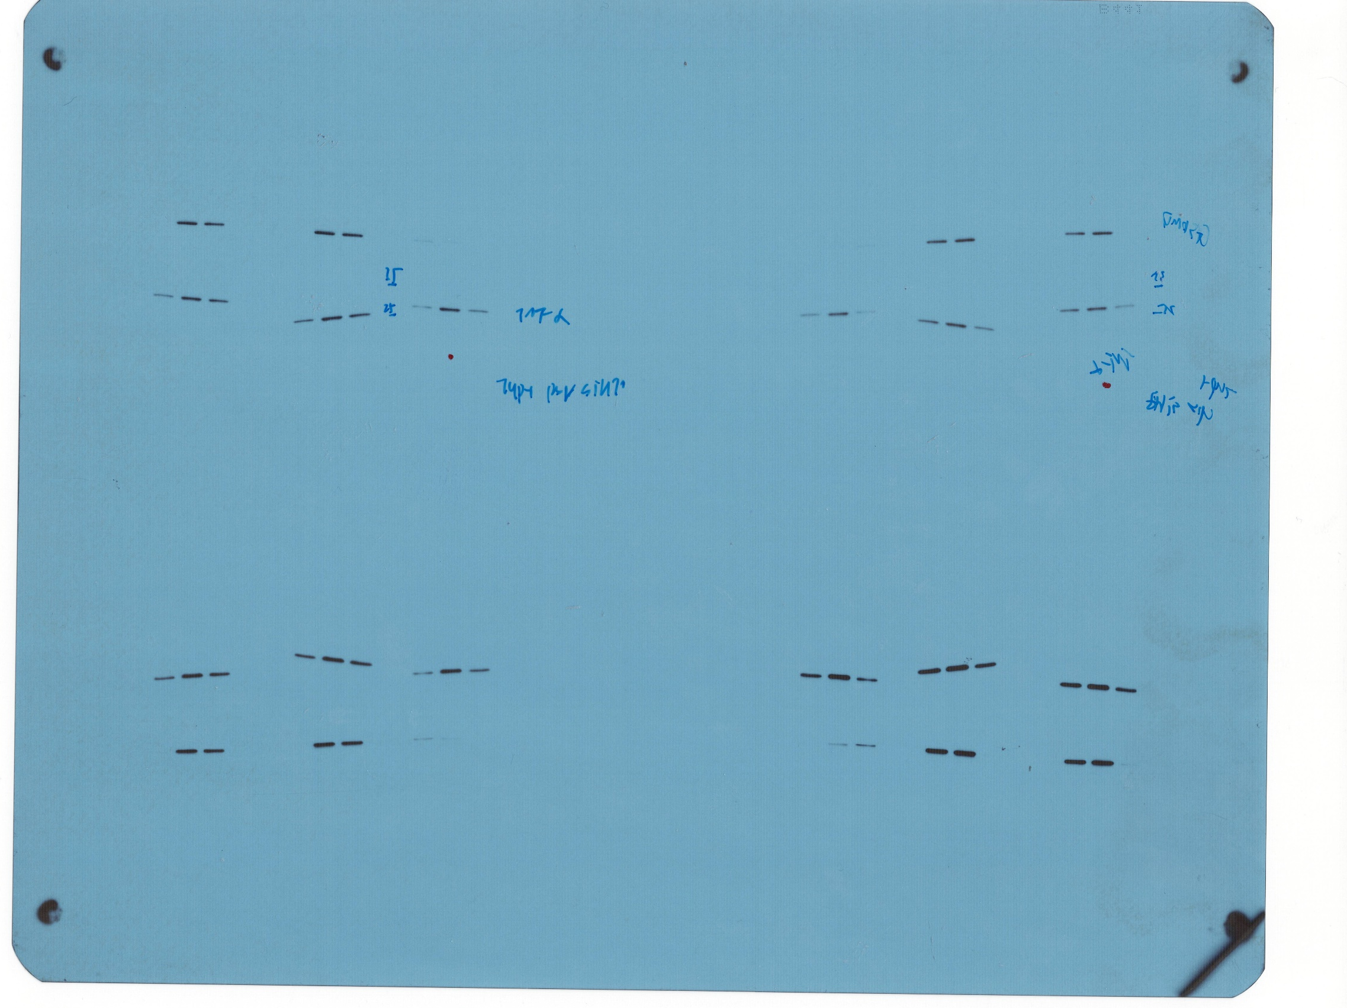
Figure 2. (B)

Slide 35
Figure 2. (B)

Slide 36
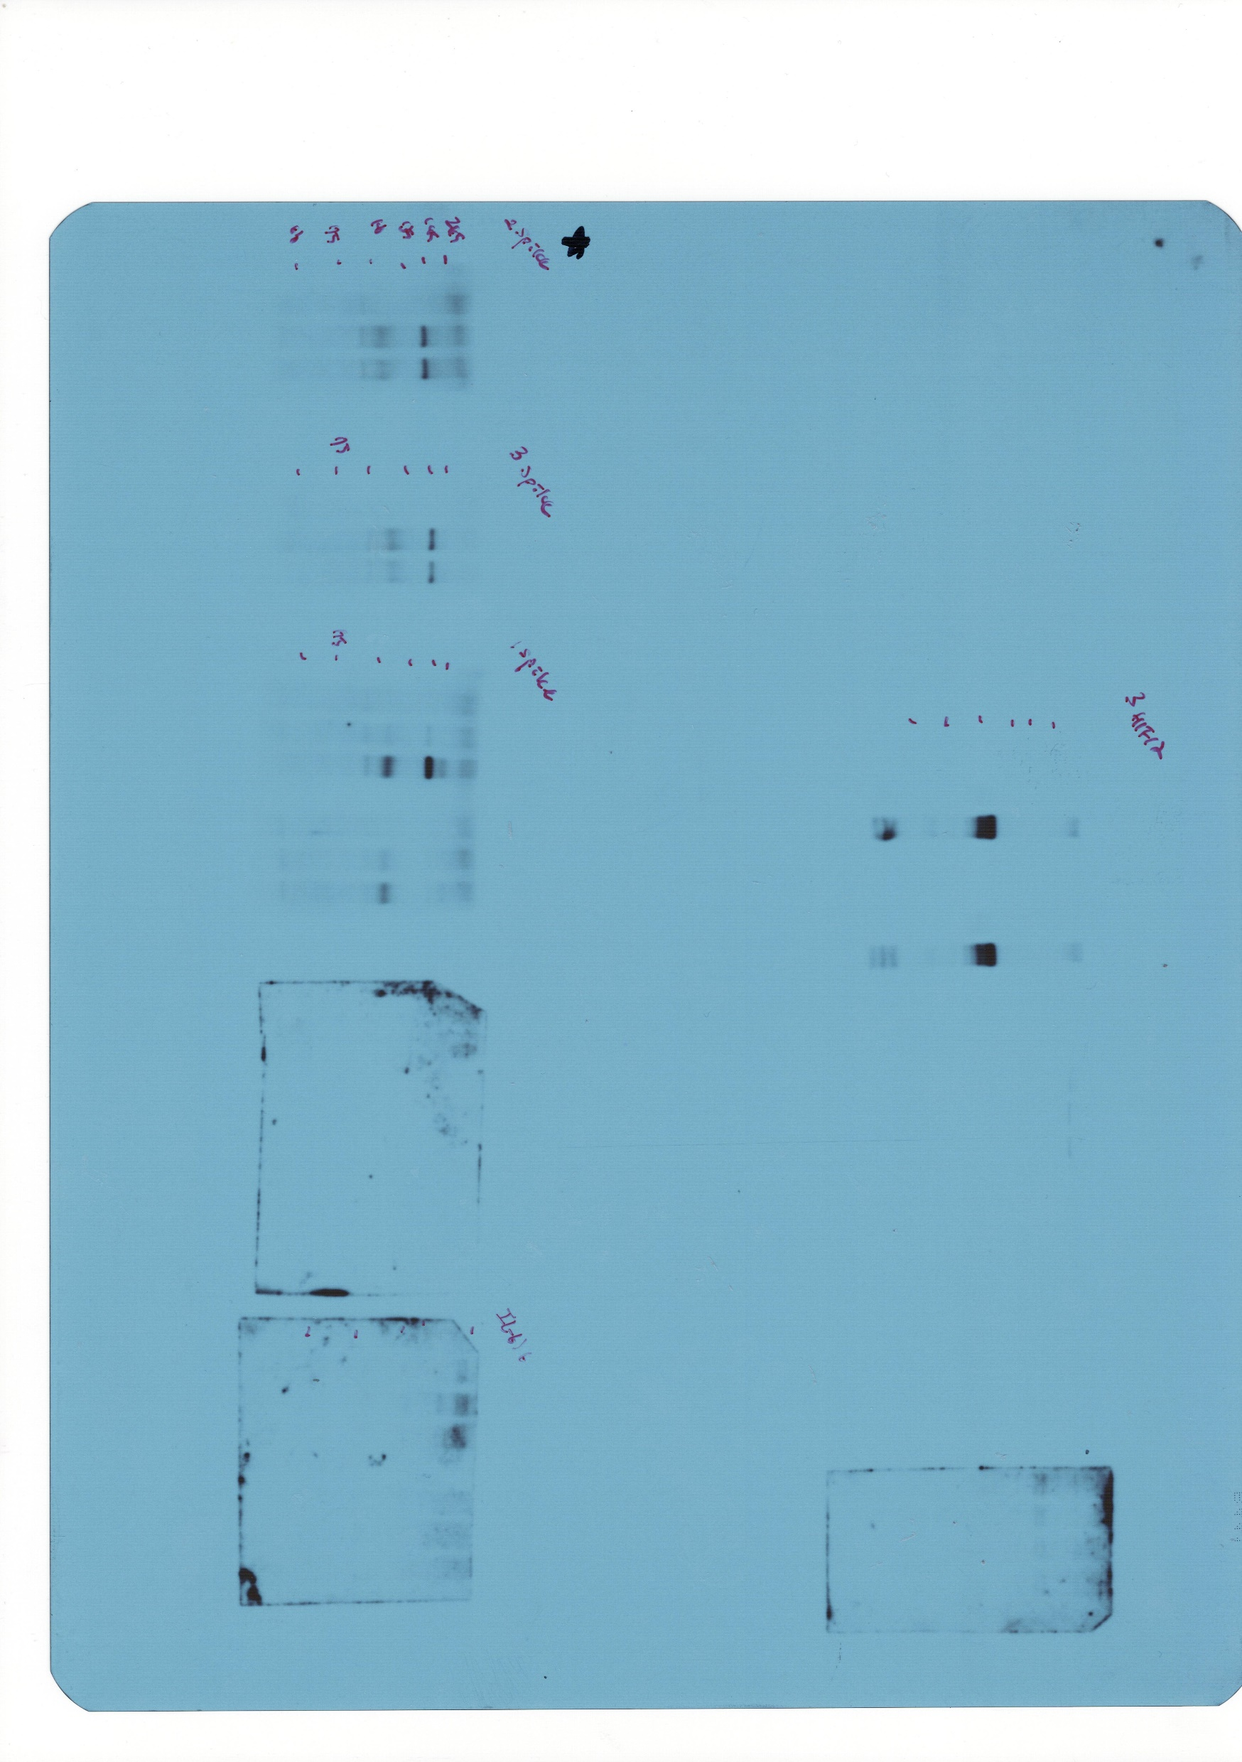
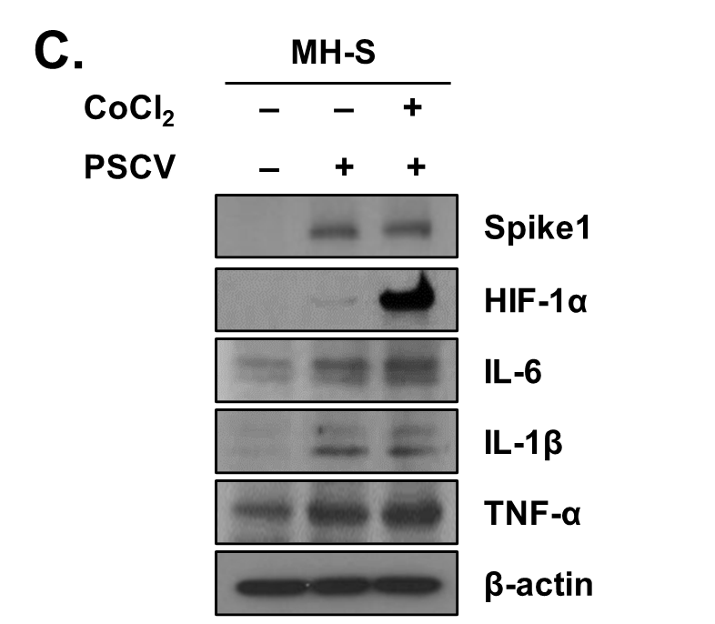
Figure 2. (C)

Slide 37
Figure 2. (C)

Slide 38
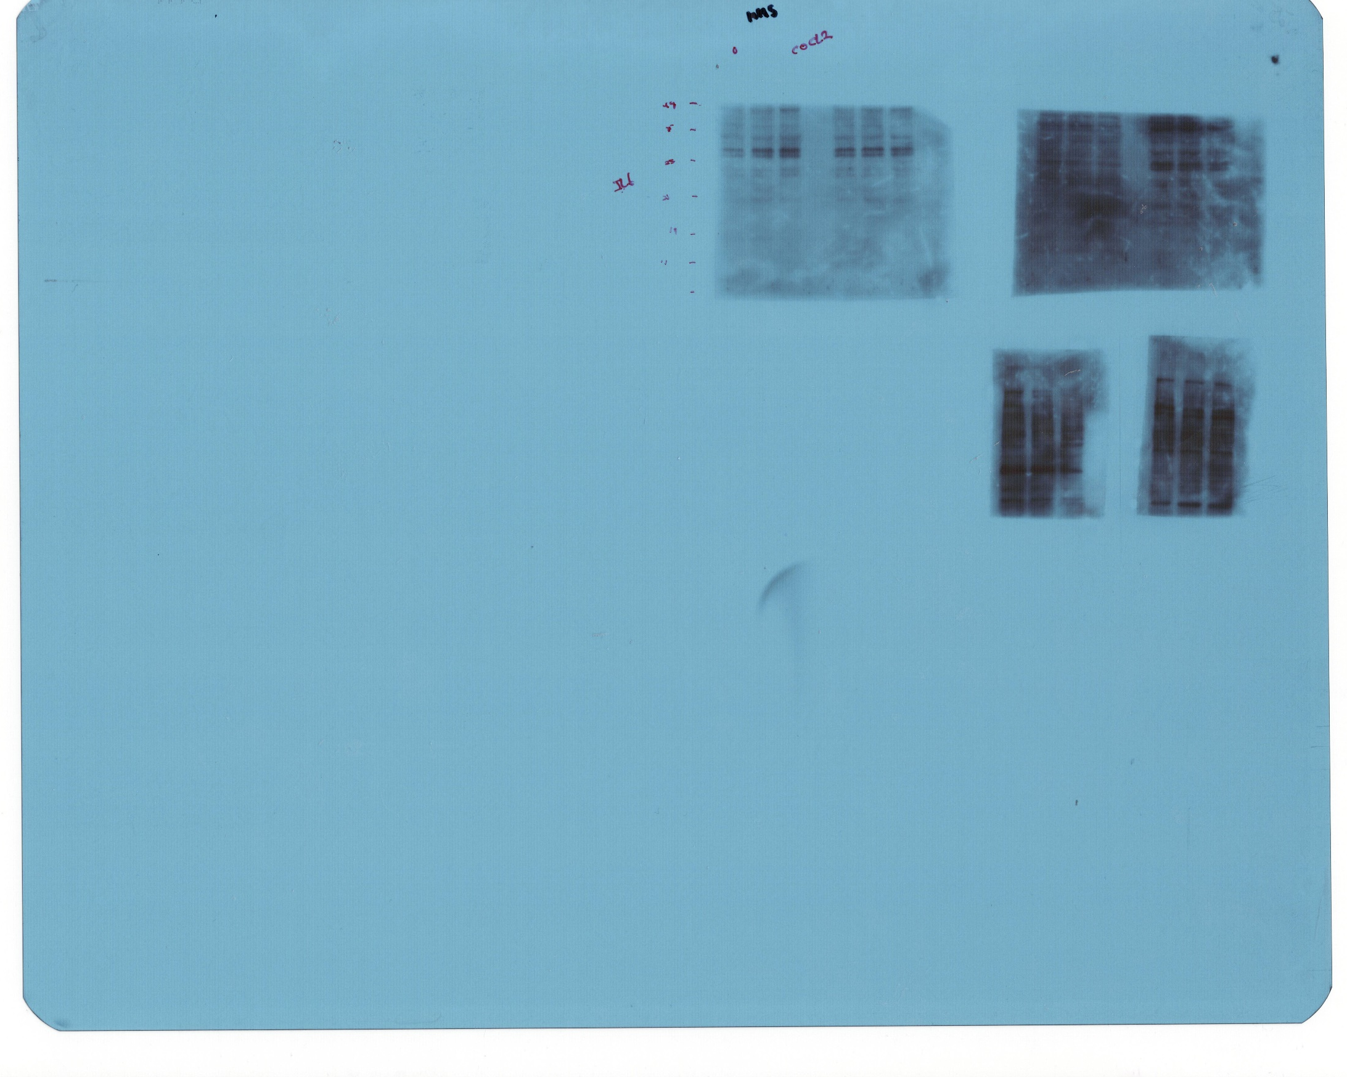
Figure 2. (C)

Slide 39
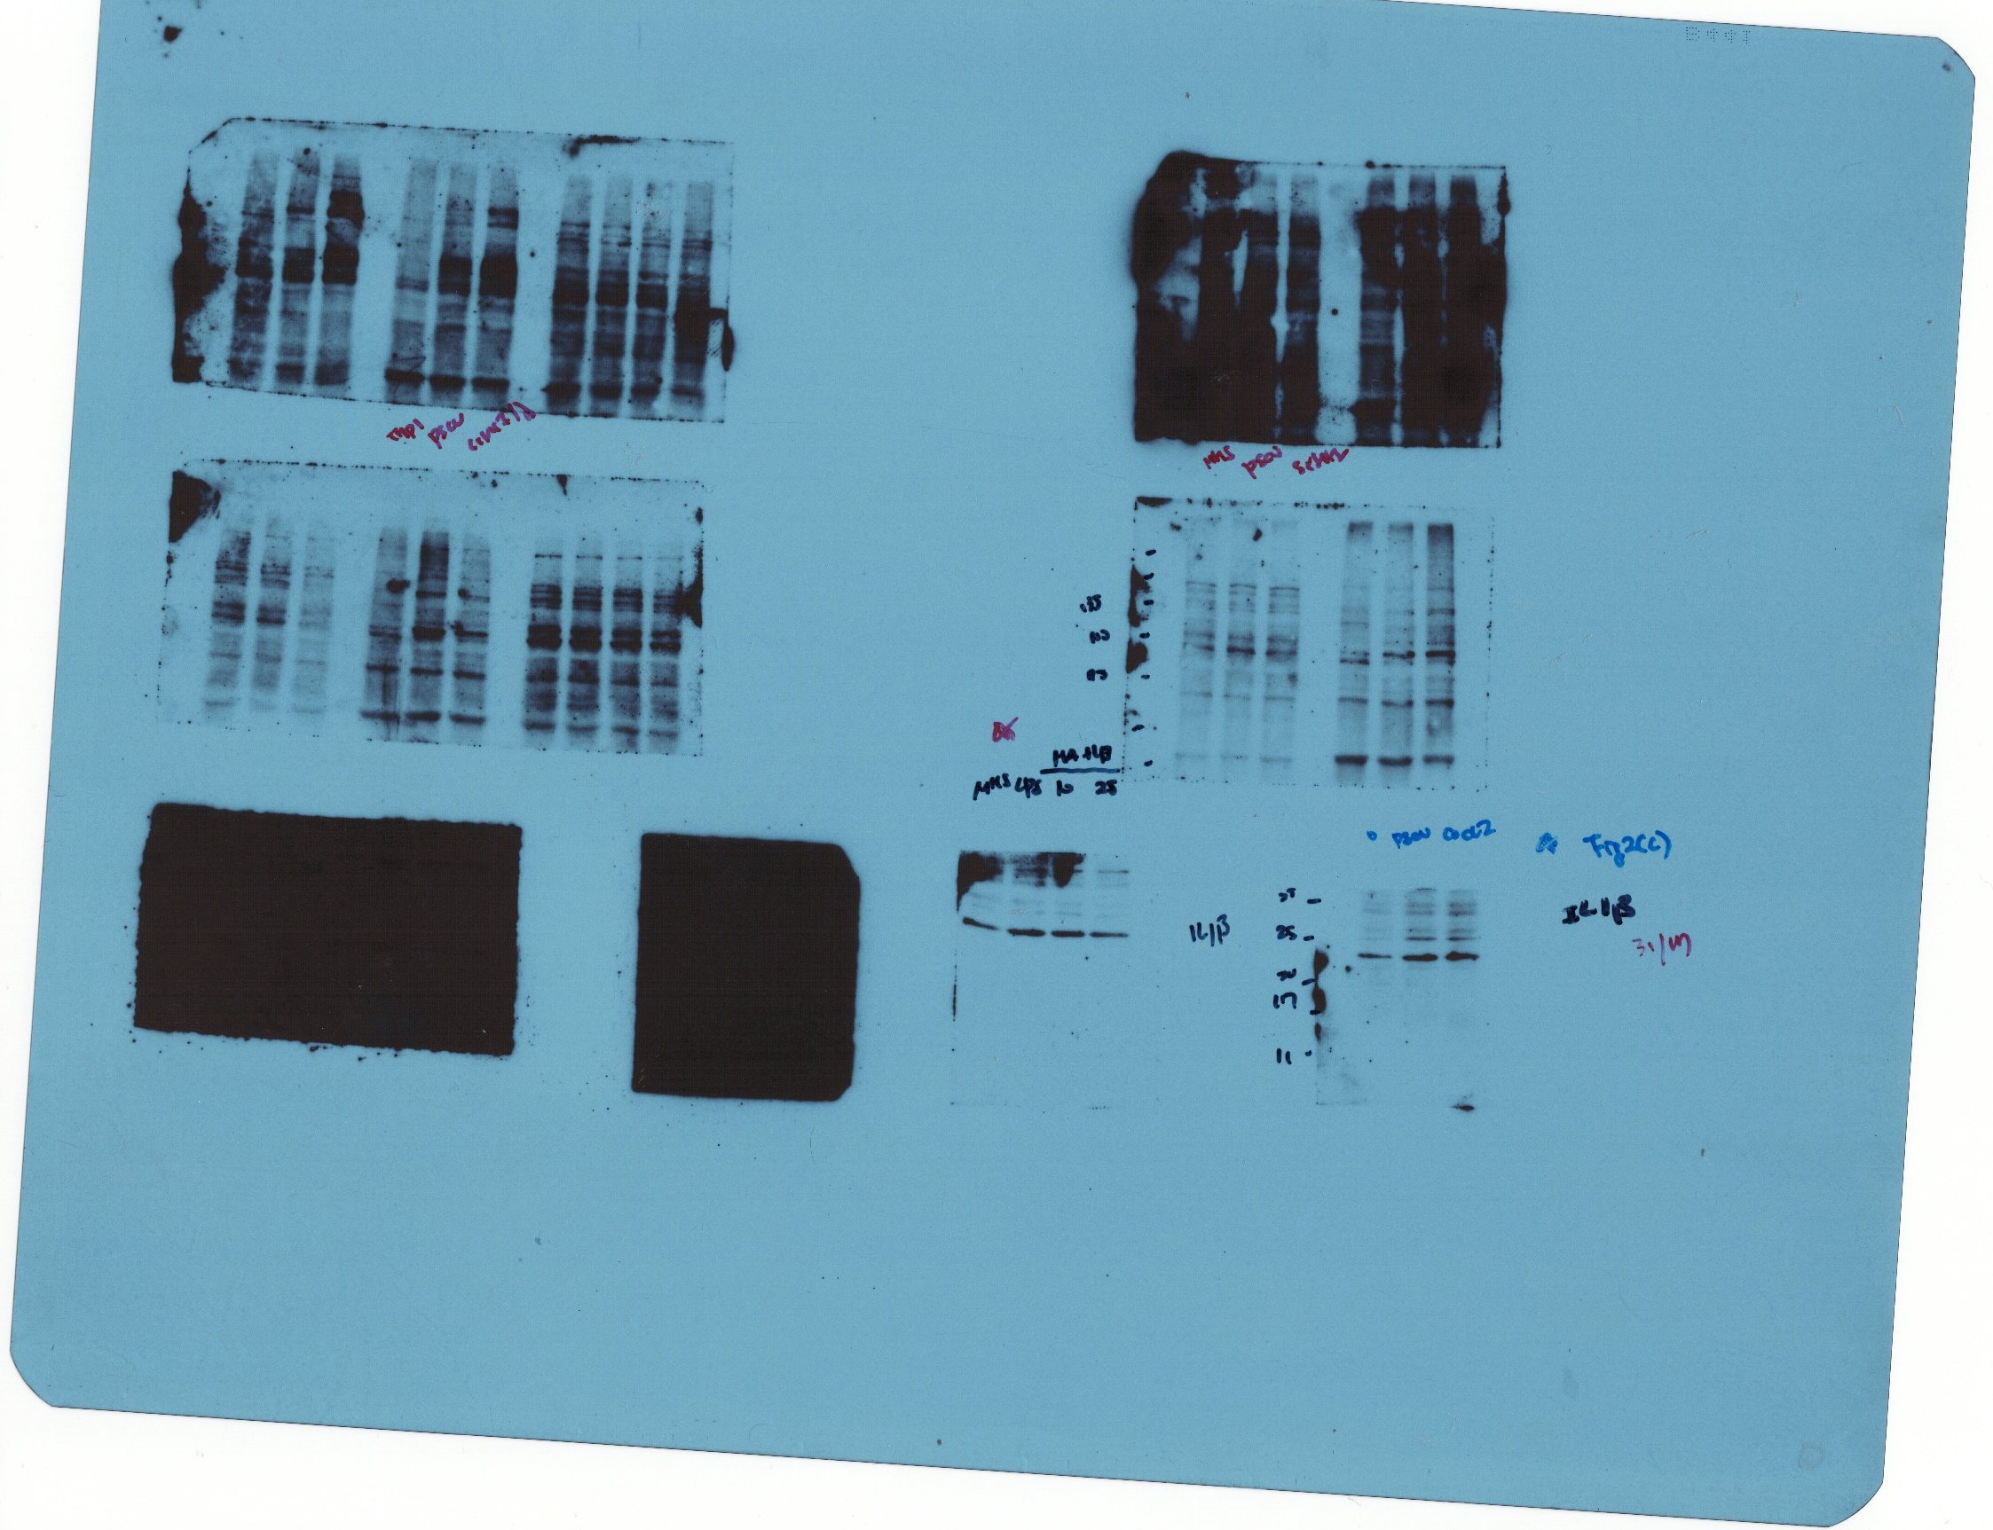
Figure 2. (C)

Slide 40
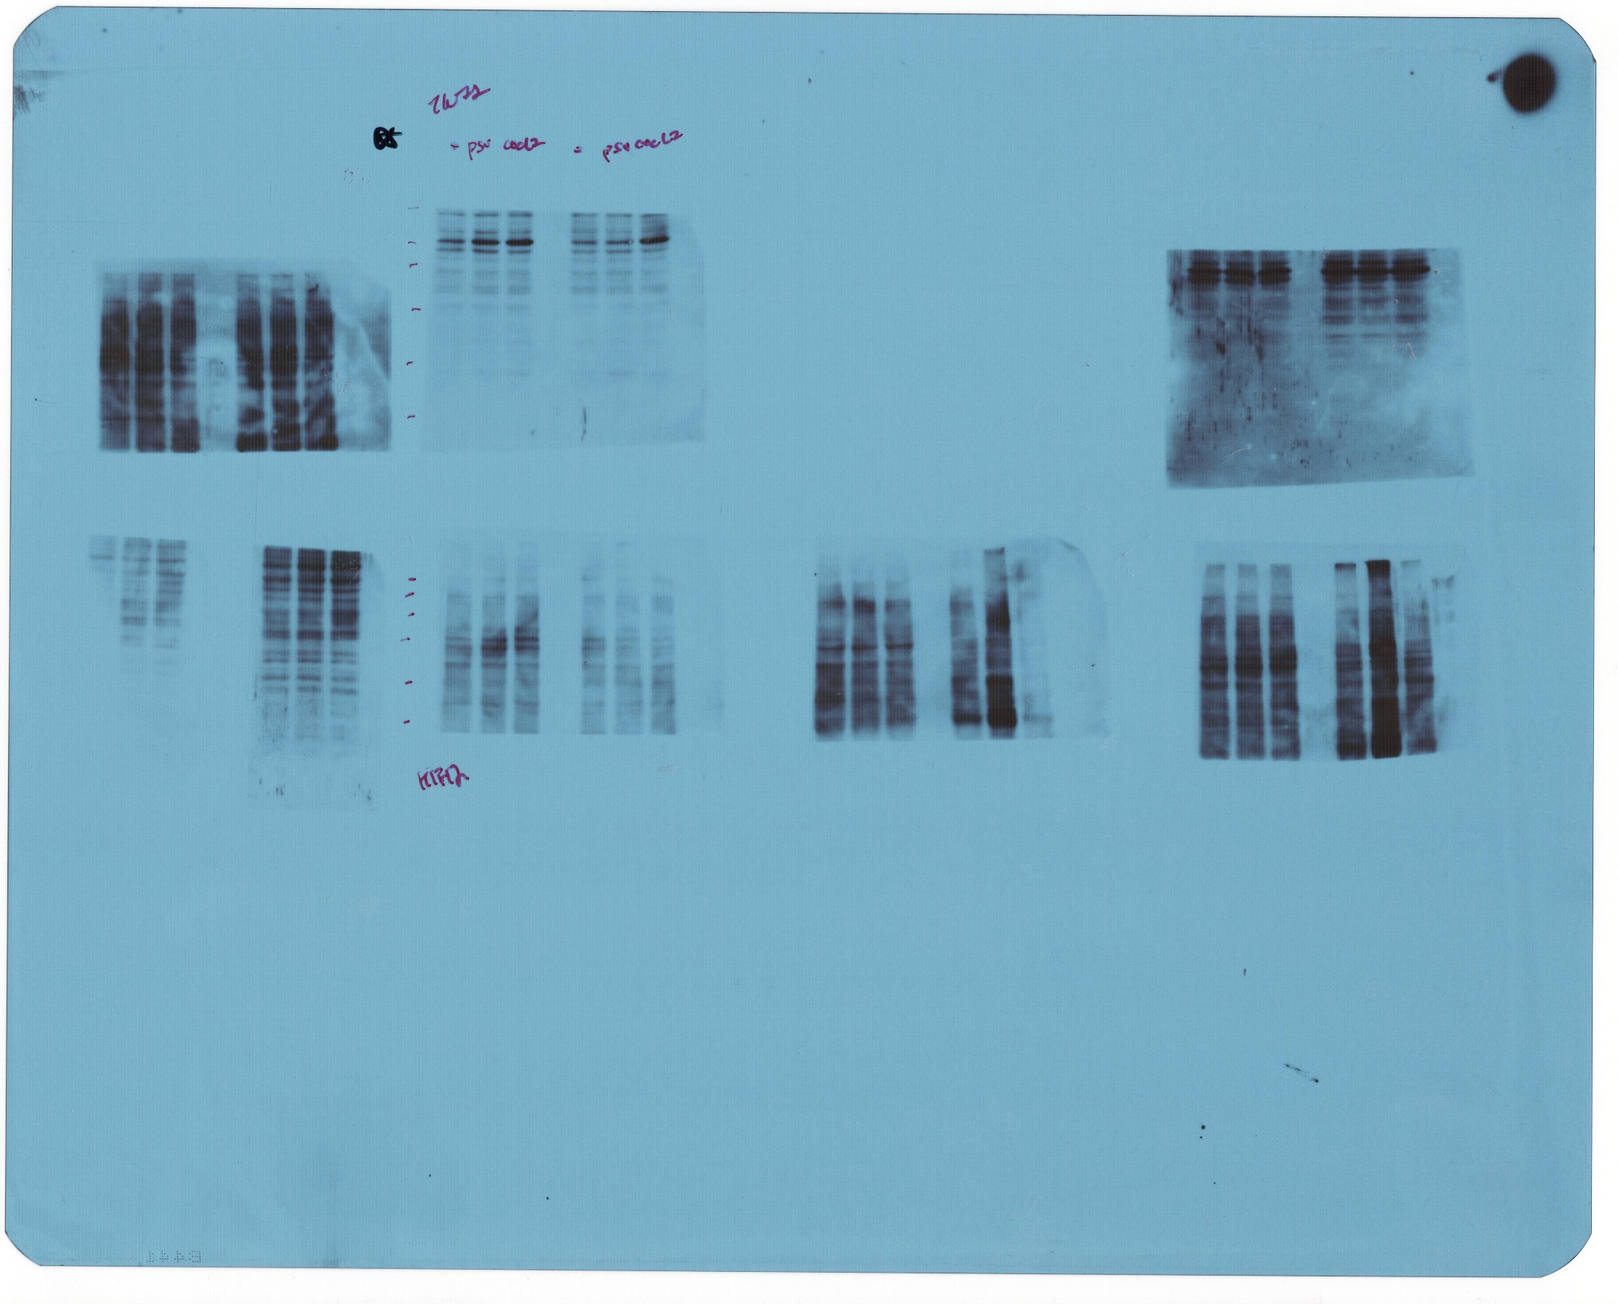
Figure 2. (C)

Slide 41
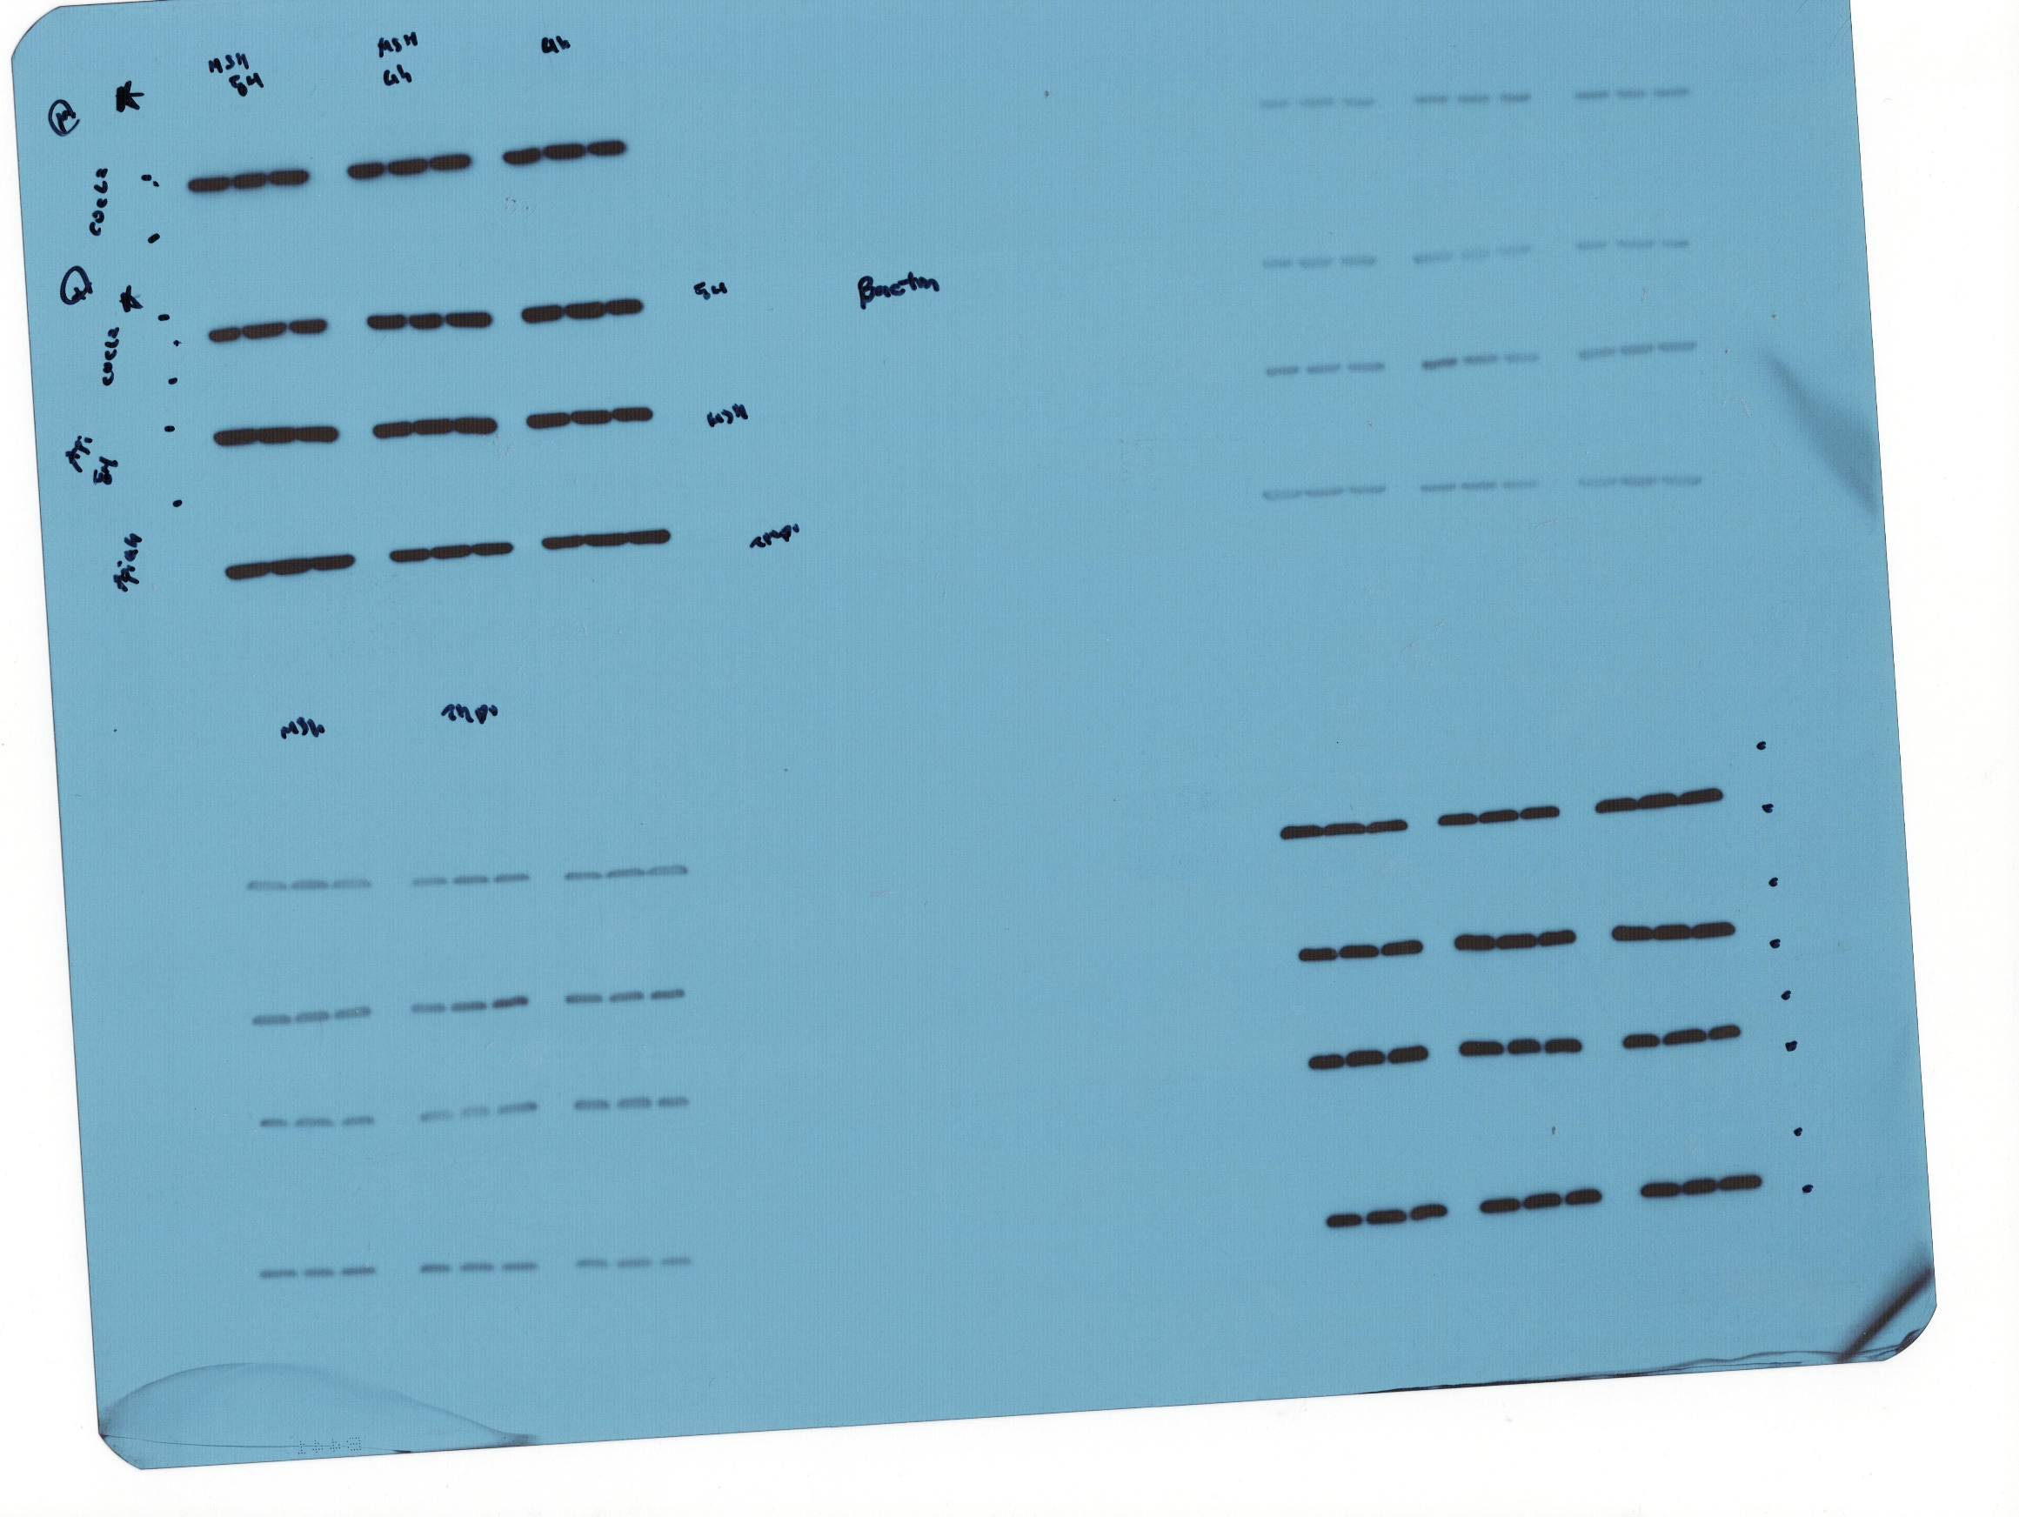
Figure 2. (C)

Slide 42
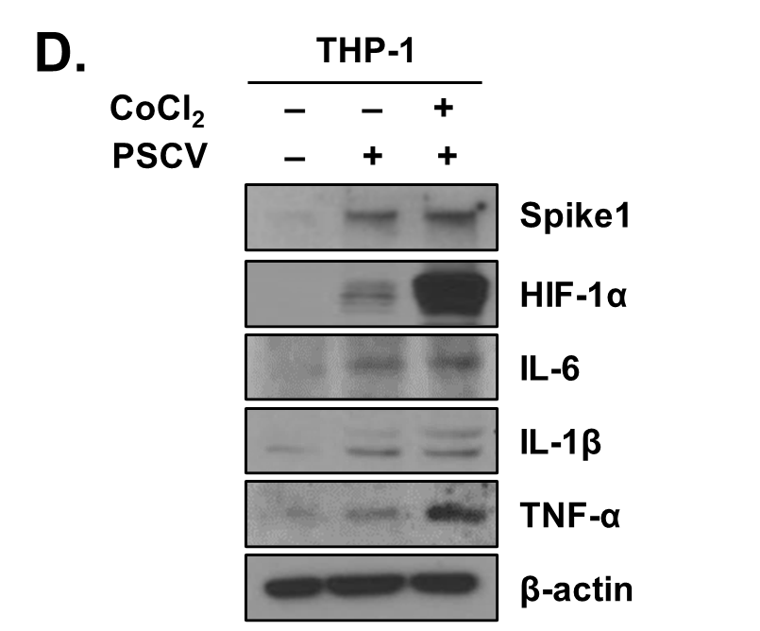
Figure 2. (D)

Slide 43
Figure 2. (D)

Slide 44
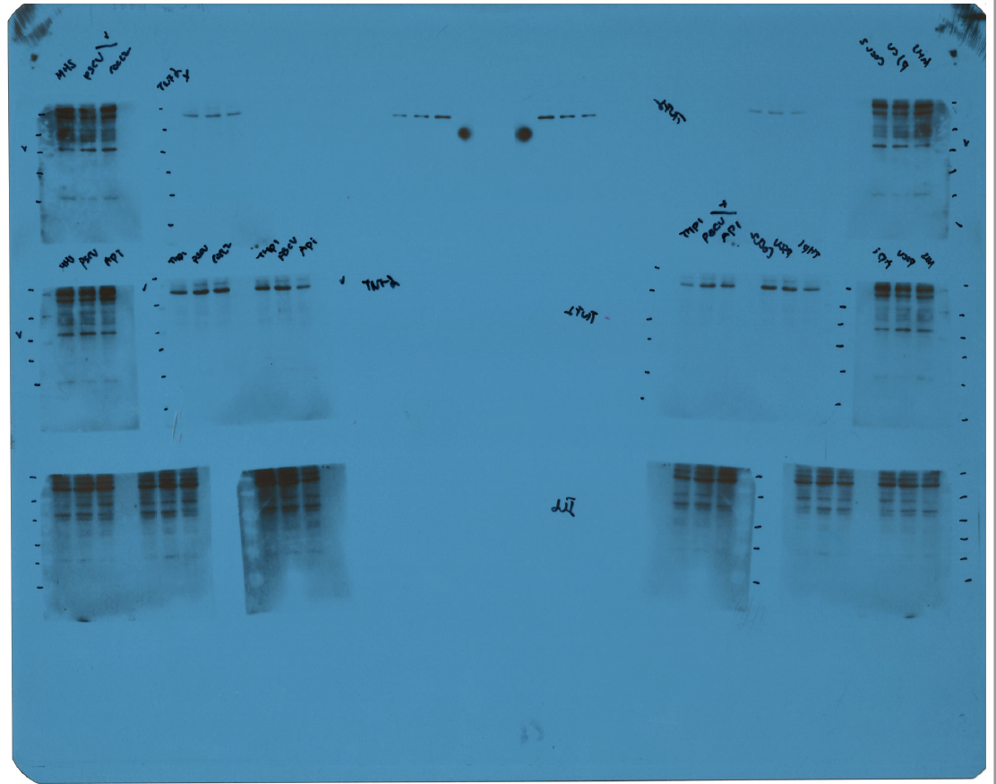
Figure 2. (D)

Slide 45
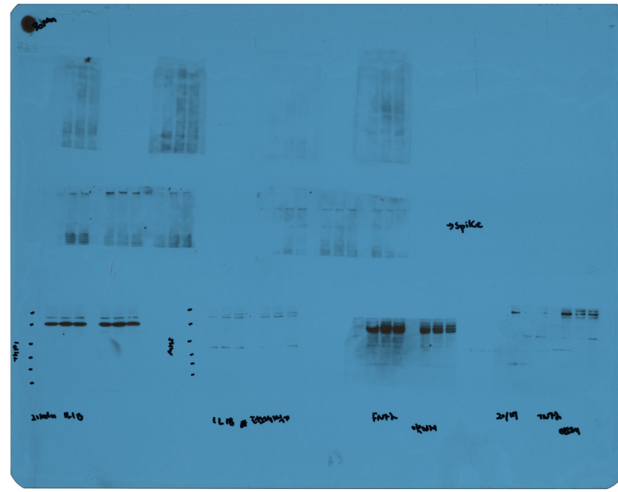
Figure 2. (D)

Slide 46
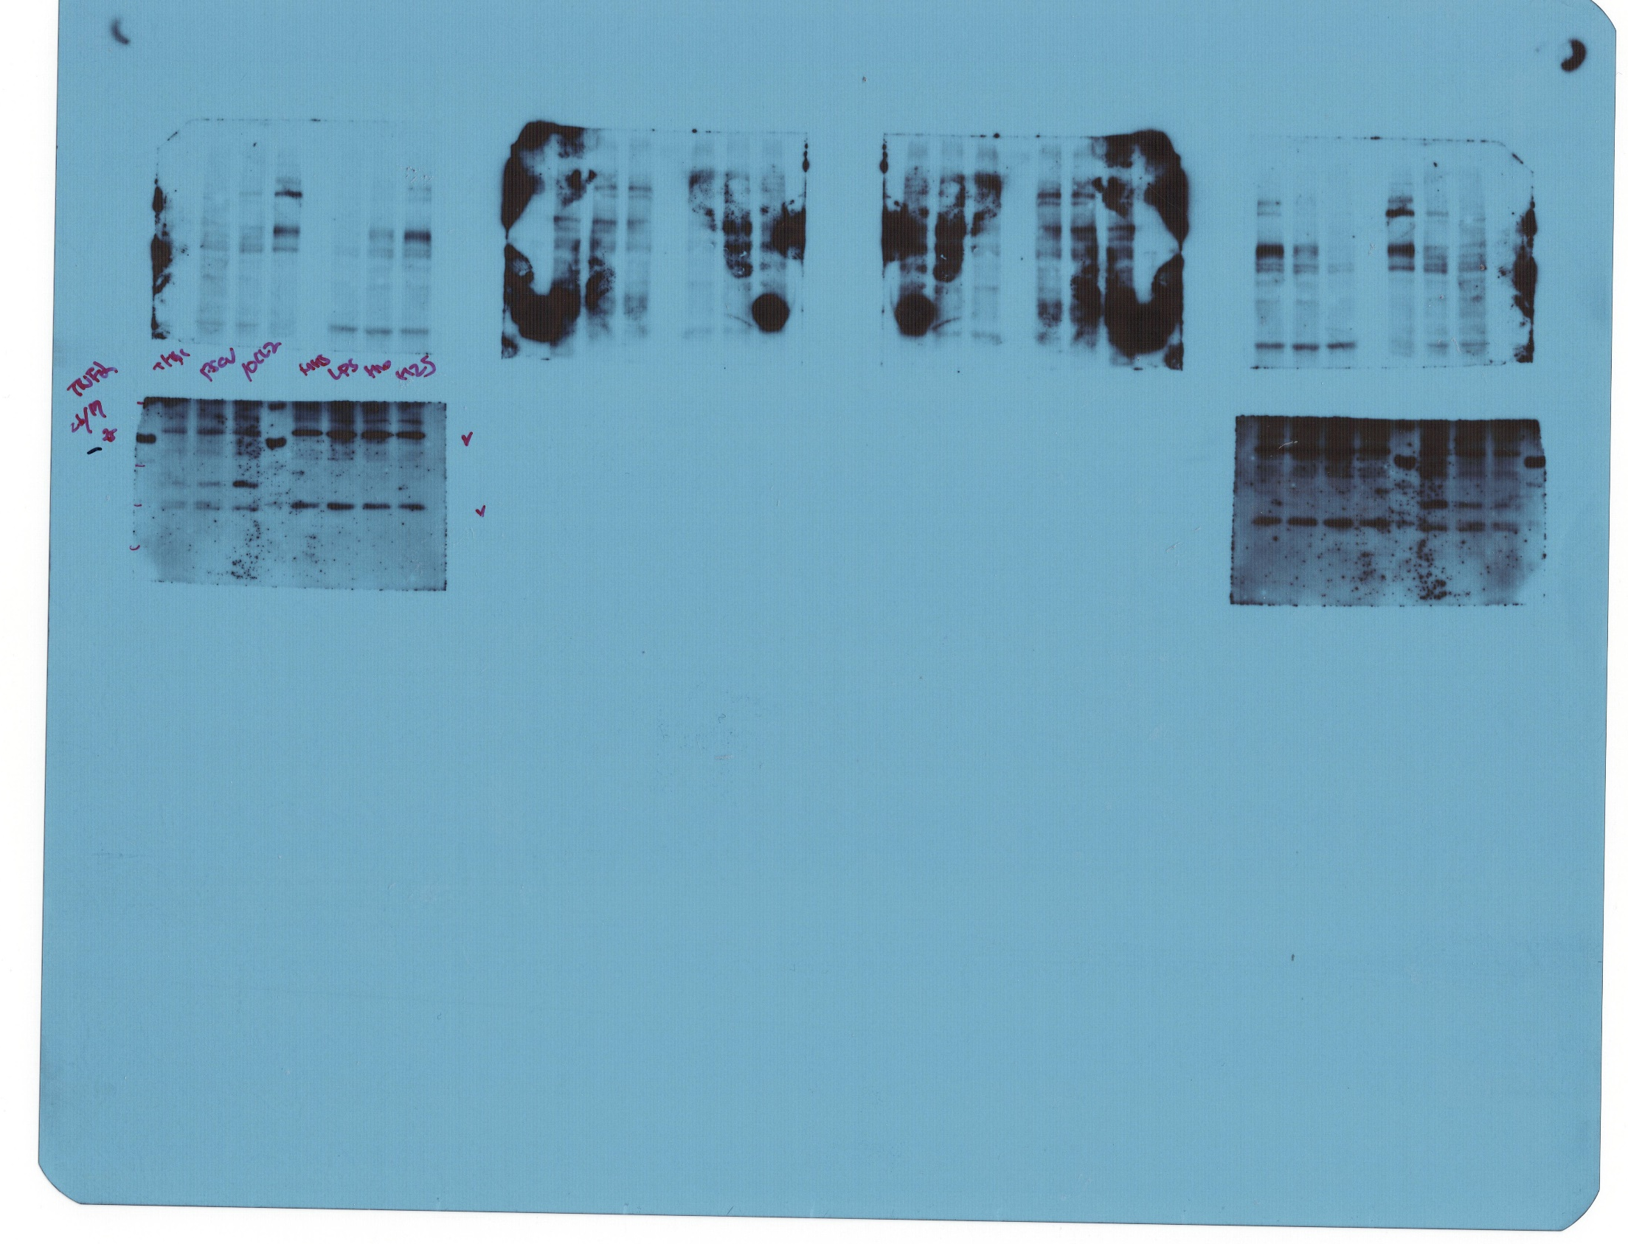
Figure 2. (D)

Slide 47
Figure 2. (D)

Slide 48

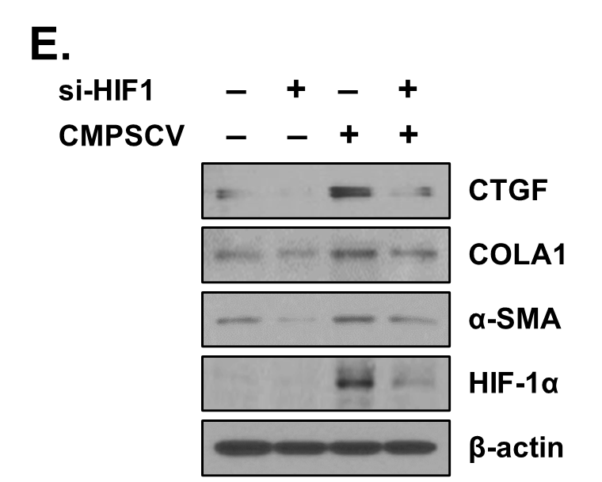
Figure 2. (E)

Slide 49
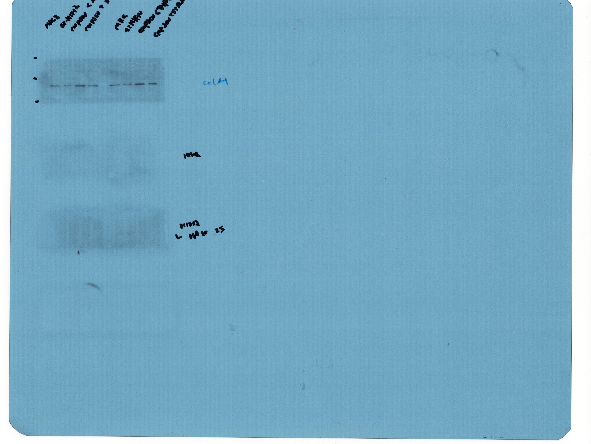
Figure 2. (E)

Slide 50

Figure 2. (E)

Slide 51
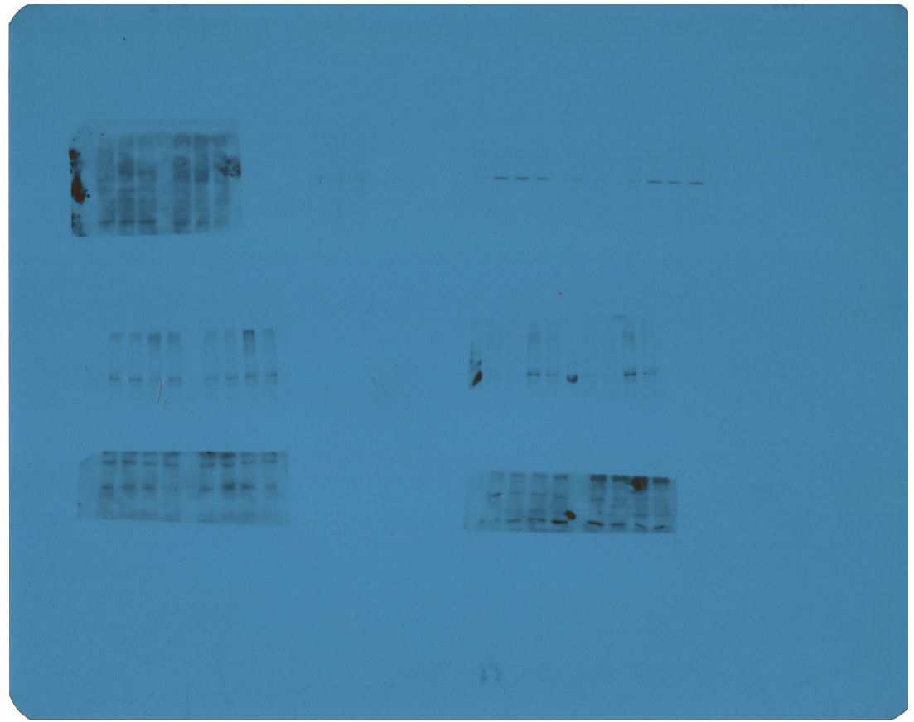
Figure 2. (E)

Slide 52
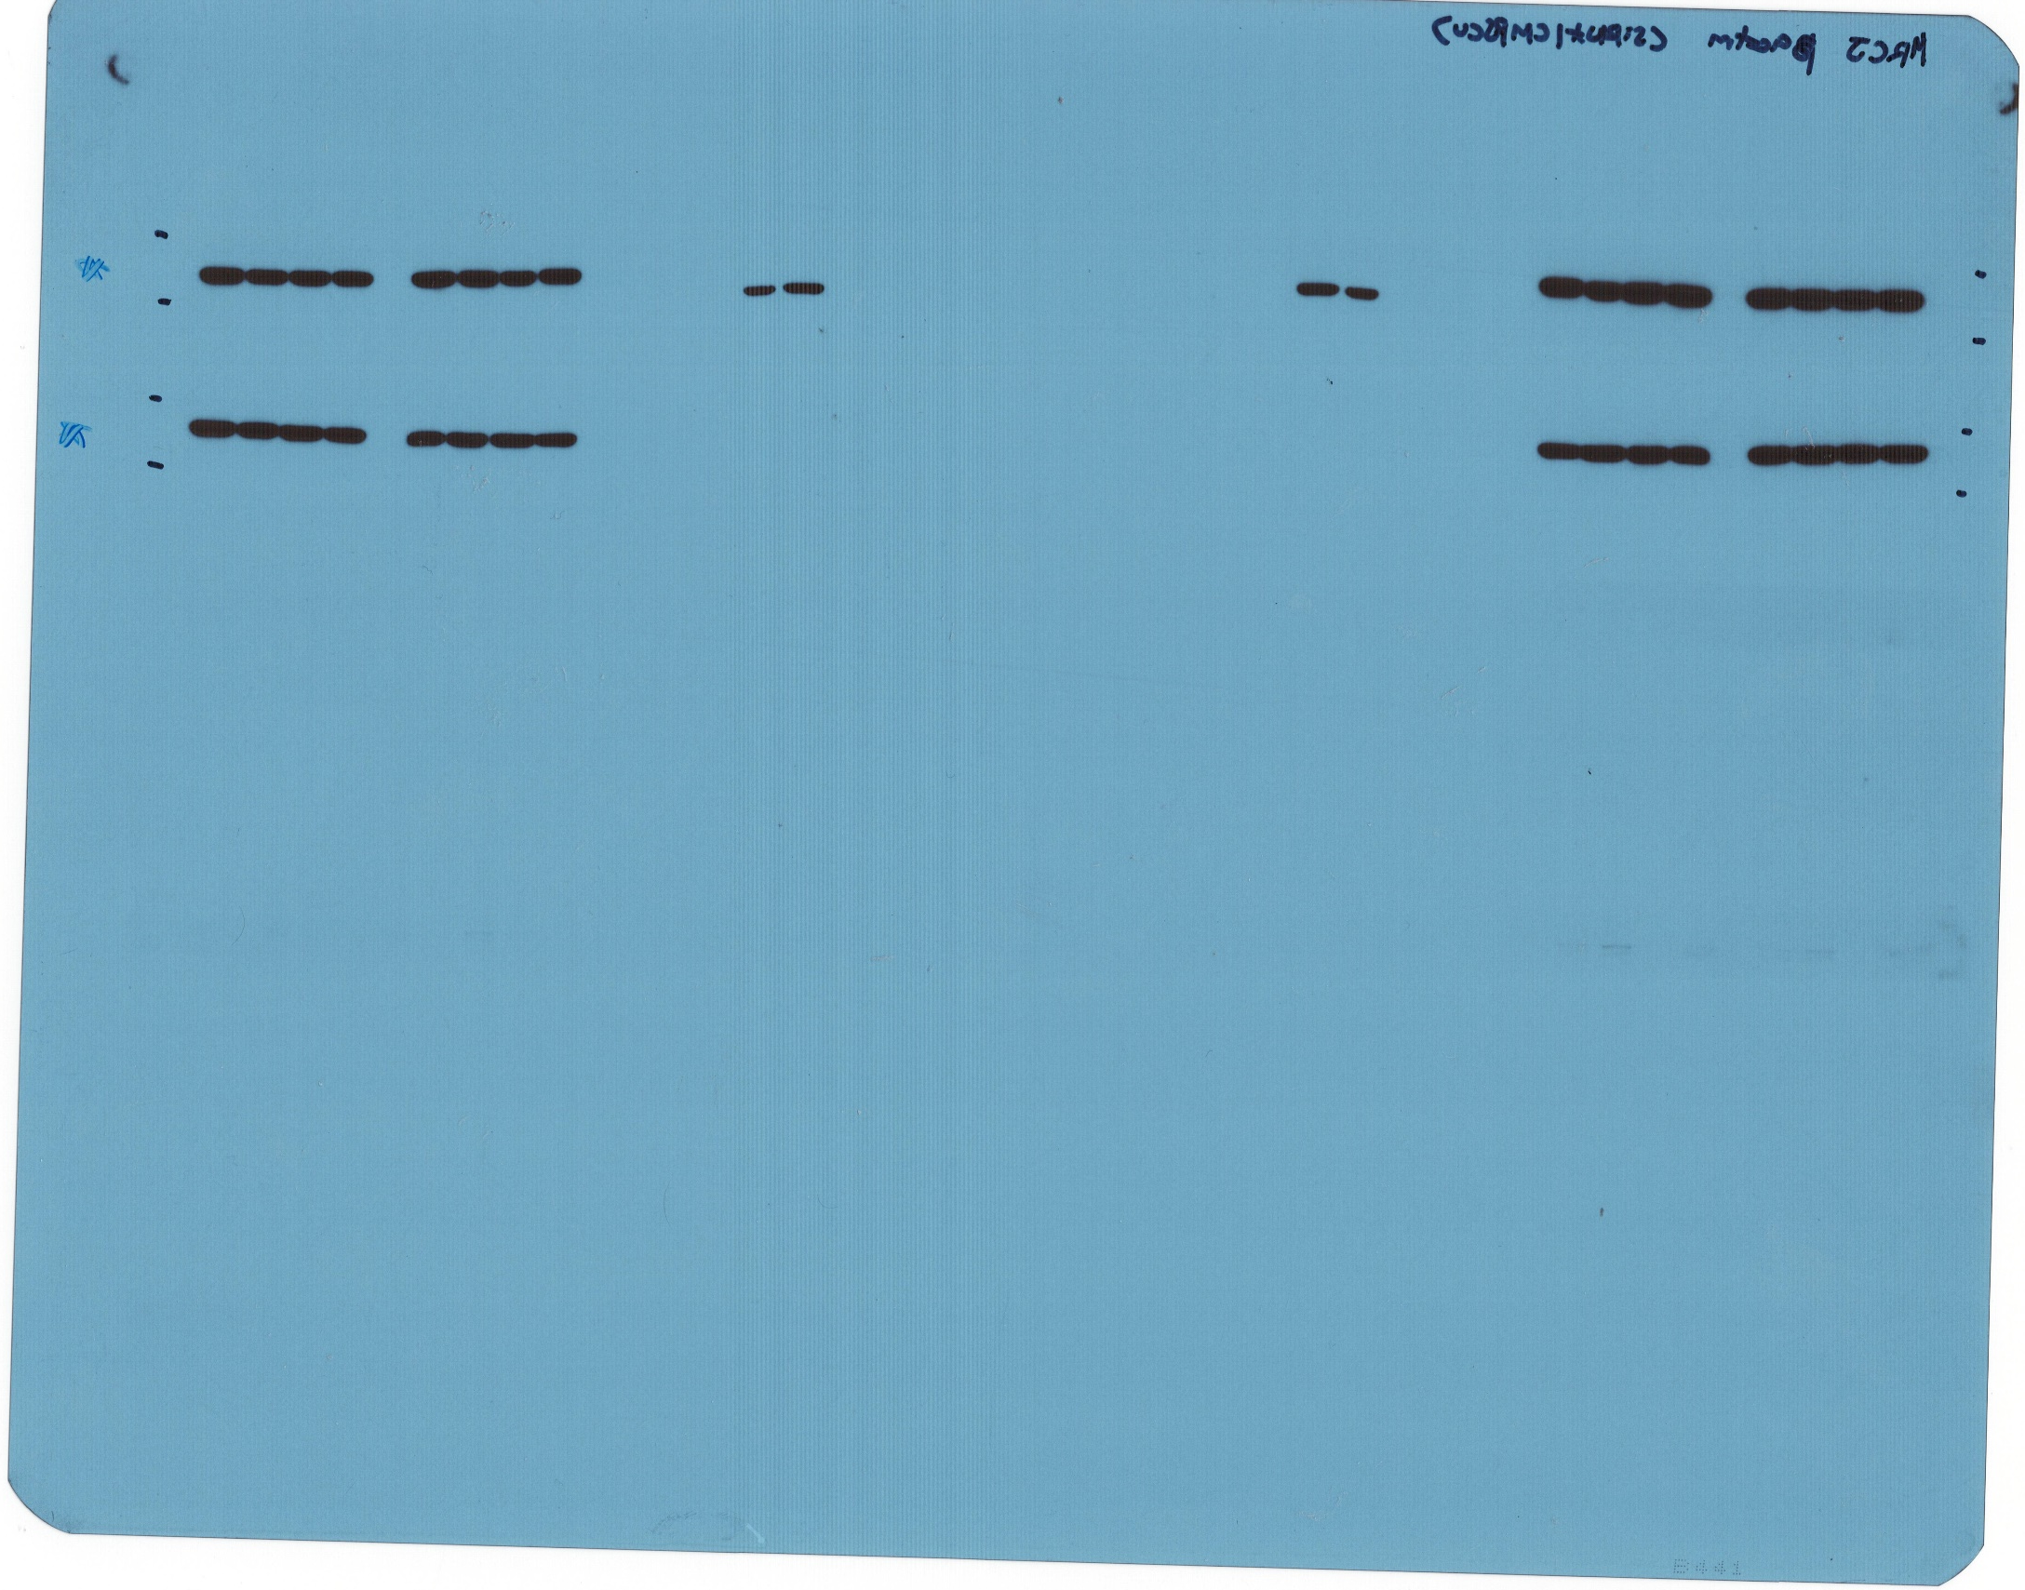
Figure 2. (E)

Slide 53
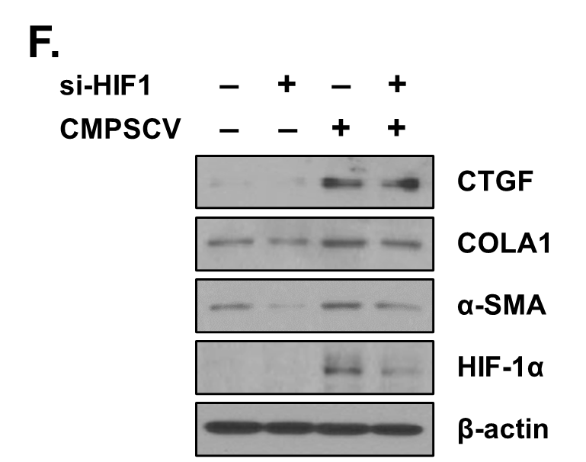
Figure 2. (F)

Slide 54
Figure 2. (F)

Slide 55


Figure 2. (F)

Slide 56
Figure 2. (F)

Slide 57
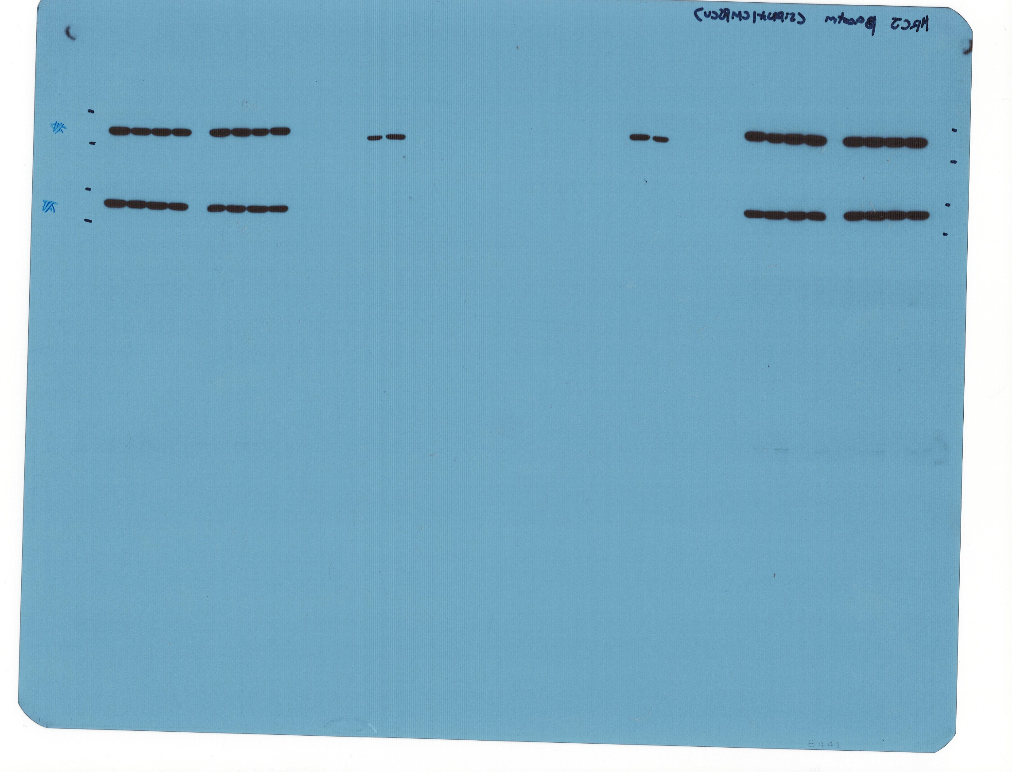
Figure 2. (F)

Slide 58
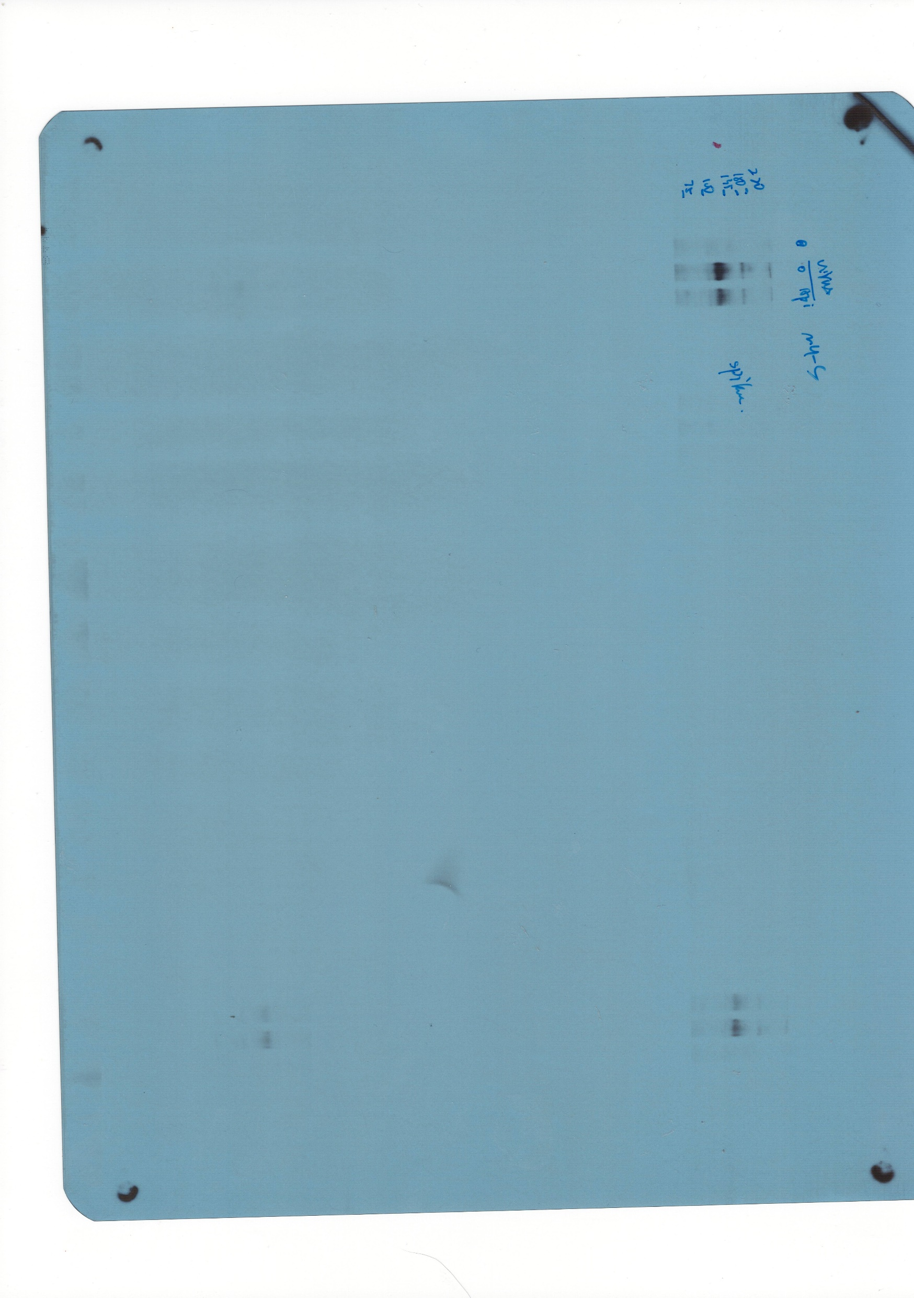
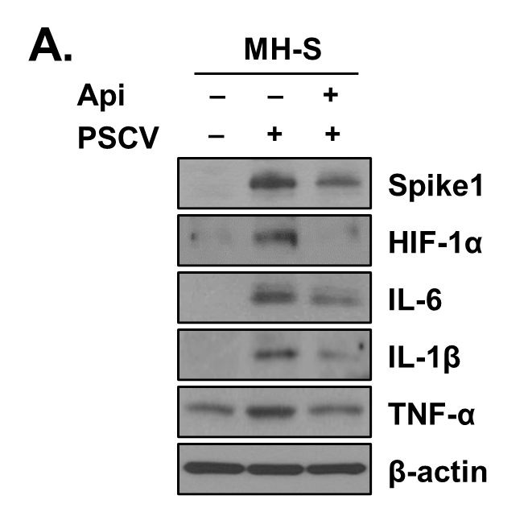
Figure 4. (A)

Slide 59

Figure 4. (A)

Slide 60
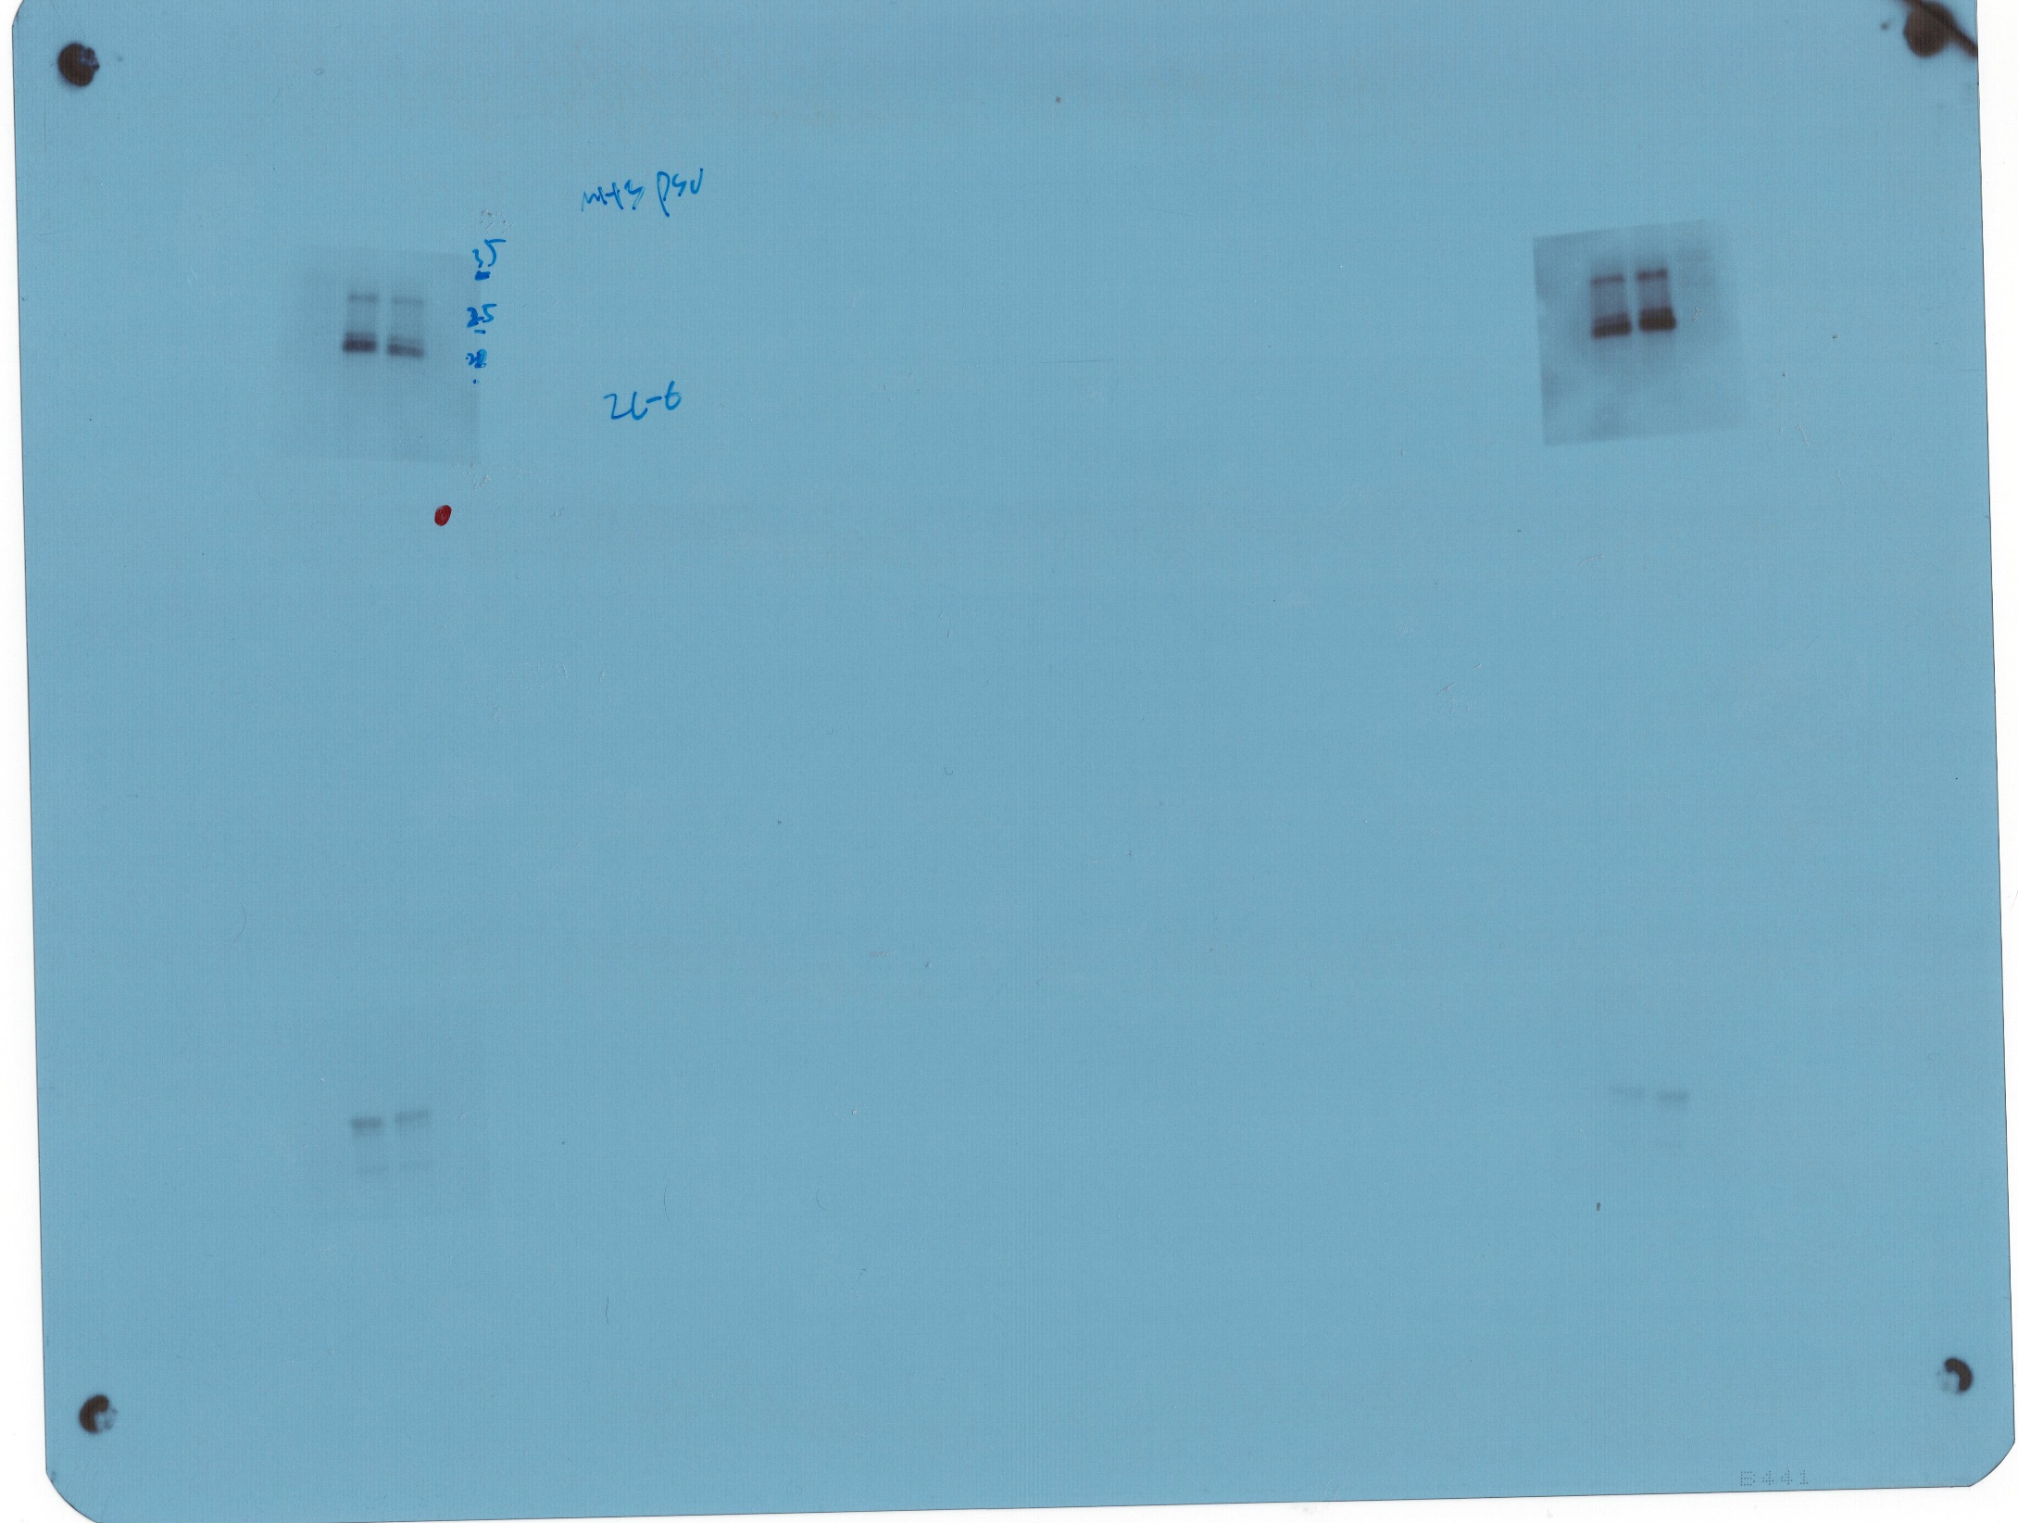
Figure 4. (A)

Slide 61
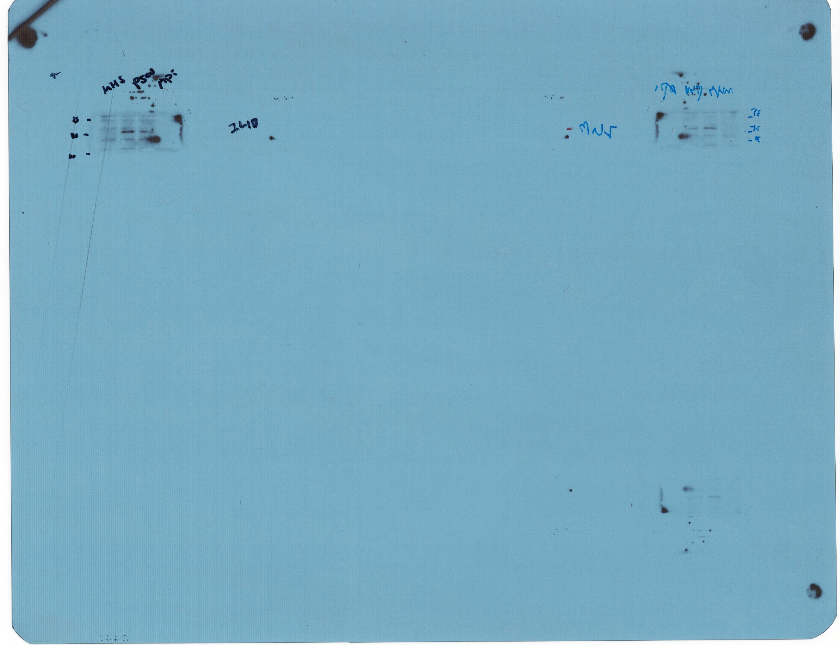
Figure 4. (A)

Slide 62
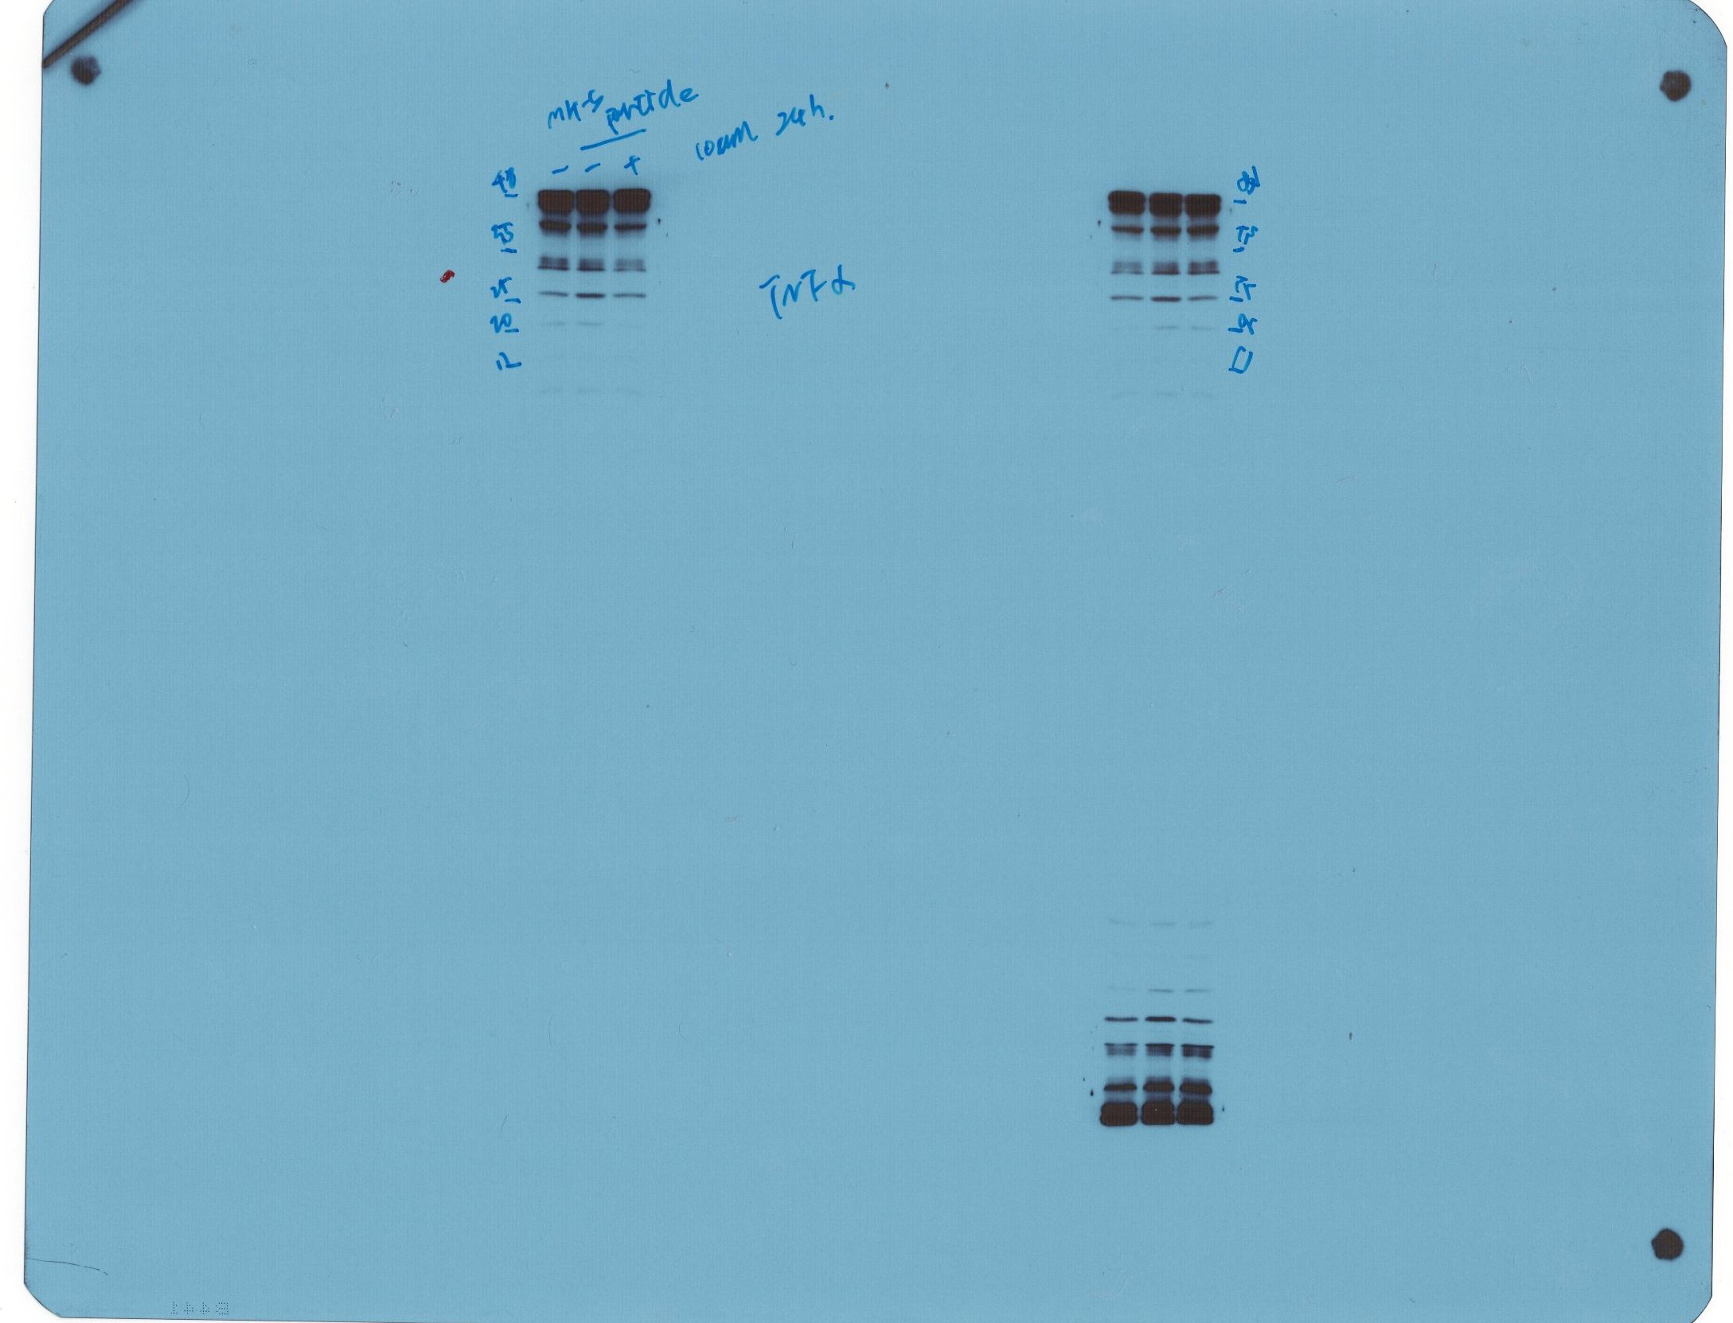
Figure 4. (A)

Slide 63
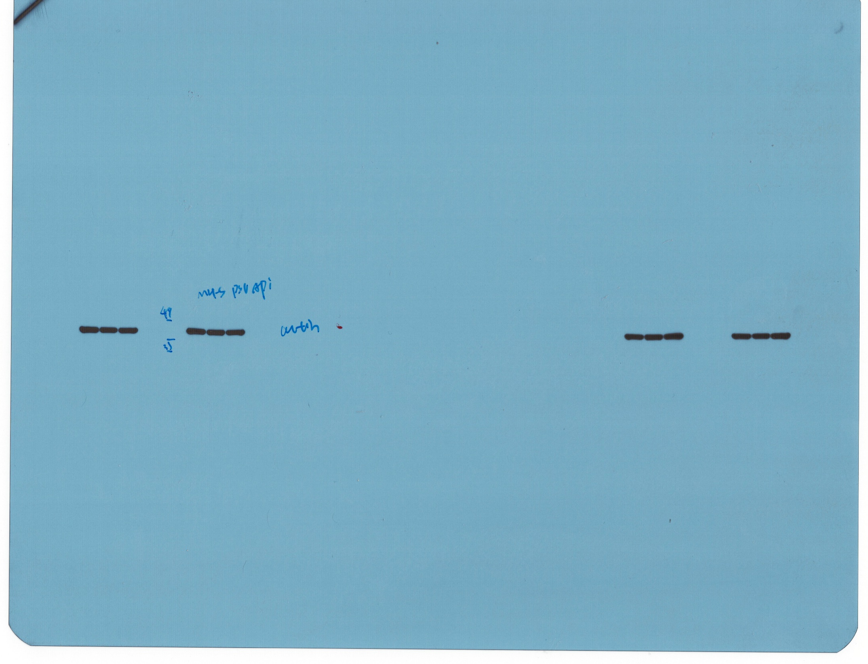
Figure 4. (A)

Slide 64

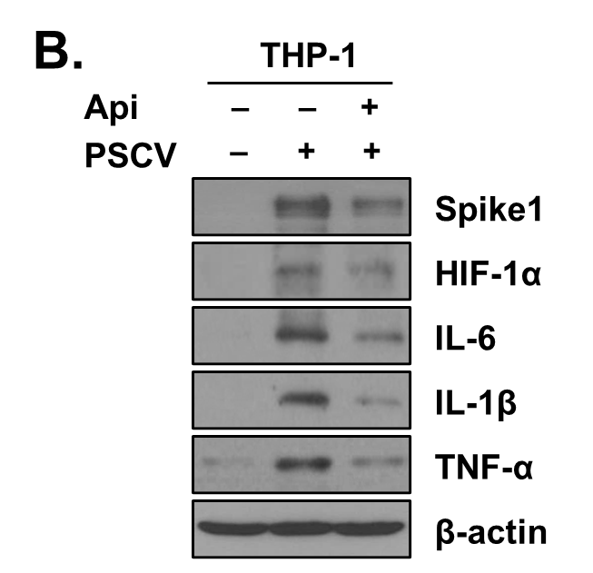
Figure 4. (B)

Slide 65
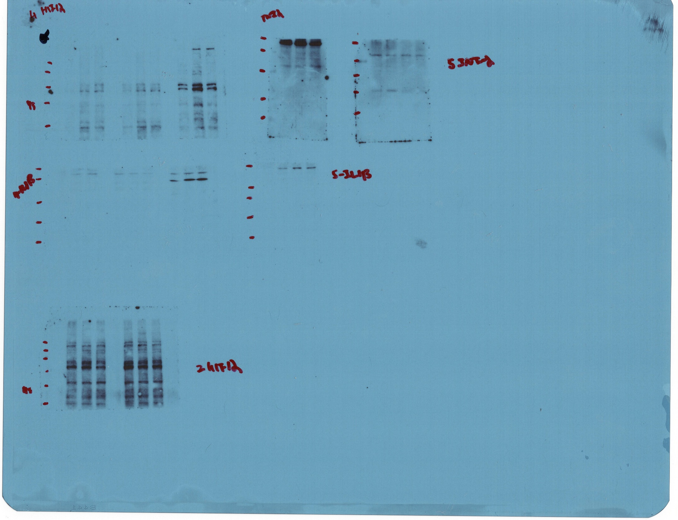
Figure 4. (B)

Slide 66
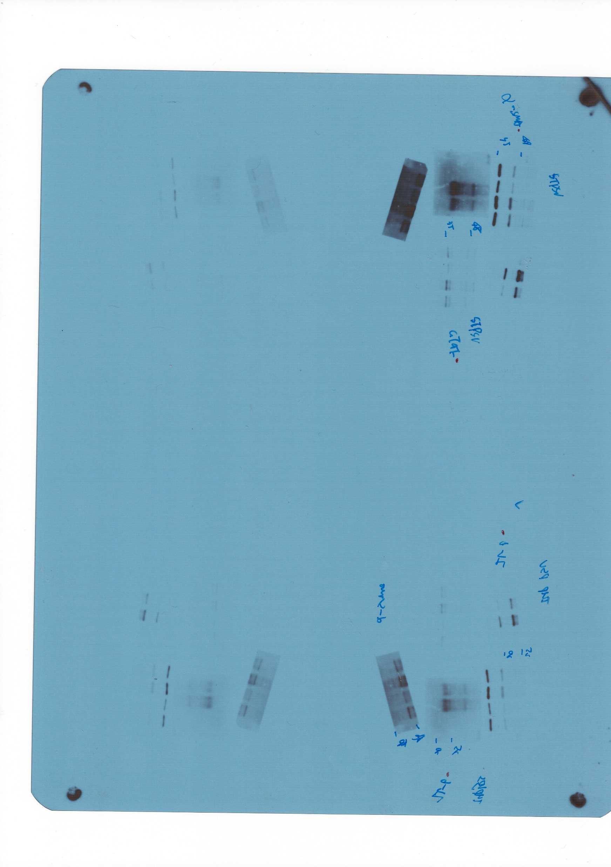
Figure 4. (B)

Slide 67
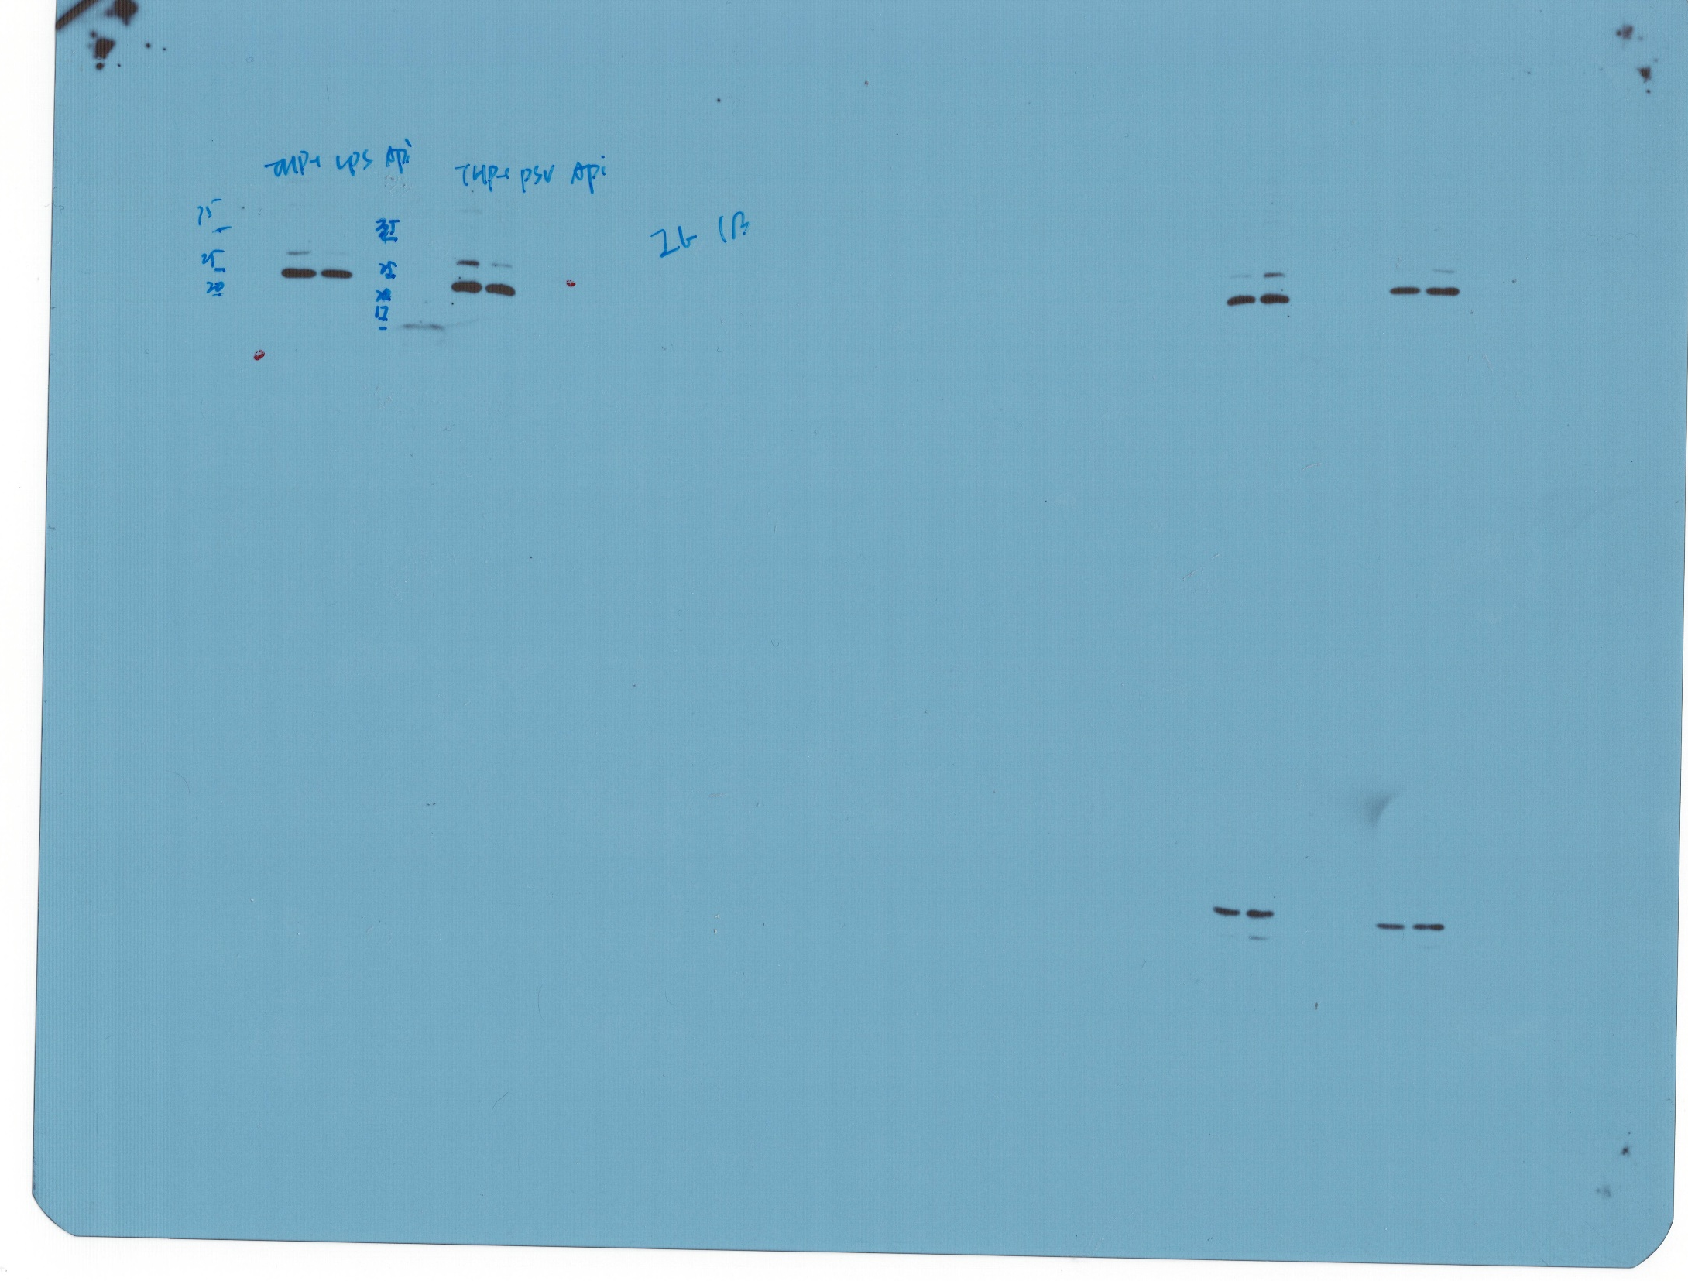
Figure 4. (B)

Slide 68

Figure 4. (B)

Slide 69

Figure 4. (B)

Slide 70


Figure 5. (C)

Slide 71

Figure 5. (C)

Slide 72

Figure 5. (C)

Slide 73
Figure 5. (C)

Slide 74
Figure 5. (C)

Slide 75

Figure 5. (F)

Slide 76

Figure 5. (F)

Slide 77
Figure 5. (F)

Slide 78
Figure 5. (F)

Slide 79

Figure 5. (F)

