Slide 1
Figure S1 Disease grade of lines inoculated at different date after silking

Slide 2
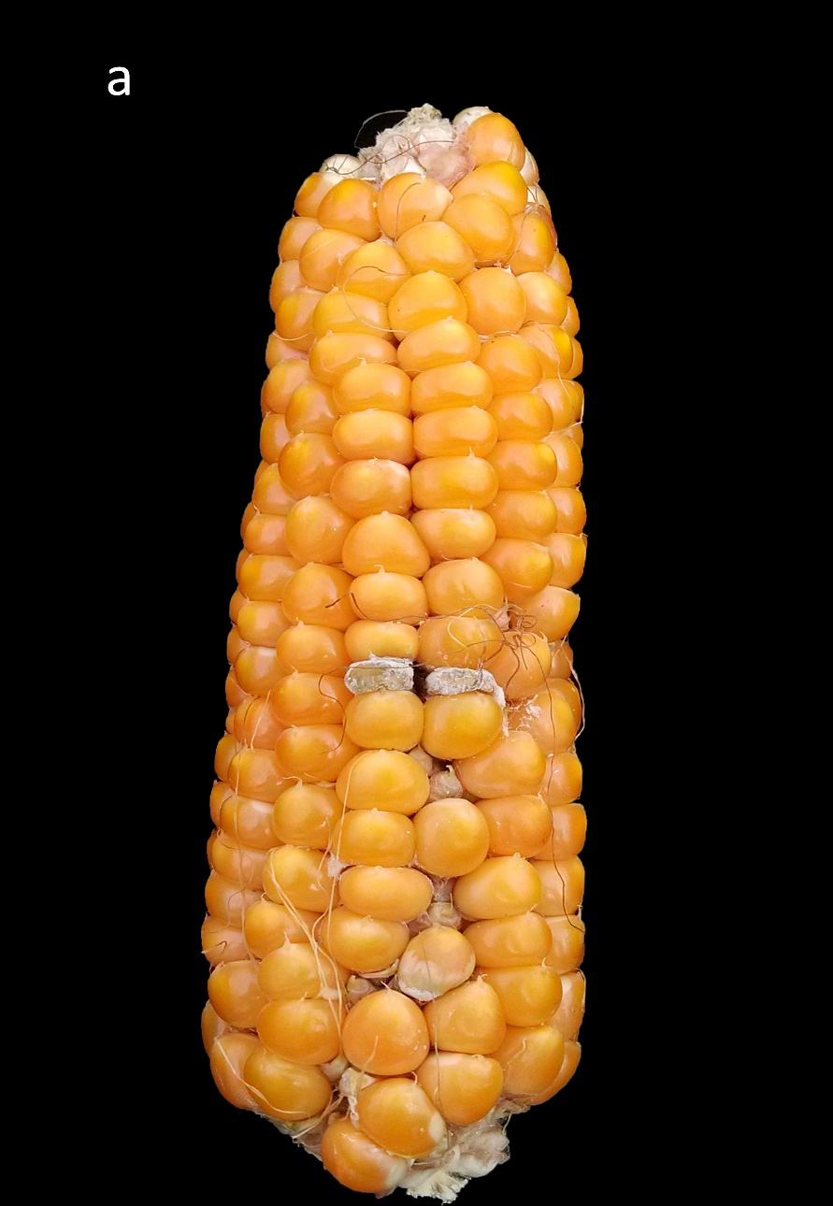
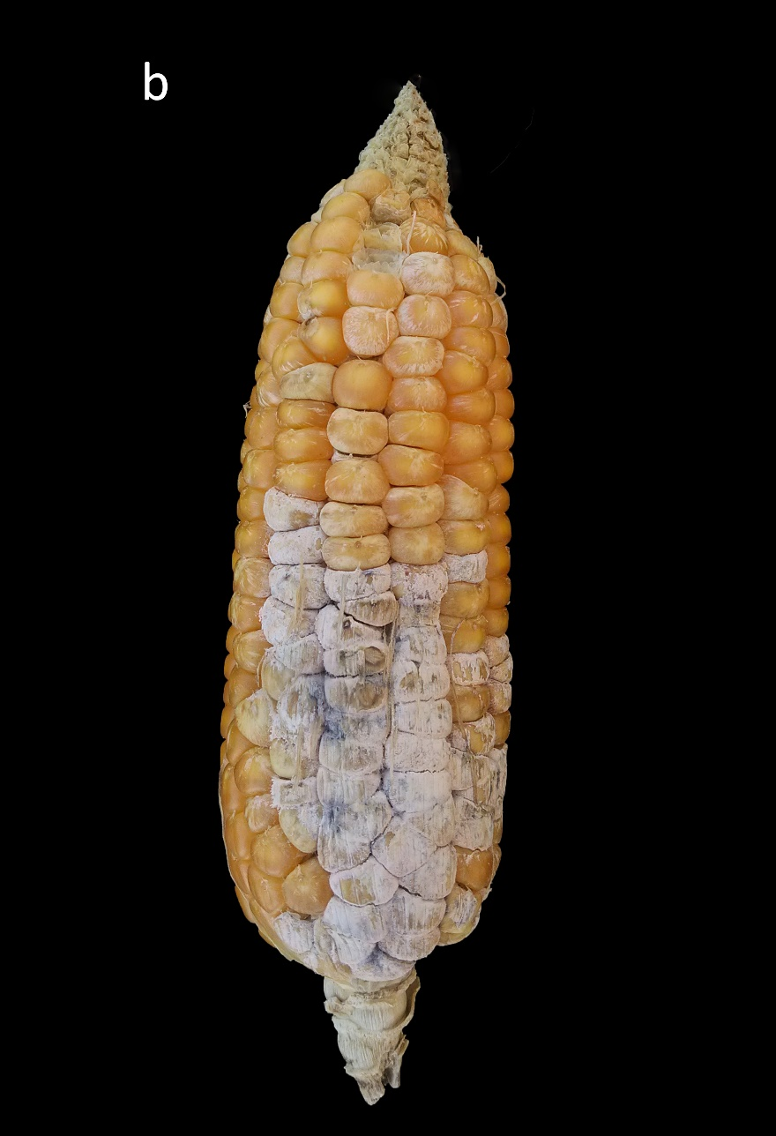
Figure S2 Phenotypic variation in FER severity at harvest between the two parental lines in artificially inoculated ears with F.verticillioides. The resistant BT-1 is represented by the one ear on the left (a) and the susceptible N6 on the right (b)

Slide 3
Figure S3 Frequency distribution plot of the Phenotypes of RIL population (a) and GWAS population (b).

Slide 4
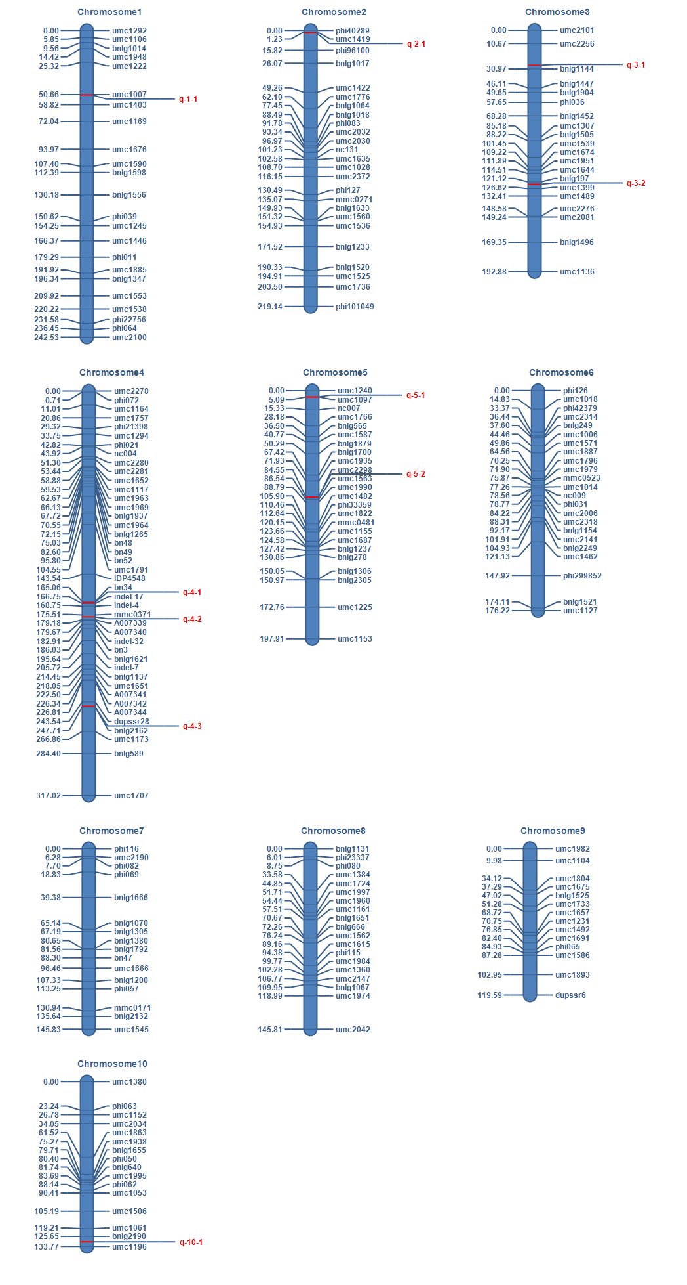
Figure S4 Linkage map consisting of 222 markers and QTL detected from the whole genome in RIL population.

Slide 5
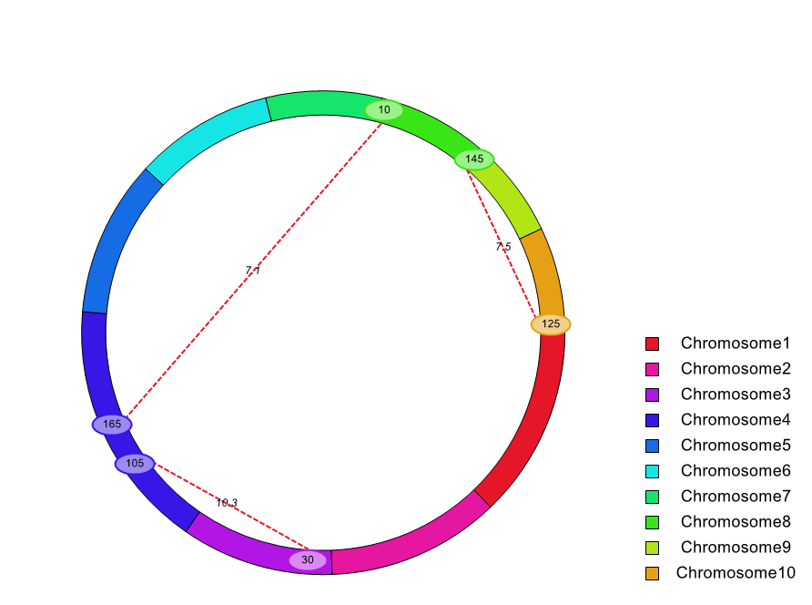
Figure S5 Cyclic graph for ICIM epistatic mapping.
(Each color represents a chromosome; oval for QTL and genetic position; number on dotted red line indicates LOD score.)

Slide 6
Figure S6 Q-Q plot of GWAS for the F. verticillioides ear rot resistance in maize.

