Slide 1
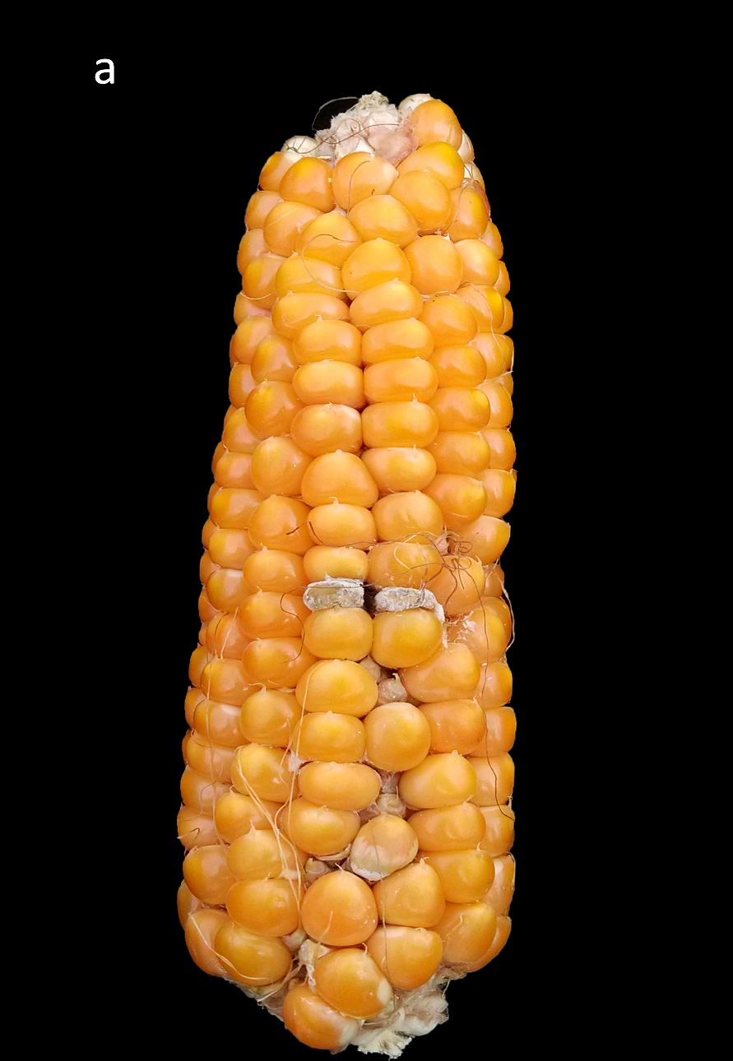
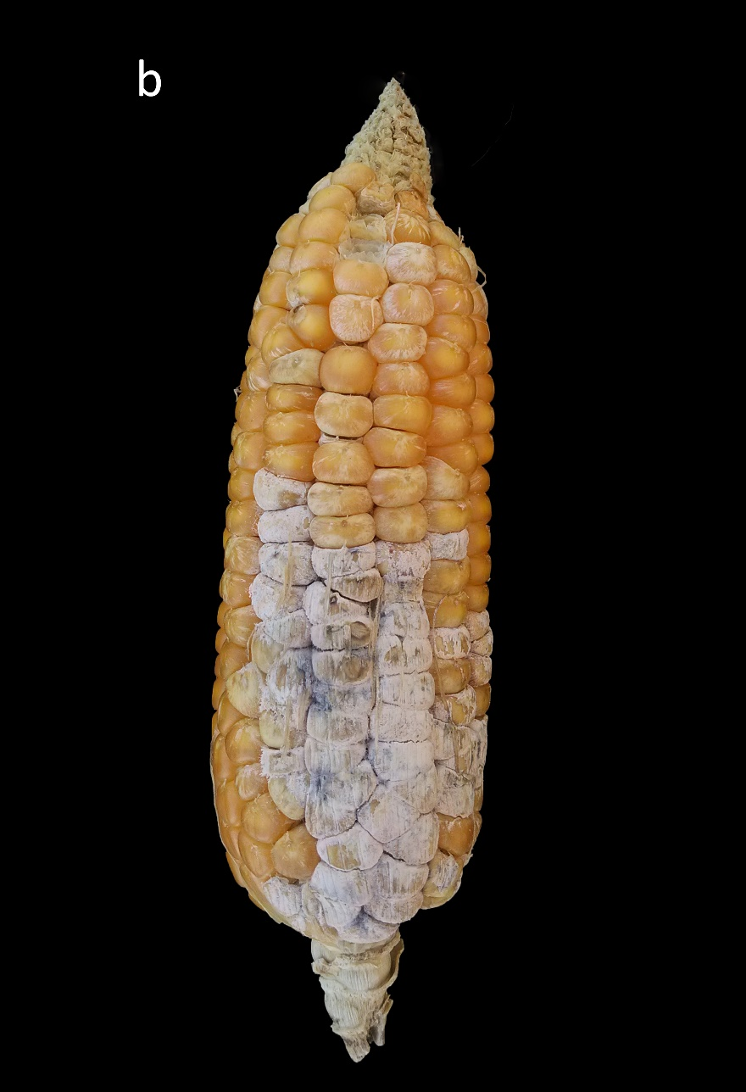
Figure S1 Phenotypic variation in FER severity at harvest between the two parental lines in artificially inoculated ears with F.verticillioides. The resistant BT-1 is represented by the one ear on the left (a) and the susceptible N6 on the right (b)

Slide 2
Figure S2 Frequency distribution plot of the Phenotypes of RIL population (a) and GWAS population (b).

Slide 3
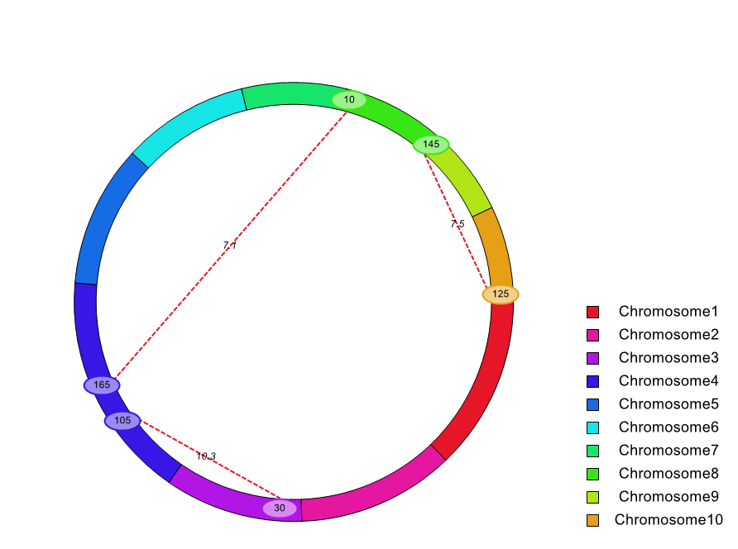
Figure S3 Cyclic graph for ICIM epistatic mapping.
(Each color represents a chromosome; oval for QTL and genetic position; number on dotted red line indicates LOD score.)

Slide 4
Figure S4 Q-Q plot of GWAS for the F. verticillioides ear rot resistance in maize.

Slide 5
Figure S5 Disease grade of lines inoculated in different date after silking

