Slide 1
Full Unedited Blots
Delenko et al

Slide 2
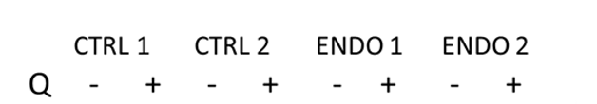
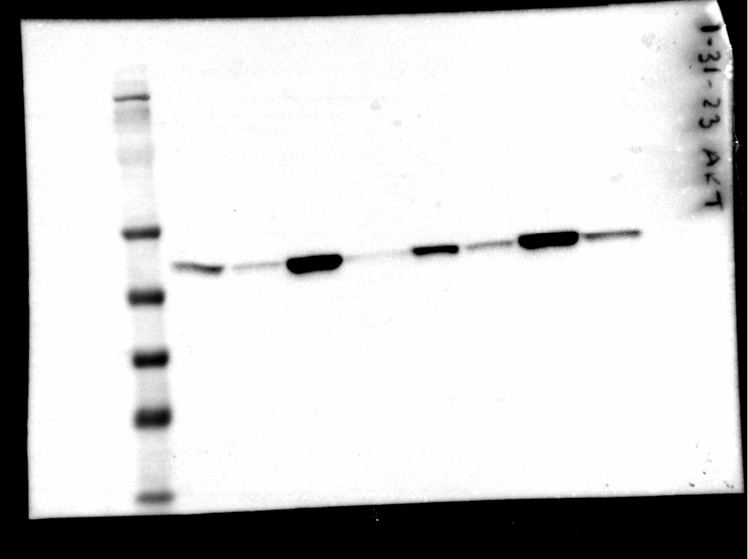
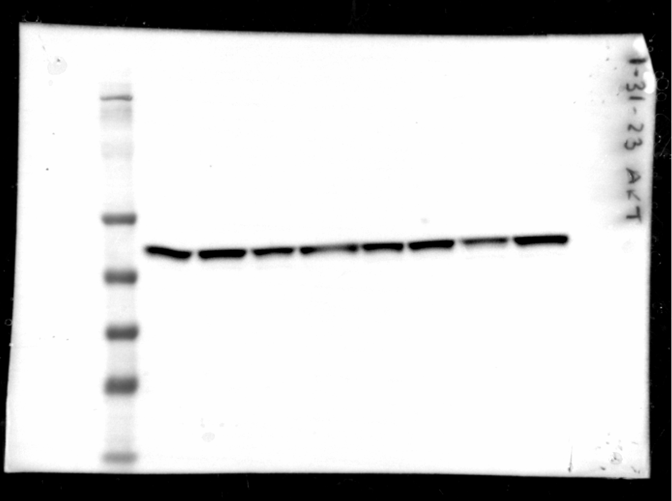
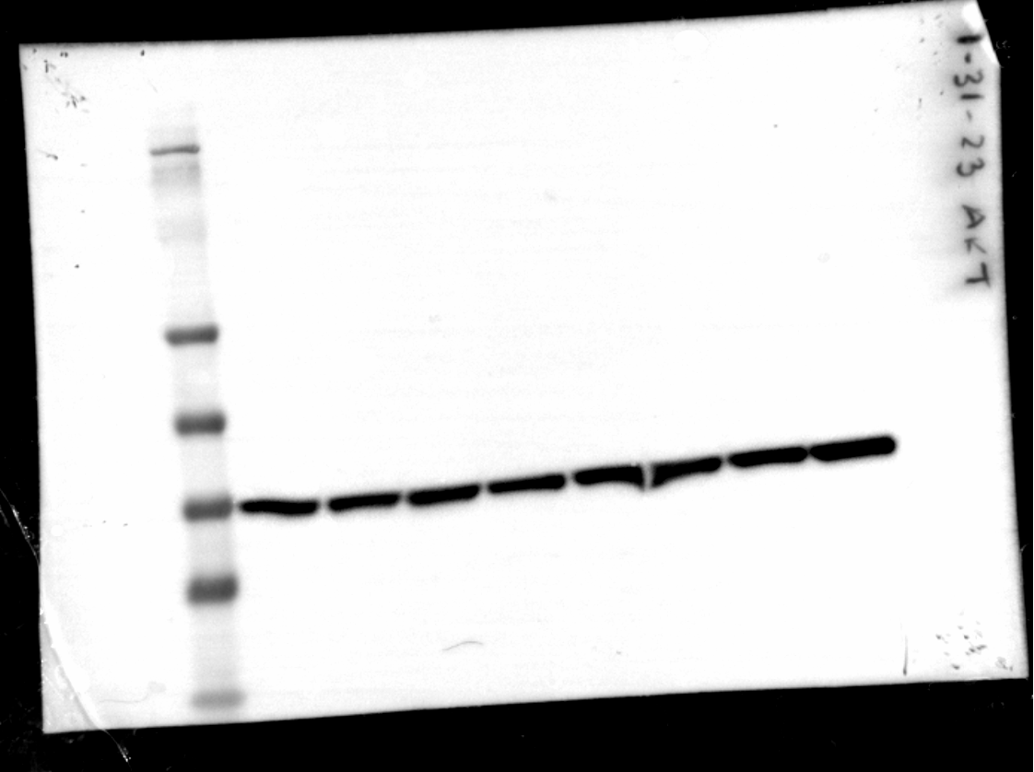
Figure 6. Quercetin inhibits AKT and ERK1/2 phosphorylation and signaling and promotes p53 (Ser46) phosphorylation
(C)
MWM
198
98
62
49
38
28
14
pAKT (S473)
AKT
GAPDH

Slide 3
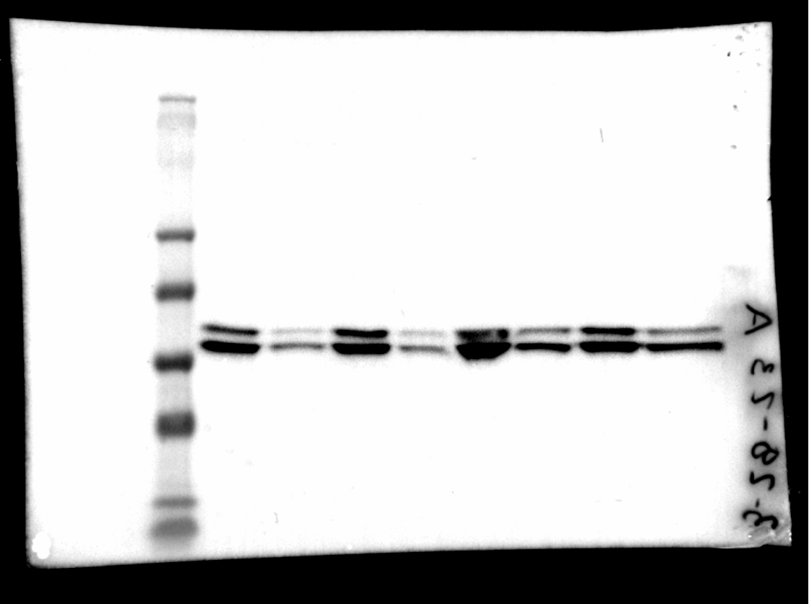
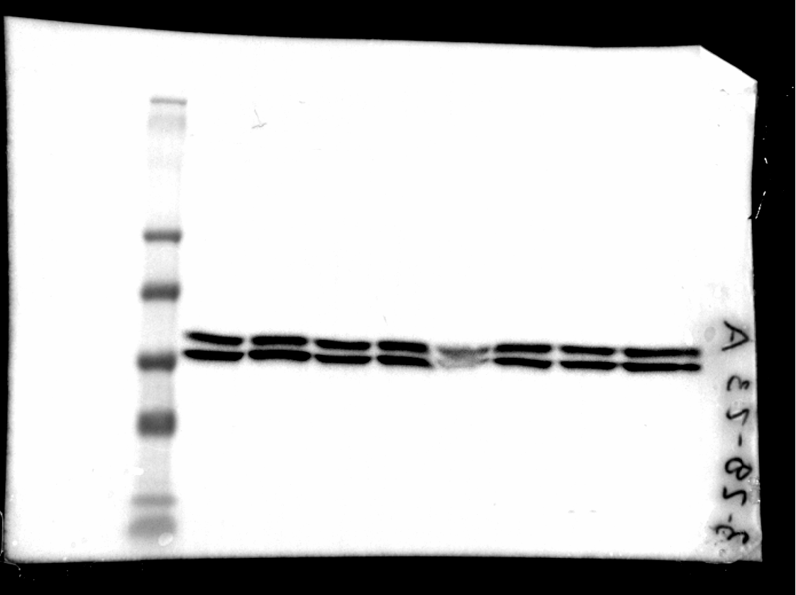
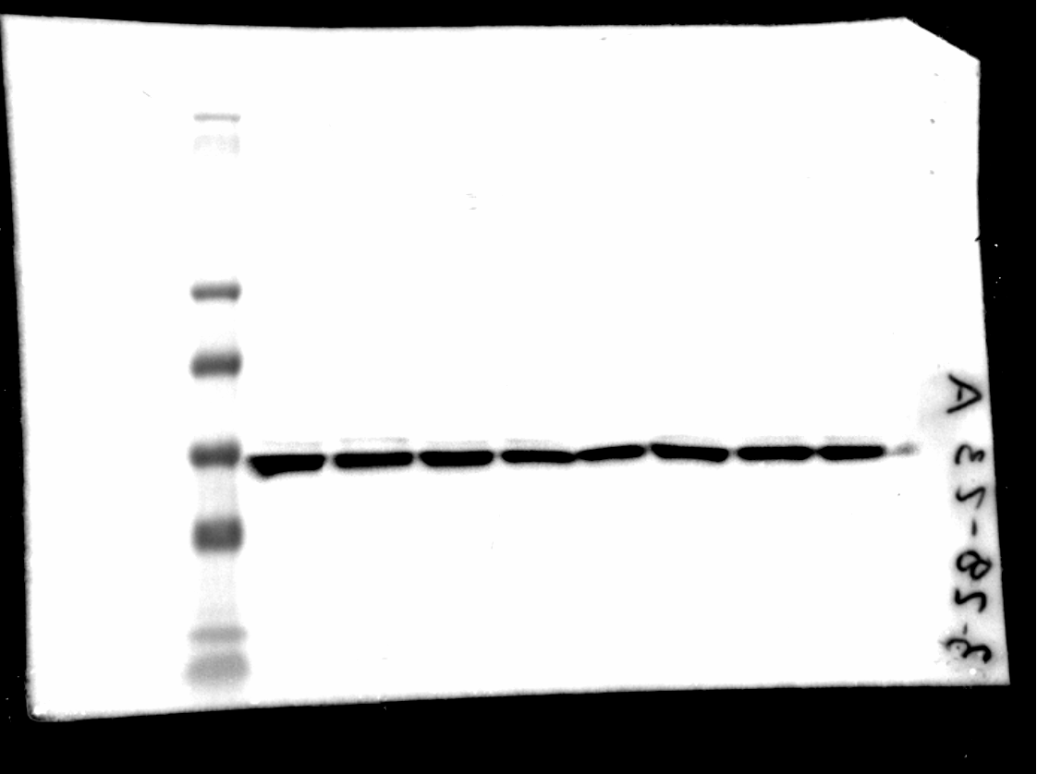
Figure 6. Quercetin inhibits AKT and ERK1/2 phosphorylation and signaling and promotes p53 (Ser46) phosphorylation
(C)
MWM
198
98
62
49
38
28
14
pERK1 (T202)
pERK2 (Y204)
ERK1
ERK2
GAPDH

Slide 4
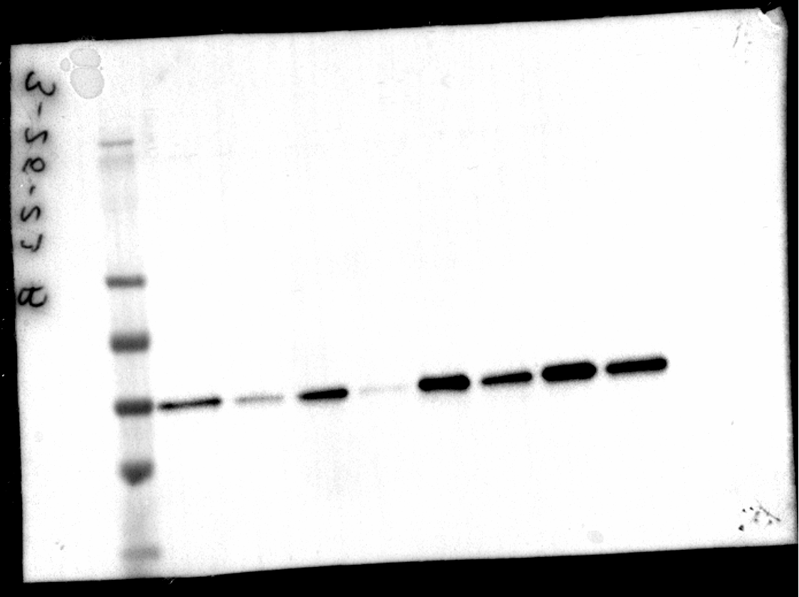
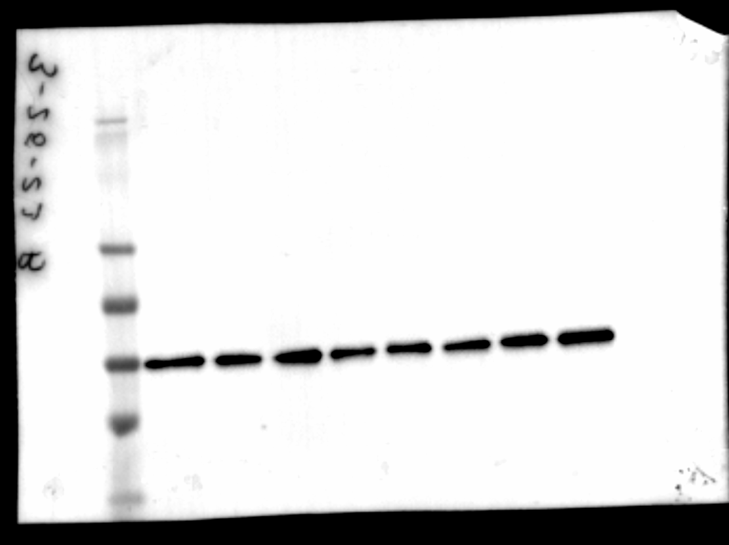
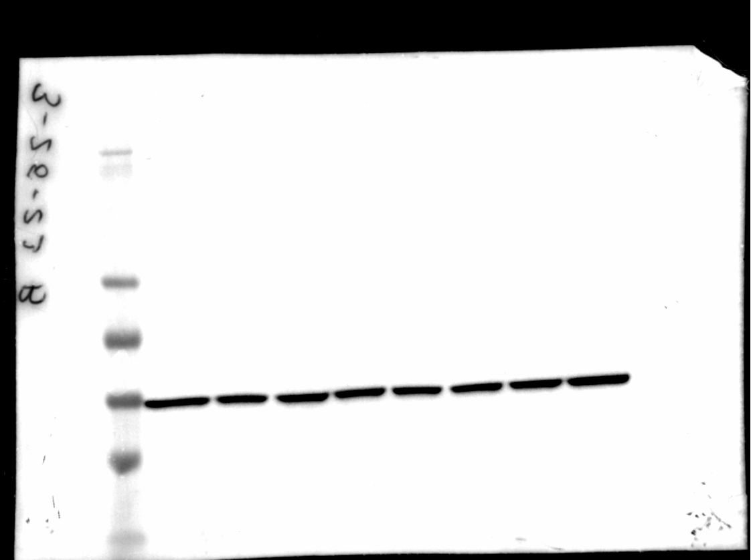
Figure 6. Quercetin inhibits AKT and ERK1/2 phosphorylation and signaling and promotes p53 (Ser46) phosphorylation
(C)
MWM
198
98
62
49
38
28
14
pPRAS40 (T246)
PRAS40
GAPDH

Slide 5


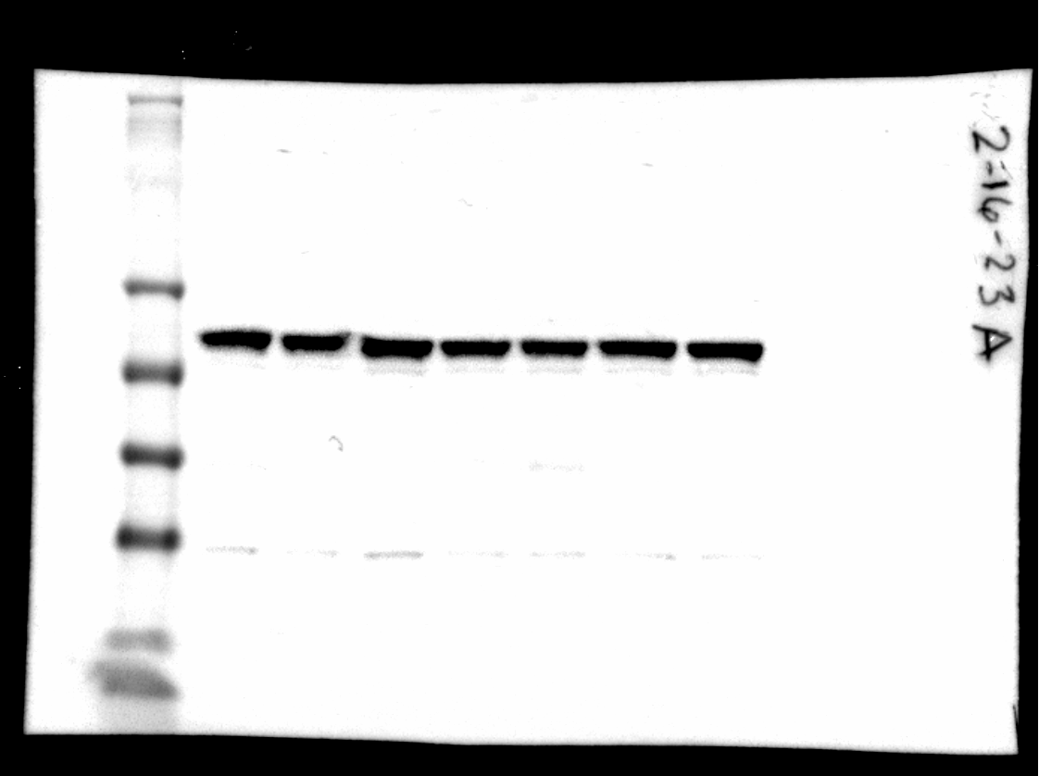
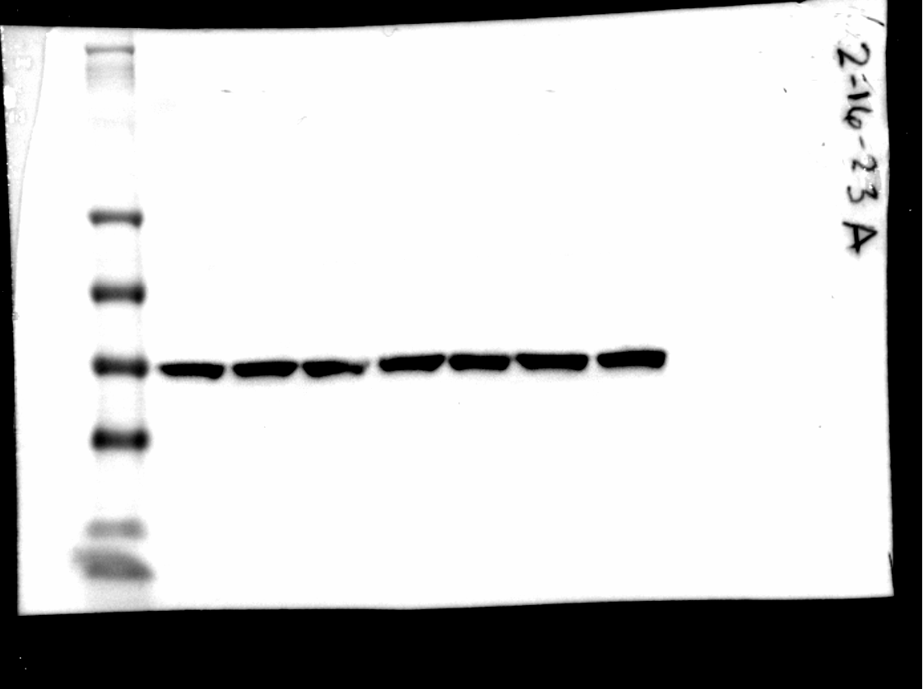
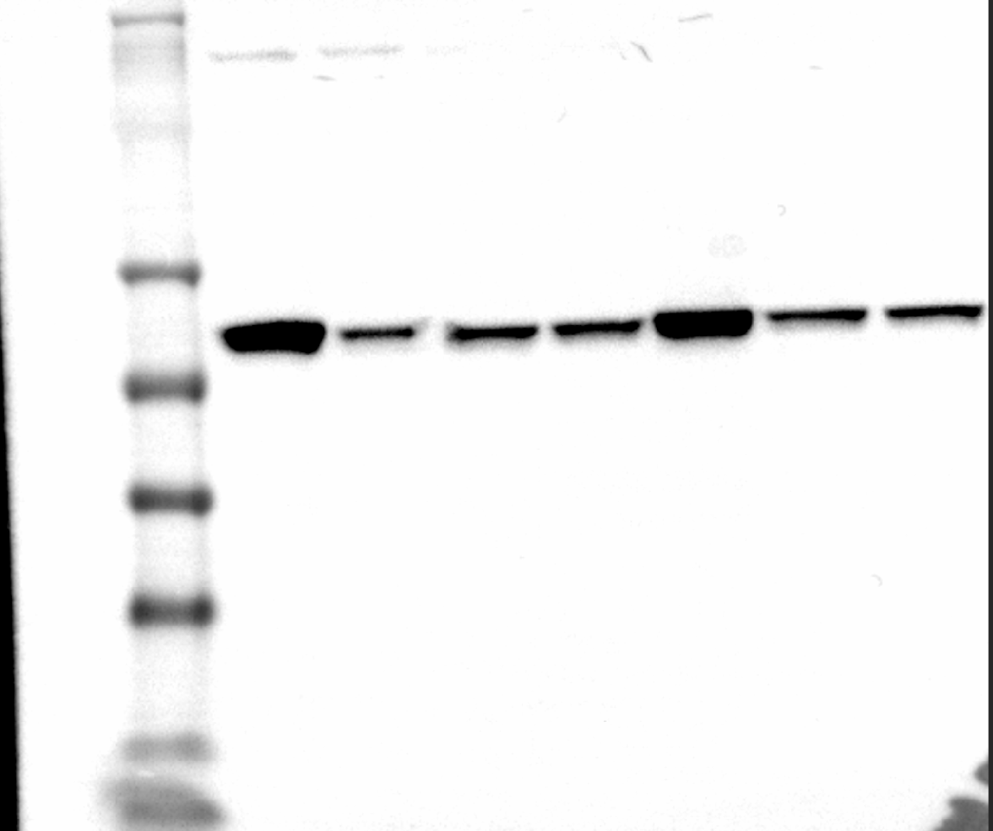
Figure 6. Quercetin inhibits AKT and ERK1/2 phosphorylation and signaling and promotes p53 (Ser46) phosphorylation
(E)
Patient 1**
Patient 2
Patient 1**
Patient 2
Patient 1**
Patient 2
MWM
198
98
62
49
38
28
14
pAKT (S473)
AKT
GAPDH
** patient shown in manuscript

Slide 6
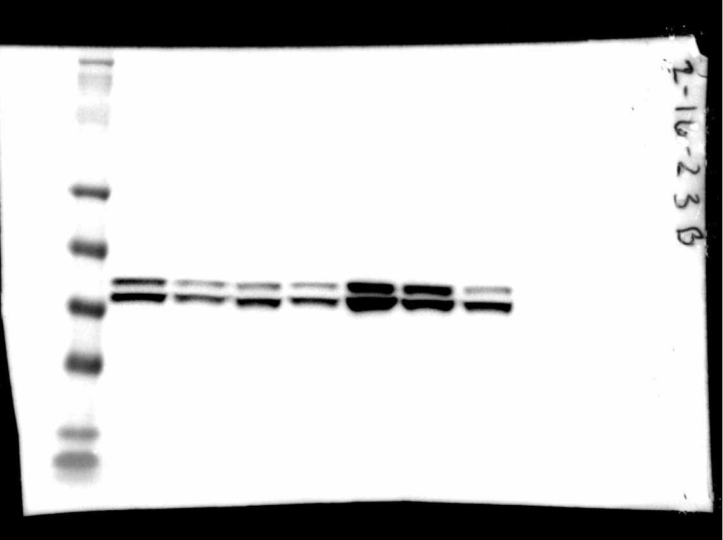
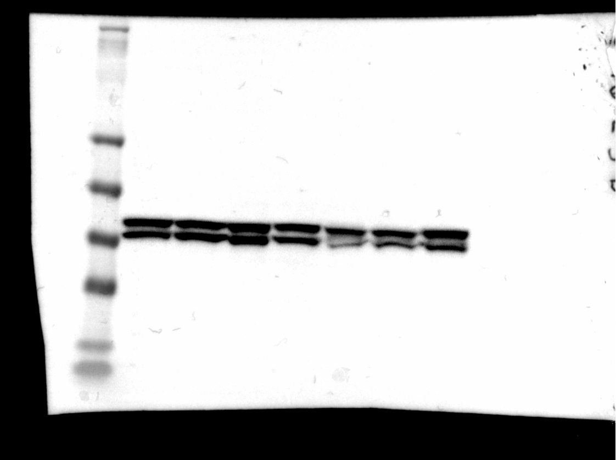
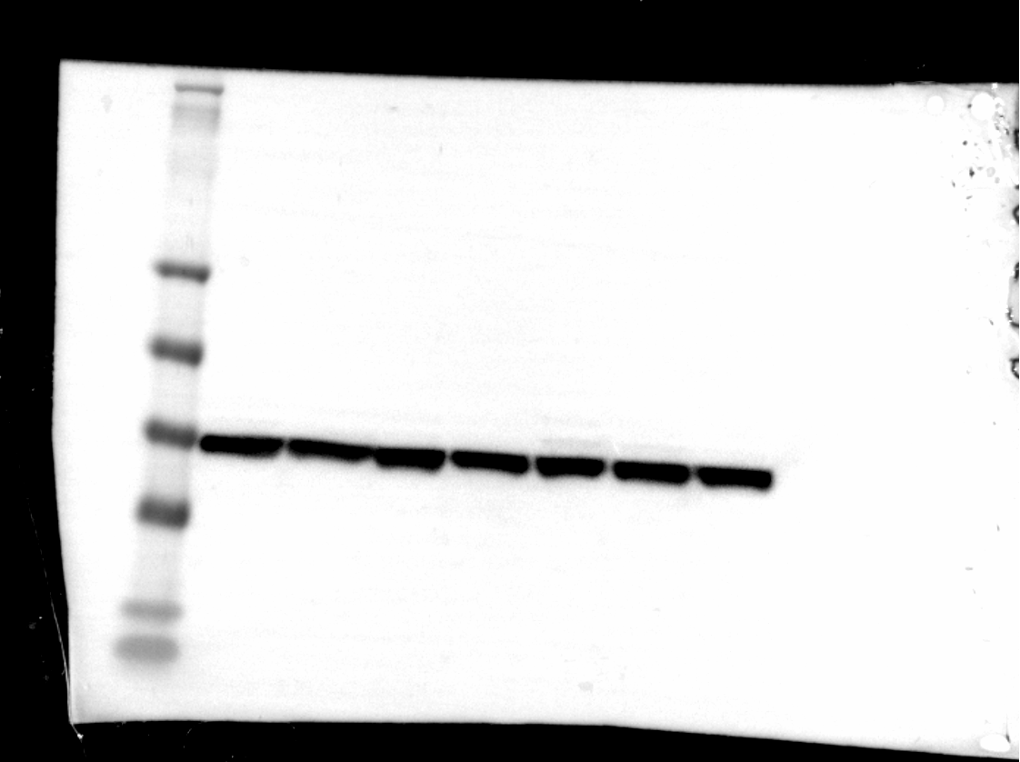
Figure 6. Quercetin inhibits AKT and ERK1/2 phosphorylation and signaling and promotes p53 (Ser46) phosphorylation
(E)
Patient 1**
Patient 2
Patient 1**
Patient 2
Patient 1**
Patient 2
MWM
198
98
62
49
38
28
14
pERK1 (T202)
pERK2 (Y204)
ERK1
ERK2
GAPDH
** patient shown in manuscript

Slide 7
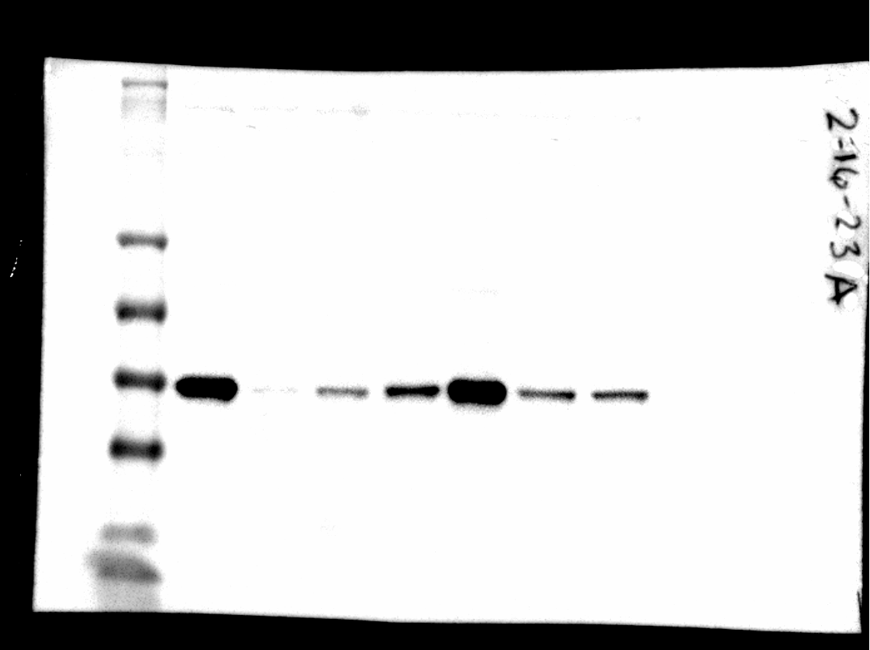
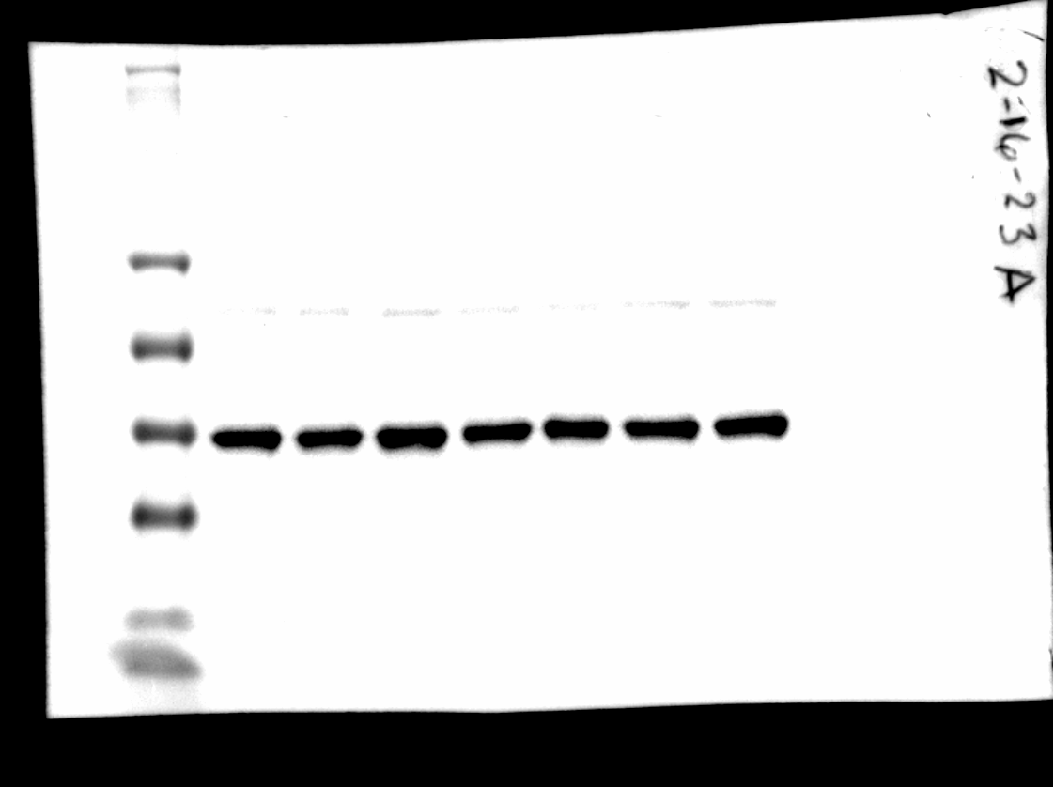
Figure 6. Quercetin inhibits AKT and ERK1/2 phosphorylation and signaling and promotes p53 (Ser46) phosphorylation
(E)
Patient 1**
Patient 2
Patient 1**
Patient 2
Patient 1**
Patient 2
MWM
198
98
62
49
38
28
14
pPRAS40 (T246)
PRAS40
GAPDH
** patient shown in manuscript

Slide 8
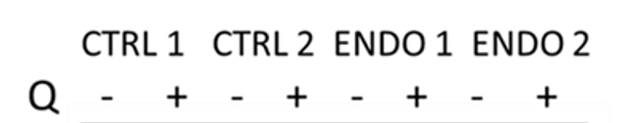
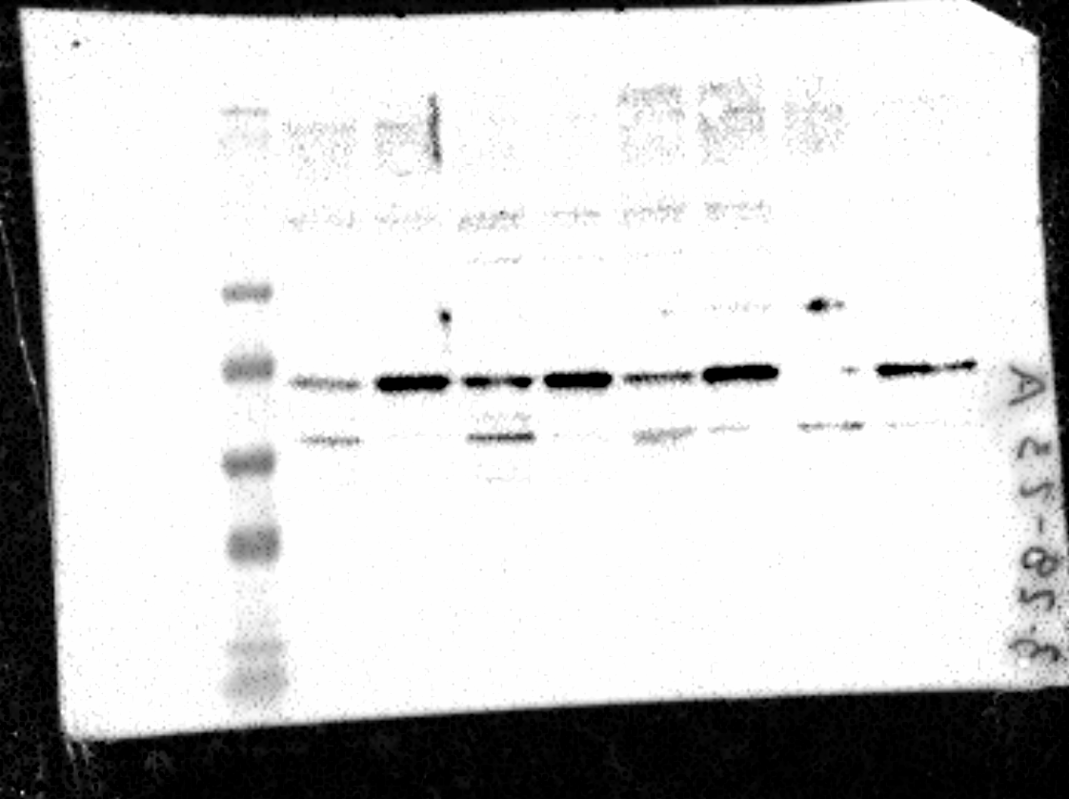

Figure 7. Quercetin induces p53, which contributes to decidualization
(A) 4 h
MWM
198
98
62
49
38
28
14
p53
p53
GAPDH

Slide 9
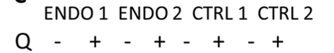
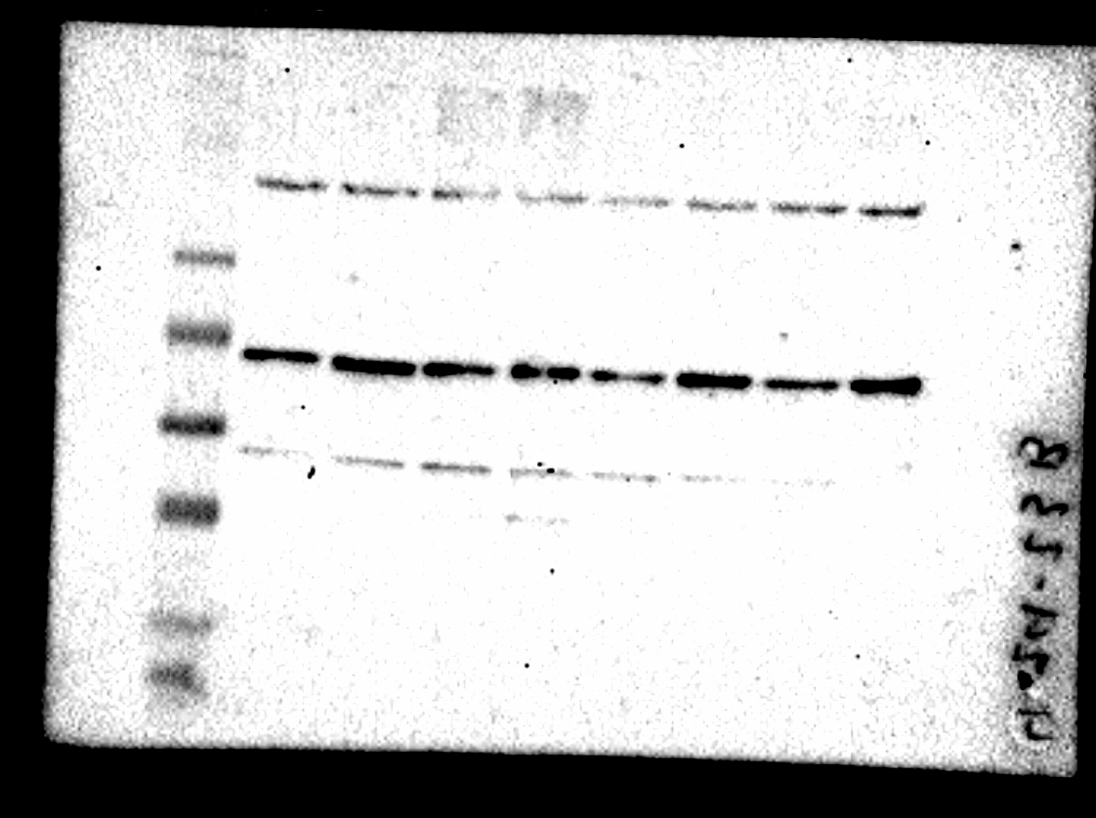
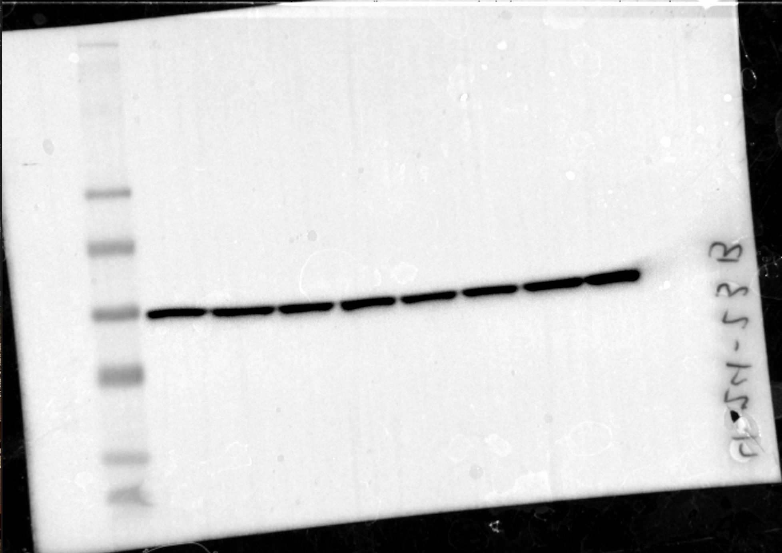
Figure 7. Quercetin induces p53, which contributes to decidualization
(C) 2 Days
MWM
198
98
62
49
38
28
14
p53
p53
GAPDH

Slide 10
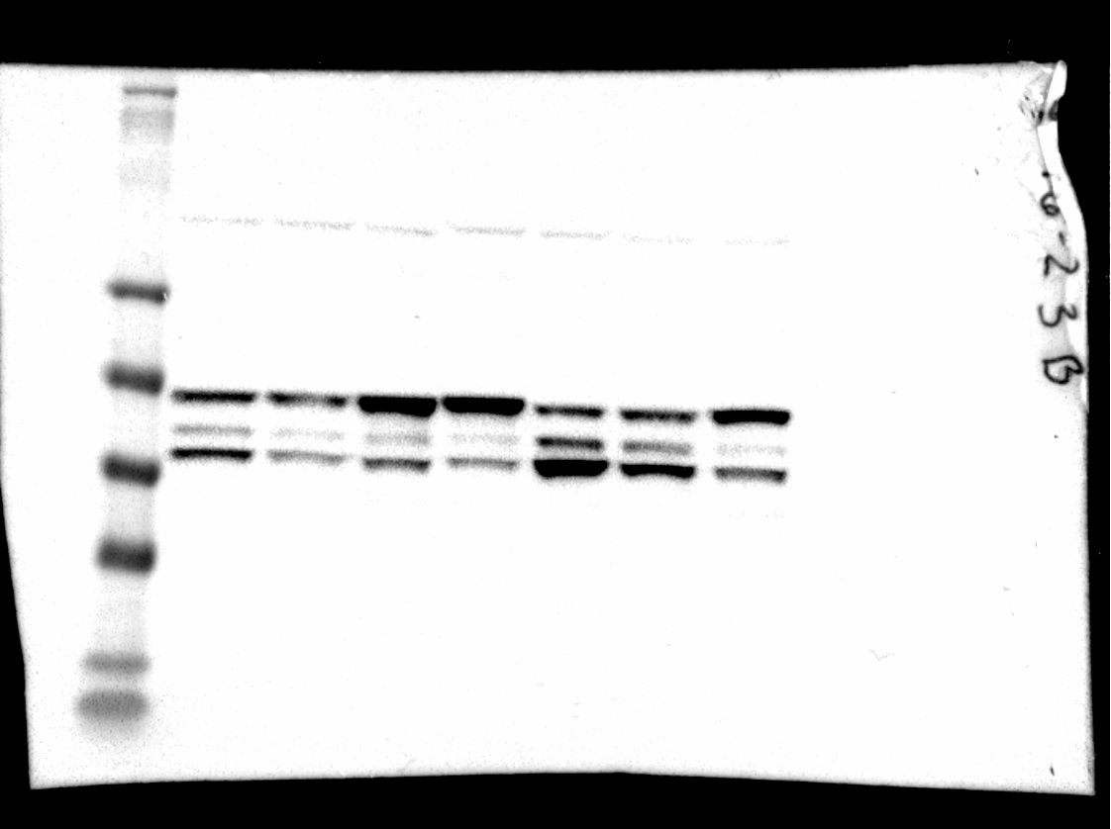
Figure 7. Quercetin induces p53, which contributes to decidualization
(E)
Patient 1**
Patient 2
Patient 1**
Patient 2
MWM
198
98
62
49
38
28
14
p53
ERK1
ERK2
p53
GAPDH
** patient shown in manuscript

Slide 11
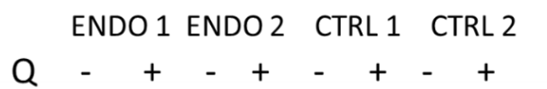
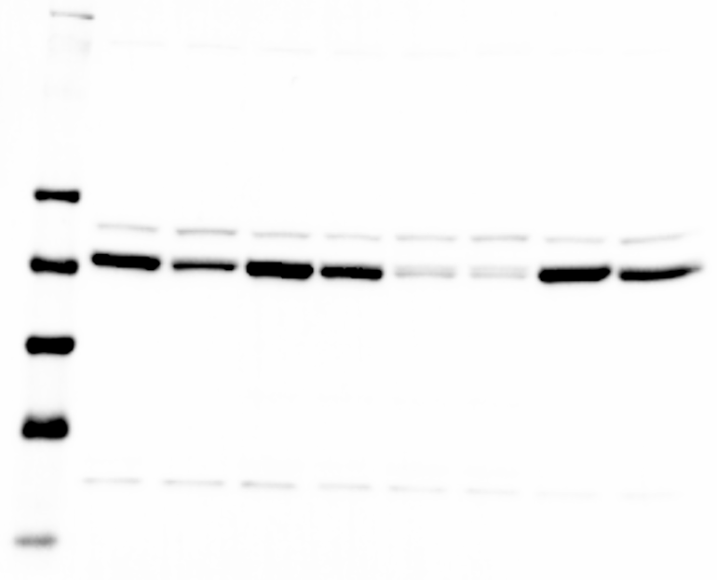
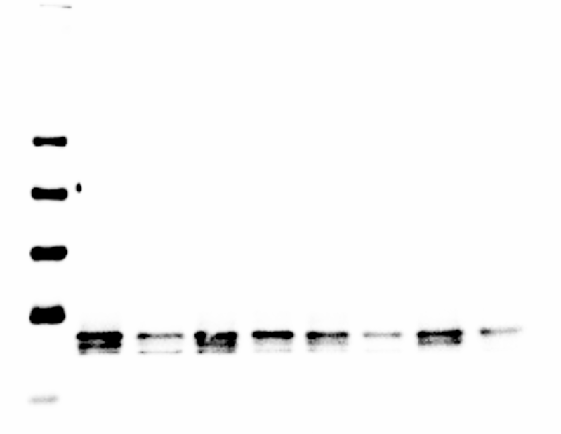
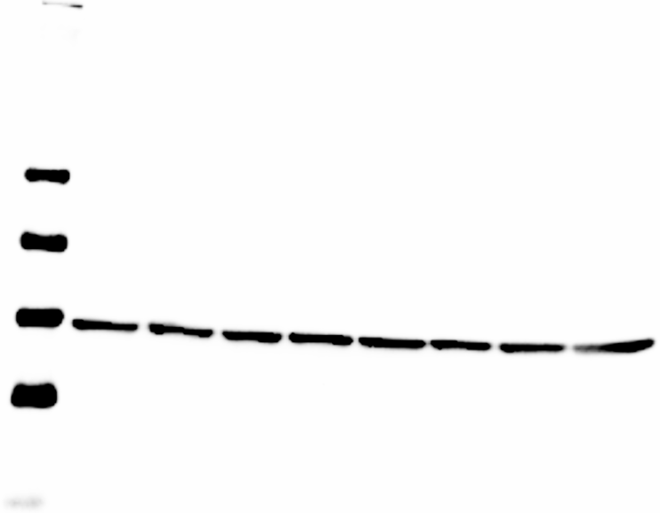
Figure 8. eSCs show evidence of senescence phenotype, which is reversed by quercetin.
(A)
MWM
198
98
62
49
38
28
14
MMP3
IL-6
GAPDH

Slide 12
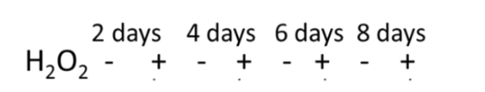
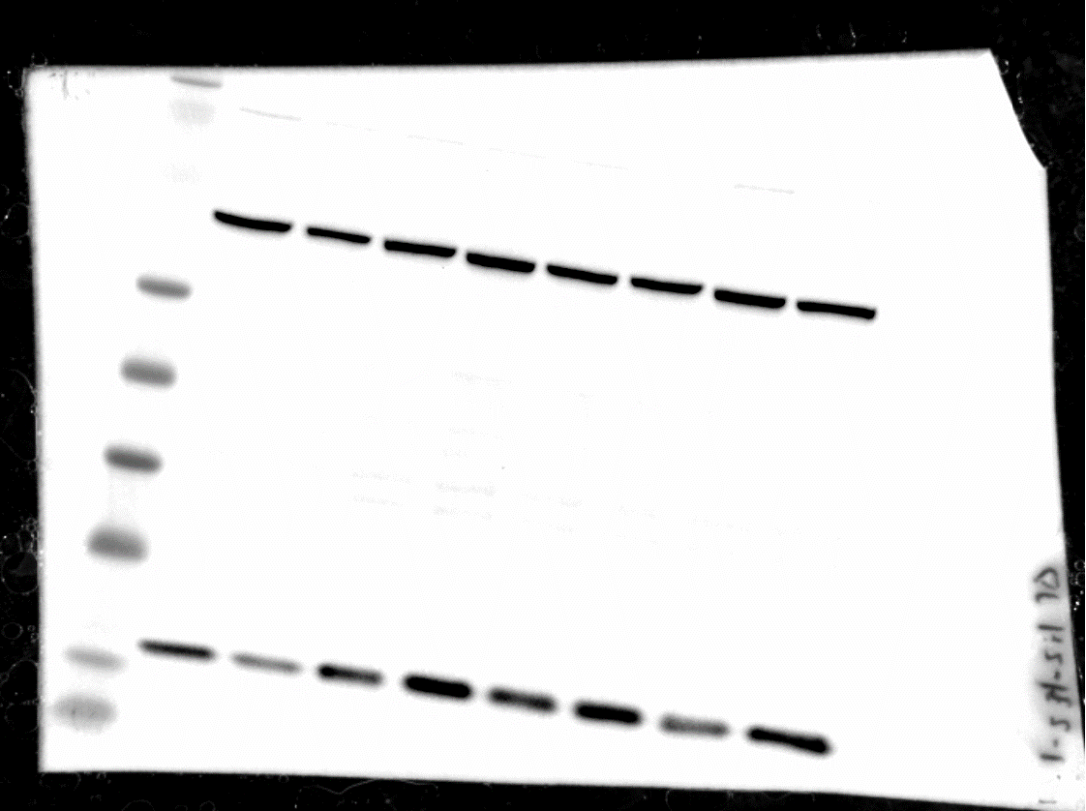
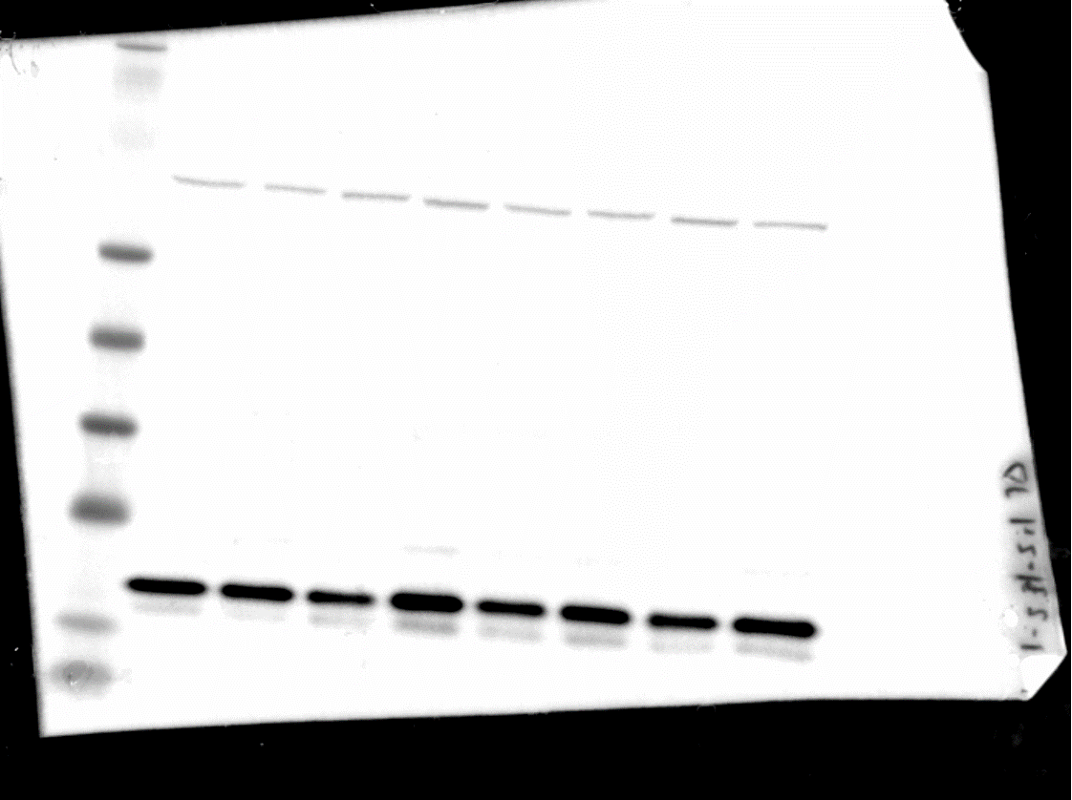
Figure 8. eSCs show evidence of senescence phenotype, which is reversed by quercetin.
(D)
MWM
198
98
62
49
38
28
14
p16
p21

Slide 13
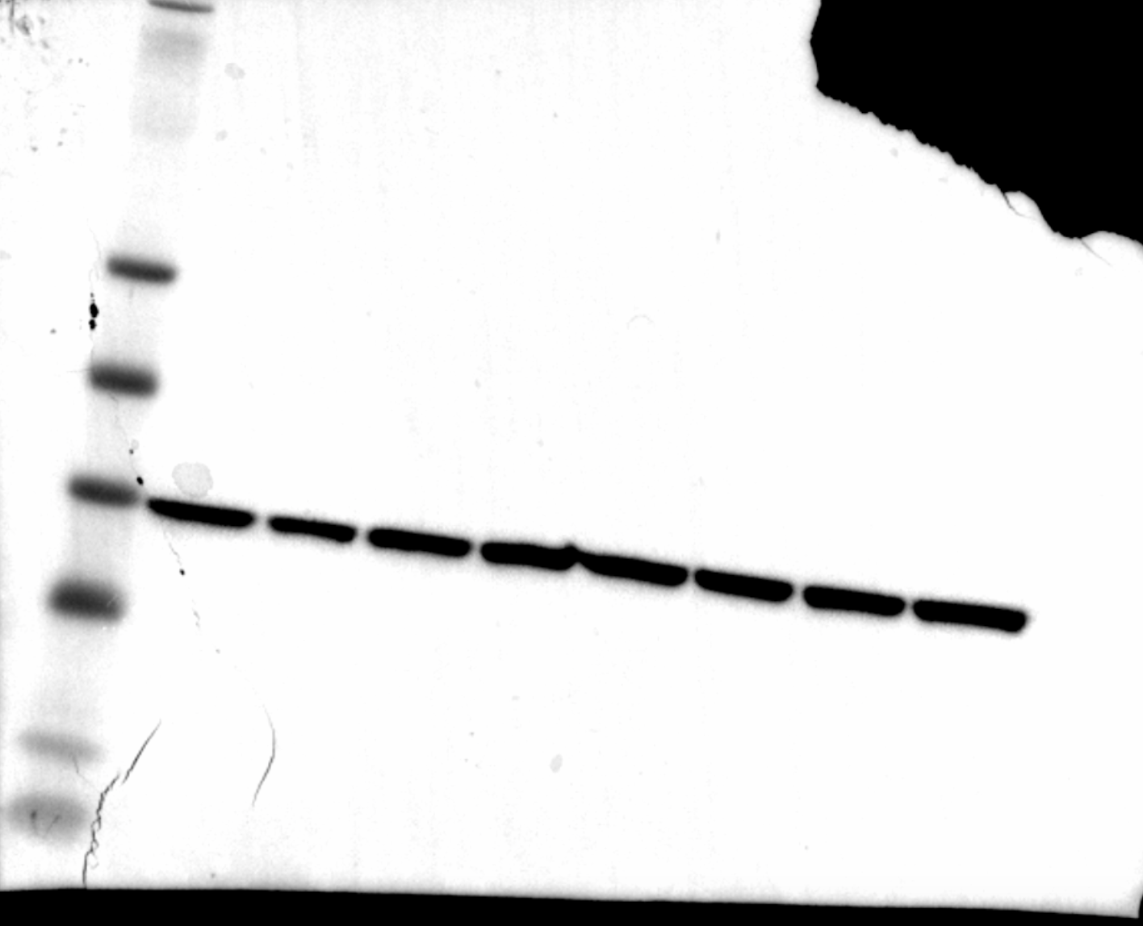
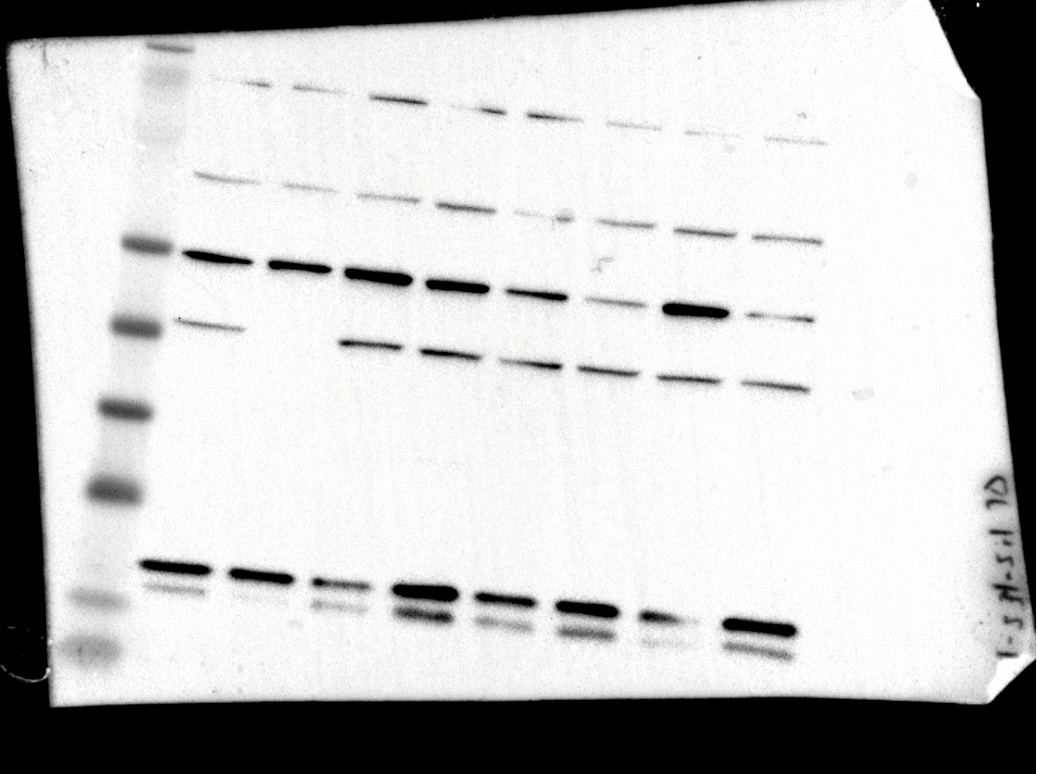
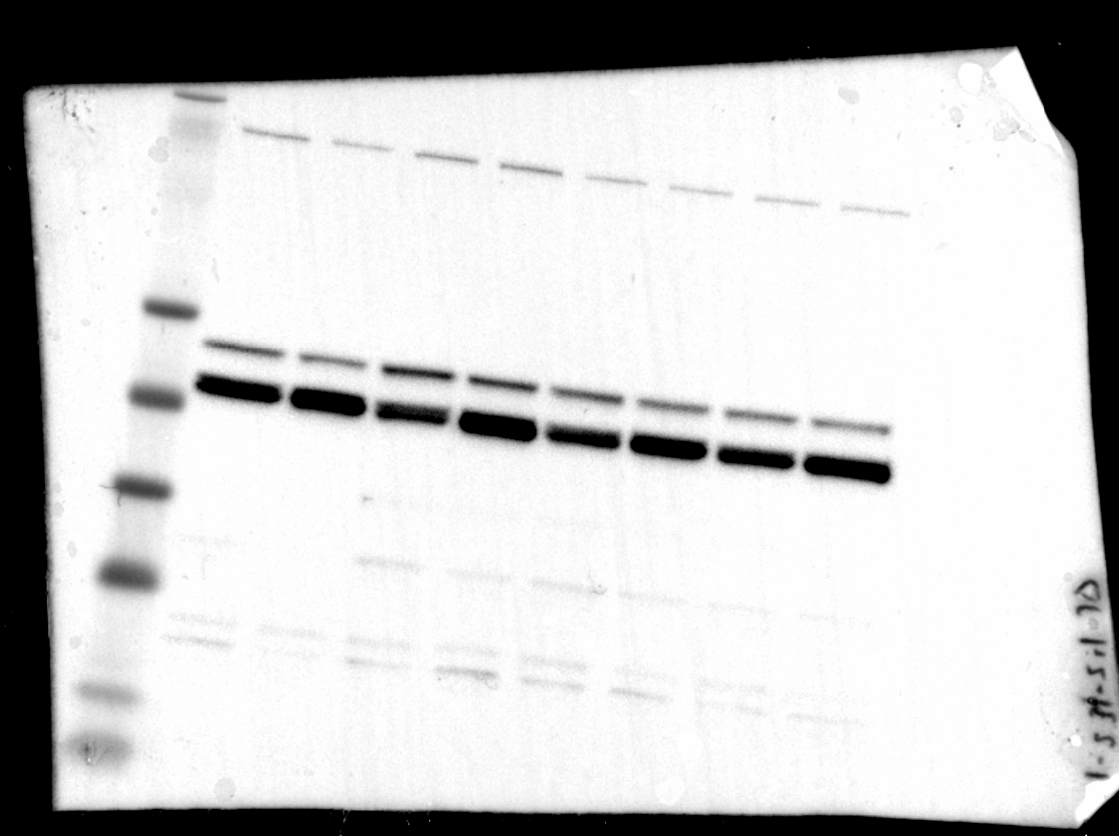
Figure 8. eSCs show evidence of senescence phenotype, which is reversed by quercetin.
(D)
MWM
198
98
62
49
38
28
14
Laminin B1
MMP3
GAPDH
LaminB1

