Slide 1
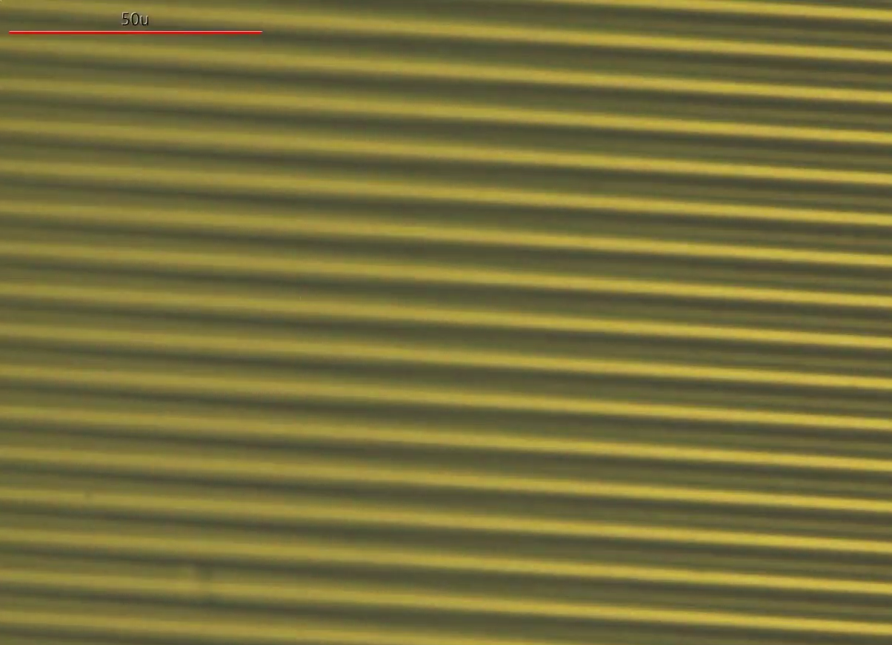
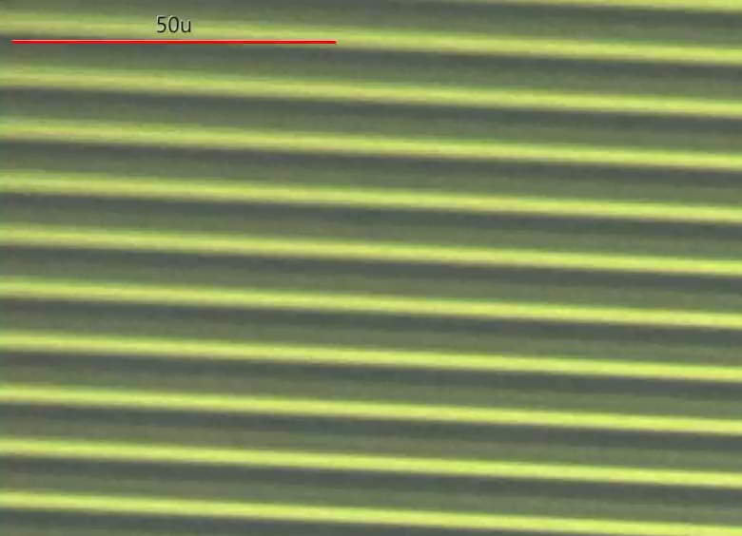
(a)
(b)
Supporting Information 1. In-situ observation movies during the comb-type STC discharging at room temperature with (a) and without cover-glass sealing.

Slide 2
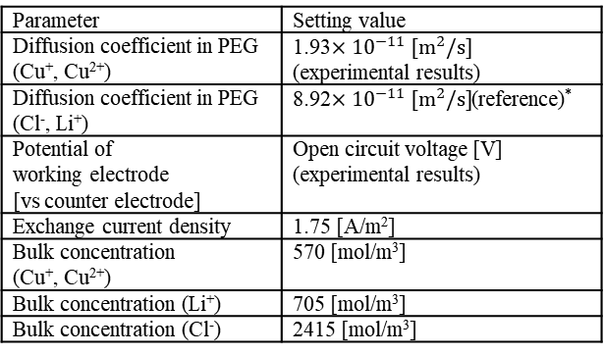
(a)
Height : 40 µm
×5
Li+
Cl-
Cu +
Cu 2+
Cu 2+
Cu +
1 µm
Ge
Pt
300 nm
Electrode distance = Electrode width (2, 5, 10, 20 µm)
(b)
Parameter | Setting value
Diffusion coefficient in PEG (Cu⁺, Cu²⁺) | 1.93$×{10}^{−11} [m^{2}/s]$ (experimental results)
Diffusion coefficient in PEG (Cl⁻, Li⁺) | 8.92$×{10}^{−11} [m^{2}/s]$(reference)*
Potential of working electrode [vs counter electrode] | Open circuit voltage [V] (experimental results)
Exchange current density | 1.75 [A/m²]
Bulk concentration (Cu⁺, Cu²⁺) | 570 [mol/m³]
Bulk concentration (Li⁺) | 705 [mol/m³]
Bulk concentration (Cl⁻) | 2415 [mol/m³]
*D. Diddens, A. Heuer and O. Borodin: Macromolecules. 43 [4] (2010) 2028.
Supporting Information 2. Simulation model (a) and the simulation parameters (b).

Slide 3
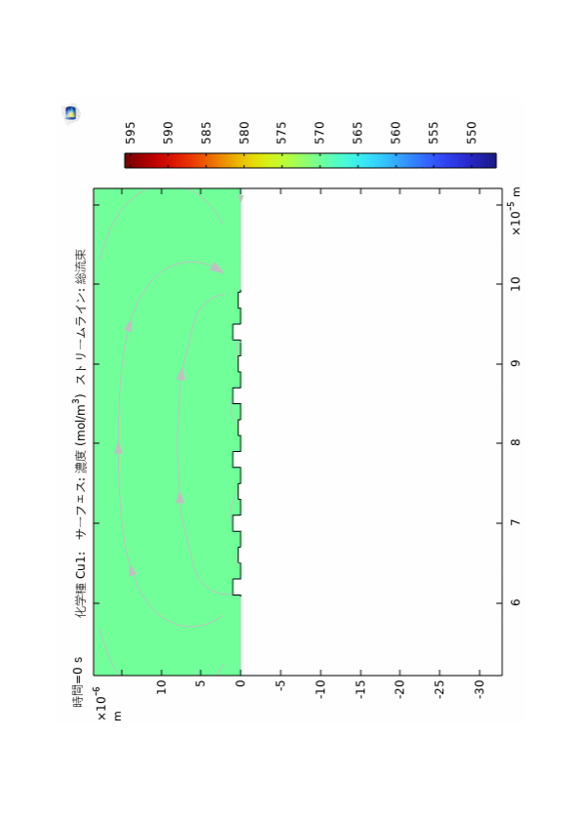
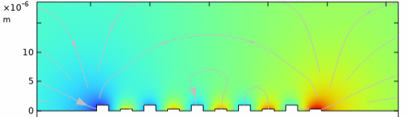
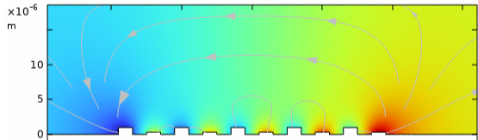
(a)
mol/m³
(b)
Cu + concentration
(c)
Supporting Information 3. Concentration distribution of Cu⁺ in cell-2 at 80 ˚C before discharge (a), after 15 s discharge (b), and after 80 s discharge (c). The ion flow were shown as gray arrows.
.

Slide 4
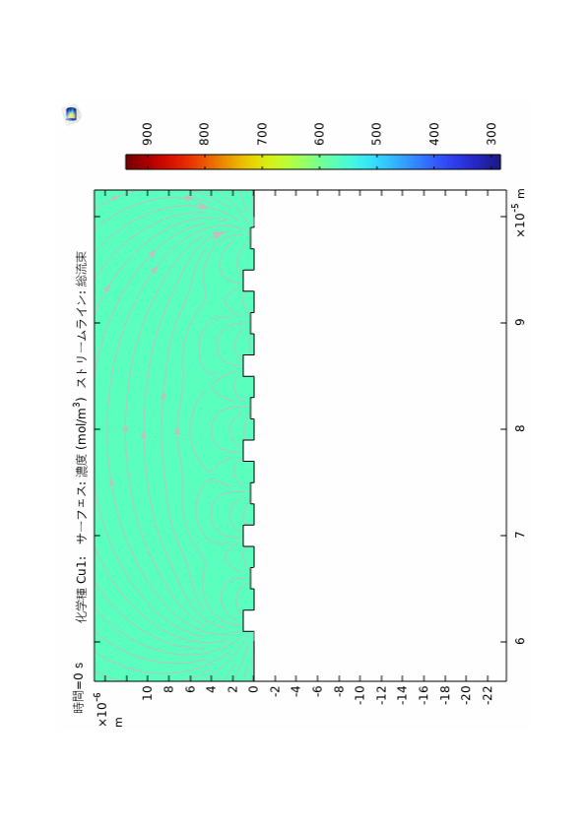
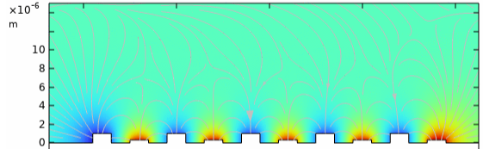
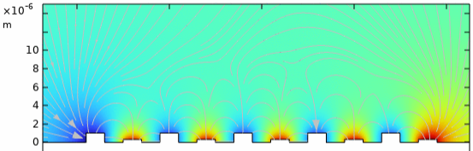
(a)
mol/m³
(b)
Cu + concentration
(c)
Supporting Information 4. Concentration distribution of Cu⁺ in cell-2 at 30 ˚C before discharge (a), after 15 s discharge (b), and after 80 s discharge (c). The ion flow were shown as gray arrows.
.

Slide 5
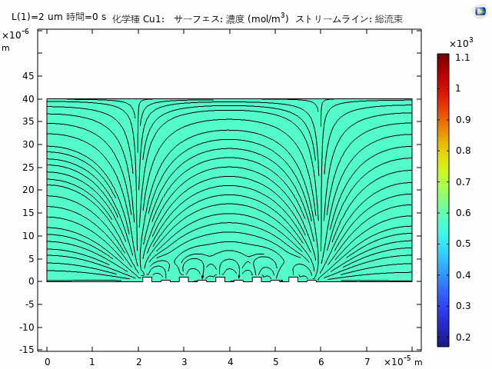
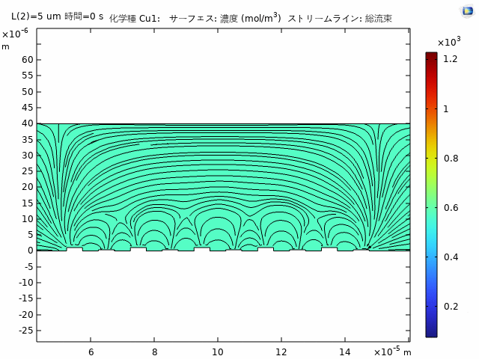
(a)
(b)
Supporting Information 5. Concentration distribution movies of Cu⁺ in cell-2 (a) and -5 (b) at 30 ˚C. The ion flow were shown as gray arrows.
.

