Slide 1
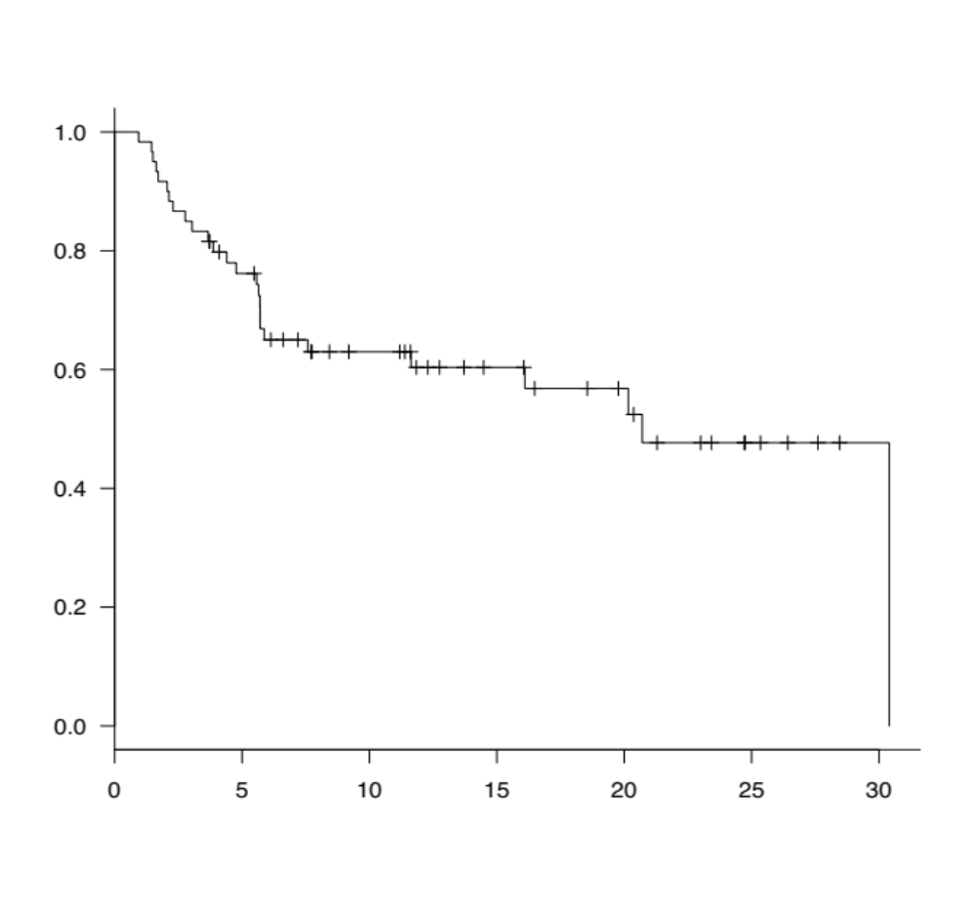
Supplemental figure 1A
1.0
Progression free survival
0.8
0.6
0.4
0.2
Median PFS 20.7 months (7.6-NR)
0
0
5
10
15
20
25
30
Months from treatment
Number at risk
60
42
27
18
13
5
1

Slide 2
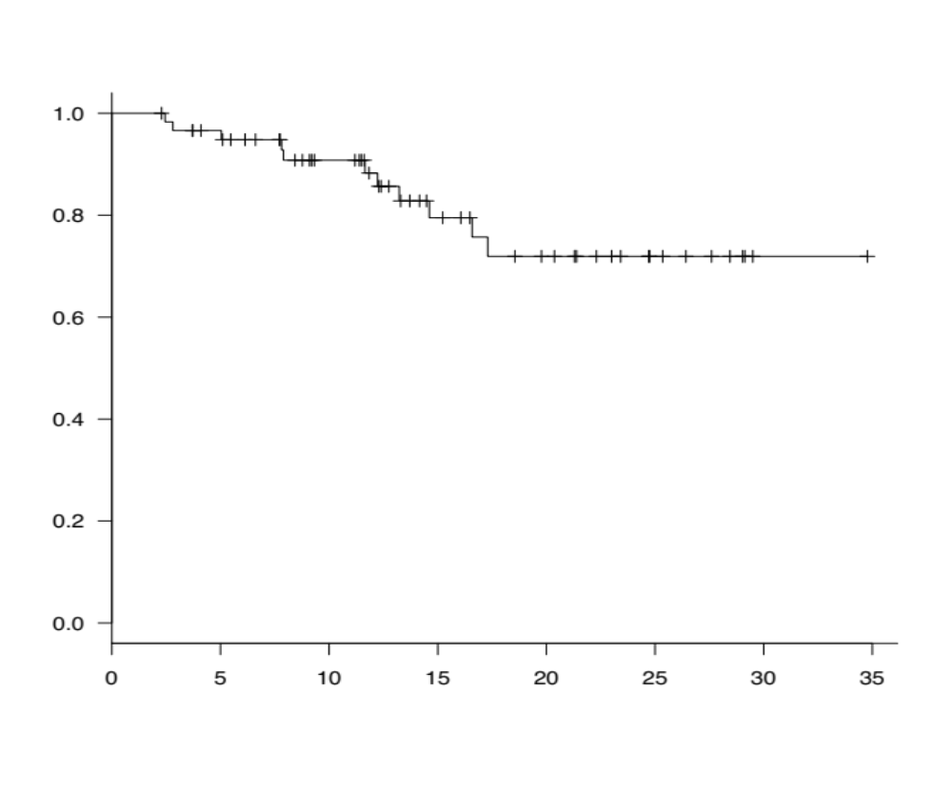
Supplemental figure 1B
1.0
Overall survival
0.8
0.6
0.4
Median OS NR (NR-NR)
0.2
0
0
5
10
15
20
25
30
35
Months from treatment
Number at risk
60
54
40
24
17
8
1
0

Slide 3
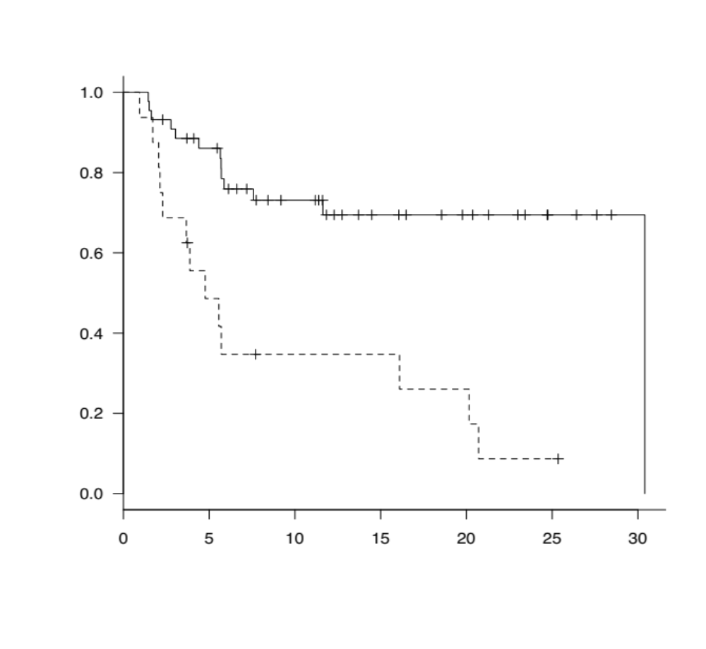
Supplemental figure 2A
1.0
Triple-class refractory (−)
Triple-class refractory (+)
Progression free survival
0.8
0.6
0.4
0.2
30.4 months (NR−NR) P < 0.0001
4.8 months (2.1−20.3)
0
0
5
10
15
20
25
30
Number at risk
Months from treatment
Triple-class refractory (−)
Triple-class refractory (+)
44
16
35
7
23
4
14
4
10
3
4
1
1
0

Slide 4
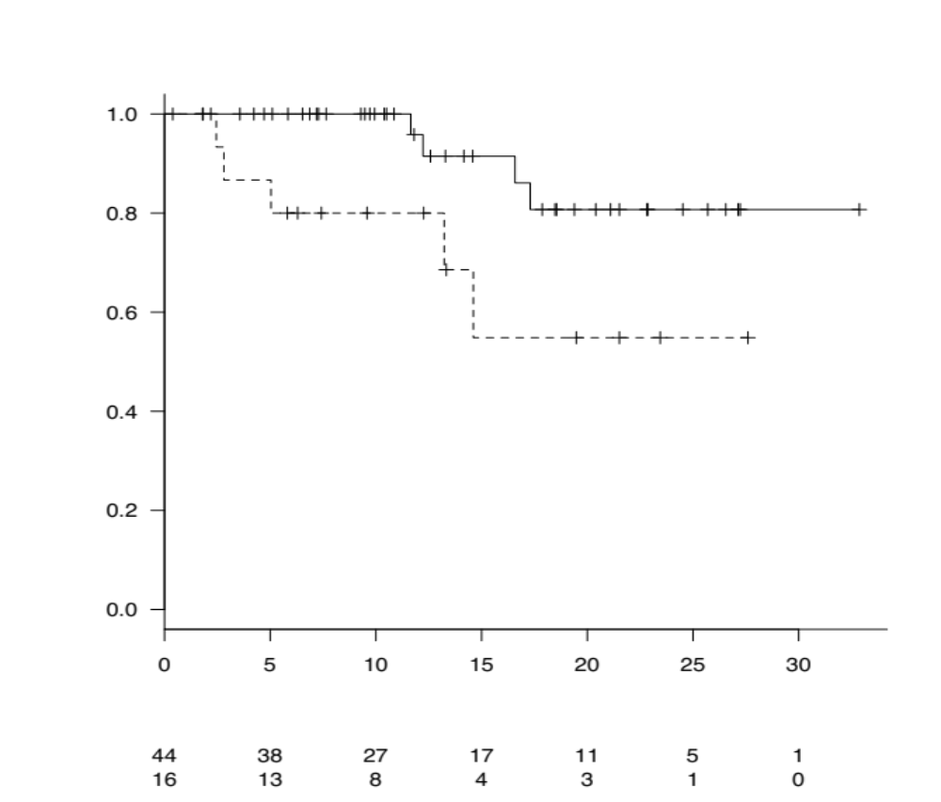
Supplemental figure 2B
1.0
Triple-class refractory (−)
Triple-class refractory (+)
Overall survival
0.8
0.6
0.4
0.2
NR (NR−NR) P = 0.027
NR (5.0−NR)
0
0
5
10
15
20
25
30
Number at risk
Months from treatment
Triple-class refractory (−)
Triple-class refractory (+)
44
16
38
13
27
8
17
4
11
3
5
1
1
0

Slide 5
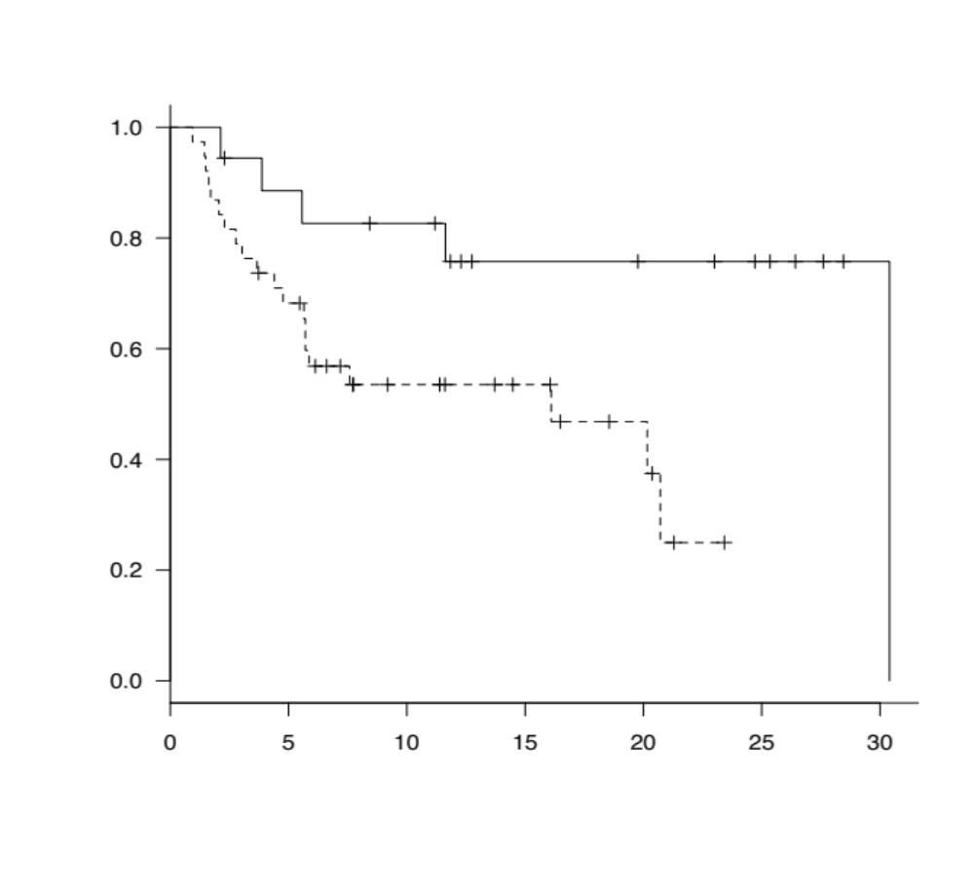
Supplemental figure 2C
1.0
1q gain/amp (−)
1q gain/amp (+)
Progression free survival
0.8
0.6
0.4
0.2
30.4 months (11.6−NR) P = 0.019
16.1 months (5.7−NR)
0
0
5
10
15
20
25
30
Number at risk
Months from treatment
1q gain/amp (−)
1q gain/amp (+)
18
38
15
25
13
13
8
9
7
5
5
0
1
0

Slide 6
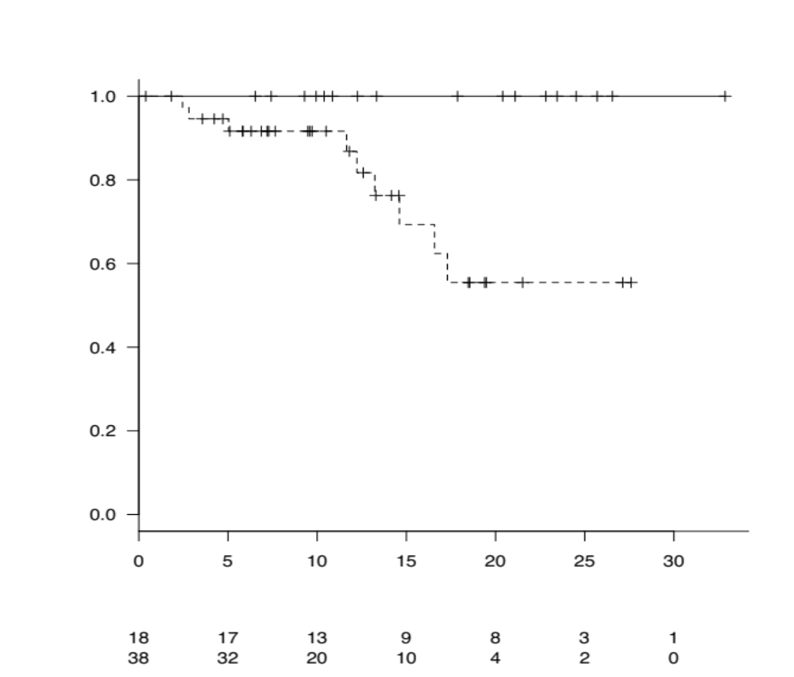
Supplemental figure 2D
1.0
Overall survival
1q gain/amp (−)
1q gain/amp (+)
0.8
0.6
0.4
0.2
NR (NR−NR) P = 0.014
NR (14.6−NR)
0
0
5
10
15
20
25
30
Number at risk
Months from treatment
1q gain/amp (−)
1q gain/amp (+)
18
38
17
32
13
20
9
10
8
4
3
2
1
0

Slide 7
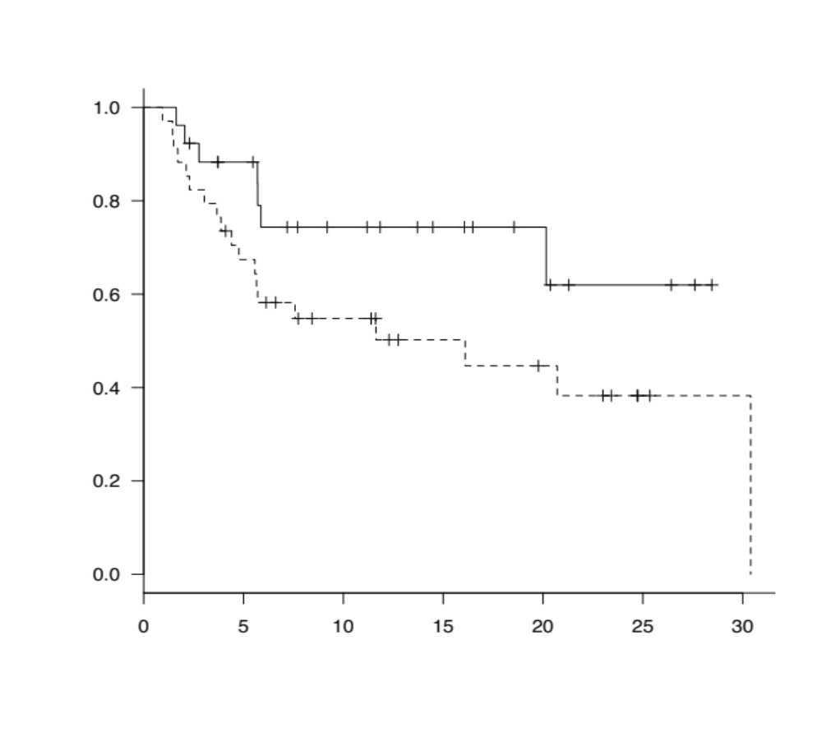
Supplemental figure 2E
1.0
Progressive disease (−)
Progressive disease (+)
Progression free survival
0.8
0.6
0.4
0.2
NR (20.2−NR) P = 0.078
11.6 months (4.8−NR)
0
0
5
10
15
20
25
30
Number at risk
Months from treatment
Progressive disease (−)
Progressive disease (+)
26
34
20
22
13
14
9
9
6
7
3
2
0
1

Slide 8
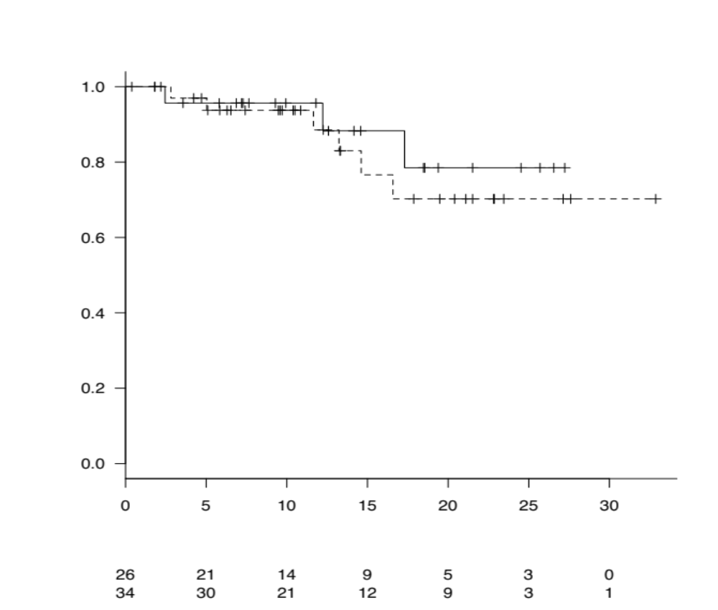
Supplemental figure 2F
1.0
Progressive disease (−)
Progressive disease (+)
Overall survival
0.8
0.6
0.4
0.2
NR (17.3-NR) P = 0.59
NR (16.6−NR)
0
0
5
10
15
20
25
30
Number at risk
Months from treatment
Progressive disease (−)
Progressive disease (+)
26
34
21
30
14
21
9
12
5
9
3
3
0
1

