Slide 1
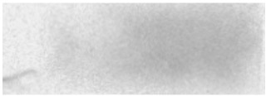
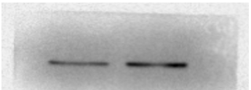
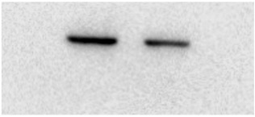
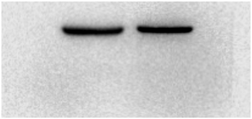
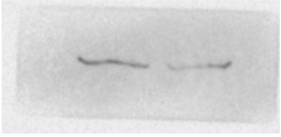
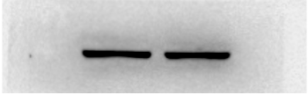
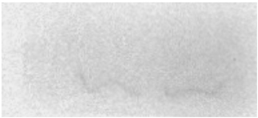
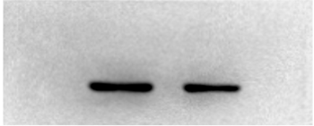
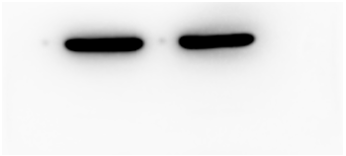
Figure2 C
Exosome
Cell
A549
A549/X
A549
A549/X
calnexin
calnexin
CD63
CD63
Alix
Alix
TSG101
TSG101
GAPDH
GAPDH

Slide 2












Figure3E
exosome
cell
A549
A549/X
A549
A549/X
Calnexin
TSG101
Alix
FLOT1
PAICS
GAPDH

Slide 3


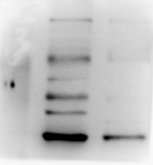
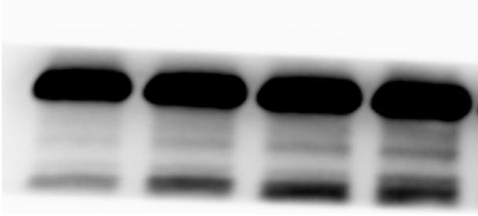


Figure4A B
sh-RNA#3
exosome
cell
sh-RNA#2
sh-RNA#1
sh-Control
A549/X
A549/X-Sh
A549/X
A549/X-Sh
PAICS
PAICS
GAPDH
GAPDH

Slide 4
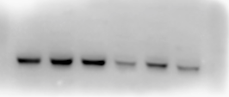

Figure5E F
A549/X
A549/X-sh
A549/X
A549/X-sh
-
+
+
-
+
+
-
+
+
-
+
+
0h
3h
12h
0h
3h
12h
0h
3h
12h
0h
3h
12h
P-IRF3
PARP
P-TBK1
RAD51
𝝲H2AX
P-STING
PAICS
PAICS
GAPDH
GAPDH

Slide 5



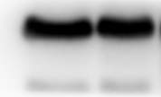
FigureS2B
exosome
cell
LLC/X
LLC/X-sh
LLC/X
LLC/X-sh
PAICS
GAPDH

