Slide 1
Title: A multimethod approach to assess arbuscular mycorrhizal fungal diversity in a hot arid and hyperalkaline region
Authors: Alexandre Robin-Soriano¹, Kenji Maurice¹, Stéphane Boivin², Amelia Bourceret³, Liam Laurent-Webb³, Sami Youssef², Jérôme Nespoulous², Inès Boussière¹, Julie Berder², Coraline Damasio¹, Bryan Vincent¹, Hassan Boukcim^{2,5}, Marc Ducousso¹, Muriel Gros-Balthazard⁴
Corresponding Author: Alexandre Robin-Soriano (alexandrerobinsoriano@gmail.com)
Affiliations:
¹ LSTM, Univ Montpellier, CIRAD, INRAE, IRD, SupAgro, Montpellier, France
² Department of Research and Development, VALORHIZ, Montferrier sur Lez, France
³ ISYEB, Muséum national d’Histoire naturelle, CNRS, EPHE-PSL, Sorbonne Université, Paris, France
⁴ DIADE, Univ Montpellier, CIRAD, IRD, Montpellier, France
⁵ ASARI, Mohammed VI Polytechnic University, Laâyoune, Morocco
Mycorrhiza

Slide 2
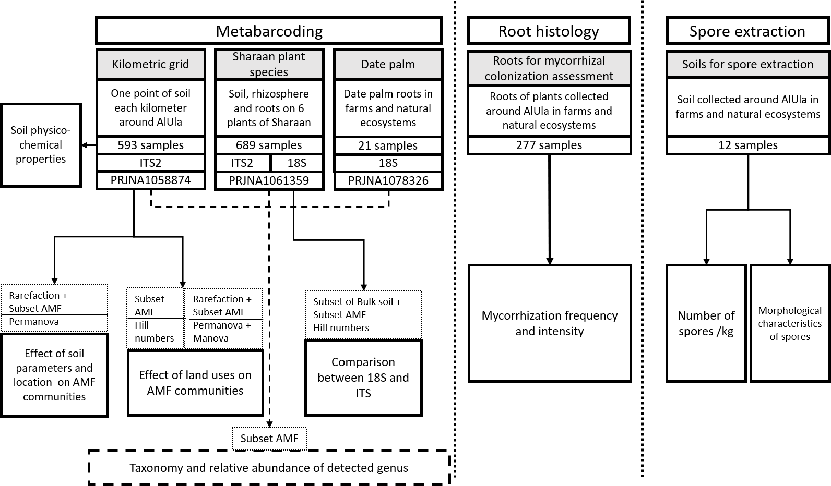
Fig. S1 Methodological workflow of the different approaches, datasets and analyses used in the study.

Slide 3
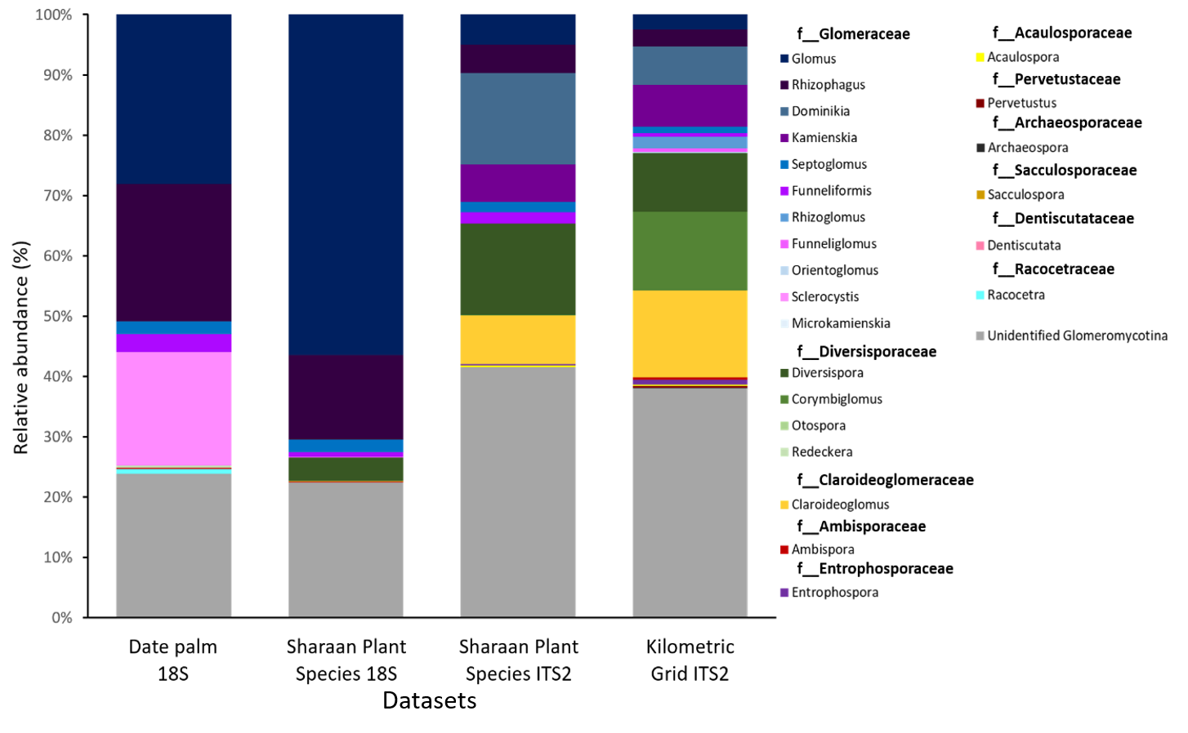
Fig. S2 The mean relative abundance of AMF subset genera across all datasets. Colors represent genera with the corresponding families (in bold). Genera are represented with color gradients within families. Unidentified Glomeromycotina encompasses all reads assigned to the Glomeromycotina subphylum but failed to be assigned at the genus level

Slide 4
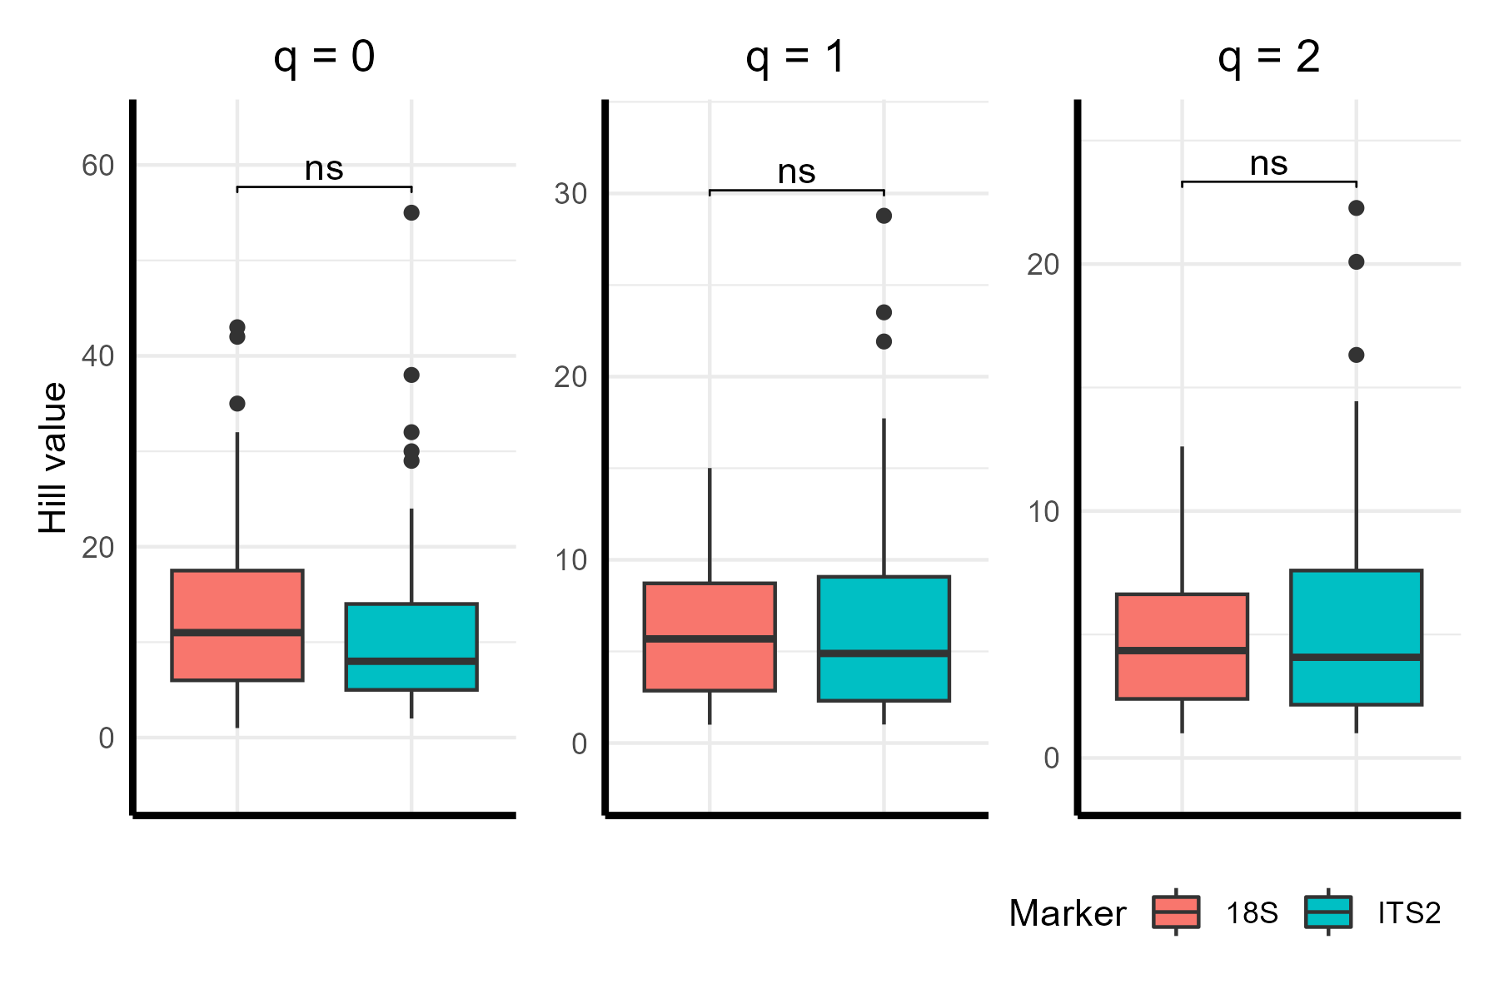
Fig. S3 Gene marker does not affect AMF diversity in SPS dataset. Hill value distribution of AMF identified in the SPS 18S and SPS ITS2 datasets at three diversity orders, where q = 0, 1 or 2. Statistical differences were calculated with a Wilcoxon test.

Slide 5
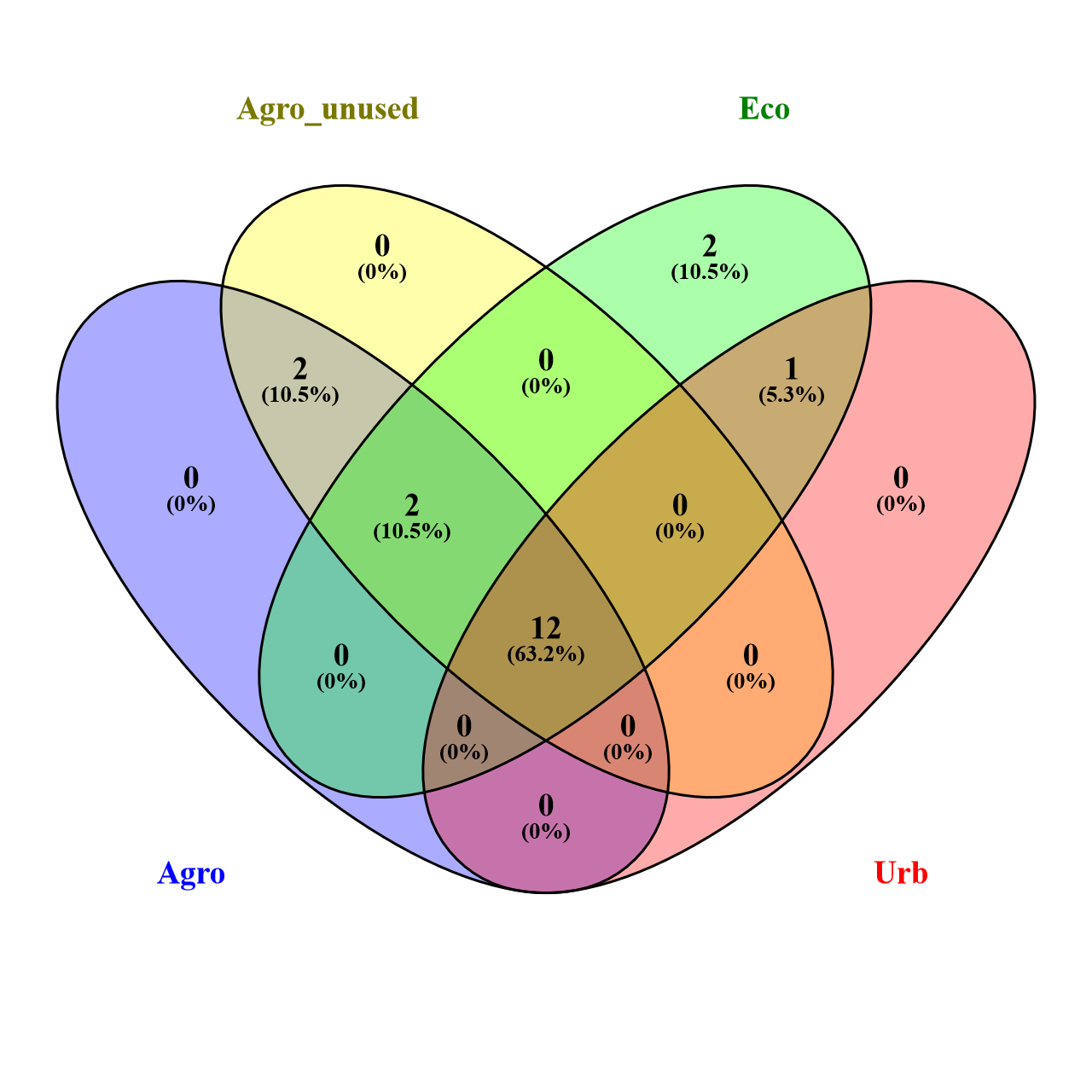
Fig. S4 A large part of the AMF are shared among all land uses. Shared and unique Genus found between Land uses in KG dataset

Slide 6
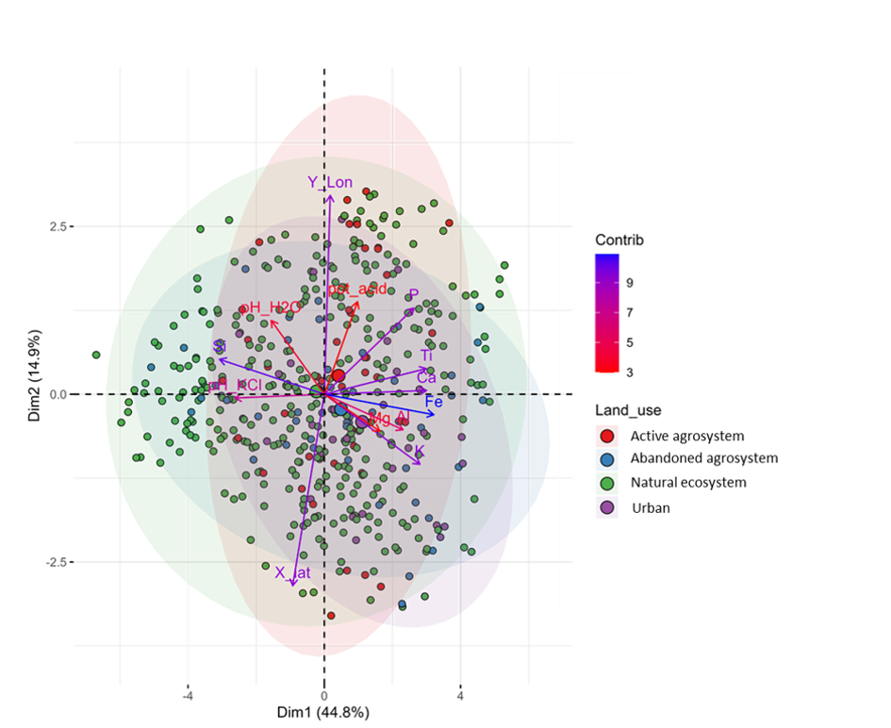
Fig. S5 Principal Component Analysis (PCA) representing visually the contribution of soil physicochemical properties and geographic variables differences between land uses in Grid dataset. Samples are colored according to land uses. Vectors are colored according to their level of contributions to each dimension.

Slide 7
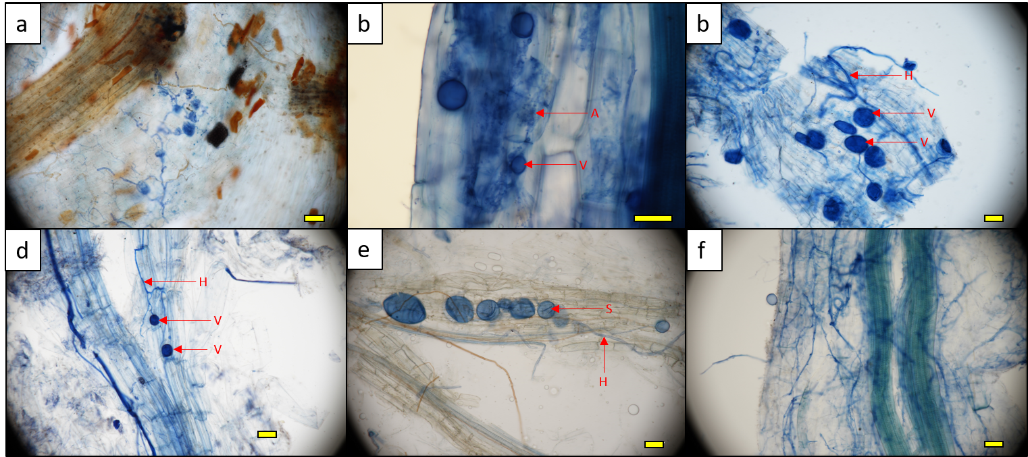
Fig. S6 a: Vesicles and hyphae in Phoenix dactylifera roots. b: Vesicles, hyphae and arbuscules in roots of an unidentified Solanaceae . c: Vesicles and hyphae in roots Astragalus spinosus. d: Vesicles, spores and hyphae in roots of Haloxylon salicornicum. e: Spores and hyphae in roots of Retama raetam. f: Spore and hyphae in Picris cyanocarpa. Yellow bar correspond to 50 µm. Arbuscular mycorrhizal structures are pointed with red arrows, V = vesicles, H = Hyphae, A = Arbuscules.

Slide 8
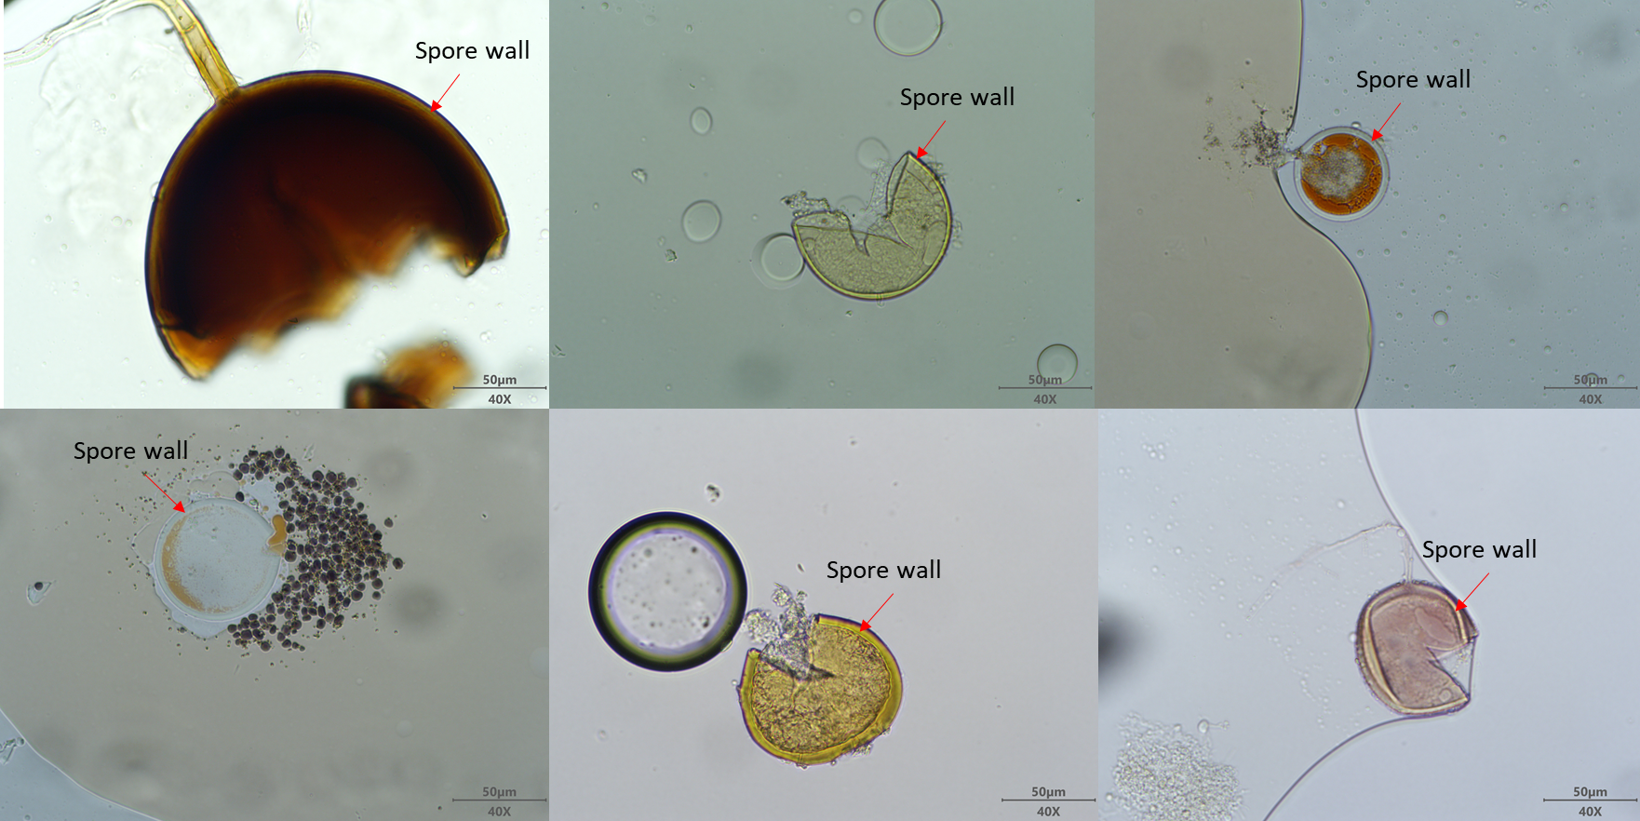
Fig. S7 Spores morphotypes observed in soils extracted in AlUla

