Slide 1
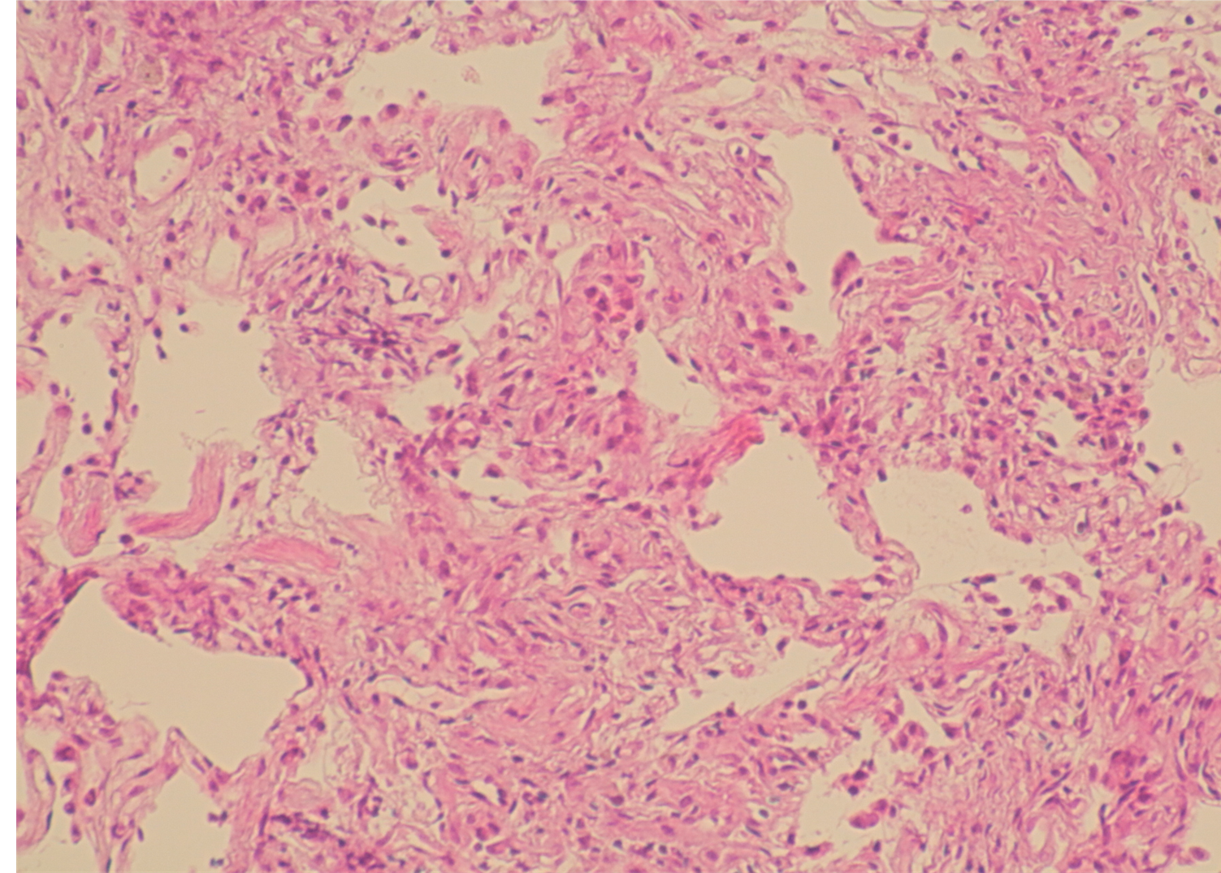
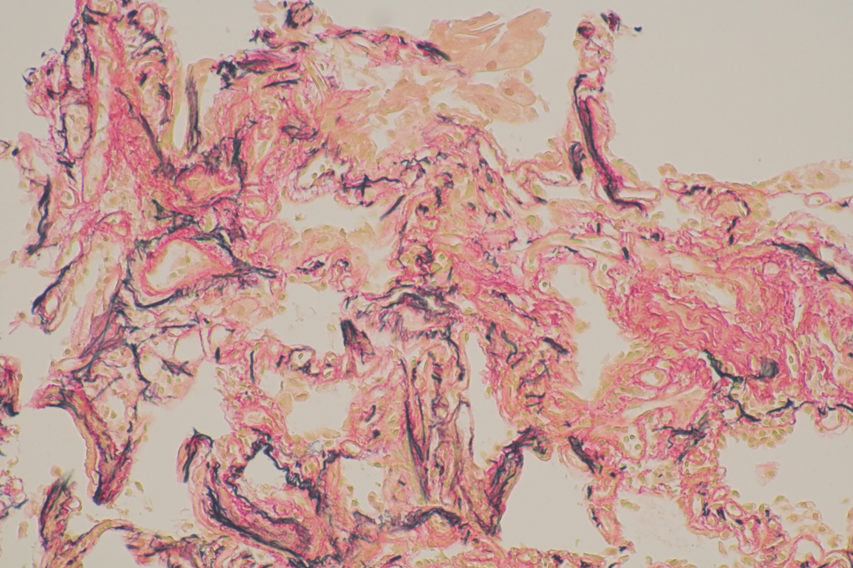
a
b
100µm
100µm
Supplementary Figure 1:
(a) Hematoxylin-Eosin stain of lung tissue, (b) Elastica van Gieson stain of lung tissue collected by bronchoscopy performed at the age of 24. Nonspecific alveolar septal fibrosis was observed. There were no findings suspicious of PAP. The scale bar indicates 100 µm.

