Slide 1
Variability in resistance training trajectories of breast cancer patients undergoing therapy
Maximilian Koeppel^{1,2}, Karen Steindorf³, Martina E. Schmidt³, Friederike Rosenberger², Joachim Wiskemann²
¹Institute of Sports and Sport Science, Heidelberg University, Heidelberg, Germany
²Working Group Exercise Oncology, Department of Medical Oncology, National Center for Tumor Diseases Heidelberg (NCT Heidelberg) and Heidelberg University Hospital, Heidelberg Germany
³Division of Physical Activity, Prevention and Cancer, German Cancer Research Center (DKFZ) and National Center for Tumor Diseases (NCT) Heidelberg, Heidelberg, Germany
Supplementary Information 8 - Variation between individuals for butterfly and rowing exercise

Slide 2
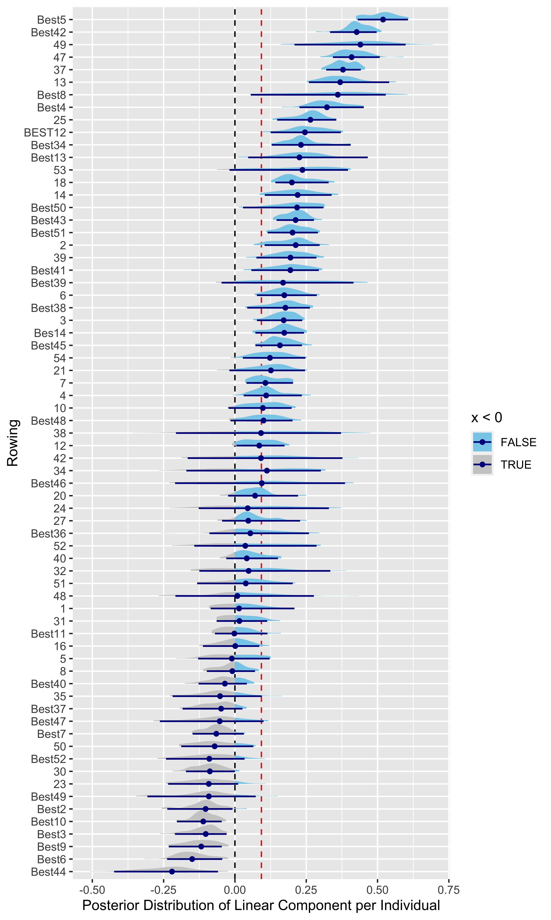
SDC 8a. Variation of linear components between individuals for Rowing exercise
The dashed black line marks the zero line, the dashed red line the population level estimate. A blue area under the curve characterizes positive parameter values, whereas a grey area under the curve characterizes negative values

Slide 3
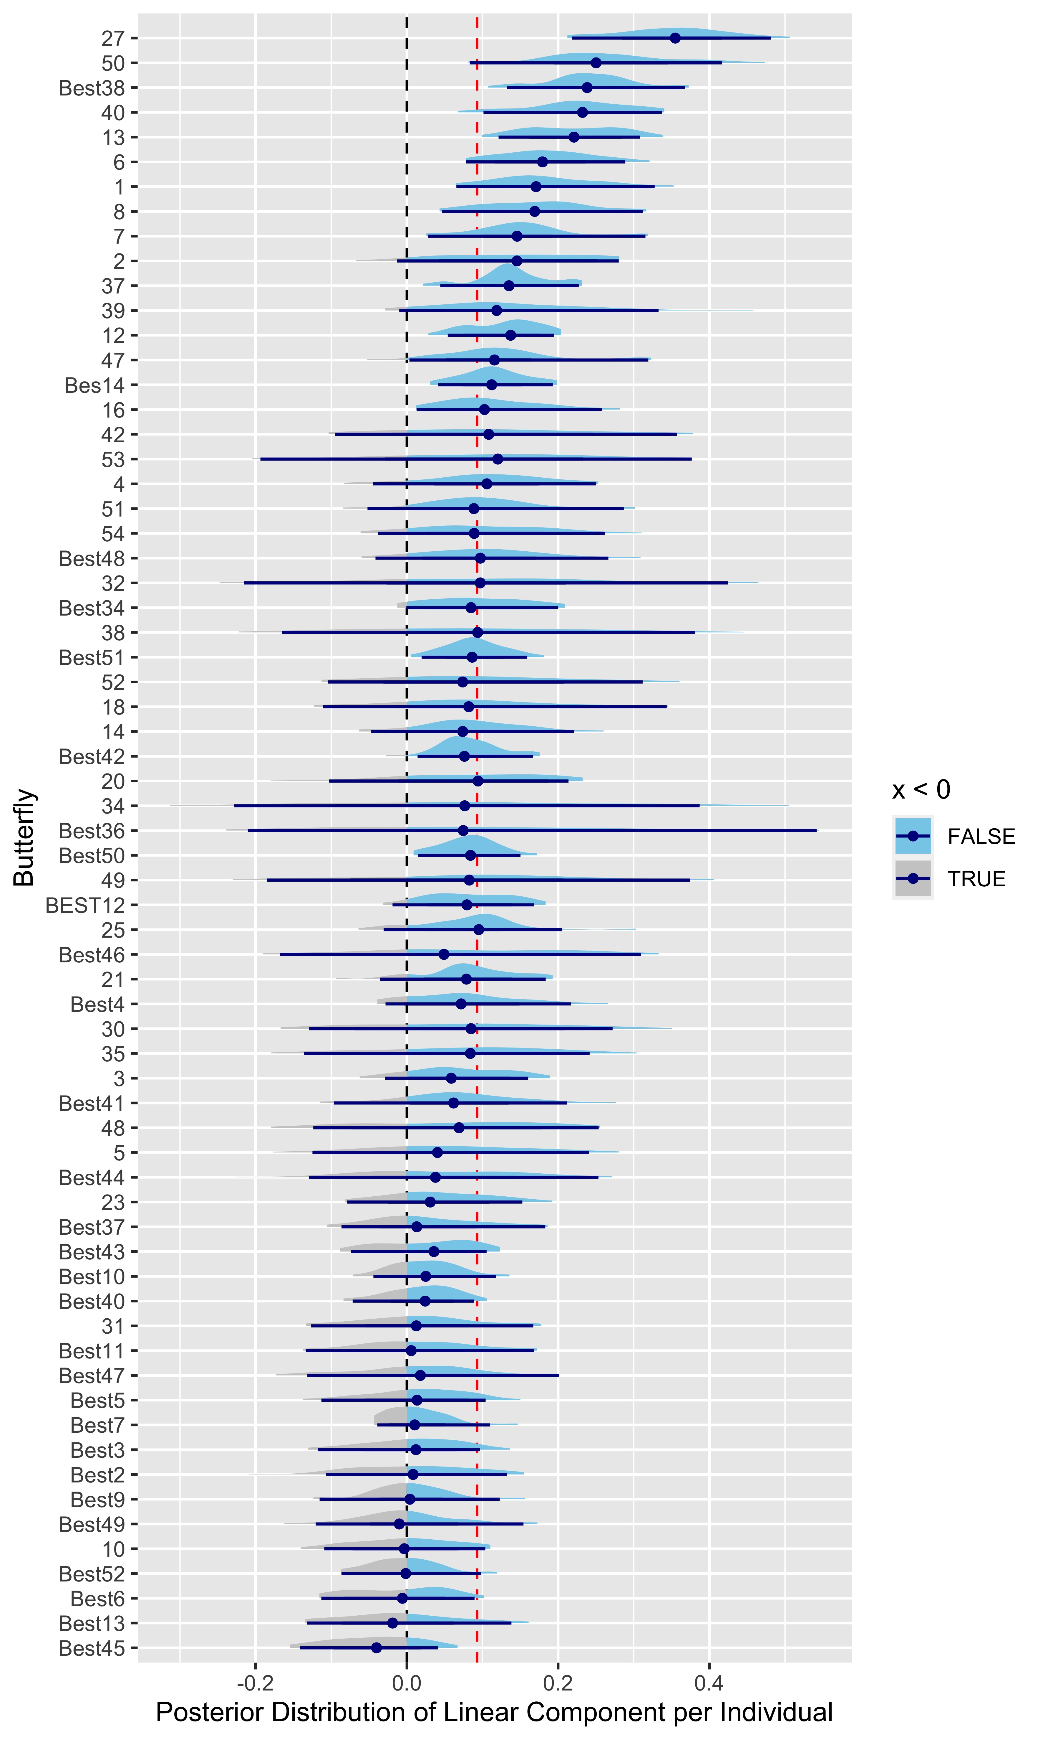
SDC 8b. Variation of linear components between individuals for Butterfly exercise
The dashed black line marks the zero line, the dashed red line the population level estimate. A blue area under the curve characterizes positive parameter values, whereas a grey area under the curve characterizes negative values

