Slide 1
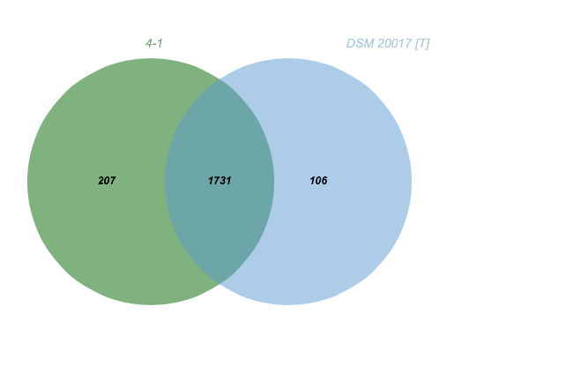
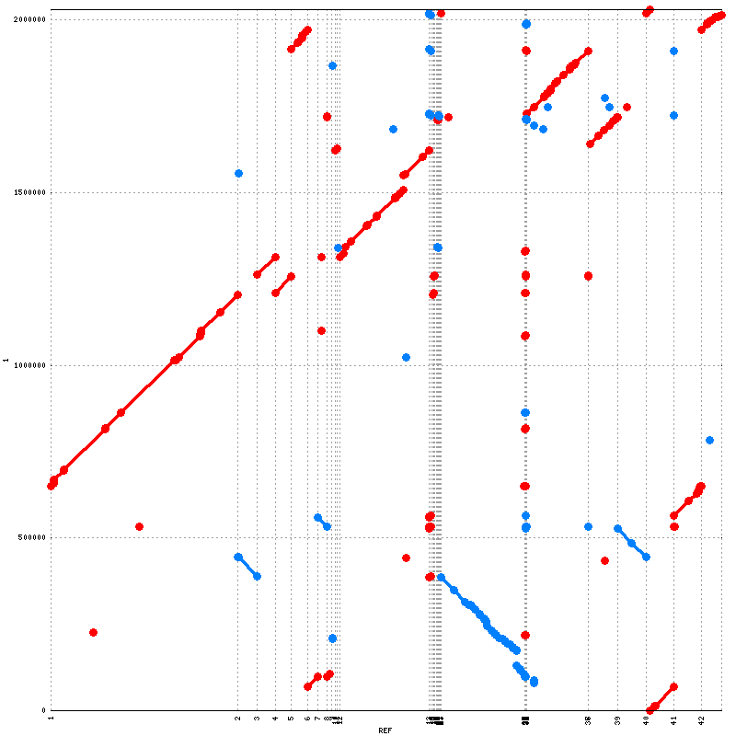
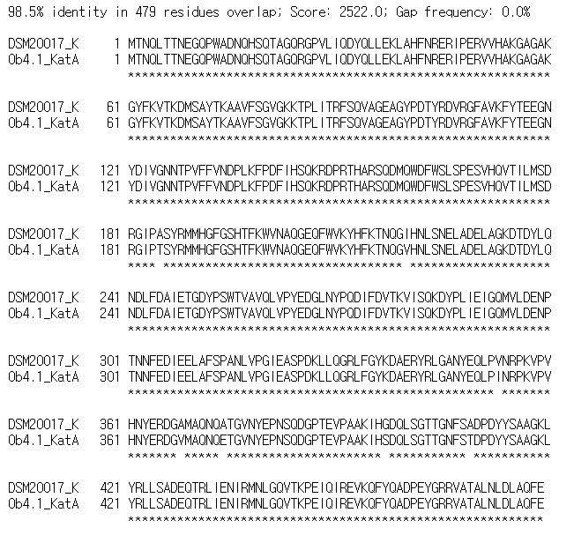
A
C
 | Size | GC Contents | CDS
L. sakei ob4.1 | 1.91 Mbp | 41.1% | 1,893
L. sakei DSM20017 | 2.03 Mbp | 41.1% | 2,002
B
D
L. Sakei ob4.1 Contig No.
L. Sakei DSM 20017 Contig No.
Supplementary figure1.

Slide 2
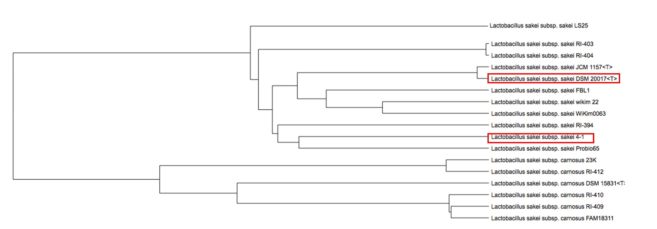
Supplementary figure2.

Slide 3
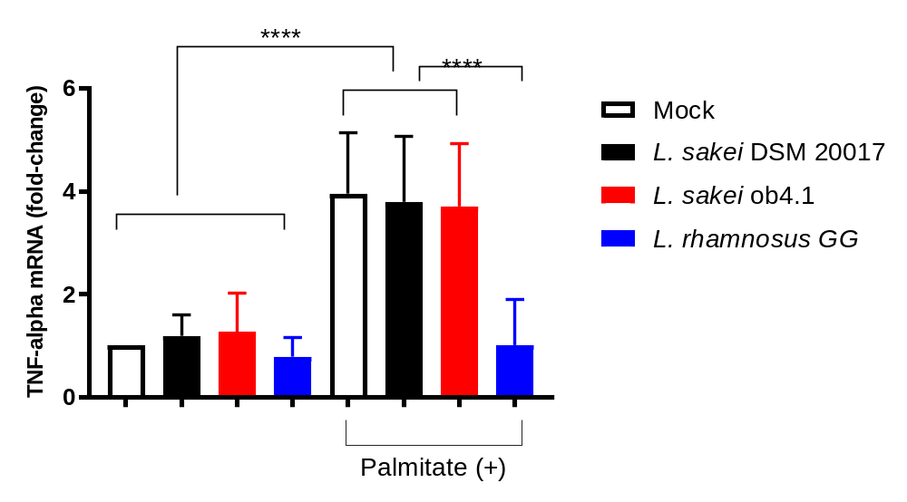
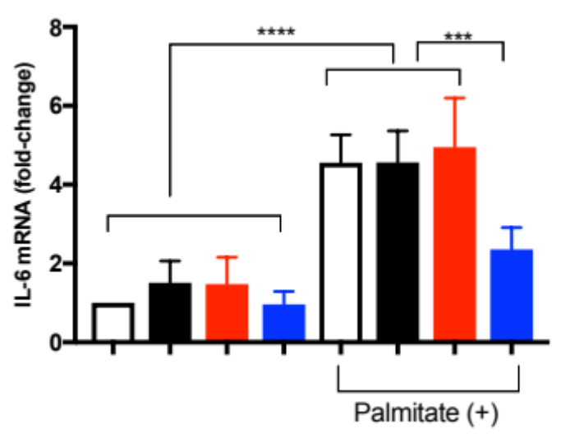
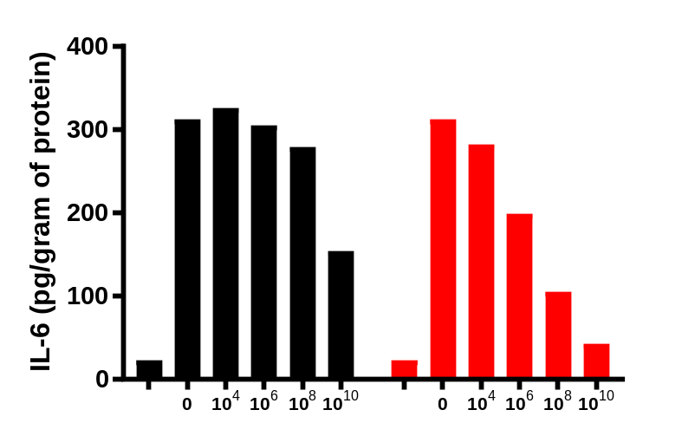
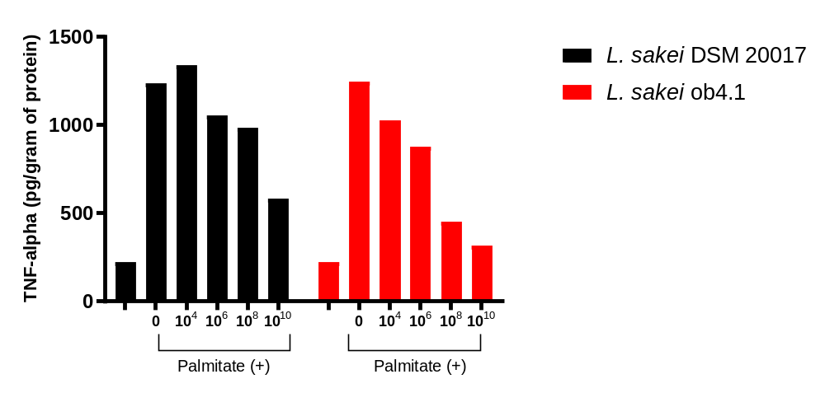
Supplementary figure3.

