Slide 1
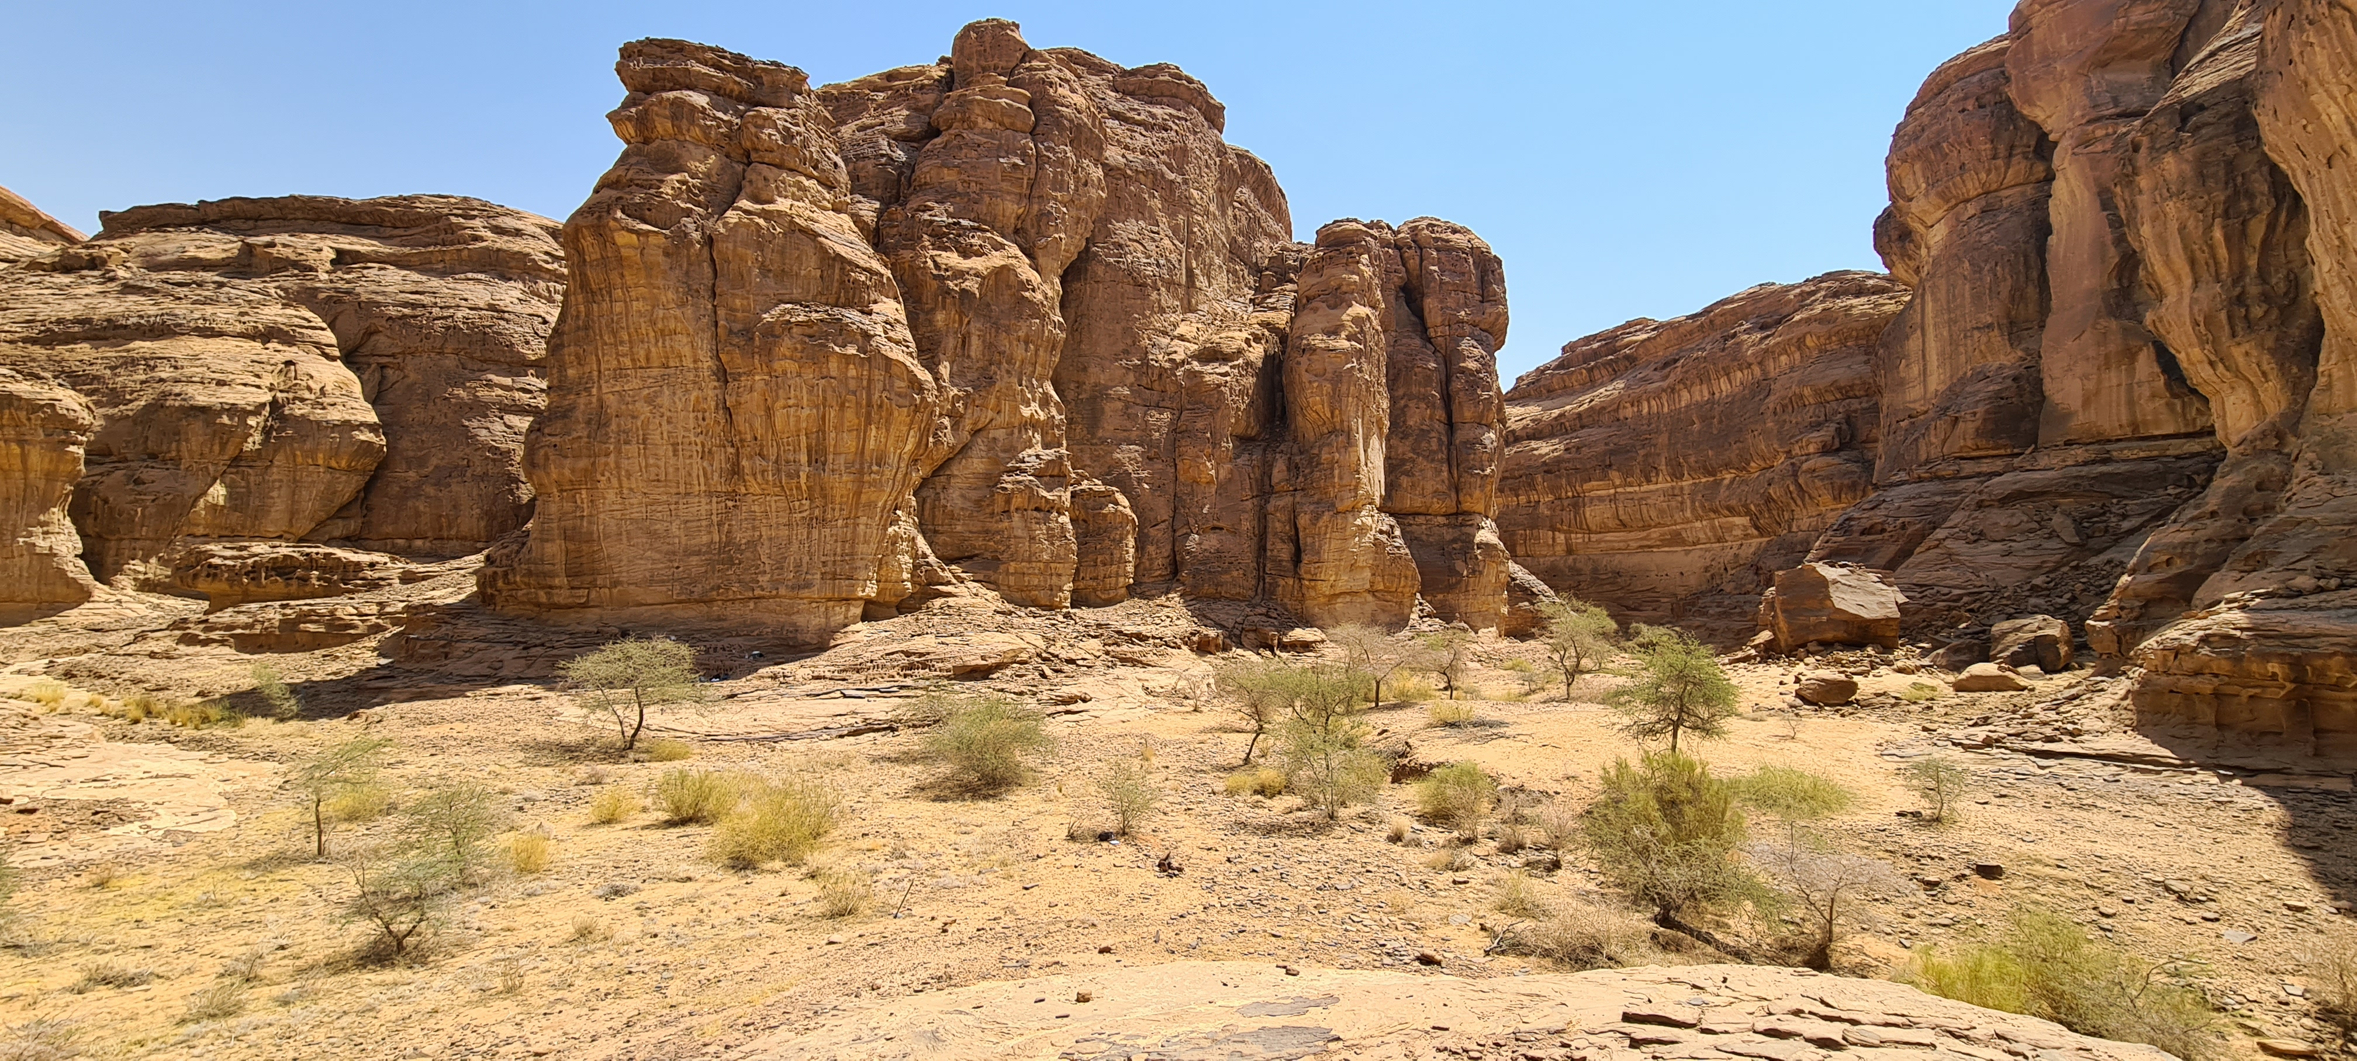
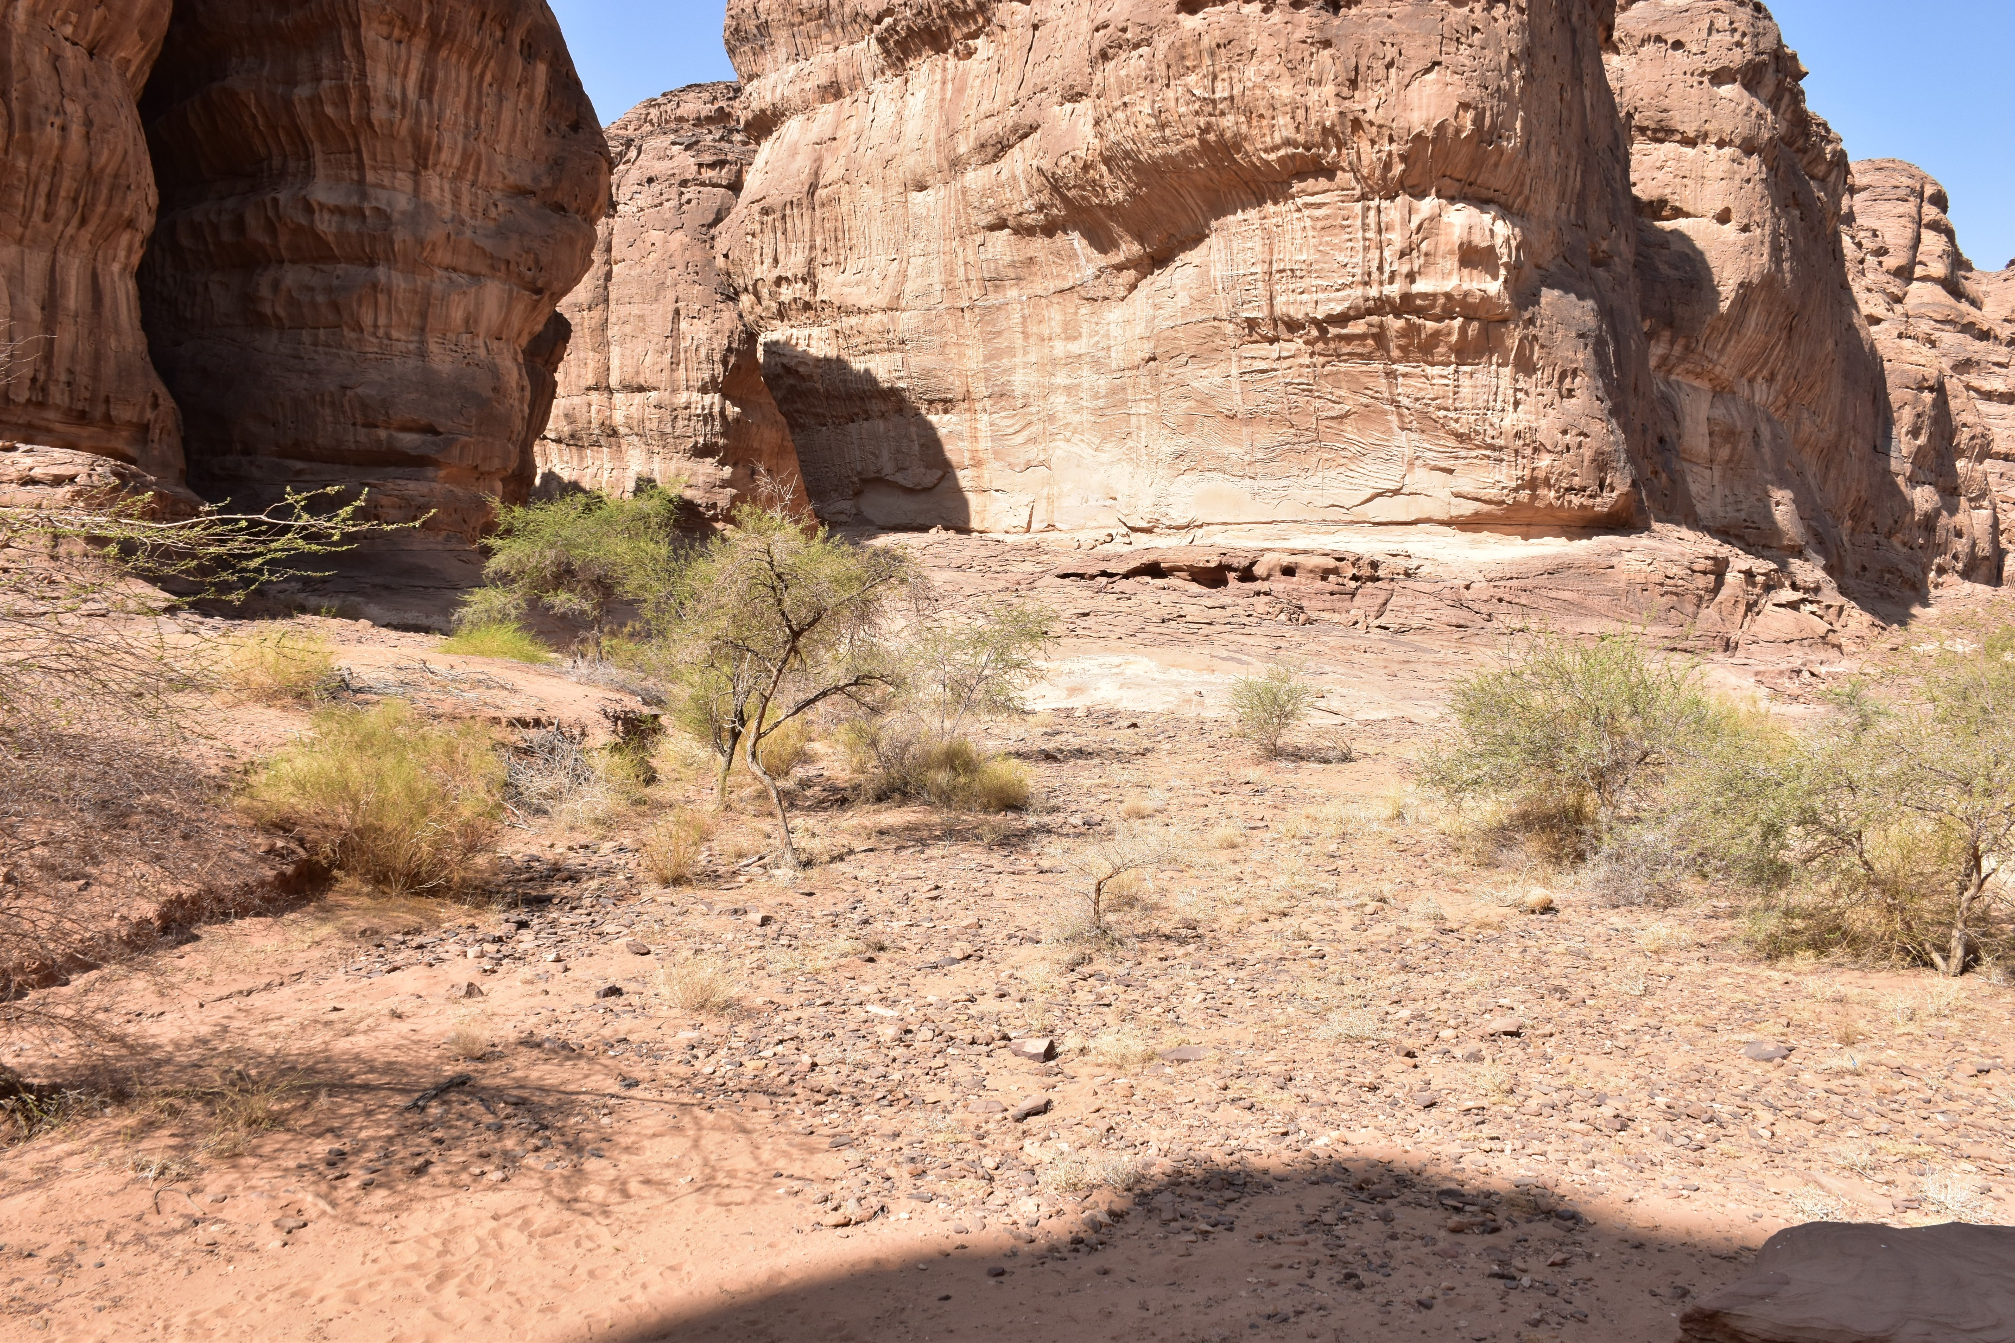
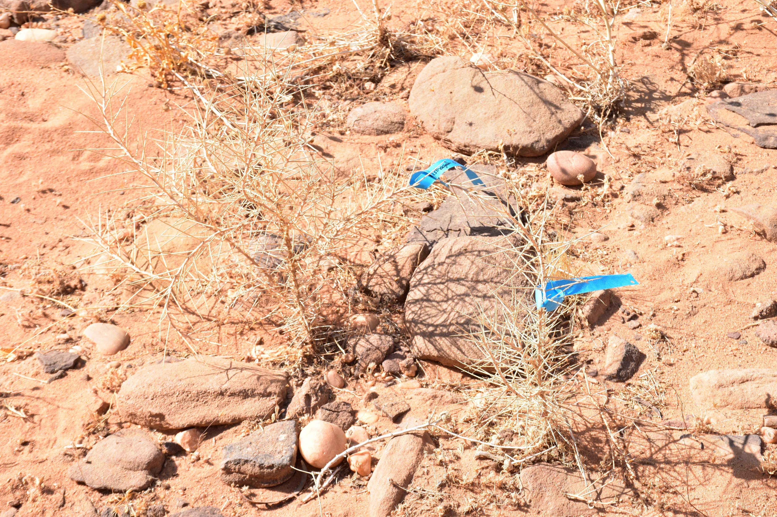
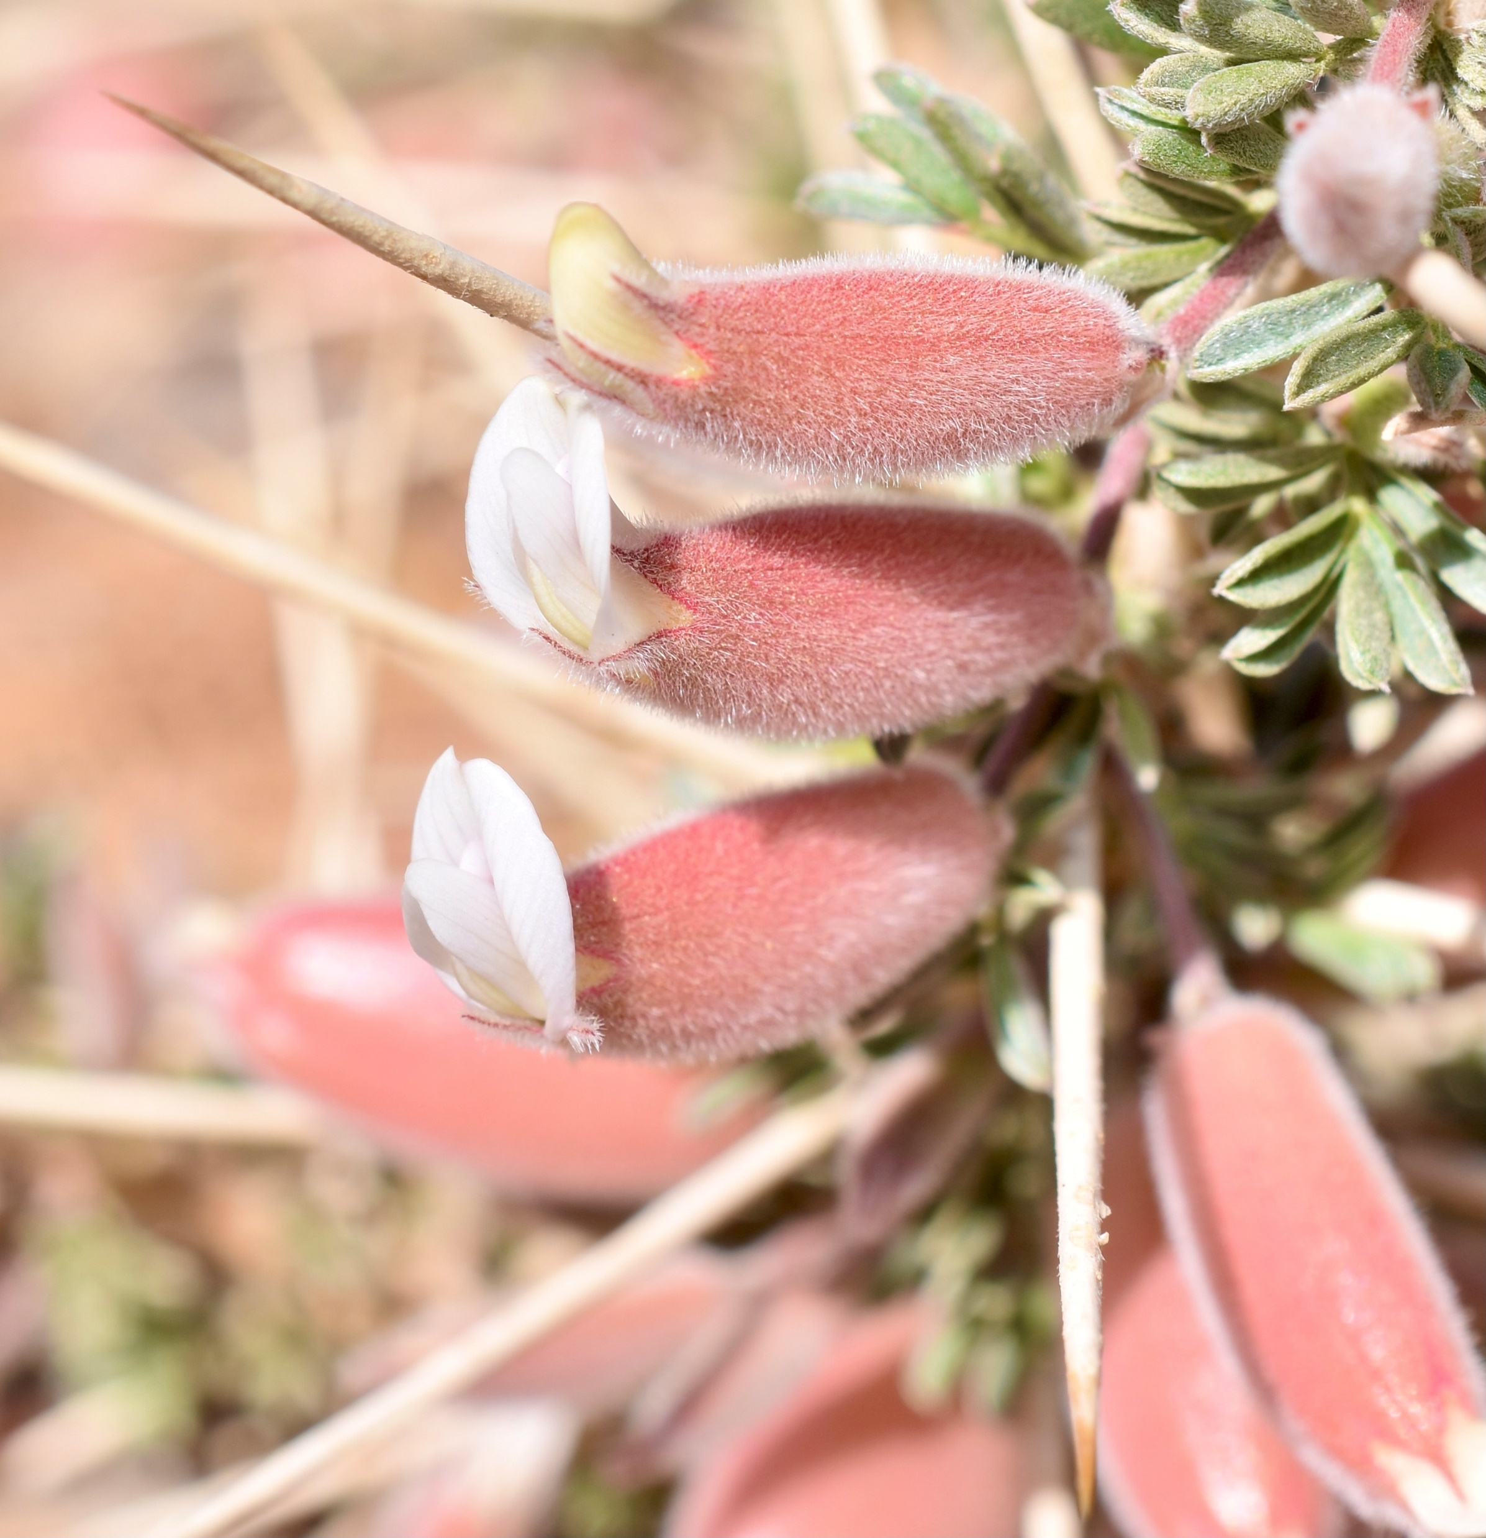
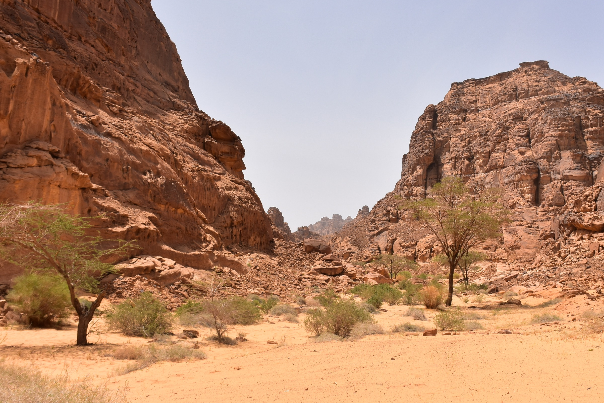
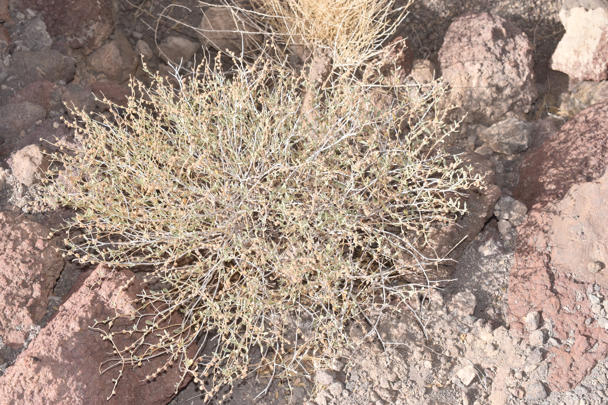
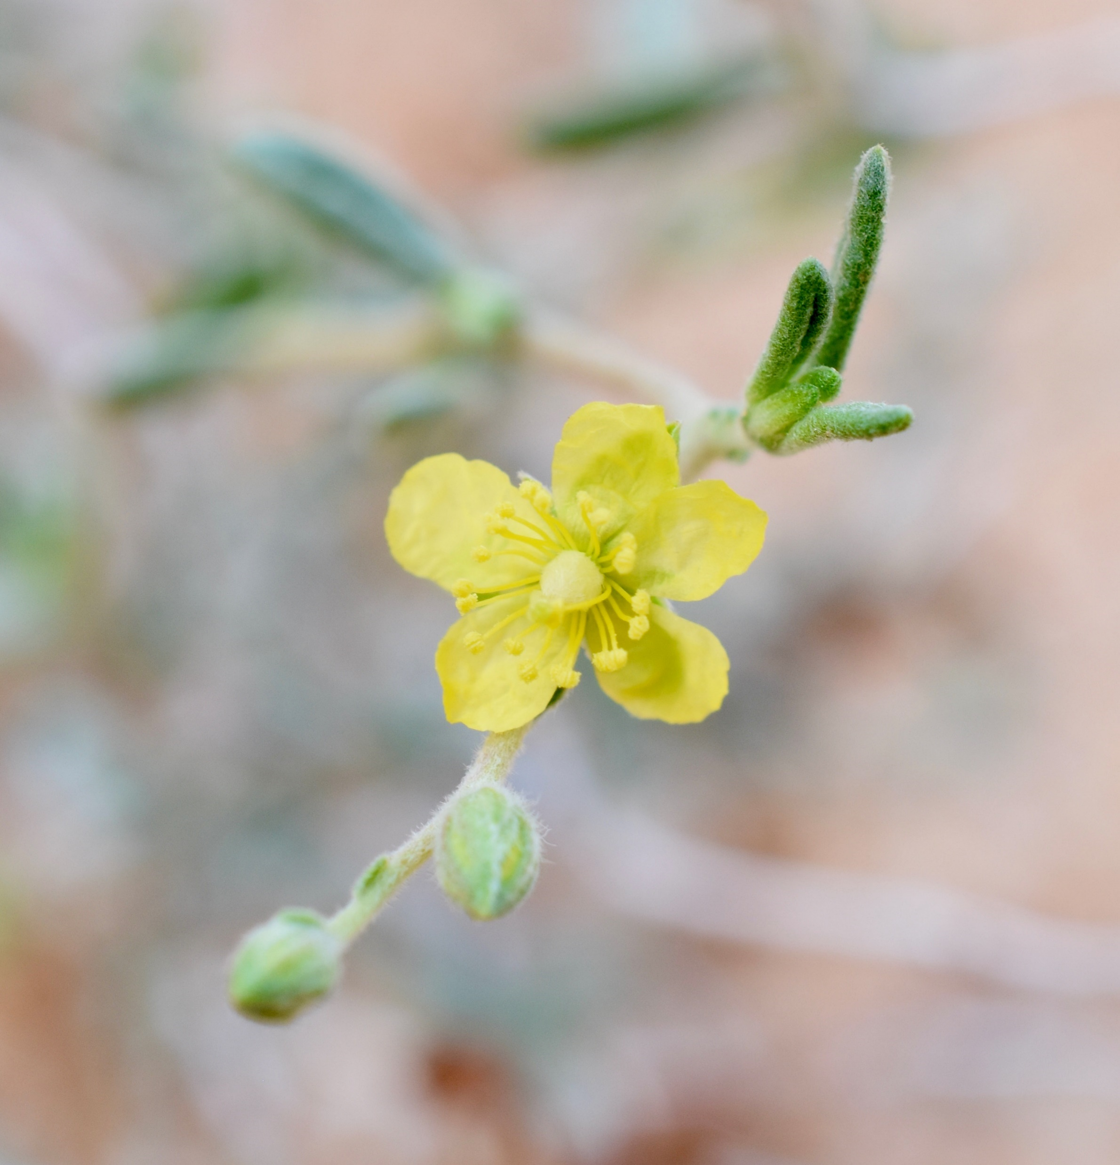
A
B
D
F
C
E
G
Figure S1: Overview of the sampling site in the Sharaan Nature Reserve for Helianthemum lippii and Astragalus spinosus (A, B) and in a natural environment close to AlUla city (C). An Astragalus spinosus specimen is presented in D with its associated flowers (F). An Helianthemum lippii specimen is presented in E with its associated flowers (G).

Slide 2
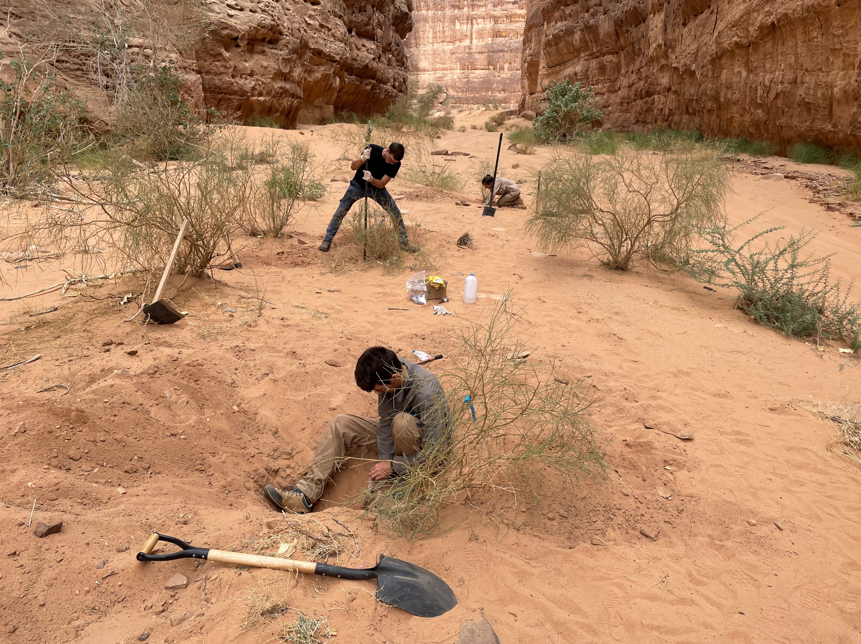
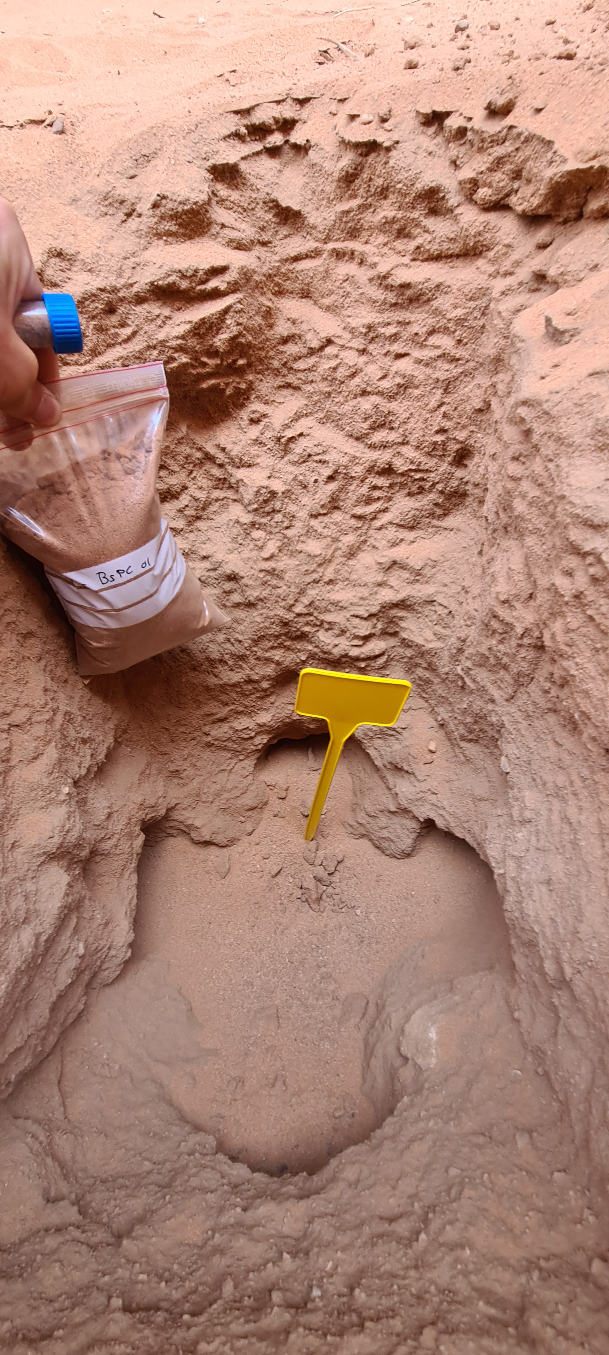
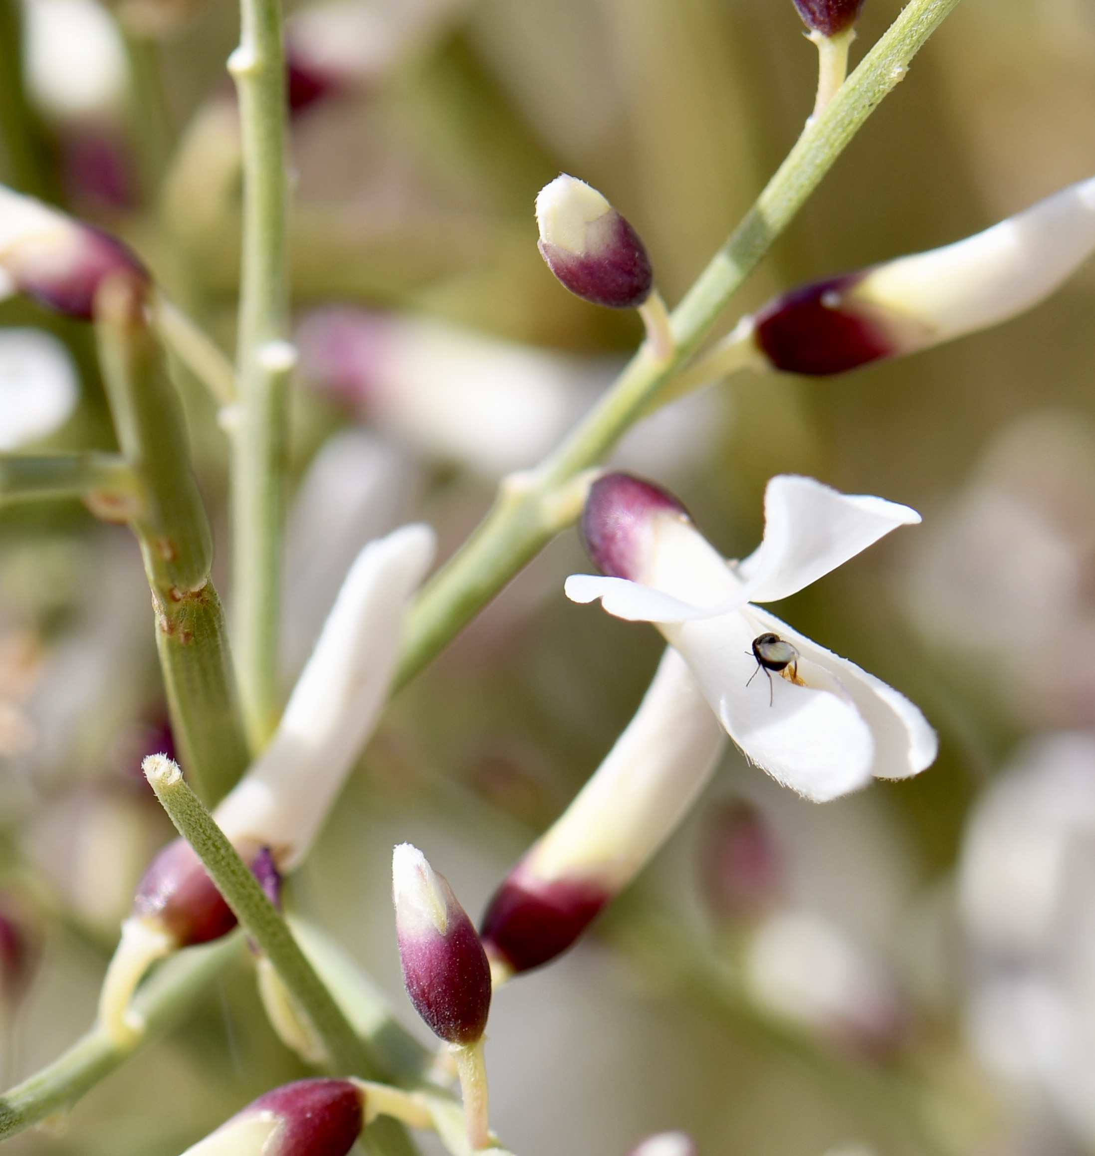
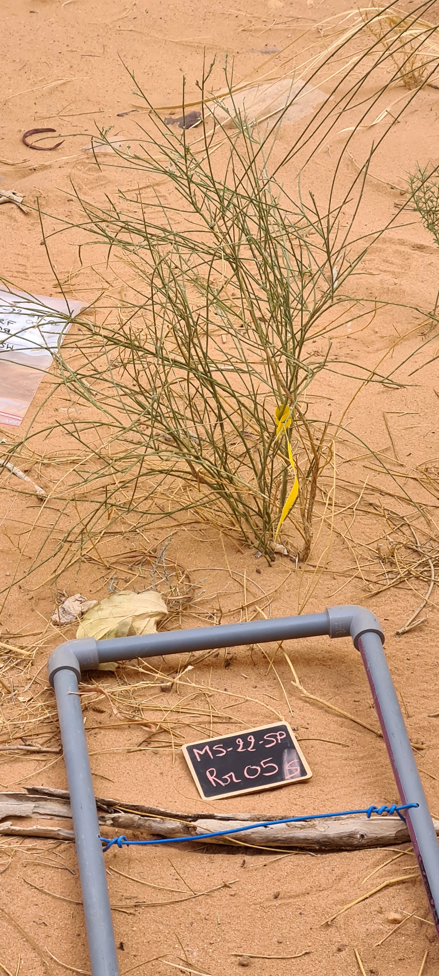
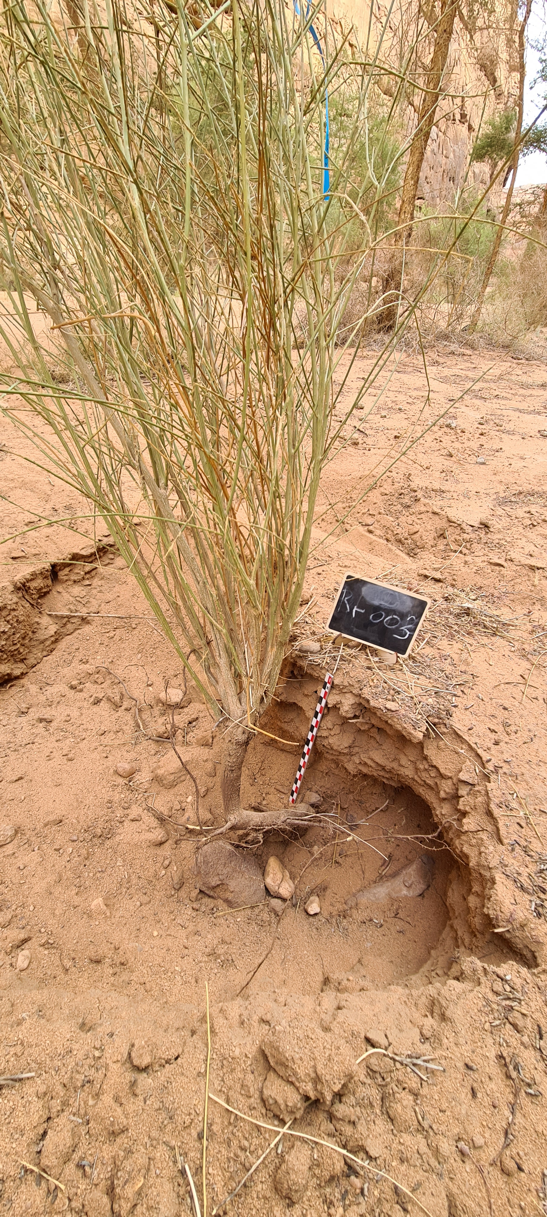
A
B
C
D
E
Figure S2: Overview of the sampling site in the Sharaan Nature Reserve for Retama raetam (A) with its associated soil (B). Retama raetam specimens are presented in C and D with associated flowers (E).

Slide 3
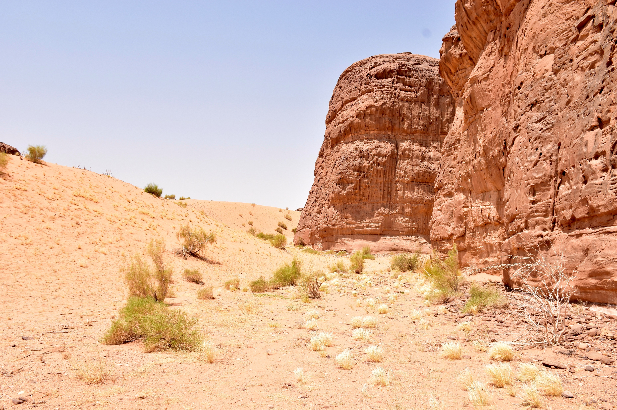
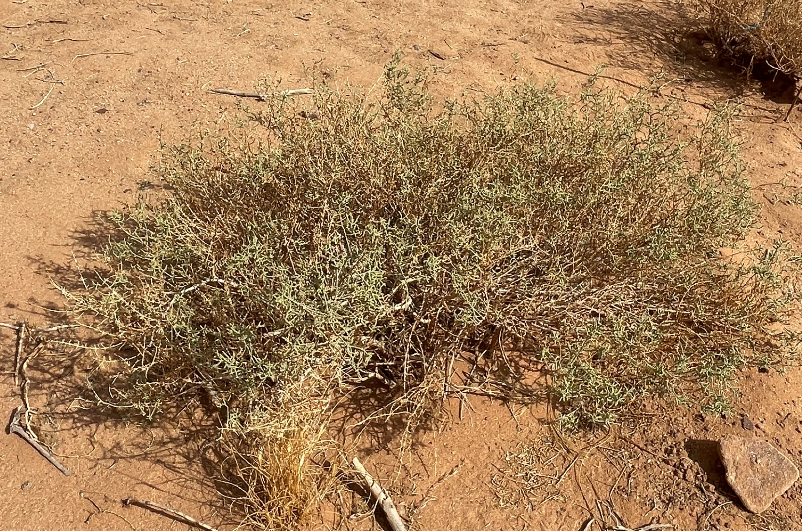
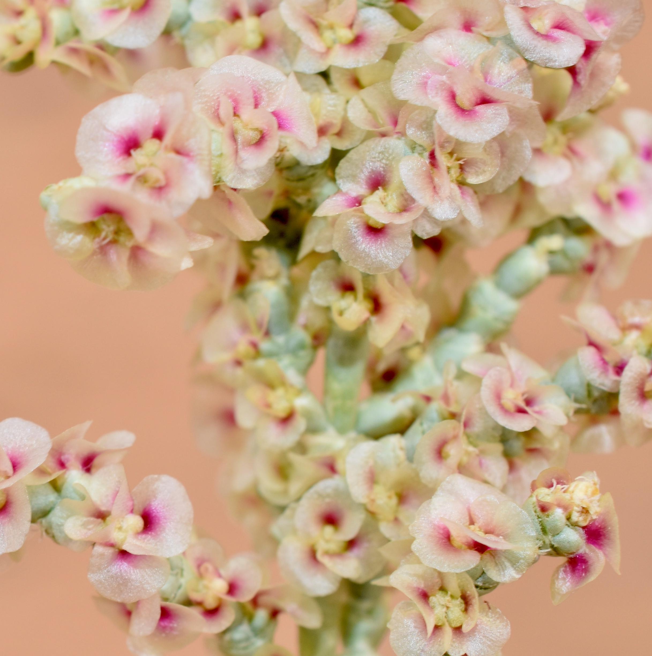
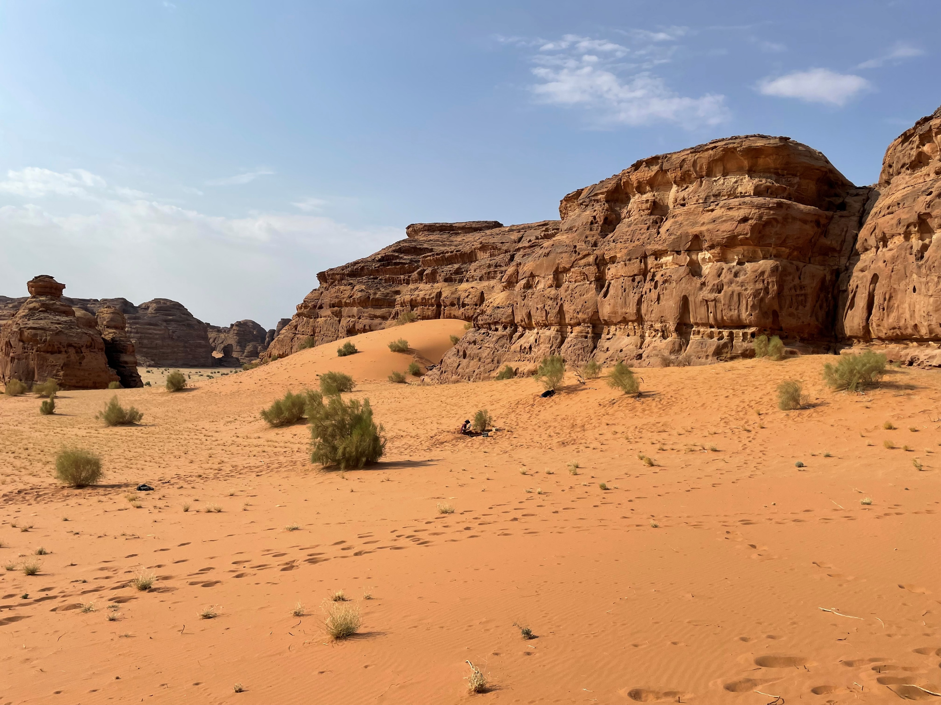
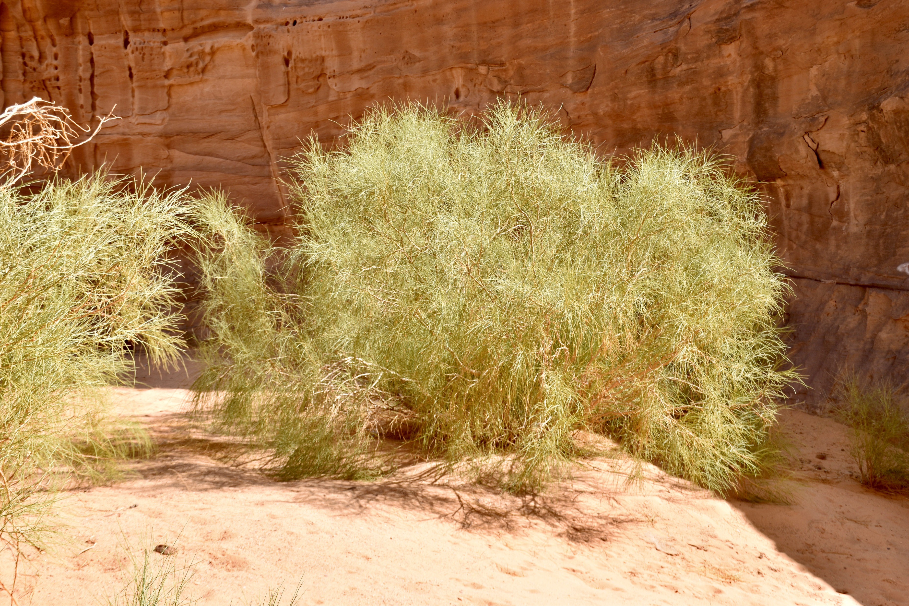
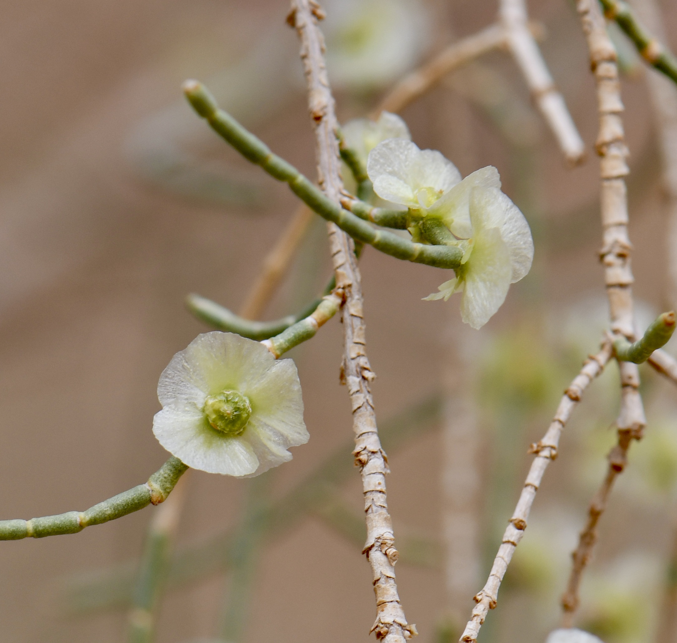
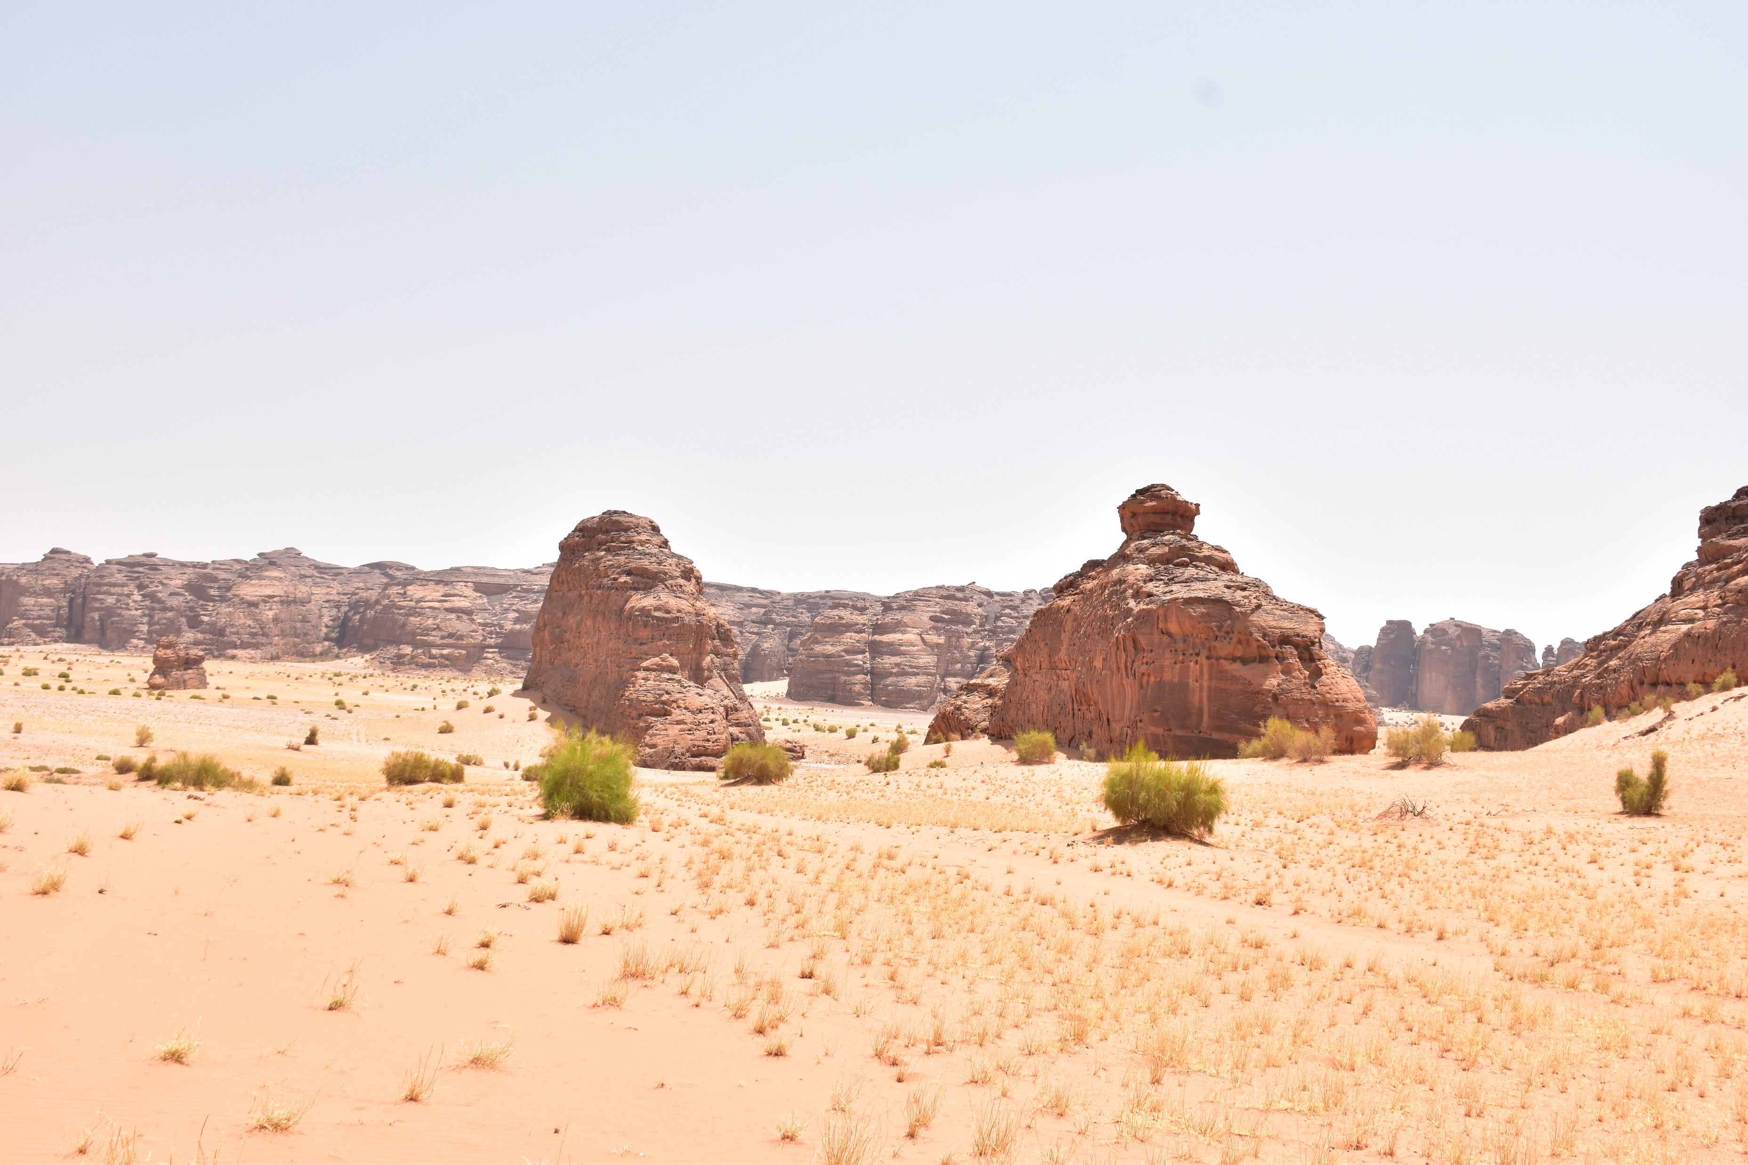
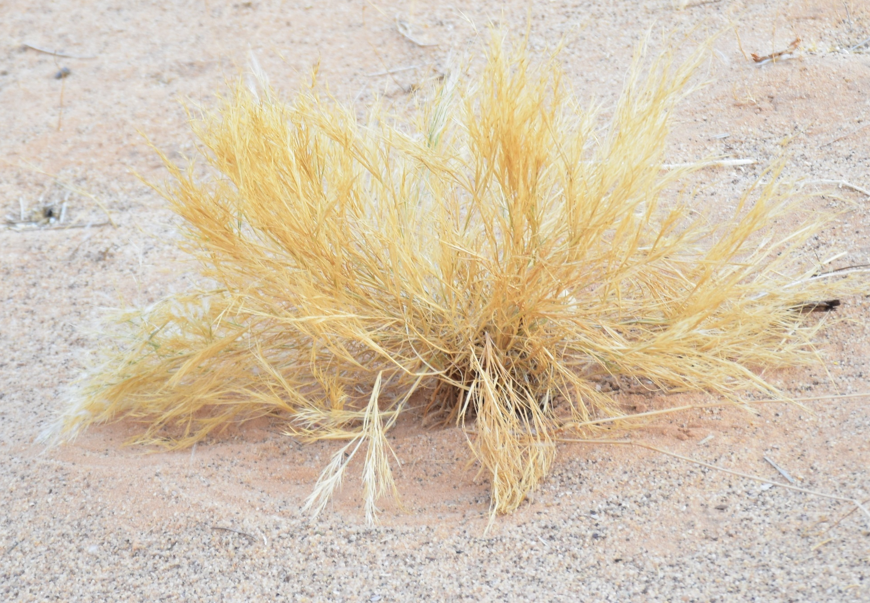
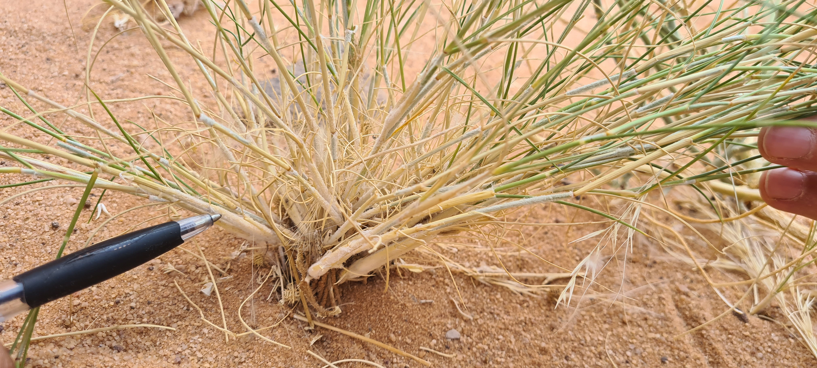
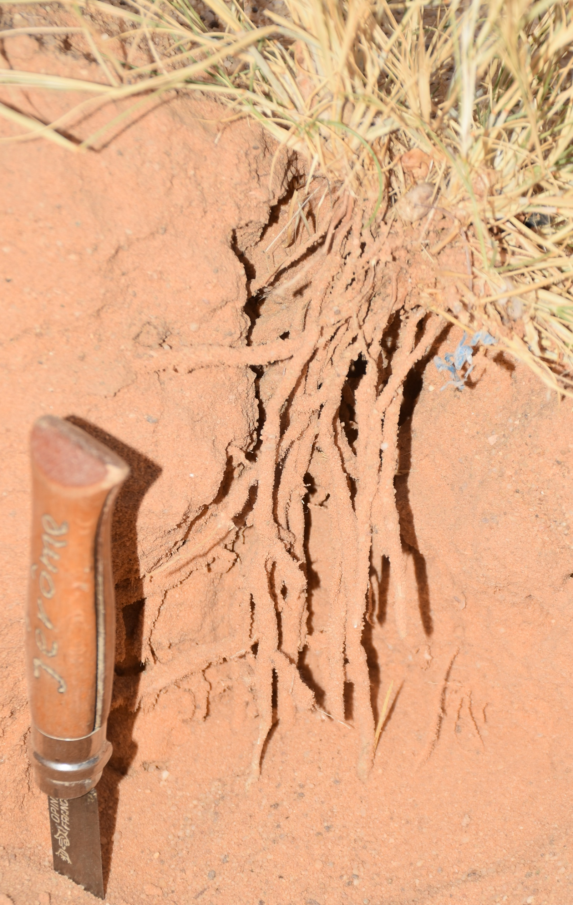
A
B
C
D
E
F
G
H
I
J
Figure S3: Overview of the sampling site in Sharaan Nature Reserve for Haloxylon salicornicum (A) with a sample specimen (B) and its associated flowers (C). Overview of the sampling site in Sharaan Nature Reserve for Haloxylon persicum (D) with a sample specimen (E) and its associated flowers (F). Overview of the sampling site in Sharaan Nature Reserve for Stipagrostis plumosa (G) with a sample specimen (H, I). The rhizosheat compartment with soil particles finely attached to the roots is presented in J.

