Slide 1
A missense c.80G＞A mutation in the CAV3 gene in a Han Chinese family with rippling muscle disease
Department of Neurology, Jiangxi Provincial People’s Hospital, The First Affiliated Hospital of Nanchang Medical College, Nanchang, Jiangxi Province, China.
Correspondence author: Yaoyao Shen, E-mail: 15270881796@163.com

Slide 2
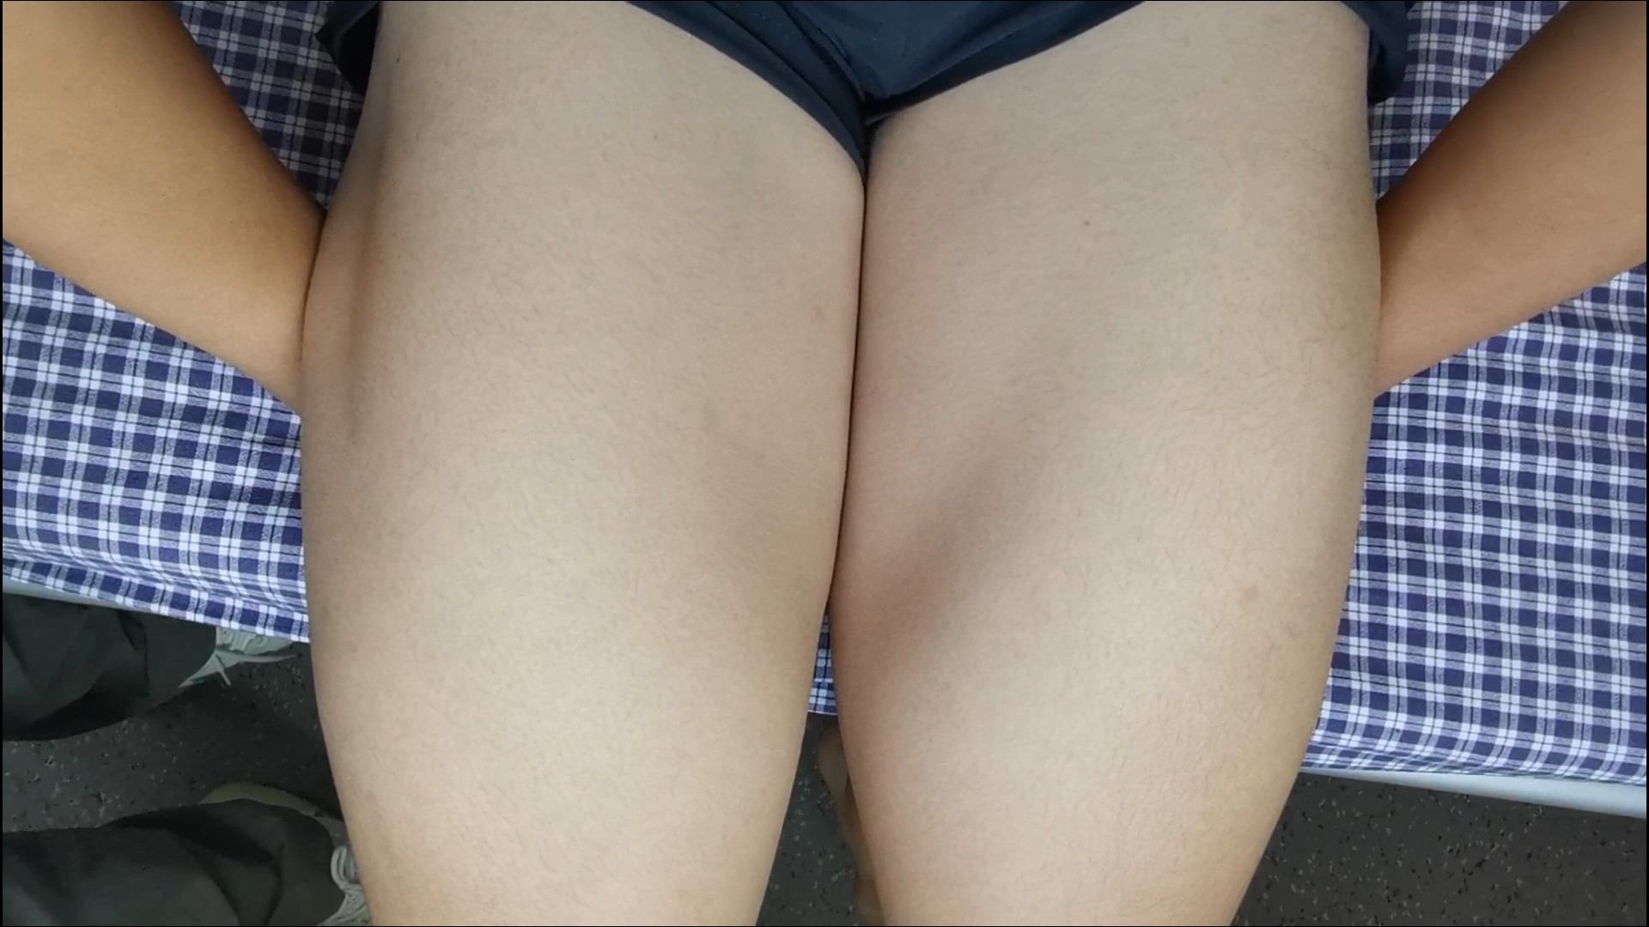
Video

