Slide 1
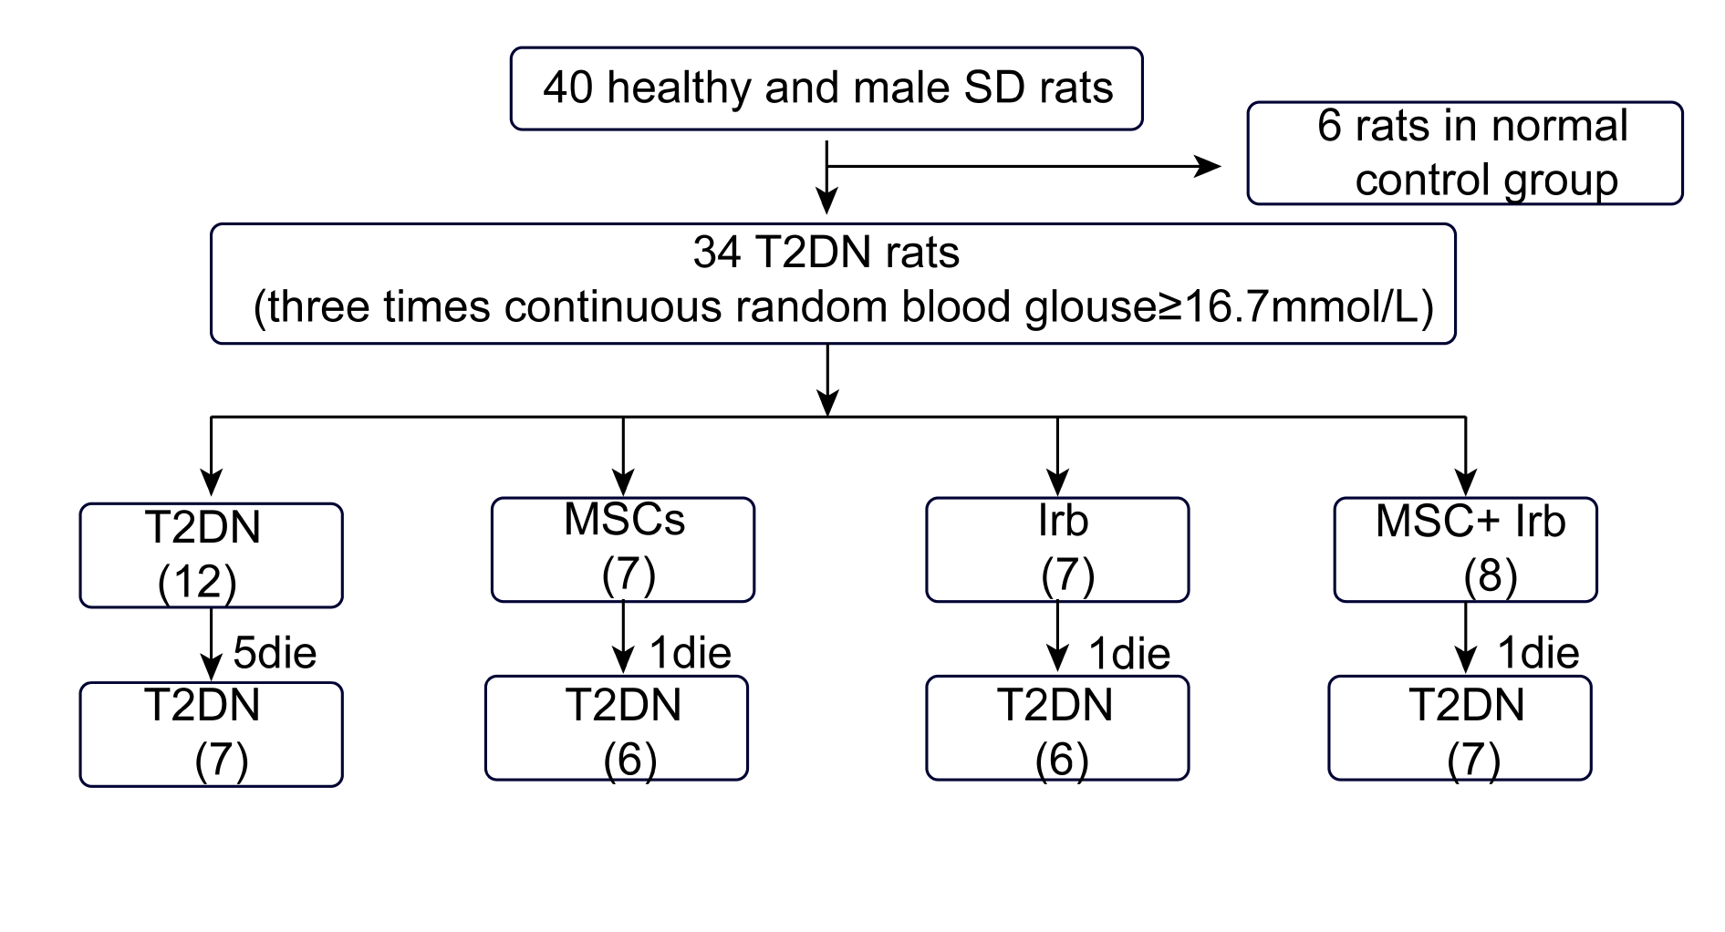
Figure S1. Animal allocation situation

Slide 2
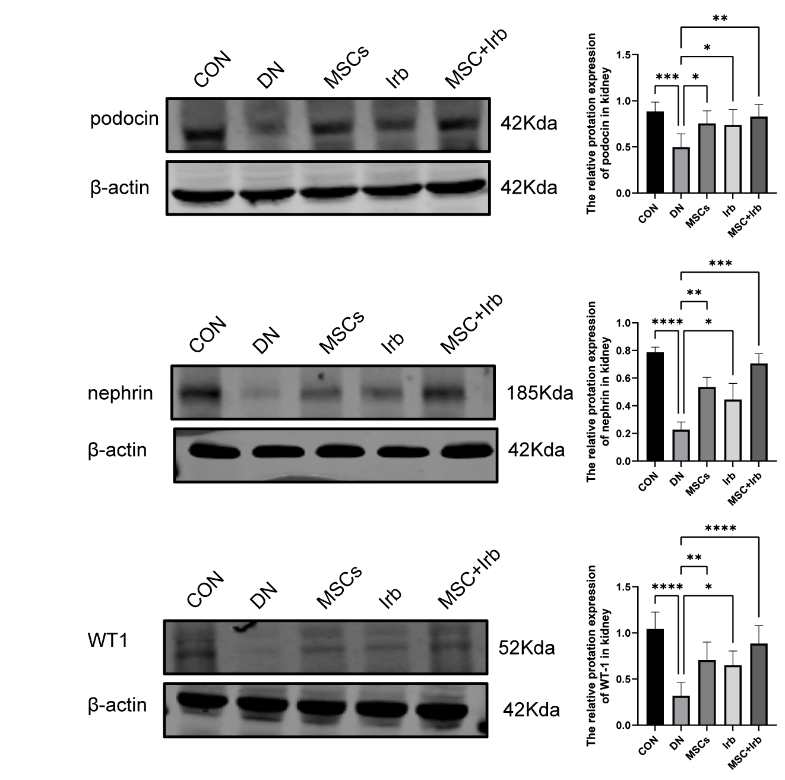
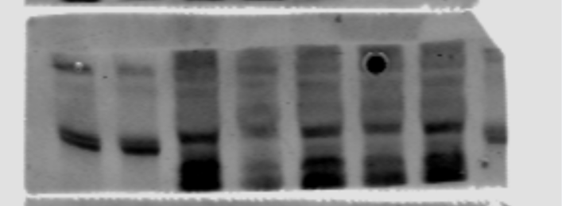
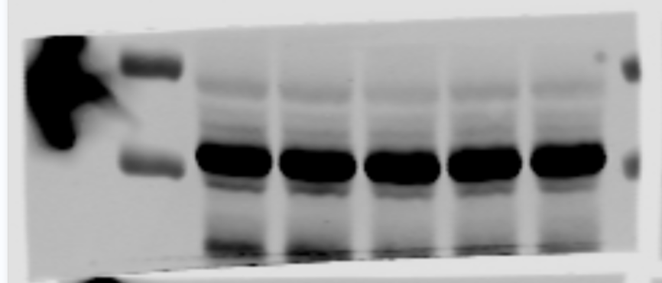
Figure S2. Uncropped images of the western blot(podocin).
55kDa
40kDa
55kDa
40kDa
podocin
55kDa
40kDa
β-actin
55kDa
55kDa
40kDa
40kDa
55kDa
40kDa
55kDa
40kDa
55kDa
40kDa
55kDa
40kDa
55kDa
40kDa

Slide 3
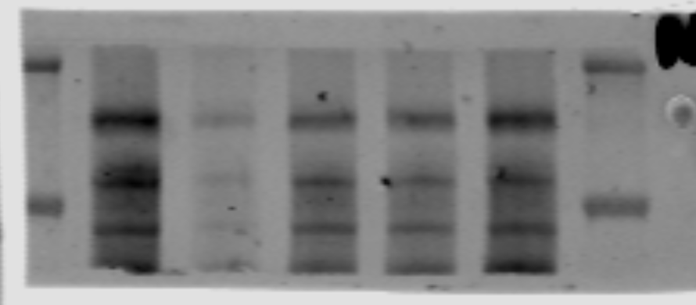
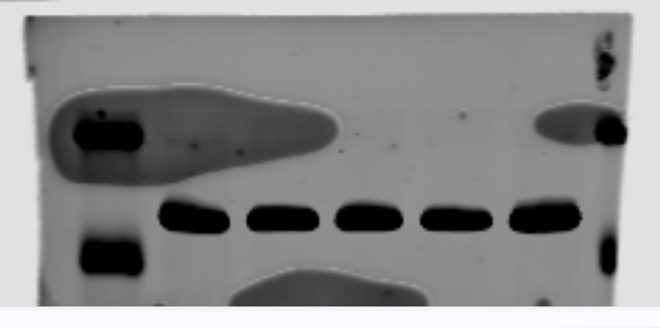
Figure S3. uncropped images of the western blot(nephrin).
250kDa
130kDa
55kDa
40kDa
nephrin
β-actin
250kDa
130kDa
55kDa
40kDa

Slide 4
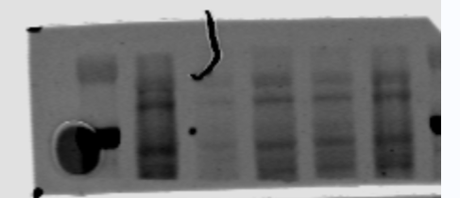
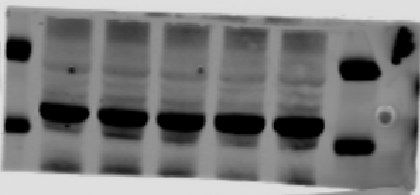
Figure S4. uncropped images of the western blot(WT-1).
55kDa
40kDa
55kDa
40kDa
WT-1
β-actin
55kDa
40kDa
55kDa
40kDa

