Slide 1
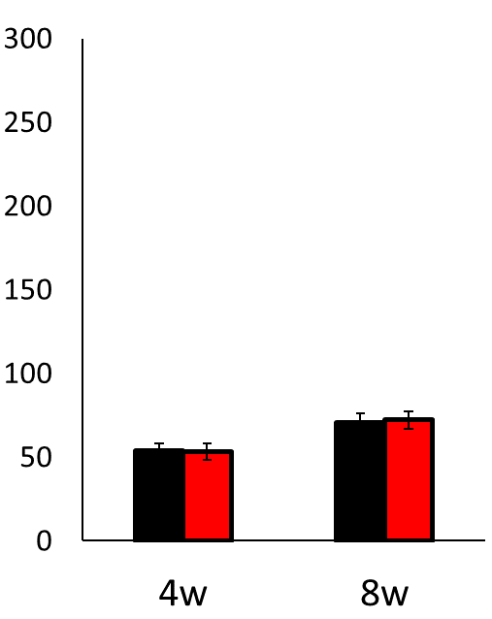
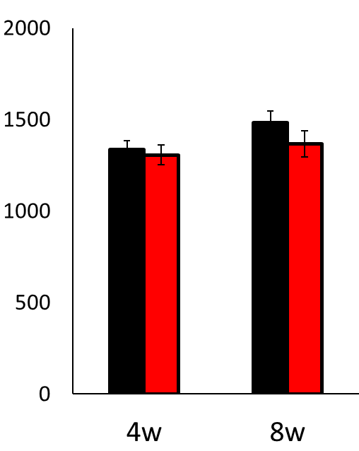
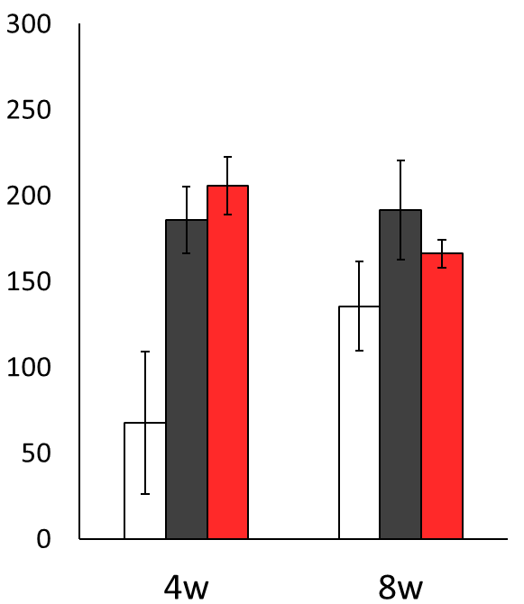

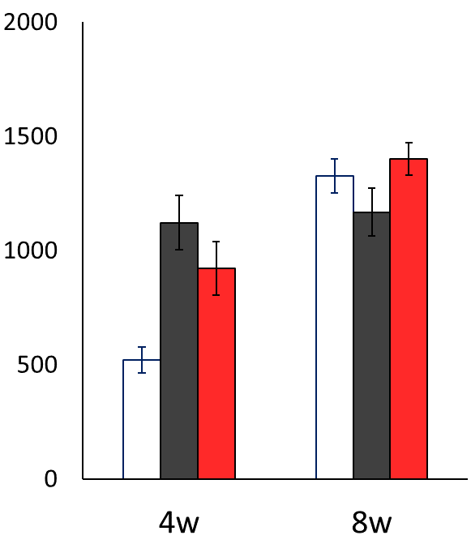
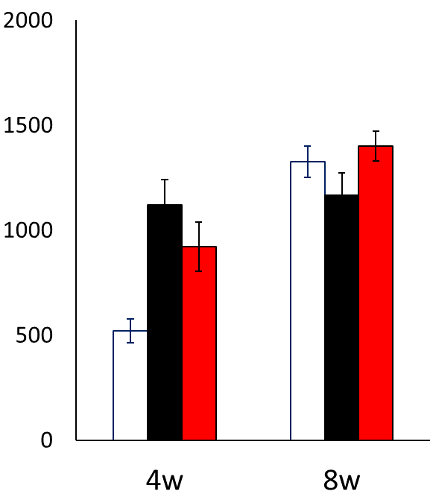
(A)
(B)
■ NW
■ EW
Time spent in central (sec)
Distance moved (cm)
(C)
(D)
■ GF-NW
■ GF-EW
■ GF
Time spent in central (sec)
Distance moved (cm)

Slide 2
Corticosterone (ng/g)
Time (week)

