Slide 1
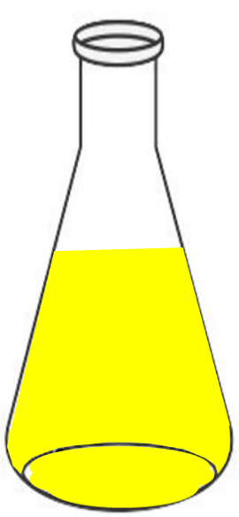
Voltmeter
Electrical load
Rubber cork
e-
e-
Glucose
NAD+
Yeast
Reduction
CO₂ + H⁺
Reference electrode
(Ag/AgCl)
CO2 + Ethanol
Cathode
NADH
Oxidation
O₂ + H₂O
Glucose
Anode
Yeast
Anode
Cathode

