Slide 1
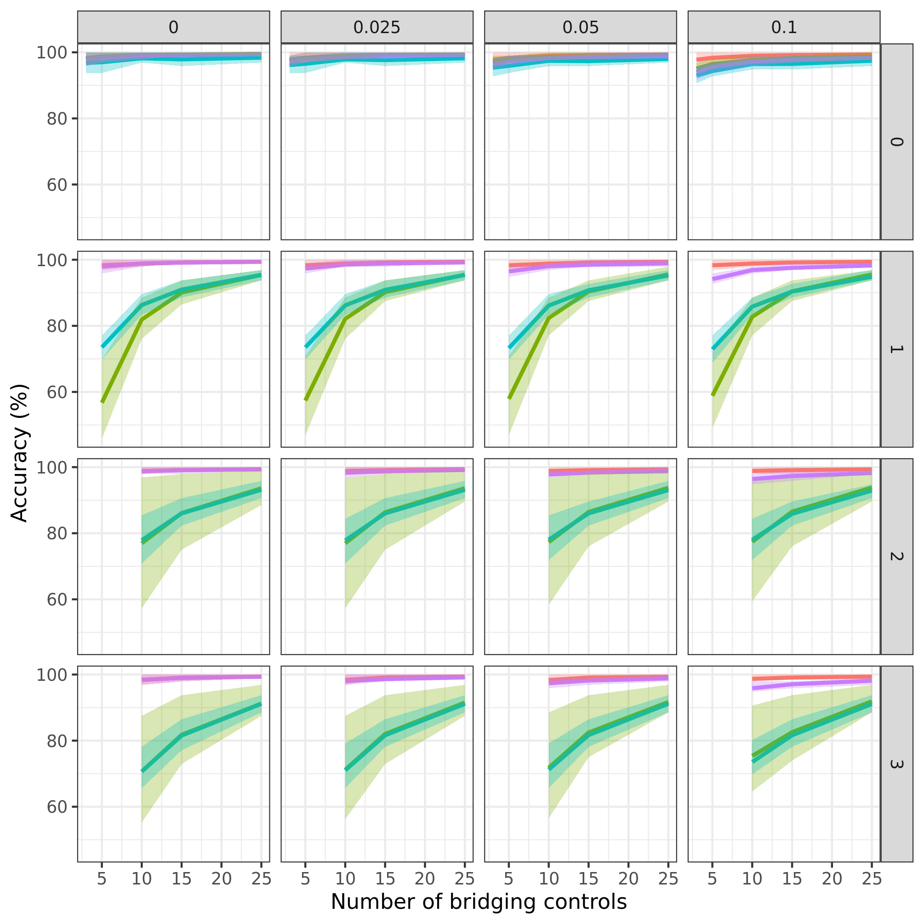

Supplementary Figure 1. Accuracy (percentage of proteins correctly found as differentially expressed after batch correction) according to the number of outliers within the bridging controls (rows) and the slope of the plate effect (columns).

Slide 2
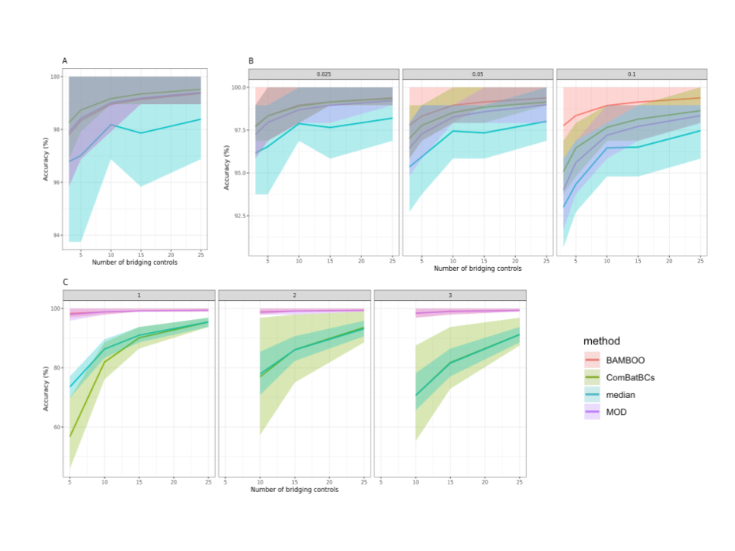
Supplementary figure 2. Accuracies over the simulation of the four batch correction methods. a) The accuracies of the four methods without plate wide batch effects or outliers. b) The accuracies of the four methods with a plate wide batch effect of 0.0025, 0.05 and 0.1. c) The accuracies of the four methods with 1, 2 or 3 outliers. Lines represent mean of the accuracy over all the simulations runs, ribbons indicate the IQR for each method.

Slide 3
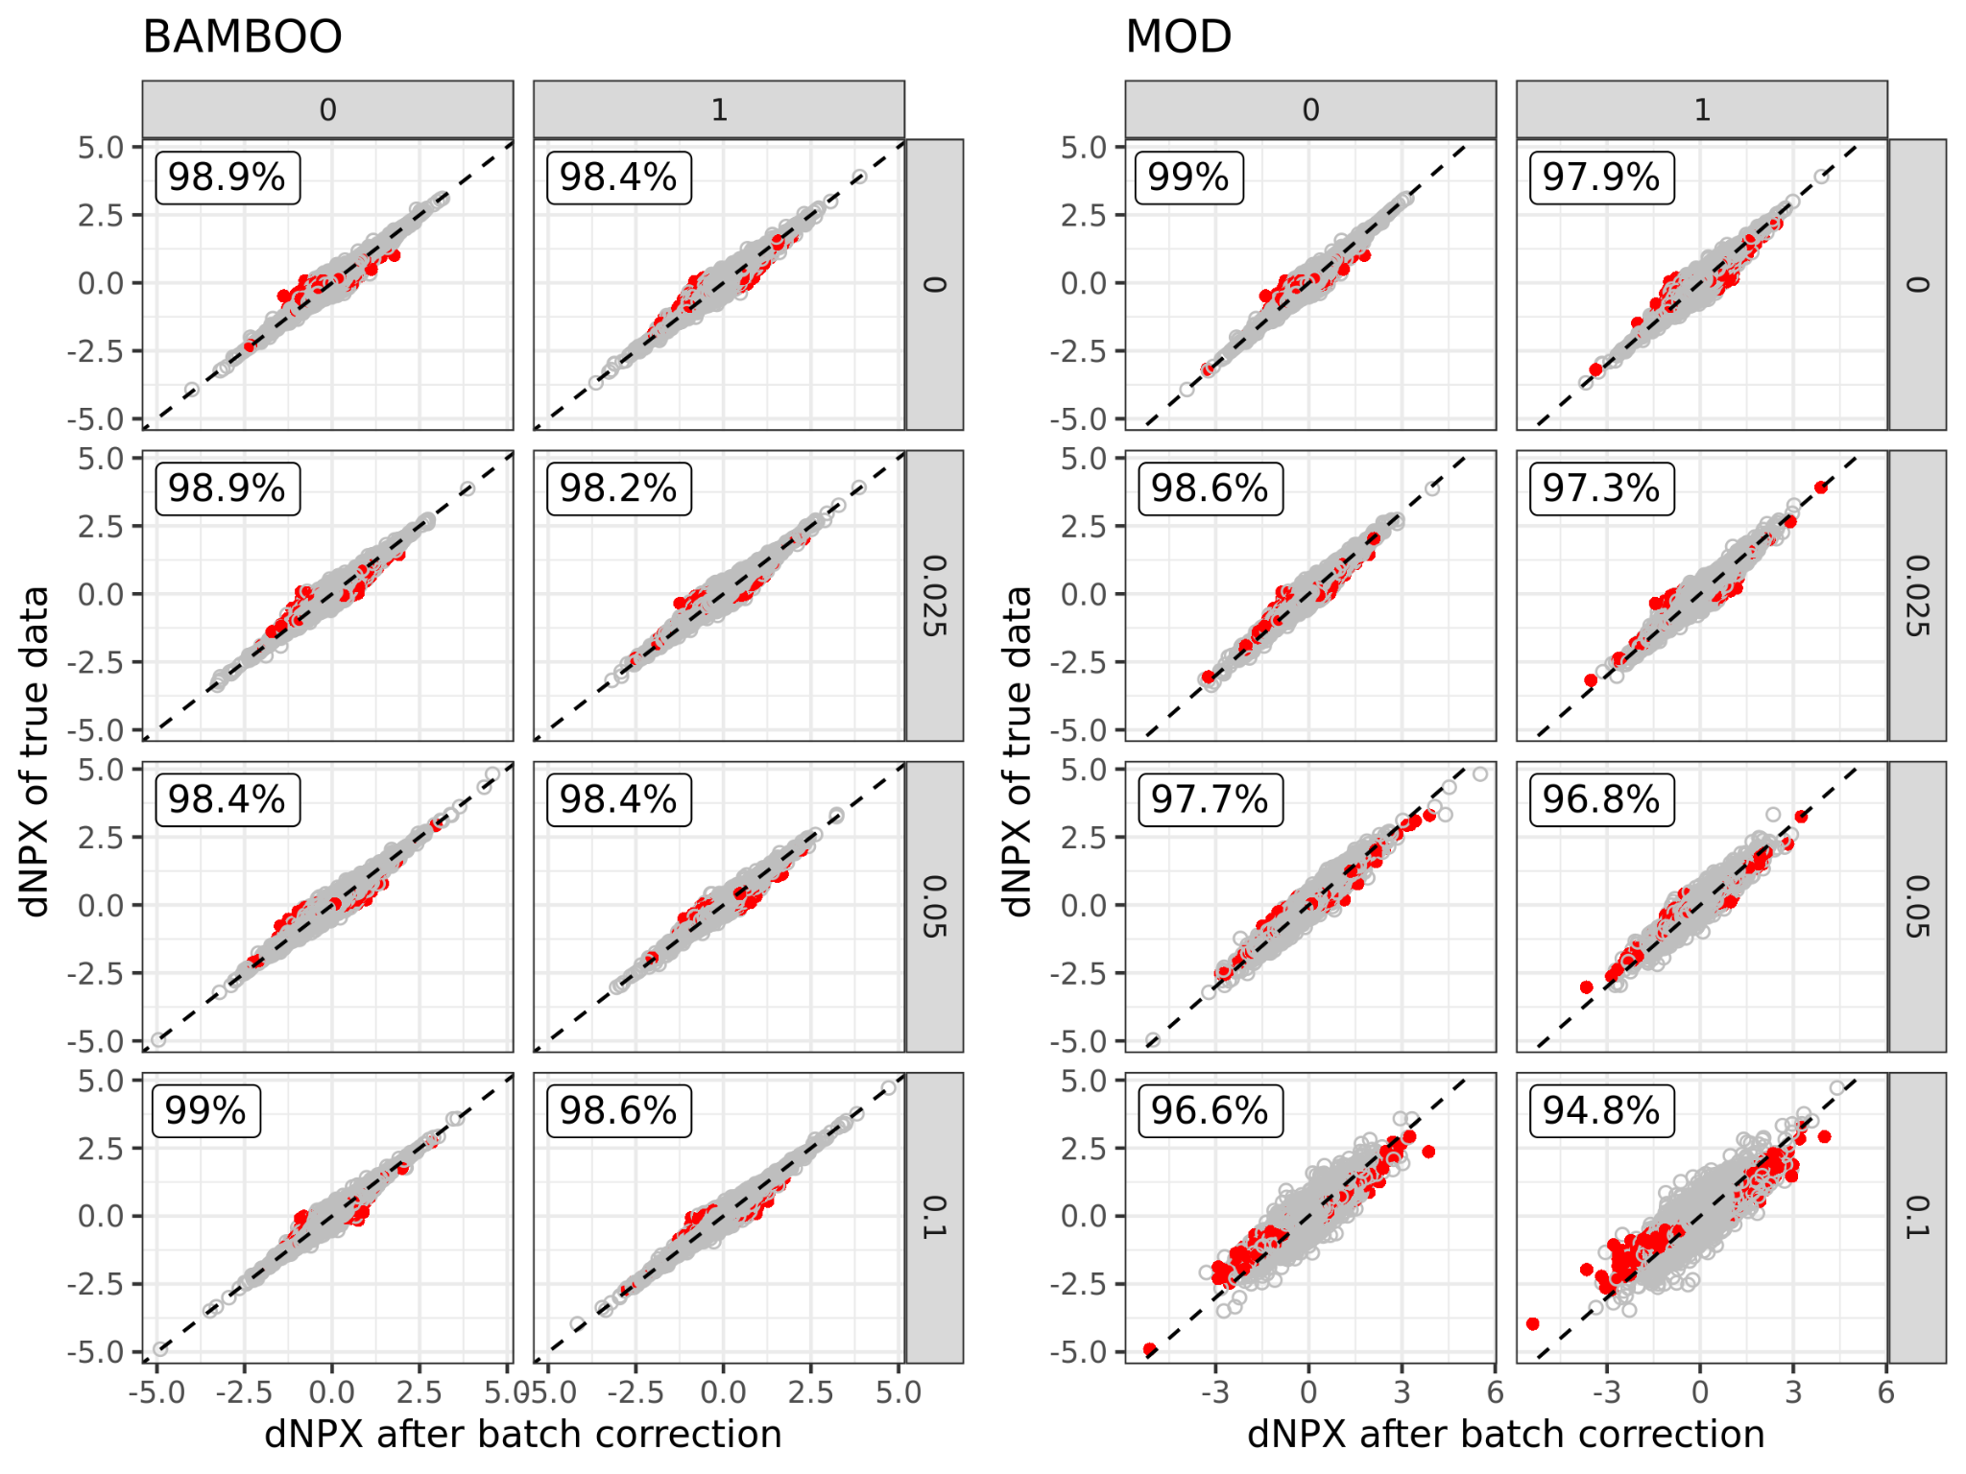
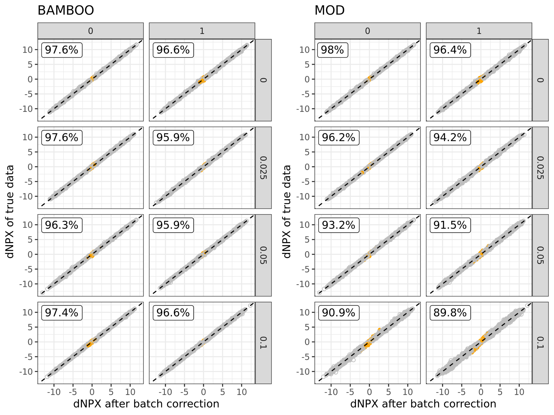
Supplementary figure 3. True negative rate for BAMBOO and MOD approaches using 5 bridging controls. Left figure (BAMBOO), right figure (MOD). The effect size between the two groups after batch correction are on the x-axis and the effect size in the “true” data (i.e. before batch introduction on the simulated data) are on the y-axis. Columns show the number of outliers in the simulations and the rows the slope of the plate effect that was introduced. False positives (proteins that were not significantly different in the true data and found statistically significant after batch effects correction) are in red and true negatives (proteins that were not significantly different in the true data and still not statistically significant after batch effects correction) in grey.
Supplementary figure 4. True positive rate for BAMBOO and MOD approaches using 5 bridging controls. Left figure (BAMBOO), right figure (MOD). The effect size between the two groups after batch correction are on the x-axis and the effect size in the “true” data (i.e. before batch introduction on the simulated data) are on the y-axis. Columns show the number of outliers in the simulations and the rows the slope of the plate effect that was introduced. False negatives (proteins that were significantly different in the true data and found not statistically significant after batch effects correction) are in orange and true positives (proteins that were significantly different in the true data and still statistically significant after batch effects correction) in gray.

Slide 4
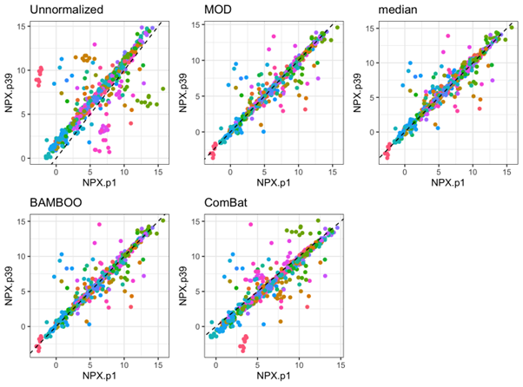
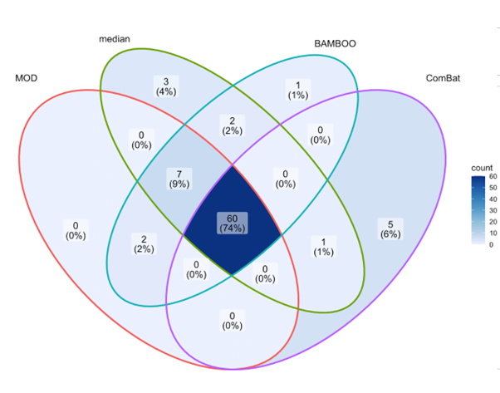
Supplementary Figure 5. Paired measurements of the bridging controls on plate A and B before batch effects correction and after correction for the four different methods. Each color indicates a protein.
Supplementary Figure 6. Venn diagram of the number of differential proteins found after batch correction with MOD, median centering, BAMBOO and ComBat between healthy controls and infected individuals.

