Slide 1
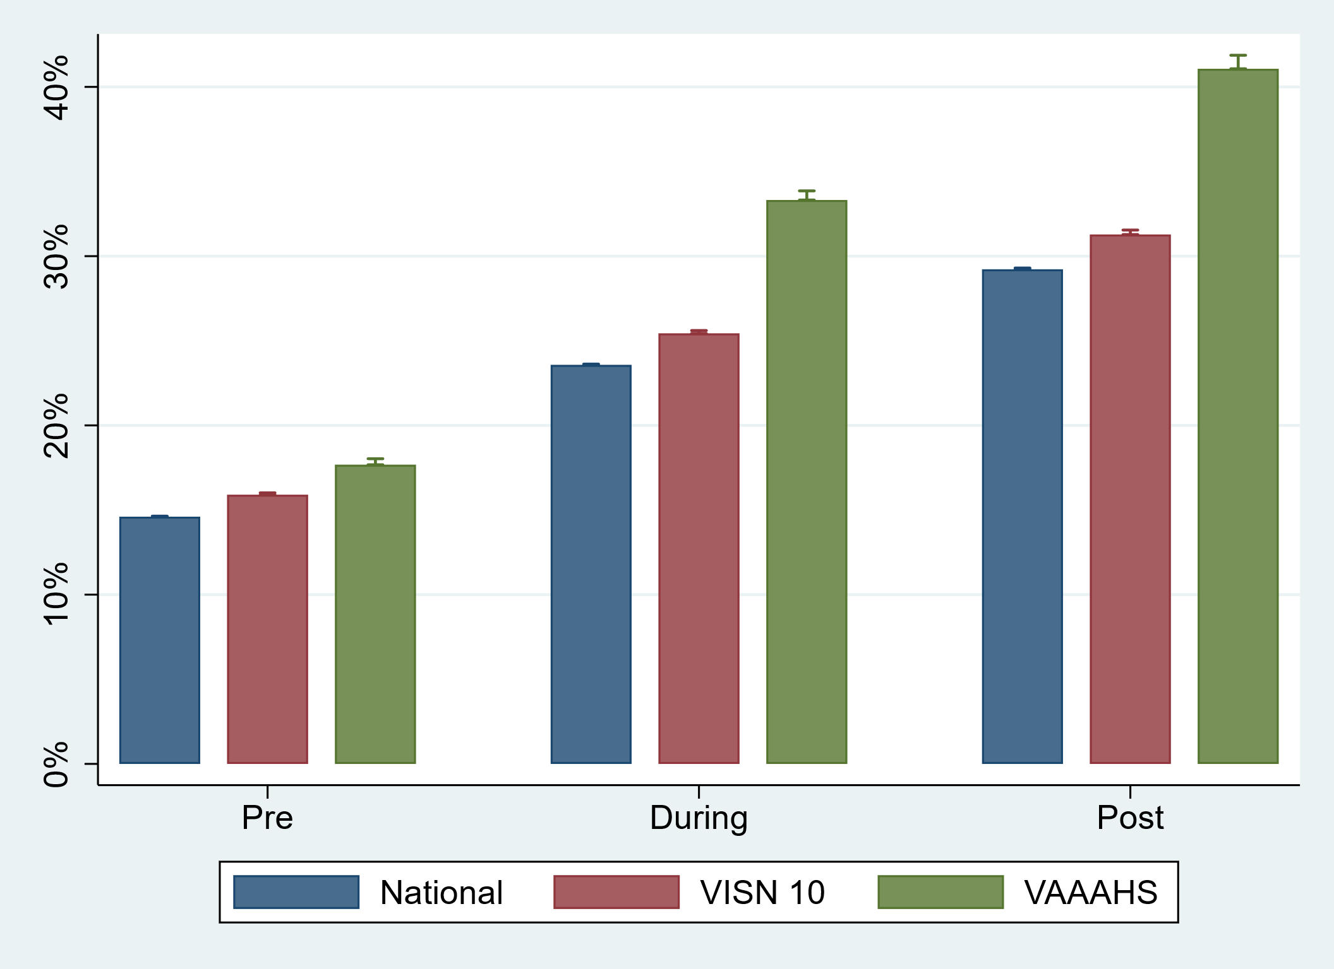
Additional File 2. Average percentage of patients with Type 2 diabetes and chronic kidney disease, atherosclerotic cardiovascular disease, or heart failure on a sodium glucose cotransporter-2 inhibitor or glucagon-like peptide-1 receptor agonist pre intervention, during intervention, and post intervention.
Average % of patients on a sodium glucose cotransporter-2 inhibitor or glucagon-like peptide-1 receptor agonist
VA National
VISN 10 Region
VAAAHS

