Slide 1
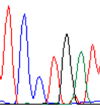
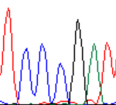
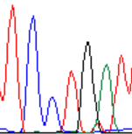
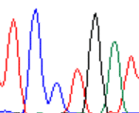
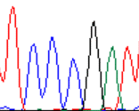
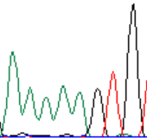
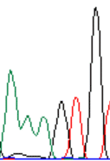
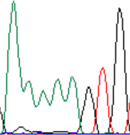
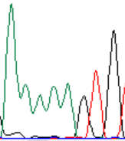
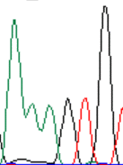
Supplementary Figure 1. RCR amplification and determination of the phase in Patients 2–7
a. RCR amplification of SYNE1 locus (Patient 2)
Product 1
Product 2
Product 3
Product 4
Product 5
Variant 1 c.21250C>T, p.R7084*
MT
WT
MT
MT
WT
T C C T G A T
T C C C G A T
T C C T G A T
T C C T G A T
T C C C G A T
Variant 2 c.22622_22623delAA, p.K7541Sfs*28
WT
MT
WT
WT
MT
A A A A A G T G
A A A G T G
A A A A A G T G
A A A A A G T G
A A A G T G

Slide 2
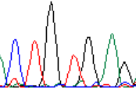
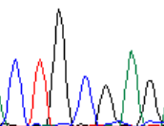
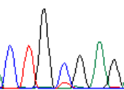
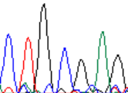
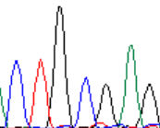
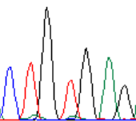
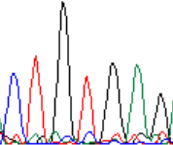
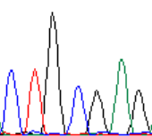
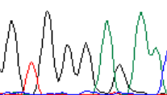
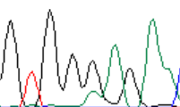
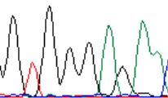
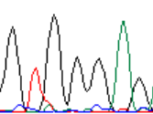
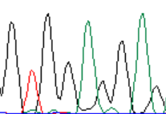
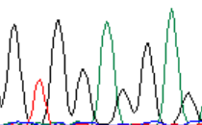
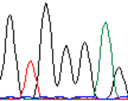
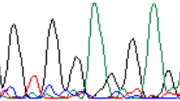
b. RCR amplification of SYNE1 locus (Patient 3)
Product 1
Product 2
Product 3
Product 4
Product 5
Product 6
Product 7
Product 8
Variant 1 c.18325C>T, p.Q6109*
MT
WT
WT
WT
WT
MT
MT
WT
C T G T G A G
C T G C G A G
C T G C G A G
C T G C G A G
C T G C G A G
C T G T G A G
C T G T G A G
C T G C G A G
Variant 2 c.19943_19944delAG, p.E6648Gfs*8
WT
MT
MT
MT
MT
WT
WT
MT
G T G G A G G A G
G T G G G A G
G T G G G A G
G T G G G A G
G T G G G A G
G T G G A G G A G
G T G G A G G A G
G T G G G A G

Slide 3
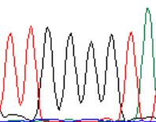
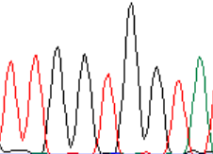
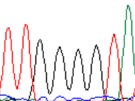
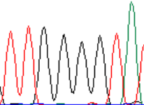
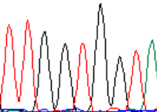
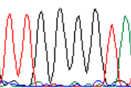


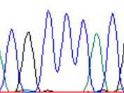
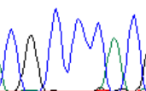


c. RCR amplification of ATP7B locus (Patient 4)
Product 1
Product 2
Product 3
Product 4
Product 5
Product 6
Variant 1 c.2810delT, p.V937Gfs*5
MT
WT
MT
MT
WT
MT
T T G G G G T A
T T G G T G G T A
T T G G G G T A
T T G G G G T A
T T G G T G G T A
T T G G G G T A
Variant 2 c.2975C>T, p.P992L
WT
MT
WT
WT
MT
WT
C G C C C A C
C G C T C A C
C G C C C A C
C G C C C A C
C G C T C A C
C G C C C A C

Slide 4
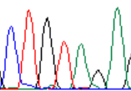
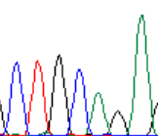
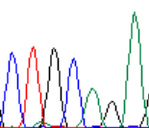
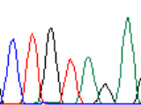
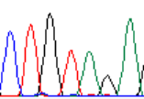
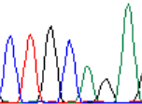
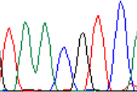
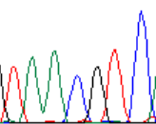
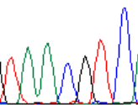
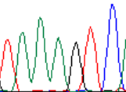
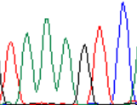
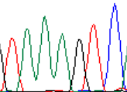
d. RCR amplification of SYNE1 locus (Patient 5)
Product 1
Product 2
Product 3
Product 4
Product 5
Product 6
Variant 1 c.18325C>T, p.Q6109*
MT
WT
MT
MT
WT
MT
C T G T A G A
C T G C A G A
C T G C A G A
C T G T A G A
C T G C A G A
C T G T A G A
SNP c.11576A>C
C
A
A
C
A
C
T A A C G T C
T A A A G T C
T A A A G T C
T A A C G T C
T A A A G T C
T A A C G T C

Slide 5
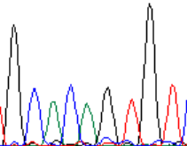
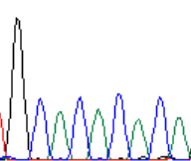
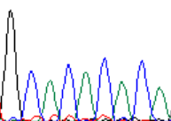
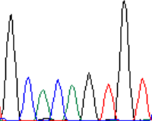





Product 1
Product 2
Product 3
Product 4
Product 5
Variant2 c.4640_4643dup, p.Q1548Hfs*19
WT
MT
MT
WT
MT
G C A C A G
G C A C A C A C A
G C A C A C A C A
G C A C A G
G C A C A C A C A
SNP c.11576A>C
C
A
A
C
C
T A A C G T C
T A A A G T C
T A A A G T C
T A A C G T C
T A A C G T C

Slide 6
















e. RCR amplification of COQ4 locus (Patient 6)
gDNA:oriC-AmpR=1:100
Product 1
Product 2
Product 3
Product 4
Product 5
Product 6
Product 7
Product 8
Variant 1: c.238C>T
heterozygous
heterozygous
heterozygous
heterozygous
heterozygous
heterozygous
heterozygous
heterozygous
C A C C G C A
/T
C A C C G C A
/T
C A C C G C A
/T
C A C C G C A
/T
C A C C G C A
/T
C A C C G C A
/T
C A C C G C A
/T
C A C C G C A
/T
Variant 2: c.718C>T
heterozygous
heterozygous
heterozygous
heterozygous
heterozygous
heterozygous
heterozygous
heterozygous
C G G C G C T
/T
C G G C G C T
/T
C G G C G C T
/T
C G G C G C T
/T
C G G C G C T
/T
C G G C G C T
/T
C G G C G C T
/T
C G G C G C T
/T

Slide 7












gDNA:oriC-AmpR=1:10
Product 1
Product 2
Product 3
Product 4
Product 5
Product 6
Variant 1: c.238C>T
heterozygous
WT
WT
MT
WT
MT
C A C C G C A
/T
C A C C G C A
C A C C G C A
C A C T G C A
C A C C G C A
C A C T G C A
Variant 2: c.718C>T
heterozygous
MT
MT
WT
MT
WT
C G G C G C T
/T
C G G T G C T
C G G T G C T
C G G C G C T
C G G T G C T
C G G C G C T

Slide 8










f RCR amplification of CLCN2 locus (Patient 7)
Product 1
Product 2
Product 3
Product 4
Product 5
Variant 1 c.61dupC
WT
MT
MT
WT
MT
A C C C T G G
A C C C C T G G
A C C C C T G G
A C C C T G G
A C C C C T G G
Variant 2 c.983+2T>A
MT
WT
WT
MT
WT
G G G A G A G
G G G T G A G
G G G T G A G
G G G A G A G
G G G T G A G

