Slide 1
a
b
c
PC3-LN3-PSMA
PTr
P28ζ
PC3-LN3
Isotype
Isotype
d
e
Supplementary Figure 1| Anti-tumor activity of P28ζ CAR T cells

Slide 2
a
Supplementary Figure 2| Glucose availability has differential effects on pro-inflammatory cytokine production by P28ζ CAR T cell.

Slide 3
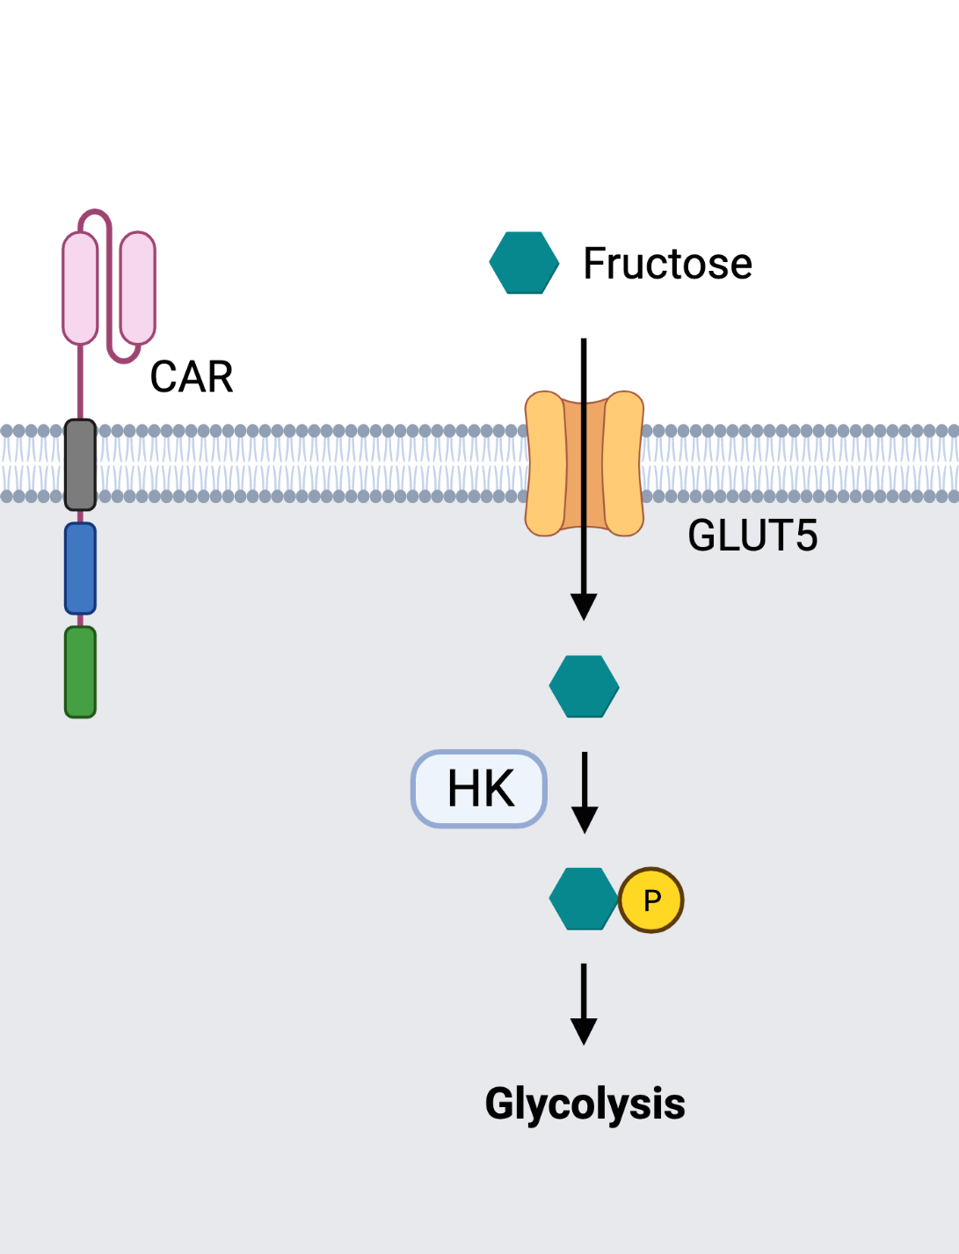
a
Supplementary Figure 3| Proposed model for fructose utilization by CAR T cells.

Slide 4
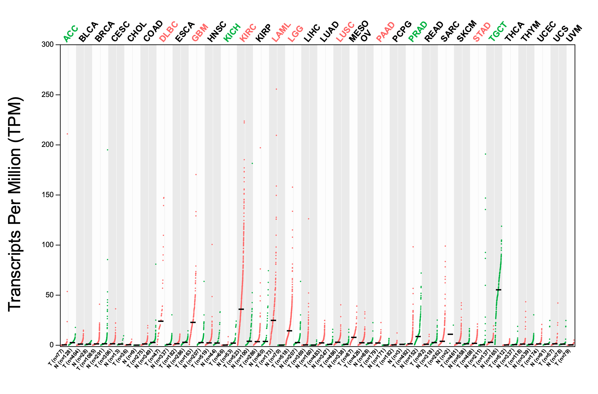
a
b
Supplementary Figure 4| GLUT5 expression in human cancers is heterogenous.

Slide 5
a
Supplementary Figure 5| Serum Fructose Kinetics Following Intraperitoneal (IP) Fructose Injection.
Notes:
SUP FIG3
Supplementary Figure 3: a) serum concentration of fructose in tail vein blood of mice given normal drinking water or 5% fructose supplemented drinking water; b) serum concentration of fructose in tail vein blood over time after administration of 300mg of intraperitoneal fructose (n=3)

