Slide 1
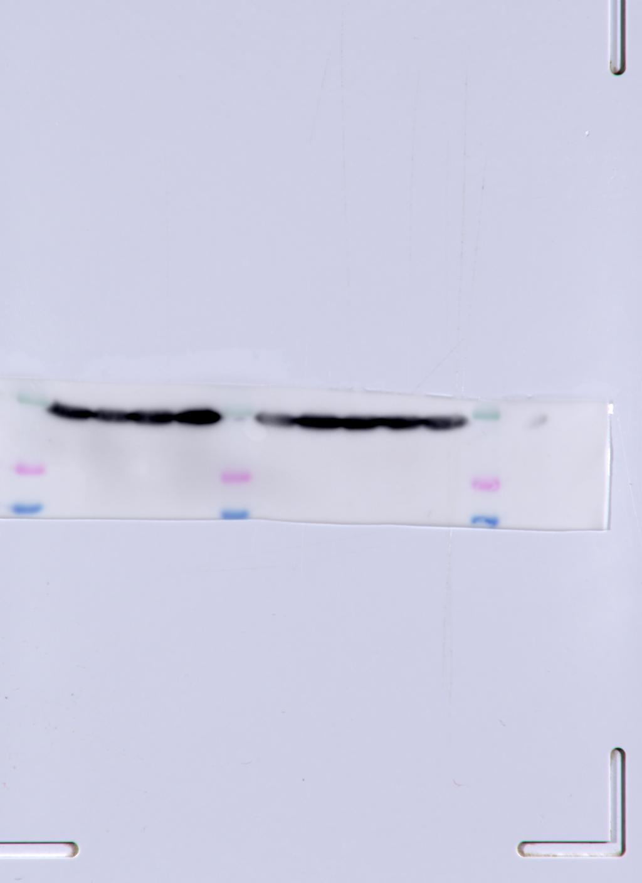
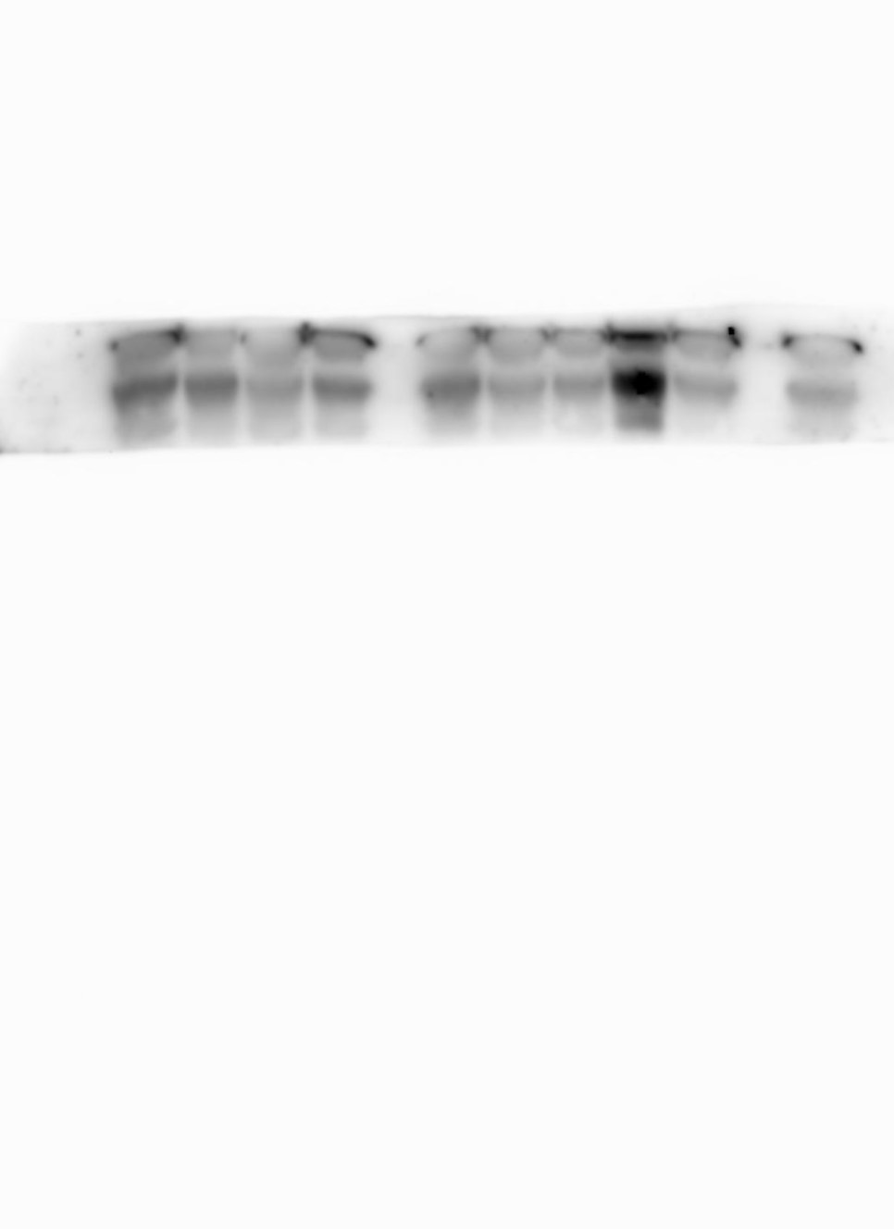
Upper membranes
Upper GAPDH
Upper GAPDH used
iNOS
CX3CR1

Slide 2
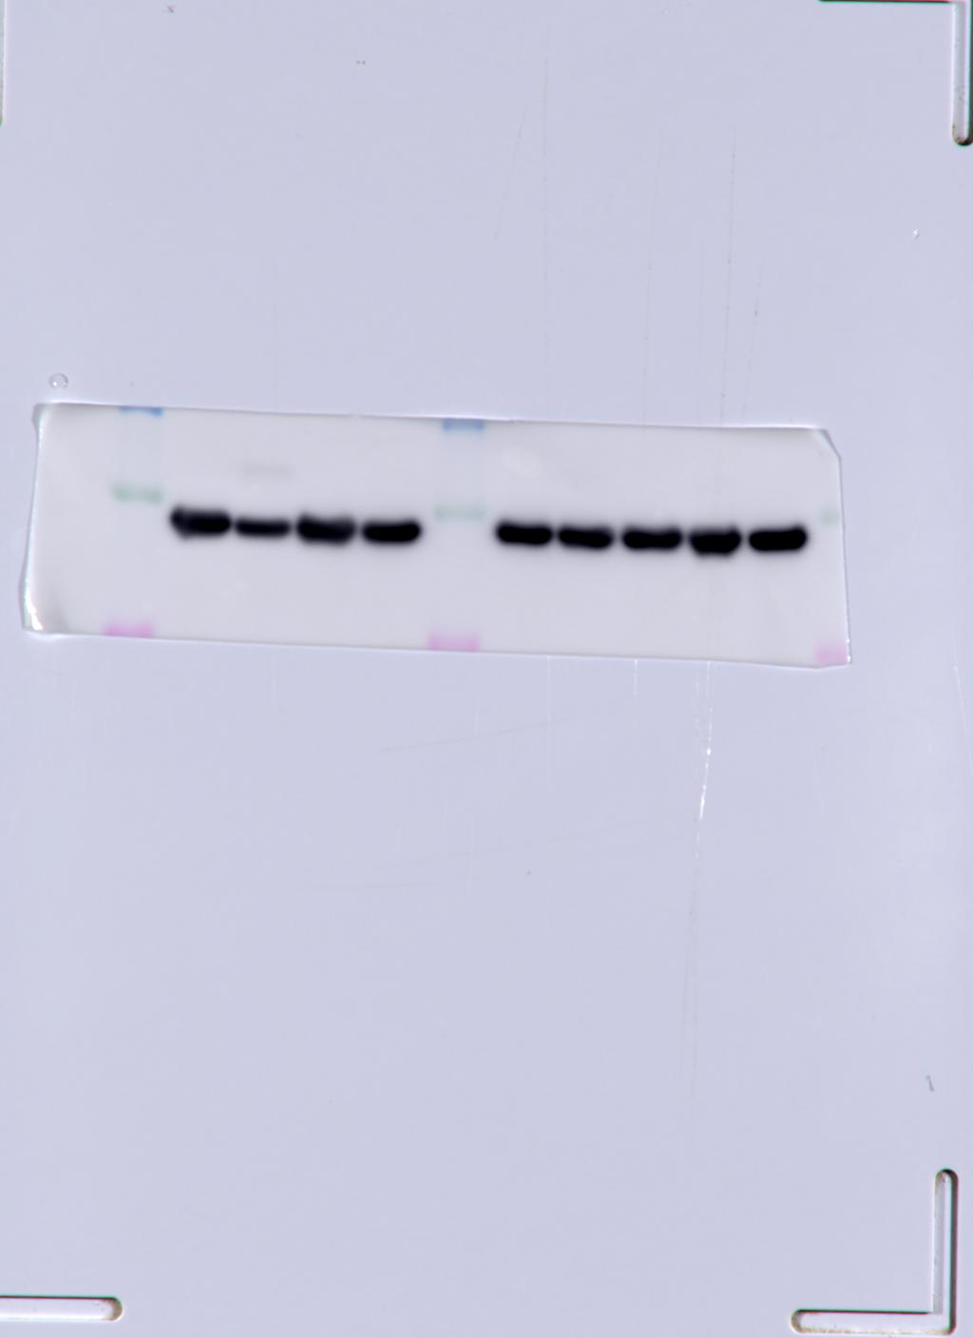
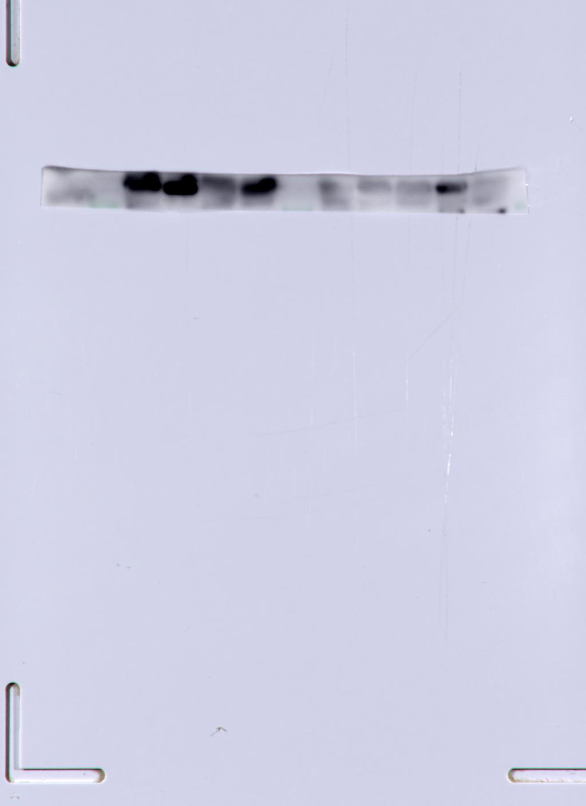
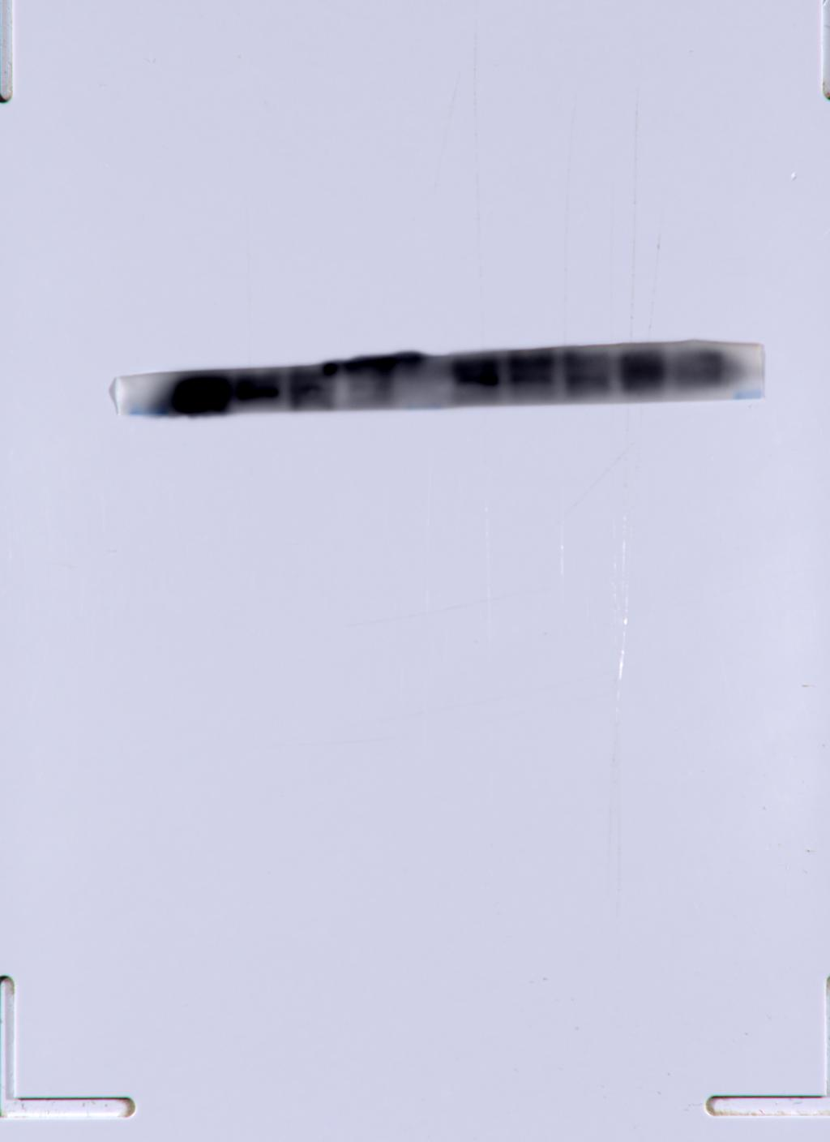
Lower membranes
Lower GAPDH
CCR2
MSR1

