Slide 1
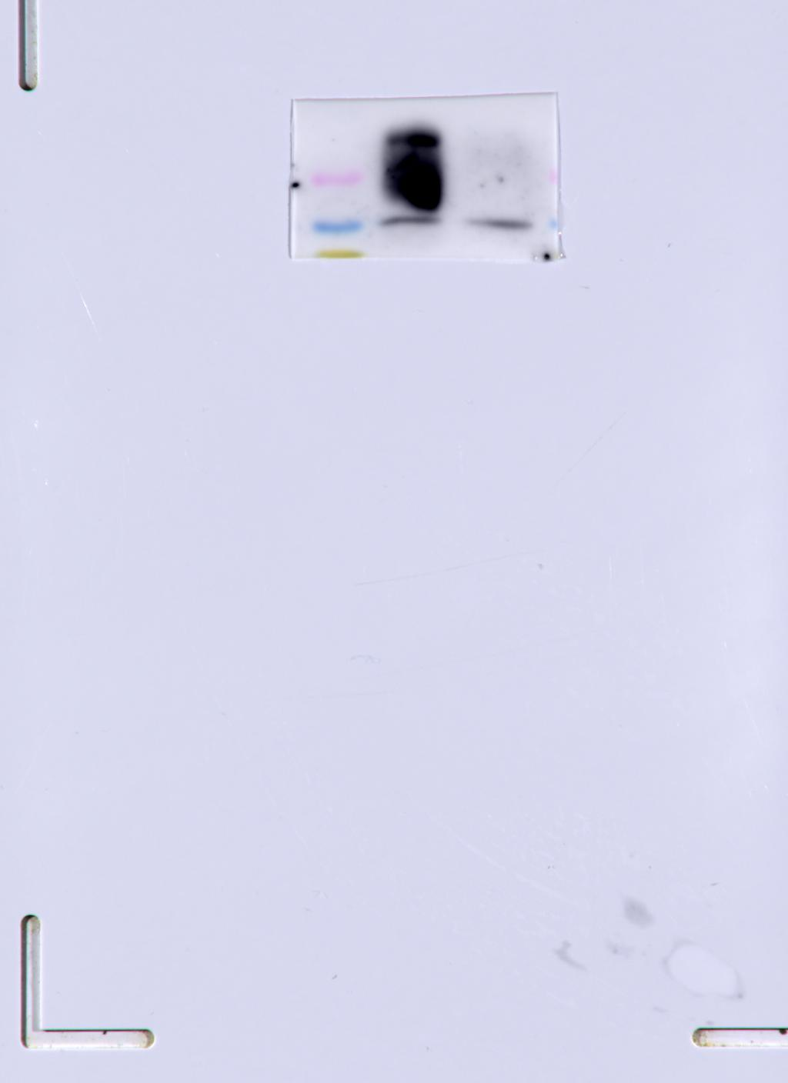
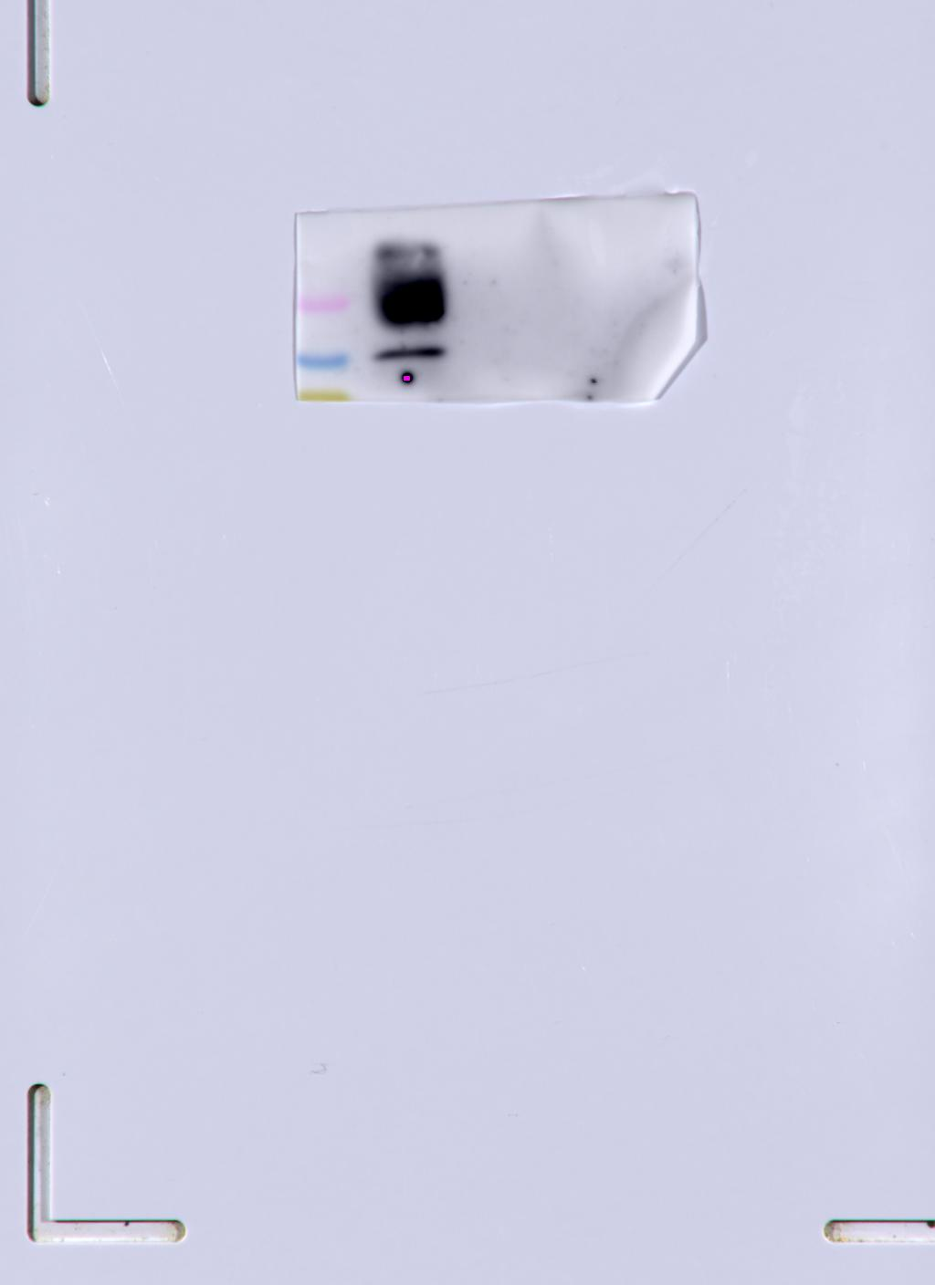
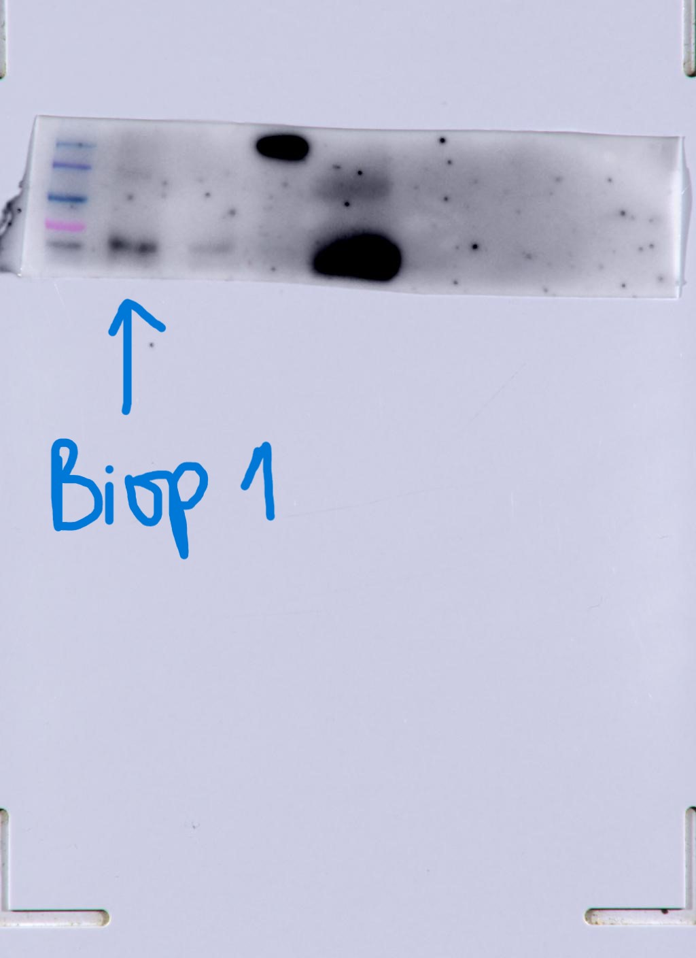
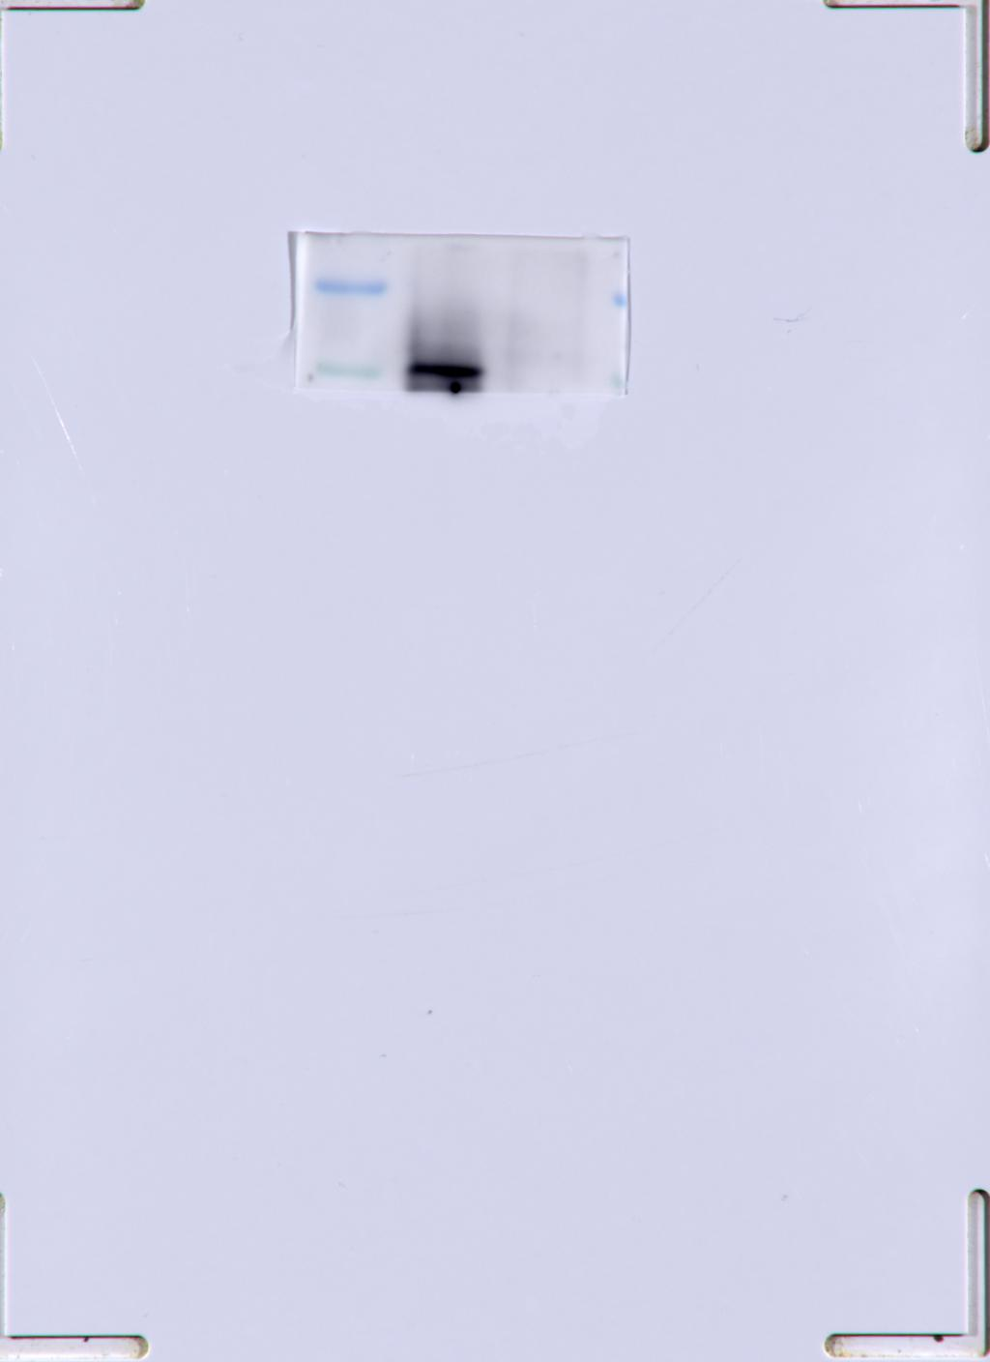
Biopsy 1
CD9 Biopsy 1
CD81 Biopsy 1
HSP70 Biopsy 1
TSG101 Biopsy 1

Slide 2
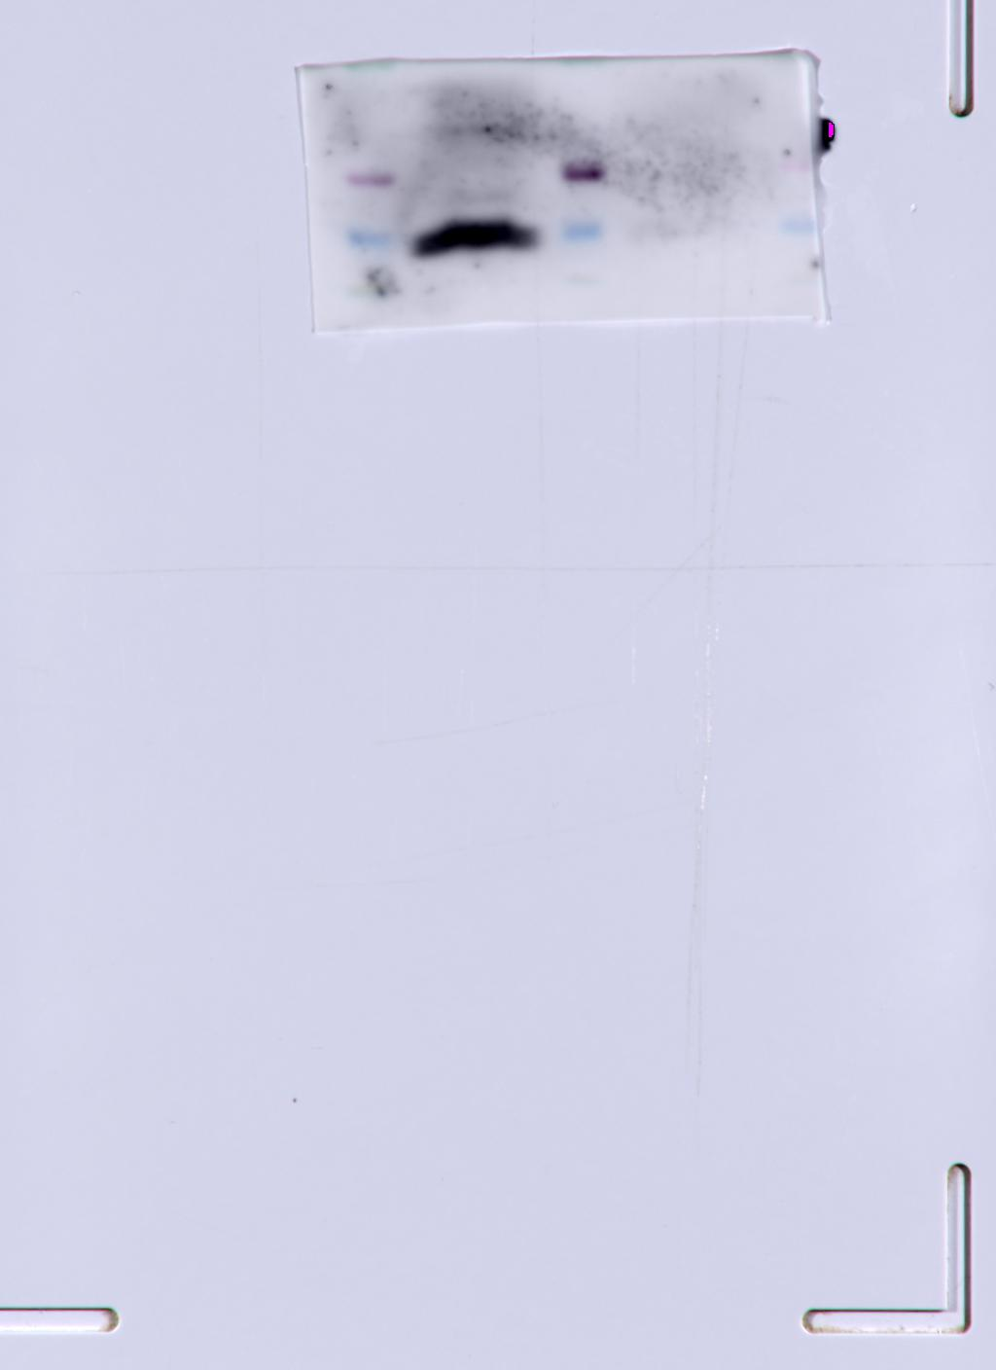
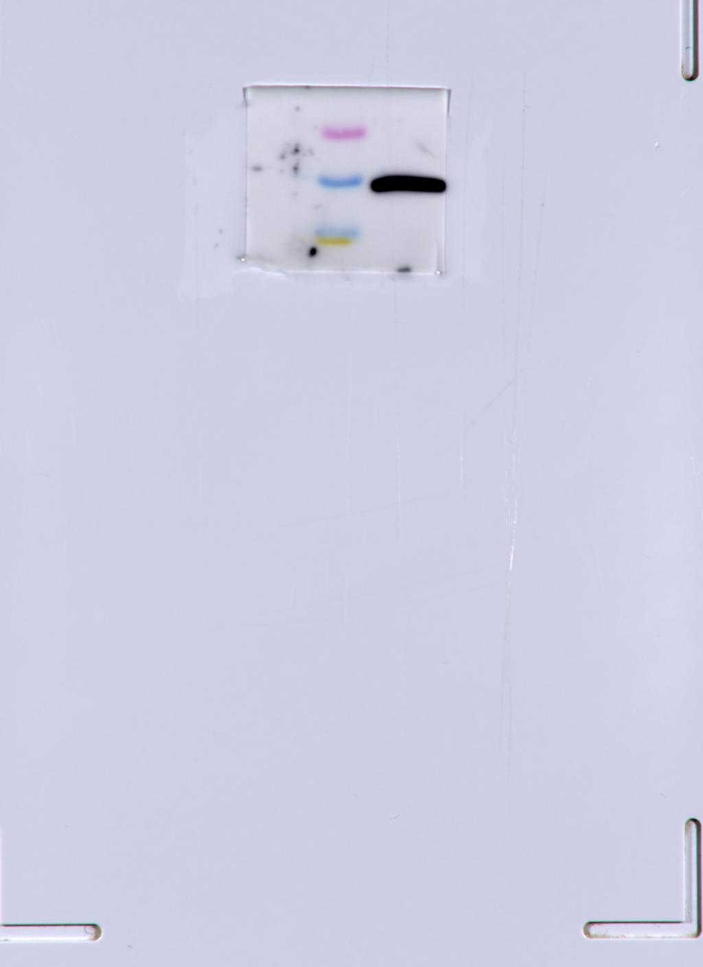
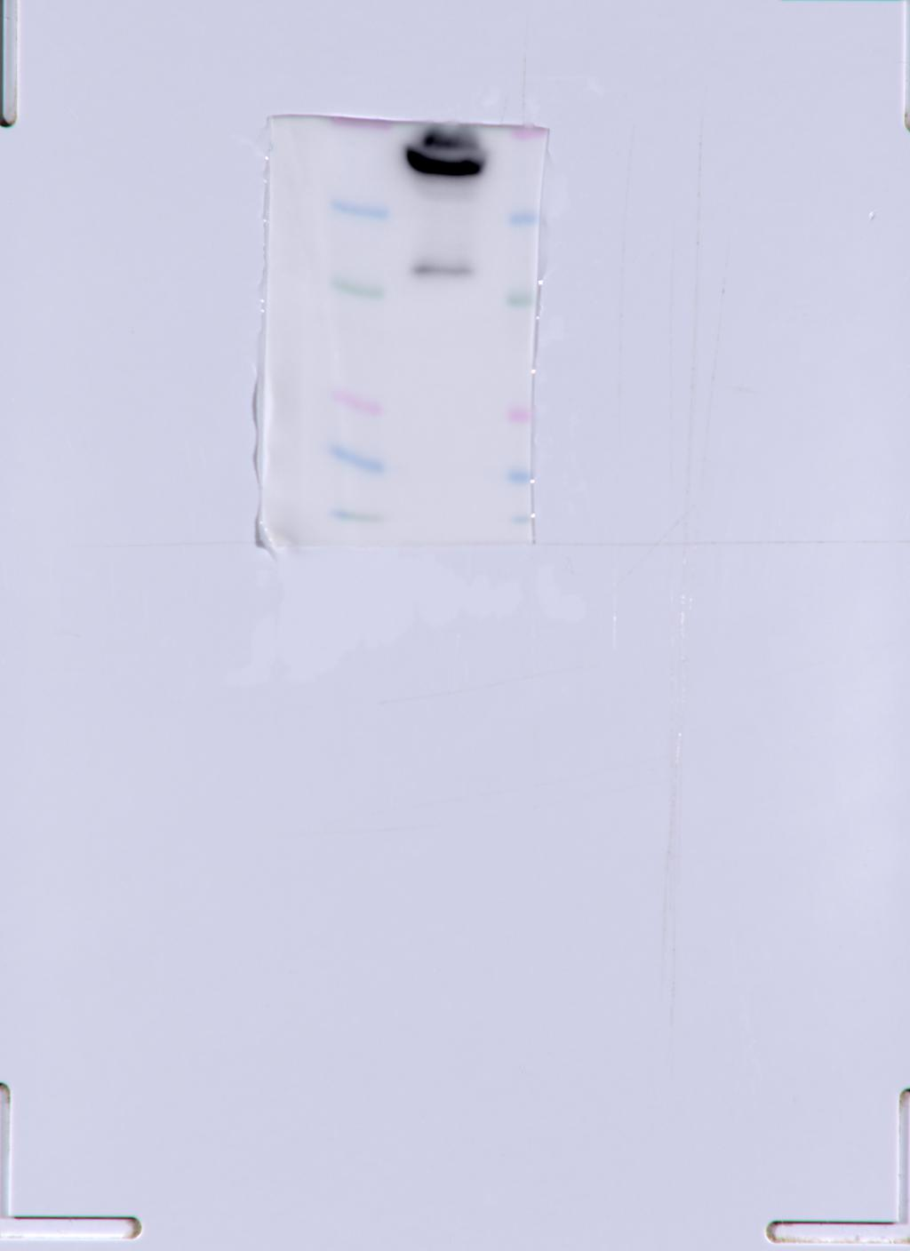
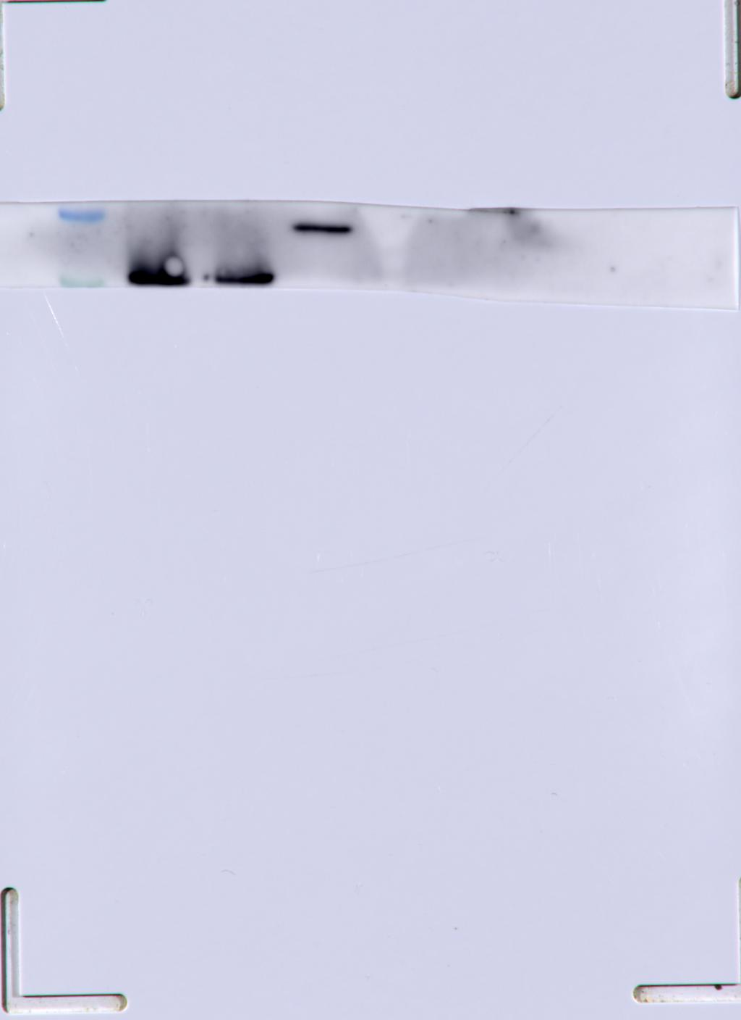
Biopsy 2
CD9 Biopsy 2
CD81 Biopsy 2
HSP70 Biopsy 2
TSG101 Biopsy 2

Slide 3
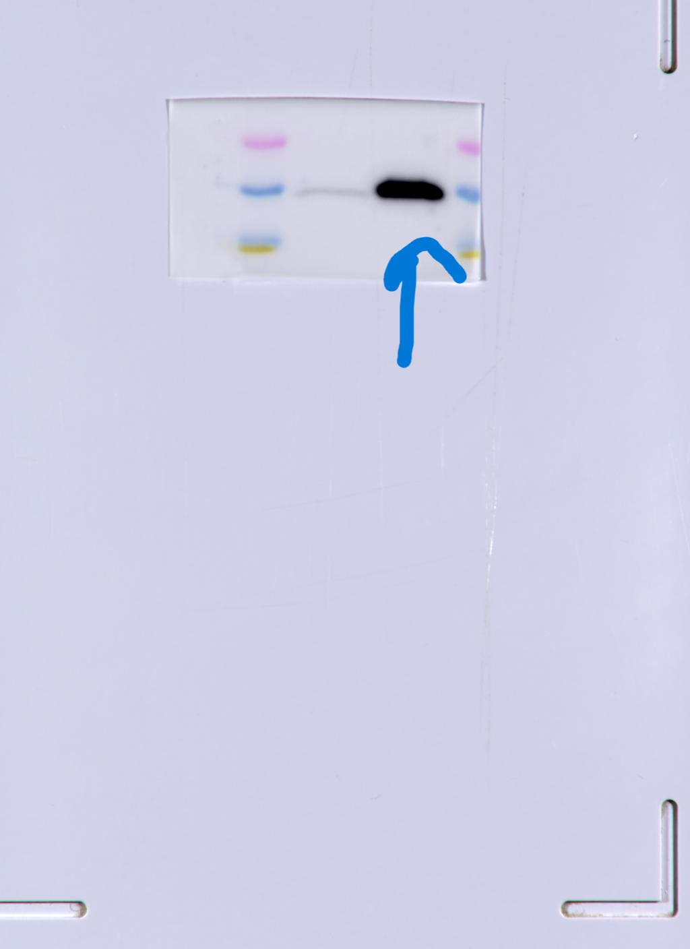
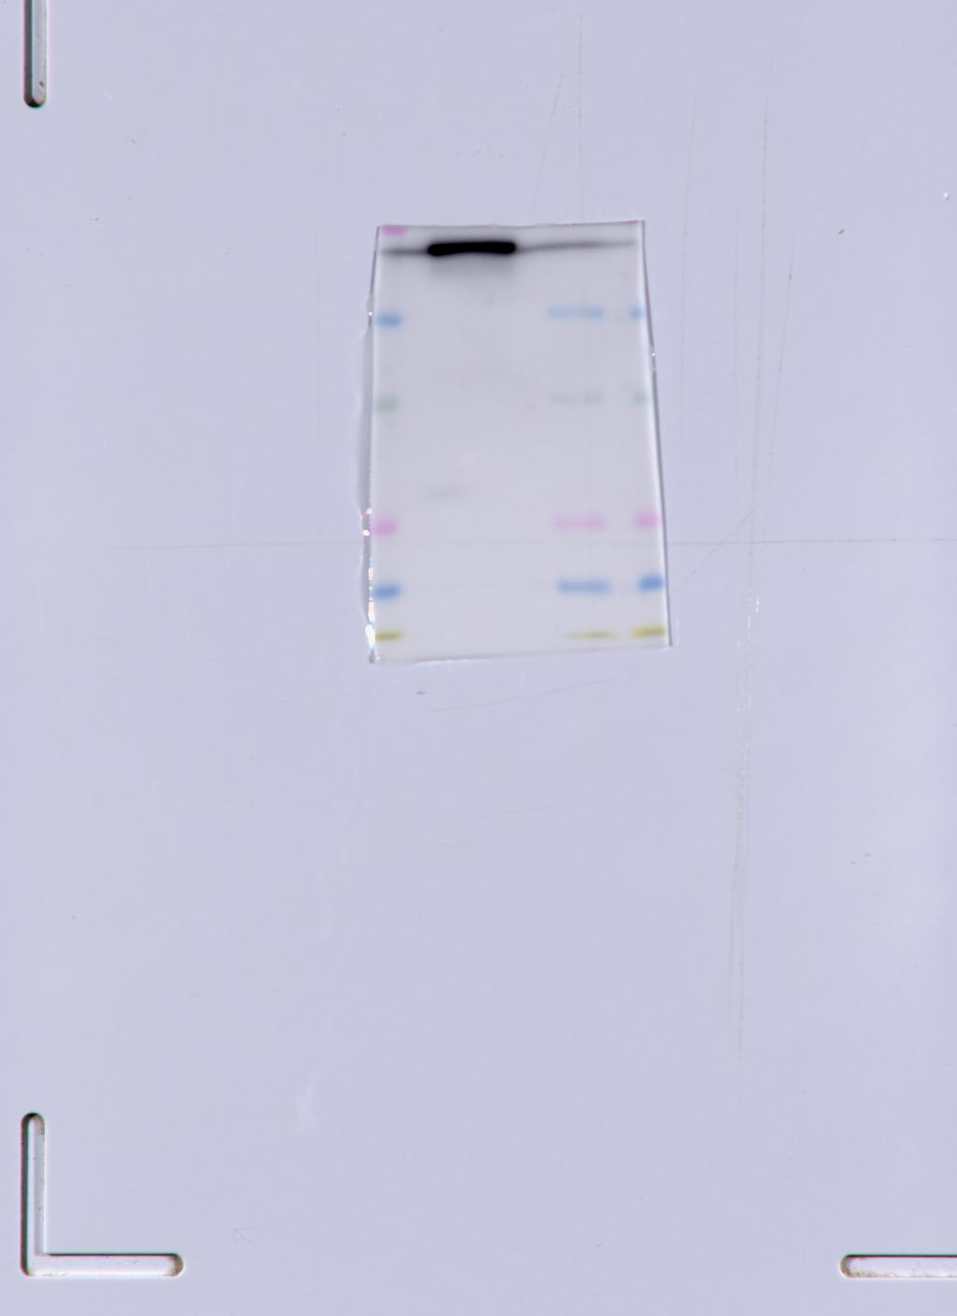
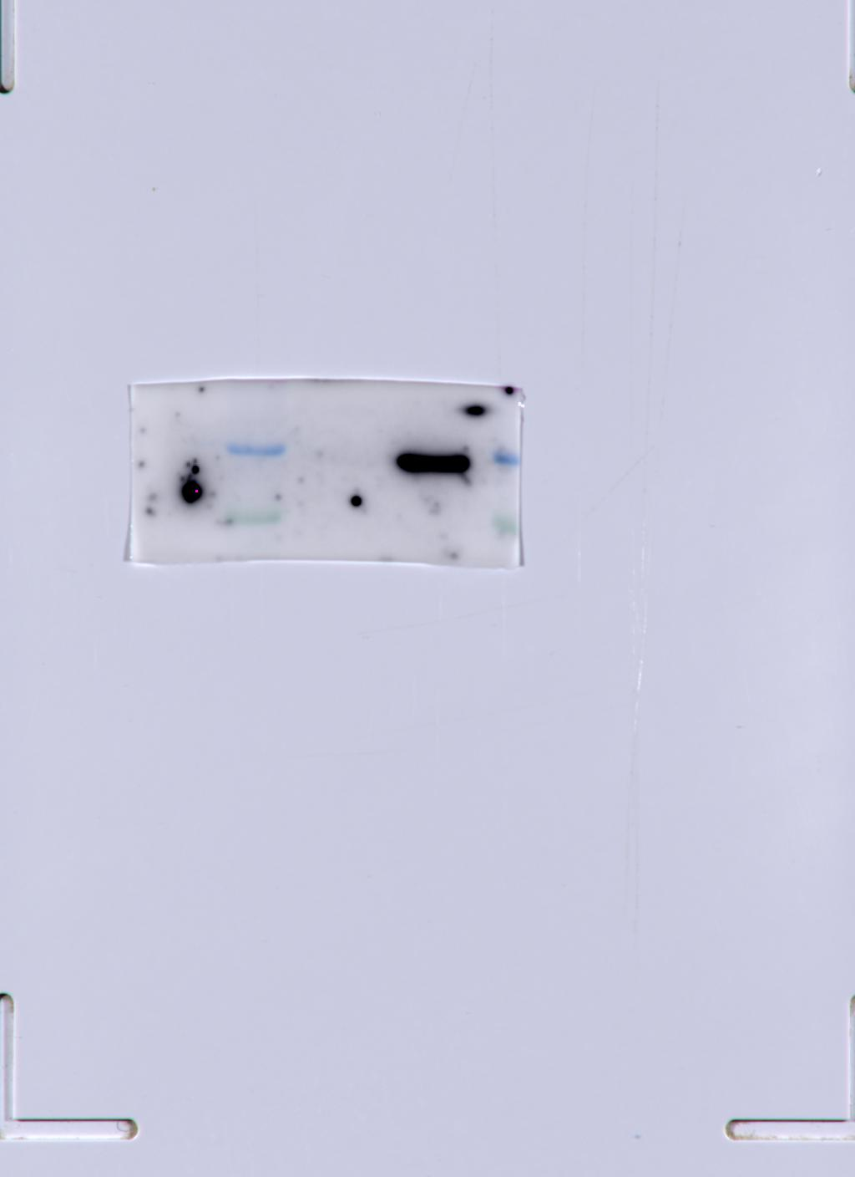
Biopsy 3
CD9 Biopsy 3
CD81 Biopsy 3
HSP70 Biopsy 3
TSG101 Biopsy 3

