Slide 1
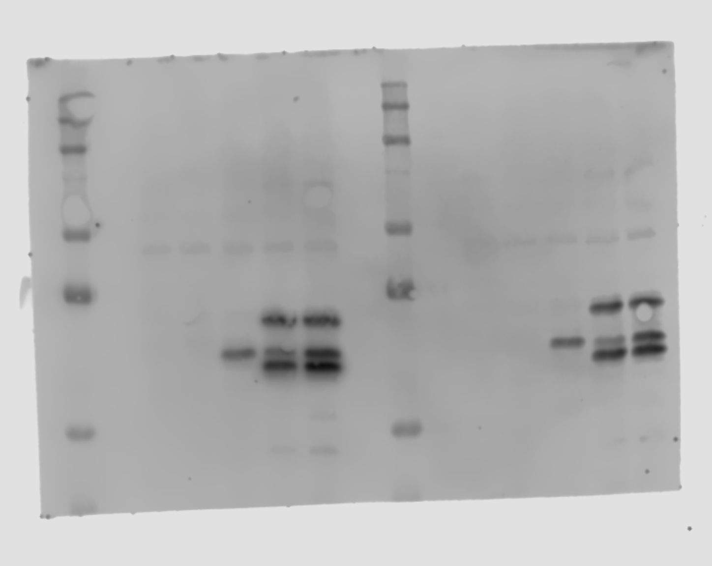
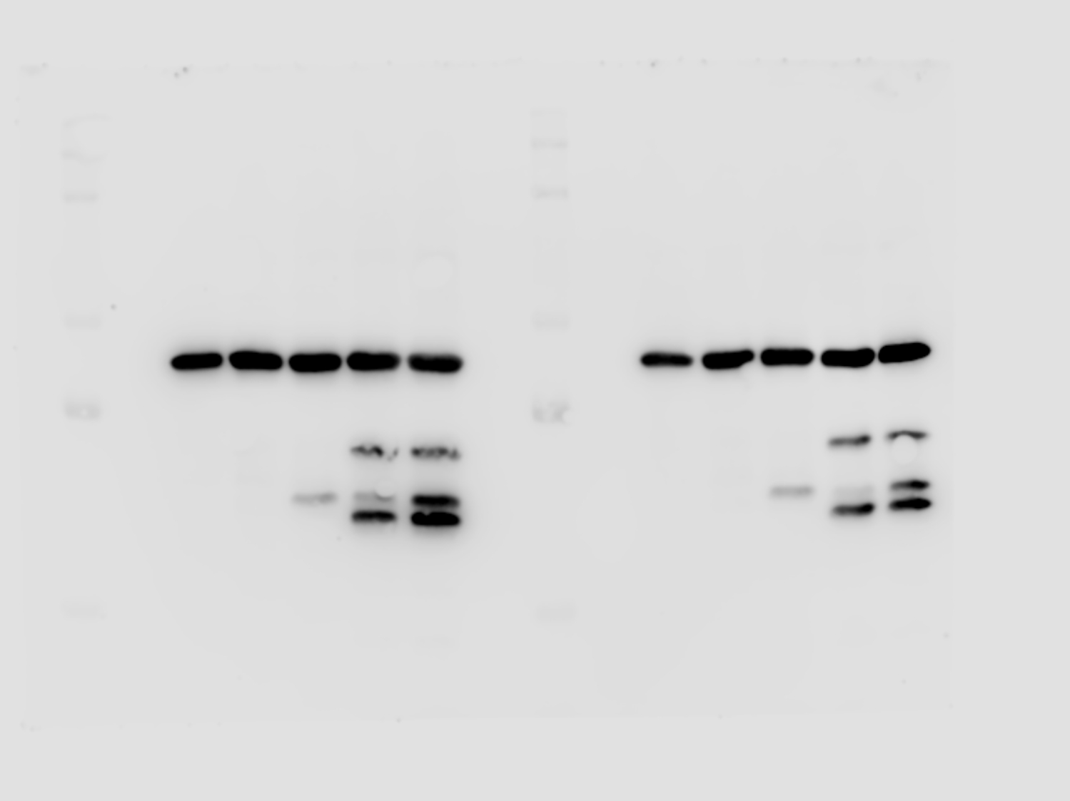
Figure 1: GFP and Beta Actin Blots (Blot on the left of the two blots is the blot in the figure)
GFP
Beta Actin
Notes:
Blot #510

Slide 2
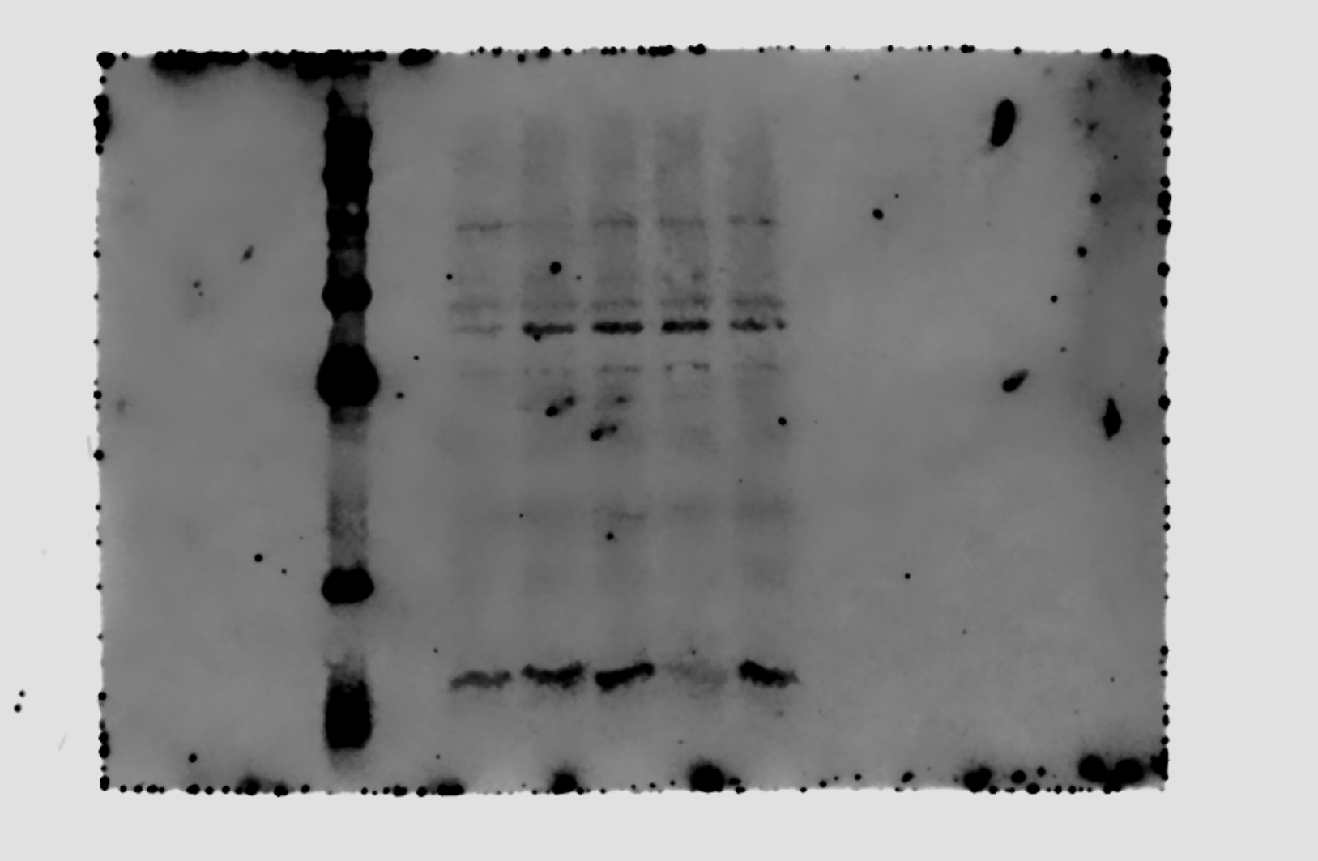
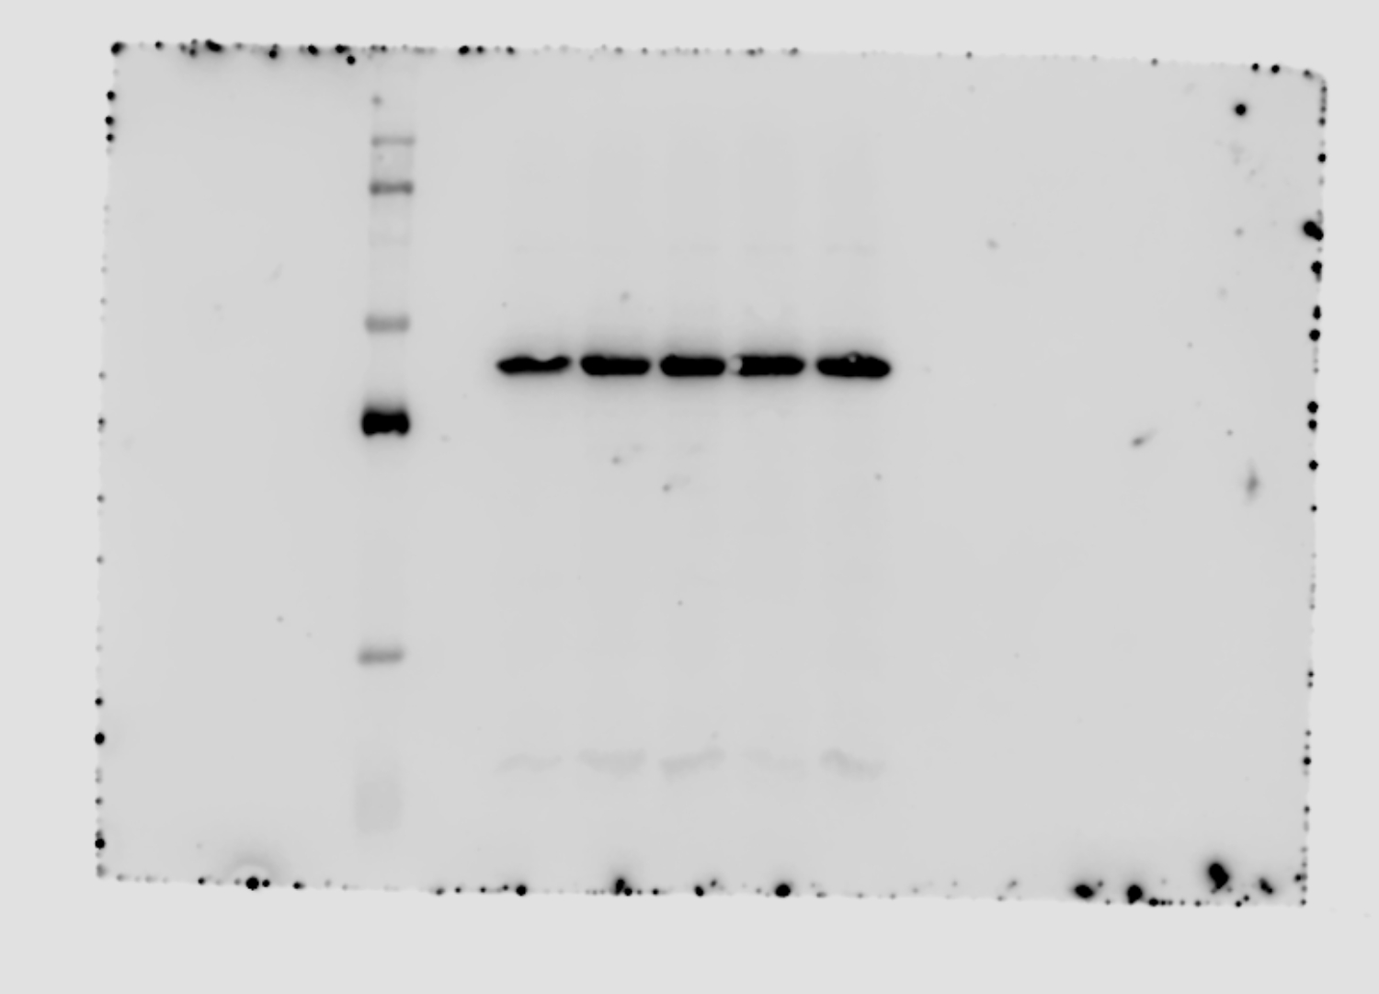
Figure 1: VHL and Beta Actin Blots
VHL
Beta Actin
Notes:
Blot #473

Slide 3
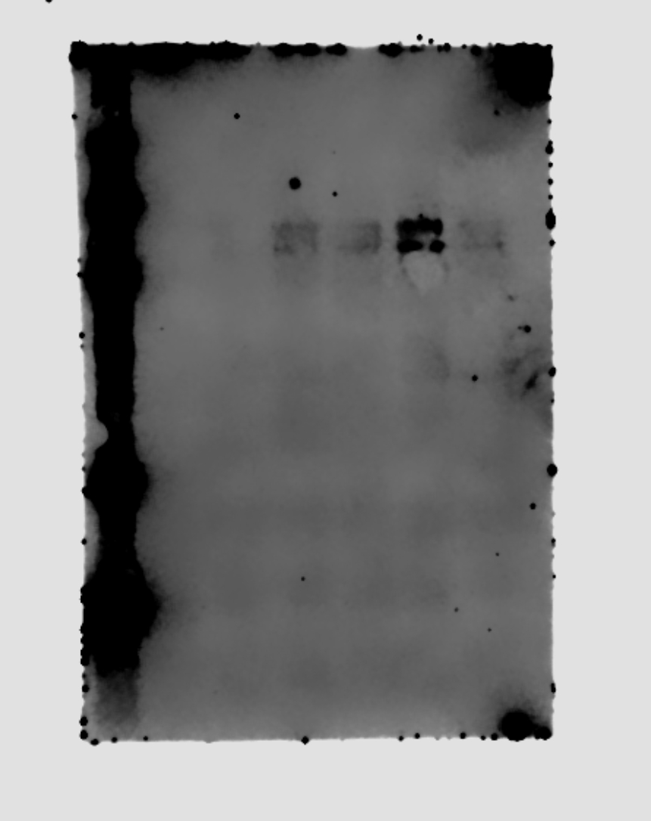
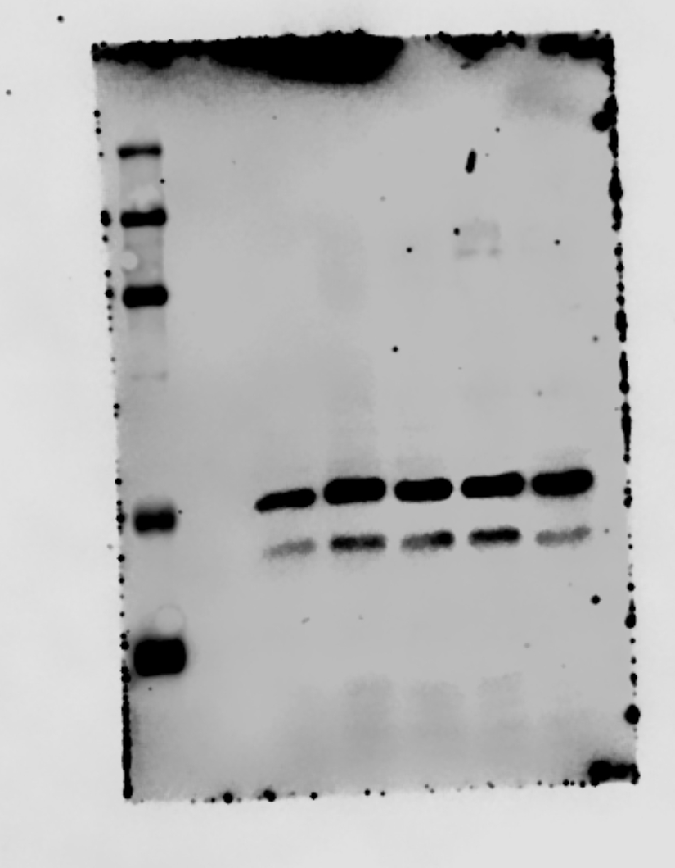
Figure 1: HIF1Alpha and Beta Tubulin Blots
HIF1Alpha
Beta Tubulin
Notes:
Blot #477

Slide 4
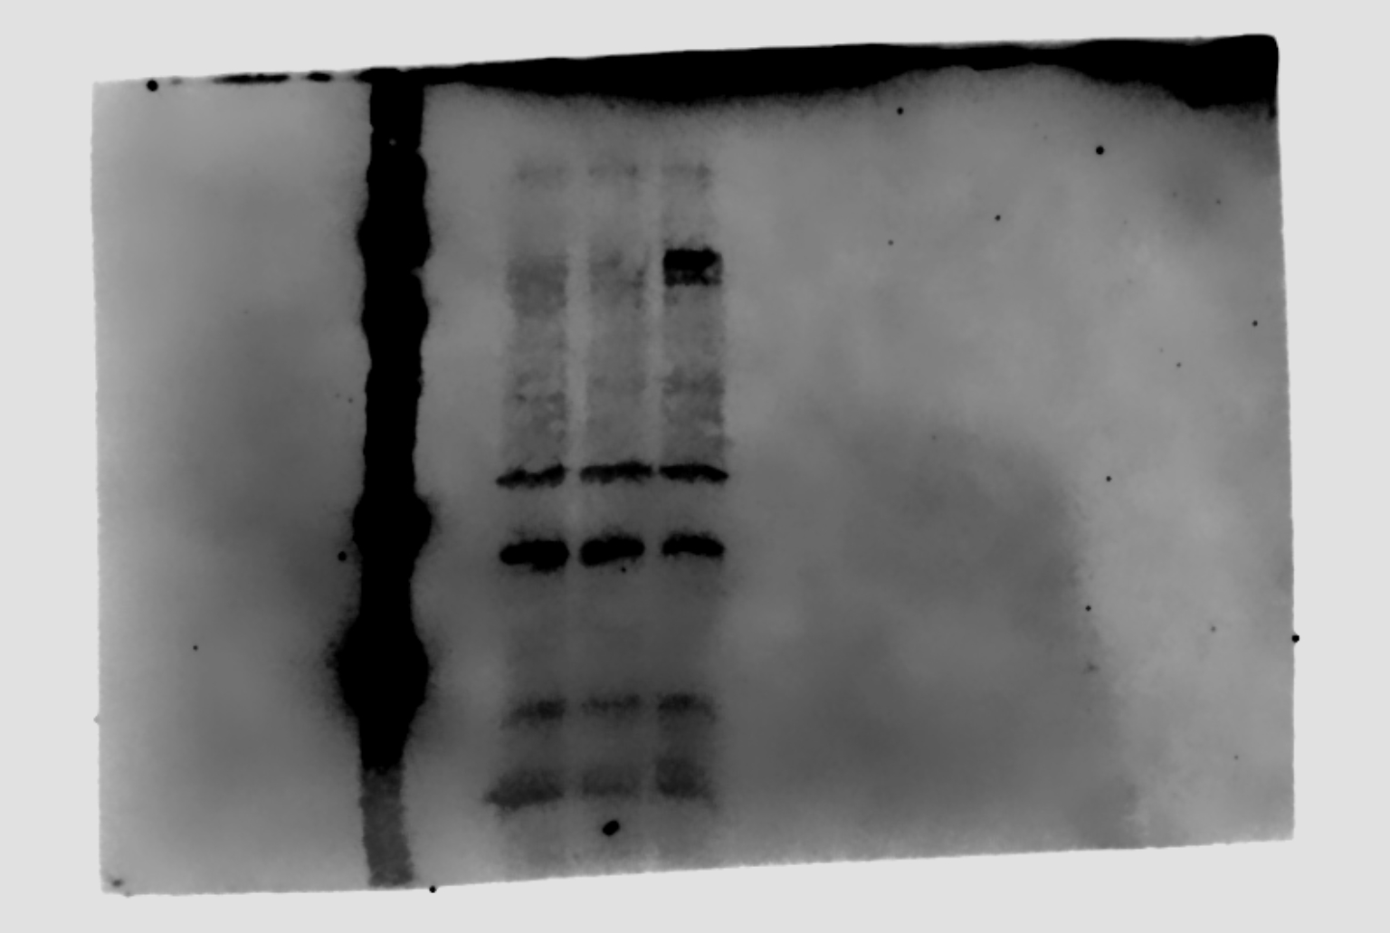
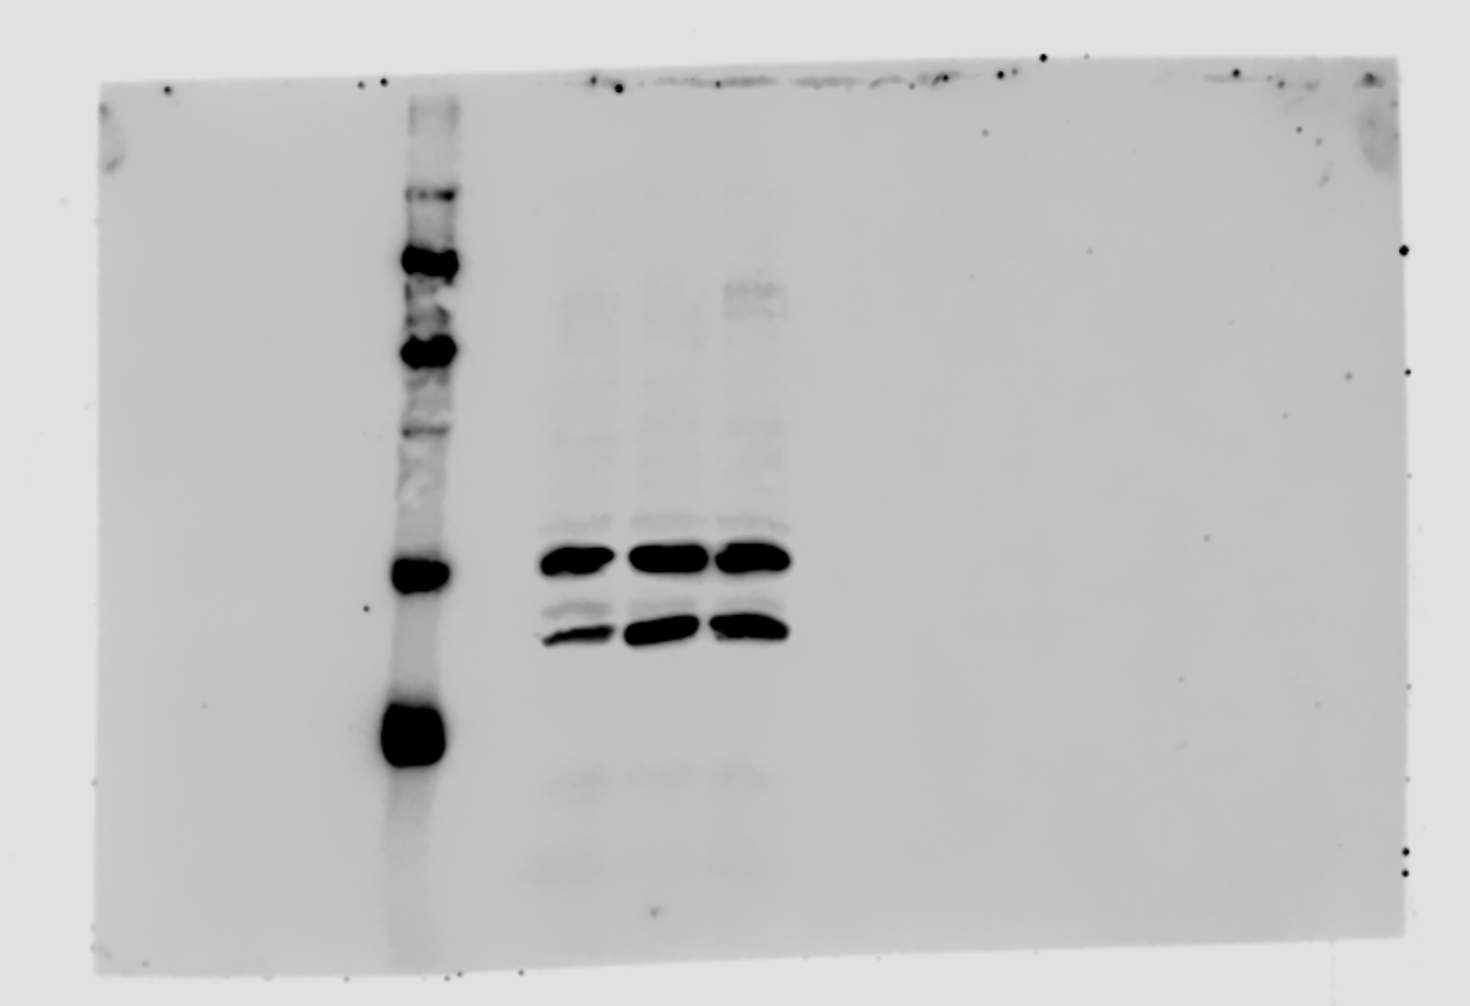
Figure 5: HIF1Alpha and Beta Tubulin Blots
HIF1Alpha
Beta Tubulin
Notes:
Blot #497

