Slide 1
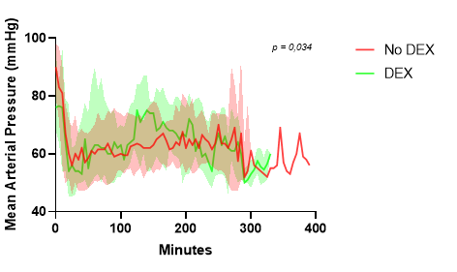
NEPHRODEX STUDY
Hemodynamic effect of dexmedetomidine during pediatric kidney
transplantation : a single-center retrospective study
HYPOTHESIS: Continuous intraoperative dexmedetomidine infusion stabilize hemodynamic in pediatric kidney transplantation
DESIGN & OUTCOMES:
Intraoperative hemodynamic status
38 pediatric patients undergoing kidney transplantation
28 without dexmedetomidine
Postoperative hemodynamic status
10 with dexmedetomidine
Higher mean arterial blood pressure (MAP)
Postoperative graft function
No heart rate difference
A retrospective single-center study
Rapid decrease of blood creatinine
Higher month-one GFR
CONCLUSION: intraoperative use of dexmedetomidine in pediatric kidney transplantation is associated with better hemodynamic stability through higher MAPs. This could contribute to improve recovery of graft function.
Monteil et al. 2023

