Slide 1
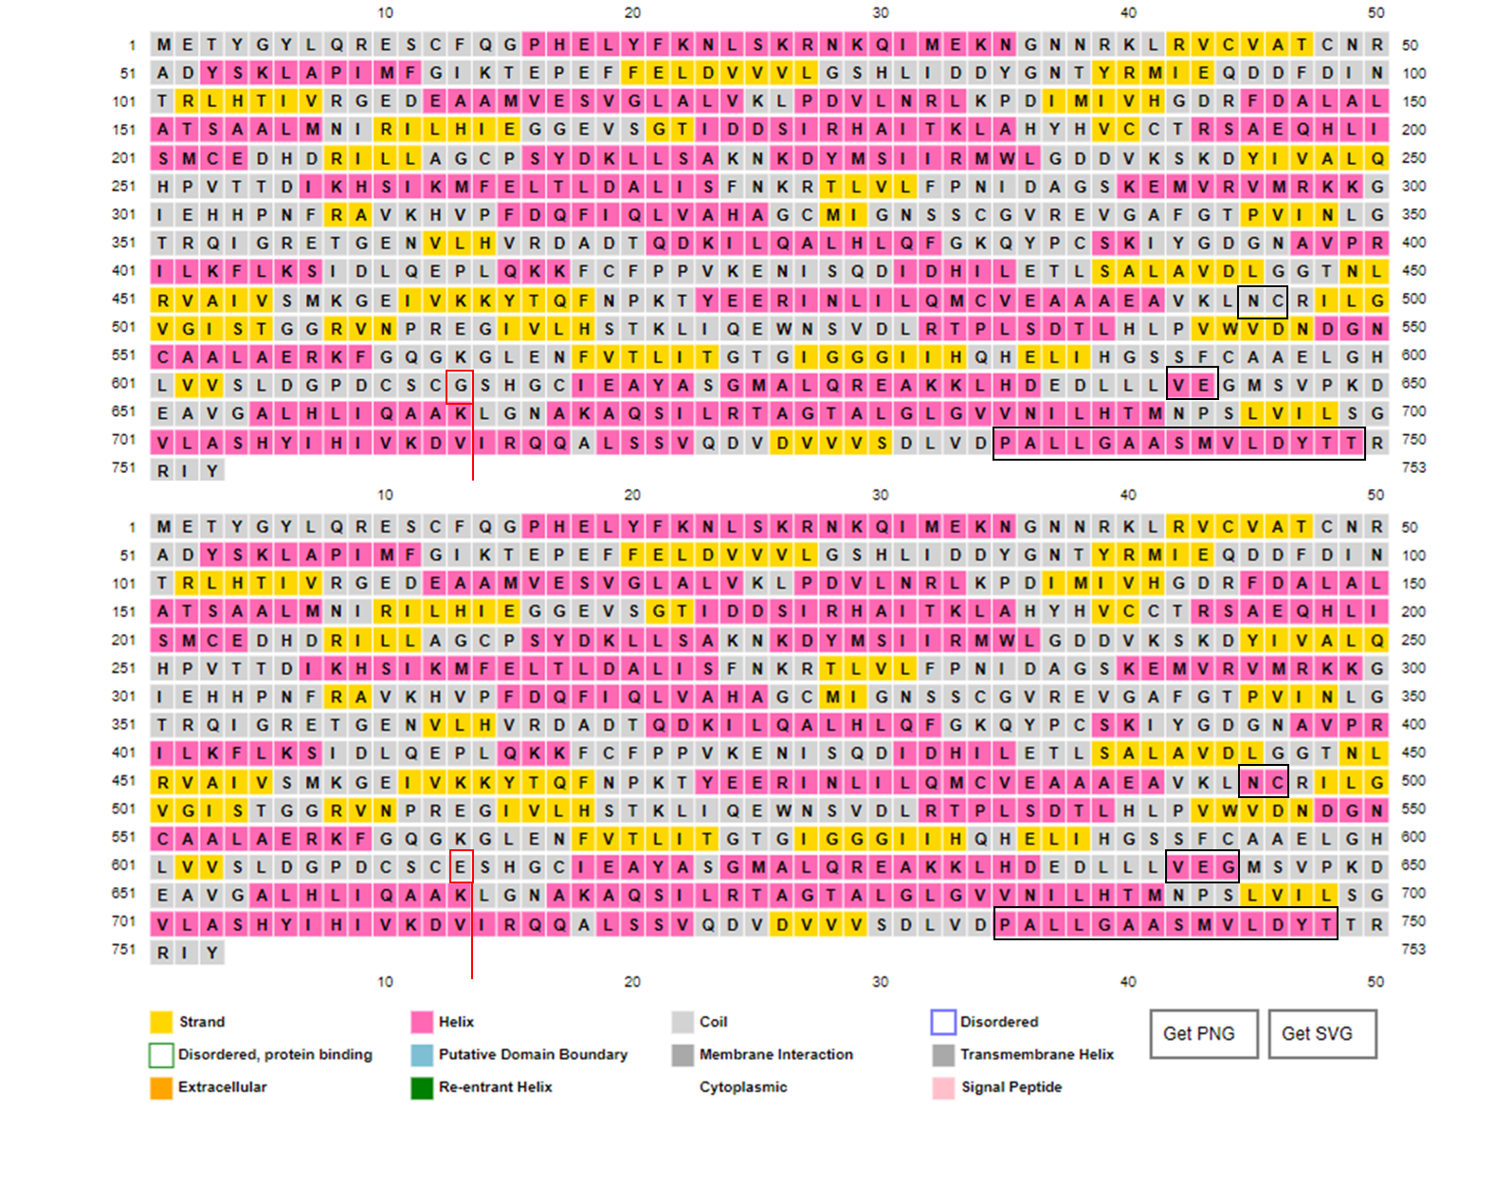
A
B
Supplementary Figure 1: Secondary structure of wild type (A) and mutant GNE (B) showing the regions of changes (black boxes)

