Slide 1
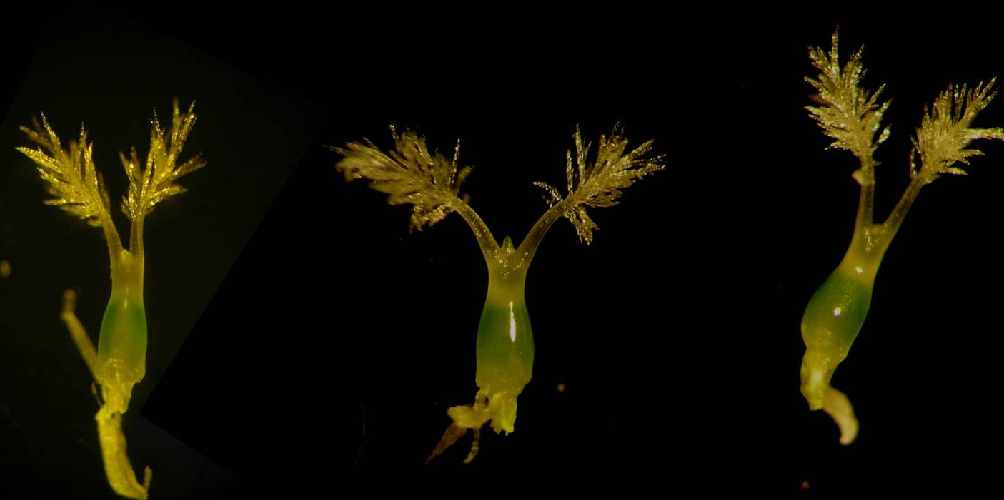
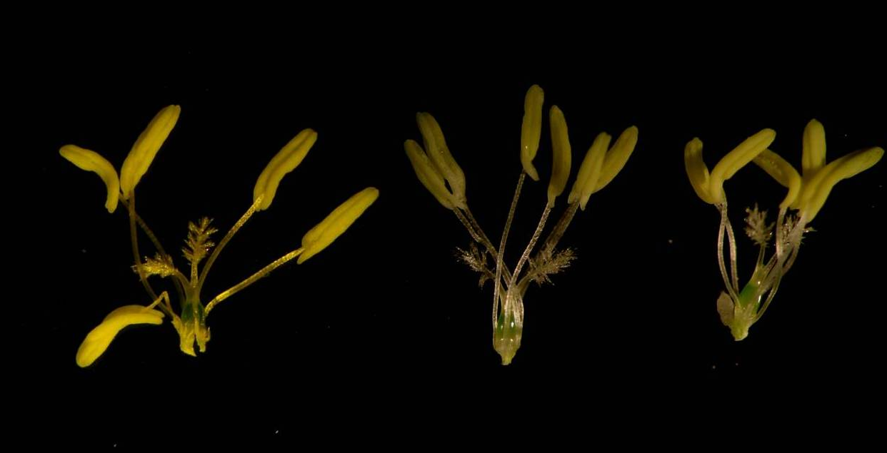
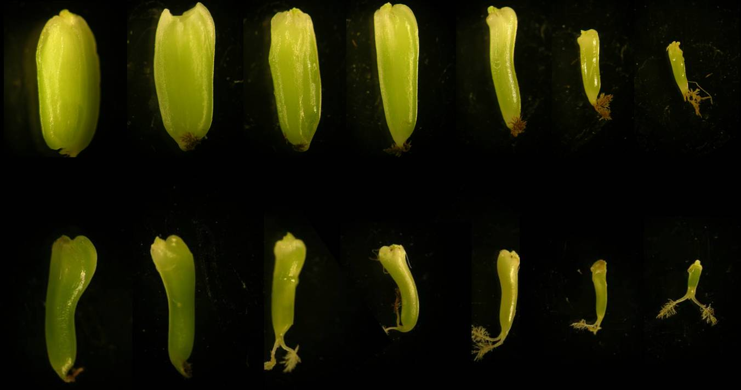
ds
WT
ox
ds
WT
ox
Setting rate
FigureS1. Seed setting rate of SDG711 transgenic plants and morphology of floral organ morphology.

Slide 2
relative protein content
FigureS2. Storage protein content of SDG711 transgenic and WT seeds.

Slide 3
Relative expression
FigureS3. The expression level of regulator genes of starch metabolism in WT and SDG711 transgenic seeds at 3 DAP.

Slide 4
Relative expression
Relative expression
FigureS4. The expression level of some starch synthase genes and amylase genes in WT and SDG711 transgenic seeds at 3 DAP.

Slide 5
H3K27me3-P1
H3K27me3-P2
FigureS5. chromatin immunoprecipitation (ChIP) analysis of H3K27me3 of some starch synthase genes and amylase genes in WT and SDG711 transgenic seeds at 3 DAP.

Slide 6
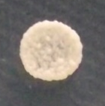
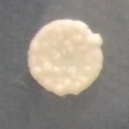




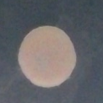
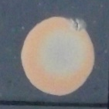
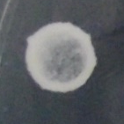
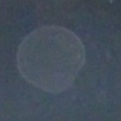
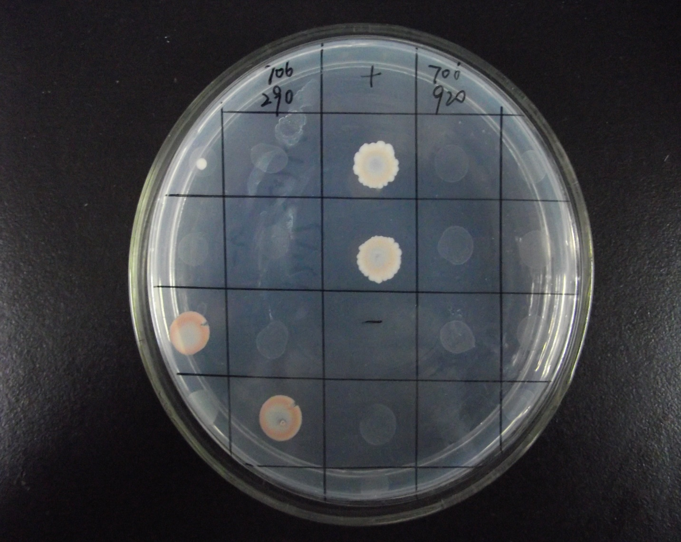


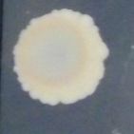
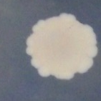
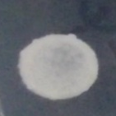

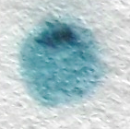







SD-2
SD-4
lacZ
Positive
Negative
OsCLF/OsiEZ1
OsCLF/OsFIE1
OsCLF/OsFIE2
OsCLF/OsEMF2b
OsiEZ1/OsFIE1
OsiEZ1/OsFIE2
OsiEZ1/OsEMF2b
FigureS6. Protein interactions among PRC2 members in rice.

Slide 7

LD-OsCLF-PcG
OsFIE1-PcG
OsFIE2-PcG
SD-OsiZE1-PcG
OsFIE2-PcG
OsFIE2-PcG
FigureS7. PRC2-like complexes act at different stages of the rice life cycle.

Slide 8
FigureS8. The expression level of imprinted genes in WT and SDG711 transgenic seeds at 3 DAP.

