Slide 1
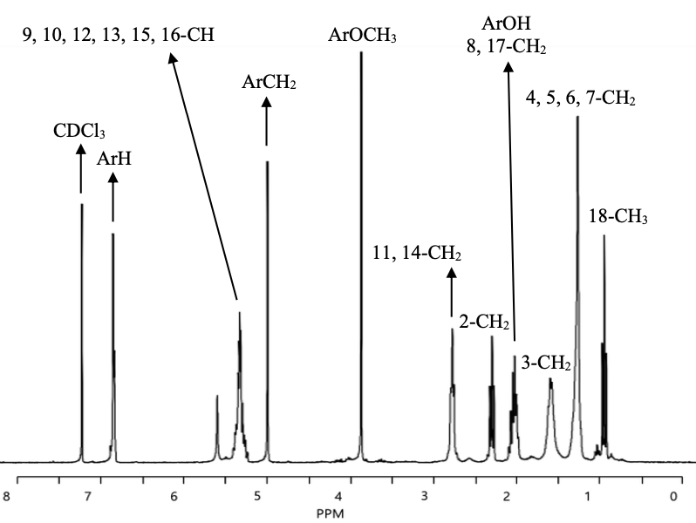
8
7
6
5
4
3
2
1
9
11
14
15
10
12
13
16
18
17
Supplementary Fig. S1 ¹H-NMR chromatogram of LAVE. The NMR spectra were measured by Avance III 300 MHz (Bruker BioSciences Corp., USA). ¹H-NMR (CDCl₃) δ: (0.914 – 0.968) (m, 3H, 18-CH₃), 1.264 (m, 8H, 4, 5, 6, 7-CH₂), (1.572 – 1.615) (m, 2H, 3-CH₂), (2.000 – 2.045) (m, 4H, 8,17-CH₂), (2.000 – 2.045) (s, 1H, ArOH), 2.296 (m, 2H, 2-CH₂), 2.773 (m, 4H, 11,14-CH2), 3.869 (3H, ArOCH₃), 4.996 (m, 2H, ArCH₂), (5.319 – 5.337) (e, 6H, 9,10,12,13,15,16-CH), (6.837 – 6.856) (s, 3H, ArH).

